Slide 1
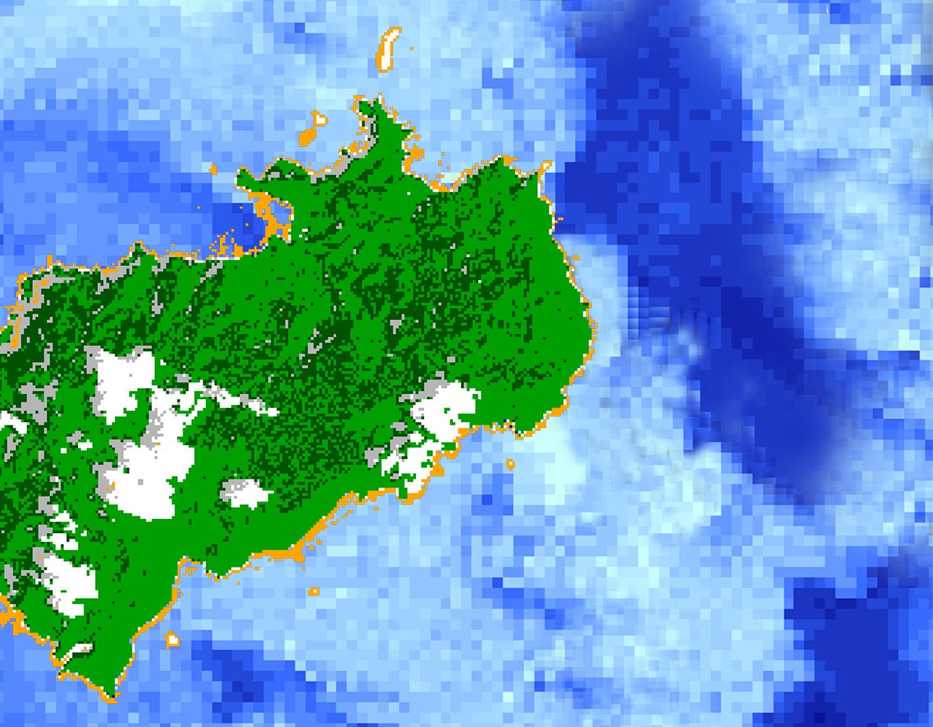
COSTA RICA OCEANS
Utilizing NASA Earth Observations to Assess Changes in Vegetation and Marine Environments at the Isla del Coco Marine Reserve
Dionne Blanks
Samantha Darring
Yu Chuan Shan
Elaina Gonsoroski
Farnaz Bayat
Andrew Knight
Manasi Parkhi
Mobile County Health Department & University of Georgia
2017 Summer
Notes:
Your project Website Image should be placed behind the hexagon grid. An example image has been placed in this position for your reference. Delete the example image, insert your image, right click your image and select the “Send to Back” option. Position and adjust the size of your image so that it lines up with the provided margin rulers.

Slide 2
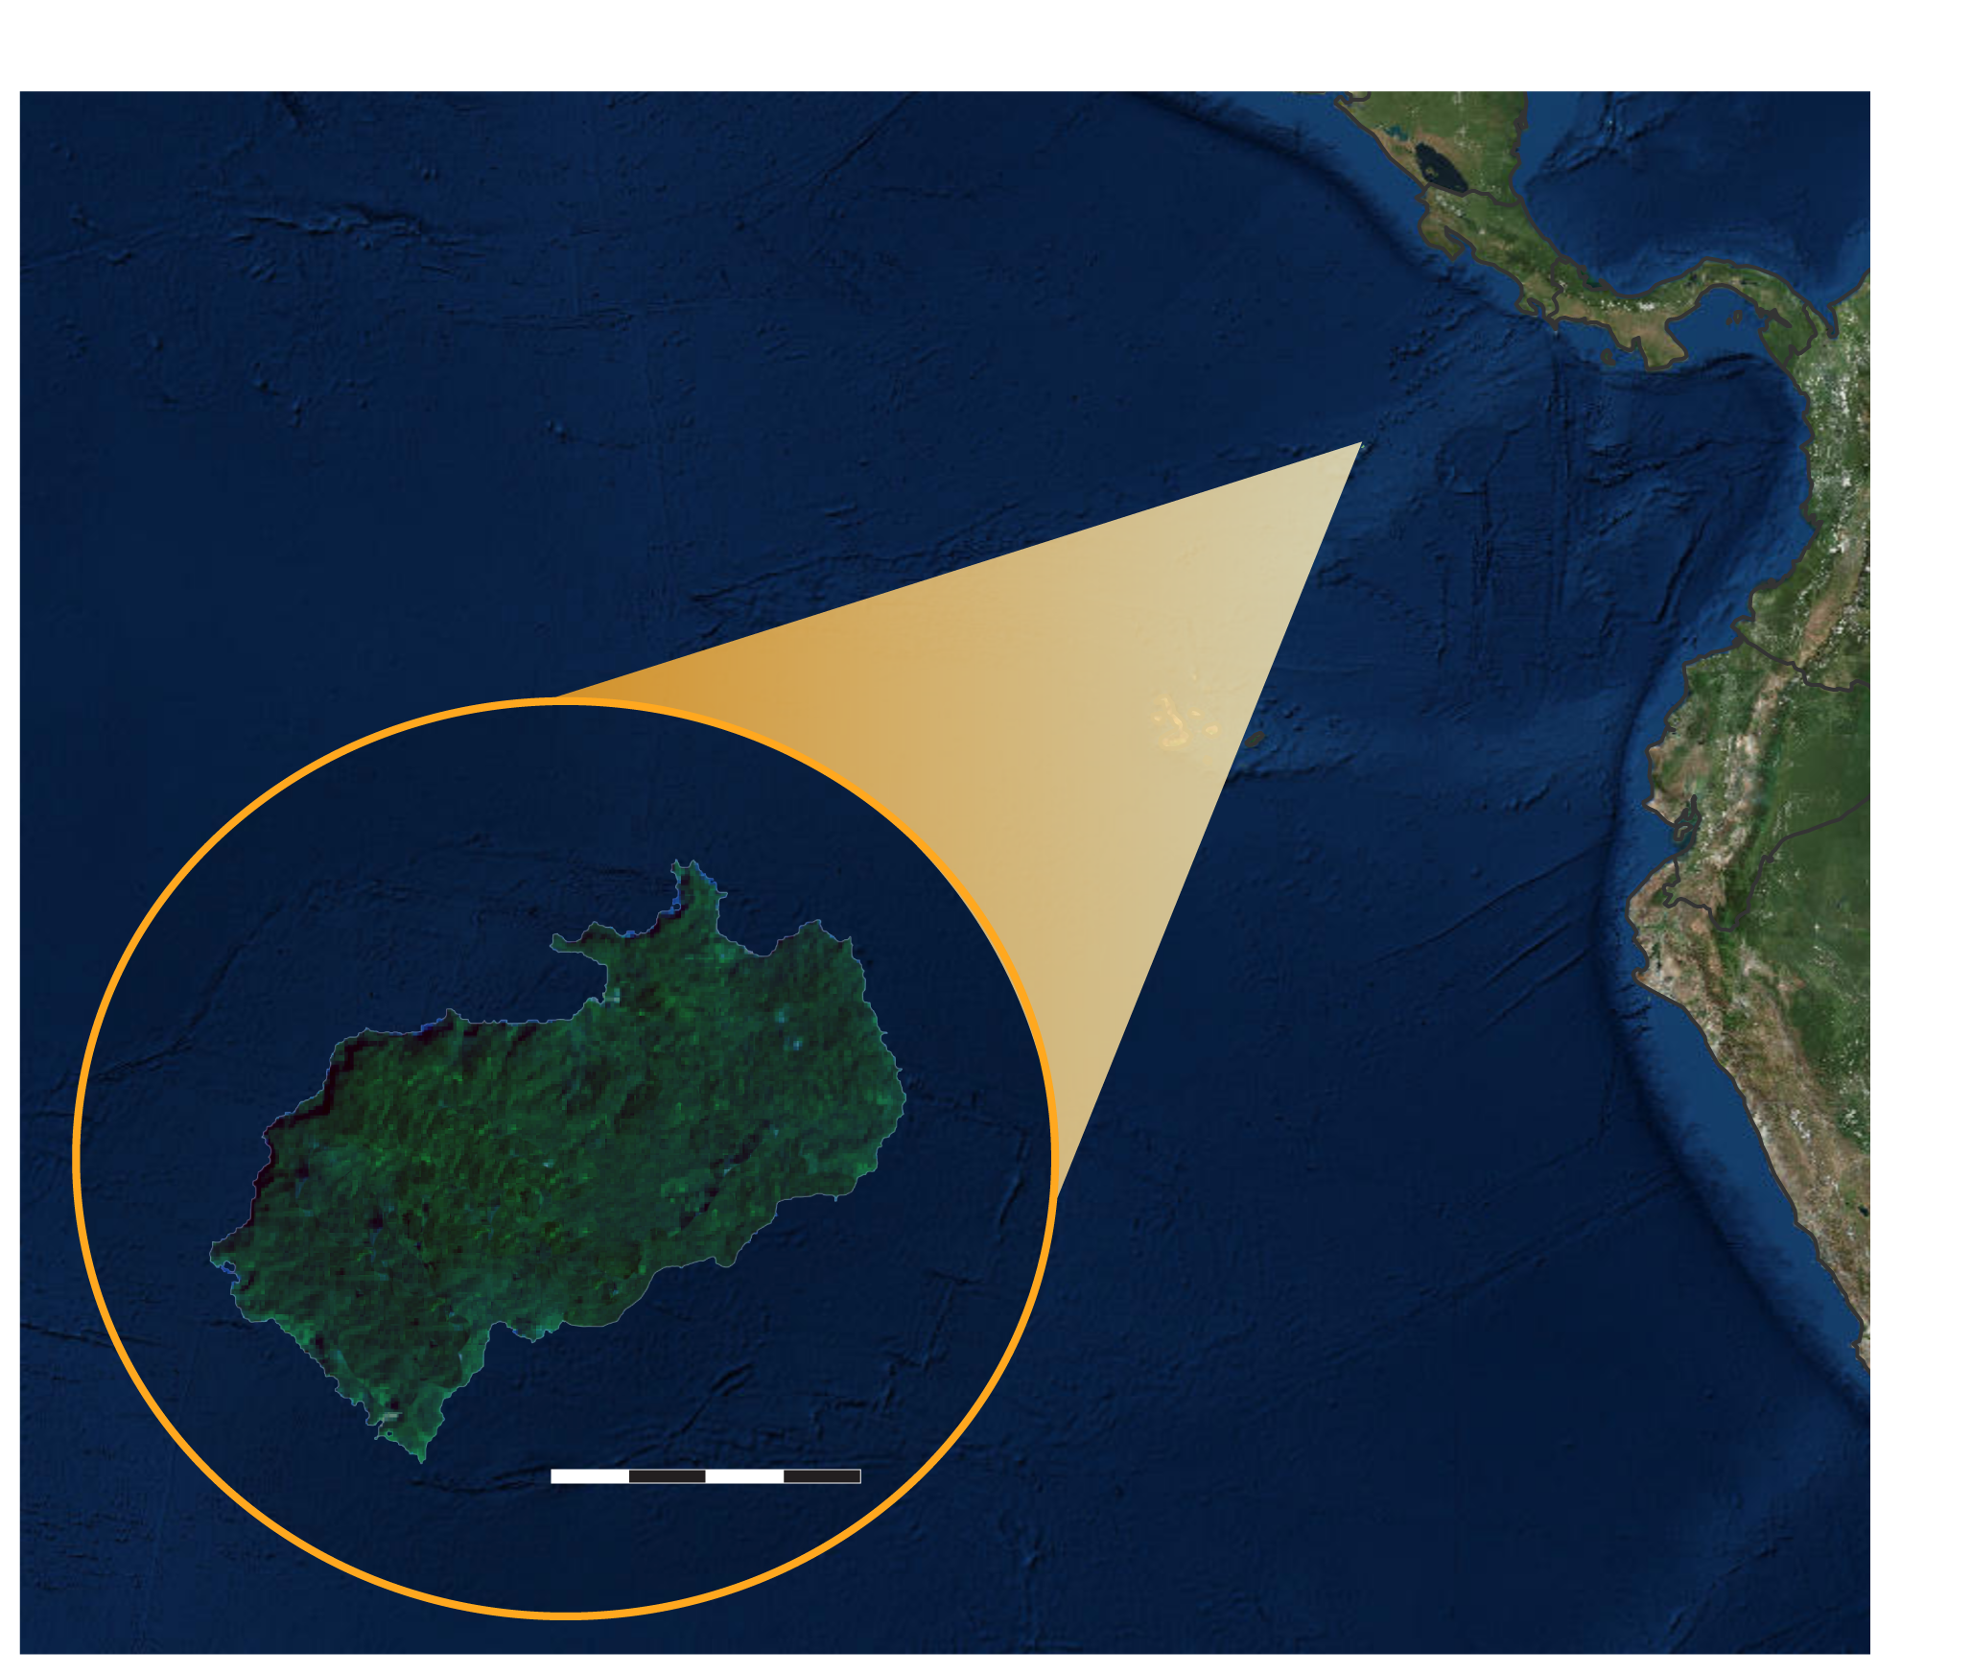
Study Area: Isla del Coco
Remote island located 350 miles off the main island, Costa Rica
Declared a National Park in 1978 due to its rich diversity and endemic species
Diverse cloud forest and unique marine community
Study Period: 2000 - 2016
4 Km
Image Credit: TBD
Notes:
The Isla del Coco is located 532 km off of the Pacific Coast of Costa Rica. It was declared a National Park in 1978 and is a UNESCO World Heritage site. The island has native species unique to the island making conservation very important. The island is also home to cloud forest but decreased cloud coverage over these areas could threaten this unique ecosystem. The island is also surrounded by a diverse marine community in large part due to the presence of coral reefs. In order to assess all of these different environmental variables the team used data from 2000 - 2016 in order to study the island and its surrounding waters.

Slide 3
Community Concerns: Land
Changes in the environment threaten unique vegetation on the island:
Apparent decreased cloud cover over the island’s native cloud forest
Known disruptions natural habitat of native animal and plant species
Changes in tropical wildlife populations due to climate change
Image Credit: Esteban Herrera Herrera
Notes:
Those monitoring the island would like to
Image Source: http://commons.wikimedia.org/wiki/File:Claude_Monet_-_The_Magpie_-_Google_Art_Project.jpg

Slide 4
Community Concerns: Water
Steady increase in coral bleaching and decline influenced by:
Sea surface temperature and deeper water temperature rise
Sediment level fluctuation
Changes to exposure in solar radiation
Increased shoreline erosion
Image Credit: Monet
Image Credit: Esteban Herrera Herrera
Notes:
Many factors can impact biodiversity of the ocean surrounding the Cocos. Costa Rica is concerned about protecting diversity to do this they would like to monitor coral reefs surrounding the Cocos island which serve as habitat for a variety of animals.
Image Source: http://commons.wikimedia.org/wiki/File:Claude_Monet_-_The_Magpie_-_Google_Art_Project.jpg

Slide 5
Partners
Área de Conservación Marina Isla del Coco (ACMIC)
Ministry of Environment and Energy, Water Directorate (DA-MINAE) of Costa Rica
Embassy of Costa Rica to the United States
Image Credit: Monet
Image Credit: Esteban Herrera Herrera
Notes:
This project partnered with the Área de Conservación Marina Isla del Coco (ACMIC), the Sistema Nacional de Áreas de Conservación de Costa Rica (SINAC), the Ministry of Environment and Energy, Water Directorate (DA-MINAE) of Costa Rica and the Embassy of Costa Rica to the United states.
Image Source: http://commons.wikimedia.org/wiki/File:Claude_Monet_-_The_Magpie_-_Google_Art_Project.jpg

Slide 6
Objectives
Image Credit: Esteban Herrera Herrera
Image Credit: Monet
Compile current and historical land cover maps
Analyze and create time series of vegetation greenness and cloud coverage
Estimate ocean water Sea surface Temperature (SST)
Detect changes in R_{rs}(λ) and IOPs of the deep-water area
Evaluate annual Total Suspended Sediment (TSS)
Notes:
This project aims to generate an overall assessment of the island vegetation and ocean parameters surrounding the island. First the team worked to evaluate historical and current changes in vegetation health over time to create a time series analysis of vegetation. The team also created a land cover map. To assess different ocean parameters important to the health of the marine ecosystem the team estimated suspended sediment (SSD), detected changes in different biophysical parameteres in the water, and studied variations in sea surface temperature (SST). Lastly, the team analyzed cloud coverage over the island and created a time series using this information.
Image Source: http://commons.wikimedia.org/wiki/File:Claude_Monet_-_The_Magpie_-_Google_Art_Project.jpg

Slide 7
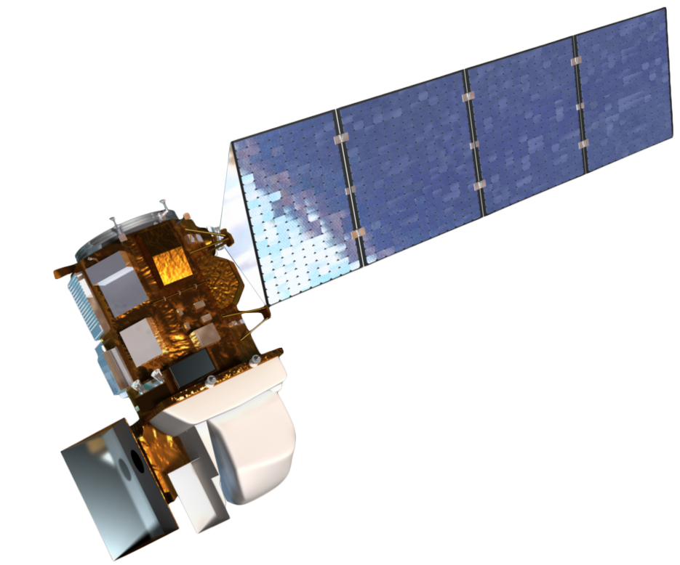
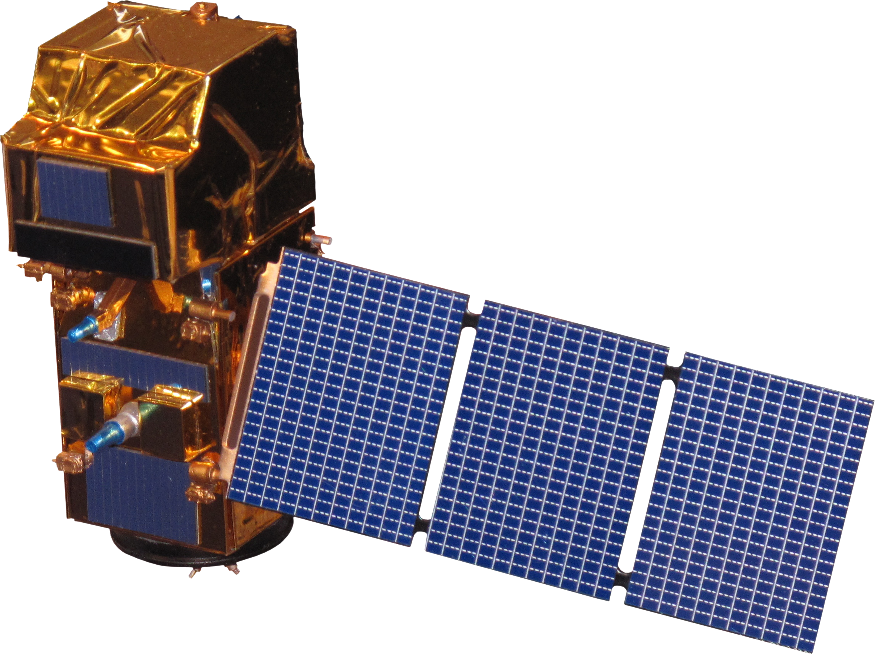
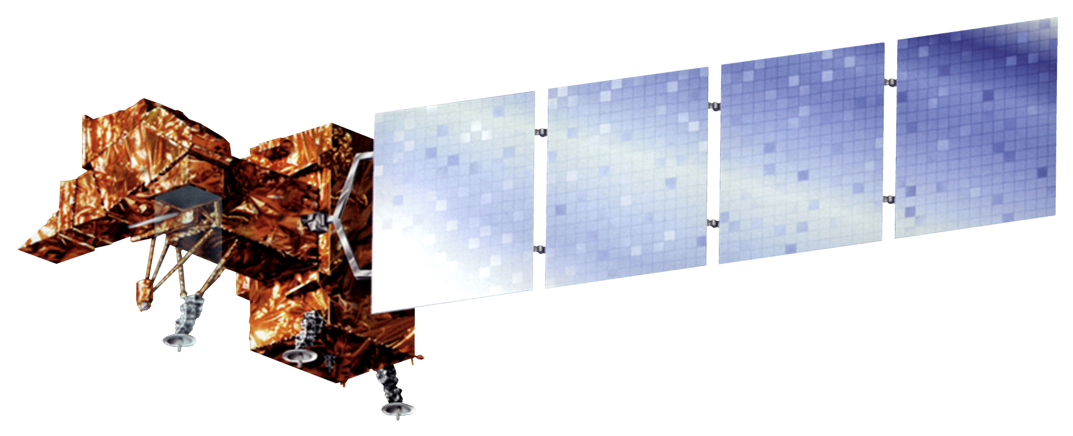
Earth observations
Landsat 7 ETM +
Landsat 8 OLI
Sentinel-2 MSI
Aqua MODIS
Terra MODIS
Envisat MERIS
Image Credit: NASA,ESA
Notes:
The team used Landsat 7 Enhanced Thematic Mapper Plus (ETM+) and Landsat 8 Operational Land Imager (OLI) in order to assess vegetation change over the study period. In addition, the team used the Moderate Resolution Imaging Spectroradiometer (MODIS) aboard the Aqua and Terra satellites to evaluate ocean parameters and vegetation respectively. To further assess ocean parameters the team used the Medium-resolution Image Spectrometer board the European Space Agency’s Envisat as well as Sentinel-2.
NOTE: For every image on the slide include an image source in the speaker notes (ex. URL; Name, Affiliation, etc.)
Image Source: Envisat MERIS, ESA

Slide 8
Methodology: Land
Vegetation Health and Cloud Cover
Data Acquisition & Processing
Aqua and Terra MODIS
Landsat 7 ETM+ & Landsat 8 OLI
Land Elevation Data
Cloud Detection Time Series
NDVI Time Series
Land Cover Classification
Data Analysis
End Products
Cloud Cover Time Series
Vegetation Health Change Detection
Land Cover Characterization
Notes:
Cloud Frequency:
Land Classification: Landsat 7 ETM+ was used to create a land cover classification map of the island for March 2000. Landsat 8 OLI was used to classify the island for October 2016. Pre-processing included TOA of each band of both satellite images. Next, an unsupervised classification clustering algorithm was used. The number of classes were set to 100, 20 maximum iterations, and a threshold of 95. The classes were than grouped and recoded to it’s appropriate land feature. An accuracy assessment of 259 random point was performed to assess similarities between the classified image and the satellite image. This process is done for both Landsat images. Land cover mapping can help view physical changes of vegetation on the island.
NDVI Analysis: Aqua and Terra MODIS(13Q1) products were obtained to evaluate the vegetation health condition for 2003 and 2016 using the Normalized Difference Vegetation Index (NDVI) subdataset. Model builder tool in ArcMap (10.4) was used to extract, clip, and reproject the NDVI values within the study area. Additionally, the maximum NDVI values were calculated for each month, season, and year to assess the changes occurring to the vegetation health condition.

Slide 9
Methodology: Water
Water Column Characteristics
Poes AVHRR
Landsat 7 ETM+ & Landsat 8 OLI
Aqua & Terra MODIS
Data Acquisition & Processing
Sea Surface Temperature (SST)
Total Suspended Sediment (TSS)
Other Biophysical Variables
Data Analysis
TSS Time Series Analysis
SST Time Series Analysis
Biophysical Variable Time Series Analysis
End Products
Notes:
we used a variety of space borne sensors to and processes to create time series analysis for TSS, SST, and biophysical variables. Methodology will be discussed in more depth in later slides.

Slide 10
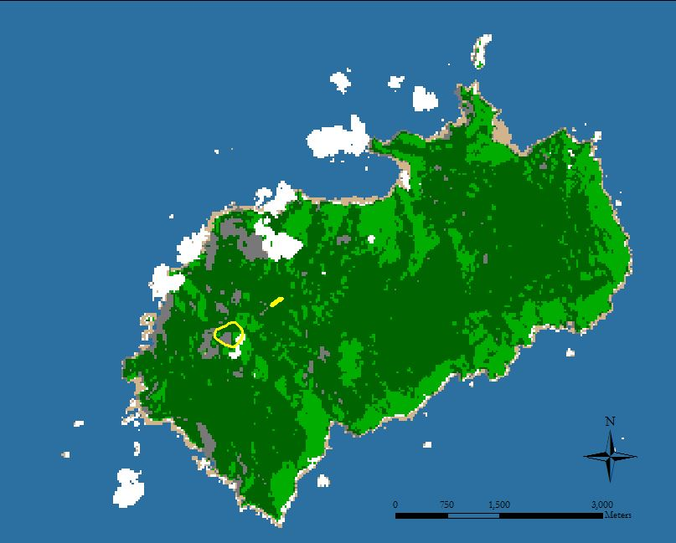
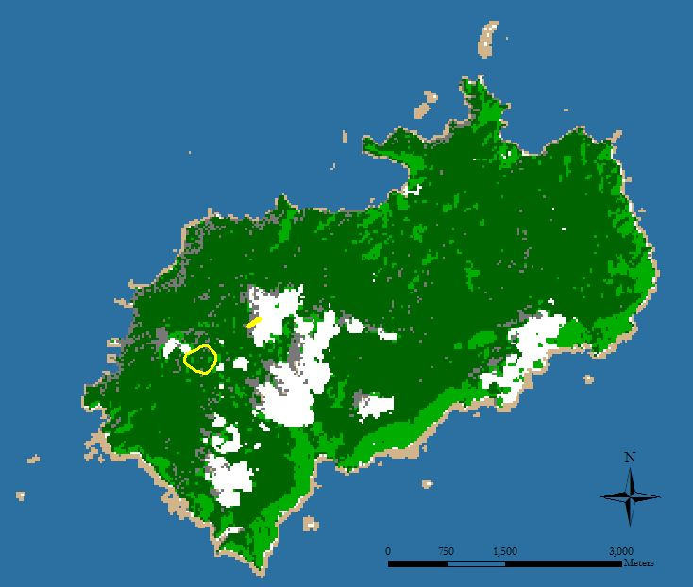
Land Cover Classification
March 31, 2000
October 13, 2016
500m Elevation
500m Elevation
Water
Water
Shadow
Shadow
Coastal Forest/Scrub
Coastal Forest/Scrub
Evergreen Forest
Evergreen Forest
Cloud
Cloud
Barren
Barren
Overall Classification Accuracy: 98.05% Overall Kappa Statistics: 95
Sample Classes: 100
Overall Classification Accuracy: 95.70% Overall Kappa Statistics: 95 Sample Classes: 100
Notes:
The accuracy assessment determines the class type at specific locations, comparing to the reference map. A stratified random sampling method was selected for assessment. SRS is a minimum number of observations randomly placed within each category. The class type is determined from the reference source, than claimed on the classified map for comparison. To compare, an error matrix is produced. The total accuracy of the number of correct plots/total number of plots. A minimum requirement of good accuracy is 80% . Our results indicate the overall accuracy for 2000 is 98.05% and 95.07% for 2016. However, total accuracy does not disclose if an error was evenly distributed between classes of if classes were good or bad. for this, User’s and Producer’s accuracy are generated.
Kappa statistics reflects the difference between an actual agreement and the agreement expected by chance. (Observed accuracy determined by diagonal in error matrix). There is 95% better agreement than by chance alone for 2000 and 92% better agreement than by chance alone for 2016.

Slide 11
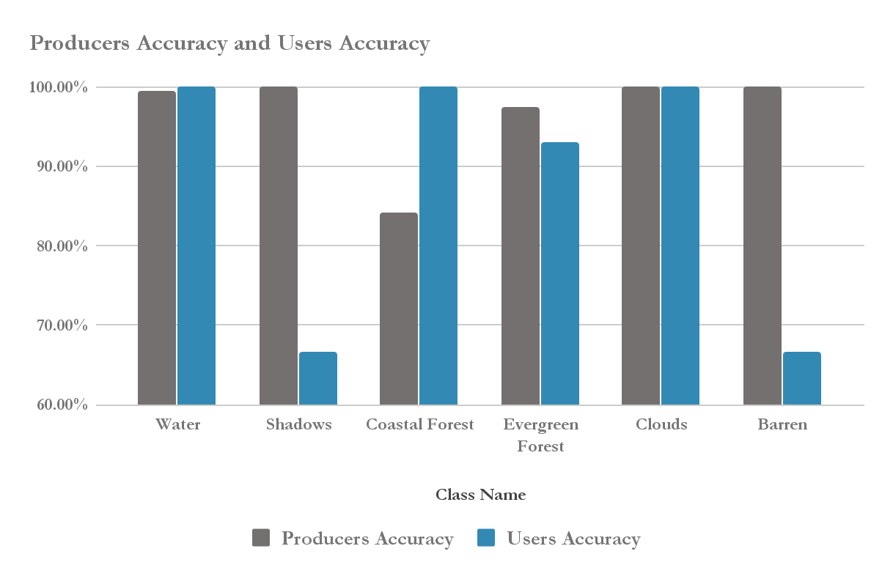
Producers and Users Accuracy
March 31, 2000
Notes:
User’s accuracy is the number correctly identified in a given map class/number claimed to be in that map class. How many pixels on the map are actually what they say they are?
Producer's accuracy is the number correctly identified in reference plots of a given class/number actually in that reference class. How many of the pixels on the map are labeled correctly?

Slide 12
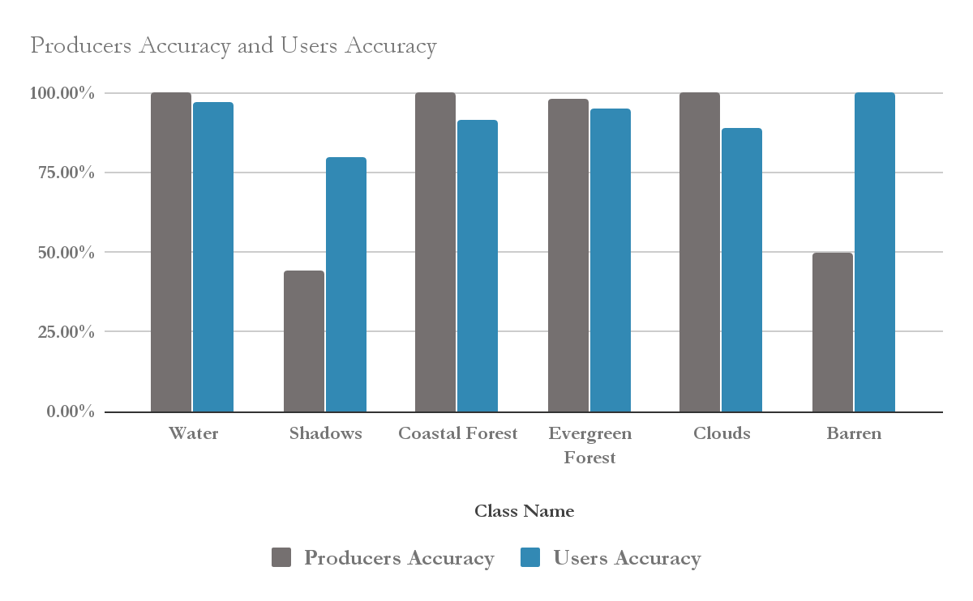
Producers and Users Accuracy
October 13, 2016
Notes:
User’s accuracy is the number correctly identified in a given map class/number claimed to be in that map class. How many pixels on the map are actually what they say they are?
Producer's accuracy is the number correctly identified in reference plots of a given class/number actually in that reference class. How many of the pixels on the map are labeled correctly?

Slide 13
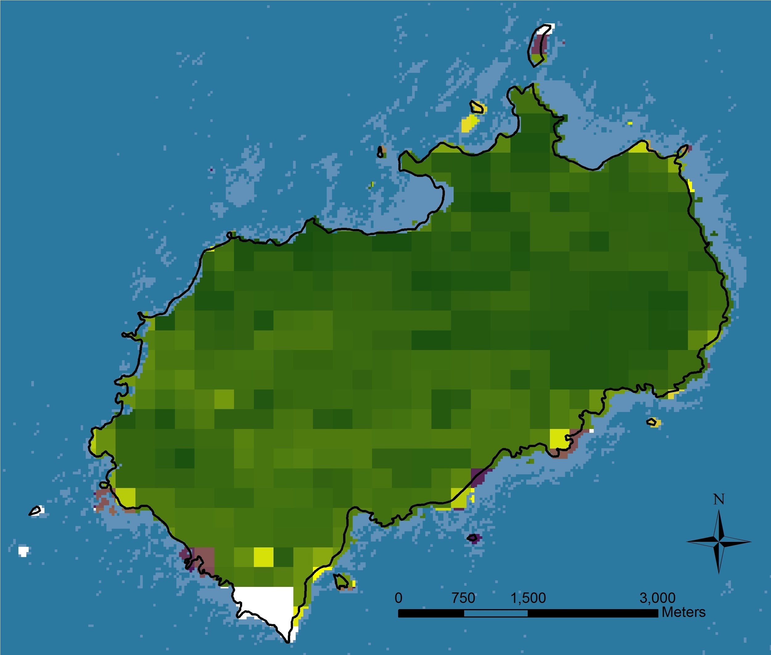
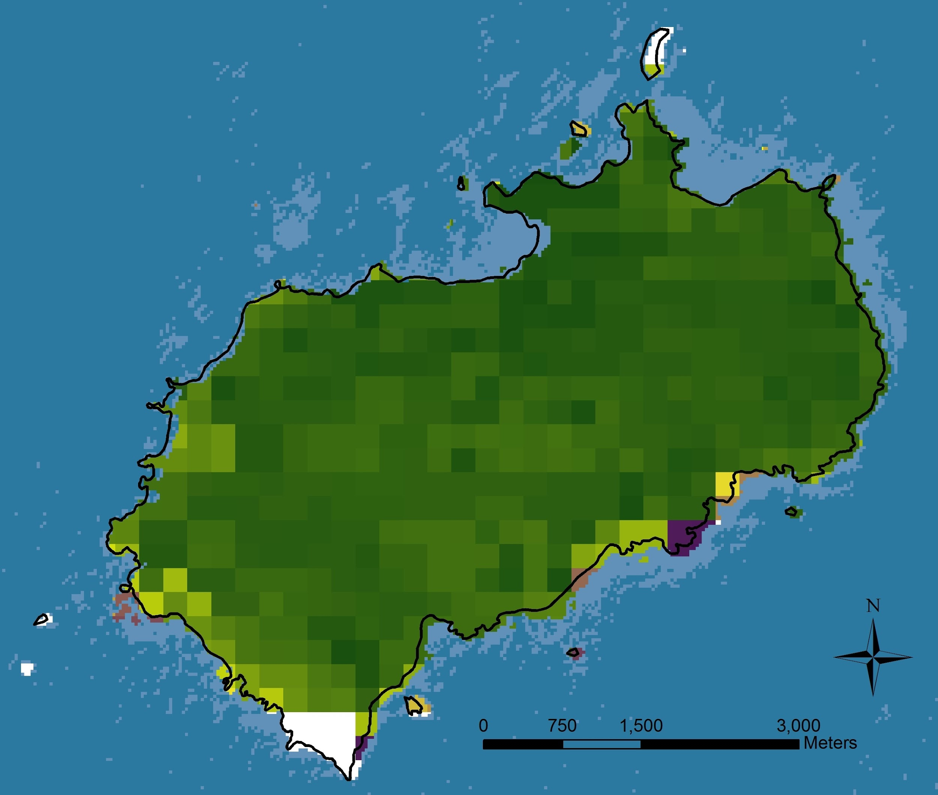
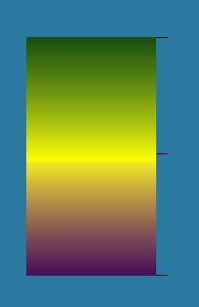
Vegetation Health Monitoring
MODIS Maximum NDVI 2003
MODIS Maximum NDVI 2016
NDVI
NDVI
1.0
1.0
0
0
Notes:
Aqua and Terra MODIS Vegetation Indices (MYD13Q1, and MOD13Q1) products are designed to assess the health condition of vegetation over time and space. Normalized Difference Vegetation Index (NDVI) values typically range from -1.0 to 1.0 with pixel values more than zero representing areas covered by vegetation. Higher NDVI values demonstrate healthier vegetation land cover. The maximum NDVI values were extracted for each pixels for monthly, seasonally, and yearly analysis of the changes occurring to the vegetation health condition.
main point is these tropical rain forests are highly green - even a 10 percent decline in greenness of such forest can still result in a moderately high green vegetation canopies (NDVIs of ~.80 on a 0 to 1 scale)

Slide 14
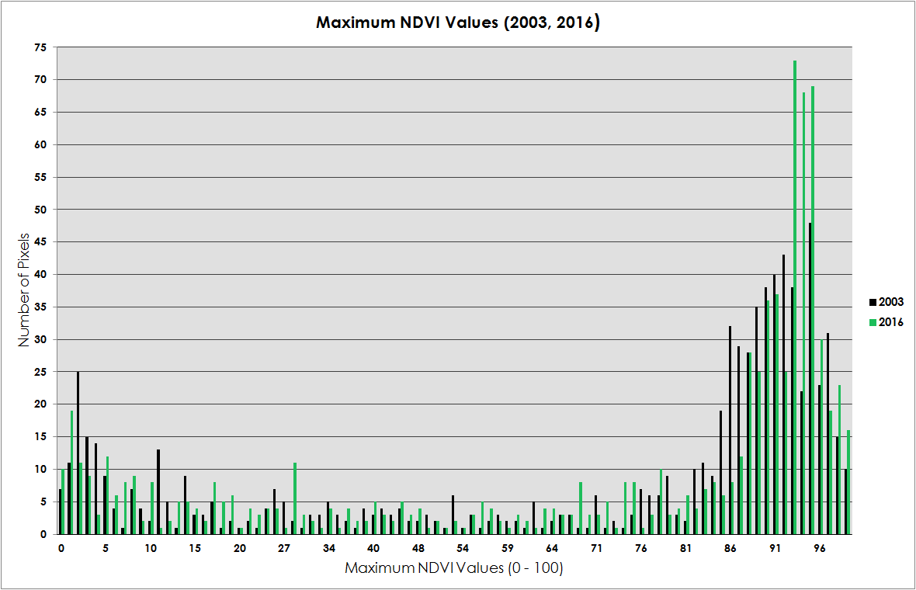
Vegetation Health Time Series
Notes:
Number of pixels associated with a maximum NDVI value are shown in the graph for 2003 and 2016. There are more pixels with higher NDVI values for 2016; however this does not indicate the geographic location of the pixels.

Slide 15
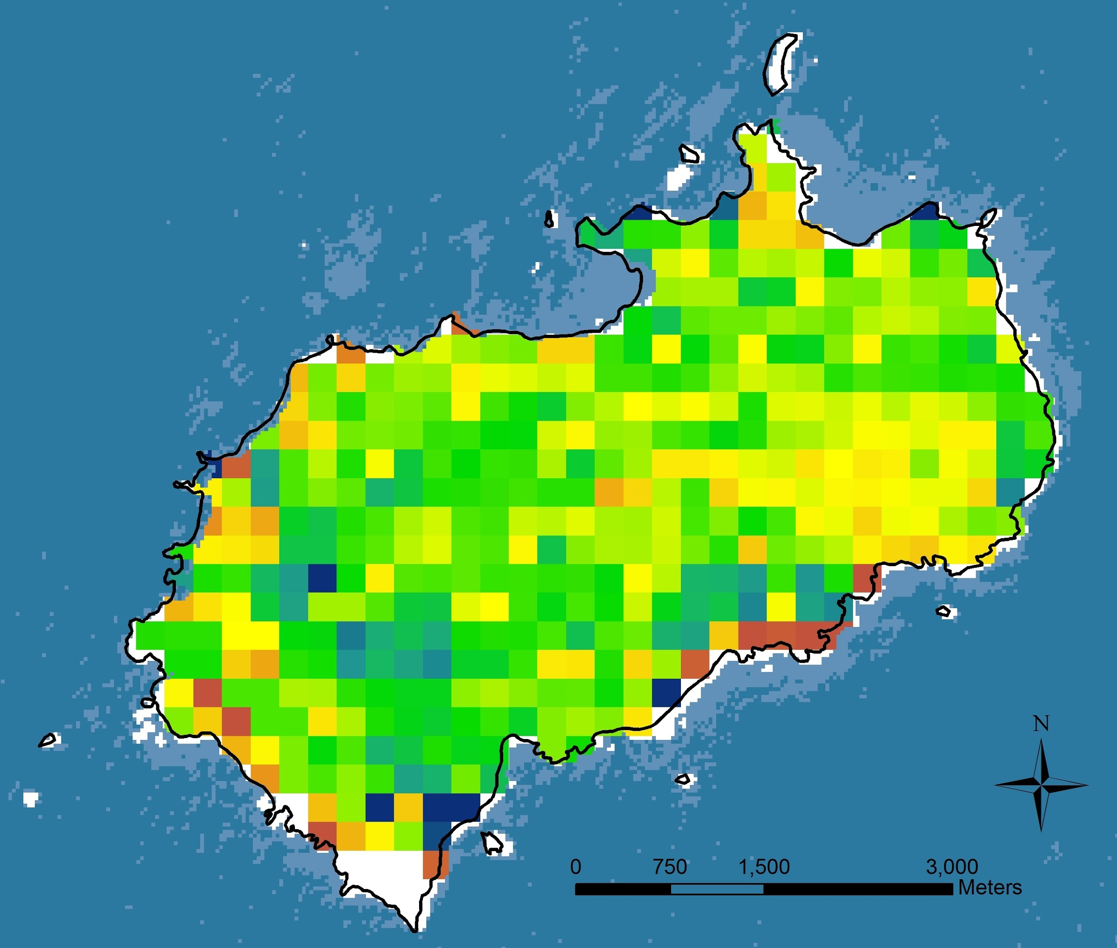
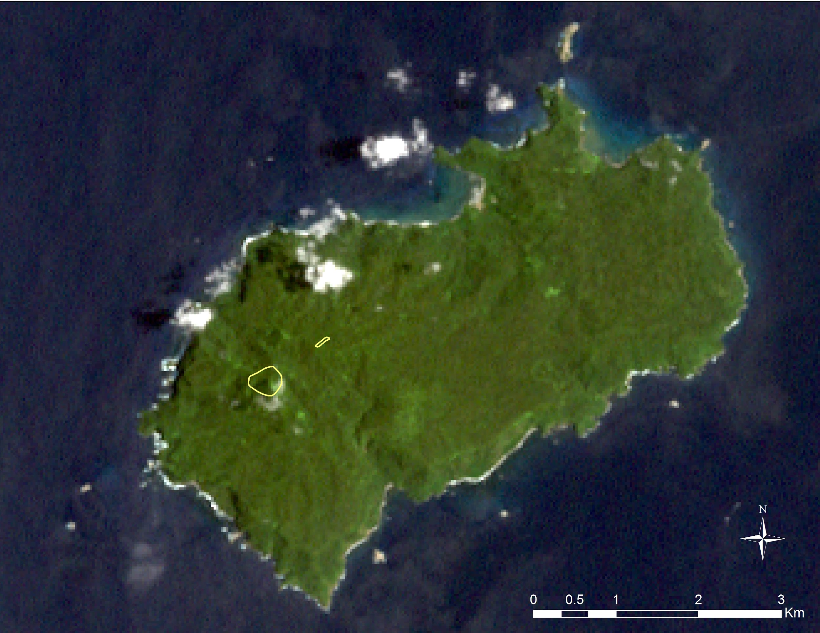
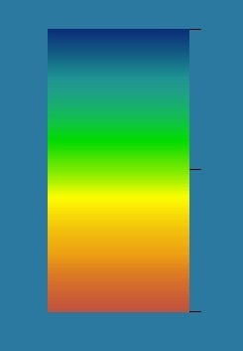
Vegetation Health Time Series
MODIS Maximum NDVI Changes 2003 - 2016
Landsat 7 ETM+ True Color, March 2000
NDVI Percent Change
51.0
500 m Elevation
-94.0
Notes:
MODIS NDVI percent values were calculated to display the changes occurred between 2003 and 2016. The blue colors present the positive changes and warm colors present negative changes of the NDVI percent values. Also 500 meter elevation data was used to show the cloud forest habitat on Landsat 7 ETM+ (True Color) for March 2000.
The most extreme NDVI decline occurs along the coastal land/water interface, usually near steep slopes and barren shorelines

Slide 16
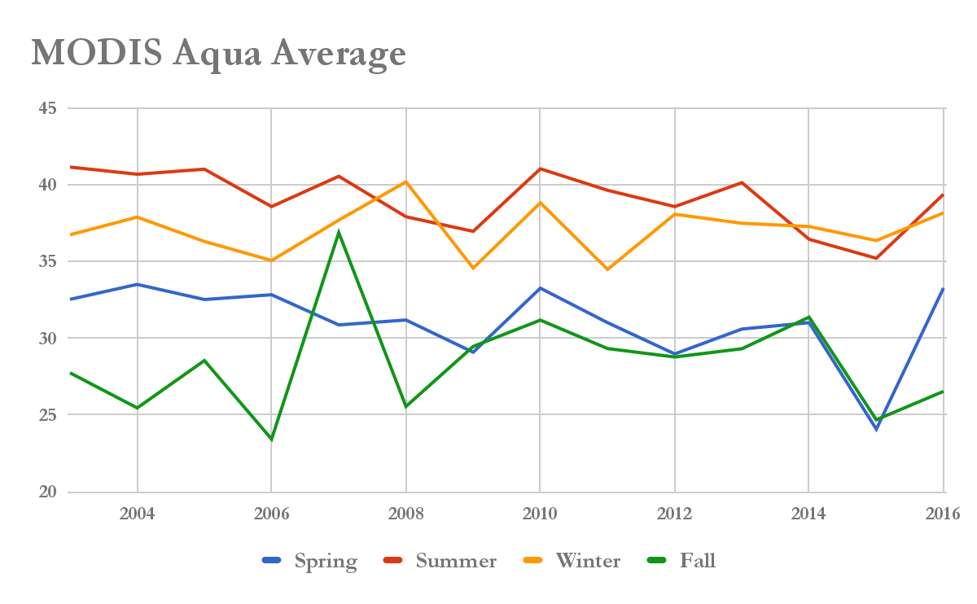
Cloud Detection Time Series
Notes:
Assuming it is percent cloud frequency, these numbers seem low given that in temperate environments there is usually about 1 out of 8 or 16 days has cloud free conditions for a given pixel.
Cloud Frequency Based on Blue Reflectance Threshold of 0.18 or Higher
- keep in mind that this cloud detection method is probably highly conservative - detection in part depends on the land cover type - clouds in tropical rain forest may have a lower threshold than .18 blue reflectance
this method is only for atmospheric contamination from clouds - it doesn't classify bad data due to aerosol contamination or poor viewing geometry (off nadir looks)

Slide 17
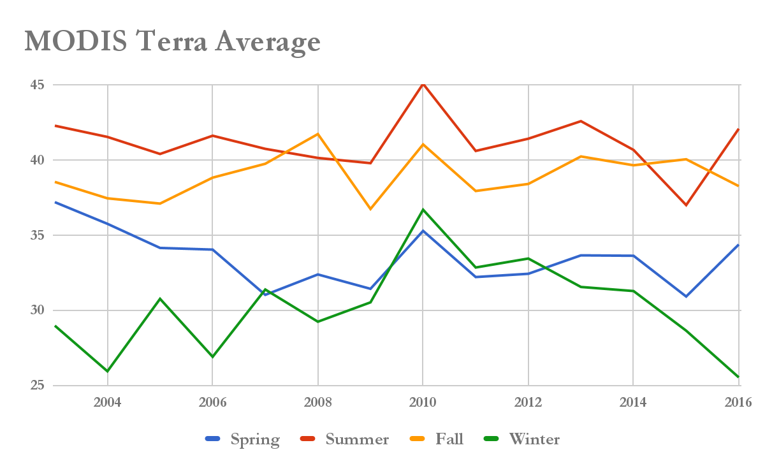
Cloud Detection Time Series

Slide 18
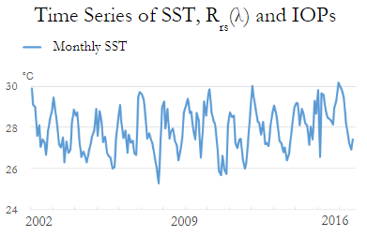
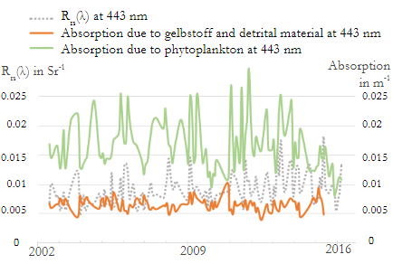
SST and Biophysical Variables
Products of Aqua MODIS from July 2002 to October 2016 were collected for remote sensing reflectance (R_{rs}(λ)) and inherent optical properties (IOPs)
These level 3 ocean color products were derived using Quasi-Analytical Algorithm (QAA)
Analysis using linear regression model showed no significant trend over the study period
Notes:
Coral reef bleaching is closely related to sea surface temperature anomaly and biophysical parameters in the ocean. Corals shares a symbiotic relationship with the microscopic algae called zooxanthellae. The algae that live in the tissues of corals are their main food source. When the symbiotic relationship is stressed due to abnormal SST or pollution, these algae tend to leave corals’ tissues. The presence of these algae can be assessed by chlorophyll-a concentration.
Products of chlorophyll-a are traditionally derived using empirical algorithm, but recent studies have shown there could be significant uncertainties present in those products. Therefore, remote sensing reflectance and inherent optical properties data derived by quasi-analytical algorithm is applied in more and more researches to infer chlorophyll-a concentration and water qualities.

Slide 19
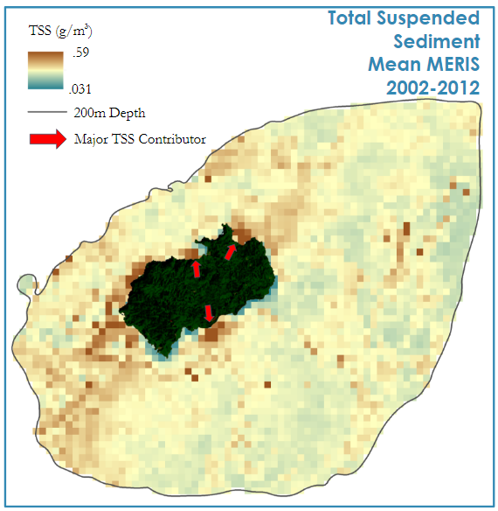
TSS Mean 2002-2012 (MERIS)
TSS (g/m³)
Total Suspended
Sediment Mean
MERIS 2002-2012
Map represents mean values of TSS for 20 scenes captured by Envis MERIS between 2002-2012
MERIS level 2 product pre-derived TSS using neural network model
Shows that a large contributor of TSS are bays
Bays are areas we expect to see frequent land cover change
.59
.031
200m Depth
Major TSS Contributor
4 Km
Notes:
The European Space Agency derives products from RAW MERIS data for the public. These products are known as level 2 products. ESA’s TSS model uses a Neural Network as part of their methodology for determining TSS. This allows the computer to create a model based off the same neuron pattern used by the human brain that can use initial results to cycle back on itself and enhance results. 20 TSS maps were averaged taking into account cloud coverage to create a mean image to give a snapshot of TSS through the years. Bahias Wafer, Chatham, and Iglesias are highlighted because of plumes of TSS emanating from them. The bays are the same place you expect to see frequent land cover change
European Space Agency. (2015), ENVISAT MERIS User Handbook, 2 (1)
This island receives an incredible amount of rainfall. To me that must contribute to the TSS levels in the coastal water around island

Slide 20
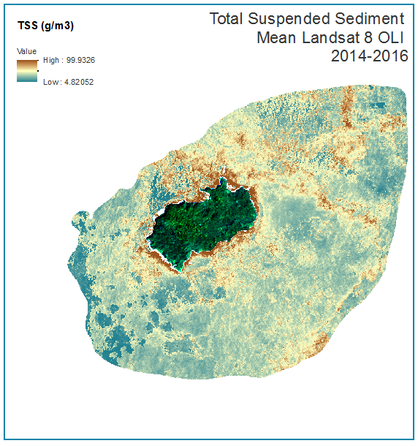
TSS Mean 2014-2017 (LS8 OLI)
Total Suspended Sediment
Mean Landsat OLI 8
2014-2016
Map represents mean values of TSS for 8 scenes captured by LS8 OLI between 2002-2012
Used Semi-Classification Plugin for QGIS to perform Dark Object Subtraction atmospheric correction
Derived using Min, et al. (2013) algorithm, TSS=.24exp(188.3R_{rs}(TM2))
Still shows that a large contributor of TSS are bays additionally shorelines play a large role
TSS (g/m³)
99.93
4.82
4 Km
Notes:
This map is a very similar map to the MERIS Mean TSS map in the previous slide with a few differences. First this map uses newly acquired data from landsat 8 OLI using 8 scenes from 2014-2016. LS8 data in this case was not atmospherically corrected so it had be done using a plugin in QGIS. Once corrected an algorithm chosen based on the similarity of study sites was chosen to derive TSS. A Major difference created by this is the different scale of TSS values. This means that you can not compare data values between the two maps however the spatial pattern can still be compared. TSS is still emanating from the bays
Min, J.-E.; Ryu, J.-H.; Lee, S.; Son, S. Monitoring of suspended sediment variation using Landsat and MODIS in the Saemangeum Coastal Area of Korea. Mar. Pollut. Bull. 2012, 64, 382–390.

Slide 21
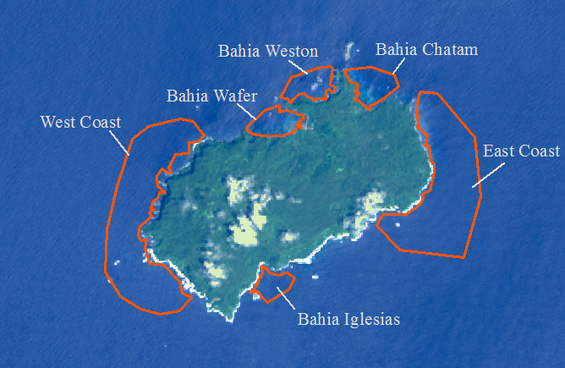
TSS Sample Site Map
Notes:
Sites for TSS sampling

Slide 22
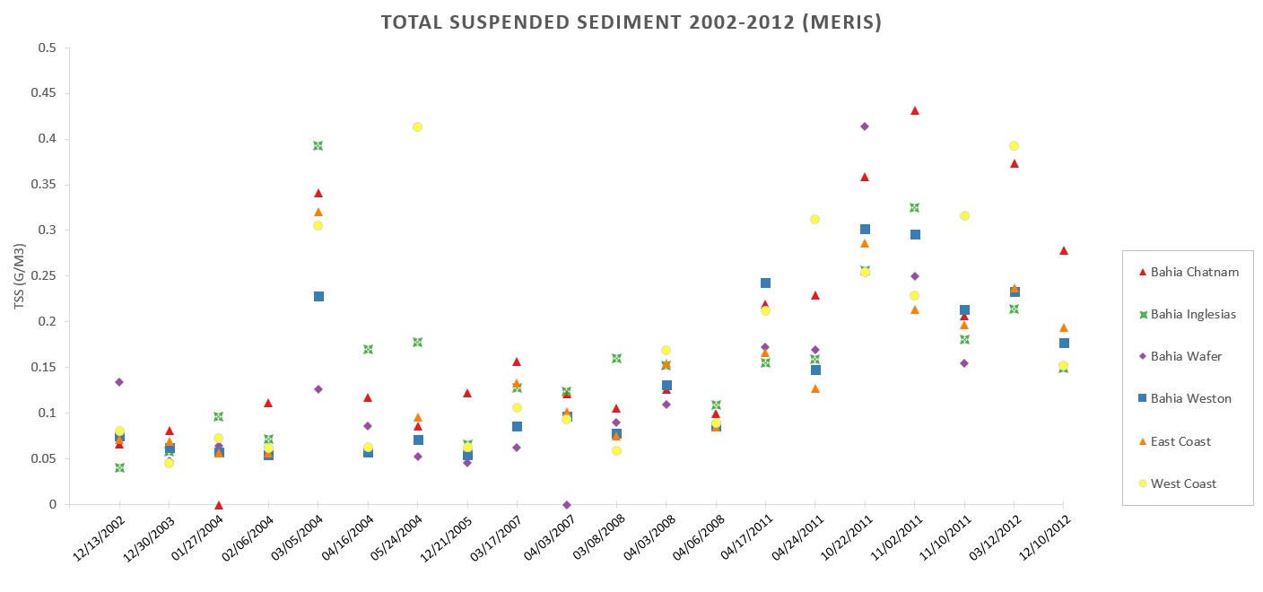
TSS Mean MERIS - Study Sites
Notes:
This XY plot shows the mean value of TSS collected from sample areas for each cloud free date using MERIS.

Slide 23
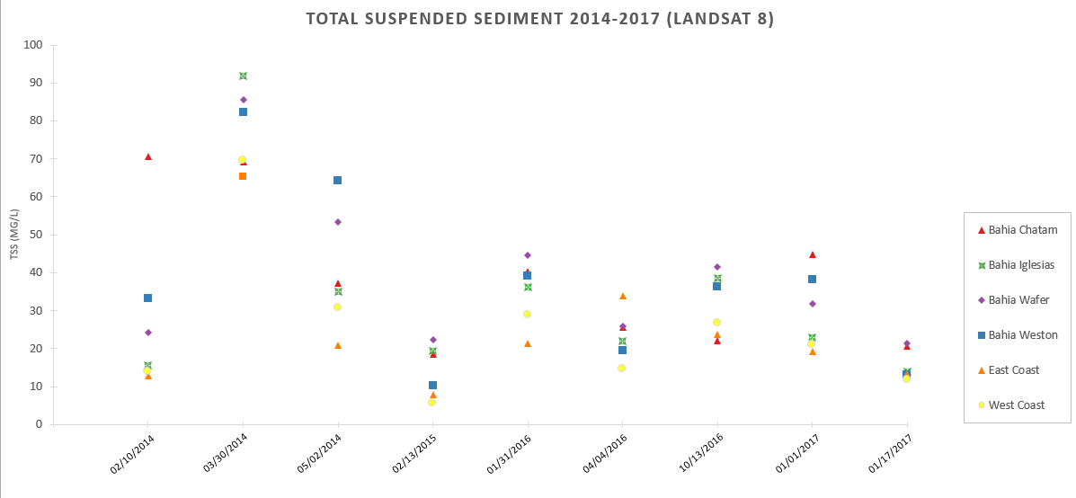
TSS Mean Landsat 8 - Study Sites
Notes:
This XY plot shows the mean value of TSS collected from sample areas for each cloud free date using landsat 8. Bahia Wafer is consistently high

Slide 24
Conclusions
MODIS annual NDVI indices showed promise for monitoring vegetation greenness changes
Higher suspended sediments were noted near the shoreline by bays were the island undergoes more change.
Relatively cloud free Landsat Imagery was useful for mapping land cover
Time series analysis of SST, Rrs(λ), IOPs data was used for biogeochemical activity assessment.
Bahia Wafer, Chatham, and Iglesias are frequent contributors to TSS based on data ranging from 2002-2012.
Image Credit: Esteban Herrera Herrera
Notes:
TSS is originating from the bays and any changes in these areas should be considered as it could increase total suspended sediment in the water column and affect coral health.

Slide 25
Errors and Uncertainties
MERIS and Landsat 8 maps use different algorithms so they can only be visually compared.
TSS maps scene choice was highly depended on cloud free imagery sample dates were chosen accordingly
Cloud coverage hindered full visual mapping of vegetation and NDVI maximum values
Image Credit: Esteban Herrera Herrera
Notes:
MERIS and Landsat have different sensors and parameters, that combined with the use of different algorithms makes it hard to compare the images beyond visually. Imagery was taken in an opportunistic fashion based on cloud free imagery availability.

Slide 26
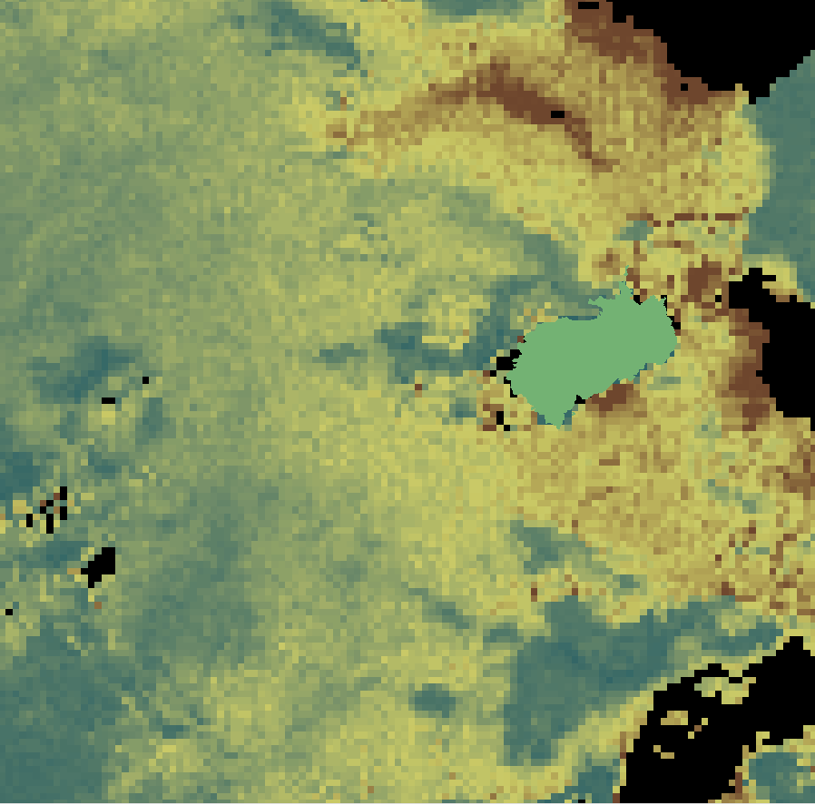
Future Work
Land cover change for multiple time intervals
Apply methodologies in these studies to higher spatial resolution data
Coral reef mapping using atmospheric and water column correction with high resolution data
Gather in-situ data to help validate SST results
Develop methodologies across multiple current sensors to help monitor SST trends in the future
TSS Plume (red) seen to the north of the Cocos using MERIS
Notes:
Applying methodologies described in this study to higher resolution data could enhance results in land cover and change detection. An attempt at coral reef mapping using Mishra et al. water column correction was done but landsat 8 resolution proved to be to low for meaningful results.

Slide 27
Acknowledgements
Esteban Herrera Herrera (Project Partner) Alejandra Solano (Project Partner) Steve Padgett-Vasquez (Mentor)
Dr. Marguerite Madden, University of Georgia (Science Advisor) Dr. Deepak Mishra, University of Georgia (Science Advisor) Dr. Cedric Fichot, Boston University (Science Advisor) Joseph Spruce, NASA Langley Research Center (Science Advisor) Bernard Eichold II, M.D., Dr. PH, Mobile County Health Department (Mentor)
Tyler Lynn (Center Lead) Caren Remillard (Center Lead) Sean Cameron (Fellow)
Elaina Gonsoroski (Fellow) Áreas de Conservación de Costa Rica, Área de Conservación Marina Isla del Coco
Embassy of Costa Rica to the United States
Ministry of Environment and Energy, Water Directorate

