Slide 1

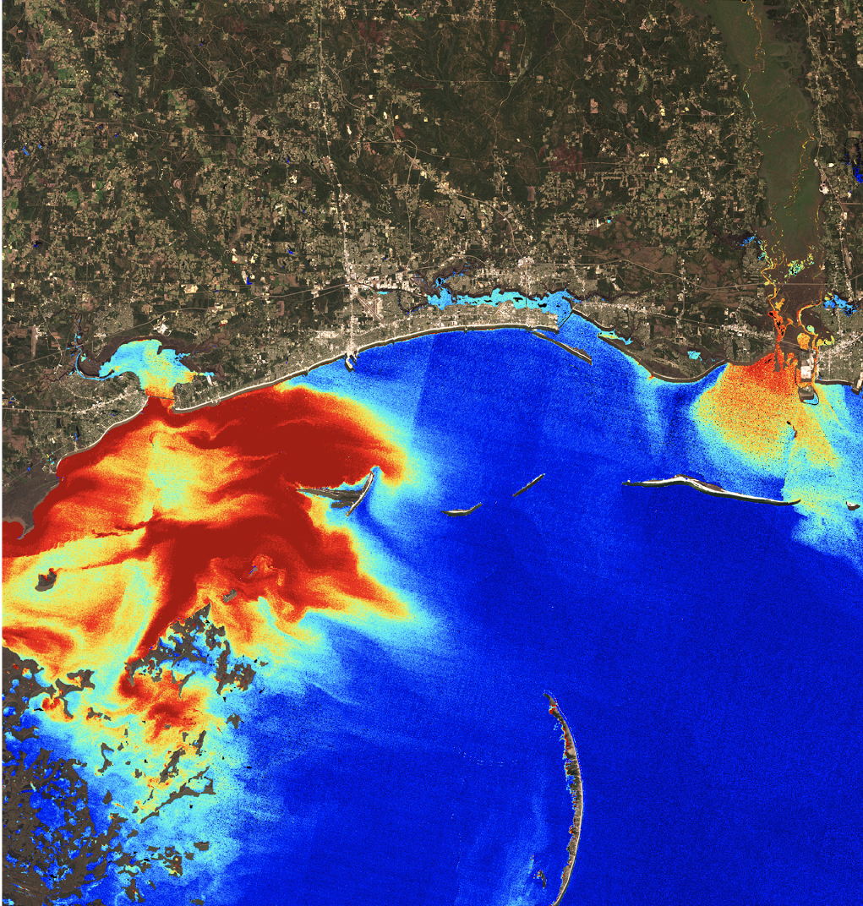

MISSISSIPPI SOUND WATER RESOURCES II
Analyzing the Impact of Environmental Disturbances on Oyster Reef Health in the Mississippi Sound Using NASA Earth Observations
Rachael Green
Carter Grimm
Hannah Russ
NASA Langley Research Center
2017 Summer
Basemap: ESRI
Notes:
Good Morning, (introduce team) and we are the Mississippi Sound Water Resources II NASA DEVELOP Team at Langley Research Center. Over the past 10 weeks, we have partnered with the Mississippi Department of Marine Resources on our project. The goals of this project were to assess water quality in the Mississippi Sound, specifically analyzing the effects that major environmental disturbances have had on oyster reefs between 2002 - today.

Slide 2
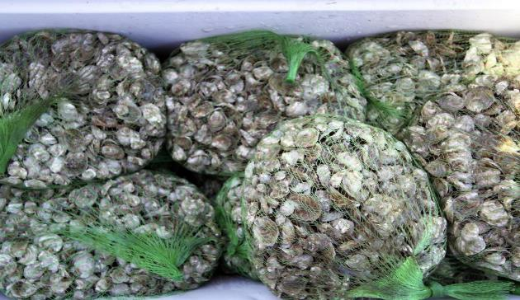
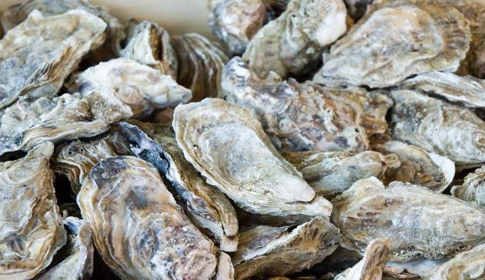
Why are oysters important?
Oyster reefs provide habitat for many marine species
Greatly improve water quality
Large economic player
Image Credit: Google Images: Norfolkdistrict
Image Credit: Flickr: Paul Asman & Jill Lenobles
Notes:
Why oysters? Why is the research that we have done important?
Oysters are vital to both the environment and economy of coastal Mississippi and the surrounding area.
Environmentally: Oysters improve water quality by filtering up to 50 gallons of water per day. Oyster reefs provide habitat for many other marine species from finfish to shellfish to crustaceans. Oyster reefs also protect coastlines from damaging waves and storm surge.
Economically: Oyster harvesting is a major player in both the local and regional economy of the Gulf....the field provides jobs and livelihood to thousands of people.
Image (top): https://www.flickr.com/photos/armyengineersnorfolk/6299229318
Image (bottom): https://www.flickr.com/photos/pauljill/3252265364/in/photolist-5XoHbL-4QcwJK-PLsmGL-j6uagD-7EYkcG-3VpybY-5dkSvB-4PxMu6-oJYbc-6gbaVW-arh2VL-7DAqJ-4XVctR-9k7uwL-5XoHgy-vTVYHM-5bvvsg-oiRvz-5cAsdd-GV9Qy-4dUc1S-fziMu-7rZu8S-tD9V8c-5wvMiS-5gXDbv-TmnJsm-dCUkZt-4QgMcW-bM6e7-trarKD-e1gZrG-84WvqJ-fb2gEw-7b5t3V-9MsQyP-9xAnZu-8XK65Z-R1KBmB-eKY6Hh-qFA2e4-mLjBKc-dqdnQi-6Xbb6r-eC4gjL-vKTUx-4RiC6p-5X6Nsz-7Gc36v-5Jfmjk

Slide 3
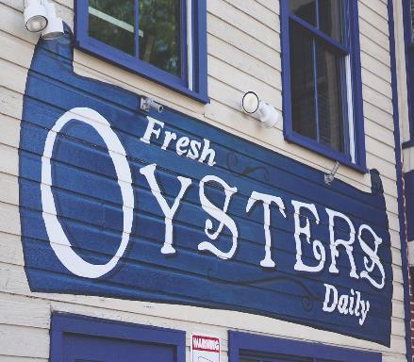
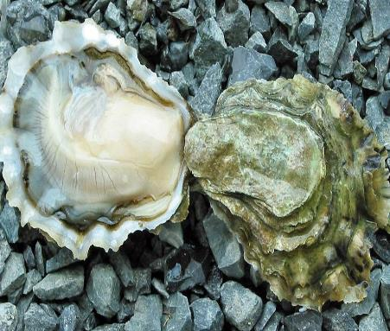
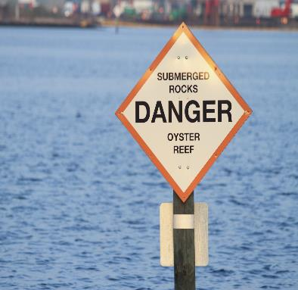
Community Concerns
Since 2002, reef habitats have declined by 90%
A decline in oysters will negatively impact both the health of the ecosystem as well as the economy of the Sound
Image Credit: Flickr: Tu.finamore
Image Credit:Google Commons
Image Credit: U.S. Army Corps of Engineers
Notes:
There has been a sharp decline in oyster productivity within the Sound since 2002...nearly 90% decline. This has already begun to negatively affect both the economy and environment of the Sound and it may only get worse.
Image (left): https://www.flickr.com/photos/tjfinamore/18006387775/in/photolist-trarKD-e1gZrG-84WvqJ-fb2gEw-7b5t3V-9MsQyP-9xAnZu-8XK65Z-R1KBmB-eKY6Hh-qFA2e4-mLjBKc-dqdnQi-6Xbb6r-eC4gjL-vKTUx-4RiC6p-5X6Nsz-7Gc36v-5Jfmjk-5rEAmf-5XzjeQ-fsXZTk-bRra4c-XaeeEF-6sJX9a-cCEHeu-7PMBEZ-e4yiRw-9U8yA-REWv8f-eC4eUC-baicEF-eDEeGy-2cvtx-5rE8RQ-vKTUA-fCBaku-eC14pR-7n3Z1-eC4fjS-ekMo4G-5Qje1W-b6kcVV-44QWc-7b5sNK-5inRv-fCKJ5W-52ZBst-7Cnbiy
Image (middle): https://www.google.com/search?site=imghp&tbm=isch&q=oysters&tbs=sur:fc#imgrc=XTRZ-x-VJ4491M:
Image (right): https://www.flickr.com/photos/armyengineersnorfolk/8148450636/in/photolist-dLznxH-dLzpaT-dLEWZE-8Layhs-bNkAPK-bv88eb-nKdNgr-bSSjeT-nKdMXF-bSSje6-o2Hn4e-bzqWzd-o2HmGT-dq3Vnj-8LaFYL-nKeMV2-dq3J8P-VWLCVQ-aSSi4K-bv88a3-dLEWo1-bzqWAd-dLzpeZ-bNkANZ-dq3KTT-bzqWBJ-aSSjog-dq3JiK-dq3L4R-dq3W6s-o2Aop1-o2BDb5-dq3Lga-dq3Uxj-dq3Kkr-Nh1Lgh-dq3JvF-dLzppF-dq3Wud-bNkAMz-dq3K7D-dq3Wg7-dq3JGT-aSSaRr-dq3VcE-yk6GmW-tKHnmh-dLzp56-dLzoDr-bv884u

Slide 4
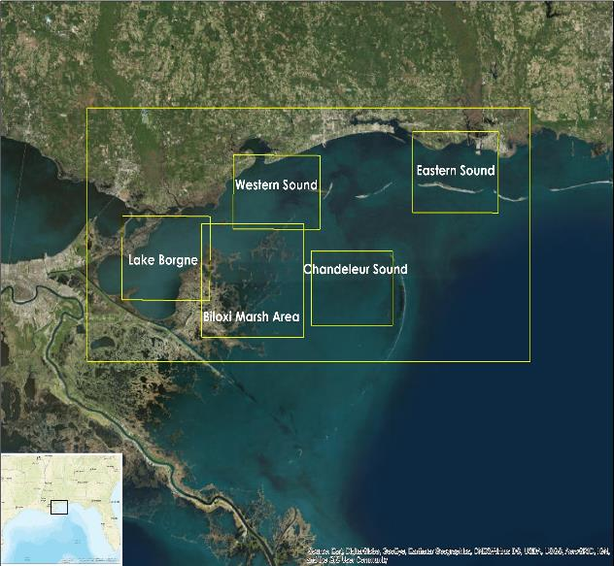
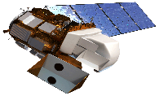
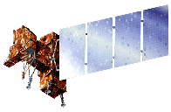
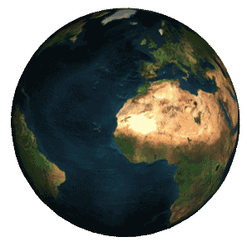

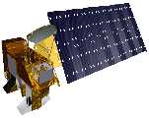
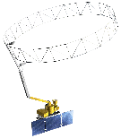
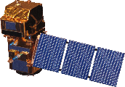
Earth Observations and Study Area
Image
Landsat 8 OLI & TIRS
Landsat 7 ETM+
Aqua MODIS
Landsat 5 TM
SMAP
Sentinel-2 MSI
Basemap: ESRI
Image Credit: ESRI
Image Credit: Best Animation
Notes:
Study area - entire extent of Mississippi Sound - East from Mobile Bay, West to Lake Borgne and South into the Louisiana marshlands. Two particular areas of interests - Western Sound and Biloxi Marsh. Western Sound because 97% of Mississippi’s oysters are harvested there. Biloxi Marsh due to its proximity to the sound itself, as well as the role it plays in diverting freshwater flowing into the sound.
Earth Observations - Explored the capabilities of many EO Satellites that could assess water quality. We found that Landsat 5,7,8 and Aqua MODIS were the most useful to us. SMAP and Sentinel-2 were not as useful due to limitations in the availability of imagery near coastlines / marshlands.

Slide 5
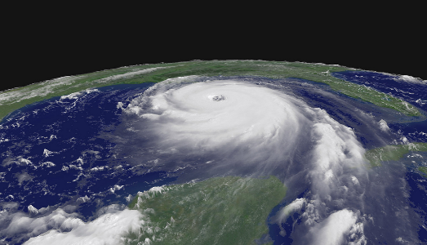
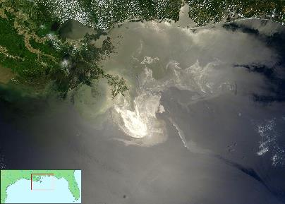
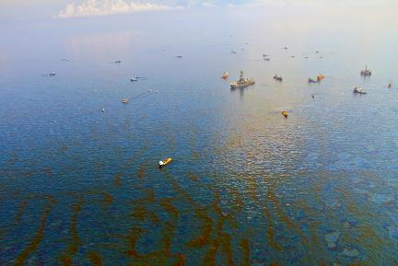
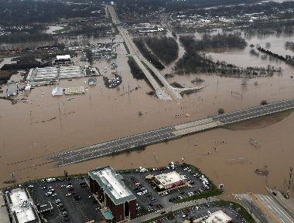
Environmental Impacts
Hurricane Katrina – August, 2005
Deepwater Horizon Disaster – 2010
Major Mississippi River Flooding – Spring 2011
Openings of the Bonnet Carré Spillway – 2011 & 2016
Image Credit: Flickr: Will Scott
Image Credit: Google Commons
Image Credit: Flickr: Green Fire Productions
Image Credit: Department of Defense
Notes:
The decline in oyster production came to light following a number of environmental disturbances that took place in the area. Our team chose a number of these events to take a closer took at. Namely, Hurricane Katrina (2005), The Deepwater Horizon Disaster (2010) Flooding events of 2011 and 2016, and the resulting openings of the Bonnet Carre Spillway.
Image (top left): https://www.flickr.com/photos/gsfc/4922919267/in/photolist-8v2fop-DXbBV-DXcMw-DXfSa-DXcK1-DXfGH-DXeir-83jqi-DXd7x-5Boyap-4jm2D-DXc5m-2j78e4-4s9WB-4rLpY-4rLsu-DXdx2-DXeFY-DXcy2-DXaqT-8gUm9-8gUCq-DXbrW-DXfci-4qhLE-4iQHz-DXb4Z-4rLoD-4iQJ6-5EZ99a-4rLgA-8gUsu-4rLkp-cEEbkm-4v7r8-DXaF1-4iQHW-4s9Sq-4iQHJ-4v7pa-4s9Wq-hzxP7-8gUaP-DXbFE-84WJo-8v5kxq-8v2fjH-aLhac-84WG5-8gVgp
Image (bottom left): https://www.flickr.com/photos/armyengineersnorfolk/6299229318
Image (bottom middle): https://www.google.com/search?site=imghp&tbs=sur%3Afc&tbm=isch&sa=1&q=deepwater+horizon+spill&oq=deepwater+horizon+spill&gs_l=psy-ab.3..0j0i30k1j0i5i30k1j0i8i30k1.5826.6751.0.6960.6.6.0.0.0.0.117.559.0j5.5.0....0...1.1.64.psy-ab..1.5.559...0i67k1.hnuP_oBXBMo#imgrc=LyULhj7g3dHGkM:
Image (bottom right): https://www.google.com/search?site=imghp&tbs=sur%3Afc&tbm=isch&sa=1&q=mississippi+river+flooding&oq=mississippi+river+flooding&gs_l=psy-ab.3..0l4.63008.66111.0.66318.26.19.0.0.0.0.292.2550.0j12j3.15.0....0...1.1.64.psy-ab..11.15.2549...0i67k1.Qtsw1TQ8I5E#imgrc=G2HpFTOq_Ts95M:

Slide 6
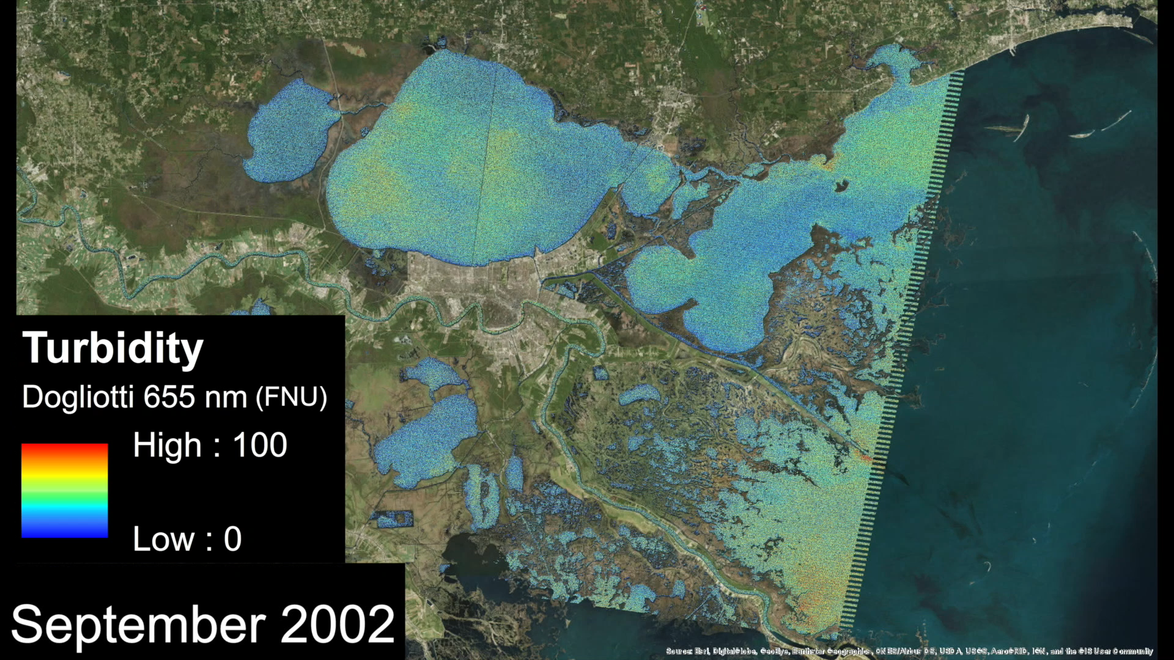
Methodology
Data Products
Analysis
Results
Chlorophyll-a, Water Discharge, Gage Height, Turbidity, TSM, Oyster Landings, Salinity
Correlation analysis of water quality parameters and oyster landings
Case Studies
Ran imagery through ACOLITE and input into ArcMap
Time Series
Notes:
We gathered both in-situ and remotely sensed data on many water quality parameters including chlorophyll, water discharge, gage height, turbidity, TSM and salinity. We compiled these datasets into monthly and yearly averages before cross comparing them with each other and with oyster catch data in an attempt to create correlations. We specifically looked at how these correlations matched up with the occurrences of environmental events to create our case studies. We ran our remotely sensed NASA EO data through data processors and refined them in ArcMAP to develop a time series of these parameters within the Biloxi Marsh area.

Slide 7

Oyster Landings
Average Annual Mississippi Oyster Landings 2002 - 2015
Hurricane Katrina DWH Spill Bonnet Carré
Notes:
Oyster landings suffered a devastating fall in 2004 and again in 2010. Today, oyster reefs off the coast of Mississippi still have not recovered.
Landings data provided by NOAA’s Office of Science and Technology

Slide 8
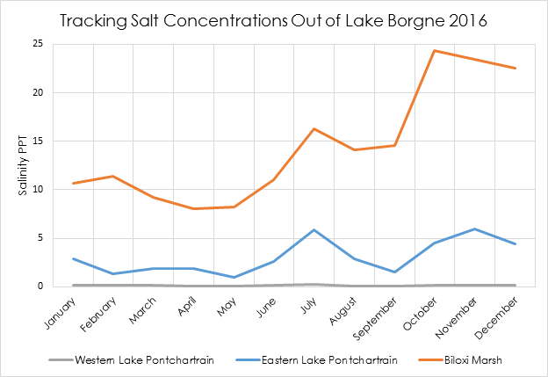
Salinity
Bonnet Carré Flooding
Bonnet Carré & Flooding
Notes:
SMAP is not able to effectively assess salinity in coastal areas, instead in-situ data was used for comparisons
Left:
Though salinity has been decreasing since 2011, there is not sufficient data to verify the overall trend in salinity for the Western Sound
The data suggests that salinity has become increasingly varied. Oysters prefer a habitat with salinity concentrations between 20 and 30 PPT and an increase in variability would result in salinity fluctuations outside of their comfort zone.
Right:
This map demonstrates how various water monitoring stations, positioned in Lake Pontchartrain and the Biloxi Marsh, record salinity after a freshwater event
After the Bonnet Carré opening and flooding event in 2016, salinity in Western and Eastern Lake Pontchartrain decrease, but salinity in the north eastern Biloxi Marsh does not respond to the influx of freshwater
This suggests that freshwater is traveling from Lake Pontchartrain, into Lake Borgne, and diverting down through Three-Mile Pass instead of flowing out into the Sound.
Salinity data for the Western Sound is from USGS Water Monitoring Station #301527088521500 Mississippi Sound at USGS East Ship Island Light
Salinity of western Lake Pontchartain: Station USGS 300602090375100 CRMS5373-H01-RT
Salinity of eastern Lake Pontchartrain: Station USGS 301001089442600 Rigolets at Hwy 90 near Slidell, LA
Salinity of the Biloxi Marsh: Station USGS 300722089150100 Mississippi Sound near Grand Pass

Slide 9
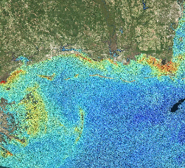
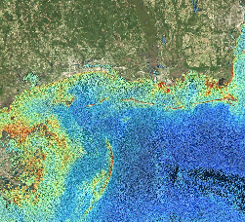
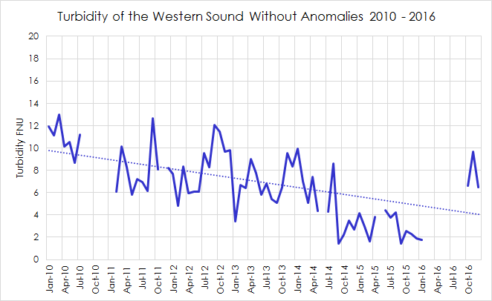
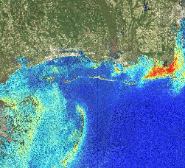
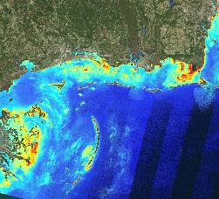
Turbidity
2005
2008
2011
2015
Basemap: ESRI
T Dogliotti 655 nm (FNU)
0
50
100
Notes:
Turbidity has been decreasing in the Western Sound since 2010, though there is not sufficient data to verify the overall trend
Anomalies were excluded so that they would not skew the trendline, dates include Tropical Storm Cindy (June, 2014) and the flooding event (July, Aug, Sept, 2016)
A decrease in turbidity may suggest that the western sound is becoming more saline, but further study is needed for verification
Turbidity data is from USGS Monitoring Station #301527088521500 Mississippi Sound at USGS East Ship Island Light
Basemap Credit: ESRI

Slide 10
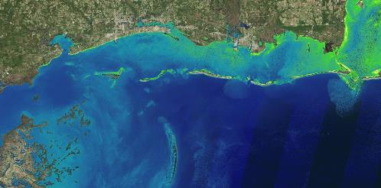
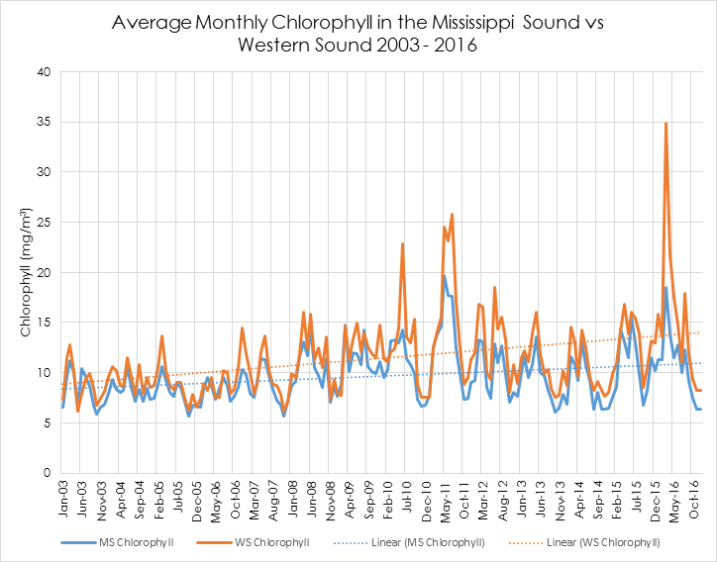
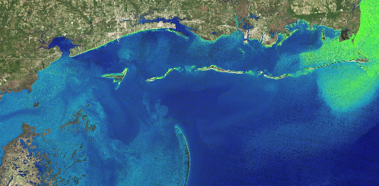

Chlorophyll-a
October 14, 2015
January 18, 2016 (After the 2016 opening of the Bonnet Carre)
Hurricane Katrina DWH Spill Bonnet Carré Bonnet Carré & Flooding
Basemap: ESRI
Chlorophyll OC2 (mg m⁻³)
0
5
10
Notes:
There are spikes of high chlorophyll-a concentrations in the Western Sound for each of the case studies except during Hurricane Katrina
As with salinity, chlorophyll-a data is also becoming more varied
( Mississippi Sound: Pre-January 2010 ơ =1.9527, post-January 2010 ơ = 3.0658; Western Sound: Pre-January 2010 ơ = 2.3892, post-January 2010 ơ = 4.7042)
This could be attributed to the decline in turbidity (shown on the previous slide)
A decrease in turbidity would allow for more sunlight in the water column, increasing photosynthesis in phytoplankton - which is used as an indicator for chlorophyll productivity
Chlorophyll-a is from term one Aqua MODIS data
Basemap Credit: ESRI

Slide 11
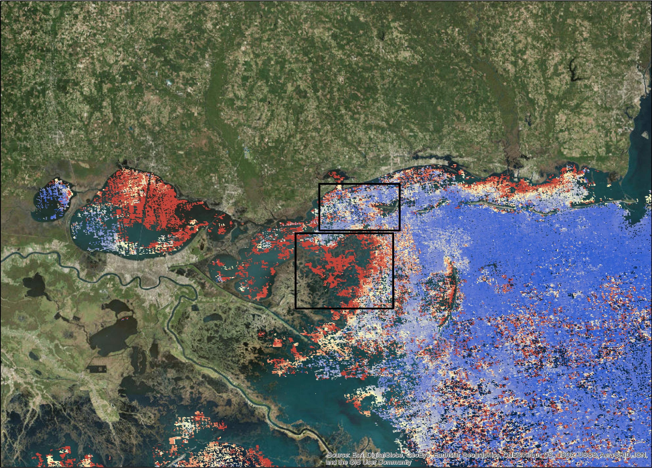
Total Suspended Matter
TSM July 2011 – Flooding Event
Hurricane Katrina DWH Spill Bonnet Carré Bonnet Carré & Flooding
Basemap: ESRI
High
Low
Notes:
Seasonality was removed from the data sets in order to accurately establish a trendline
High TSM can be correlated with pulses in Pearl River water discharge shown on the next slide
TSM data is from term one’ s Aqua MODIS data
(Image on right) Aqua MODIS monthly aggregate in July 2011 after major flooding event. Imagery shows a concentration of TSM throughout the Biloxi Marsh while relatively low TSM values throughout the sound. Suggests the diversion of freshwater through the marsh

Slide 12
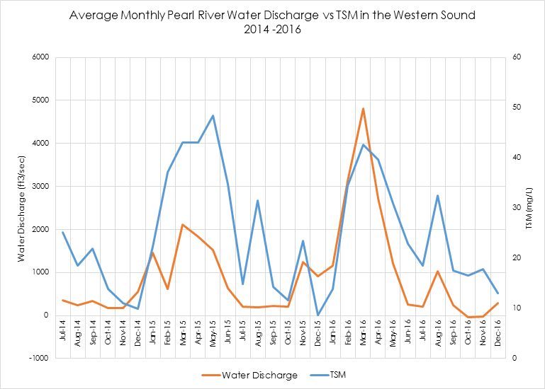
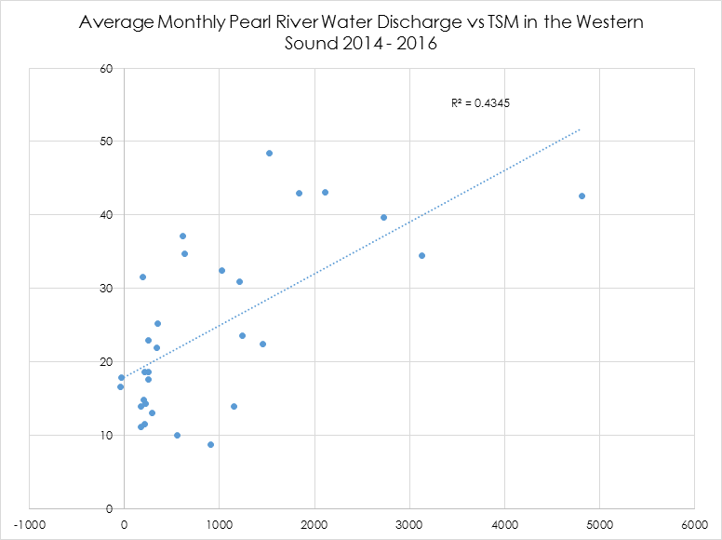
Pearl River Water Discharge
Bonnet Carré & Flooding Event
Notes:
TSM spikes in the Western Sound correlate to high water discharge of the Pearl River. Spikes in both parameters are especially noticeable during the flooding event of 2016
Water Discharge from USGS Station: 02492620 PEARL RIVER AT NSTL STATION, MS

Slide 13
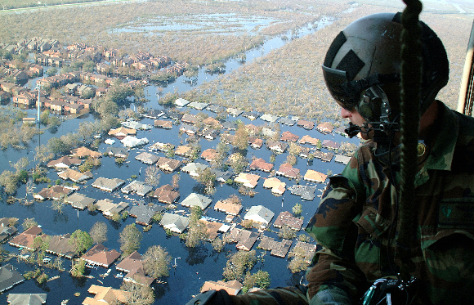
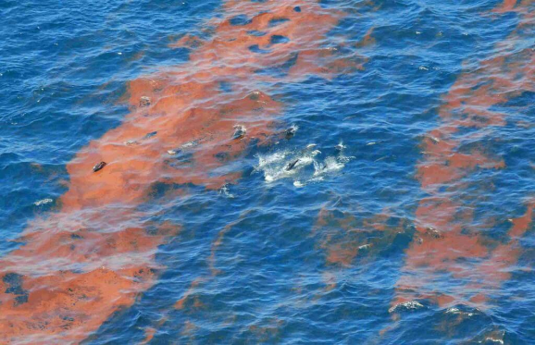
Hurricane Katrina & Deepwater Horizon
Katrina had minimal effect on TSM and chlorophyll-a concentrations
No other water quality parameters were available for this study period
Image Credit: Google Commons
DWH did not seem to affect TSM and chlorophyll-a concentrations
No other water quality parameters were available for this study period
Image Credit: Google Commons
Notes:
Hurricane Katrina: The team hypothesizes that the sharp decline in oyster landings following Hurricane Katrina was due more to the direct, physical impacts on the oyster reefs as well as fishing restrictions, rather than changes in water quality.
Deepwater Horizon:
Katrina picture: http://www.af.mil/News/Article-Display/Article/129978/life-after-katrina-airmen-ready-to-help-again/
DWH picture: https://www.mmc.gov/priority-topics/offshore-energy-development-and-marine-mammals/gulf-of-mexico-deepwater-horizon-oil-spill-and-marine-mammals/

Slide 14
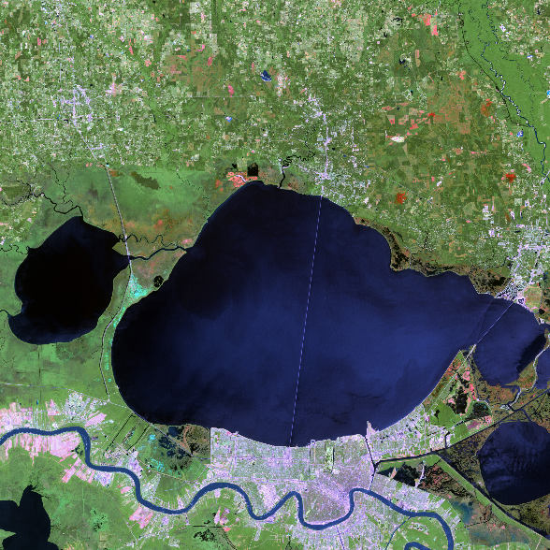
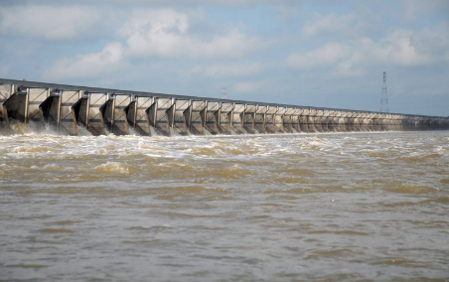
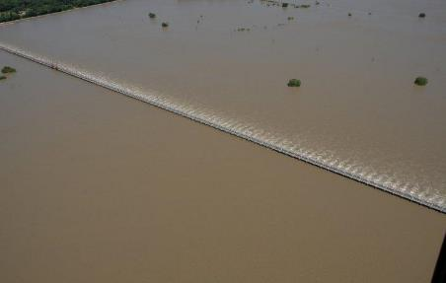
The Bonnet Carré Openings
Image Credit: Google Commons
Bonnet Carré Spillway
Image Credit: NASA Earth Observatory
Image Credit: Army Corps of Engineers
Notes:
Bonnet Carré 1: There is a strong correlation between the 2011 Bonnet Carre spillway opening and an increase in chlorophyll-a and decrease in TSM in the Sound
Bonnet Carre 2: The 2016 opening resulted in a spike in turbidity and TSM. There was a slight increase in chlorophyll-a concentrations, as well as an overall decrease in salinity.
Lake Pontchartrain Imagry: https://earthobservatory.nasa.gov/NaturalHazards/view.php?id=15419
Bonnet Carre Image (top): https://www.flickr.com/photos/usacehq/5710676866
Bonnet Carre Image (bottom): https://www.flickr.com/photos/usacehq/5733663473/in/photolist-9JEwoM-9VTQAD-9GCHgY-9VWVzs-9GzH2p-6YYoj4-9Jnpgx-6YYyhF-6Z3yAm-ksUpoL-6Z3tSW-6Z3ygs-9LjYbe-DnA7rx-Dd2935-CqcAC6-CqczJn-DnA7iX-CqcA9a-9Lmace-9JJf18-9J5MAw-d2htLm-btHNuX-dp4ne7-d1Bg2U-4AtGjX-9LjYcc-6QTk4C-CdJihW-dp4n7u-dp4f4i-dyyngK-dyDQHL-c6WzWy-6ZJn6x-dp4nhy-6ZNmRW-bNiTEn-dyDQRA-9LnLoY-9LnLsN-9LnLoo-9N5BK6-dp4nod-6QTjzL-9LjYdZ-6ZJkYc-9G1ppu-6QPgdt/

Slide 15
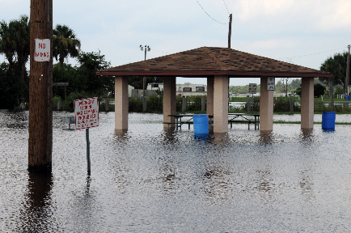
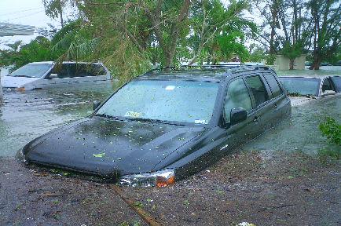
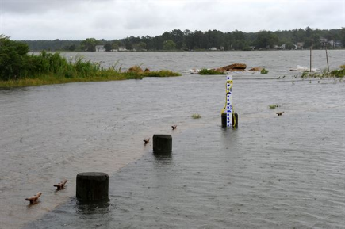
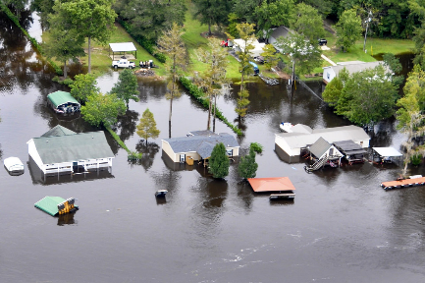
Flooding Event - 2016
Image Credit: Wikimedia Commons
Notes:
Major flooding in March of 2016 resulted in a spike in TSM, turbidity, and chlorophyll-a
There was also a decrease in salinity
It is likely that the combined effects of both the Bonnet Carre opening and flooding event are what contributed to the dramatic spikes in water quality parameters
Top Left: https://www.google.com/search?site=imghp&tbm=isch&q=flooding&tbs=sur:fc#imgrc=Xh_w8AqFVSTwTM:
Bottom Right: https://www.google.com/search?site=imghp&tbm=isch&q=flooding&tbs=sur:fc#imgrc=AY_1qOSh6PT5cM:
Top Right: https://www.google.com/search?site=imghp&tbm=isch&q=flooding&tbs=sur:fc#imgrc=GdAAb8Bo7pE2RM:
Bottom Left: https://www.google.com/search?site=imghp&tbm=isch&q=flooding&tbs=sur:fc#imgrc=_0Zxrln36vs85M:

Slide 16
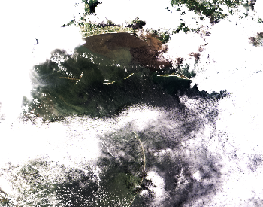
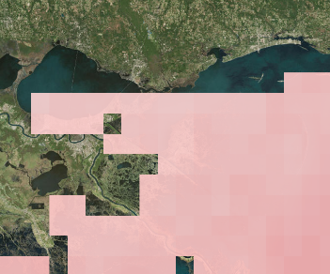
Errors and Uncertainties
Remote Sensing
Gaps in data availability
Cloud cover
Certain parameters were too coarse for accurate analysis
In situ
Limitations in hydrological monitoring stations
Insufficient data preceding 2010 - Katrina / DWH
Seasonality of the oyster landings data
Notes:
We came across a few issues over the course of this project related to data acquisition and processing.
Difficulties with acquiring quality remote sensing data included:
Cloud cover obscuring the view of the sensors
Large gaps between dates of observed data
Certain parameters were too coarse for accurate analysis
Difficulties with In-Situ data include:
Limitations in the parameters that each hydrological monitoring station hosted
Insufficient data prior to 2010
Seasonality of the oyster landings made data difficult to draw comparisons with water quality parameters

Slide 17
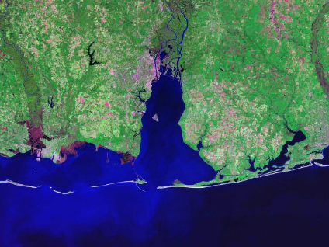
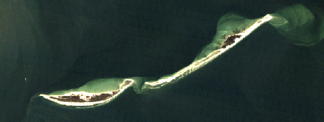
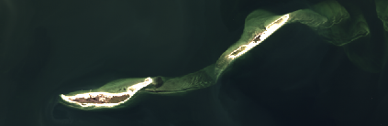
Future Work
Land changes in the barrier islands
Degradation of the islands may disrupt the flow of freshwater into and out of the Sound
Large, frequent precipitation events may increase variability of water parameters
Image Credit: Google Commons
2002
Image Credit: Google Commons
2013
Notes:
Future work on this project would include an in-depth analysis of land changes to the barrier islands that border the sound to the South. Degradation of the islands may disrupt the flow of freshwater into and out of the Sound. The resulting increase in salinity could increase oyster mortality and predation. Additionally work in the future would include researching trends in precipitation, assessing how large rainfall events directly affect water quality.
Image (top): https://www.google.com/search?site=imghp&tbs=sur%3Afc&tbm=isch&sa=1&q=mobile+bay%2C+map&oq=mobile+bay%2C+map&gs_l=psy-ab.3..0j0i5i30k1j0i8i30k1l2.11382.12389.0.12692.5.5.0.0.0.0.142.467.0j4.4.0....0...1.1.64.psy-ab..1.4.467...0i67k1.NJ7Du1W_M_o#imgrc=znHquZEaoEMUkM:

Slide 18
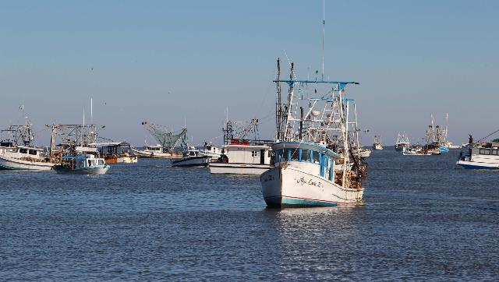
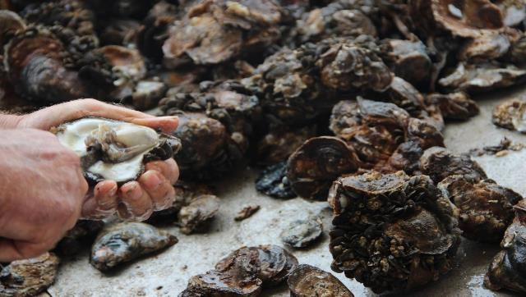
Conclusions
An increase in the variability of water quality parameters over time
Data does not suggest increasing salinity
Possible increase in freshwater diversion through marsh
Limitations in the availability of remotely sensed data
Image Credit: Monet
Image Credits: Mississippi Department of Marine Resources
Notes:
Our data suggests a number of things.
The first is an increase in the variability of water quality parameters over time, specifically in response to these major environmental disturbances
To begin our project we hypothesized that the salinity in the Sound may be increasing which in turn was harming oyster populations. Our data suggests that this may not necessarily be the case, and instead there is a more complicated salinity / freshwater relationship going on
Finally, we have concluded that there are severe limitations in the availability of remotely sensed data near coastlines and marshlands. Improvements in technology and research is needed to improve remote sensing data in these areas.
Images were provided by our partners.

Slide 19
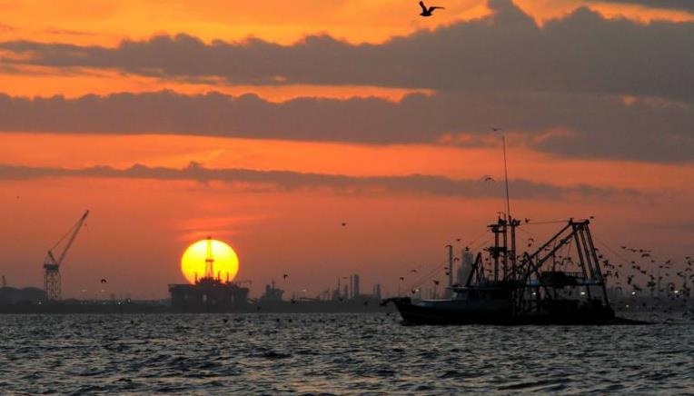
Acknowledgements
Partners - Mississippi Department of Marine Resources (MDMR)
Mississippi Sound Water Resources I Team
Science Advisors
Emily Gotschalk (Project Co-Lead)
Brigitte Moneymaker (Project Co-Lead)
Katherine Cavanaugh
Jessica Gregory
Erika Higa
Catherine Stolfi
George Ramseur, Scott Gordon, Charlie Robertson, Karen Clark & Robert Gruba
Dr. Kenton Ross, NASA Langley Research Center
Ben Holt, NASA Jet Propulsion Laboratory
Dr. Severine Fournier, NASA Jet Propulsion Laboratory
Image Credit: MDMR
Notes:
We have a number of people we would to thank for their hard work and commitment to our success over the past ten weeks. First, the MSWRI Team led by our Center Lead, Emily Gotschalk. We would also like to thank our science advisors, Dr. Kenton Ross here at Langley, as well as Ben Holt and Dr. Severine Fournier at JPL. Finally we would like to that our partners at the Mississippi Department of Marine Resources for their confidence in us to tackle this issue.

