Slide 1
National Aeronautics and
Space Administration
CHILE WATER RESOURCES II
Applications of NASA Earth Observations in Google Earth Engine to Estimate Glacier Trends and Water Availability in Chile’s Aconcagua Watershed
Mariana Webb
William Babis
Stuart DeLand
NASA Ames Research Center, Moffett Field, CA
2017 Summer
Notes:
Presenter: bb
Good day, today we will talk about the Chile Water Resources II project: Applications of NASA Earth Observations in Google Earth Engine to Estimate Glacier Trends and Water Availability in Chile’s Aconcagua Watershed. This research was conducted by a research team at the Ames Research Center in Mountain View California in coordination with the Chilean Ministry of Agriculture. The purpose of this project was to aide in the Ministry’s decision making process by creating cloud-based tools in Google Earth Engine which allow for near real time monitoring of glacial extents and contributing environmental factors.

Slide 2
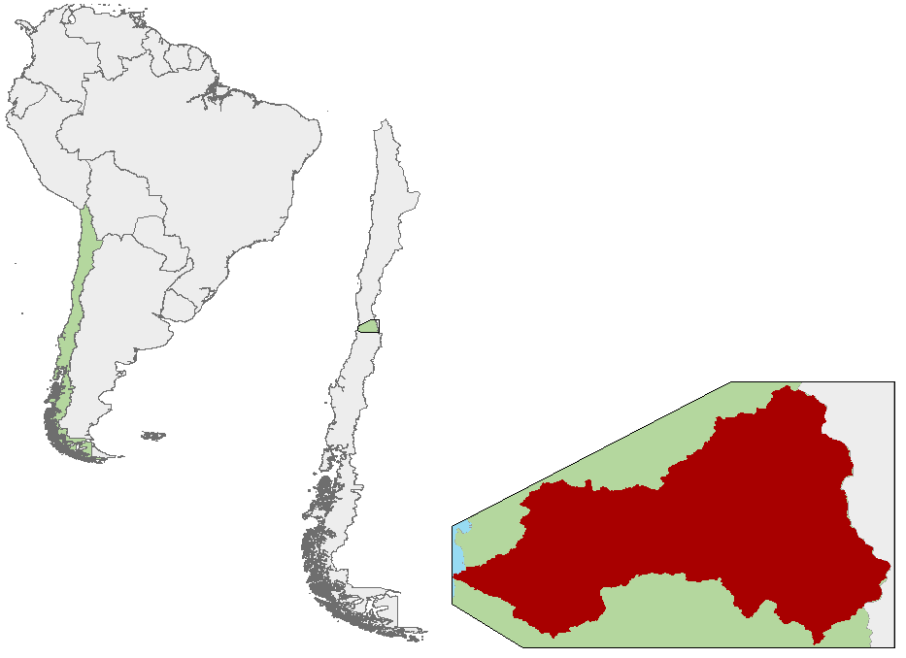
Study Area & Time Period
Study Area: Aconcagua River Valley,
Central Chile
7,340 km² square meters of glaciers
Mediterranean-type climate: winter rainfall and summer dryness, high vegetation diversity
Orchard fruits, wine, wheat, maze, and potatoes
Study Period:
1988 to mid-2017
Real-time updates
Study Area
Aconcagua River Valley
Chile
South America
Pacific Ocean
Kilometers
Notes:
Presenter: bb
Study Area & Time Period:
The project focused on the Aconcagua basin, located just north of the capital city of Santiago. The basin is characterized by eastern areas of glacier in the high elevation Andes Mountain Range. These glaciers supply meltwater runoff to the lower fertile river valleys. Aconcagua is important to Chile’s national economy, as the Mediterranean-type climate supports fruit and agriculture farming practices and is among the top three regions contributing to Chile’s gross domestic product (GDP).

Slide 3
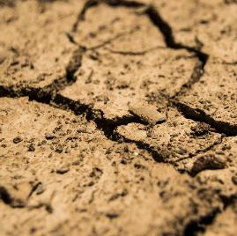
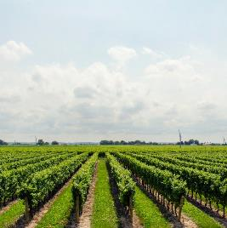
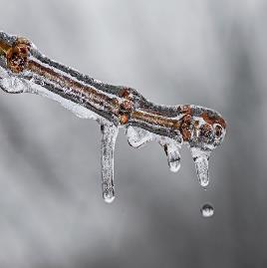
Community Concerns
Project Partners:
Chilean Ministry of Agriculture
Agricultural Office of the Chilean Embassy
Partner Concerns:
Agricultural practices account for 70% of Chilean water consumption
Regional growth of the agricultural economy
Chilean reliance on glaciers for water storage and supply
Global weather intensification and a rising zero-degree isotherm
Sources: Pixabay
Notes:
Presenter: mw
Community Concerns:
Researchers partnered with the Chilean Ministry of Agriculture and the Agricultural Office of the Chilean Embassy. In recent years, Aconcagua has experienced stressed hydrologic resources as a result of anomalous climate conditions and anthropogenic water consumption. 70 percent of all regional water is consumed by agricultural practices, and in 2011 the Chilean government announced plans to increase the national land under irrigation by 57% by the year 2022.
Overall, the wet and cool winter months account for 80 percent of Aconcagua’s total annual precipitation, while dry, warm conditions prevail during the spring and summer months. Consequently, the basin depends on seasonal glacial accumulation to provide water storage for the dry season when up to 67 percent of water is derived from glacial runoff. Globally, weather intensification and the rising zero-degree isotherm are poised to threaten the stability and longevity of glacial water resources. In recent years, Chile has experienced periods of prolonged drought as well as glacier shrinkage. The Aconcagua basin is especially vulnerable to these changes as a consequence of its agricultural economies and reliance on sub-tropical glaciers for water resources. The depletion of traditional water resources have forced some farmers to tap into ground water resources, a last resort.
Image Citations:
Drought: https://www.pexels.com/photo/earth-dry-brown-soil-36016/
Ice Melt: https://www.pexels.com/photo/tree-branch-covered-with-frosted-ice-40802/
Ag: https://www.pexels.com/photo/grapes-vineyard-wine-sky-21393/
Urban: https://www.pexels.com/photo/outdoor-defocused-aerial-urban-501123/

Slide 4
Objective
CONTACT NPO TO SEE VERSION WITH VIDEO
Create a Google Earth Engine tool that leverages NASA Earth observations to replicate the capabilities of advanced geospatial analysis software, with the overall goal of enhancing the Chilean Ministry of Agriculture’s
understanding of water resource availability in the Aconcagua River Valley
Landsat false-color time-lapse over the Aconcagua Basin
Notes:
Presenter: mw
As a result of concerns articulated by the Chilean Ministry of Agriculture, the project aims to aide in decision-making processes by leveraging NASA Earth observations to enhance the Ministry’s understanding of water resource availability via real-time monitoring of hydrologic indicators and glacial extents. The video is a representation of glacial extent in the Aconcagua watershed on a seasonal basis, and how rapidly the amount of present ice versus meltwater, can change. This image highlights the objectives of this project well, as the team customized their cloud-based tools to keep up with these annual and interannual variations.

Slide 5
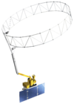
Earth Observations
Satellite | Landsat 4/5 | Landsat 8 | SMAP | Terra | Aqua | TRMM
Sensor | TM | OLI | Passive Radiometer | MODIS | AMSR-E | PR & TMI
Data Years | 1988-2011 | 2013-Present | 2013-Present | 2001-Present | 2001-2011 | 2000-2016
Usage | Glacial extent | Glacial extent | Soil moisture | Snow cover & Surface Temp. | Snow water equivalent | Precipitation
Resolution | 30m | 30m | 10km | 500m | 25km | 0.25 degrees
Source: Publicdomainpictures
Notes:
Presenter: mw
These NASA sensors and satellites were integrated into certain modules within the team’s Google Earth Engine tool. Atmospherically corrected Landsat 4/5 and Landsat 8 imagery was used in the supervised classification and Kendall’s Tau correlation tools. This suite of sensors/satellites has the longest duration of imaging, making it ideal for considering glacial conditions from the 1980’s all the way to present day. SMAP, Terra, Aqua, and TRMM satellites, and their sensors used in this project, provided the independent variables in the Pearson’s correlation module.
Image citation: http://www.publicdomainpictures.net/view-image.php?image=67167

Slide 6
Google Earth Engine
Source: Google Earth Engine
Source: Wikipedia
Notes:
To conduct our analysis, we used the Google Earth Engine. This code-based platform is a recent cloud-based geospatial analysis tool that allows users to access, import, and and analyze large quantities of data due to its server-side processing. Google Earth Engine has the potential to transform the way in which geospatial information is studied and disseminated by improving upon the accessibility and breadth of data currently available.
Image source: https://en.wikipedia.org/wiki/File:Crops_Kansas_AST_20010624.jpg

Slide 7
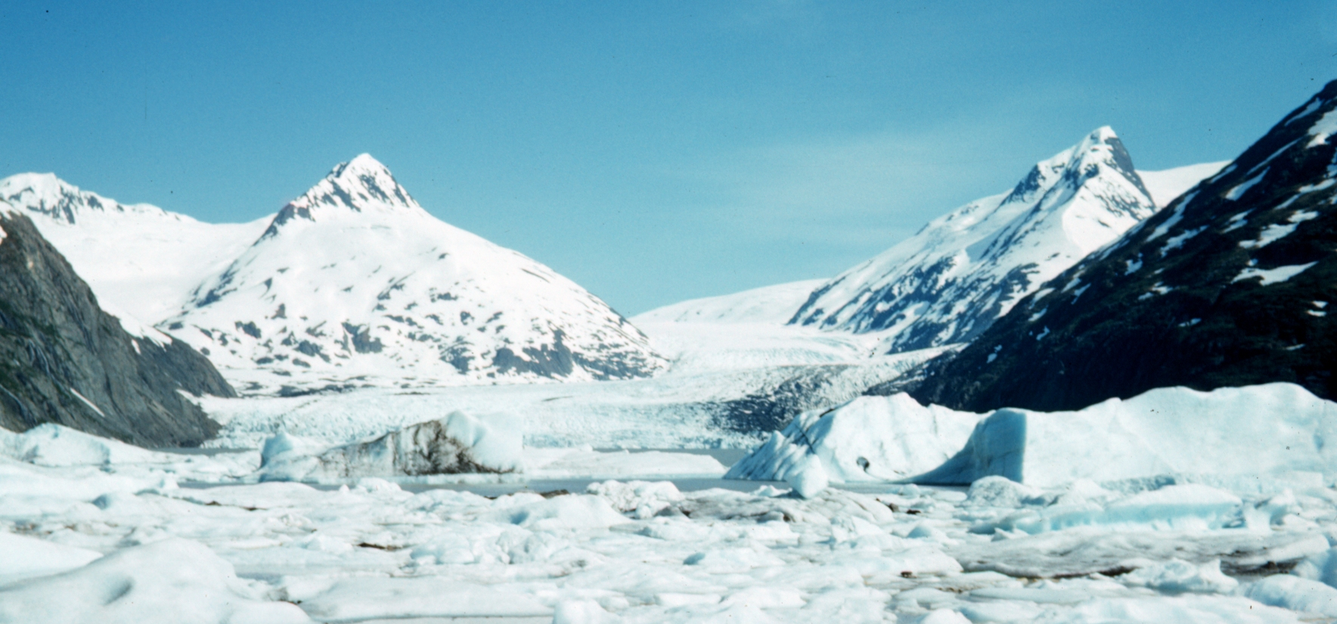
Methodology
Classify
Digitize training sites
Calculate glaciated area using supervised classification
Image Acquisition/Processing
Results
Trend Analysis
Upload AMSR-E, AMSR2, SMAP and in situ data into Google Earth Engine
Convert raw values into reflectances and atmospherically correct
Create Landsat NDSI series from 1988-2017
Run Kendall’s Tau trend analysis on dataset
Google Earth Engine tools with graphical outputs of glacier water resource analysis
Correlations
Compare in situ discharge data to NASA Earth observations datasets
Notes:
Presenter – sd
Landsat datasets were the first to be examined and added into this study. As such, atmospheric correction and the conversion of raw pixel values (DN values) into spectral reflectances were carried out in Google Earth Engine; as the platform had these datasets, integration into the team’s tool was straightforward. MODIS snow cover and surface temperature products were also hosted on Google Earth Engine, making visualization and manipulation a matter of coding, as opposed to local processing. SMAP, AMSR-E, and AMSR2 needed to be downloaded from NASA’s Earthdata repository, uploaded to a cloud storage, then imported as Assets to Google Earth Engine.
Each of the 3 modules of the team’s tool had two broad phases that tasks were divided into. The classification module required the use of training points on Landsat imagery to ensure the spectral reflectances of ice and non ice were properly represented in the final output. Then, the classification was run to calculate total glacier extent for a user defined year. The trend analysis required that Landsat imagery from 1988-2017 be converted into NDSI index, where areas of ice and snow exhibit specific numeric values based on their spectral reflectances. Then, Kendall’s Tau was run on this indexed, 29 year time series to output continuous gains/losses of glacial trends. Finally, the correlation module transformed the data extracted from 5 independent variables (Precipitation, Snow Cover, Snow Water Equivalent, Soil Moisture, and Surface Temperature) into monthly values that could be compared against in situ river discharge data. These dependent and independent variables were then compared across time on a monthly and annual basis to produce correlations and the statistical significance of that correlation.
The results of each of these modules are available to the user in UI/console format.

Slide 8
Step I: Image Acquisition &Processing
Data Download:
NASA Earthdata search
Filter for desired time period, data filter, etc.
Download and then upload to Google Cloud
Add to Google Earth Engine Asset Folder (shared private repository)
Notes:
Presenter – sd
Earthsearch: https://search.earthdata.nasa.gov/
FireFox Download Them All: http://www.downthemall.net/
Product Names: MOD10A1.006 (MODIS/Terra Snow Cover Daily L3 Global 500m Grid), SPL3SMP_E (SMAP Enhanced L3 Radiometer Global Daily 9 km EASE-Grid Soil Moisture, Version 1), AE_MoSno (AMSR-E/Aqua Monthly L3 Global Snow Water Equivalent EASE-Grids, Version 2), (MOD11A1.006) MODIS/Terra Land Surface Temperature and Emissivity Daily L3 Global 1 km Grid SIN, TRMM Merged HQ/Infrared Precipitation
Imagery was either acquired from NASA’s Earthdata repository or was available on Google Earth Engine’s public data repository. All imagery was mosaicked and clipped to our study area for final product generation (highlight true color RGB image in this slide, note location of the Andes on the eastern side of the image).

Slide 9
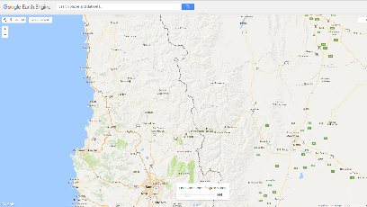
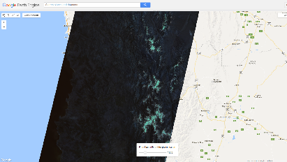
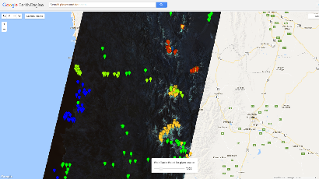
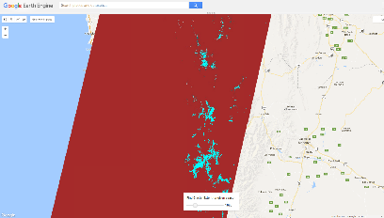
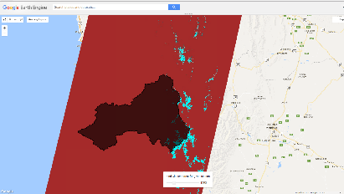
Step 2: Supervised Classification
Classification:
Select year 1987 to 2017
Visualize Landsat 4,5, or 8
Add training points to distinguish ice from non-ice
Classify and superimpose study area
Notes:
Presenter: bb
Imagery from Landsats 4, 5, and 8 required atmospheric correction and the conversion of raw pixel brightness values (DN) to spectral reflectances before analysis
The classification module uses training points to determine which parts of the Landsat imagery are and are not glaciers, based on spectral reflectances. These training points are then run through Google Earth Engine’s supervised classification module to produce the final map outputs for each of the possible years.
The images above represent the 5 steps Google Earth Engine takes to run the supervised classification: Image 1 is a base map of the study area, Image 2 is the mosaicked and clipped Landsat scene, Image 3 shows the location of all training points which delineate different geographic features visible in the image, Image 4 is the resultant classified map, showing glaciated areas (blue) and non-glaciated areas (red), Image 5 shows the extent of our study area and where glaciers exist within.

Slide 10
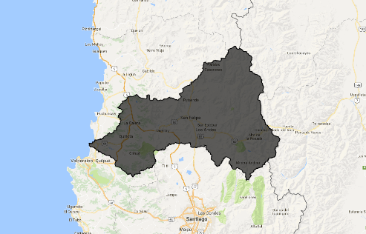
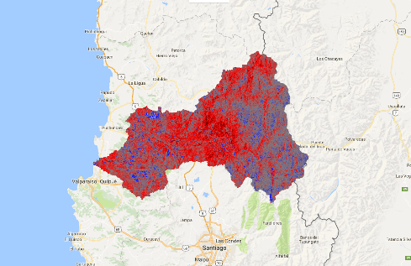
Step 3: Kendall’s Tau Time Series
Trend Analysis:
Images from 1988 through 2017 are preprocessed
Normalized Difference Snow and Ice Index (NDSI) is calculated for each image:
( Green – Near Infrared/ Green + Near Infrared)
Images are linearly detrended to differentiate seasonal trends from stochastic variation
Kendall’s Correlation is run on the resultant time series of NDSI images
Notes:
Presenter: sd
The trend analysis module required clear delineations of glacier location in our study area. Thus the Normalized Difference Snow and Ice Index (NDSI) was employed because it creates a stark contrast in pixel values between areas of ice and lack thereof (NDSI equation Green – NIR/ Green + NIR) . Once imagery across the entire spread of data was indexed, times series of individual seasons were created (e.g. Summer 1988, Summer 1989, etc.) to evaluate trends in gains/losses; data were also linearly detrended to avoid spurious correlations in our imagery. Kendall’s Tau was run on the imagery, comparing all pairwise combinations of pixel values over time. The result of this analysis is a map describing increasing/decreasing trends in the dataset of a given season from 1988 – 2017.

Slide 11
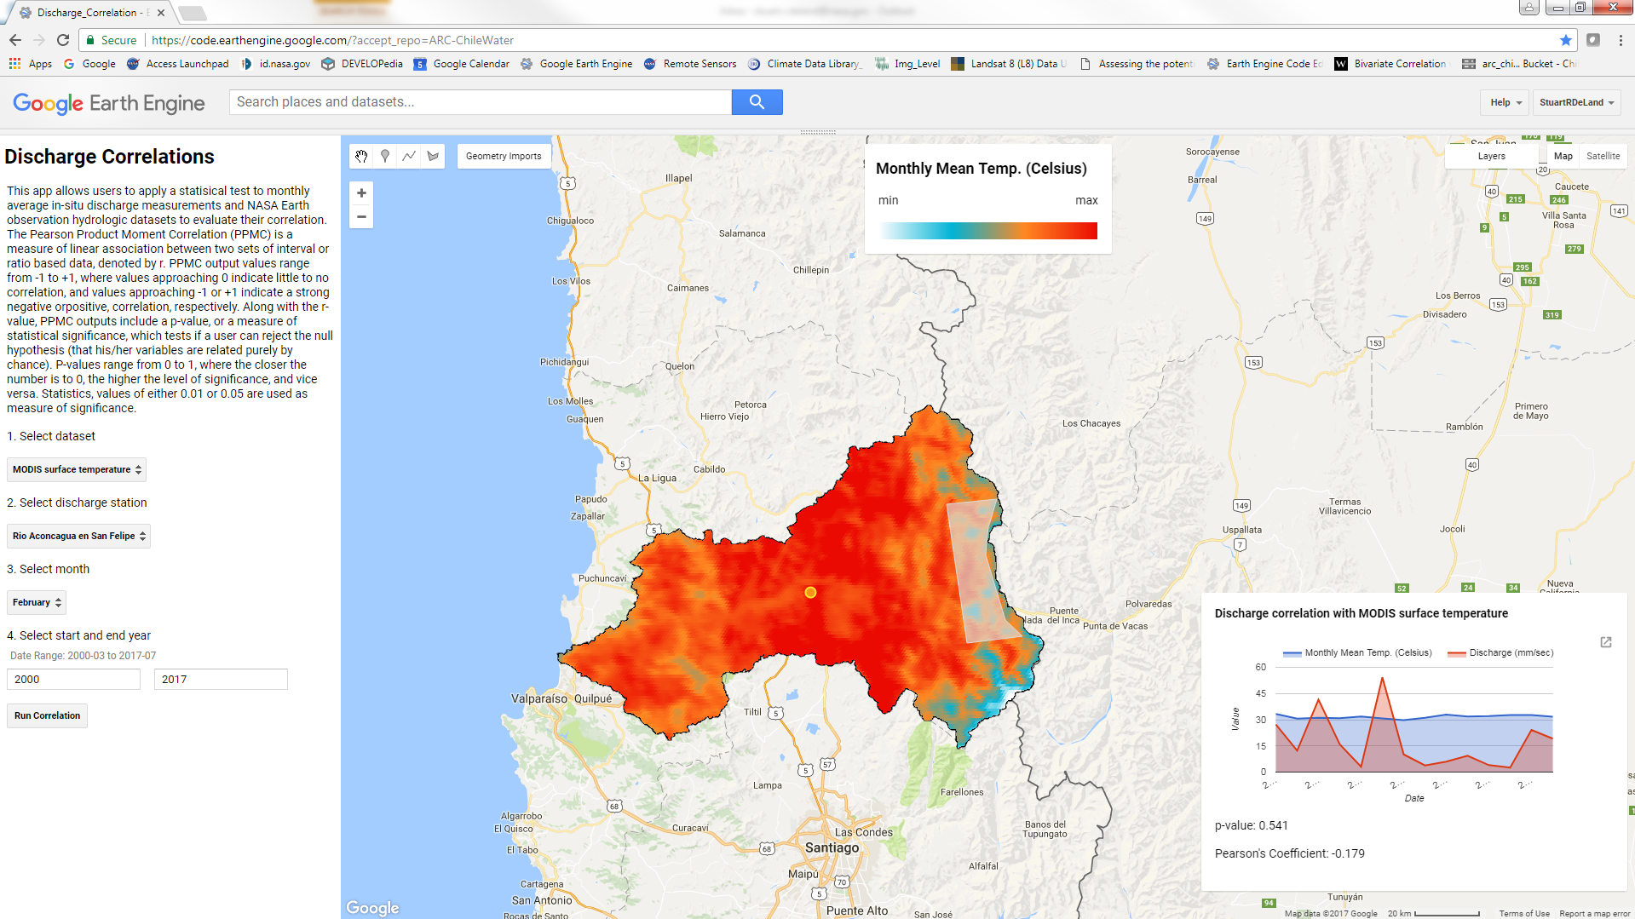
Step 4: Pearson’s Product Moment Correlation Coefficients
Data Preparation per independent variable:
SMAP Soil Moisture: Upscale temporal resolution to monthly, average monthly values of 25km pixels across study area
AMSR-E/AMSR-2 Snow Water Equivalent: Sum daily values into monthly totals
MODIS Snow Cover: Average daily percent snow cover into monthly percent average
MODIS Surface Temperature: Average daily surface temperature into monthly average
TRMM Precipitation: Sum daily (3 hour resolution) values, then sum monthly totals
Notes:
mw
Pearson’s Correlation:
The correlations module compares in situ river discharge data to one of 5 possible variables: soil moisture, snow water equivalent, snow cover, surface temperature, and precipitation. Users may select one of three discharge stations within the region, the desired month, and a range of years within the possible listed values and run the correlation. Pearson’s r values are displayed, along with p-values and a graph of the X and Y variables values across the time period.

Slide 12
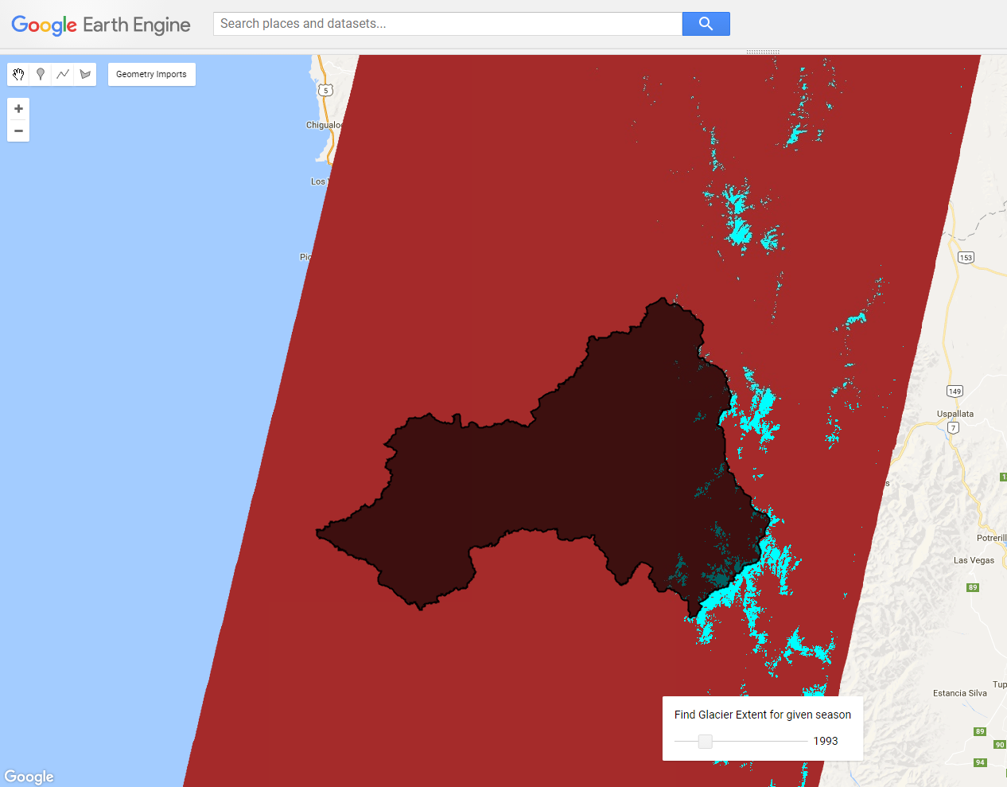
Results: Glacier Extent Classifier
Year | Glacier Extent (km^2)
1987 | 289
1990 | 104
1993 | 168
1996 | 32
1999 | 26
2002 | 144
2005 | 75
2008 | 60
2011 | 52
2014 | 21
2017 | 60
Notes:
BB
For the year of 1993, a total of 167.991 km² of glacier persisted across summer months. This output is the result of the training sites defined before the classification. Users can produce this exact same result from any year in the allowable range, 1987 – 2017. By considering the change in glacial extent from year to year or over decades of time, users can specify time frames to investigate further into why the glaciers are responding to environmental pressures as they are. The purpose of this tool is to offer the user an introduction to glacier dynamics within the Aconcagua Region and how they might expand their inquiry further.

Slide 13
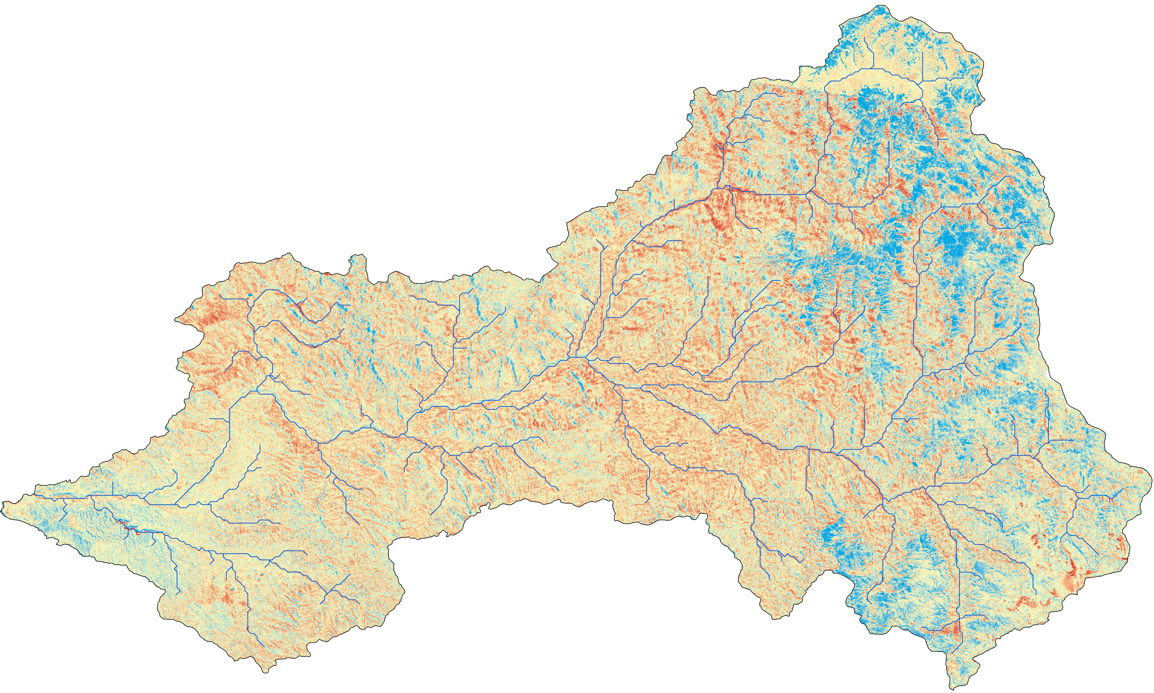
Results: NDSI Time Series
Kendall’s Tau-b Rank Correlation (1988 – 2017):
Kendall’s Tau is a non-linear trend indicator
Commonly used for analysis of hydrology
Values range from -1 (consistently decreasing) to +1 (consistently increasing)
All pairwise combinations of values over time are evaluated at each pixel
Kilometers
Rivers
-0.76
0.81
Notes:
SD
As noted in the methodologies section, Kendall’s Tau was run on images visualized in the NDSI index. As this index is specifically tailored to highlight areas of snow and ice, conclusions drawn from the output of this tool must be confined to the eastern areas of the Aconcagua Region , where glaciers are known to exist perennially. It is interesting to note that areas of highest negative trend increase are located around the headwaters of many of the rivers and streams that run through the region while areas of highest positive trend increase are located toward the centers of the glaciers in the region. Thus, while the exact cause of glacial variations in the regions remains unknown, the areas of increasing loss or glacial gain are known, making decision making easier. The Ministry of Agriculture might look at these results and locate all the farmers that work the land in areas with headwaters experiencing higher glacial loss, and warn them of the persisting lack of meltwater.

Slide 14
Results: Discharge Correlation Tool
CONTACT NPO TO SEE VERSION WITH VIDEO
Notes:
Here you can see the user interface of our Discharge Correlation Tool. The user selects the Earth observation independent variable, the discharge station, the month to be studied, and the time period. On the map, the tool visualizes the monthly mean snow cover for the region. You can see that as is to be expected, the snow cover is concentrated in the lower right-hand corner of the study region, where glaciers persist during the summer months. In the results panel in the bottom right of the screen shows a graph of the earth observation data overlayed with the observed discharge. Below that is the resultant Pearson’s Correlation Coeffient value as well as the p-value. Pearson’s R values can range from 0 to 1, with values closer to 1 indicating higher correlation. P-value is a measure of statistical significance, also ranging from 0 to 1, where values closer to 0 indicate greater statistical significance.

Slide 15
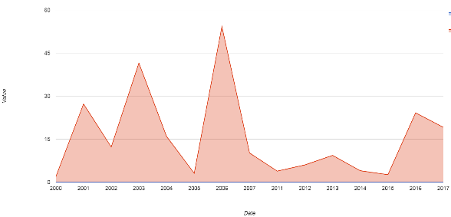
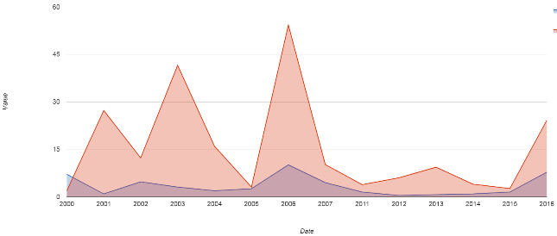
Results: Correlations
Precipitation compared to River Discharge at San Felipe Station (February, 2000 – 2017):
r = 0.004
p-value = 0.988
Snow Cover compared to River Discharge at San Felipe Station (February, 2002 – 2016):
r = 0.055
p-value = 0.522
Notes:
BB
These are two graphics show in situ data compared against two of the independent environmental variables for the month of February from 2000 – 2017 and 2002 – 2017, respectively. Pearson’s r values and p-values are reported along with each chart. The r values describe the linear correlation of the two variables on a scale of -1 to +1, with -1 being strong negative correlation, +1 being strong positive correlation, and 0 being no correlation. The p-value is a measure of the statistical significance of the r value. Traditionally p-values of 0.01 and 0.05 are considered statistically significant, thus, we can say that precipitation is not particularly correlated to river discharge in the time period, and that snow cover is moderately positively correlated with river discharge and this correlation is also statistically significant.

Slide 16
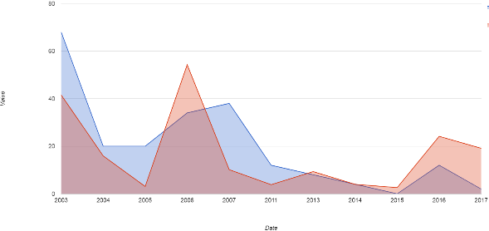
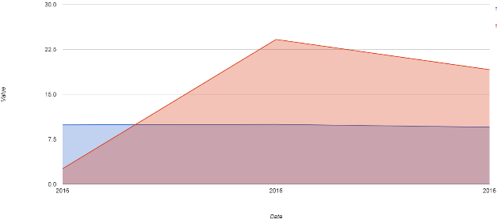
Results: Correlations Continued
Snow Water Equivalent compared to River Discharge at San Felipe Station (February, 2003 – 2017):
r = 0.633
p-value = 0.037
Soil Moisture compared to River Discharge at San Felipe Station (February, 2015 – 2016):
r = -0.135
p-value = 0.914
Notes:
BB
The next two charts detail snow water equivalent and soil moisture, in comparison to in situ river discharge measurements for the month of February from 2003 – 2017 and 2015 – 2016, respectively. Snow water equivalent is strongly correlated with river discharge with an r value of 0.633 and this correlation is statistically significant at a p-value of 0.037. Soil Moisture is not particularly correlated with river discharge with an r value of -0.135 and this correlation is not at all statistically significant with a p-value of 0.914.

Slide 17
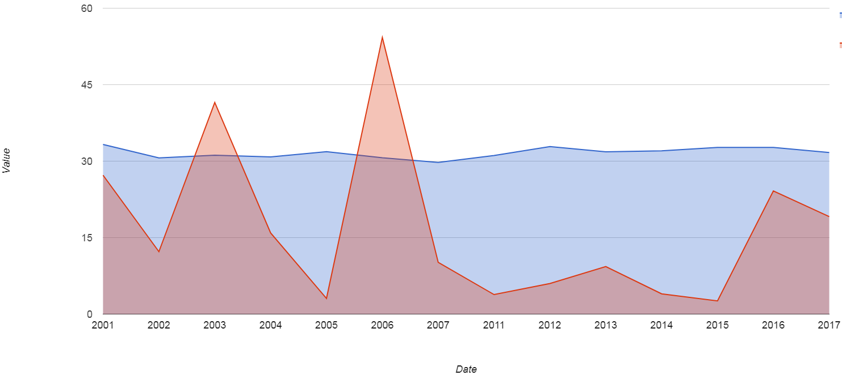
Results: Correlations Continued
Surface Temperature compared to River Discharge at San Felipe Station (February, 2001 – 2017):
r = -0.179
p-value = 0.541
Notes:
BB
The final graph details the correlation between surface temperature and river discharge for the month of February from 2001 – 2017. The two variables have very little correlation with a r value of -0.179 and a p-value of 0.541. Each of the correlations offers different information for users, as well as environmental factors to focus predictive methods on in the future. For example, if users discovered a high correlation between snow water equivalent and river discharge (which there appears to be), he or she may focus future efforts in further increasing the accuracy of SWE estimates by taking in situ measurements, along with those taken by AMSR-E and AMSR2.

Slide 18
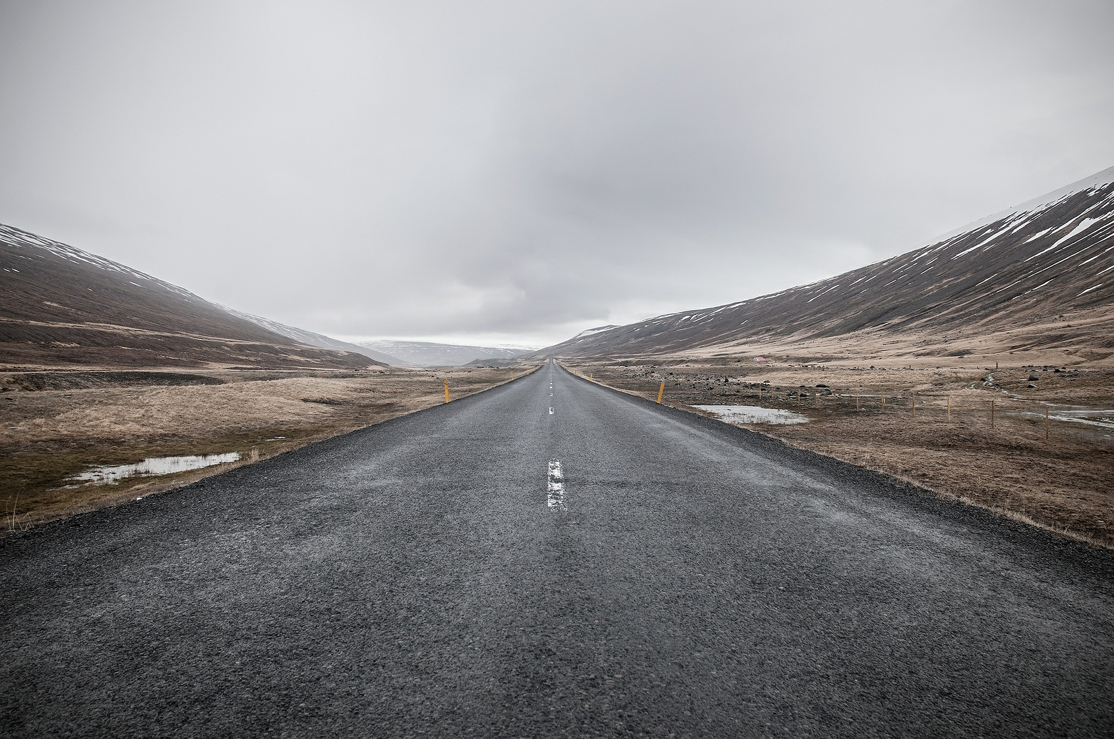
Conclusions
Trend Analysis:
The Chilean Ministry of Agriculture can use this tool in conjunction with their decision making processes to better discern glacial extent and variability across recent time periods
This tool is intended to be replicated and applied to other watersheds or river basins of Chile
Additionally, the Google Earth Engine tool has been written to allow for simple expansion in data hosting, statistical analysis, and geographic visualization
Image Source: pixabay.com
Notes:
MW
The Chilean Ministry of Agriculture can take the glacial extents, series trends, or correlations, from this Google Earth Engine tool and better inform/warn farmers within the Aconcagua region of potential water shortages, or areas of land to avoid expanding into due to reduced reservoirs.
The Google Earth Engine tool was built to allow future users to expand upon its capabilities. Given Chile’s unique geographic boundaries, there are a multitude of ecosystems throughout the country, requiring different types of inputs or analysis to thoroughly visualize and study an area of concern. With this in mind, the team created a detailed infrastructure within each of the modules.
Thank you for your time.

Slide 19
Acknowledgements
Project Partners
Agricultural Office at the Chilean Embassy to the U.S.
Chile Ministry of Agriculture
Advisors
Dr. Juan Torres-Perez, Bay Area Environmental Research Institute
Dr. Eduardo Bendek, NASA Ames Research Center
Jenna Williams, NASA Ames Research Center
Dr. Kenton Ross, NASA Langley Research Center
Nick Clinton, Google Earth Engine Developer Advocate
Brittany Zajic, Planet Labs

