Slide 1
Thailand Agriculture
Monitoring Food Crop Health and Stress Due to Changing Climate for Enriched Agricultural Land Management
Tim Klug (Project Lead)
Arom Boekfah
Chayanit Choomwattana
Komsan Rattanakijsuntorn
Watanyoo Suksa-ngiam
Atipat Wattanuntachai
Notes:
[Tim]

Slide 2


Background
Thailand : the world’s largest exporter of rice
Rain-fed agriculture in the northeastern region
Source: Kim Seng
Notes:
[Komsan: Background ]
Thailand is one of the world’s leading producers and exporters of rice. The rice is grown in most areas of the country, with each region’s rice having its own characteristics and needs. Thailand experiences three seasons: cool dry, hot dry, and wet season. These seasons play a significant role in rice cultivation. The rice-planting season usually starts in May when showers signal the end of the dry season. By late November, it is ready to be harvested. While the Central and Western regions of Thailand are able to grow rice year-round because of an extensive irrigation network, some parts of Thailand can grow rice during only the wet season.
[ Corner rice plant logo designed by DEVELOP participant Komsan Rattanakijsuntorn at NASA MSFC.]
Image source: https://www.flickr.com/photos/captainkimo/6462574499

Slide 3
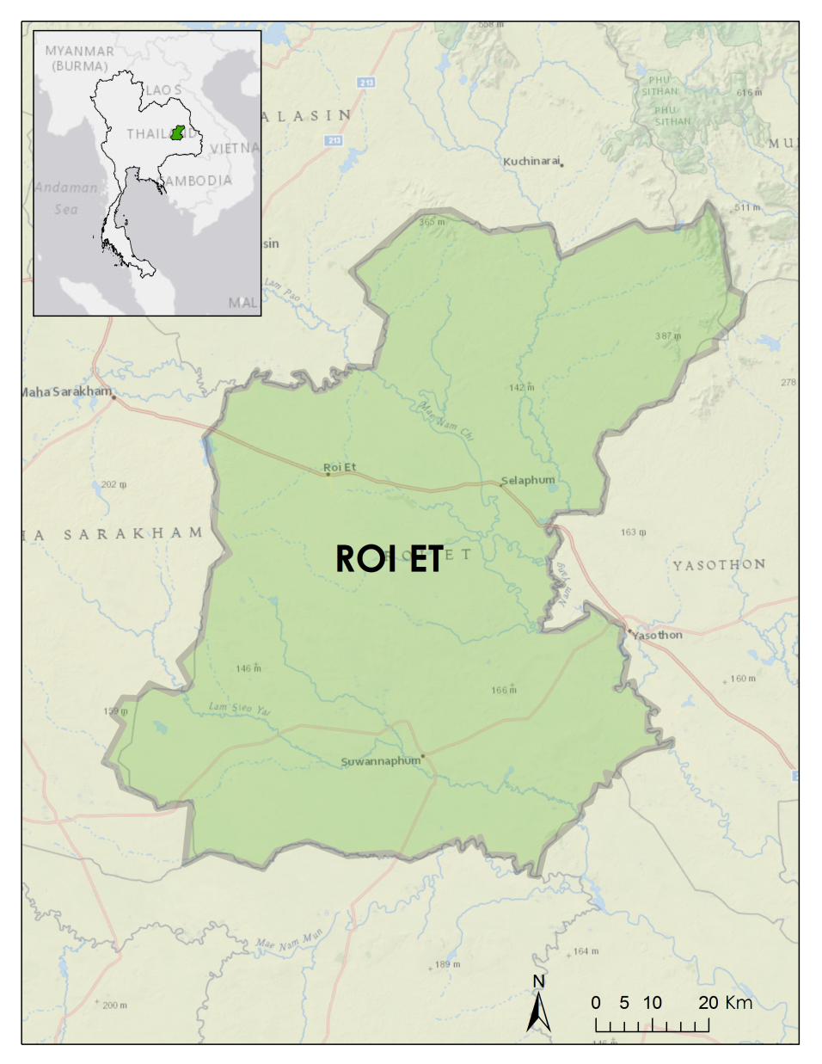
Study Area
The province of Roi Et located in the northeastern region of Thailand
Roi Et: one of the largest producers of Jasmine rice
Notes:
[Komsan: Study Area ]
Unlike other areas in Thailand, the majority of the northeastern region’s rice is dependent on rain instead of irrigation.
Our study area, Roi Et, is a province located on a plateau in northeastern Thailand. It is well known for producing large quantities of Jasmine rice, which is a premium product that plays a significant role in Thai economy.
Image credits: Esri, National Geographic, DeLorme, MapmyIndia, UNEP-WCMC, NASA, ESA, METI, NRCAN, GEBCO, NOAA, increment P Corp., © OpenStreetMap contributors, and the GIS user community.

Slide 4

Community Concerns
Relatively low rice crop yield compared to other regions in the Mekong area
Rice fields in Roi Et primarily rain-fed dependent, growing during the wet season
The rice crops dependent on rain and vulnerable to climate change
[Image needed]
Source: Pisut Konepun
Notes:
[Komsan: Community Concerns ]
Although Roi Et produces large quantities of Jasmine rice, the rice crop yield is relatively low compared to other regions in the Mekong area.
Because the rice fields in Roi Et are primarily rain-fed, rice is mostly only grown during the wet season.
The rice crops’ dependence on rain leaves the region vulnerable to climate change.
Image source: https://www.flickr.com/photos/pondpisut/16790458290

Slide 5
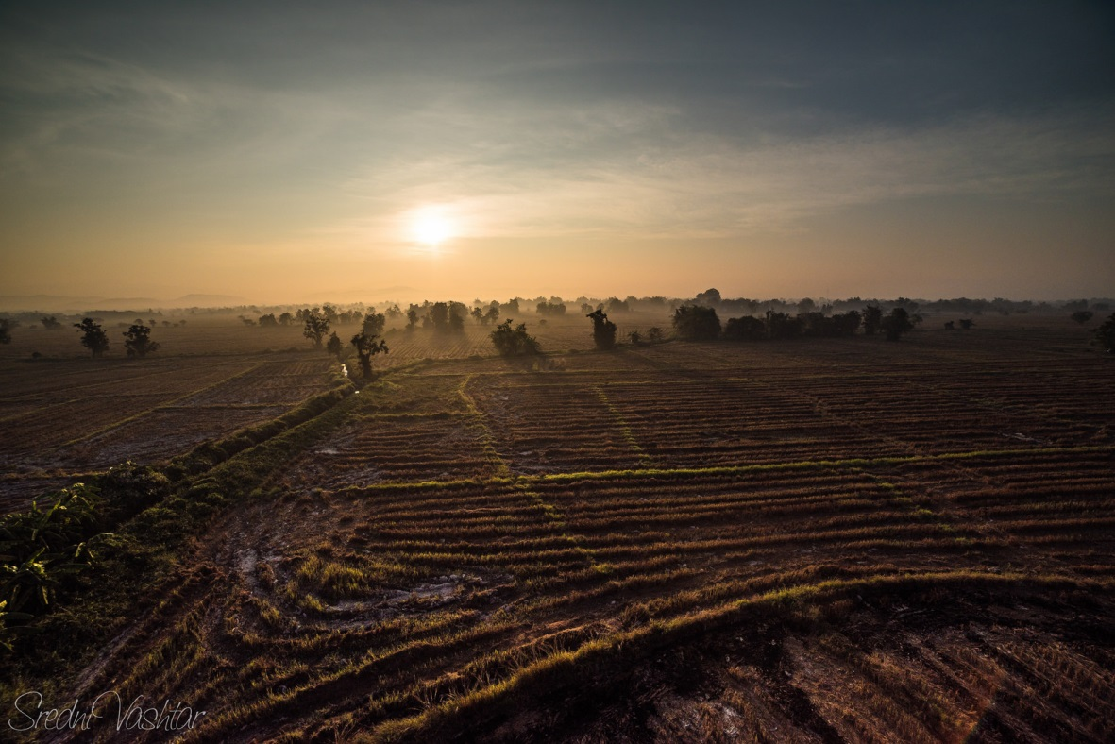
Objectives
To monitor agricultural lands under the change of environmental variables
To improve the understanding of agricultural lands under changing climate patterns
To produce a model that can be used to predict rice yields from NASA remote sensing imagery
Source: Diego F. Garcia P.
Notes:
[Tim] Agricultural health and stress can be monitored using remote sensing data products such as land cover classifications, land surface temperature, precipitation, and vegetation indices.
Analysis of these products over time can expose patterns and correlations between rice yield and environmental factors such as climate and water availability.
These products can then be compiled into a linear regression model and compared against government reports of rice yield. Such a model could be used to estimate a season’s rice yield based on remotely sensed data.
Image source: https://www.flickr.com/photos/gogeid/17005078875/

Slide 6
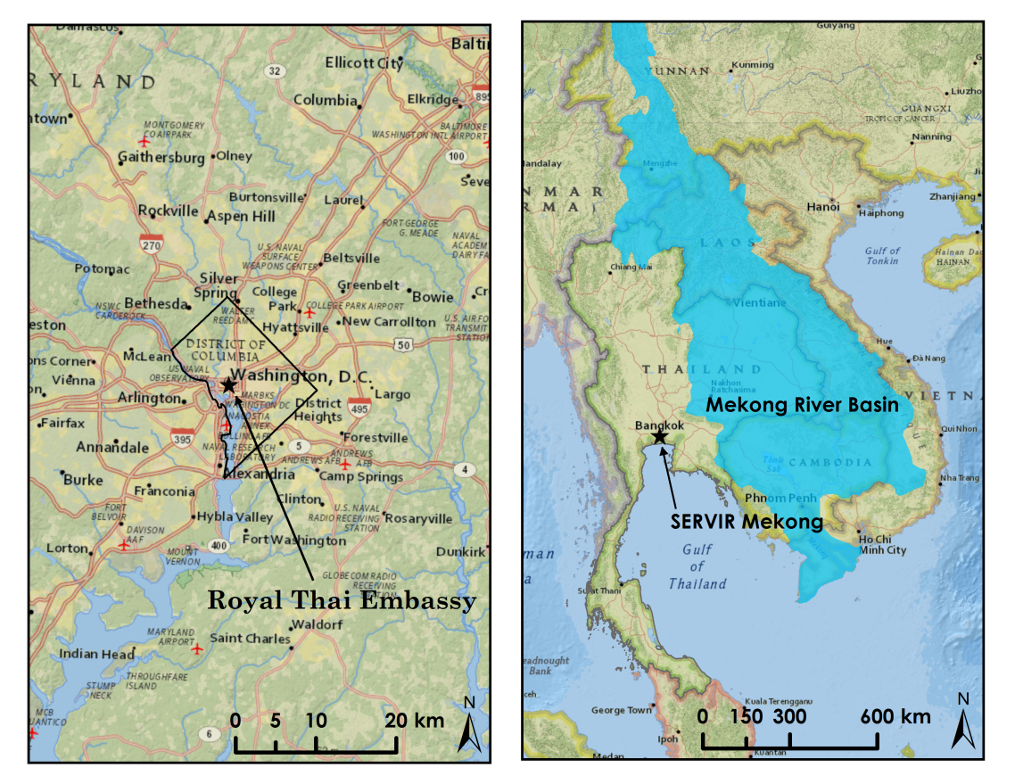
Project Partners
Royal Thai Embassy
SERVIR Mekong
Notes:
[Tim] This project is partnered with the Royal Thai Embassy and NASA SERVIR Mekong to monitor and improve the understanding of climate change patterns and environmental variables on agricultural lands in Roi Et. SERVIR is a joint initiative of NASA and USAID and part of NASA’s Capacity Building Program. SERVIR Hubs are located at Marshall Space Flight Center, in Panama, Kenya, Nepal, and newly in Mekong, Thailand.
Image credits: National Geographic, Esri, DeLorme, HERE, UNEP-WCMC, USGS, NASA, ESA, METI, NRCAN, GEBCO, NOAA, increment P Corp.
Gassert, F., P. Rai, P. Reig, and M. Luck. 2012. “Mekong River Basin Study.” Working Paper. Washington, DC: World Resources Institute.

Slide 7

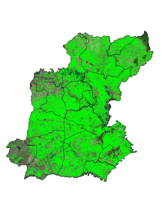


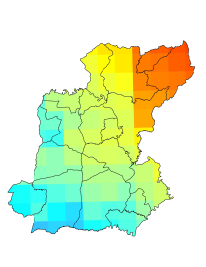
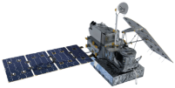
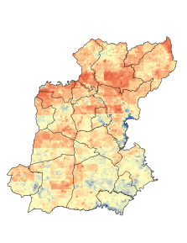
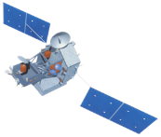
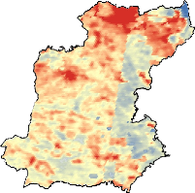
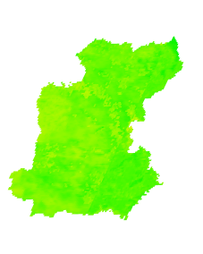
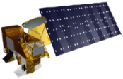
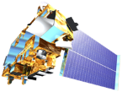
Methodology
Satellites/Sensors
Intermediate Data
End Products
Analysis
Land Cover Classification
Time series maps
Government Rice Yield Data
Landsat 5, 7, 8
TM, ETM+, OLI
Monthly Precipitation (averaged mm/hr)
GPM
Microwave Imager
SDCI
Scaled Drought Condition Index
Prediction Models
Linear Regression
TRMM
Precipitation Radar
Land Surface Temperature
Degrees C
NDVI
Normalized Difference Vegetation Index
Aqua/Terra
MODIS
Notes:
[Tim] For the methodology of the Thailand Agriculture project
Three main classes of satellites and sensors were used in this project.
First, high resolution sensors from Landsat suite were used to classify rice area.
Second, precipitation radar data from GPM and TRMM were used to average monthly rainfall in part of calculating SDCI.
Third, land surface temperature and NDVI from Aqua/Terra were used in part of calculating SDCI.
Using Land Cover Classification, SDCI, Precipitation, and NDVI , we can develop prediction models.

Slide 8
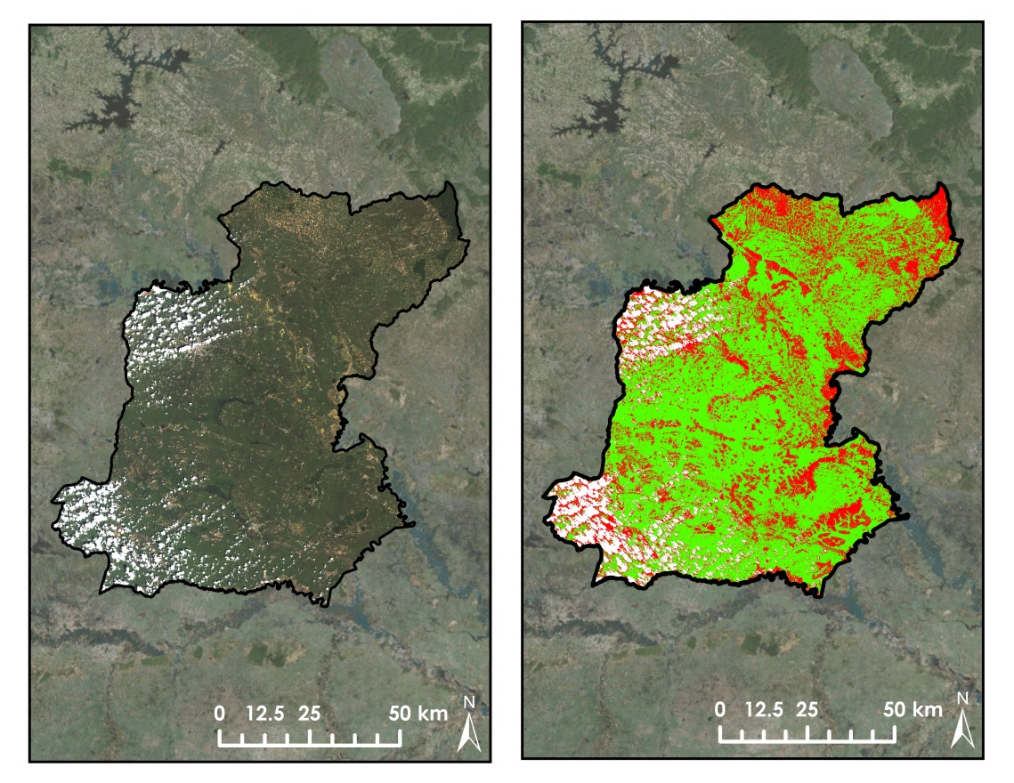
Land Cover Classification
Landsat 8 Imagery (October 2014)
Land Cover Classification
LCC’s from Landsat 5, 7, and 8 imagery during wet season months
Notes:
[Arom] A supervised land cover classification was conducted over the study area by drawing training sample polygons around known terrain types. Three classes of pixel values were defined: rice fields, non-rice land cover, and cloud cover.
Classifications were partially validated using Google Earth, Esri’s Basemaps, and by comparing the spectral signature of rice across all Landsat band wavelengths to classification results.
Image credits: NASA, USGS, Esri, DigitalGlobe, GeoEye, Earthstar Geographics, CNES/Airbus DS, USDA, AEX, Getmapping, Aerogrid, IGN, IGP, swisstopo, and the GIS User Community

Slide 9
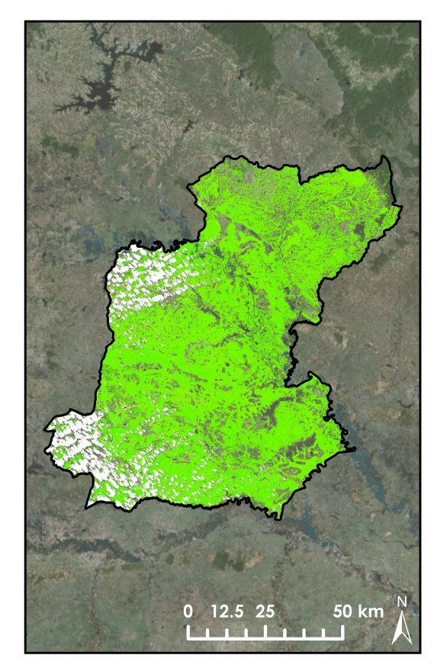
Normalized Difference Vegetation Index
Landsat – NDVI (10/2014)
Mean = 0.663, SD = 0.064
Landsat - NDVI over classified rice area
Notes:
[Arom] NDVI was calculated over the classified rice area from Landsat 5, 7, and 8 imagery.
Image credits: NASA, USGS, Esri, DigitalGlobe, GeoEye, Earthstar Geographics, CNES/Airbus DS, USDA, AEX, Getmapping, Aerogrid, IGN, IGP, swisstopo, and the GIS User Community

Slide 10
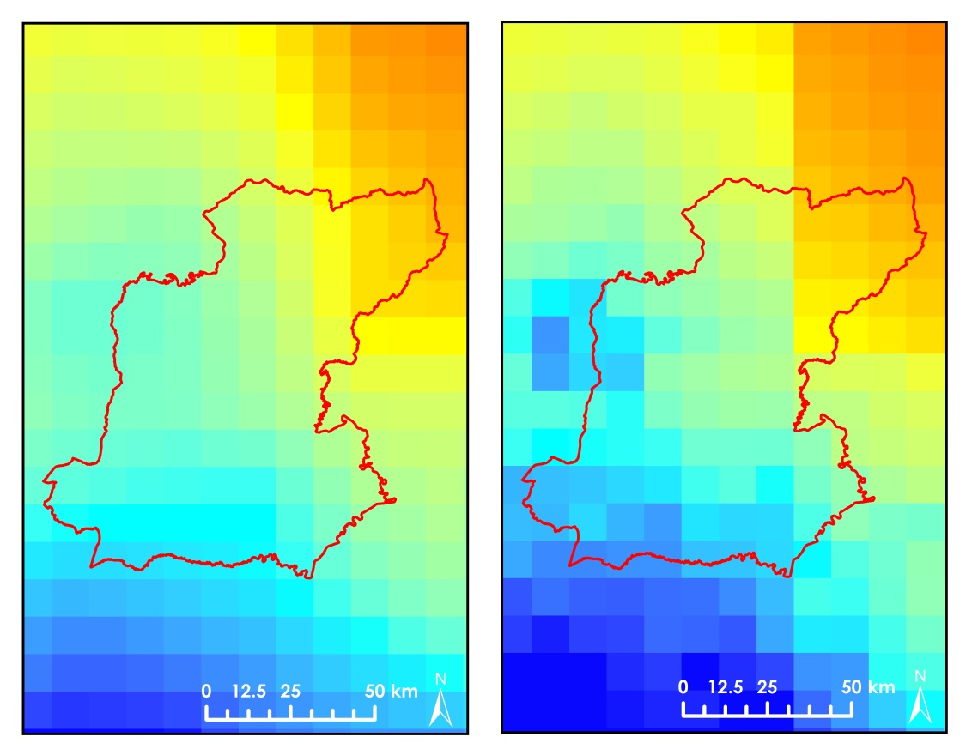
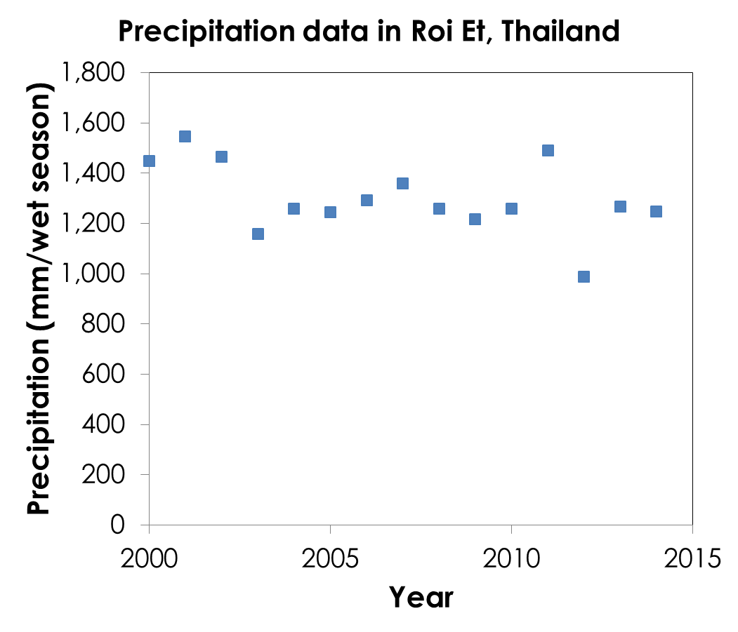
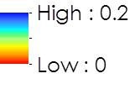
Precipitation Data
TRMM (10/14) – PR (mm/hr)
(Resampled data)
GPM (10/14) – PR (mm/hr)
Monthly precipitation rate (PR) from TRMM and GPM
Notes:
[Atipat] The graph shows that there is a fluctuated and slightly downward trend between 2000 and 2015. Monthly precipitation data were obtained from TRMM (3B43) and GPM (GPM_3IMERGM). The two pictures show the differences between TRMM on the left and GPM on the right.

Slide 11
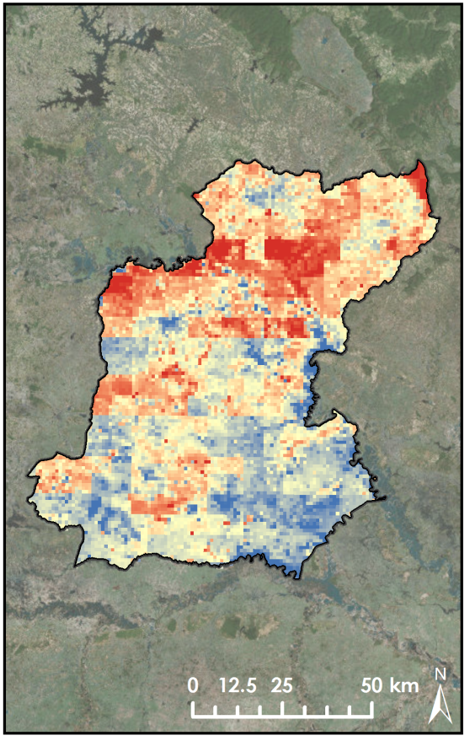
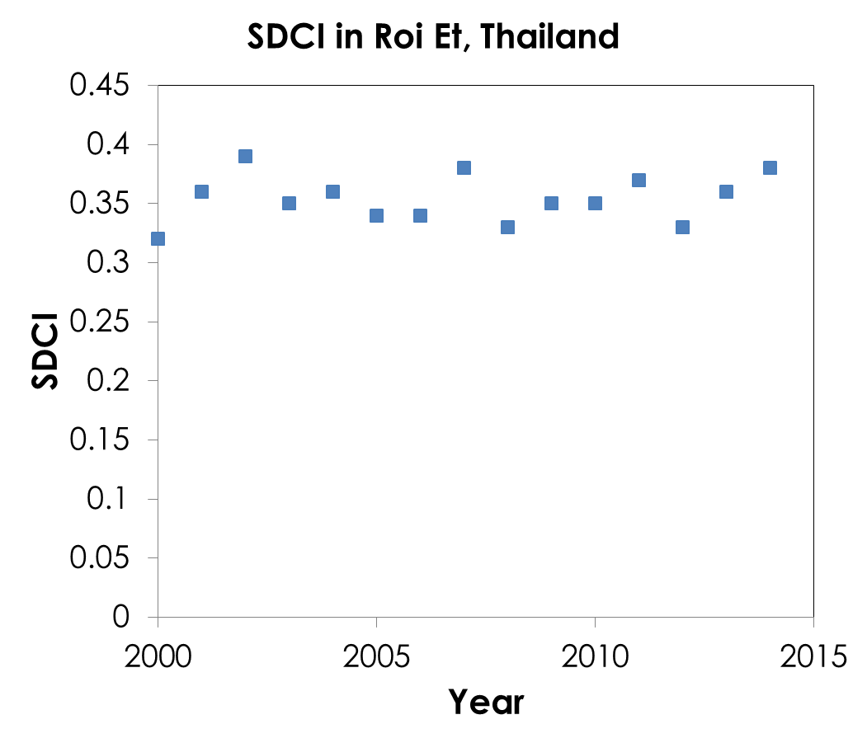
Scaled Drought Condition Index
SDCI (September 2014)
SDCI calculated from NDVI, land surface temperature, and precipitation data
Notes:
[Atipat] This SDCI model was supplied to our team by the Thailand Disasters project. Inputs include the MOD13A3 NDVI product, MOD11C2 for land surface temperature, and TRMM and GPM monthly precipitation data. Then We calculated SDCI from NDVI, Land Surface Temperature, and precipitation data. graph indicates that SDCI oscillated between 0.30 and 0.40 during the period 2000 and 2014. Analysis showed that there was no linear relationship between time and SDCI. The picture on the right hand side shows the geographical distribution of SDCI within Roi Et.
Image credits: NASA, USGS, Esri, DigitalGlobe, GeoEye, Earthstar Geographics, CNES/Airbus DS, USDA, AEX, Getmapping, Aerogrid, IGN, IGP, swisstopo, and the GIS User Community

Slide 12
Results
Pearson’s Correlation Table (N = 120)
 | Statistical Rice Yield | Yield per Area | Classified Rice Area | SDCI | NDVI | Precipitation
 | (ton) | (ton/km²) | (km²) |  |  | (mm/wet season)
Statistical Rice Yield | 1
Yield per Area | -0.0002 | 1
Classified Rice Area | 0.750*** | -0.245** | 1
SDCI | 0.095 | -0.099 | 0.252** | 1
NDVI | 0.116 | 0.304*** | -0.040 | -0.238** | 1
Precipitation | -0.114 | -0.220* | -0.013 | 0.347*** | 0.030 | 1
Two tailed significance, * p < 0.05;** p < 0.01; *** p < 0.001
Notes:
[Arom] This table shows the correlation Matrix. In this table value one suggests that the two variables on the row and column are the same variable.
Based on our available satellite data and Pearson’s correlation , classified rice area from land cover classification has a significant positive correlation with the predicted rice yield.
the predicted rice yield per area has a significant negative correlation with classified rice area.
The predicted rice yield per area has a significant positive correlation with NDVI.
The predicted rice yield per area has a significant negative correlation with RAIN.
SDCI has a significant positive correlation with classified rice area and RAIN but a significant negative correlation with NDVI.

Slide 13
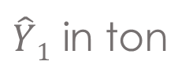
Results(cont.)
$\hat{Y}1$ in ton
Notes:
[Watanyoo] We then conducted multiple-regression analysis for the predicted rice yield (the number of ton). However, only two independent variables provide significant coefficients for the linear regression equation. These variables are Classified Rice Area from Land Cover Classification and NDVI. Hence, we conducted multiple-regression analysis again. The results in this table show that both variables can provide Adjusted R Squared as much as 0.576. We can say that 57.6 % of the variance of predicted rice yield can be explained by both Classified Rice Area and NDVI.
The F ratio is also significant, saying that the variance explained by the regression model is significantly larger than the unexplained variance. Hence we can accept this predicting model.
The coefficients of the intercept, classified rice area, and NDVI are all significant, the p-values are less than 0.05 .

Slide 14
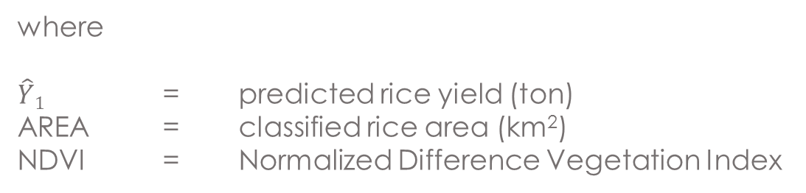
Results(cont.)
Prediction Model:
$${\hat{Y}}_{1}=−116,342+187.91×AREA+213,952 ×NDVI$$
where
$\hat{Y}1$ = predicted rice yield (ton)
AREA = classified rice area (km²)
NDVI = Normalized Difference Vegetation Index
Notes:
[Watanyoo] We then obtain the first regression equation:
$${\hat{Y}}_{1}=−116,342+187.91×AREA+213,952 ×NDVI$$
where
$\hat{Y}1$ = predicted rice yield (ton)
AREA = classified rice area (km²)
NDVI = Normalized Difference Vegetation Index

Slide 15

Results(cont.)
$\hat{Y}2$ in ton/ km²
Notes:
[Watanyoo] We proceeded into the second prediction equation. The number of ton per squared kilometer was used as the dependent variable. Only three variables can be used to predict yield per area: the number of ton per square kilometers. These variables are Classified Rice Area, NDVI, and Precipitation. However, the number of adjusted R square is equal to 0.18 and this number is small. We can say that 18% of the variance of the predicted number of ton per square kilometer can be explained by both Classified Rice Area and NDVI.
The F ratio is also significant, suggesting that the variance explained by the regression model is significantly larger than the unexplained variance. Hence we can accept this predicting model.
The coefficients of classified rice area, NDVI, and precipitation are all significant, the p-values are less than 0.05. However, classified rice area and precipitation have a negative relationship with the yield per area.

Slide 16
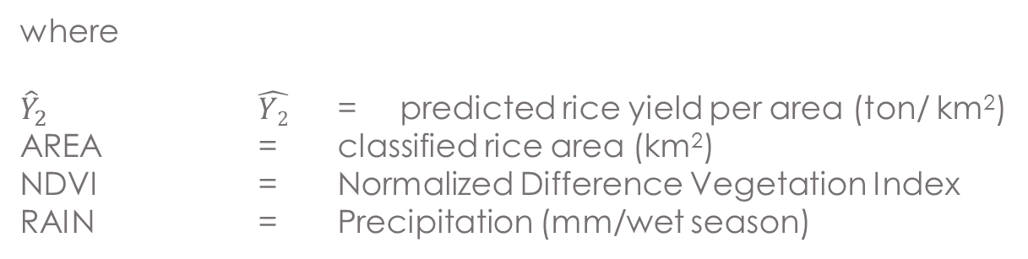
Results(cont.)
Prediction Model:
${\hat{Y}}_{2}=121.05−0.07×AREA+491.03 ×NDVI−0.08×RAIN$
where
${\hat{Y}}_{2}$ = predicted rice yield per area (ton/ km²)
AREA = classified rice area (km²)
NDVI = Normalized Difference Vegetation Index
RAIN = Precipitation (mm/wet season)
Notes:
[Watanyoo] We then obtain this second regression equation
${\hat{Y}}_{2}=121.05−0.07×AREA+491.03 ×NDVI−0.08×RAIN$
where
${\hat{Y}}_{2}$ = predictedriceis predictedyield per area (ton/ km²)
AREA = classified rice area (km²)
NDVI = Normalized Difference Vegetation Index
RAIN = Precipitation (mm/wet season)

Slide 17
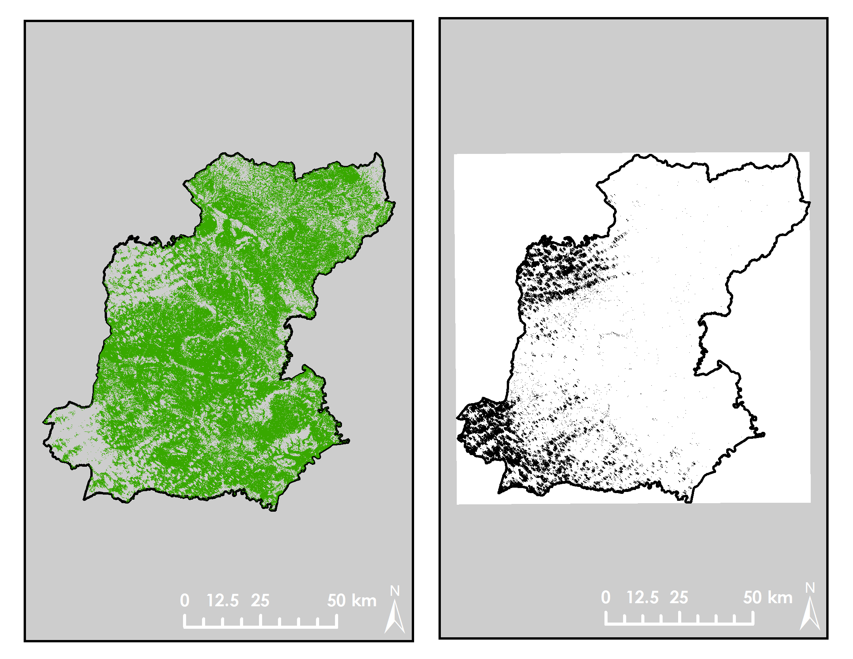
Limitations and recommendations
Rice Classification
Cloud Mask
Wet season cloud cover
Inconsistent rice growth stages
Landsat 7 gap error
Limited validation resources
Notes:
[Chayanit] Major errors and uncertainty in this project stem from the nature of using satellite remote sensing to monitor wet season land cover in a tropical region. The availability of cloud-free images was minimal and temporally inconsistent season to season. This meant that rice crops were likely to be in different growing stages with different spectral signatures between available Landsat images.
In addition to partial cloud cover, the use of Landsat 7 images taken after the onset of the gap error further reduced our model’s ability to consistently measure and compare rice crop land cover between seasons.
This limited our ability to perform a multiple regression analysis using the variables of land cover, vegetation indices, temperature, and precipitation. Instead, we have prepared a model to compare these data against government reports of rice yield per sub-province can be used to predict rice yield in the future. The model could combine remote sensing indices from satellites together with other techno-economics variables in order to make the prediction more accurate.
Finally, as with all remotely sensed data, imagery and classifications must be validated before any statistical analysis. Fortunately, for this project, many Google Earth and Google Street View images taken during the same year and season could be used for validation. However, due to the large size of the study area and resolution of available imagery, minors errors in validation efforts are likely. Training samples validated from field observation such as collaboration between researchers and famers to validate the for Roi Et, Thailand presence of rice fields can improve the effectiveness of this model.

Slide 18
Conclusions
Statistically significant relationship between rice yield and classified rice area
Prediction model of rice yield and yield per area: classified rice area and NDVI
No positive relationships between rice production and environmental variables (SDCI and precipitation)
Notes:
[Chayanit] Classified rice areas from Landsat images significantly positively relate to rice yield data from National Statistical Office of Thailand.
The rice area from land cover classifications, NDVI can be used to predict both the rice yield and yield per area in Roi Et, Thailand.
Rice production is not positively dependent on the environmental variables (SDCI and Precipitaion) based on the available Landsat data.

Slide 19
Advisors
Dr. Jeffrey Luvall (NASA at National Space Science and Technology Center)
Dr. Robert Griffin (University of Alabama in Huntsville)
Partners
Bunyakiat Raksaphaeng(Royal Thai Embassy)
Dr. Bill Crosson (SERVIR Mekong)
Dr. Peter Cutter (SERVIR Mekong)
Special thanks to NASA Develop Thailand Disasters Team for SDCI index calculations.
Notes:
[Chayanit] We would like to thank our advisors: Dr. Jeffrey Luvall and Dr. Robert Giffin who provided us the helpful direction, suggestion, and guideline.
Also, we would like to thank our partners, Bunyakiat Raksaphaeng from Royal Thai Embassy, Dr. Bill Crosson and Dr. Peter Cutter from SERVIR Mekong. These people provided us tremendous support in advising our project .
Special thanks to NASA Develop Thailand Disasters Team for SDCI index calculations.

Slide 20

Questions?
Source: Kim Seng
Notes:
Image source: https://www.flickr.com/photos/captainkimo/4707131787/

Slide 21
Results(cont.)
Source: National Statistical Office of Thailand
Notes:
Government agricultural reports indicate a strong correlation between total land area occupied by rice and the output tonnage of rice harvested each season.
Landsat LCC’s could be used to predict the rice yield.
Website for National Statistical Office of Thailand: http://roiet.nso.go.th/

Slide 22
Results(cont.)
Source: National Statistical Office of Thailand
Notes:
Even though NDVI has no significant correlation with the rice yield, the results show that NDVI can improve the prediction ability and provide an increase in R squared.
Website for National Statistical Office of Thailand: http://roiet.nso.go.th/

Slide 23
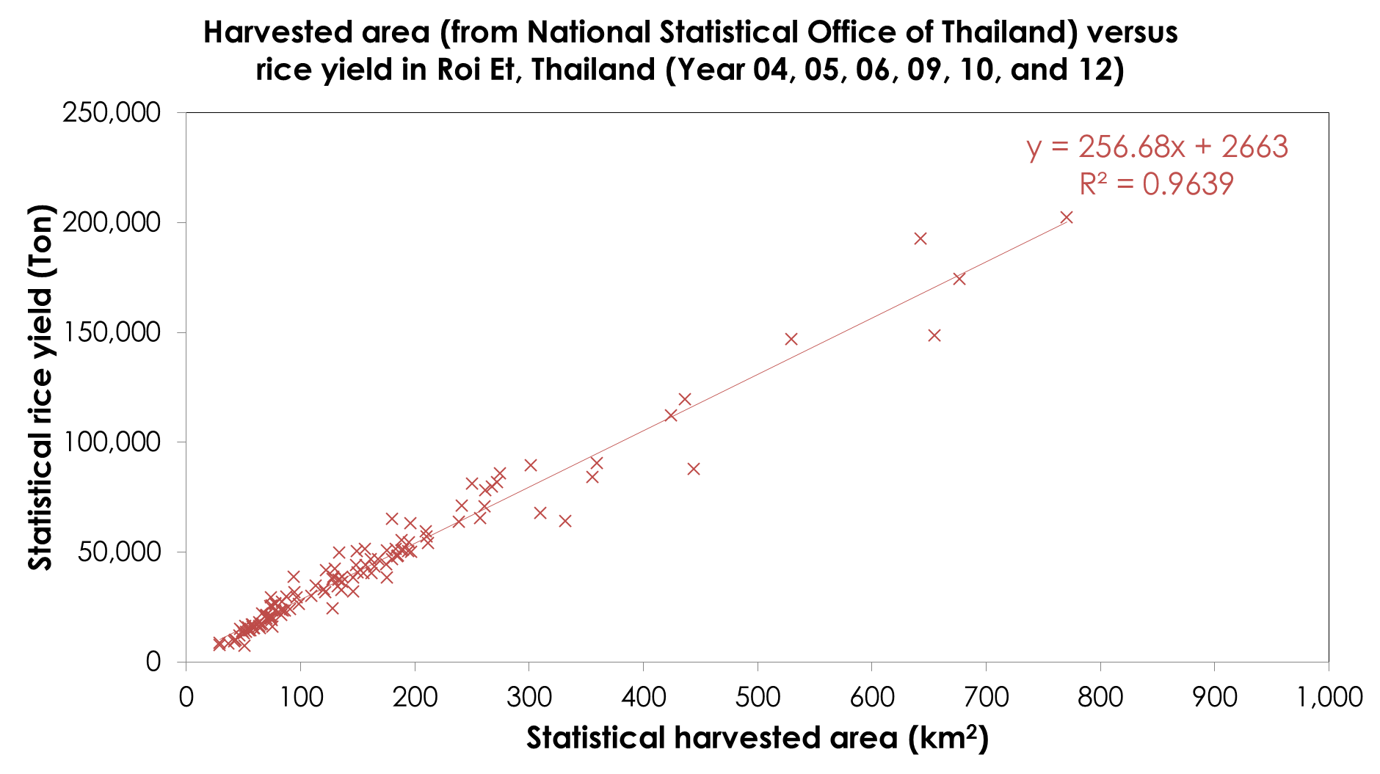
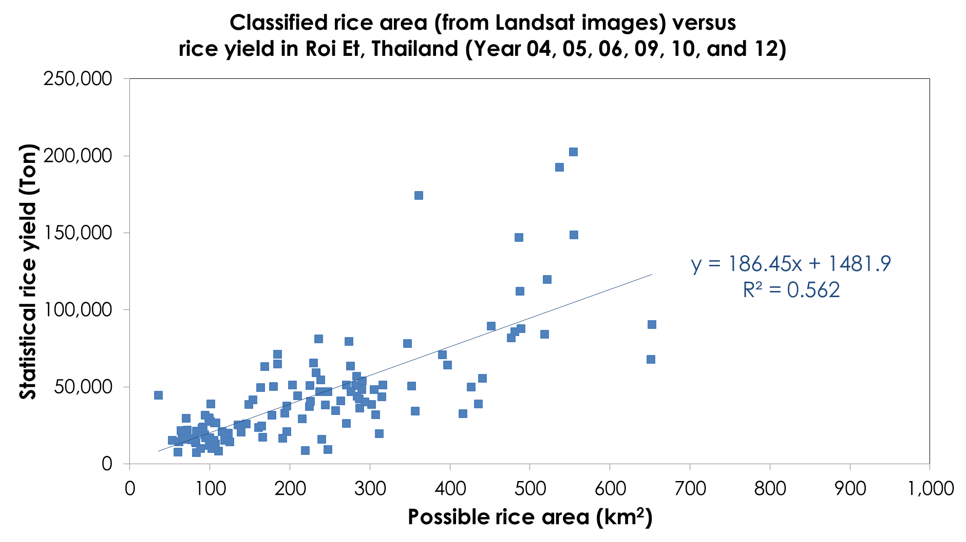
Results(cont.)
A strong correlation between land cover occupied by rice and total rice yield per district
Reasonable predictions of rice yield from wet season Landsat LCC’s
Source: National Statistical Office of Thailand
Notes:
As shown in the top right hand picture, the reports from National Statistical Office of Thailand indicate a strong correlation between total land area occupied by rice in squared kilometers and the output tonnage of rice harvested each season in Ton. We presented the relationship in a linear regression equation .
In the bottom right hand picture, we show that Landsat LCC’s could be used to predict the rice yield too. The results are presented in a linear regression providing R squared as much as 56.2 % .
Website for National Statistical Office of Thailand: http://roiet.nso.go.th/

Slide 24

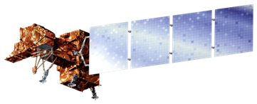





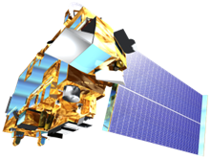


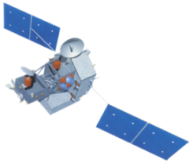
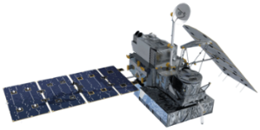


NASA Earth Observations
Landsat 5, 7, 8: Land cover classifications, NDVI, and land surface temperature
Terra/Aqua MODIS: land surface temperature, and NDVI
TRMM and GPM: precipitation
Notes:
We used Landsat 5, 7, 8 to conduct supervised land cover classifications, NDVI, and land surface temperature products. Terra and Aqua MODIS products were used to conduct land surface temperature and NDVI.
For precipitation, we used TRMM and GPM.

