Slide 1
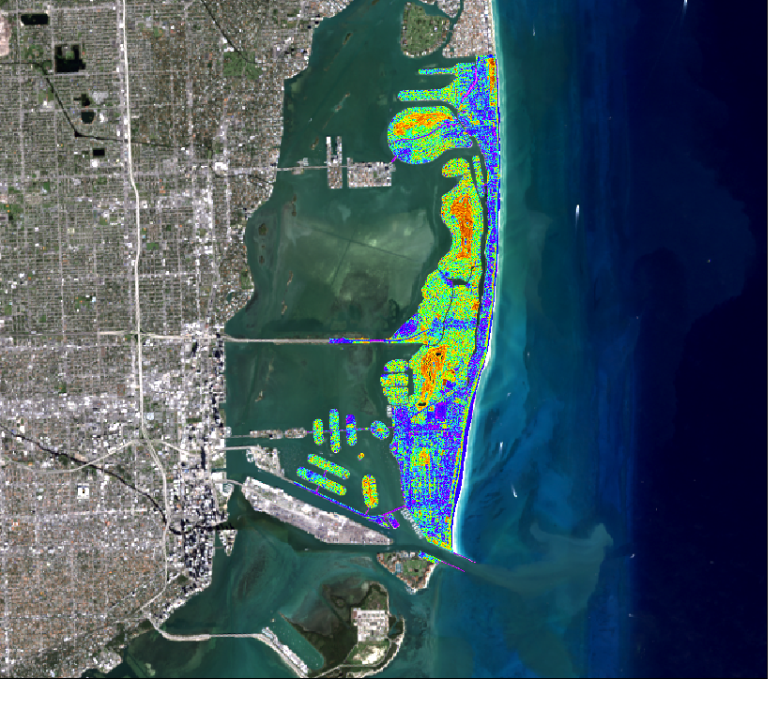
MIAMI BEACH URBAN DEVELOPMENT II
Utilizing NASA Earth Observations to Assess Vegetation Resiliency and Water Quality Concerns to Enhance Green Infrastructure Plans in Light of Extreme Weather Events
Austin Stone
Caren Remillard
Emad Ahmed
Matthew Becton
Shannon Duffy
Charles Lu
Notes:
Welcome, and thank you for coming. We are here to present our project: “Utilizing NASA Earth Observations to Assess Vegetation Resiliency and Water Quality Concerns to Enhance Green Infrastructure Plans in Light of Extreme Weather Events”. This project seeks to use satellite imagery in conjunction with data provided by the CIty of Miami Beach Public Works Dept. in order to determine how extreme weather events such as Hurricane Irma impact natural resources such as vegetation and water quality in the coastal city of Miami Beach. This project will serve as a guideline for using satellite data to quickly determine vegetation loss and resilience in the wake of disaster, as well as provide a method for predicting water quality over time.
The team working on this project consists of Austin Stone and Caren Remillard, Emad Ahmed, Matthew Becton, Shannon Duffy, and Charles Lu.
Austin

Slide 2
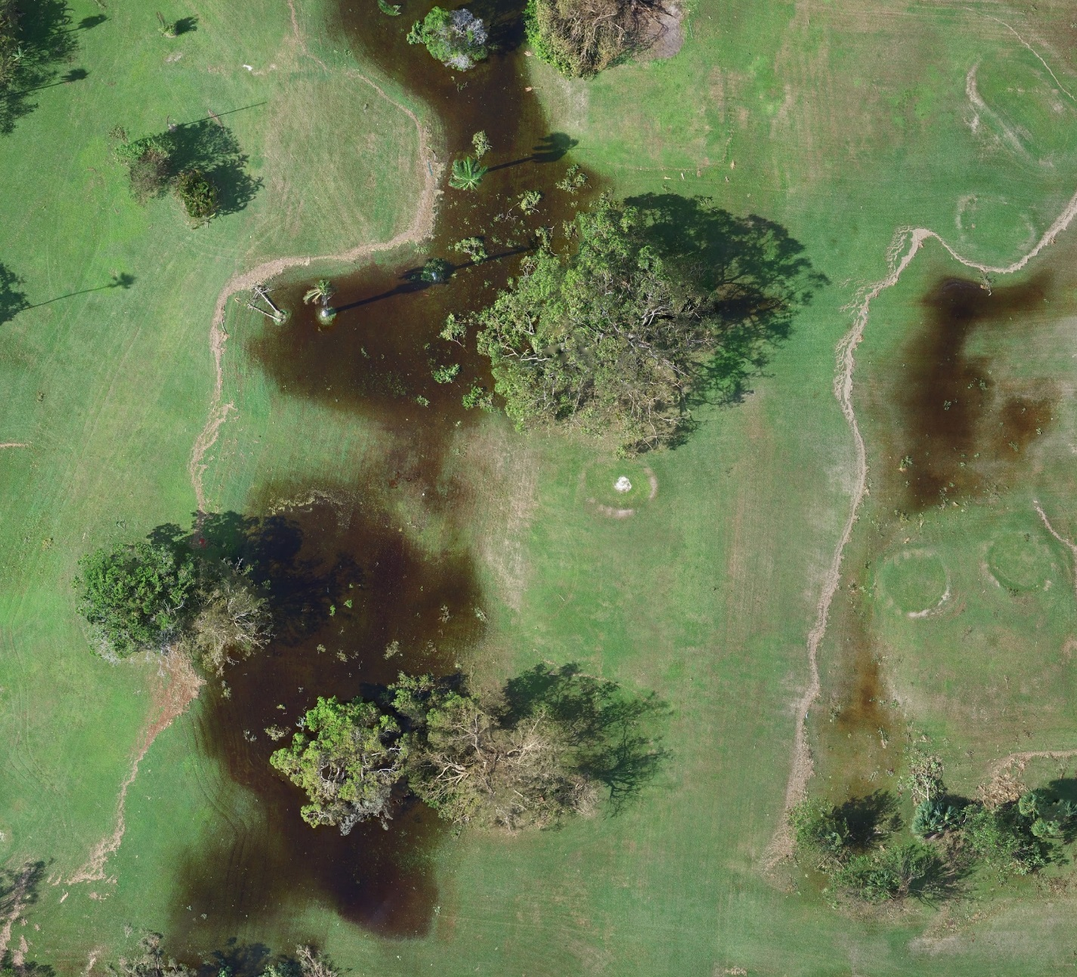
Community Concerns
Extreme weather events, like hurricanes, pose major threats to coastal communities surrounding Biscayne Bay.
Predicted changes in shoreline, could significantly impact the economy (primarily the tourist industry) of Miami Beach.
Declining water quality poses a critical risk to the coastal community of the bay area.
Hurricane damage assessments are needed to enhance coastal resiliency strategies.
Image credit: Miami Beach Public Works Department
Notes:
Our focus is on the City of Miami Beach, Florida, a thriving tourist center in the southeastern United States. As an economic powerhouse on the very edge of the coast, this city stands to suffer enormously from extreme weather events, such as the hurricanes that regularly plague the area. In addition to the damage caused to residential and commercial structures and property due to flooding and high winds, damage to vegetation canopy and declining water quality threaten to severely impact the tourism industry, which is a major component of Miami Beach’s revenue.
To this end, we propose a way of using remote sensing data to quickly and cheaply determine damage to and resilience of local vegetation, as well as using historic water quality data to train a software model to give general predictions of how water quality depends on tide and location in the nearby Biscayne Bay.
These products will be used by the City of Miami Beach’s Public Works Dept. to plan out strategies for mitigating both structural and economic damage caused by extreme weather events.
Image Source: Miami Beach Public Works Dept., Francisco D’Elia, image shows flooding caused by Hurricane Irma to a Miami Beach golf course
Matt

Slide 3
Project Partner
City of Miami Beach, Public Works Department
Notes:
Our Partner for this Project is the City of Miami Beach’s Public Works Department. Last year, the NASA DEVELOP program worked with representative Francisco D’Elia, and he appreciated the scope of what we could do so much that he requested our assistance this year as well. His needs have changed over time, especially with the impact of the recent and destructive Hurricane Irma, and we have done all we can to help him to gather and process information for the betterment of Miami Beach as a whole.
Matt

Slide 4
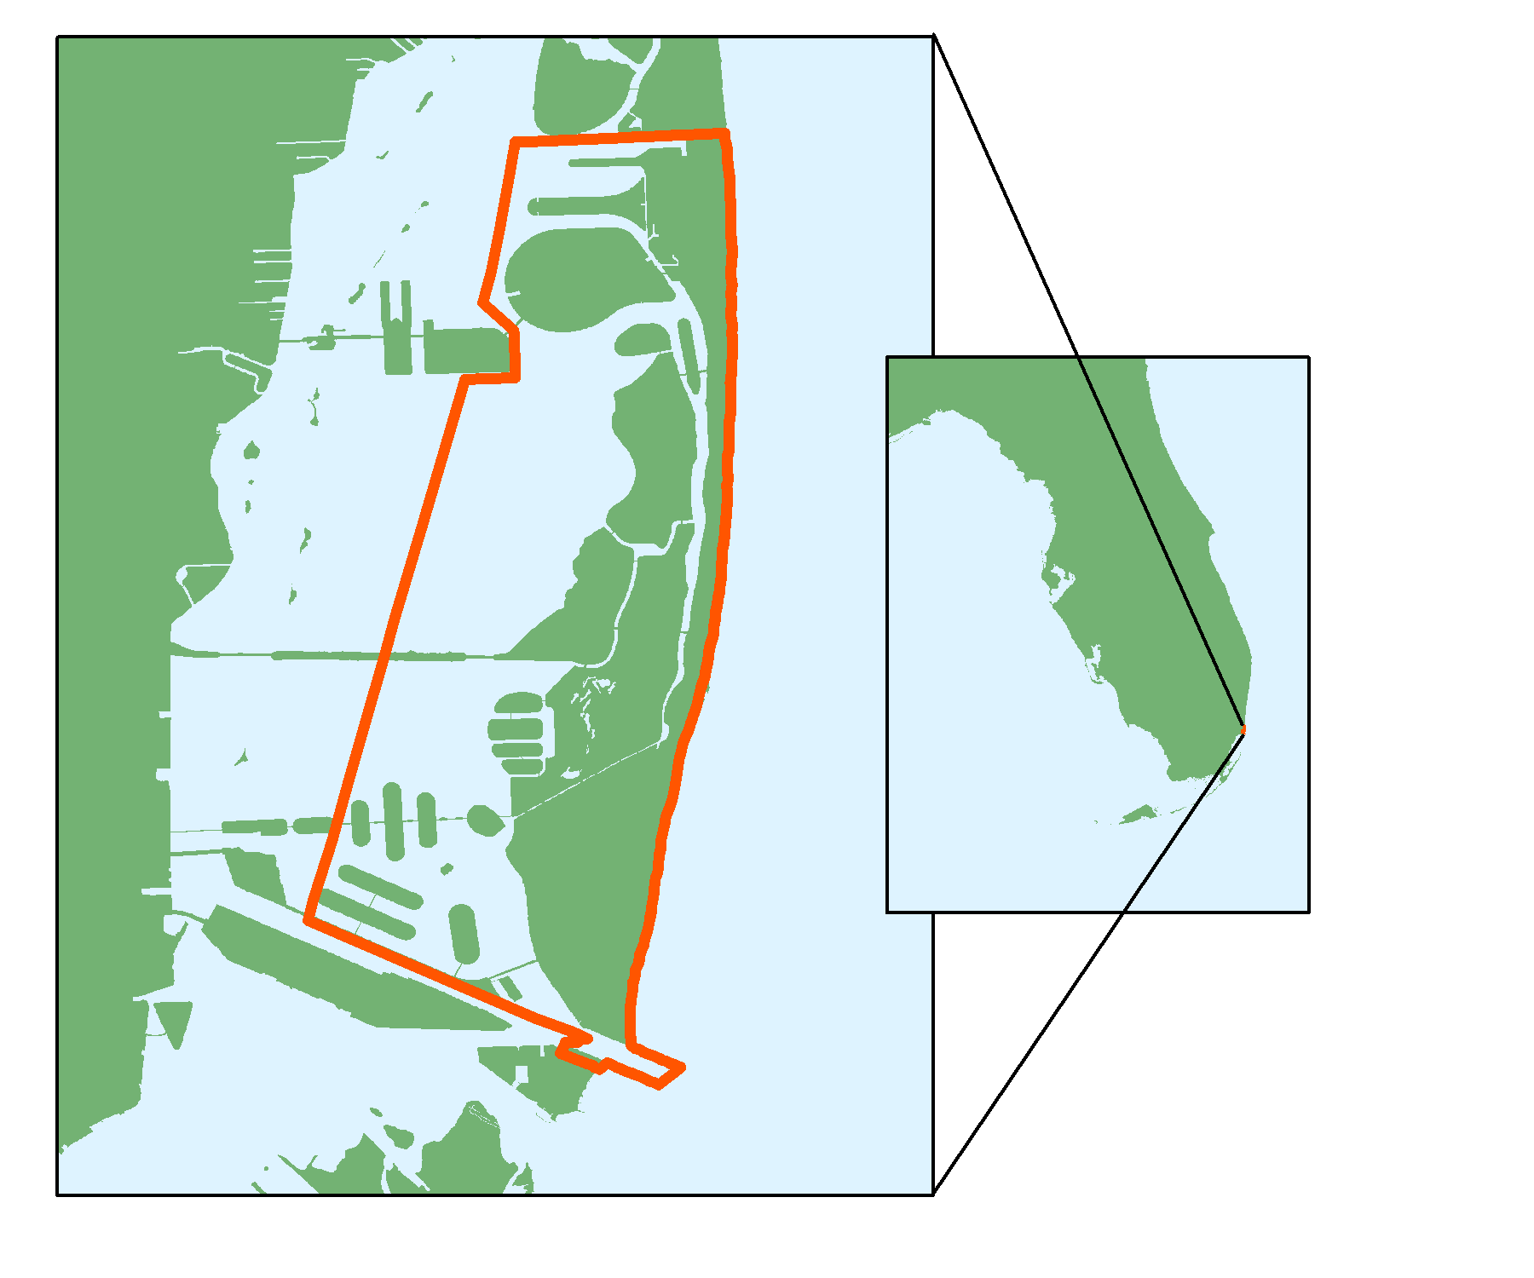
Study Area & Period
Florida
Miami-Dade County
Biscayne Bay Area
City of Miami Beach
1990-2017
Biscayne Bay
Image Credit: Monet
City of
Miami Beach
Notes:
We are focusing on the city of Miami Beach and the Biscayne Bay. Studying the city of Miami Beach is particularly critical because of its vulnerability to storm damage and high property values. The region has been susceptible to coastal erosion and vegetation loss due to natural disasters like Hurricane Irma. Additionally, we are studying water quality within the Biscayne Bay. Because of its inland tributaries such as the Miami River, our partner is concerned about water quality trends within the region.
Matt

Slide 5
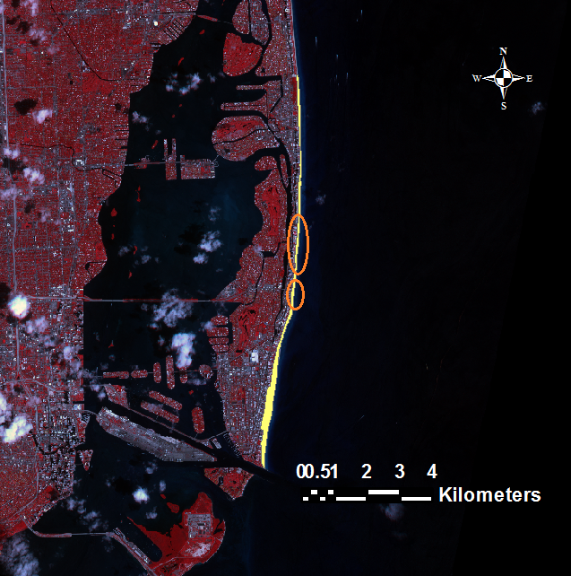
Previous Term
Objectives
Examine coastal damage in Miami Beach following Hurricane Irma
Map the distribution of historic urban vegetation in Miami Beach
Assess mangrove resiliency in Biscayne National Park for future green infrastructure strategies
Results
Hurricanes cause significant coastal ecological changes which can be recognized by NASA EO
Green infrastructure planning has shown positive effects in the past few decades
Mangrove forests in Biscayne National Park exhibit resiliency in hurricane and non-hurricane years
3km
Sand
Vegetation
Water
Notes:
At the start of the first term, the project partner was excited about studying the mangroves in Biscayne National Park and their resiliency patterns. The team found that mangroves have an unmitigated potential to protect shorelines and show great recovery after storm damage.
However, due to the unplanned Hurricane Irma, the objectives underwent a radical change for the second term. It was determined that the City of Miami Beach Public Works Dept. could really use an in-depth analysis of how the Hurricane impacted coastal and urban vegetation as well as building a foundation for predicting water quality patterns in the bay.
Matt

Slide 6
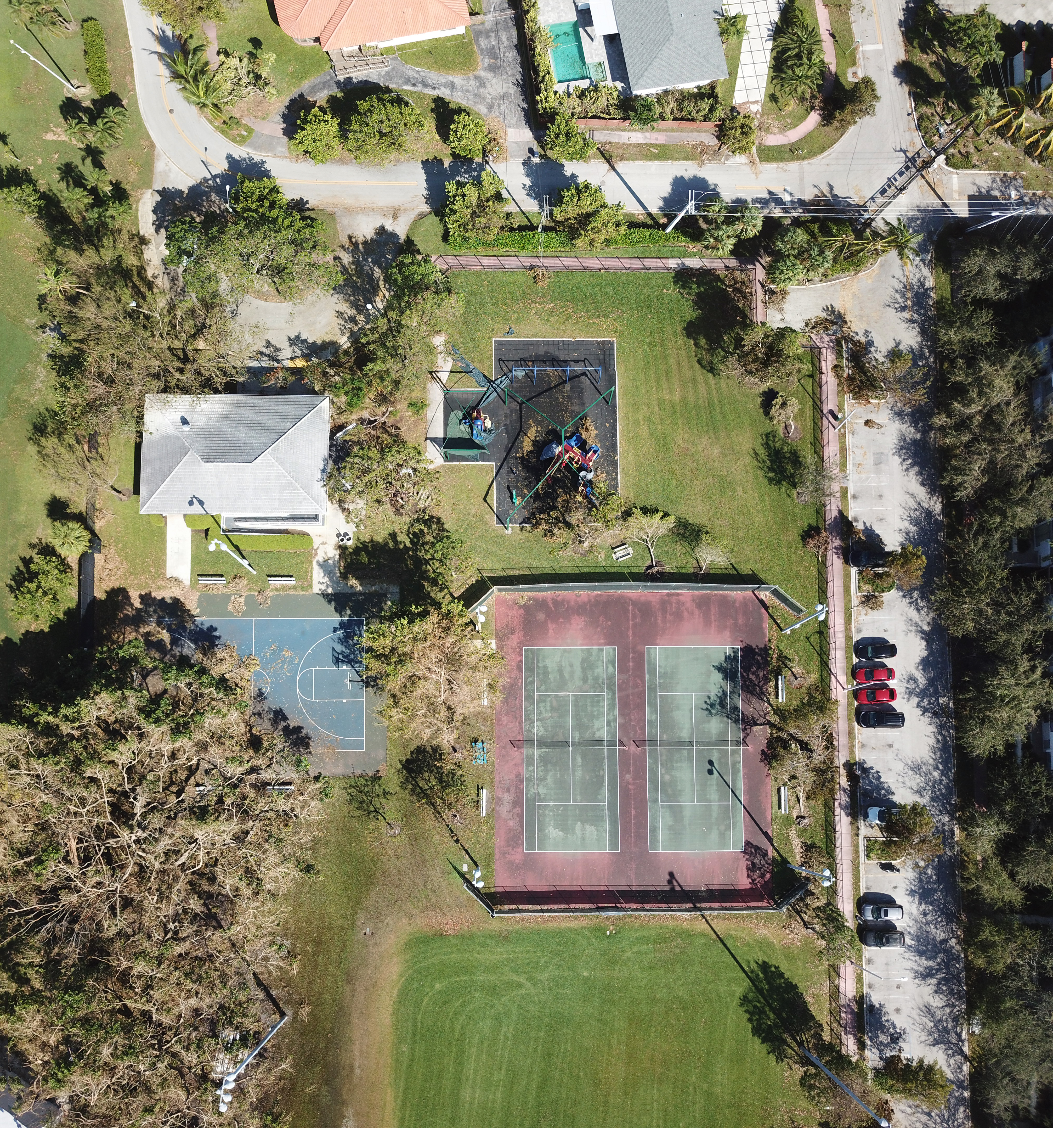
Objectives
Assess resiliency of coastal and urban vegetation in response to Hurricane Irma
Analyze water quality patterns in the Biscayne Bay area from 1990 to present
Communicate the relevance of NASA Earth observing satellites to the city of Miami Beach and how the project’s methods can be applied to geographically similar locations
Image credit: Miami Beach Public Works Department
Notes:
Our primary objectives are to assess the resiliency of coastal vegetation in response to Hurricane Irma, to analyze water quality patterns in the Biscayne Bay area from 1990 to present day, and to communicate the relevance of NASA Earth observation satellites to our project partner. Our final maps and models will help advise the city on how to prepare for and mitigate the effects of coastal storms.
Matt

Slide 7
Vegetation Analysis Methods
Vegetation Damage
Comparative Vegetation Analysis with NDVI
Vegetation Resiliency Map
Landsat 8
PlanetScope
Vegetation Data
Vegetation Recovery
$$Damage=\frac{{NDVI}_{Sep 07}−{NDVI}_{Dec 12}}{{NDVI}_{Sep 07}}$$
LANDSAT 8 OLI
Sep 11
Sep 7
Sep 13
Dec 12
Irma
PLANET
$$Damage=\frac{{NDVI}_{Sep 07}−{NDVI}_{Sep13}}{{NDVI}_{Sep 07}}$$
$$Recovery=\frac{{NDVI}_{Dec 12}−{NDVI}_{Sep13}}{{NDVI}_{Sep 07}−{NDVI}_{Sep13}}$$
Notes:
Our project is broken down into two analysis. Our vegetation analysis began with Landsat 8 and PlanetScope imagery. The two satellites were used for verification and comparison of our NDVI resiliency analysis. Using imagery from before and after Hurricane Irma (September 11), we analyzed vegetation damage in Miami Beach and created a comparative analysis of the ratio of recovered vegetation further on after Irma.
Emad

Slide 8
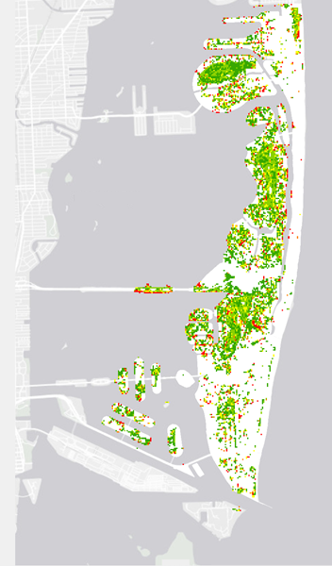
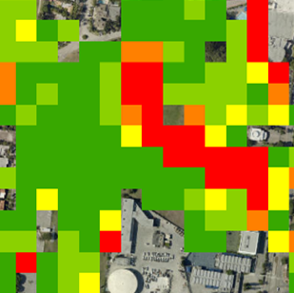
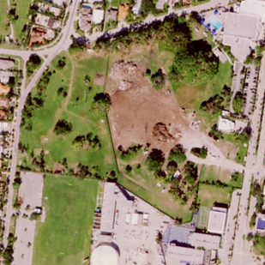
Landsat 8 Results
Long-term Damage
September 7, 2017 –
December 12, 2017
No Damage
Minimal Damage
Moderate Damage
High Damage
Severe Damage
Image credit: Miami Beach Public Works Department
Notes:
This a result for damage analysis using LandSat 8 images. Since Images following the storm are very cloudy we computed damage from Dec 12 and Sep 7. From the result we cannot see what happen in between but we can clearly identify areas which are not recovered yet. The pic on the right side is a comparison of our result with high resolution image which shows earth work going on, it might not be a result of the storm but picked up pretty well.
Emad

Slide 9
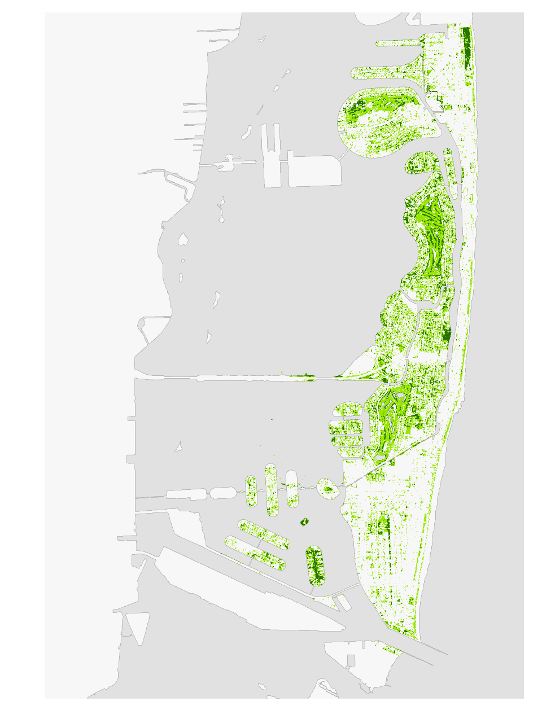
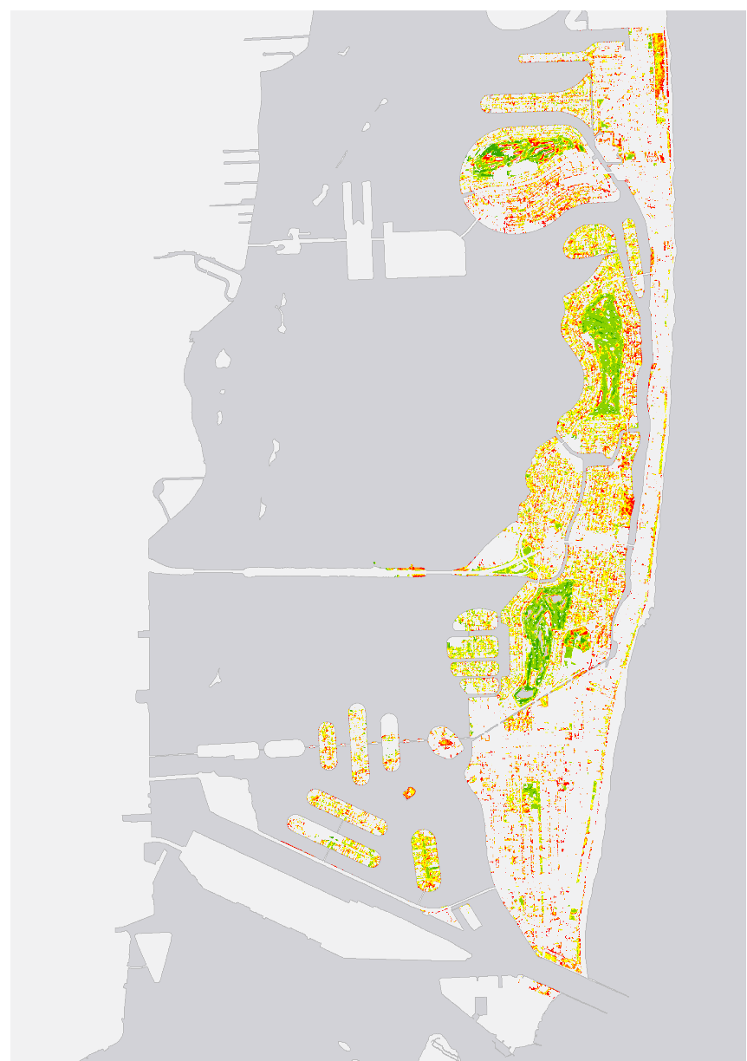
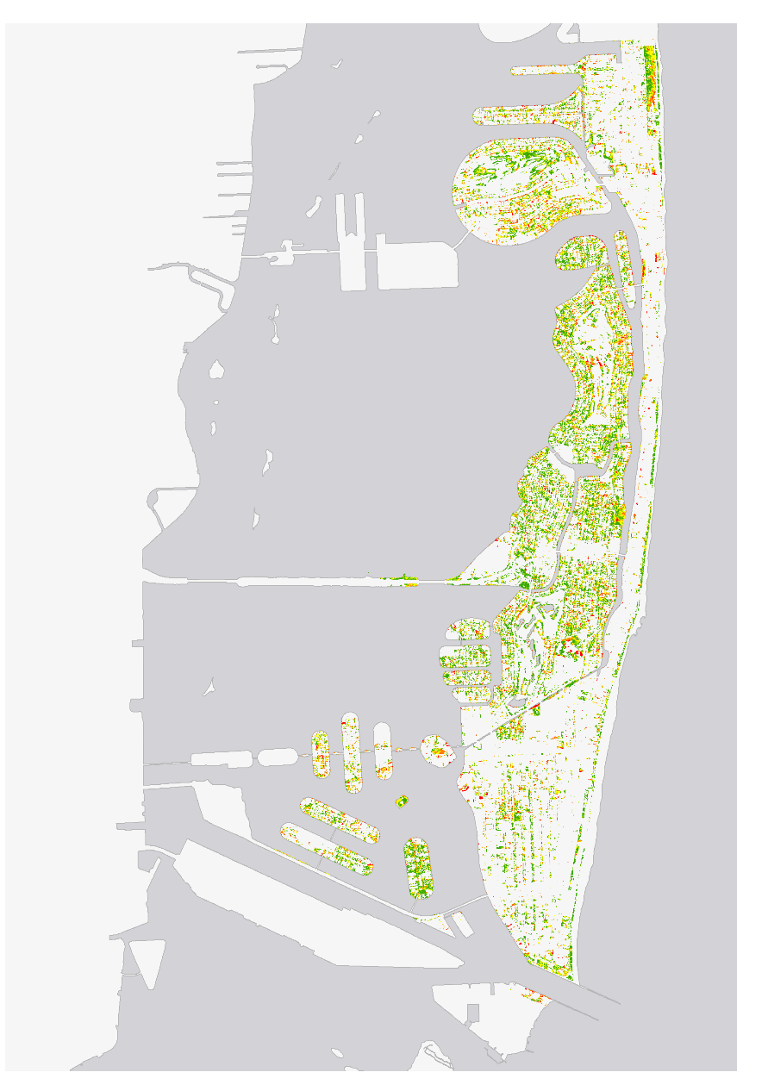
Results
Vegetation Cover
September 7, 2017
Immediate Damage
September 13, 2017
Vegetation Recovery
December 12, 2017
No Damage
No Recovery
Grasses and Shrubs
Minimal Damage
Minimal Recovery
Moderate Damage
Moderate Recovery
Canopy
High Damage
High Recovery
Severe Damage
Full Recovery
Vegetation cover makes up 30% of the land
74% of vegetation experienced moderate to severe damage
80% of damage was more than 50% recovered
Notes:
Regarding vegetation analysis we first extracted the vegetation area with two classes as canopy and non-canopy using NDVI and green band value.
We run a damage analysis using the difference between NDVI value before and after Irma as a fraction of the before value. And then we grouped negative and zero values as “No Damage” and classified the rest based on the extent of damage.
Similarly, we run vegetation recovery for the damaged areas using the difference between immediately after and 90 days after the hurricane as a fraction of the damaged extent. As a result we get some vegetation that didn’t show any increase rather show a decrease in NDVI value which we grouped it as “No Recovery (Late damage)” and the rest classified based on percentage recovered.
Emad

Slide 10
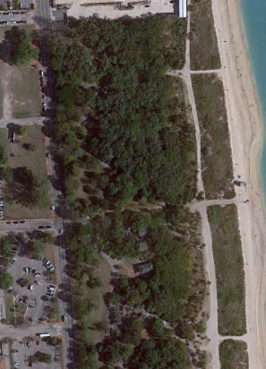
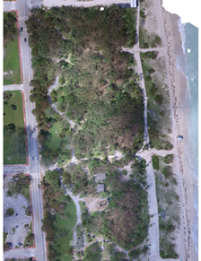
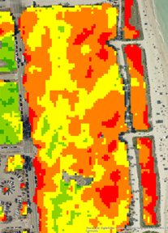
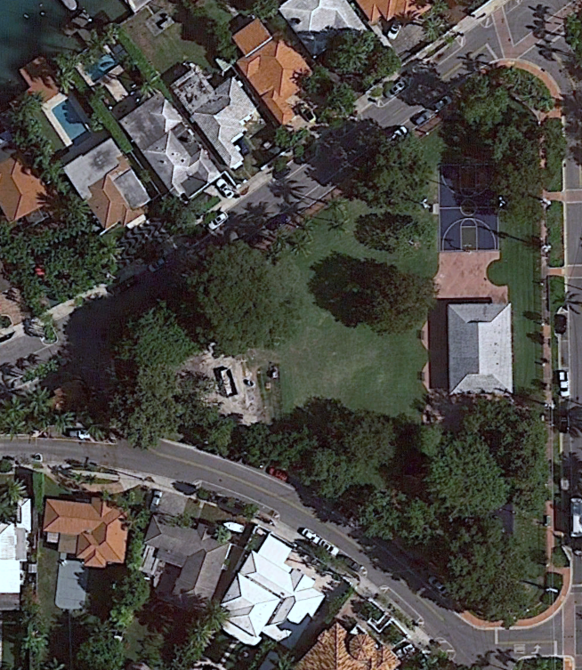
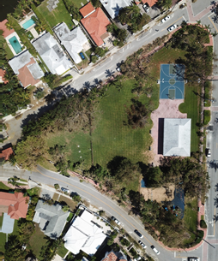
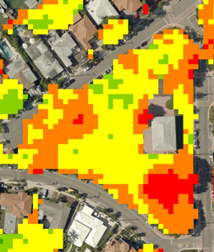
Results
March
September 13
Damage
North Shore Park
No Damage
Minimal Damage
Image credit: Google Earth Pro
Image credit: Miami Beach Public Works Department
Moderate Damage
September 13
Damage
High Damage
March
Severe Damage
Still Water Park
Image credit: Google Earth Pro
Image credit: Miami Beach Public Works Department
Notes:
We also did a visual assessment using Images taken from drone just after the Hurricane. Images before(Jan 1, 2016), after(Sep 13, 2017) and our analysis result is shown for North shore and Still water Park.
Emad

Slide 11
Conclusions – Vegetation Analysis
Damage
Immediately following Hurricane Irma, our analysis showed that vegetation experienced severe damage.
Recovery
Our results will help our project partners to identify areas and species that demonstrated the highest rate of resiliency.
Image credit: Miami Beach Public Works Department
Notes:
To conclude this portion of the presentation, we will end by stating that, although Hurricane Irma caused major damage to not only urban structures but also the surrounding vegetation, we have shown that NASA Earth Observations can be used to track and quantify damage and recovery with much less personnel investment than would be required by in situ analyses.
We show not only that the vegetation of Miami Beach can recover from natural disaster, but also demonstrate how Earth Observations can be used to track and analyze such behavior.
And now, we’ll introduce the water quality analysis portion of our project. (Transition)
Emad

Slide 12
Water Quality Methodology
Turbidity
Aqua MODIS
Sentinel 3 (future)
In situ data
Water Quality Time Series
Water Quality
Data
Chlorophyll
Water Quality Predictive Tool
in situ parameters
Deep Water Code
Notes:
Our water quality analysis utilized Aqua MODIS alongside in situ data from our partner. In the future we think Sentinel 3 data could also be useful for another project with Miami Beach. With the combined data we analyzed seasonal trends in turbidity and chlorophyll-a before and after Irma. We also used the in situ data points to generate a deep learning forecasting tool to forecast future seasonal trends.
Shannon

Slide 13
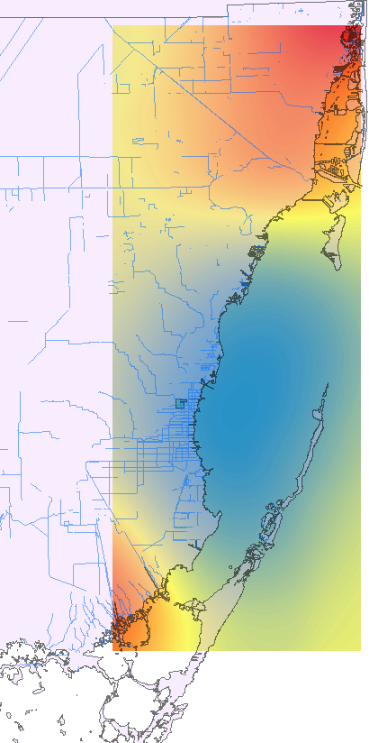
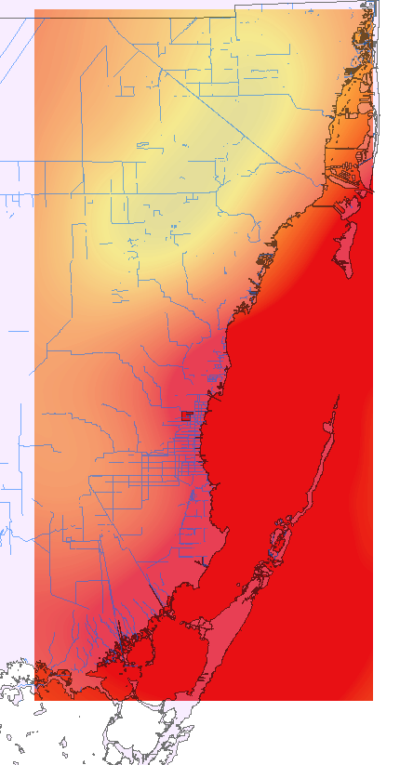
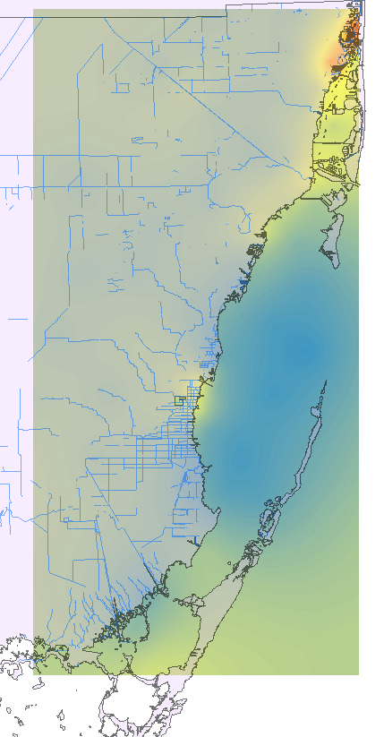
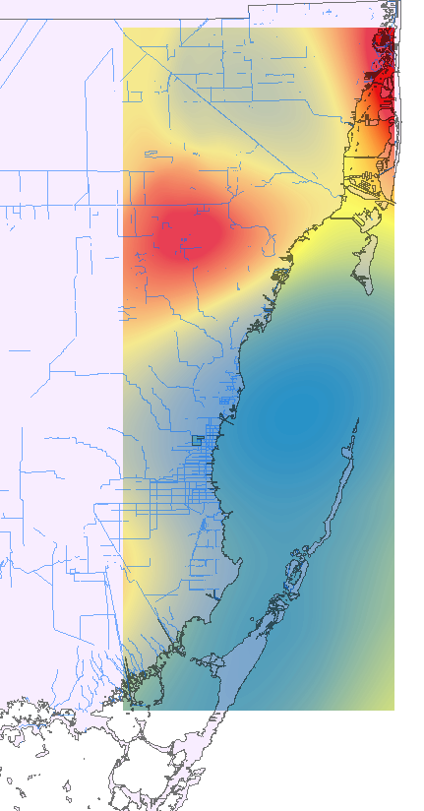
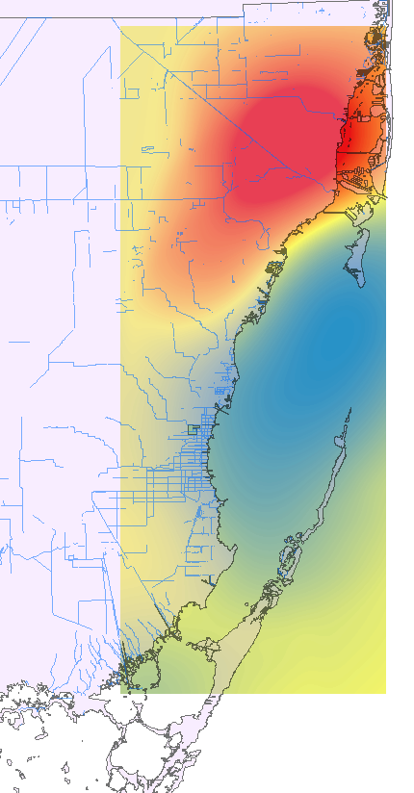
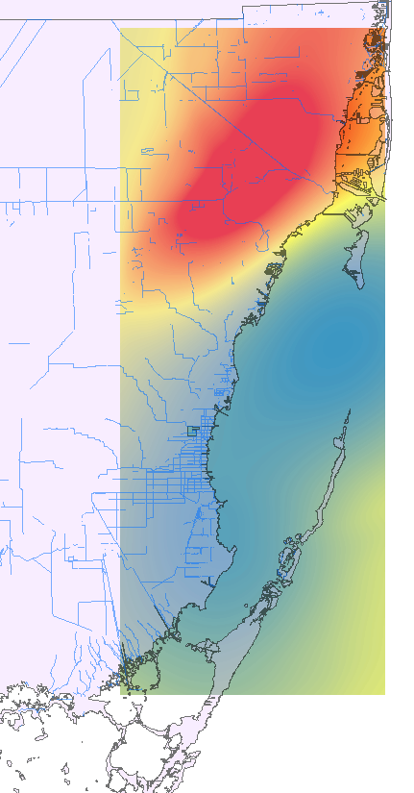
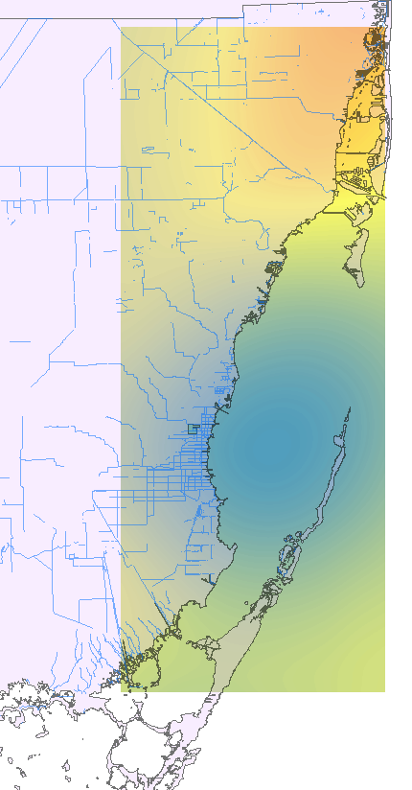
Results
In situ Water Quality Testing Sites
Chlorophyll
Biscayne Bay 2014-2017
Chlorophyll-a Content (µg/L)
High : 3.0972
Low : 0.1959
* Starred months’ values were generated using predictive model
testing sites
January 2014
January 2017
March 2014
March 2016*
January 2015*
March 2015*
January 2016*
Notes:
Our partner provided us with in situ water quality data collected at points throughout the Biscayne Bay and its contributing tributaries. Data covered parameters such as pH, turbidity, chlorophyll-a, and temperature. The points are displayed on the map above.
Using these points, we were able to created krigged surfaces to depict trends in cholorophyll content in the bay. Our partner was specifically interested in the changes shown during the dry season in January and during the onset of the wet season in March. The astricked dates represent data that we were not granted access to. In those cases, we krigged data generated by our deep learning model at a sample of station points.
Data was measured as migrograms per liter and microcgrams per cubic meter.
Shannon

Slide 14
Deep Water Results
Training
Input
Forecast
Real
Predicted
ml/m³
1990
1994
1998
2002
2006
2010
2014
2015
2017
Accuracy of Turbidity Forecasting using LSTM networks
Real
Training
Validation
Testing
Nephelometric Turbidity Unit
1990
1994
1998
2002
2006
2010
2014
Notes:
The in situ water quality data contained almost a million measurements of over 400 different attributes. The Correlation Matrix plot on the right shows the correlation between all attributes with at least 1,000 measurements (Yellow shows two attributes are highly positively correlated and Dark Blue shows two attributes are highly negatively correlated).
Because we had so much data, we used Long Short Term Memory networks, which are a type of deep learning model to analyze the water quality data. Deep learning models have many hyperparameters to tune and the top left graph shows the effect on performance (RMSE) of different settings of one parameter (number of neuron cells). Making sure the model’s performance generalizes to unseen data is also important so accuracy should be measured on a holdout test set and hyperparameters should only be tuned on the validation set to prevent overfitting. The bottom left plot shows the predicted output of a LSTM model on turbidity for a single measurement station (AC01) over 1990 - 2014.
Charlie

Slide 15
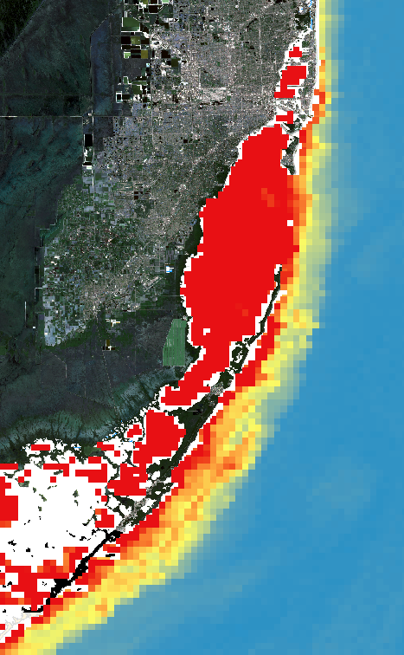
Results
Comparison of MODIS, in situ, and predicted Chlorophyll-a
MODIS
Chlorophyll
Biscayne Bay January 2015
In situ Jan 2017
Predicted Jan 2016
Predicted Jan 2015
In situ Jan 2014
MODIS Jan 2017
MODIS Jan 2016
MODIS Jan 2015
MODIS Jan 2014
Chlorophyll-a Content
(ml/m³)
High : 3
Low : 0.1
mL/m³
Notes:
Charlie

Slide 16
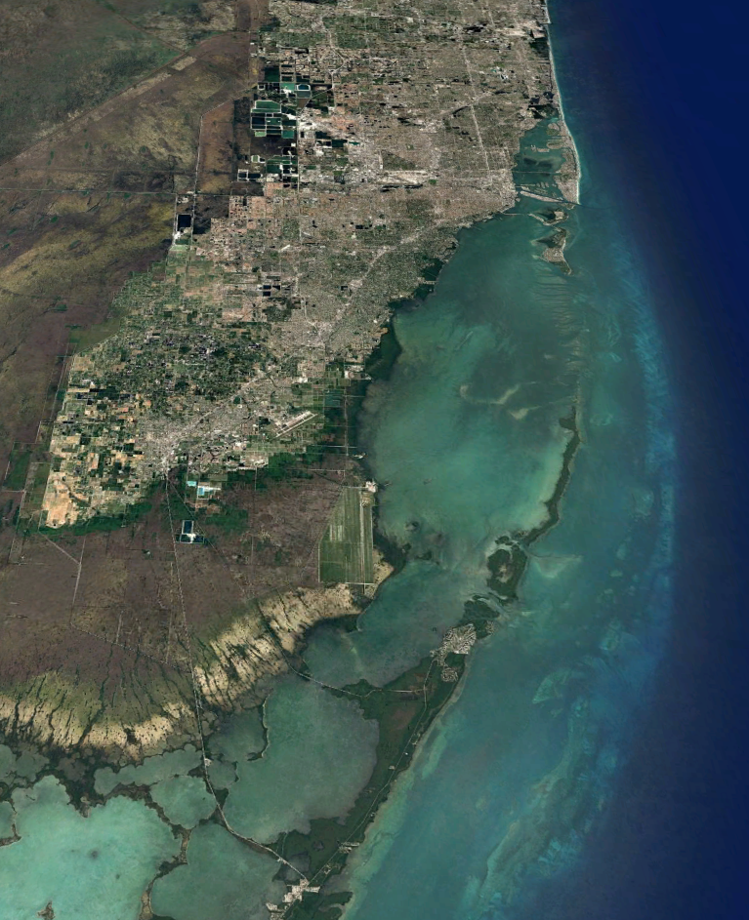
Water Quality Conclusions
Analysis
Earth Observations can be used to track and analyze water quality, with in situ measurements used for calibration.
Prediction
We demonstrate how a deep learning model can be used to accurately predict spikes or general changes in water quality for a given area of interest.
Image credit: Google Earth
Image credit: Google Earth

Slide 17
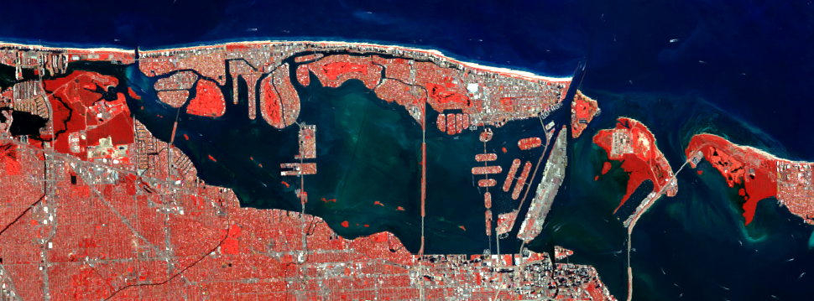
Errors and Uncertainties
NDVI Analysis
Water Quality
Flooded vegetation was considered highly damaged
Land cover beneath vegetation impacted reflectance values
Seasonality
Inability to account for tidal directions
Possible measurement error of in situ data
Pixel resolution of MODIS and limitations of data to ocean areas
Image credit: Landsat 8

Slide 18
Future Work
Water Quality
Incorporate higher resolution data like Sentinel-3 to retrieve more accurate Chlorophyll-A and Turbidity results to compare with in situ measurements
Build upon ‘Deep Water’ code to generate maps of predicted water quality patterns
Vegetation
Project Partners will use results to identify species that are more likely to recover after extreme weather events
Image credit: Miami Beach Public Works Department
Notes:
Austin

Slide 19
Acknowledgements
Francisco D’Elia, Miami Beach Public Works Department
Dr. Rosanna Rivero, College of Environment and Design, University of Georgia
Dr. Marguerite Madden, Department of Geography, University of Georgia
Miami Beach Urban Development I Team: Maria Luisa Escobar Pardo (Project Lead), Christopher Cameron, Abhishek Kumar, Sonia Linton, David Rickless, Navid Hashemi Tonekaboni, Sam Weber
Notes:
We would like to thank our science advisors Dr. Rosanna Rivero at the University of Georgia College of Environment and Design and Dr. Marguerite Madden and the University of Georgia Department of Geography. We would also like to thank our project partners at the City of Miami Beach Public Works Department, Francisco D’Elia, for his support and involvement throughout this project. Finally, we would like to acknowledge the team members who completed the first phase of this project during the Fall 2017 term.

Slide 20
Questions?

Slide 21
Extra Slides

Slide 22
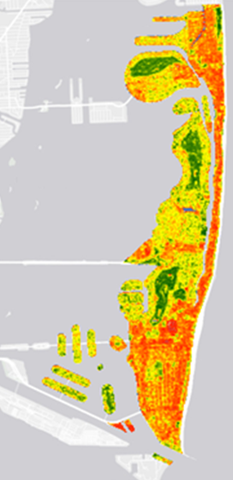
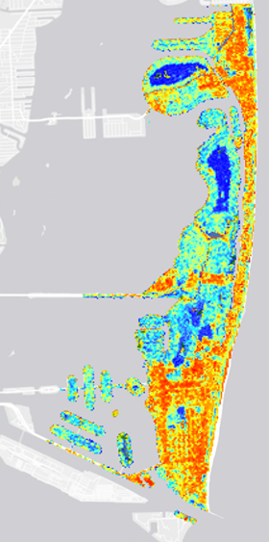
Results
Correlation between ILC and NDVI (2011)
Correlation coefficient calculated using “Band Collection Statistics” Tool is -0.693
Scatter plot of 1000 randomly selected points is shown below
NDVI
Imperviousness
100
100
0
0
Notes:
We have tried to see the correlation between Impervious Land cover and NDVI. We downloaded Impervious Land cover (ILS) from National land cover dataset for 2011 with values between 0 for pervious and 100 for totally impervious surface. So we rescale the NDVI data by making 0 for bare land, concrete and 100 for the highest NDVI value (healthiest vegetation). Then we calculated the correlation using Band Calculation statistics tool in arcGIS and get -0.693 which shows a moderate negative correlation b/n NDVI and ILC. To get a better visualization of the correlation we randomly selected about 1000 points and extracted the values and graph a scatter plot in excel.

Slide 23
Water Quality Results
Ammonia Nitrogen
Ammonia Nitrogen (Dissolved)
BOD_5
COD
Cadmium
Chlorophyll-A
Color (Apparent)
Copper
DO%
Depth
Dissolved Oxygen (Fld)
Fecal Coliform
Hardness
Lead
Light (Mean K)
Nitrate/Nitrite (NOX)
Ortho Phosphate (OPO4)
Oxidation Reduction (Fld)
Phenols
Pheophytin-A
Phosphorus, Total (TP)
Salinity
Specific Conductivity (Field)
Temperature (Field)
Total Coliform
Total Dissolved Solids (TDS)
Total Kjeldahl NItrogen (TKN)
Total SUspended SOlids (TSS)
Turbidity
Zinc
pH (Field)
Correlation Matrix of
Water Quality Attributes
Ammonia Nitrogen
Ammonia Nitrogen (Dissolved)
BOD_5
COD
Cadmium
Chlorophyll-A
Color (Apparent)
Copper
DO%
Depth
Dissolved Oxygen (Fld)
Fecal Coliform
Hardness
Lead
Light (Mean K)
Nitrate/Nitrite (NOX)
Ortho Phosphate (OPO4)
Oxidation Reduction (Fld)
Phenols
Pheophytin-A
Phosphorus, Total (TP)
Salinity
Specific Conductivity (Field)
Temperature (Field)
Total Coliform
Total Dissolved Solids (TDS)
Total Kjeldahl NItrogen (TKN)
Total SUspended SOlids (TSS)
Turbidity
Zinc
pH (Field)

Slide 24
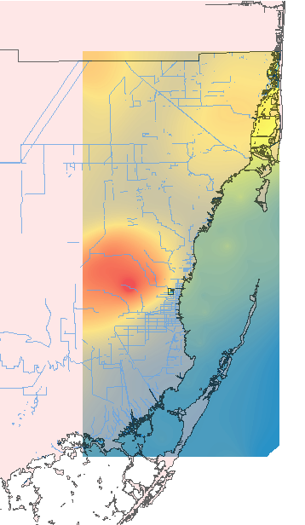
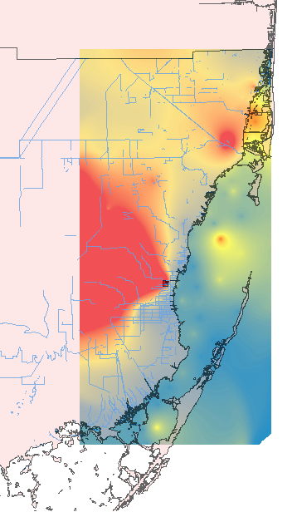
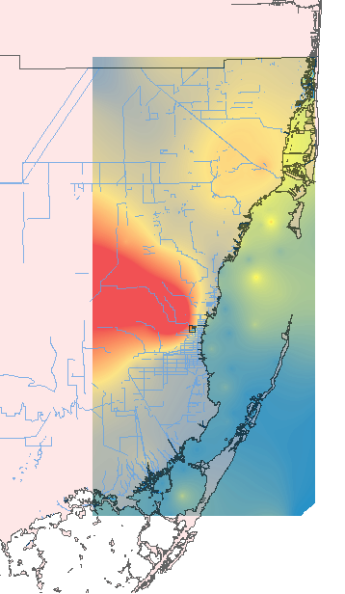
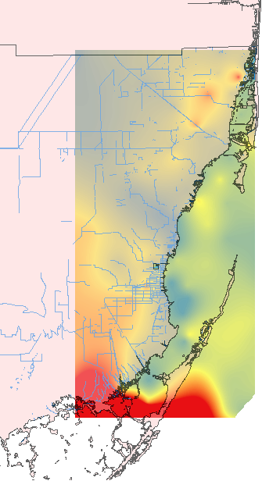
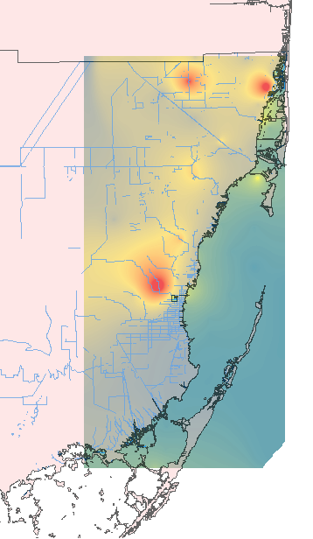
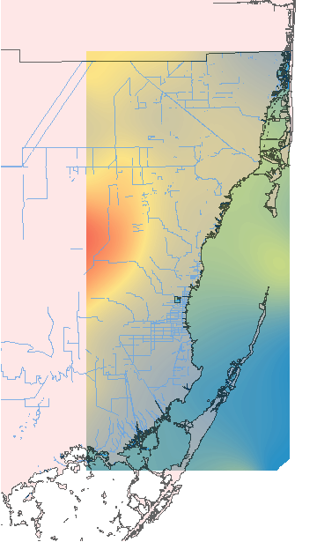
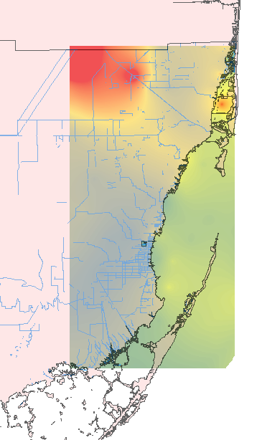
Turbidity Analysis
March 2016*
January 2015*
January 2016*
March 2015*
January 2017*
January 2014
March 2014
Turbidity
Biscayne Bay 2014-2017
Turbidity (NTU)
High : 8.747
Low : 0.0003
*Stared months’ data
were generated using a
predictive model*

