Slide 1
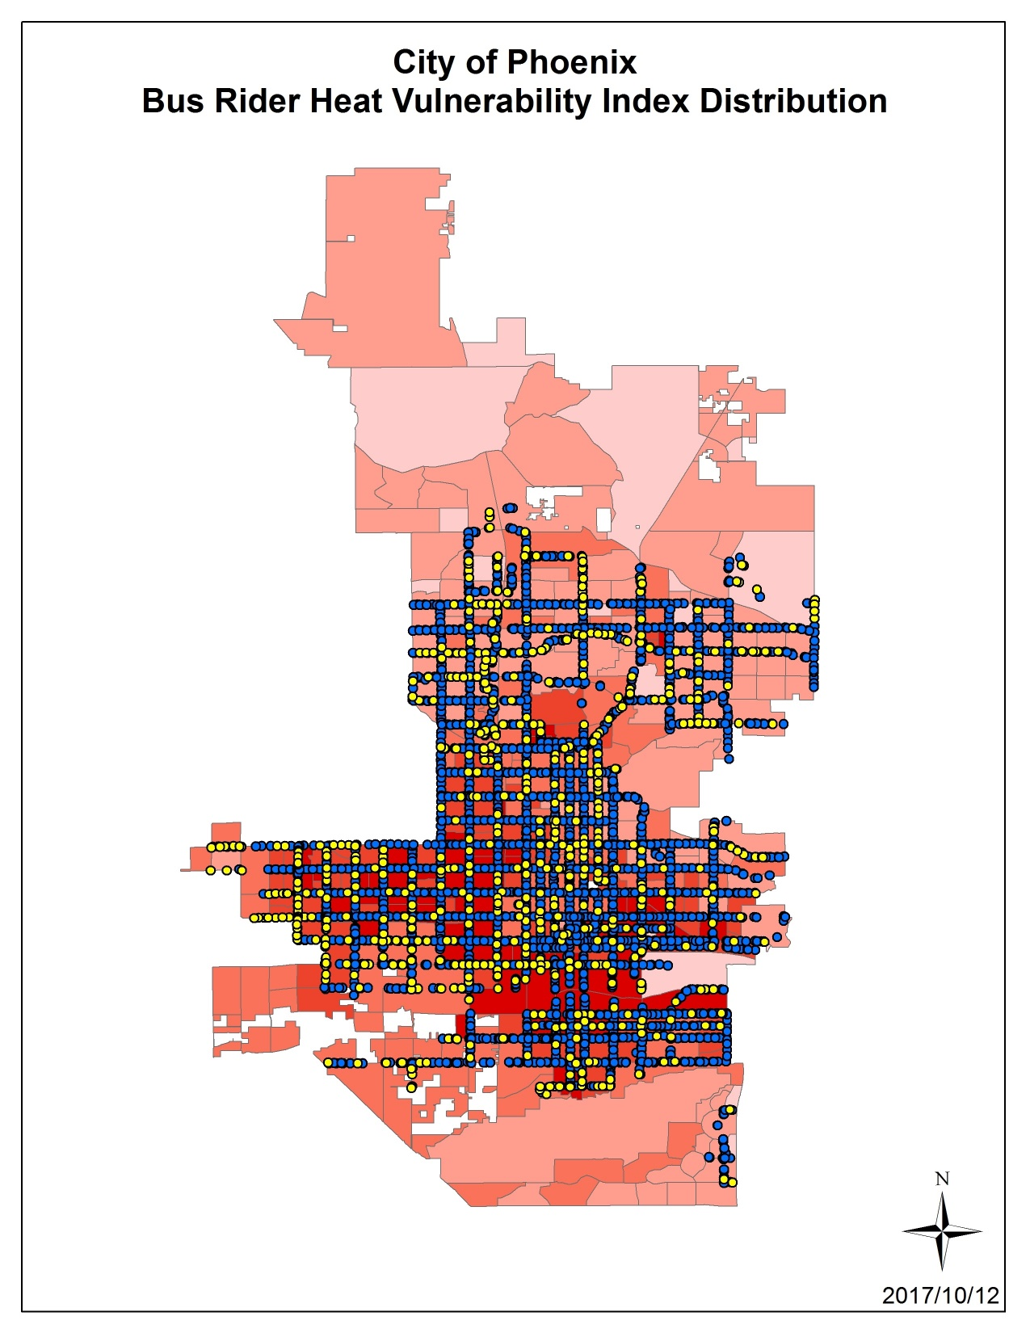
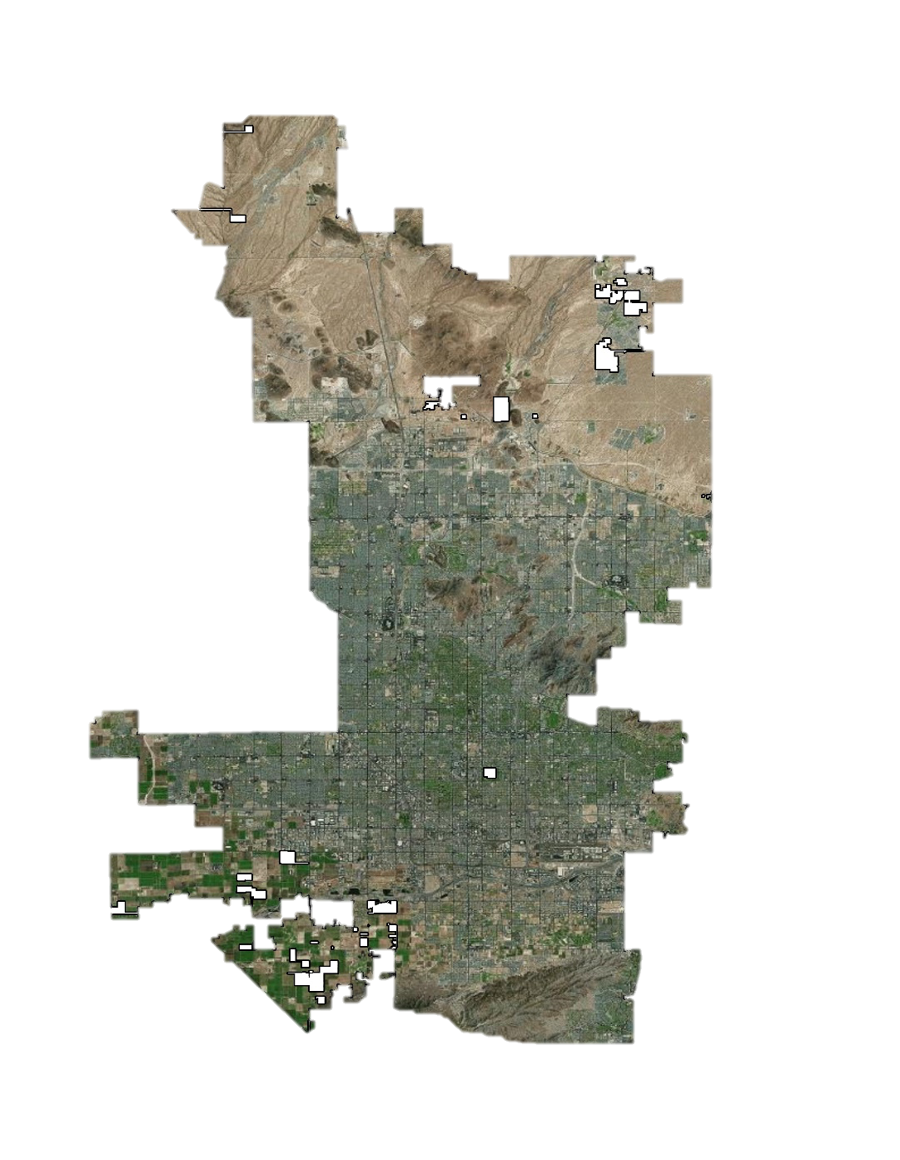
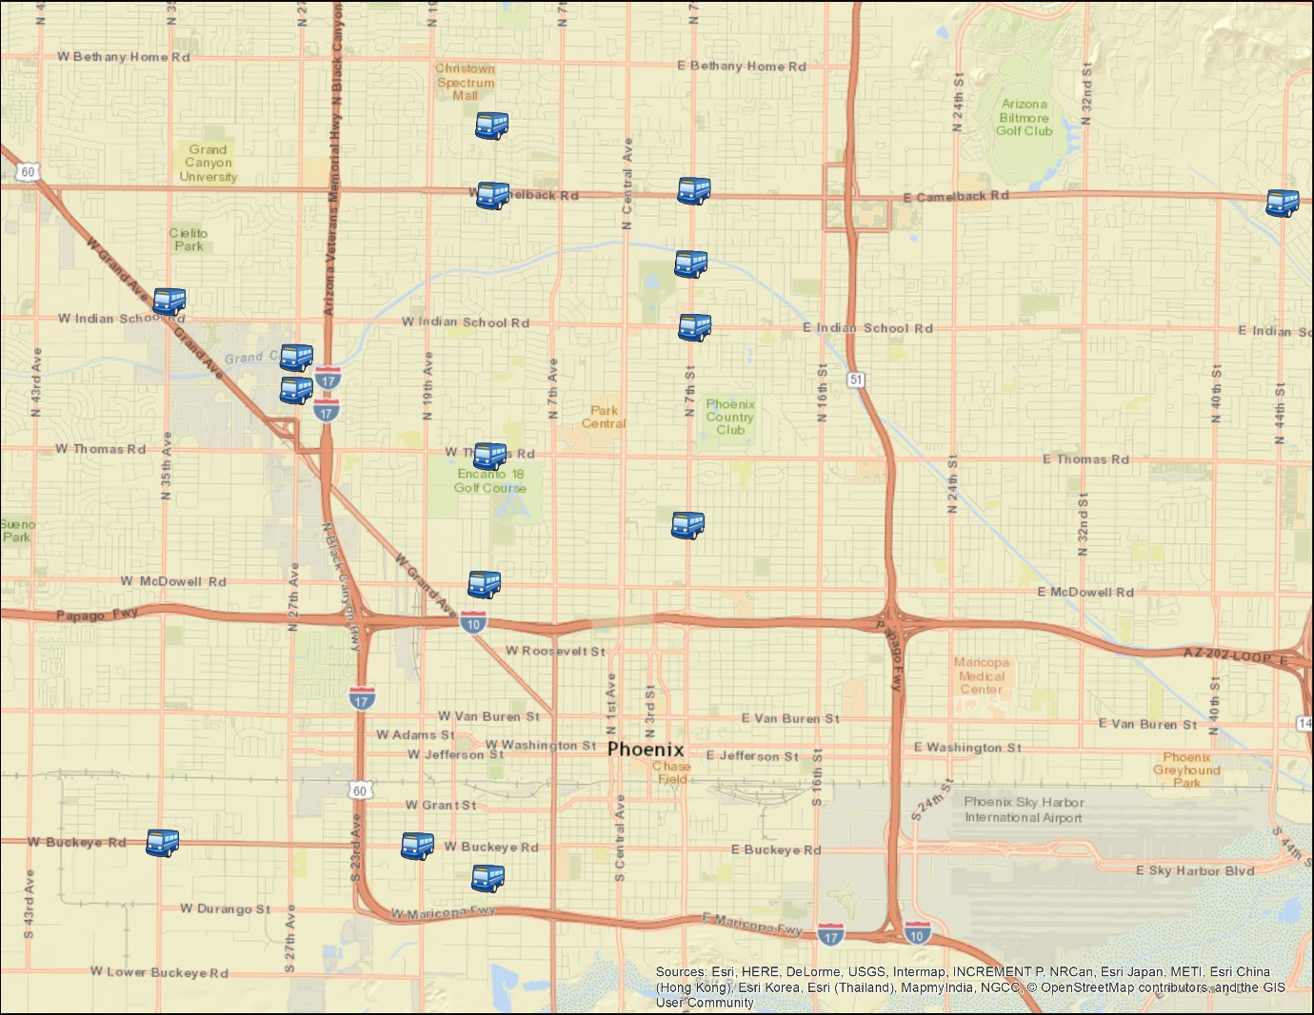
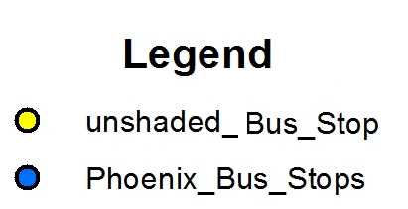
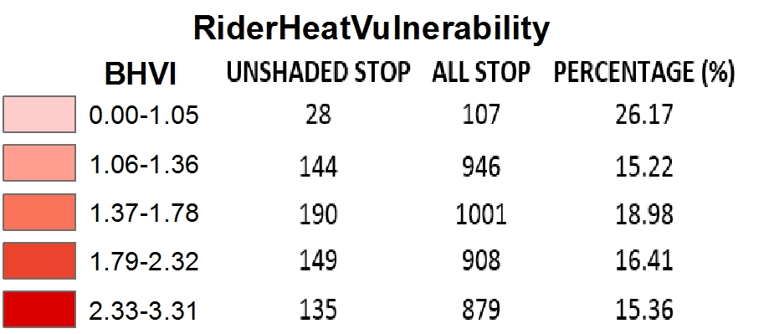
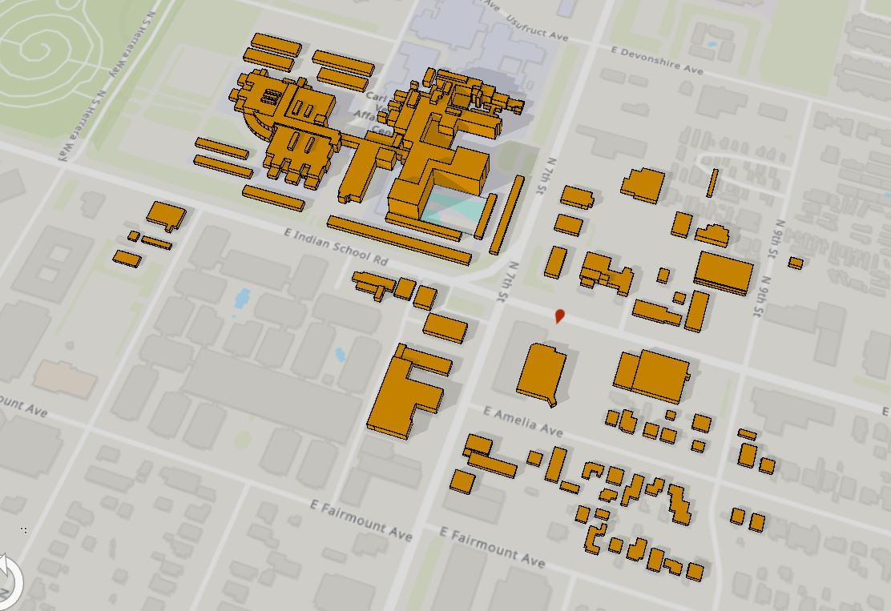
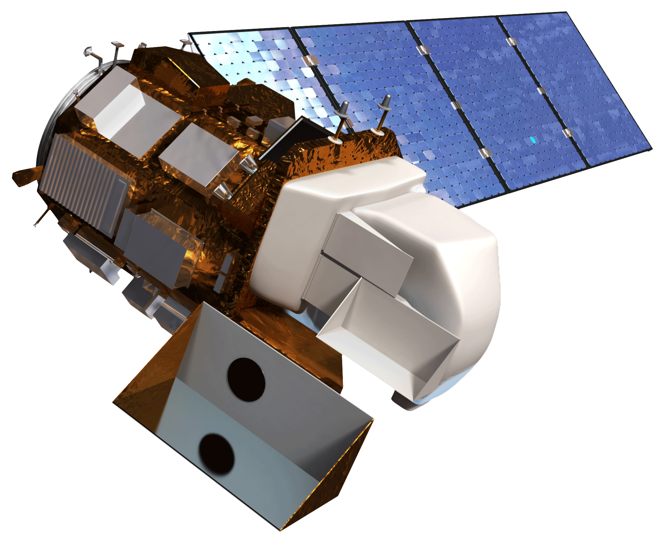
Utilizing NASA Earth Observations and Ground Measurements to Reduce Extreme Heat Experienced by Transit Riders in Phoenix, Arizona
Abstract
Methodology
Phoenix, Arizona, a city with 1.5 million residents, experiences extreme heat every year from May through October, with summer daily maximum temperatures regularly rising over 100°F, and a record high temperature of 122°F. Residents are prone to thermal discomfort during these summer months, especially those who rely on public transportation, making environmental heat a significant public health concern. The City of Phoenix Public Transit Department is heavily invested in addressing this concern through infrastructure development aimed at reducing riders’ heat exposure at bus stops. The Department’s previous method of determining priority for improvements such as shade structures, was based solely upon ridership. The NASA DEVELOP team provided the Transit Department with an analysis of the thermal environment at city bus stops, data which may be used when prioritizing the installation of new shade structures at unshaded stops. Land Surface Temperatures (LST) from Landsat 8 Operational Land Imager (OLI) and in situ LST and air temperature measurements were collected to provide a better understanding of the thermal environment at transit stops. LiDAR data was used to extract building heights in order to examine secondary shade potential within the thermal environment. We also created an assessment on the vulnerability of riders based on a selection of demographic and socioeconomic characteristics of the surrounding area. These results will contribute to the Phoenix Transit Department’s efforts to reduce the risk of heat-related illness for transit riders across the city and promote the viability of public transportation to achieve long-term health and sustainability goals.
DATA
PROCESSING
ANALYSIS
Landsat 8 satellite imagery
Ground in situ Measurement Data
Landsat 8 Based LST
Ground Measurement Based LST
Ground Measurement Based Air Temperature
LST Validation
LiDAR
NAIP Aerial Imagery
LiDAR Building and Walkway Layers
NAIP Vegetation Prevalence Layer
Secondary Shade Analysis
CENSUS ACS
Census Social Vulnerability Layers
Heat Vulnerability Analysis
Results
Objectives
Provide partners with heat-related information
Validate satellite LST by conducting site visits to sampled bus stops
Assess vulnerability of residents using Census data
Estimate secondary shade at and around bus stops
Study Area
Phoenix Health & Air Quality II
Phoenix, AZ
DH
DC
NH
NC
Earth Observations
LiDAR
Landsat 8 OLI
Conclusions
Project Partners
Landsat 8 Land Surface Temperature closely matches in situ LST of transit stops.
Normal Difference Vegetation Index (NDVI) shows more vegetation equates to a lower LST.
LiDAR preliminary results show secondary shading also lowers LST values, this topic should be explored more in future work.
City of Phoenix, Public Transit Department
Arizona State University, Urban Climate Research Center
Arizona State University, Center for Policy Informatics
Team Members
Acknowledgements
David Hondula, Joe Bowar, Herb Munoz, Jorie Bresnahan, Ariana Middel, David Sailor, Matthew Toro, Tamara Dunbarr, McKenzie Murphree, Mary Wright, Hana Putnam
Lance Watkins
Project Lead
Elizabeth Dyer
Yalin Qu
Dean Blumenfeld
Mario Chavez
Arizona – Tempe
Fall 2017

