Slide 1
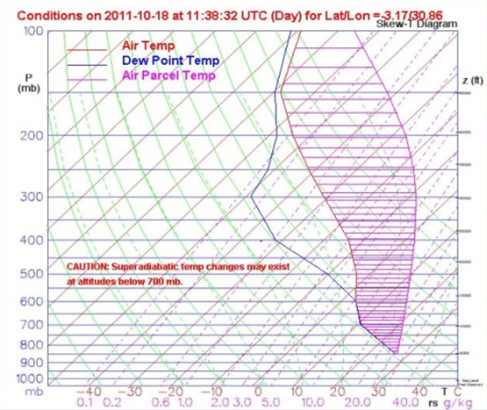
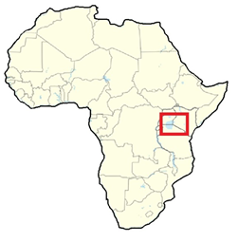
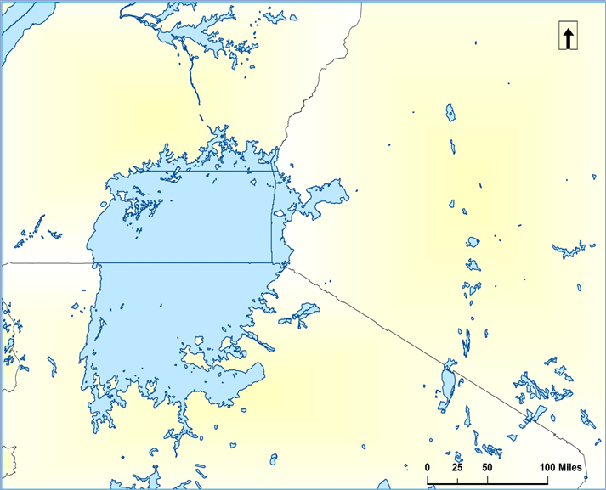
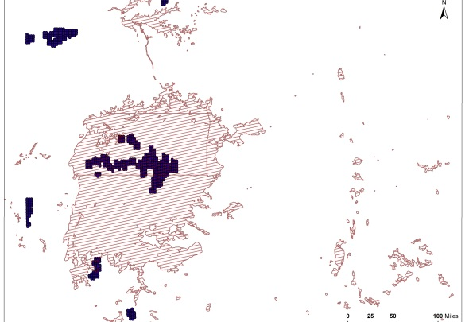
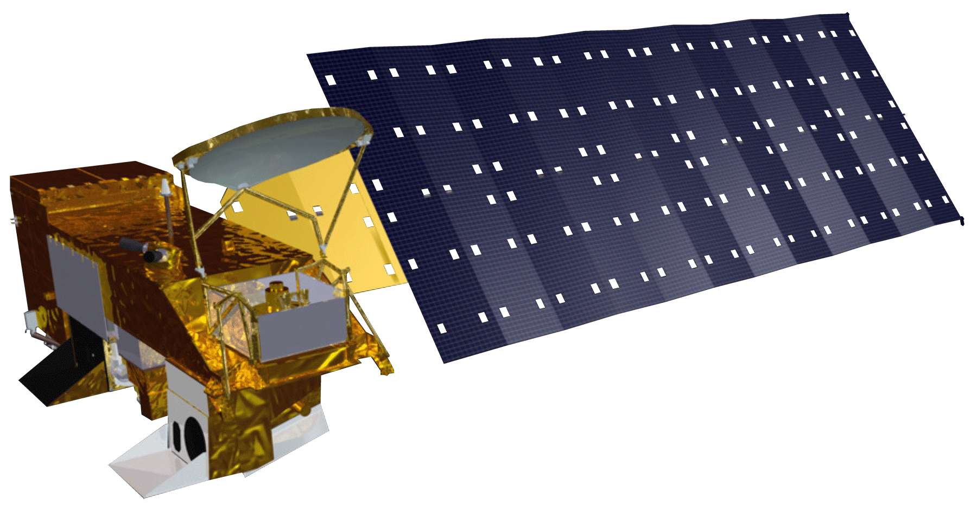
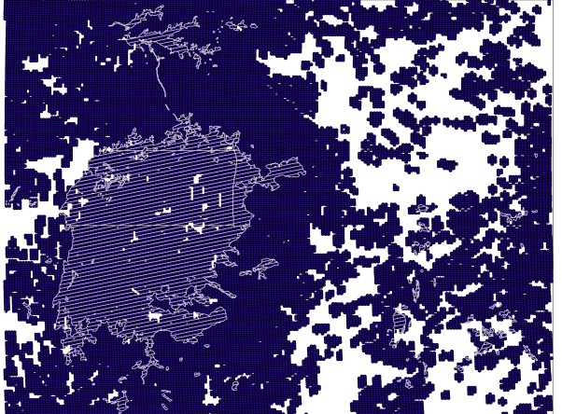
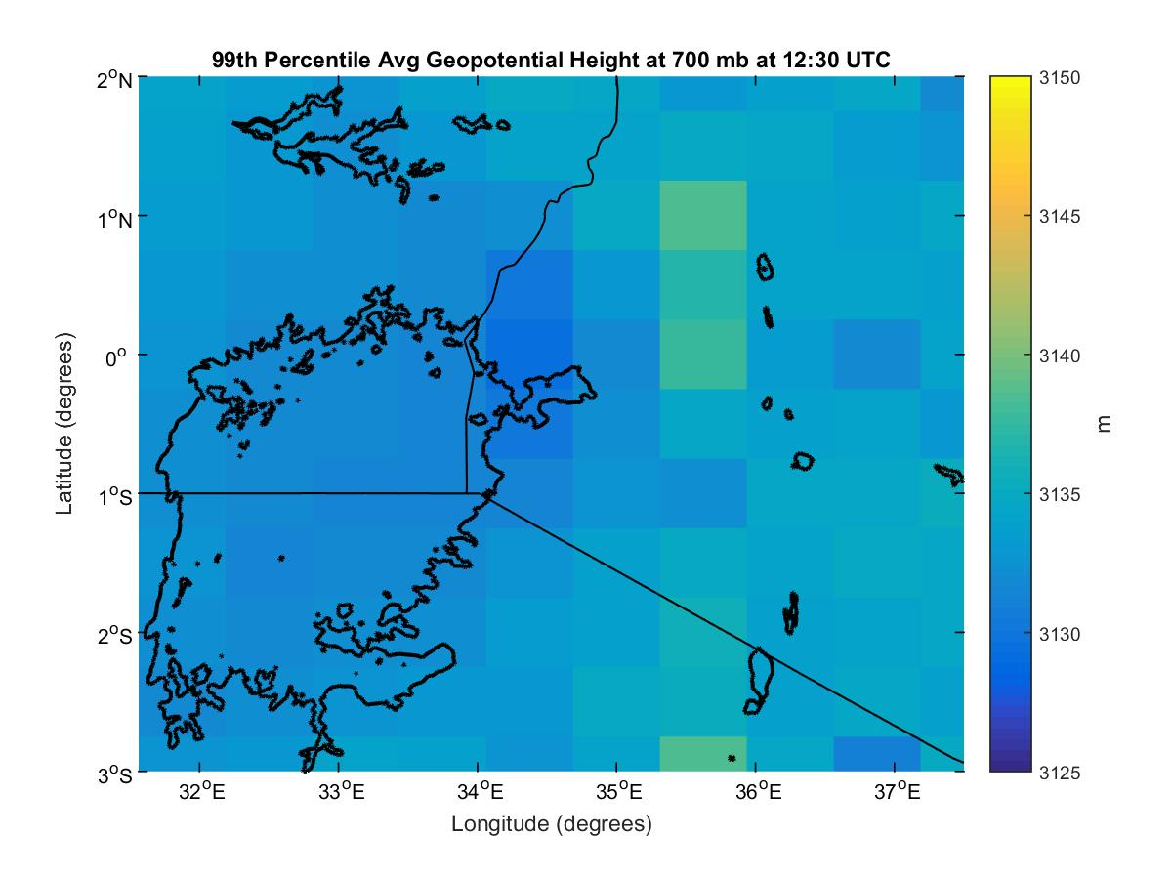
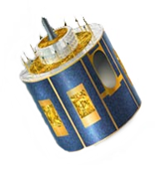
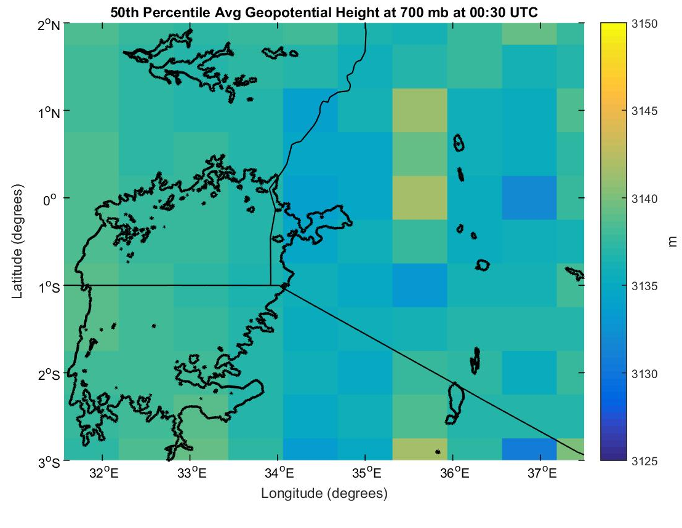
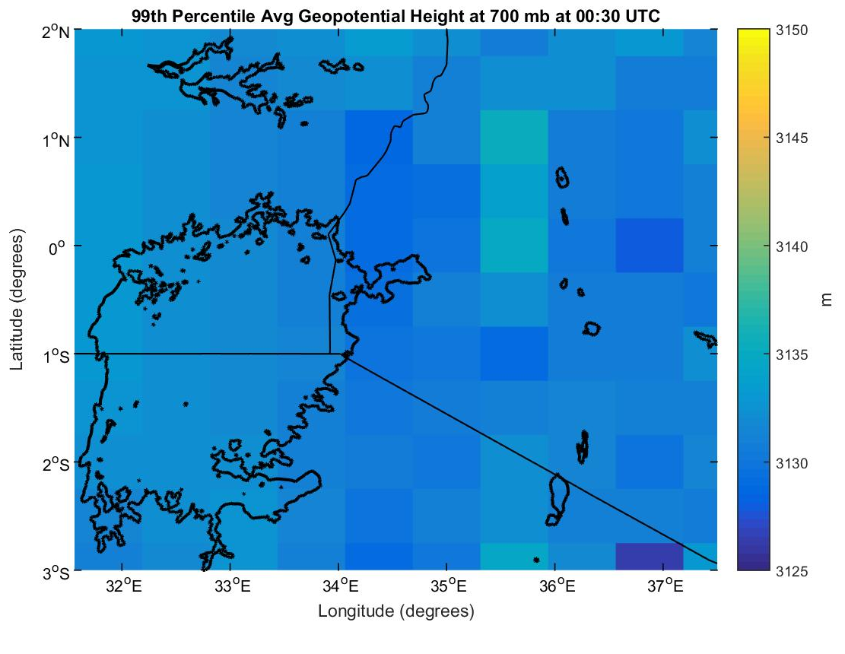
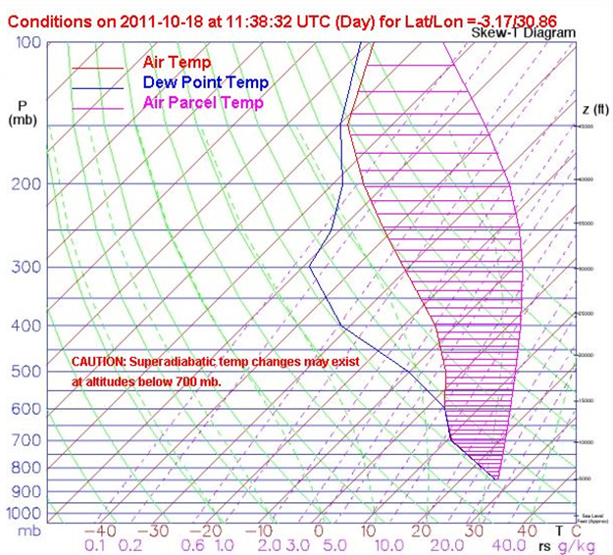
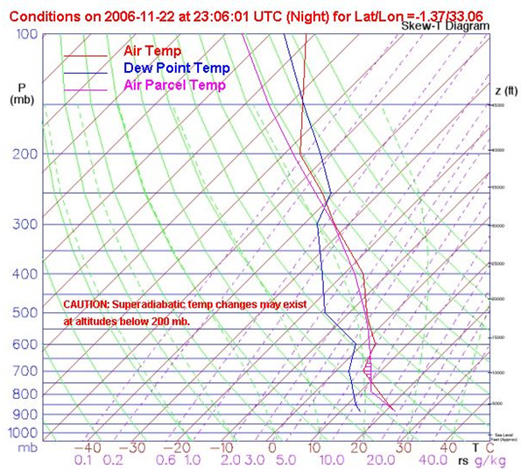
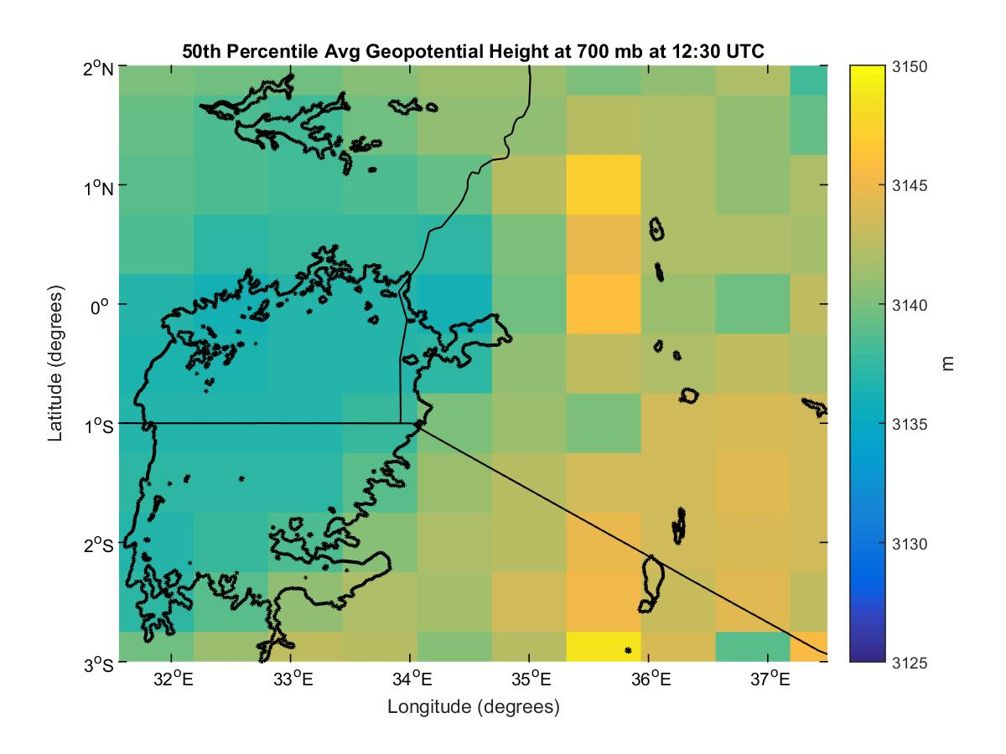
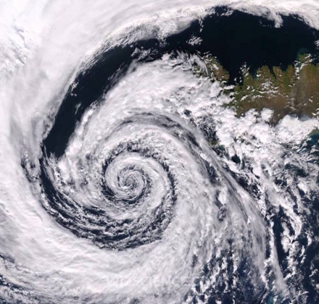
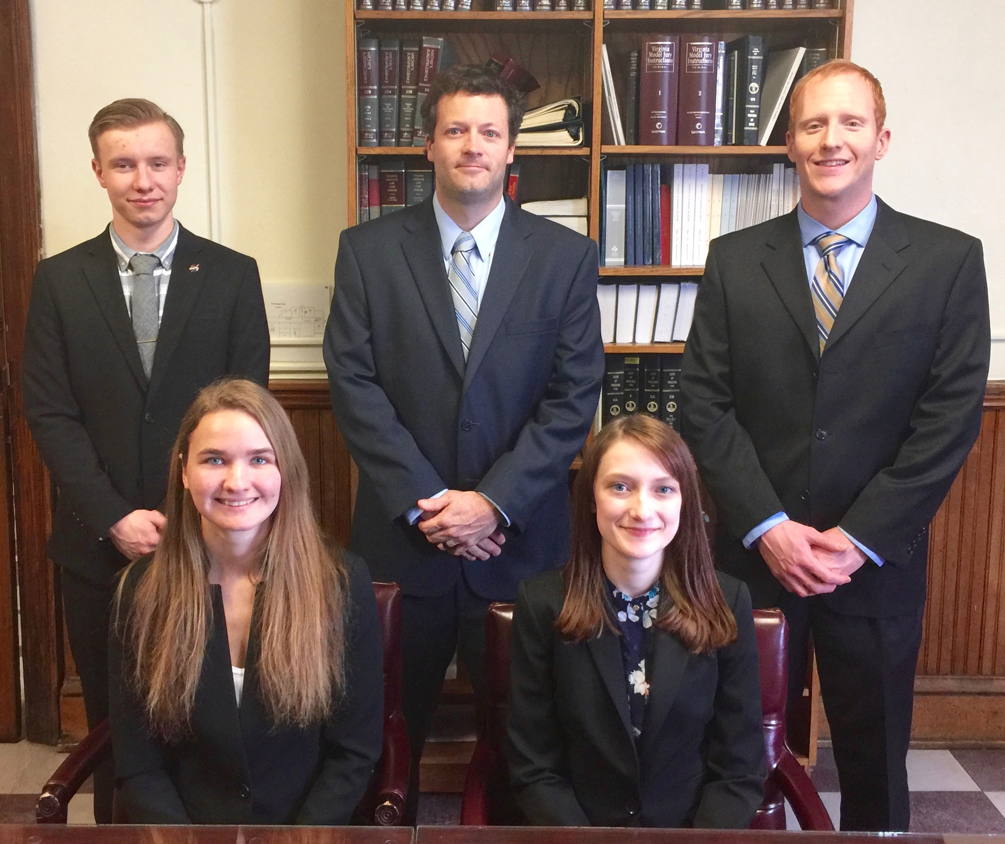
African Great Lakes Weather II
Utilizing NASA Earth Observations to Identify Indicators to Help Predict Deadly Storms over the African Great Lakes
Annabel White (Project Lead)¹, Jakub Blach¹, Michael Brooke¹, Megan Buzanowicz², Kathy Dooley¹, Rajkishan Rajappan¹, Ryan Umberger¹ NASA DEVELOP National Program at ¹Wise County Clerk of Court’s Office, ²NASA Langley Research Center
Abstract
Objectives
The African Great Lakes lie along the East African Rift Valley and play an important role in the economy and culture of the millions of people in the region. Intense storms can develop around the lakes with little warning and create life-threatening hazards to fishermen. This project aims to find correlations between weather indicators and the onset of storms. The results will help the Kenya Meteorological Department to improve the forecasting accuracy of local and regional authorities. For the years 2005 to 2013, the NASA DEVELOP team compared potential storm indicators on days of heightened and average overshooting top (OT) detections. OTs are dome-like protrusions that form above the anvil of storms. Persistent OT detections are associated with storm events and therefore served as an indicator for hazardous storms over the study area. The Hazardous Storm Event Database (HSED), derived from the Spinning Enhanced Visible and Infrared Imager (SEVIRI) sensors present on Meteosat 8 & 9 satellites, contained the OT detection information used in this project. Aqua Atmospheric Infrared Sounder (AIRS) sensors, along with various Modern-Era Retrospective Analysis for Research and Applications (MERRA) products, provided meteorological data for statistical and spatial comparisons.
Identify and analyze weather variables surrounding intense storm events over Lake Victoria, Africa as identified by overshooting top activity.
Create weather variable contour maps for days of average and hazardous weather to highlight significant differences that occur during storm events.
Improve understanding of weather patterns over Lake Victoria to aid the project partner in local storm forecasting efforts.
Methodology
Study Area
HSED
Compile OTs and organize by percentiles
50th Percentile
(days with average number of OTs)
AIRS
Skew-T log-Ps
Uganda
Uganda
Kenya
Lake Victoria
Kenya
MERRA
Variables
Wind
Pressure
Temperature
Humidity
Vertical pressure velocity
Lake
Victoria
99th Percentile
(days with most OTs)
Weather Maps
Tanzania
Image credit: https://commons.
wikimedia.org/wiki/File%3AISD_highres_STS030_STS030-89-59.jpg
Tanzania
Earth Observations
Aqua - AIRS
Meteosat 8, 9 SEVIRI
Results
MERRA Weather Variables
Aqua AIRS Skew-T log-P Plots
Average Weather Days
Hazardous Weather Days
Storm Over Land
Storm Over Lake
50th Percentile Avg Geopotential Height at 700 mb and 00:00 UTC
99th Percentile Avg Geopotential Height at 700 mb and 00:00 UTC
Conclusions
Lifted Index: -13.3
CAPE: 10081
Lifted Index: 0.3
CAPE: 37
Decreased geopotential height, increased humidity, and increased vertical pressure velocity at the 700 mb pressure level were identified as potential storm indicators from MERRA data.
Additional variables either showed no significant differences or could not provide enough resolution to make a reliable conclusion.
Atypical drivers may produce storms over the lake, as illustrated by the low Lifted Index (LI) and CAPE values shown from the Skew-T analysis.
Forecasting accuracy is limited by MERRA data resolution.
50th Percentile Avg Geopotential Height at 700 mb and 12:00 UTC
99th Percentile Avg Geopotential Height at 700 mb and 12:00 UTC
Weather Maps: 30 day average value maps at 00 and 12 UTC for the average and hazardous study dates illustrate which atmospheric conditions are favorable for storm development.
Skew-T Plots: Typical plots produced from hazardous weather days. Storms which occur over land display high Convective Available Potential Energy (CAPE) values, typical of storm events, while storms over the lake lack a high CAPE value.
Team Members
Project Partners
Acknowledgements
Left to Right: Megan Buzanowicz, Jakub Blach, Kathy Dooley, Michael Brooke, Annabel White (Project Lead), Ryan Umberger, Rajkishan Rajappan
Kenya Meteorological Department
Dr. Kenton Ross – NASA DEVELOP National Program
Kristopher Bedka – Climate Science Branch at NASA Langley’s Science Directorate
Steve Licata – NASA Jet Propulsion Laboratory, Atmospheric Infrared Sounder Project
Dr. DeWayne Cecil – Global Science and Technology, Inc.
Robert VanGundy – University of Virginia’s College at Wise
April Huff – NASA DEVELOP/Wise County Clerk of Court’s Office
Fall 2015 NASA DEVELOP African Great Lakes Weather I Team
Image credit: https://www.youtube.com/watch?v=I-dEEwWVhPU
Wise County and City of Norton Clerk of Court’s Office

