Slide 1
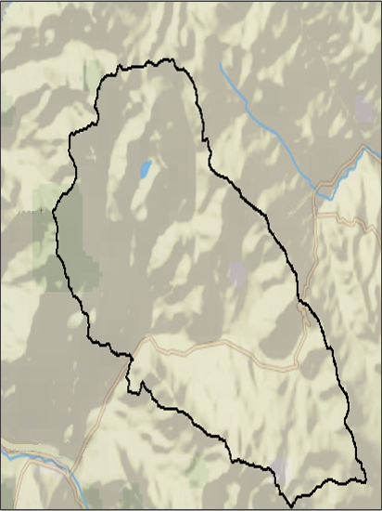
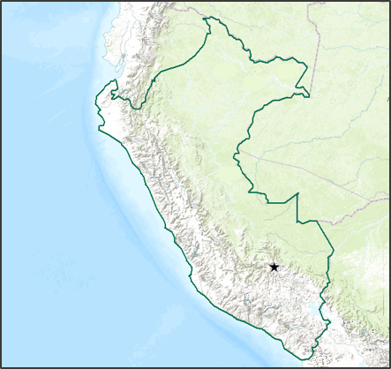
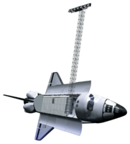
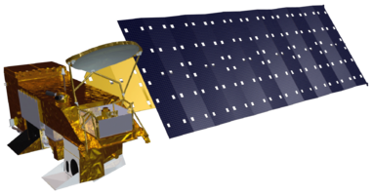
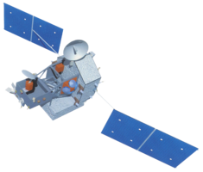
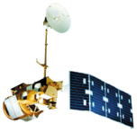
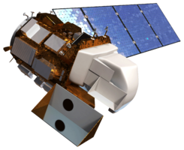
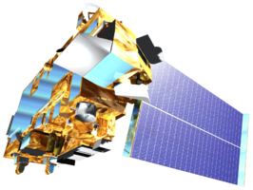
Peru Climate
Monitoring and forecasting shifting climate and land use change impacts in Peru’s Parque de la Papa for enhanced agricultural management
Rebekke Muench (Project Lead), Kayla McDonald, Ryan Murphy, Michael Sclater, Richard Rose, Dajon Begin
NASA DEVELOP National Program at NASA Langley Research Center
Abstract
Objectives
Keep this blank for now.
Body text point size should be at least 24.
Caption text point size should be at least 16.
Feel free to rename, move, and resize sections as needed.
Create Growing Degree Days, chill hours, elevation, slope, and weevil, suitability maps
Use Landsat imagery to determine how potato crop locations have changed over the past 30 years
Develop a methodology that can be applied throughout Peru to determine potato suitability
Study Area
Peru
Methodology
N
Legend
Parque de la Papa
Peru
1
Data Acquisition
Aqua and Terra MODIS, Landsat, TRMM, SRTM
Figure 1: Map depicting the location of the Parque de la Papa
2
Data Analysis
Earth Observations
Prepare temperature (MODIS) and precipitation (TRMM) data
Tools: Python and DEVELOP dnppy package
Process slope data (SRTM) and land cover (Landsat)
Tools: ArcMap slope tool and Google Earth
3
Final Factors
SRTM
Aqua
TRMM
Growing Degree Days and Chill Hours (MODIS)
Average and accumulated precipitation (TRMM)
Slope (SRTM)
Current and Historic Land Cover (Landsat)
Landsat 5
Landsat 8
Terra
Results
Conclusions
Use images.
Make sure that it has some sort of flow, that it makes sense. Show your results in a logical order.
No bullets.
Use bullets.
Use complete sentences with periods.
Team Members
Project Partners
Acknowledgements
Use a professional-looking photo.
Individual headshots are ok, if they aren’t pixelated and are all the same size.
Include a caption that states the team members’ names.
International Potato Center (CIP)
Dr. Noelle Barker
Dr. David Ellis
Asociacion para la Naturalexa y el Desarollo Sostenible (ANDES)
Emily Adams, Center Lead at Langley NASA DEVELOP
If you are including affiliations, use DEVELOP as the affiliation for a DEVELOPer or former DEVELOPer—not their school or former school.
NASA Langley Research Center

