Slide 1
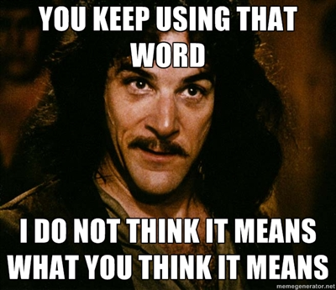
How to: Literature Review
KEYS TO OVERALL PROJECT SUCCESS

Slide 2
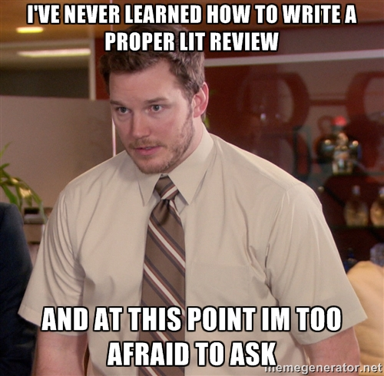
Why Lit Review?
Find out what information already exists regarding your project
Provides a context for your own research
Allows you to write a well thought out introduction
Identify major seminal works, methodologies and/or research techniques
Find other people working in the field
Future project partners?
Show relationships between previous studies and identify gaps
Allows you to write a well thought out discussion/ conclusions
Inspires future DEVELOP project ideas

Slide 3
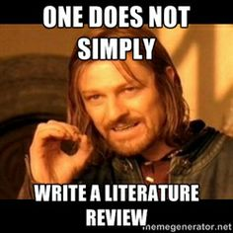
DO
DO NOT
Summarize professional literature relevant to your project
Articles published in a peer-reviewed scientific journal
Reports published by government agencies, NGOs, etc
Theses or Dissertations
Skim random internet sources
Wikipedia
The information presented on government, NGOs, etc websites are directed towards public awareness.
You will need to have a much more thorough knowledge base for your project

Slide 4
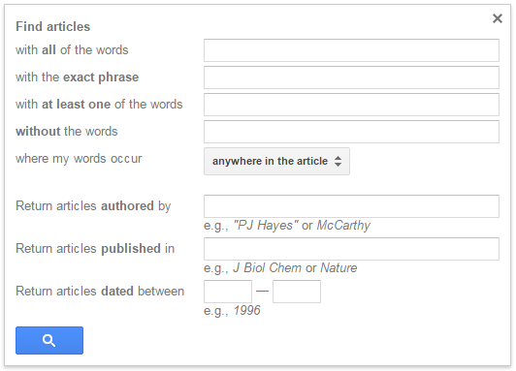
Finding good sources
Try different searches with different combinations of key words
There are good results beyond the 1st page

Slide 5
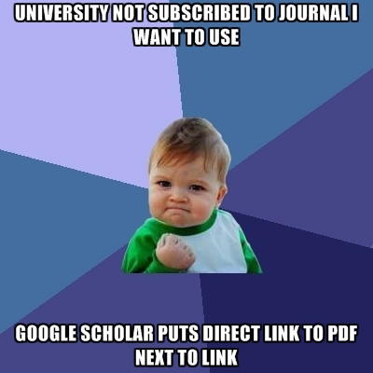
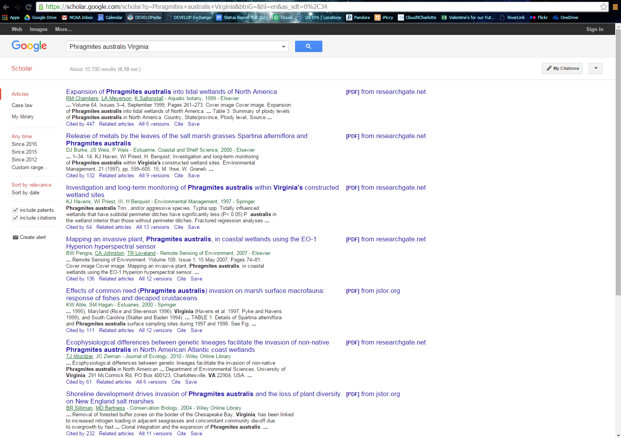
Example: Phragmites australis invasion in coastal Virginia
☹ This looks like a great article! What to do?
Save PDF in a folder for reference later
Notes:
What to do – look to see a team member’s university offers access to the materials
Possibly investigate requesting the article if you have to – chances are similar material will get the job done

Slide 6
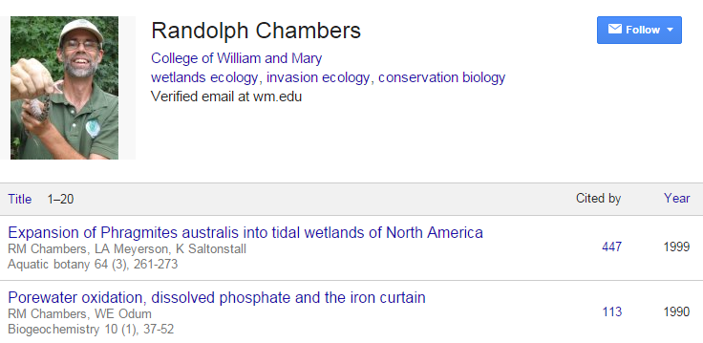
Other Google Scholar Tips
Science is time sensitive!
Notes:
Clicking on the author gives a list of their other work – not all authors are clickable
Going directly to the journal will give you a variety of sources, likely not all related to your topic
Cited by give an idea of the impact the journal has had and can also lead to additional sources

Slide 7
Other Lit Review Tips
“Phragmites australis is an invasive species of special concern in the wetlands of the North American Great Lakes (Marks et al., 1994; Galatowitsch et al., 1999).”
Notes:
Checking the references lists of the papers you have already found can lead to additional sources

Slide 8
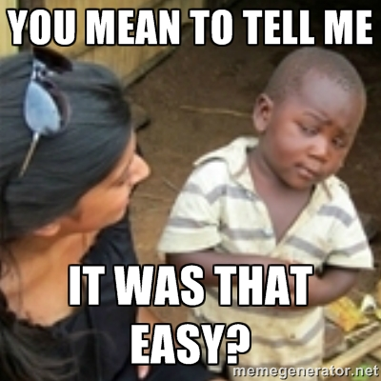
After you find a good article
Read, highlight, summarize and take notes of your own thoughts
You are not turning this in, it is just for your own knowledge and SUCCESS
The more sources the better!
Stay organized
Ex. AuthorLastName_YEAR_NameOfArticle
What NOT to do
Better!

Slide 9
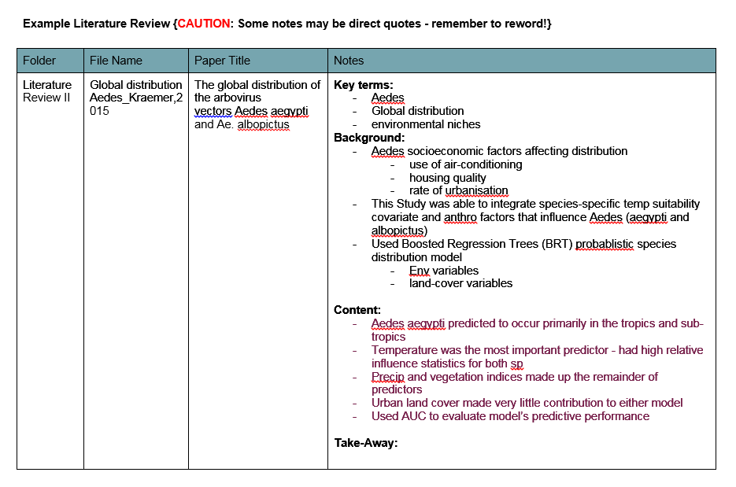
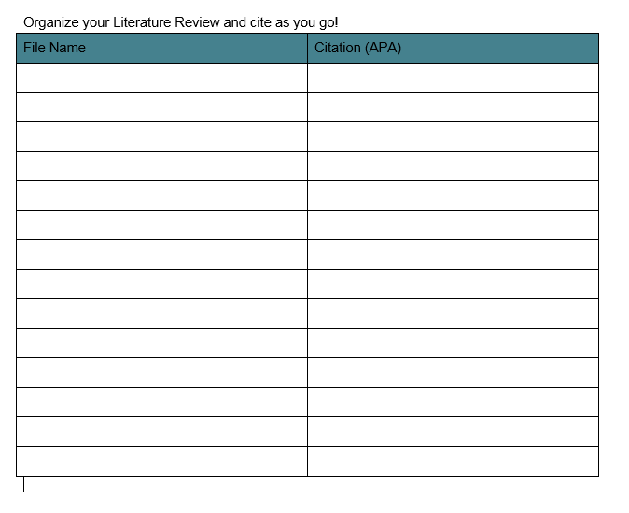
Templates on DEVELOPedia
Type ‘literature review’ in the search bar of DEVELOPedia to find these templates
Lit review template
Citations template

