Slide 1
SOUTHERN BHUTAN
Ecological Forecasting III
Utilizing NASA Earth Observations to Model Land Cover Change and Elephant Wildlife Corridors in Southern Bhutan
Thinley Yidzin Wangden, Kezang Choki Tshering, Kelzang Jigme, & Thinley Jurmi
Maryland – Goddard
Notes:
Hello everyone, we are the Southern Bhutan Ecological Forecasting III team at the NASA Goddard Space Flight Center.
*Members introduce themselves
Our topic was utilizing NASA Earth observations to model land cover change and elephant wildlife corridors in southern Bhutan

Slide 2
Background Information
Asian elephants (Elephas maximus) are an endangered species
Urbanization has complicated elephant conservation in Bhutan leading to increased human-elephant conflict (HEC)
Research on land change dynamics may help reduce such conflict
Image Credit: James M
Notes:
To start off with some background information on this issue, the Asian elephant has been listed as Endangered on the International Union for Conservation of Nature (IUCN) Red List since 1986. Although Bhutan is dedicated to conserving the elephants, expanding human settlements and rapid urbanization presents major challenges in the conservation of Asian elephants.
Urban expansion has led to irreversible changes in the landscape, encroaching on forested areas and wildlife habitats, resulting in land use conflict and increased negative human-elephant interactions.
Research on land use land cover (LULC) dynamics and future change potential using remote sensing analysis can be instrumental in ensuring proper urban planning strategies with the consideration of wildlife habitat to alleviate the conflict.
------------------------------Image Information Below ------------------------------
Image Credit: Asian Elephants by James M [CC BY-ND 2.0 (https://creativecommons.org/licenses/by-nd/2.0/)]
Image Source: Creative Commons https://www.flickr.com/photos/41453183@N05/29794874122/

Slide 3
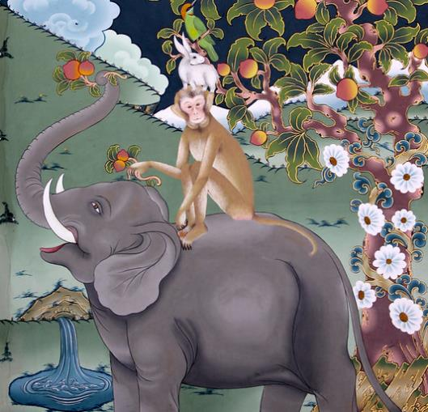
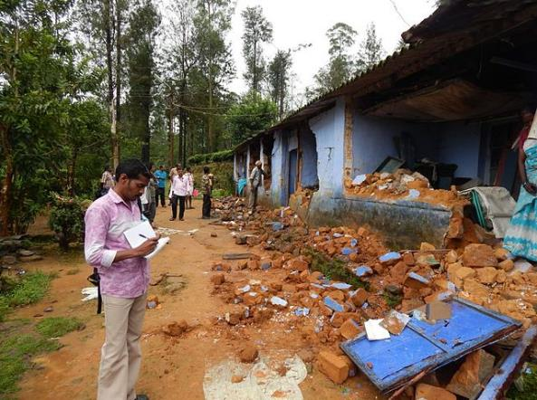
Community Concerns
Asian elephants are integral to the functioning of Bhutan’s diverse ecosystems
Elephants are culturally significant in Bhutan
Escalating HEC in southern Bhutan
Lack of research on land use and elephant habitats hinders the ability of policymakers to address HECs
Image Credit: Kandukuru Nagarjun
Image Credit: Ganesh Raghunathan
Notes:
Asian elephants are a keystone wildlife species in Bhutan. The loss of the Asian elephant species in Bhutan would not only be detrimental to the functioning of Bhutan's ecosystem, but also a loss of a culturally significant symbol.
Increased urbanization and habitat loss have led to more human-elephant conflicts in southern Bhutan. The movement patterns of elephants in recent years have been found to be associated with the scarcity of forage and habitat loss, leading to agricultural crop-raiding and damages to property in the southern region of Bhutan. Moreover, the loss of lives have occurred on both sides. It has become a matter of the farmers' lives and livelihood versus the survival of elephants in the region.
Finally, the lack of information on land change dynamics and how it affects elephant habitats limits the ability of policymakers to respond to the conflict accordingly.
------------------------------Image Information Below ------------------------------
•Image Credit: Elephant, monkey, squirrel, bird by Kandukuru Nagarjun [CC BY 2.0 (https://creativecommons.org/licenses/by/2.0/)]
Image cropped from the original
Image Source: Creative commons https://www.flickr.com/photos/nagarjun/15180516273/in/photolist-eUgh1-9SxHeP-p5kvxe-7f6ML8-2bQvKL1-4s2Voy-2htw12Y-dqzHvR-25X4anX-iA8YUx-9nEy1a-byQAPp-byQBye-a2G7Bn-9nEwYn-2hso6qZ-9h8W5f-NpXSNi-25X47V2-q5k6nm-p8s7Bc-9i75bP-5QkSjc-q52cV6-9i72dB-HPdVXy-25TjM41-a2K22U-bzCS2f-9nEya4-iA9Fzb-9nHxh1-9nEv28-9nHzhj-9nEvVn-9nEwrz-5Qq8A7-5uLd2n-e4MAYi-9i74s8-9h5N64-2axmscc-aAF73R-9i73He-9iaagm-9h8Vu9-9i73fH-9ia7mN-5mAm77-dBwoVM
•Image Credit: Elephant damages to a residential colony in the Valparai region by Ganesh Raghunathan [CC BY-SA 4.0 (https://creativecommons.org/licenses/by-sa/4.0/)]
Image Source: Wikipedia commons https://commons.wikimedia.org/wiki/File:Tracking_elephant_damages_to_a_residential_colony_by_NCF_team_in_the_Valparai_region.jpg

Slide 4
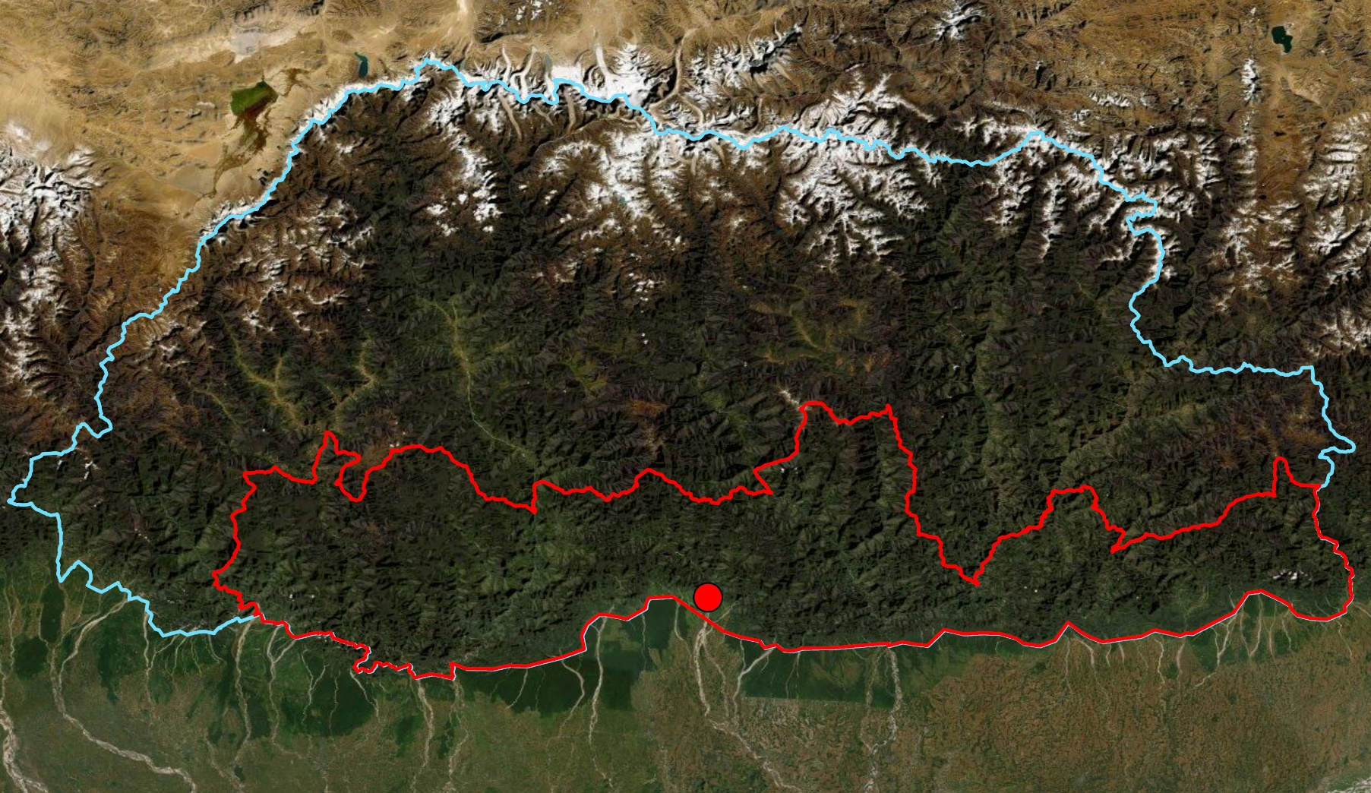
Study Area & Period
N
Study Area:
Southern Bhutan
Gelephu
Study Period:
2010 - 2019
Forecasted to 2030
Bhutan
Gelephu
India
Study area
0 25 50 75 100 kilometers
Bhutan boundary
Notes:
Our study area was the southern foothills of Bhutan where elephants are found. The region is highlighted on the map by the red outline. Our partners had a particular interest in Gelephu in Sarpang district. The town of Gelephu is expanding considerably as a major commercial center in Bhutan. Part of the town lies on previous elephant feeding grounds, so it is a hotspot for human-elephant conflicts.
As for our study period, we studied historical land-use patterns from 2010 to 2019 in the region and forecasted it to 2030.
------------------------------Image Information Below ------------------------------
Southern Bhutan Eco III team
Basemap sources: Esri, DigitalGlobe, GeoEye, i-cubed, USDA FSA, USGS, AEX, Getmapping, Aerogrid, IGN, IGP, swisstopo, and the GIS User Community

Slide 5
Objectives
Refine
2010, 2015, and 2019 LULC maps to include human settlement
Produce
Land change maps from 2010 - 2019
Generate
A future LULC map forecasted to 2030
Update
Potential biological corridor map for Asian elephants
Notes:
The objectives of this term were to :
Refine LULC maps for 2010, 2015, and 2019 to include locations of human settlements throughout the southern region of Bhutan
Produce land change maps displaying land change between 2010 to 2015, and 2015 to 2019
Generate future LULC map forecasted to 2030
Update the potential biological corridor map for Asian elephants to incorporate information on built-up urban areas and rural human settlements

Slide 6
Project Partners
The Bhutan Tiger Center
End User
The Bhutan Foundation
Collaborators
The Bhutan Ecological Society
Notes:
We worked with three partners for this project. Our end user was the Bhutan Tiger Center. The Tiger Center is responsible for managing the collection of elephant data and informing the public regarding this subject in Bhutan.
We had two collaborators: the Bhutan Foundation and the Bhutan Ecological Society.
These organizations are non-profit organizations that are involved in various environment conservation and climate change projects.
------------------------------Image Information Below ------------------------------
Clipart provided by Microsoft Office 365/PowerPoint

Slide 7
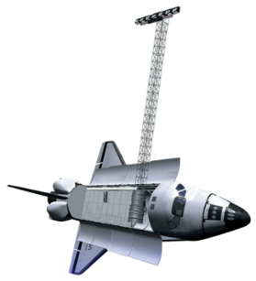
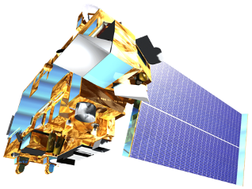
Satellites & Sensors Used
Landsat 5
Thematic Mapper (TM)
Landsat 8
Operational Land Imager
(OLI)
Shuttle Radar Topography Mission (SRTM)
Terra
Moderate Resolution Imaging Spectroradiometer (MODIS)
Image Credit: NASA
Notes:
These are the satellites and sensors that were used over the three terms of this project.
For this term, we utilized NASA Earth Observations from Landsat 5 TM and Landsat 8 OLI were used to obtain the annual image composites for the LULC maps
SRTM and MODIS were used in the previous term to obtain data for the habitat suitability model. This was used for the forecasting of LULC in this project
------------------------------Image Information Below ------------------------------
Image Credit: NASA
Image Source: DEVELOPedia http://www.devpedia.developexchange.com/dp/index.php?title=List_of_Satellite_Pictures

Slide 8
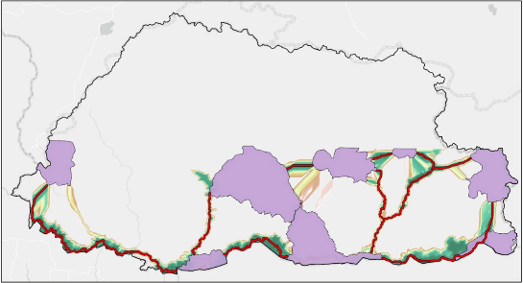
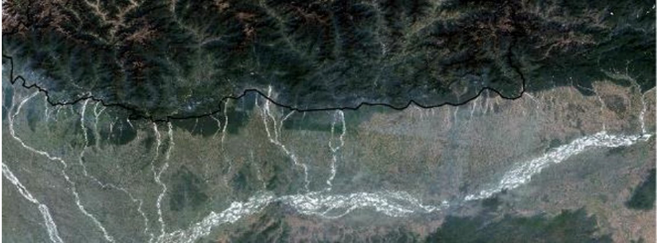
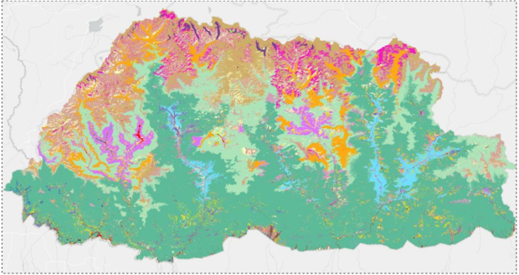
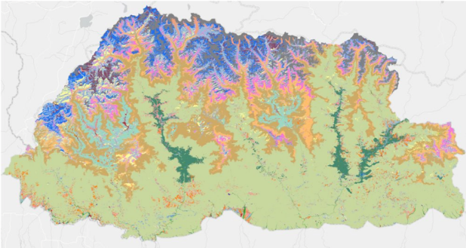
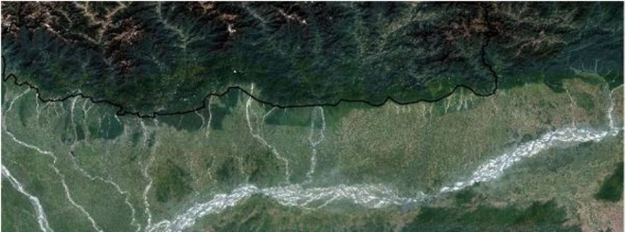
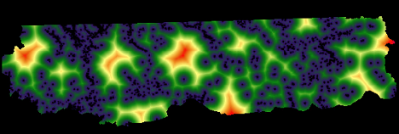
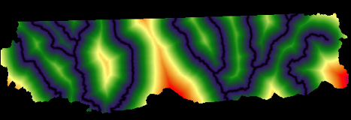
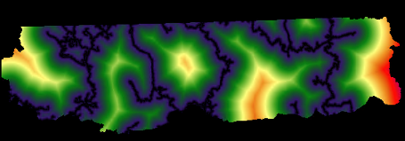
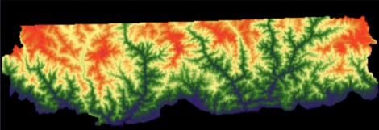
Methodology| Data Acquisition
NASA EOs:
Landsat 5 TM using GEE
2010 LULC
Landsat 8 OLI using GEE
2015 & 2019 LULC
From Partners:
LULC of Bhutan
2010
2016
From the previous terms:
Potential elephant corridor Map
Driver variables (elevation, distance to- road, river & urban) from DIVA-GIS & SEDAC
Notes:
We obtained Landsat images from Landsat 5 TM and Landsat 8 OLI using Google Earth Engine codes scripted in the first term of this project.
Our partners, the Bhutan Foundation and the Bhutan Ecological Society provided us with 2010 and 2016 LULC maps of Bhutan that included urban areas as a land cover category.
Finally, we used results from the previous terms as inputs for this project. The potential corridor map came from the last term of this project. The variables used in the elephant habitat suitability model by the first term were used as driver variables in our land change modeling. GIS data layers for these variables such as roads, rivers etc. were obtained from DIVA-GIS and the Socioeconomic Data and Application Center (SEDAC).
------------------------------Image Information Below ------------------------------
Clipart provided by Microsoft Office 356/powerpoint

Slide 9
Methodology| LULC Refinement
2016 built-up areas
LULC 2016
From partners
LULC 2010
Buffer by 10 pixels
Extract Built-up areas
Mask out
2010 built-up areas
2016 built-up areas
2019 Landsat 8 image
Merge raster
Unsupervised classification
From project
Extract urban areas
LULC 2010
LULC 2015
Merge raster
LULC 2019
Refined LULC 2010
Refined LULC 2015
Refined LULC 2019
Notes:
The LULCs provided by the partners were used to extract built-up areas in ArcGIS Pro and create a raster of built-up areas. Then the built-up areas raster for 2010 and 2016 were merged with the 2010 and 2015 LULCs respectively, from the previous terms. This created a new class for built-up areas in the LULCs.
The 2016 built-up areas raster was then converted to a shapefile and buffered by 10 pixels to be used for refining the 2019 LULC. The buffered 2016 built-up areas shapefile was used to mask out the Landsat images of 2019. Then, we performed unsupervised classification for urban and non-urban areas. Then, we extracted urban areas raster from classified raster and merged it with the 2019 LULC to create a refined LULC for 2019.

Slide 10
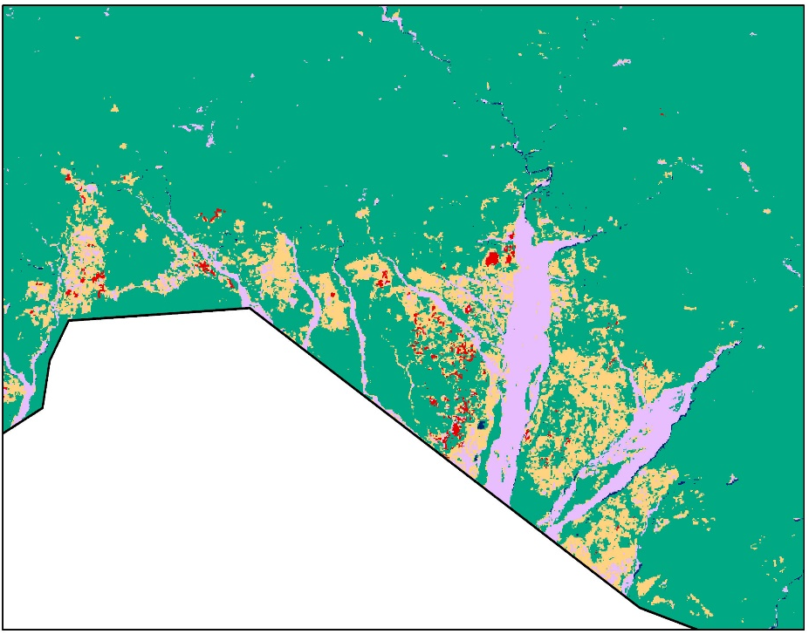
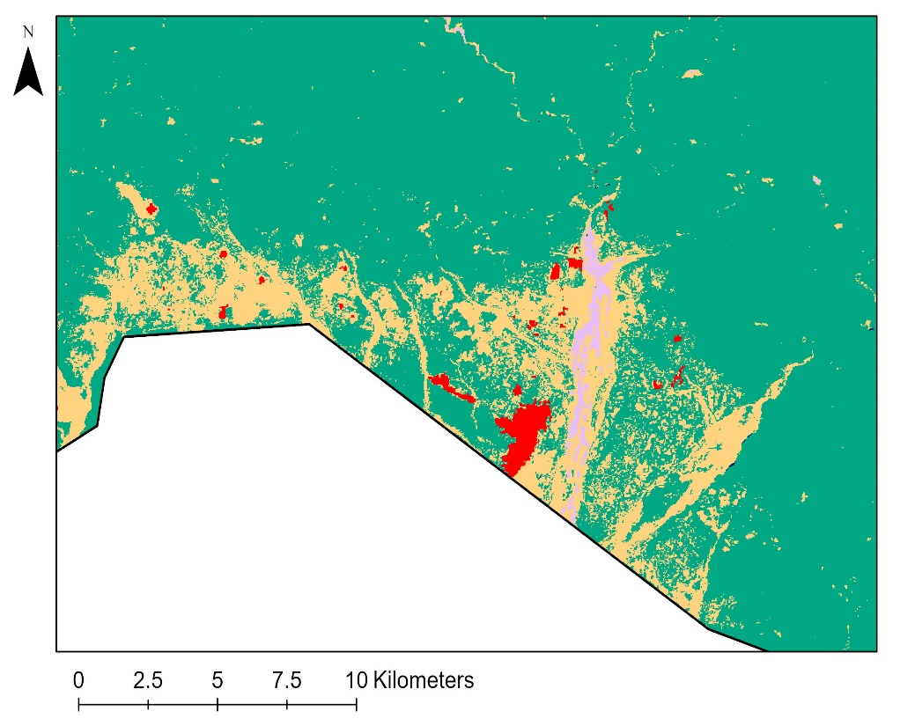
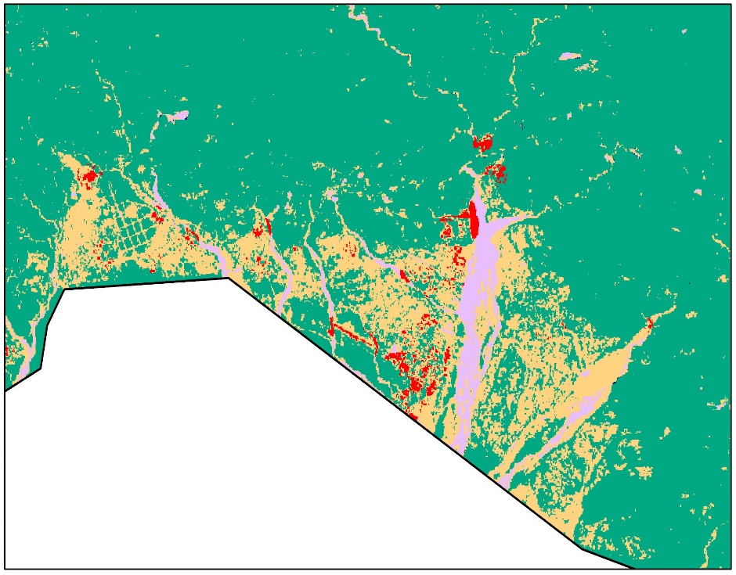
Refined LULC Maps
2010
2015
2019
0 2.5 5 7.5 10 kilometers
0 2.5 5 7.5 10 kilometers
0 2.5 5 7.5 10 kilometers
N
Forest
Cultivated
Water
Barren
Built-up areas
Notes:
These are the refined maps zoomed into the Gelephu area showing the five classes of forest, cultivated, water, barren and built-up areas. Due to discrepancies in classification of mature vs immature forests affecting the land change modeling, the team combined the two classes into a single forest category. Due to an under-classification of mature forests and an over-classification of cultivated areas near the southern border in the 2010 LULC, the team masked out cultivated areas and mature forests identified and reclassified those areas.
Since the team performed an unsupervised classification to identify built-up areas for 2019, this could have led to identifying green space near the built-up areas as cultivated, resulting in the fragmentation of built-up areas in 2019 compared to 2015.

Slide 11
Methodology| Land Change Forecasting
Inputs for TerrSet Land Change Modeler
Elevation
Distance to river
LULC 2010
LULC 2015
LULC 2019
Driver Variables
Distance to roads
Distance to urban
Change Analysis Panel
Transition Potential Panel
Land Change maps
Change Prediction Panel
Transition model
Multi-layer Perceptron
Neural Network
2010-2019
2010-2015
Forecasted LULC
2030
2015-2019
Notes:
For Land Change forecasting, the team used Land Change Modeler in the TerrSet Geospatial Monitoring and Modeling Software to conduct a change analysis on the land cover of southern Bhutan from 2010 to 2019. The inputs were the 2010 LULC, the 2015 LULC, the 2019 LULC, and the driver variables rasters. They were imported into TerrSet as IDRISI files.
The 3 LULCs were input into the Change Analysis panel to create 3 change maps for 2010-2015, 2015-2019, and 2010-2019. This generated a quantitative analysis of gains versus loss for each land cover category in the observed time period. The 2010-2019 change map along with rasters of driver variables were then, used in the transition potential panel to create a transition model using a Multi-Layer Perceptron (MLP) neural network. The driver variables considered in this study were elevation, distance to rivers, distance to roads, and distance to urban areas. Then the transition model was used in the Change Prediction panel to generate a projected map for 2030 using the Markov-Chain process.

Slide 12
Results| 2010 - 2015 Land Change Map
0 25 50 75 100 kilometers
N
Cultivated to Forest
Barren to Forest
Barren to Cultivated
Other transitions <20 km²
Water to Forest
Forest to Cultivated
Cultivated to Barren
Notes:
This land change map shows the six most prominent changes between the land classes of 2010 and 2015. The other transitions were all less than 20 square kilometers shown by a single color on the map. Although changes to Built-up area was one of our focus, it amounted to less than 20 square kilometers, indicating a slow urbanization in the area from 2010 to 2015.
------------------------------Image Information Below ------------------------------
Southern Bhutan Eco III team
Basemap sources: Esri, DeLorme, HERE, MapmyIndia

Slide 13
Results| 2015 - 2019 Land Change Map
[Place holder]
0 25 50 75 100 kilometers
N
Cultivated to Forest
Forest to Built-up
Forest to Barren
Other transitions <20 km2
Cultivated to Built-up
Forest to Cultivated
Cultivated to Barren
Notes:
This map shows the six most prominent changes between 2015 and 2019. It shows prominent transitions of other land cover to built-up areas, indicating an accelerated rate of urbanization compared to the former time period.
------------------------------Image Information Below ------------------------------
Southern Bhutan Eco III team
Basemap sources: Esri, DeLorme, HERE, MapmyIndia

Slide 14
Results| Land Cover Area (km²)
Forest 2010
(21031)
Forest 2015
Forest 2019
(20482)
Cultivated 2010
Cultivated 2015
Cultivated 2019
Barren 2010
Barren 2019
Water 2010
Barren 2015
Water 2019
Built-up 2010
(36)
Water 2015
Built-up 2019
(284)
Built-up 2015
Notes:
This is a Sankey diagram showing change in area cover in square kilometers for each class across the three LULCs. Forest remains the predominant land cover throughout the period and is relatively consistent except for the minimal decrease of approximately 2.6% in 2019, whereas there is a relatively large increase of approximately 688.9% in built-up areas from 2010 to 2019. Cultivated areas increased as of 2015 but then slightly decreased in 2019. The drastic changes observed in barren and cultivated areas from 2010 to 2015 could be attributed to the difficulty in distinguishing cultivated and barren areas in certain parts due to the differences in the acquisition date used in LULC classification - for example - some barren land may be agricultural land but in a bare state at the time of data acquisition. Vegetative phenology in the agricultural areas and subjectivity in classification are important factors to note. To reduce uncertainties due to such areas, the team decided to look at the overall change between 2010 and 2019 for forecasting land cover.
------------------------------Image Information Below ------------------------------
Sankey diagram created by the team using networkD3 package on R and Microsoft Excel

Slide 15
Results| Land Transition Area (km²)
Forest 2019
Forest 2010
Cultivated 2010
Cultivated 2019
Barren 2010
Barren 2019
Water 2019
Water 2010
Built-up 2019
Built-up 2010
Notes:
This Sankey diagram shows the overall transition in land cover from 2010 to 2019 in square kilometers. There are large increases in cultivated and built-up areas. The increase in built-up areas is quite prominent from 2010 to 2019. The water to forest transition seems the most unlikely. Potential reasons for the water to forest transition may be flooding of land and shadows in the data for 2010, given that shadowed areas can sometimes be misclassified as water. Due to these transitions that may be the result of errors, we decided to ignore transitions of less than 50,000 cells for our transition model and look at only the most prominent changes between 2010 and 2019.
------------------------------Image Information Below ------------------------------
Sankey diagram created by the team using networkD3 package on R and Microsoft Excel

Slide 16
Results| Forecasted 2030 LULC map
0 25 50 75 100 kilometers
N
Forest
Cultivated
Water
Barren
Built-up areas
Notes:
This is the forecasted LULC for the year 2030. It was created with six transition sub-models, using the 2010 and 2019 LULC maps. There is visible growth in the urban areas. Otherwise, we do not see major changes in any of the land cover category between 2019 and the forecasted 2030 map.

Slide 17
Results| Potential Corridor Map (2030)
N
0 25 50 75 100 kilometers
Least Cost Paths
Forest
Cultivated
Water
Barren
Built-up areas
Protected Areas
Notes:
We layered the potential corridor map against the forecasted LULC map to analyze the feasibility of the corridors in supporting wildlife movements amongst projected land cover changes. The pink lines displays the least cost paths that is most suitable for elephant movement in terms of resistance. From this we can clearly see the overlap in some of the corridors and areas with human activities.

Slide 18
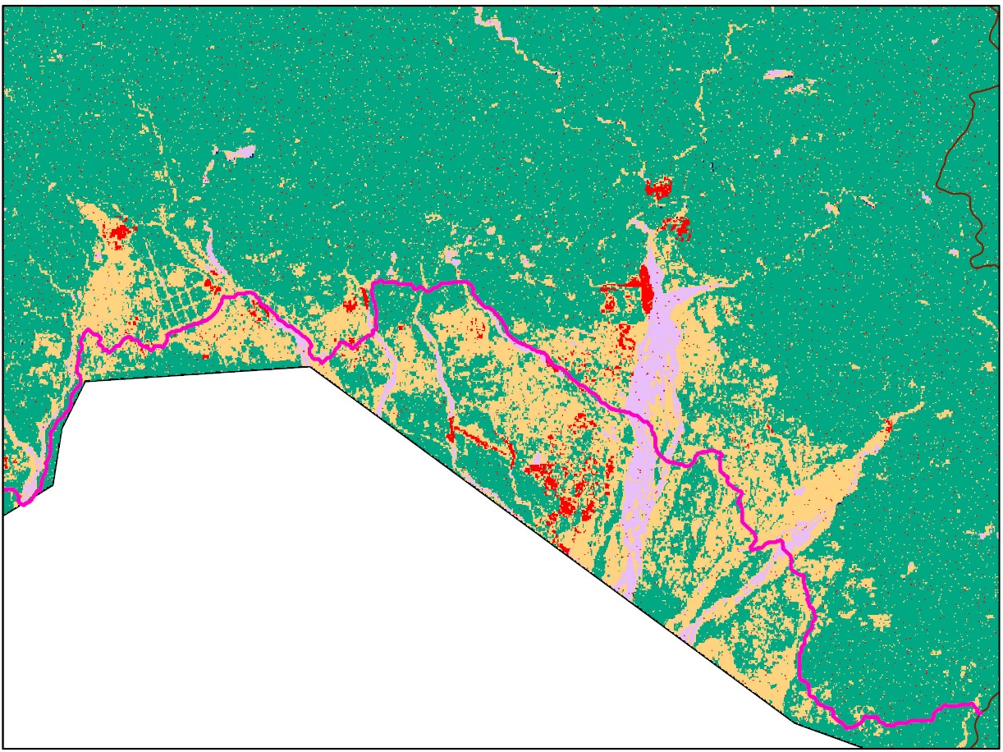
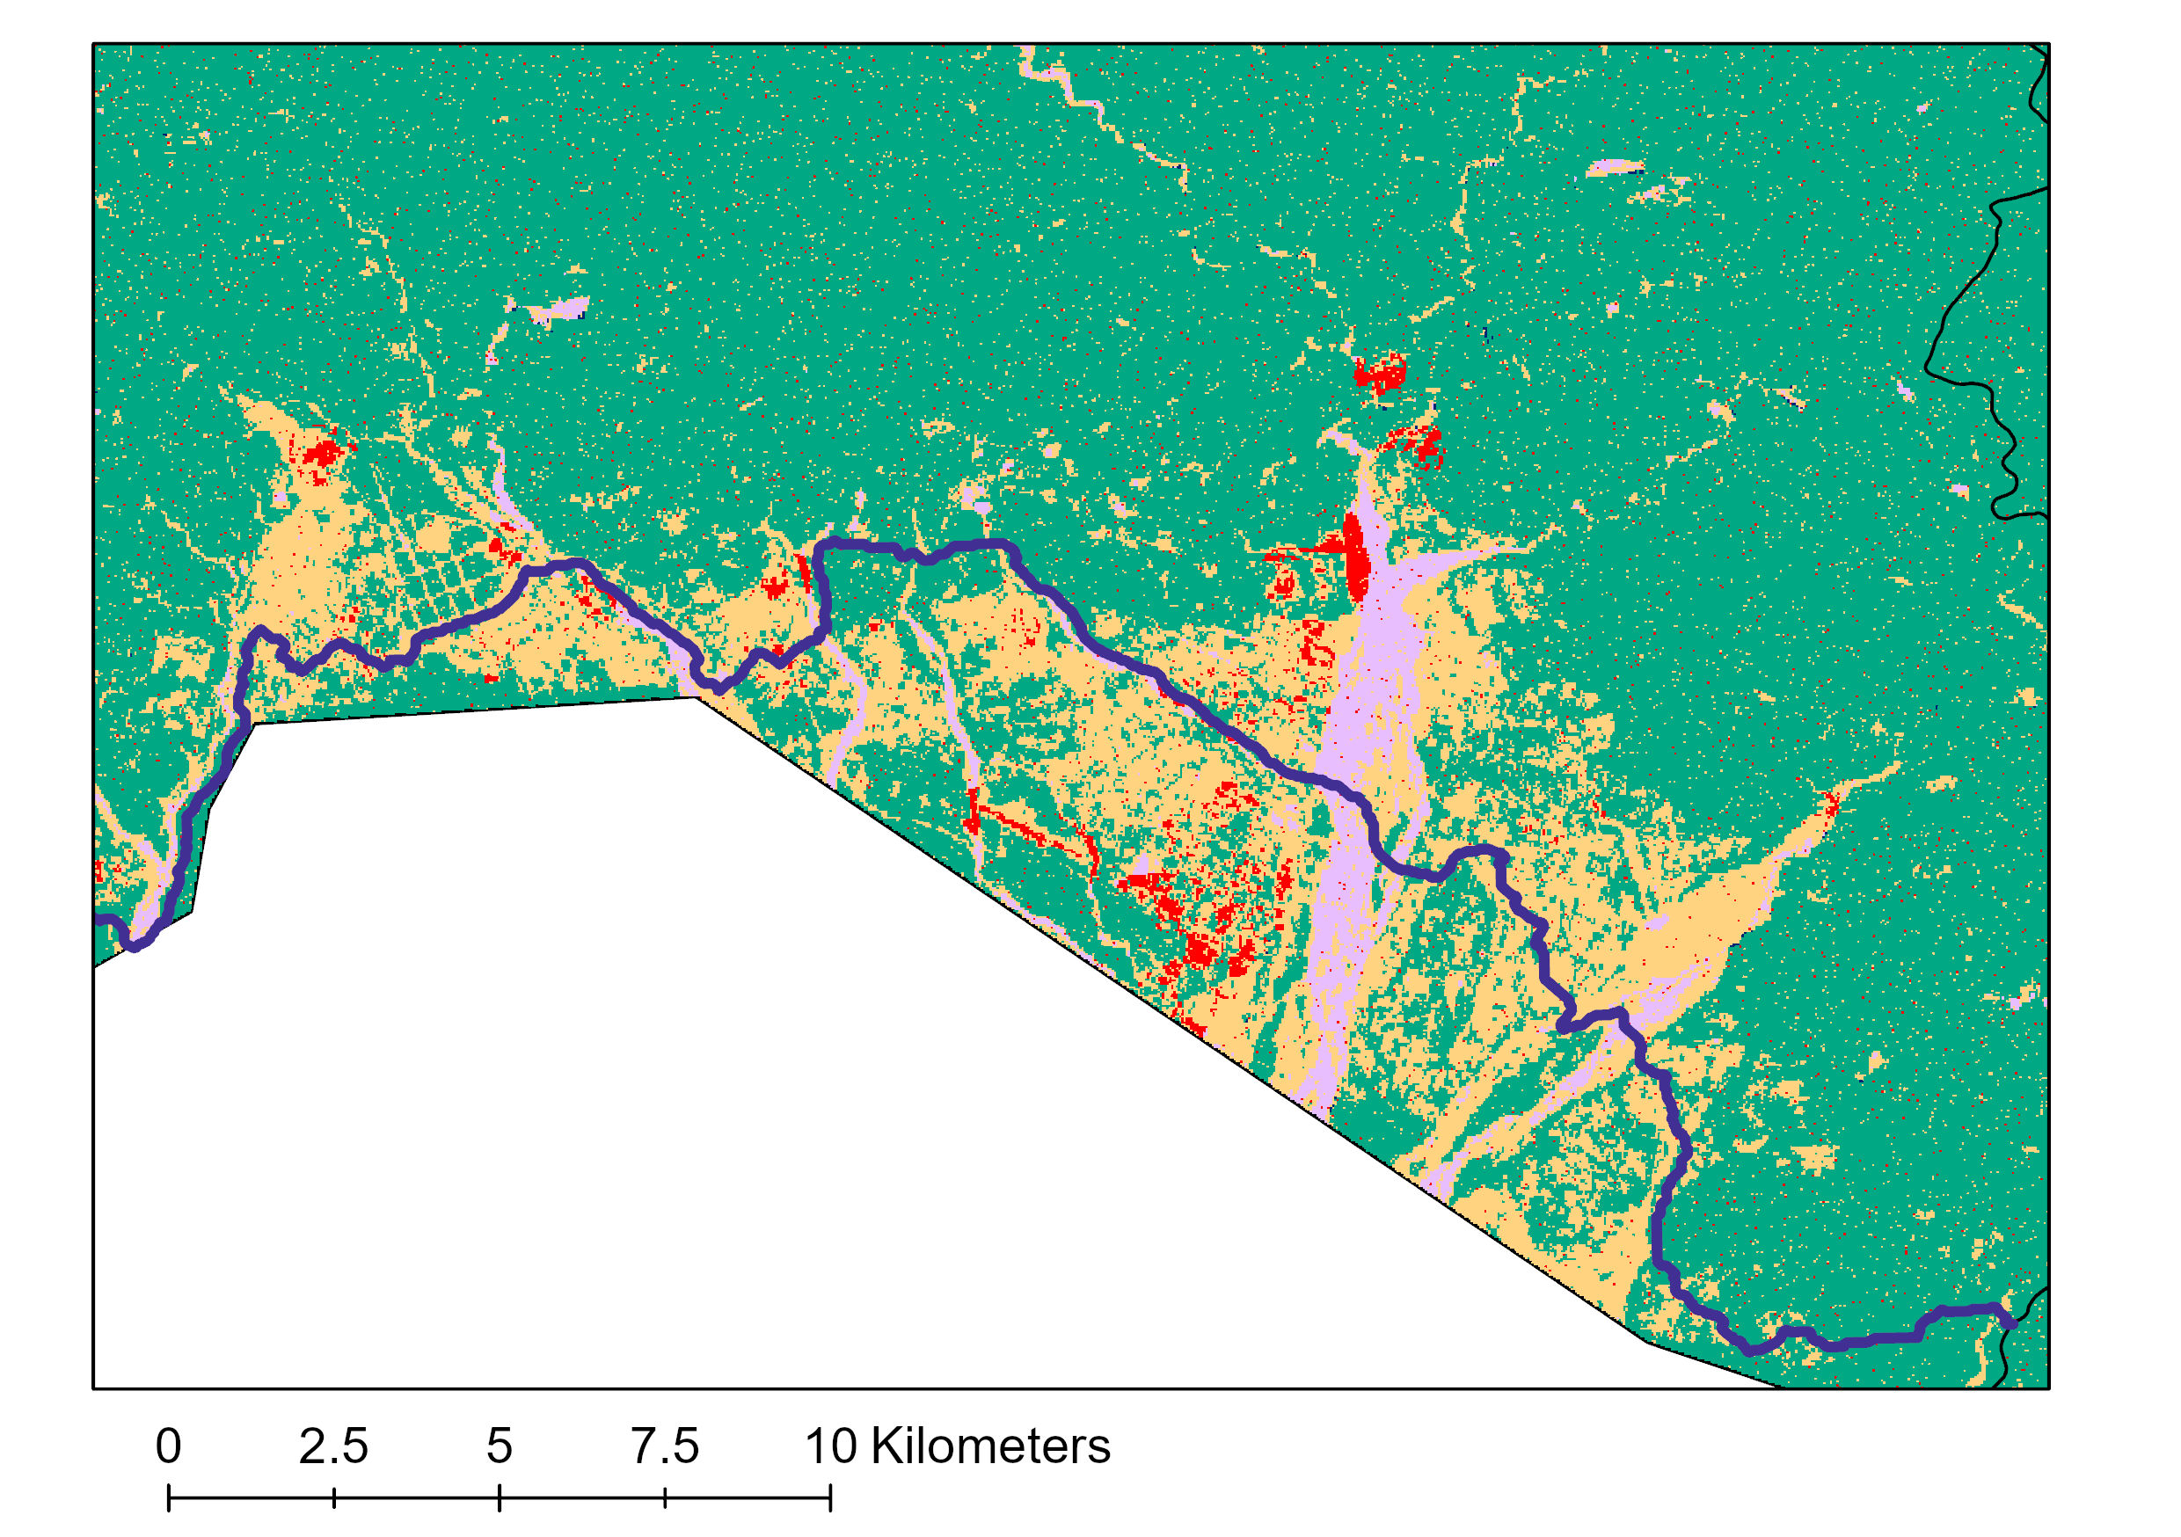
Results| Potential Corridor map: Gelephu
N
0 2.5 5 7.5 10 kilometers
Least Cost Paths
Protected areas
Forest
Cultivated
Water
Barren
Built-up areas
Notes:
This map shows a zoomed in look at the Gelephu region. As we can see in the map, the potential corridor overlaps projected cultivated areas and runs pretty closely to the projected built-up areas. This suggests an imminent threat of human-elephant interactions in Gelephu in 2030. In terms of the habitat suitability, the corridor shown above would be the optimal choice with the least cost. However, the prominence of cultivated areas and built-up areas suggests very close proximity to humans. This makes this corridor not realistically feasible as it runs through current and future human settlement areas. Another path with a slightly higher cost or including northern India in the model might give corridors that are feasible in 10 years without necessarily hindering urban expansion and planning in southern Bhutan.

Slide 19
Errors and Uncertainties
LULC Classification:
Landsat TM and OLI data have different spectral band characteristics that may affect LULC mapping
Limited reference data and the lack of in situ data
Limited availability of cloud-free Landsat data
Subjectivity in classification
Land Change Modeling:
The distance to roads variable was considered static in Land Change Modeler
The 2030 LULC forecast model needs quantitative validation
Notes:
Some errors and uncertainties in our project to keep in mind for the LULC classification is that the Landsat data from Landsat 8 OLI has additional band designations compared to Landsat 5 TM. Limited training data and subjectivity in the classification process of the LULC maps due to different interpretations of the data may have caused some errors. Limited availability of cloud-free imagery and the lack of in situ data caused some difficulties in distinguishing classes such as barren land and cultivated area which caused some discrepancies in the 2010 and 2015 LULCs. These may have caused some errors in the predicted map.
In the land change mapping process, the distance to roads variables was considered static, however roads are continuously expanding and are dynamic. Also, a quantitative validation of our LULC forecast model is needed.
------------------------------Image Information Below ------------------------------
Clipart provided by Microsoft Office 365/PowerPoint

Slide 20
Conclusions
Recent increases in built-up areas and cultivated areas
Overlap in potential corridors and human settlements
Identified potential corridors are mostly near urban areas
Need for collaboration between elephant conservationists and urban development planners
Need for inclusion of areas in India for conservation of Asian elephants in Bhutan
Notes:
From our analysis, we observed that built-up areas and cultivated areas have been increasing over the years. Built-up areas, in particular, has been increasing rapidly in more recent years with a greater increase from 2015 to 2019.
When comparing our corridor map with the 2030 LULC, the potential corridors mapped in Gelephu are not feasible as it runs through areas with human activities. This also attests to the high numbers of human-elephant conflict in Gelephu area. This highlights the need for the Asian elephant conservationists and urban development planners in Gelephu to collaborate on their efforts to reduce human-elephant conflicts, potentially saving lives on both ends.
Since all the corridors seem to run along the southern border of Bhutan, there is a need to incorporate areas in northern India in this research to promote transboundary cooperation and initiative for better conservation strategies of Asian elephants.

Slide 21
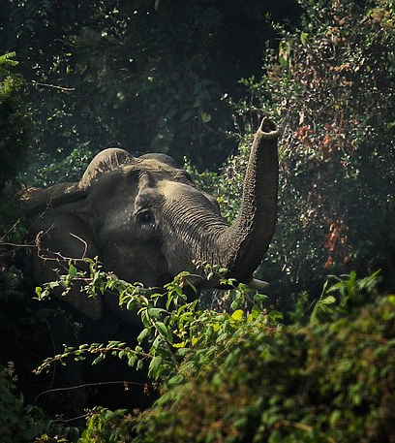
Future Work
Land Change Analysis
Longer time period
Include more driver variables
Urban planning maps of Gelephu could provide further insight
In situ data would allow for a robust accuracy assessment and further refinement of our results
Implement the Land Use Conflict Identification Strategy (LUCIS) model
Image Credit: Syedabbas321
Notes:
We could include a longer time period for the change analysis and also more driver variables such as protected areas, distance to disturbances, etc. into our land change modeling for a more accurate analysis and prediction.
Incorporating town planning maps of Gelephu would prove beneficial to this research in predicting the expansion of urban areas in the future.
Collection of in situ data would allow for a robust accuracy assessment and the further refinement of our LULC maps and the corridor map, which can lead to a better prediction of land change dynamics.
The partners can build on our results and implement the Land Use Conflict Identification Strategy (LUCIS) model to address the land use conflict in southern Bhutan to inform the urban planning process and allocation of corridors in the region.
------------------------------Image Information Below ------------------------------
Image Credit: Asian Elephant (হাতি) by Syedabbas321 [CC BY-SA 4.0 (https://creativecommons.org/licenses/by-sa/4.0/deed.en)]
Image cropped from the original
Image Source: Wikimedia commons https://commons.wikimedia.org/wiki/File:Asian_Elephant_(হাতি).jpg

Slide 22
Advisors:
Joseph Spruce, SSAI Research Consultant
Dr. Kenton Ross, NASA Langley Research Center
Sean McCartney, SSAI, NASA Goddard Space Flight Center
Fellows:
Dr. Nicole Ramberg-Pihl, DEVELOP Fellow, NASA Goddard Space Flight Center
Darcy Gray, DEVELOP Fellow, NASA Georgia Center of Geospatial Research
Partners:
Dr. Tshewang Wangchuk, Bhutan Foundation
Dr. Tshering Tempa, Bhutan Tiger Center
Dr. Nawang Norbu, Bhutan Ecological Society
Past Contributors:
Southern Bhutan Ecological Forecasting I & II Teams: Karma Dema, Kuenley Pem Dem, Palchen Wangchuk, Sonam Choden, & Tashi Choden
Notes:
Finally, we would like to convey our gratitude to everyone who has helped us successfully complete this project - our science advisors: Joseph Spruce, Dr. Kenton Ross, and Sean McCartney; our fellows: Nicole Ramberg-Pihl and Darcy Gray; our partners: Dr. Wangchuk, Dr. Tempa, Dr. Norbu; and all the past contributors. Thank you everyone.

Slide 23
Back-up Slides

Slide 24
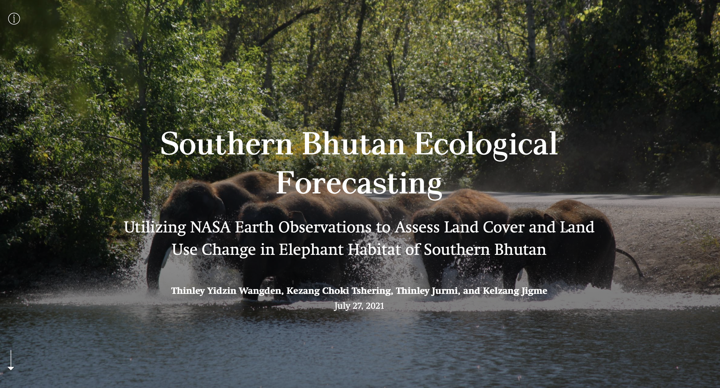
Project StoryMap
Image Credit: James M
Notes:
Project StoryMap created in AGOL by Southern Bhutan Eco III team
------------------------------Image Information Below ------------------------------
Image Credit: Asian Elephants by James M [CC BY-ND 2.0 (https://creativecommons.org/licenses/by-nd/2.0/)]
Image Source: Creative Commons https://www.flickr.com/photos/41453183@N05/29794874122/

Slide 25
Results| Refined 2010 LULC map
0 25 50 75 100 kilometers
N
Forest
Cultivated
Water
Barren
Built-up areas
Notes:
This is the refined 2010 LULC which was created using Landsat 5 TM data. Due to an under classification of mature forests and an over classification of cultivated areas near the southern border, the team masked out cultivated areas and mature forests identified in the previous LULC and reclassified those areas. There were discrepancies in the classification of immature and mature forests between the LULCs which affected the results of our land change modeling. In order to account for errors in classification, the team combined the two classes of mature and immature forests into one class representing all forests for the 2010, 2015 and 2019 LULCs.

Slide 26
Results| Refined 2015 LULC map
0 25 50 75 100 kilometers
N
Forest
Cultivated
Water
Barren
Built-up areas
Notes:
This is the 2015 refined LULC which was created using Landsat 8 OLI data.

Slide 27
Results| Refined 2019 LULC map
0 25 50 75 100 kilometers
N
Forest
Cultivated
Water
Barren
Built-up areas
Notes:
This is the refined 2019 LULC created using Landsat 8 OLI imagery.

