Slide 1
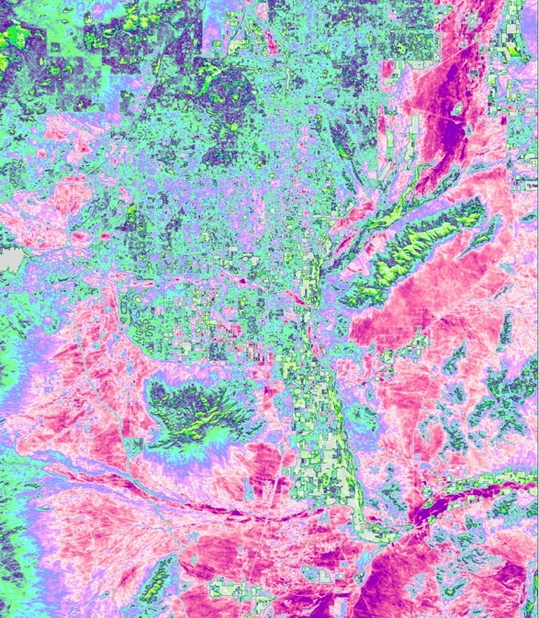
2018 Fall | Arizona – Tempe
TEMPE URBAN DEVELOPMENT
Utilizing NASA Earth Observations to Assess Thermal Landscapes and Prioritize Greening Initiatives in Tempe, Arizona
Hannah Bonestroo
Roger Alvarez
Taylor Quinn
Elizabeth Swanson
Notes:
Speaker:
Hello.
Thank you all for joining us today.
I’m Hannah Bonestroo, I graduated from Macalester College with a degree in Geography and Urban Studies
I’m Roger Alvarez, etc
I’m Taylor Quinn, etc
I’m Elizabeth Swanson, etc
And we’re all part of the NASA DEVELOP Tempe Urban Development Team.
Image Source: ArcGIS Pro; Website Image (Created by Team)

Slide 2
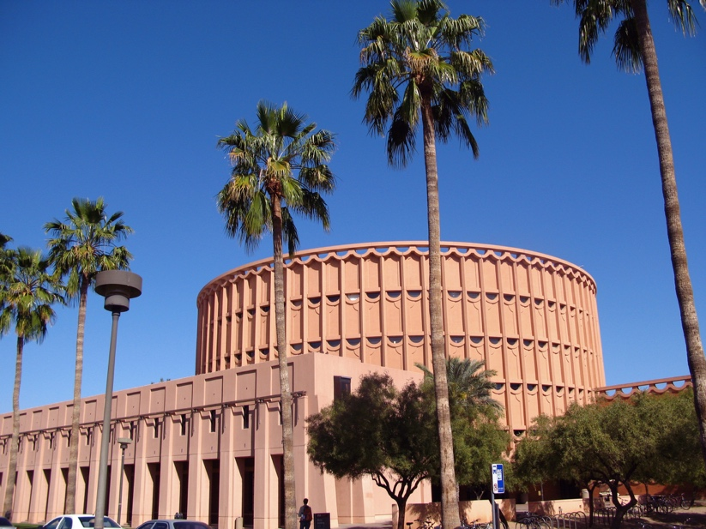
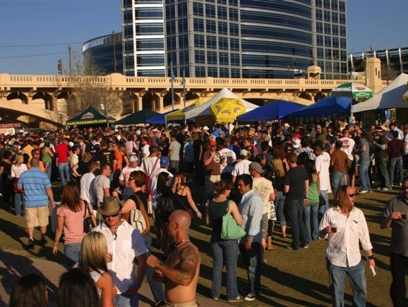
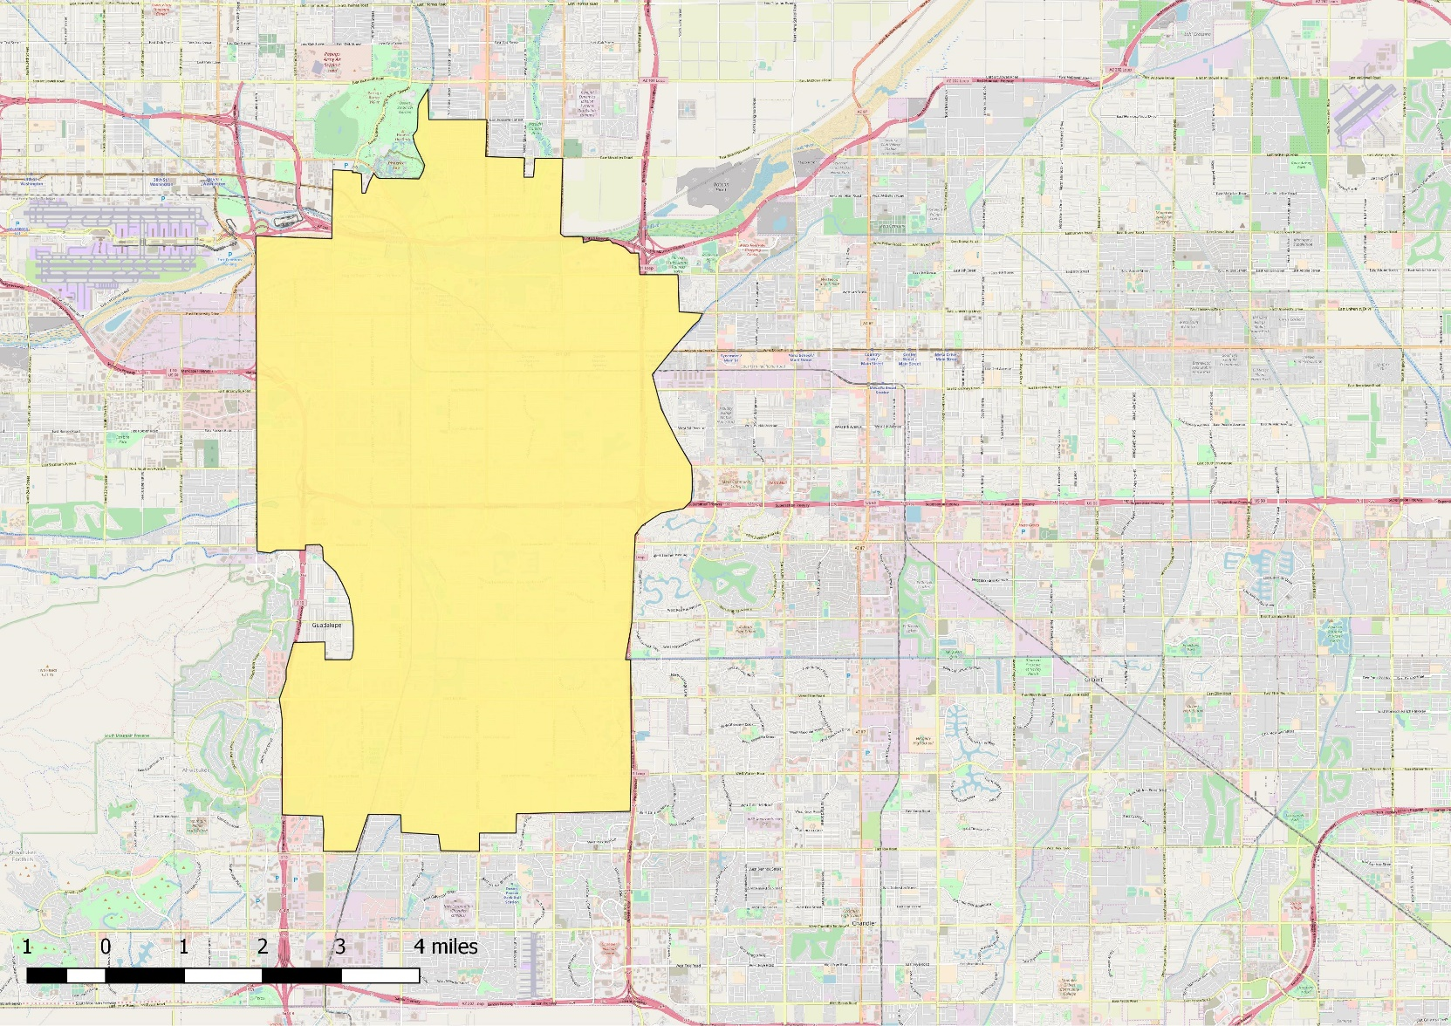
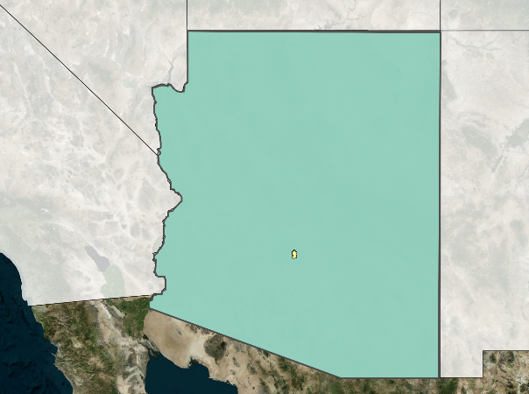
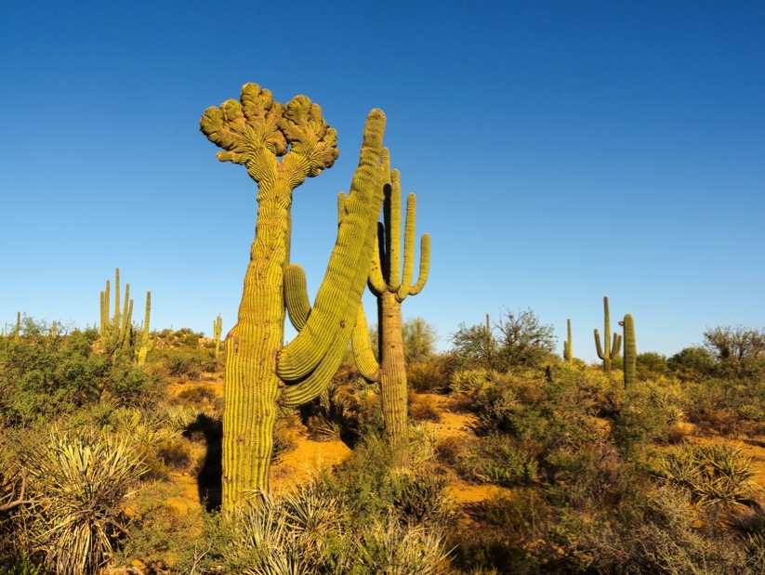
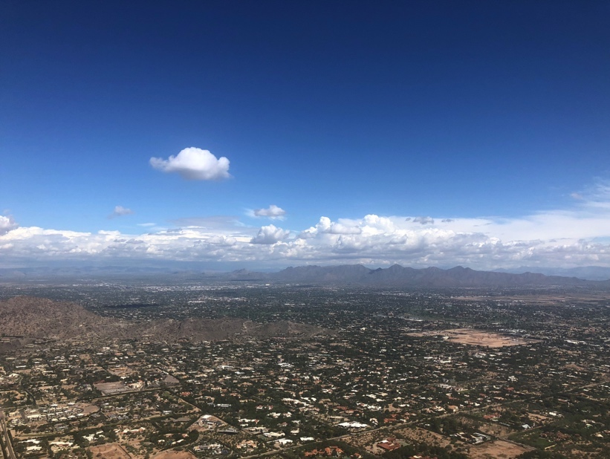
Study Area
Tempe, Arizona
Located in the northern Sonoran Desert
33.4255° N, 111.9400° W
Area: 40.23 sq mi
Population (2010): 161,719
Temperature: Summer daily maximum over 37°C (100°F)
Study Period
1998 to 2018 (May to October)
AZ
CA
City of Tempe
Image Credits: Kevin Dooley, Rick Cameron, & Nick Bastian on Flickr; Hannah Bonestroo
Notes:
Speaker: Our study area for this term, Tempe, Arizona, is an inner ring suburb of Phoenix, known for being home to the main campus of Arizona State University (click), as well as its diverse communities, arts and culture (click). Located in the northern Sonoran desert (click), Tempe regularly experiences extreme heat, with summer daily maximum temperatures reaching over 37°C or 100°F. The rapid urbanization of the region (click) in the last 50 years has caused a steady increase in the mean daily air temperature due to Urban Heat Island effect and has led the city to prioritize improving the thermal environment of its parks and green spaces.
Tempe Map:
-QGIS 2.18
-OpenStreetMap Layer, City of Tempe Polygon Layer (used US Census Bureau TIGER dataset to create Tempe Polygon)
Arizona Map
-QGIS 2.18
-Bing Aerial Layer, State of Arizona Polygon created with US Census Bureau TIGER dataset (state shapefile “tl_2018_us_state”)
Image source 1: https://www.flickr.com/photos/pagedooley/2429429397/in/photolist-4GFsHK-25iEcrN-eEQBAr-5TuZuz-VyZFyE-4Hv9Ff-jfD5Yt-8rGcVa-fscZSa-mwG9C-6BRLJG-7GGg5v-jfBx8D-nuJZVA-a4KrL8-kNYC3f-6FNE9J-3Lu9rs-o174vG-nnVRvx-pWhGey-6gQpec-oZ23re-fhRQ9n-7tQy3H-VkPrN5-nCs85E-oZhujF-nra2k8-9qUU3Q-g7yCNT-hz2pSr-AZf18B-oy1Vkw-dbgLb8-b8uUaD-DWSDPw-AZ9eKj-pvWs6k-tHAM8-AZeN4g-TnpXJM-WniLVm-f4Cjm2-mk1Ykq-4HCrtX-51pv4C-nEeFGr-5dt5pf-fcHA7H (CC BY 2.0)
Image source 2: https://www.flickr.com/photos/nickbastian/4391702467/in/photolist-7G5C94-eAnLR-7no9Qj-6PAcRh-6PmBrF-Fh5Bx-eLQ9V5-9u7i7s-eLQ9bj-9dJGff-dhpj3W-4BzPQz-eLCNt2-eLCPSP-rCWAPk-7NNwDi-qFVwUh-e9ztfA-qGeBQn-dhpjZS-7NSvdE-6PAdqy-eAnHF-dhpjP8-dhp8wH-e6u7zG-dhpkDE-ipUdJ4-rCVSre-dhp89u-dUvC92-dhpjrV-dhp9cB-4wXUpM-dhp4cn-7NSvss-qG2nYQ-9u7i3Y-rmw4nv-F9Smd-dJHiPv-dhpe5Q-dhpefB-dhphtM-bpqXHC-gr39TJ-dJNKLj-25ht34p-dmt1Aw-dhp2rE (CC BY-ND 2.0)
Image source 3: https://www.flickr.com/photos/rickcameron/45243413332/in/photolist-2bW1jwy-aNopMg-N8Cc4P-7Qzcb4-2bW1jD7-nhG8Ld-5ynVwP-83x3AW-2bW1jsf-qfYWK7-2bPiMNA-qVpVD5-qhKYQ2-5TMx4B-69B5gd-BV5Fgc-5UiS8N-dwtpzZ-4K5237-mP5RfC-5U4Y9w-qhshmg-2bPiNLN-2avfRKP-2bPiFr7-2bPiJ9b-a8Sm2j-ouV7Ua-RMbBmp-7Rg1F6-jP1iGn-feUgKc-2bPiGfG-5U4r6S-N8CawF-7gbm4t-dMqQ54-qhmqiA-8vCEe8-qWuzhK-2amuDuT-eZeRp5-ehvH65-r5dQTF-nuvhyQ-ek6hPT-eaEaqo-EYp1Nz-89mBAG-Tdfyck (CC BY-NC-ND 2.0)
Image source 4: Hannah Bonestroo; NASA DEVELOP Project Lead (Taken by team)

Slide 3
Urban Forestry Master Plan (UFMP)
25%
20-minutes
Image Credits: PowerPoint Icon
Notes:
Speaker: To address the increasing dangers of extreme heat, the city created an Urban Forestry Master Plan, also known as the UFMP, in 2017. The UFMP outlines a strategy for achieving 25% urban tree canopy cover (click) and becoming a 20-Minute walkable city by 2040 (click). The city defined this goal in the UFMP as supporting development and land use where residents can comfortably walk or bike to urban hubs and major amenities within 20 minutes of their homes.
Image source (tree): Made using MicrosoftWord; (Created by Team)
Image source (person): Made using PowerPoint icons; (Created by Team)

Slide 4
Project Partner: City of Tempe
City of Tempe
Bonnie Richardson, Architect & Urban Planner
Arizona State University, Urban Climate Research Center (UCRC)
Dr. David Sailor, UCRC Director
Image Credits: PowerPoint Icon
Notes:
Speaker: Our team collaborated with the City of Tempe (click) and the Arizona State University Urban Climate Research Center (click) this term in order to help support the UFMP and investigate how deliberate urban forestry improves the city’s thermal environment and helps mitigate extreme heat.
Image Source 1(hands): Made using PowerPoint icons; (Created by Team)
Image Source 2 (thermometer): Made using PowerPoint icons; (Created by Team)

Slide 5
Community Concerns
Urban Heat Island (UHI) effect
Declining urban forest
Lack of proper tree care information
TEMPE, AZ
Image Credits: PowerPoint Icon
Notes:
Speaker: As mentioned earlier, the mean daily air temperature in Tempe continues to increase annually due to the UHI effect and Earth’s warming climate (click). Maintaining the health of Tempe’s urban forestry is essential in heat mitigation and achieving the goal of becoming a 20-minute walkable city (click), but storm damage and lack of informed care practices, including under- and overwatering, have led to the reduction of overall tree coverage in the city since 2010 and no concrete plan for the replacement of lost trees is in place (click). Responsibility for tree care falls on the city, homeowners associations, and commercial centers. Currently, there is a lack of information available regarding proper tree care and planting best practices, as well as a misunderstanding between the groups for who is responsible for consistent tree care.
Image Source: Made using PowerPoint icons; (Created by Team)

Slide 6
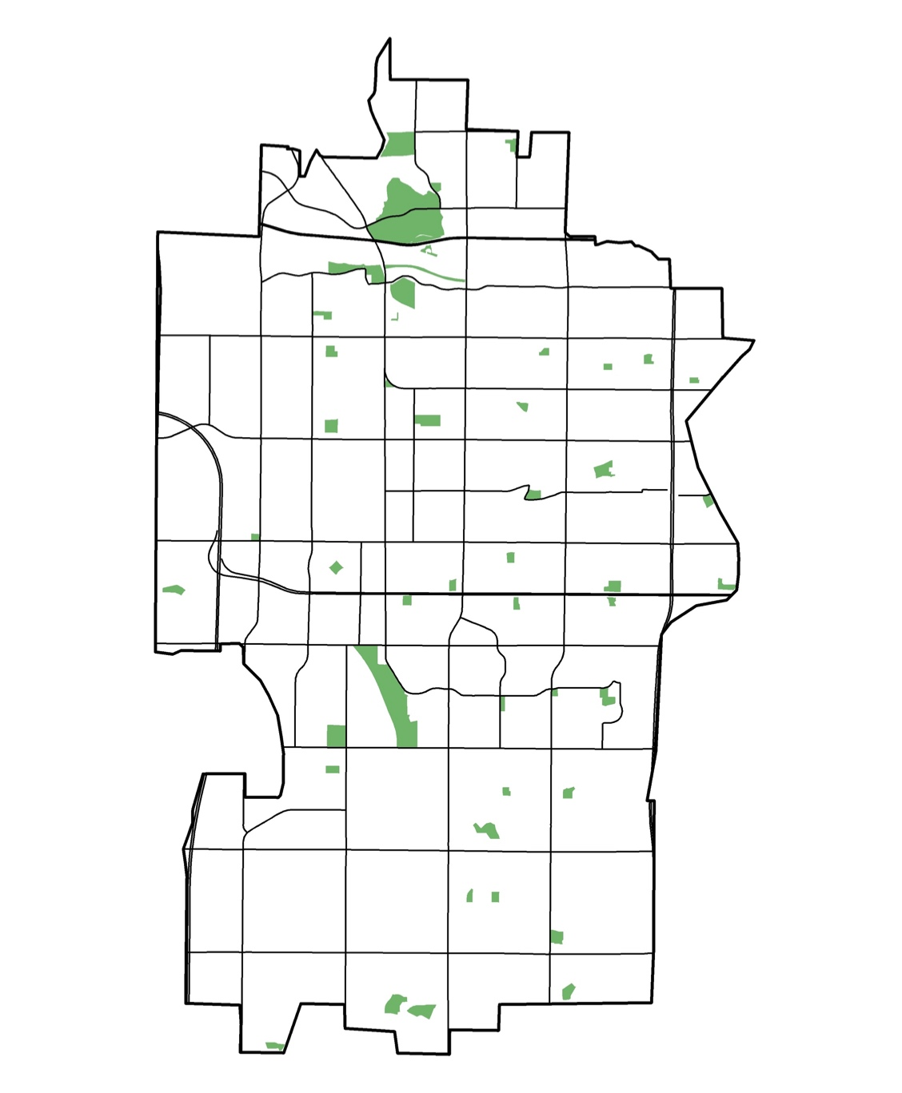
City of Tempe Parks
Offer recreational areas for Tempe residents
Open space
Events (concerts & marathons)
Kayaking/ boating
Fishing
Running, biking, skating
Park
Notes:
Speaker: Of special importance to city was investigating the thermal environment of its parks. Tempe is home to over 50 parks which provide residents with spaces to relax and enjoy recreational activities year-round, as well as provide space for important events such as concerts and festivals. However, the extreme heat the city experiences hinders the ability of residents to enjoy these public spaces.
Map:
-Created on ArcMap
-Tempe layer (used US Census Bureau TIGER dataset), major roads layer (used US Census Bureau TIGER dataset), parks layer (Esri Data and Maps dataset)
-Clipped all three layers

Slide 7
Objectives
Provide the City of Tempe with information on how the urban forest can contribute to heat mitigation strategies
Assess the change in land surface temperature(LST) and vegetation cover in Tempe from 1998 through 2018
Investigate the effects that tree clustering and land cover have on the thermal environment
Notes:
Speaker: The main objective of this project was to conduct analyses using NASA Earth observations, as well as other satellite imagery, in order to provide the City of Tempe with information on how tree canopy and land cover can contribute to heat mitigation strategies (click). We also wanted to assess the change in land surface temperature and vegetation cover in Tempe from 1998 through 2018 in order to determine the effect vegetation cover has on land surface temperature (click). Our final objective was to identify the effect different land cover classifications and tree density have on the thermal environment.

Slide 8
Measurements
Land Surface Temperature (LST)
Normalized Difference Vegetation Index (NDVI)
Measurement of the surface temperature
Includes both bare soil and vegetation temperatures
Green vegetation vs no vegetation
Uses near infrared and red visible light
Ranges from -1 to +1
NDVI = (NIR - Red)/(NIR + Red)
Image Credits: PowerPoint Icon
Notes:
Speaker: To analyze the thermal environment of Tempe and its parks we looked at both land surface temperature and the normalized difference vegetation index. We will be mentioning both of these terms a lot during the rest of the presentation, so we want to explain them before we proceed. Land surface temperature (also known as LST) is how the ground surface would feel to the touch in a specific location. The surface temperature is important as the amount of heat emitted from the ground contributes greatly to the temperature one would feel. The hottest LST ever recorded was 70.7 degrees Celsius in Libya and land surface temperature in Antarctica can reach negative 50 degrees Celsius. Normalized difference vegetation index (also known as NDVI) is an index that measures the difference between near infrared and red visible light in order to calculate the “greenness” of an area. The index ranges from -1 to +1 with -1 most likely being water to +1 being an area with dense green leaves. NDVI was used to calculate the overall vegetation cover in Tempe.
Image Source 1: Made using PowerPoint icons; (Created by Team)
Image Source 2: Made using PowerPoint icons; (Created by Team)

Slide 9
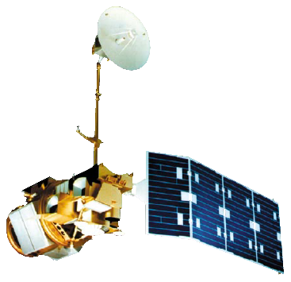
NASA Satellites & Sensors
Landsat 5 TM
Landsat 8 OLI & TIRS
Image Credits: NASA; DEVELOPedia
Notes:
Speaker: In order to find the change in NDVI and LST from 1998 to 2018, we used imagery from Landsat 5 Thematic Mapper (click) and Landsat 8 Operational Land Imager and Thermal Infrared Sensor
Image Source (Landsat 5TM): (https://earthobservatory.nasa.gov/images/81559/nasas-earth-science-satellite-fleet; NASA)
Image Source (Landsat 8 OLI & TIRS): (http://www.devpedia.developexchange.com/dp/images/c/c2/03_Landsat8.png; DEVELOPedia)

Slide 10
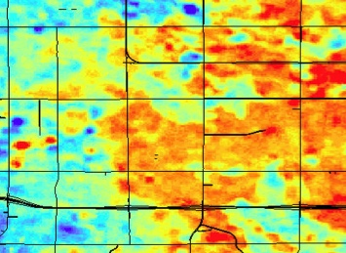
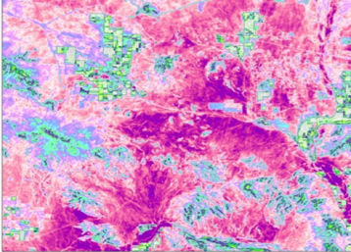
Methodology
Data
Processing
Analysis
Landsat 5 TM
Landsat 8 OLI & TIRS
United States Geological Survey (USGS) Lidar Tree Point Data
CAP LTER Land Classification using 2010 NAIP Imagery
NDVI Layers
LST Layers
Land Cover Classification
Tree Density
NDVI Time Series
LST Time Series
Regression and Correlation Analysis (Comparing Tree Density, Land Cover, and LST)
Image Credits: Freepik, Smashicons, Kirinshastry, and Gregor Cresnar on Flaticon
Data
Processing
Analysis
Data
Processing
Analysis
Data
Processing
Analysis
Data
Processing
Analysis
Landsat 5 TM
Landsat 8 OLI/TIRS
United States Geological Survey (USGS) LIDAR
TIGER/Lines Shapefiles
Vegetation Cover Analysis
Land Surface Temperature Analysis
Urban Tree Canopy Analysis
Land Cover Classification
NDVI Time Series
LST Time Series
Regression Analysis (Comparing Tree Density, Land Cover, and LST)
Landsat 5 TM
Landsat 8 OLI/TIRS
United States Geological Survey (USGS) LIDAR
TIGER/Lines Shapefiles
Vegetation Cover Analysis
Land Surface Temperature Analysis
Urban Tree Canopy Analysis
Land Cover Classification
NDVI Time Series
LST Time Series
Regression Analysis (Comparing Tree Density, Land Cover, and LST)
Landsat 5 TM
Landsat 8 OLI/TIRS
United States Geological Survey (USGS) LIDAR
TIGER/Lines Shapefiles
Vegetation Cover Analysis
Land Surface Temperature Analysis
Urban Tree Canopy Analysis
Land Cover Classification
NDVI Time Series
LST Time Series
Regression Analysis (Comparing Tree Density, Land Cover, and LST)
Landsat 5 TM
Landsat 8 OLI/TIRS
United States Geological Survey (USGS) LIDAR
TIGER/Lines Shapefiles
Vegetation Cover Analysis
Land Surface Temperature Analysis
Urban Tree Canopy Analysis
Land Cover Classification
NDVI Time Series
LST Time Series
Regression Analysis (Comparing Tree Density, Land Cover, and LST)
Landsat 5 TM
Landsat 8 OLI/TIRS
United States Geological Survey (USGS) LIDAR
TIGER/Lines Shapefiles
Vegetation Cover Analysis
Land Surface Temperature Analysis
Urban Tree Canopy Analysis
Land Cover Classification
Landsat 5 TM
Landsat 8 OLI/TIRS
United States Geological Survey (USGS) LIDAR
TIGER/Lines Shapefiles
Vegetation Cover Analysis
Land Surface Temperature Analysis
Urban Tree Canopy Analysis
Land Cover Classification
Landsat 5 TM
Landsat 8 OLI/TIRS
United States Geological Survey (USGS) LIDAR
TIGER/Lines Shapefiles
Vegetation Cover Analysis
Land Surface Temperature Analysis
Urban Tree Canopy Analysis
Land Cover Classification
Notes:
Speaker: Along with the satellite imagery, our team also used United States Geological Survey Lidar tree point data and CAP LTER land classification data using 2010 NAIP imagery. (click) Using these data sets we found the NDVI and LST in Tempe for 1998, 2008, and 2018 and also found the land cover and tree density of Tempe’s parks. (click) We then found the change in NDVI and relative change in LST from 1998 to 2018, compared LST to NDVI, and also examined the correlation between tree density, land cover and Land Surface Temperature in the city’s parks.
Image Sources:
(Flaticon Basic License) “Tree Vector” Flaticon. Designed by Freepik from www.flaticon.com. https://www.flaticon.com/free-icon/tree_785202#term=trees&page=1&position=23
(CC 3.0 BY) “Sun Vector” Flaticon. Designed by Freepik from www.flaticon.com. https://www.flaticon.com/free-icon/clear-sun_12205
(CC 3.0 BY) “Thermometer Vector” Flaticon. Designed by Freepik from www.flaticon.com. https://www.flaticon.com/free-icon/wall-thermometer_12335
(Flaticon Basic License) “Hotel Vector” Flaticon. Designed by Freepik from www.flaticon.com https://www.flaticon.com/free-icon/hotel_1175145#term=trees&page=1&position=68
(Flaticon Basic License) “Calendar Vector” Flaticon. Designed by Smashicons from www.flaticon.com. https://www.flaticon.com/free-icon/calendar_149363#term=calendar&page=1&position=2
(Flaticon Basic License) “Scale Vector” Flaticon. Designed by Freepik from www.flaticon.com. https://www.flaticon.com/free-icon/comparison_502960#term=comparison&page=1&position=
(Flaticon Basic License) “Satellite Vector” Flaticon. Designed by Kirinshastry from www.flaticon.com. https://www.flaticon.com/free-icon/satellite-dish_1214534#term=satellite&page=1&position=32
(Flaticon Basic License) “Loss Vector” Image Flaticon. Designed by Gregor Cresnar from www.flaticon.com. https://www.flaticon.com/free-icon/loss_126441#term=flow%20chart&page=1&position=11

Slide 11
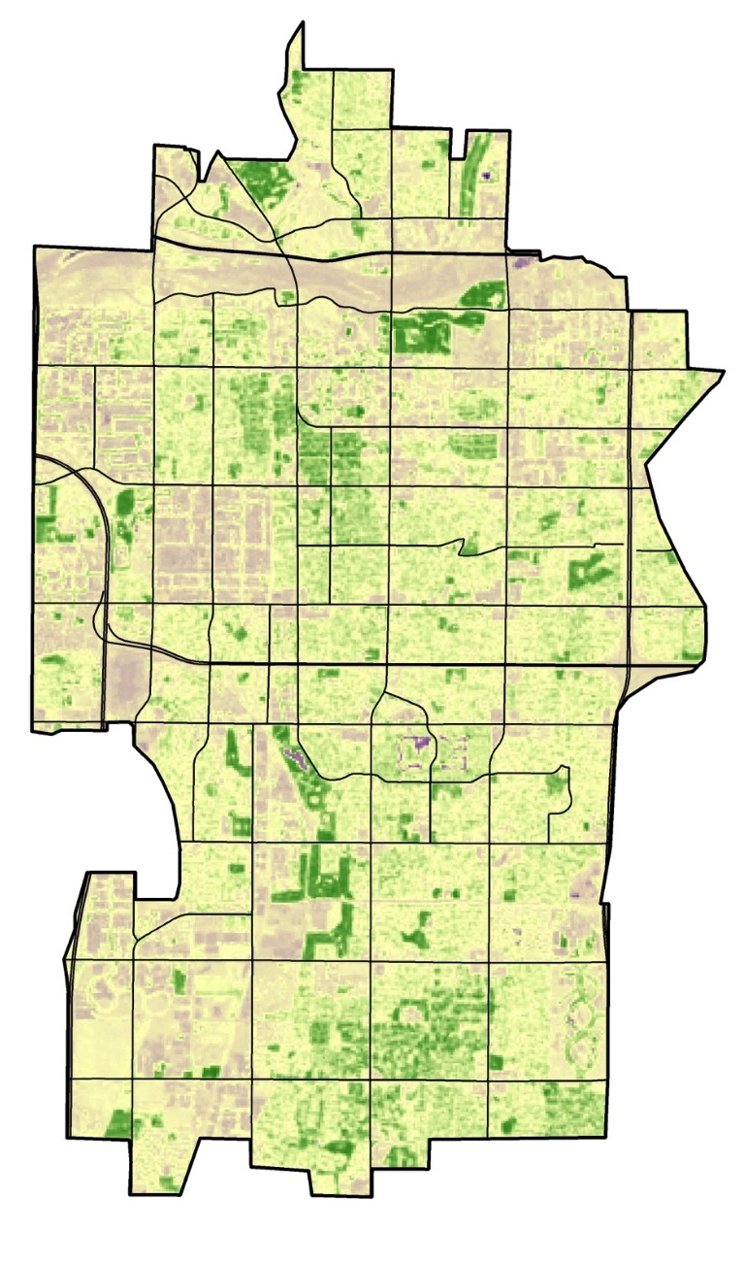
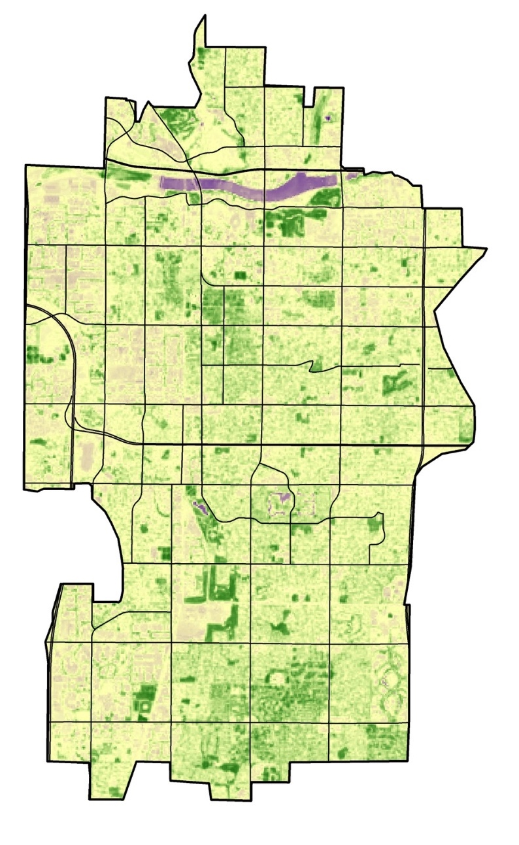
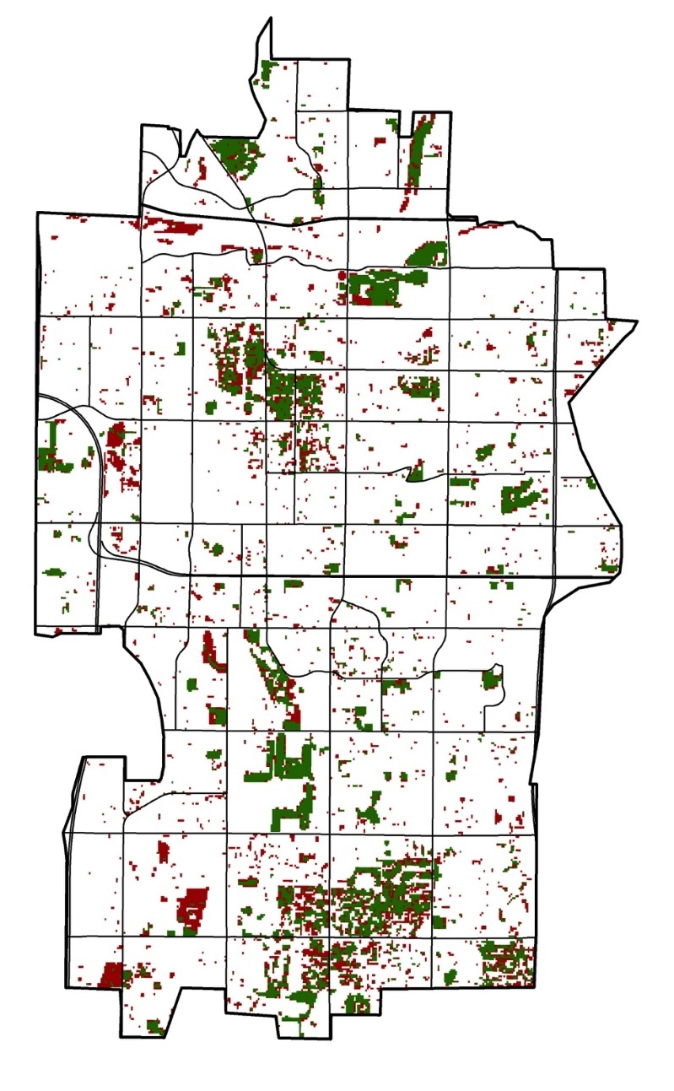
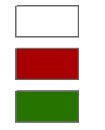
Results: Change in NDVI
July 1998
July 2018
Change in NDVI from July 1998 to 2018
NDVI
Change
0.75
None
0.11
Negative
-0.52
Positive
Notes:
Speaker: We first found the change in NDVI from 1998 to 2018. As we explained earlier, the NDVI measures the greenness of an area, with -1 being mostly water and +1 being an area with dense green leaves. The NDVI values in Tempe ranged from -0.5 shown in purple to 0.7 shown in darker green. The map on the right shows areas where NDVI changed, with red representing areas that experienced negative change, meaning they got less green, and green representing positive change, meaning that the area got overall greener. Looking at the locations that experienced the most change, there appears to be a clustering of greening in southern Tempe. Also of note is that Tempe Town Lake didn’t exist until 1999, which is why in the 2018 map it appears in a deeper purple.
Maps:
-created on ArcGIS Pro/ ArcMap (for final layout)
-Tempe layer (used US Census Bureau TIGER dataset), major roads layer (used US Census Bureau TIGER dataset), NDVI layer (imagery acquired and processed using Google Earth Engine)
-clipped all three layers
-Symbology: (1998,2018): Used “Stretch” and “Min/Max”
-Symbology (Change): Used classified

Slide 12
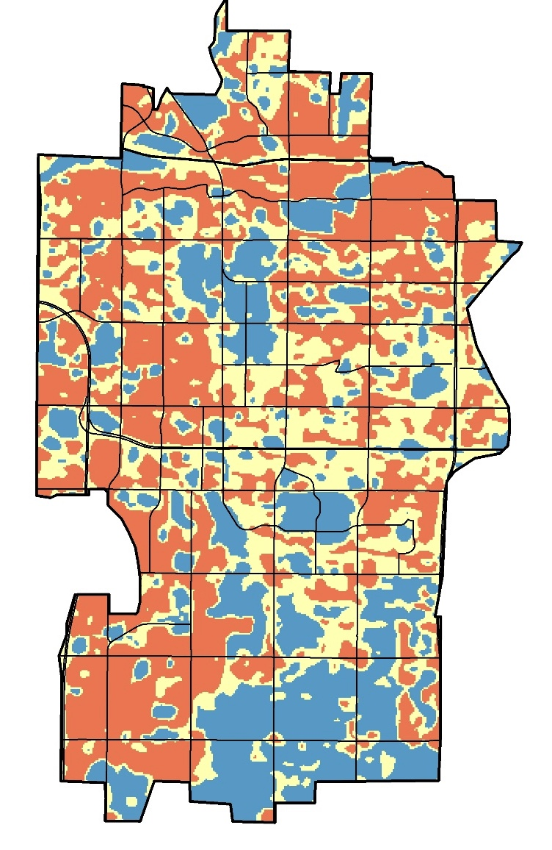
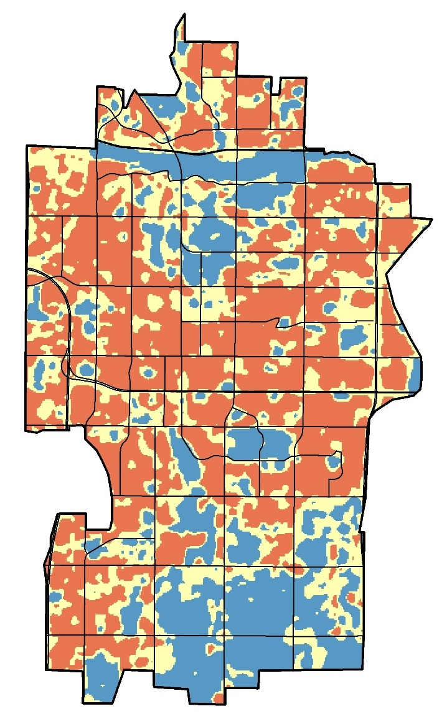
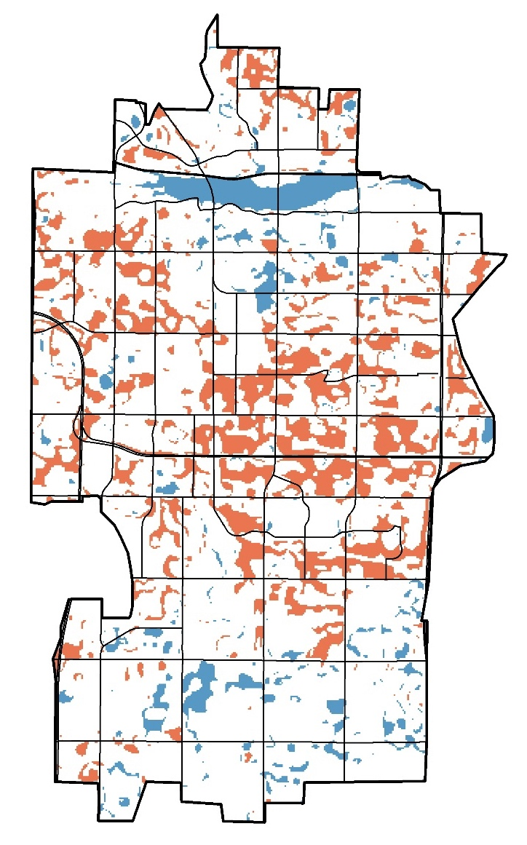
Results: Relative Change in LST
July 1998
July 2018
Relative Change in LST from July 1998 to 2018
LST °C
LST °C
Change
30-40
32-47
Below
40-42
47-49
Median
42-54
49-63
Above
Notes:
Speaker: Next we found the relative change in LST. We decided to find the relative change, rather than the absolute change, due to the variability of LST on any given day and the limited number of satellite images available in a single month, which for Landsat imagery is usually one or two images. The two maps on the left show areas that are above and below the median LST in both 1998 and 2018, with the yellow representing areas that are within one degree Celsius of the median LST and red representing areas that are hotter than the median LST and blue representing areas that are cooler than the the median LST. The map on the right depicts the difference in areas that are above or below the median LST, essentially the shift in relative LST that occurred between 1998 and 2018. The blue represents areas that were not below the median LST in 1998, but in 2018 were below the median LST. The red represents areas that were not above the median LST in 1998, but now in 2018 are above the median LST. From 1998 to 2018, areas above with LST above the median in Tempe increased by 11.7%, while areas with LST below the median decreased by 9.7%. As you can see central Tempe is an area that experienced hotspot creation.
Maps:
-created on ArcMap
-Tempe layer (used US Census Bureau TIGER dataset), major roads layer (used US Census Bureau TIGER dataset), LST layer (imagery acquired and processed using Google Earth Engine)
-clipped all three layers
-Symbology: Used classified

Slide 13
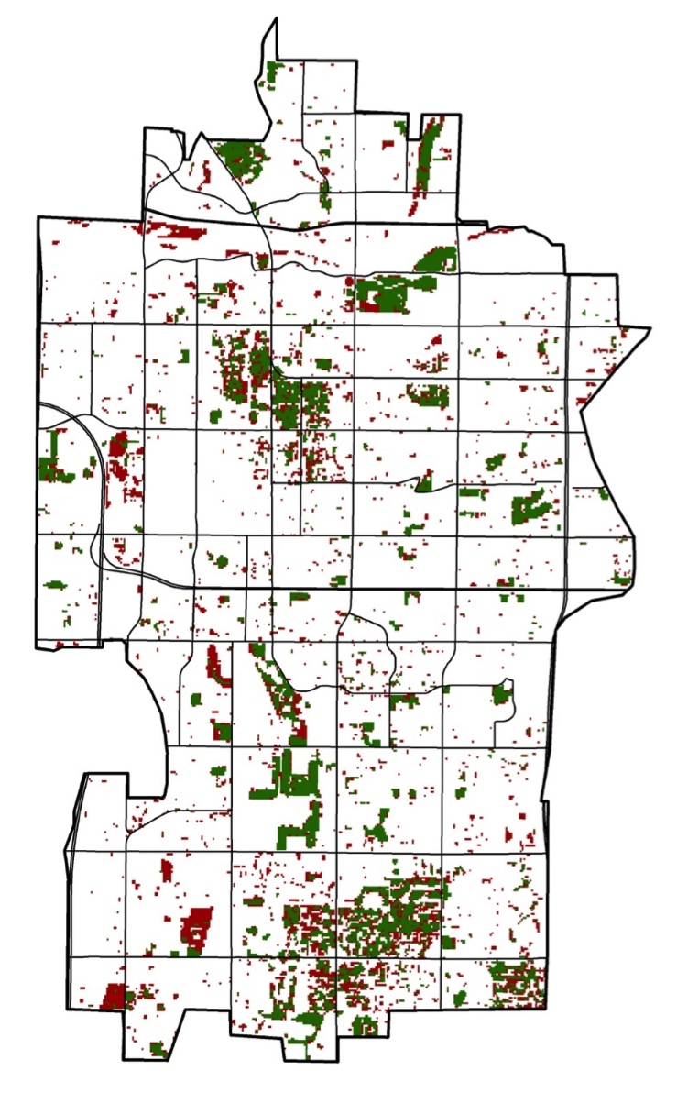
NDVI vs LST
Change in NDVI from July 1998 to 2018
Relative Change in LST from July 1998 to 2018
Change
Change
None
Below
Negative
Median
Positive
Above
Notes:
Speaker: Looking at the change in relative LST map next to the change in NDVI map, you can see that Southern Tempe became relatively cooler and also became more green. We ran a linear regression analysis between the change in NDVI and the change in LST and found that for every NDVI value increase of one, the LST decreases by nine degrees Celsius or around 16 degrees Fahrenheit. Keep in mind though that an NDVI value increase of one is a great increase in the greenness of the area, because NDVI only ranges from -1 to +1. We also ran a correlation test and found that there is a strong negative correlation between NDVI and land surface temperature, with a correlation coefficient of -0.4.
Map (LST):
-created on ArcMap
-Tempe layer (used US Census Bureau TIGER dataset), major roads layer (used US Census Bureau TIGER dataset), LST layer (imagery acquired and processed using Google Earth Engine)
-clipped all three layers
-Symbology: Used classified
Map (NDVI:
-created on ArcGIS Pro/ ArcMap (for final layout)
-Tempe layer (used US Census Bureau TIGER dataset), major roads layer (used US Census Bureau TIGER dataset), NDVI layer (imagery acquired and processed using Google Earth Engine)
-clipped all three layers
-Symbology: Used classified

Slide 14
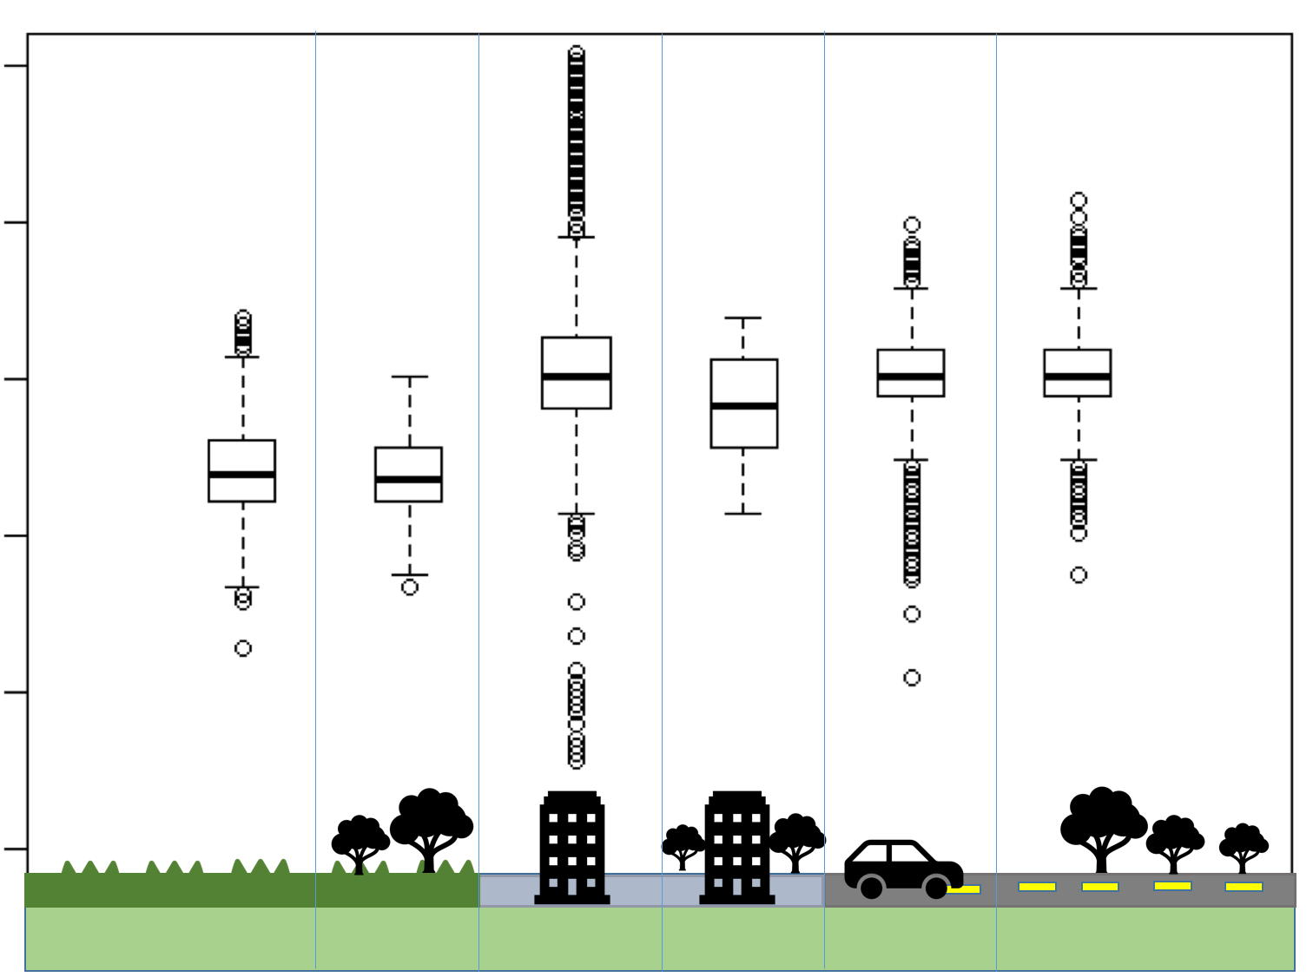
Results: Land Cover vs. LST
40
Mean LST of land with over 85% building cover and < 1% tree cover:
30.5 °C
Mean LST of land with over 85% building cover and > 5% tree cover:
29.2 °C
35
30
LST (°C)
25
20
15
Image Credits: PowerPoint Icon
Notes:
Speaker: Next we compared the mean LSTs of different land cover types with and without trees. We classified a pixel as having a certain land cover type if it had over 85% percent coverage. We classified the pixel as having no trees if it had less than 1% tree coverage and classified the pixel as having trees if it had over 5% tree coverage. This boxplot shows the LSTs of grass with no trees, grass with trees, building with no trees, building with trees, road with no trees, and road with trees. We conducted several two-sample t-test analyses and found that there was a statistically significant difference between the mean land surface temperatures of building land cover and trees and building land cover without trees. As you can see on the slide, the mean LST of land with building cover without trees was 30.5 degrees Celsius or around 87 degrees Fahrenheit. The mean LST of land with building cover with trees was 29.2 degrees Celsius or around 84.5 degrees Fahrenheit. We also found that there was a statistically significant difference between the mean land surface temperatures of each distinct land type, not considering tree cover.
Image Source 1: Made using PowerPoint icons; (Created by Team)

Slide 15
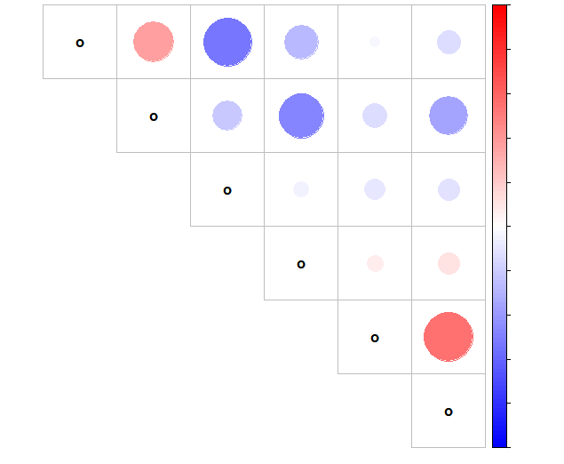
Results: Correlation Analysis
Impervious
Trees per Acre
LST
Lake
Grass
Tree
Correlation coefficient between percentage impervious surface cover and mean LST:
0.38
Correlation coefficient between percentage tree cover and mean LST:
-0.13
1
LST
0.8
0.6
Impervious
0.4
Lake
0.2
0
Grass
-0.2
-0.4
Trees per Acre
-0.6
Tree
-0.8
-1
Notes:
Speaker: Next we created a correlation matrix to see how land surface temperature was correlated to land surface type and tree density. In this plot, a large red circle indicates a strong positive correlation, while a large blue circle indicates a strong negative correlation. For instance, the plot shows that land surface temperature is positively correlated with the percent of a pixel that is covered by impervious surface including building and roads. The correlation coefficient for this relationship is 0.38. Additionally, the plot shows that land surface temperature is negatively correlated with the percent of a pixel that is covered by tree canopy, with a correlation coefficient of -0.13.

Slide 16
Results: LST of City Parks
Name | Mean LST (°C) (2018) | Percent Grass (2010) | Percent Building (2010) | Percent Soil (2010)
Papago Park | 49.7 | 8.7 | 0.2 | 68.6
Victory Park | 49.5 | 15.0 | 0.0 | 24.7
Moeur Park | 49.5 | 12.3 | 0.0 | 69.5
Rotary Park | 49.2 | 36.7 | 17.9 | 15.4
Esquer Park | 49.0 | 39.0 | 1.6 | 44.5
A 10% increase in grass land cover reduces LST by 0.32 °C
A 10% increase in tree land cover reduces LST by 0.19 °C
A 10% increase in soil land cover increases LST by 0.006 °C
A 10% increase in building land cover increases LST by 0.13 °C
Notes:
Speaker: Next we focused our attention on the city parks. We found the mean LST of each park. The above table shows the five hottest parks in Tempe. We were interested in finding out how much land cover explains the land surface temperature of the parks, so we conducted different linear regression analyses between LST and the percentage of different land cover types. We found that while a 10% increase in grass land cover reduces land surface temperature by 0.32 degrees Celsius,(click) and a 10% increase in tree land cover reduces LST by 0.19 degrees Celsius (click), a 10% increase in soil land cover increases land surface temperature by 0.006 degrees Celsius (click) and a 10% increase in building land cover increases land surface temperature by 0.13 degrees Celsius. Because of this, the top five hottest parks either have a high percentage of soil land cover, such as the more natural parks like Papago and Moeur Park, or have a high percentage of building land cover, such as Rotary Park.

Slide 17
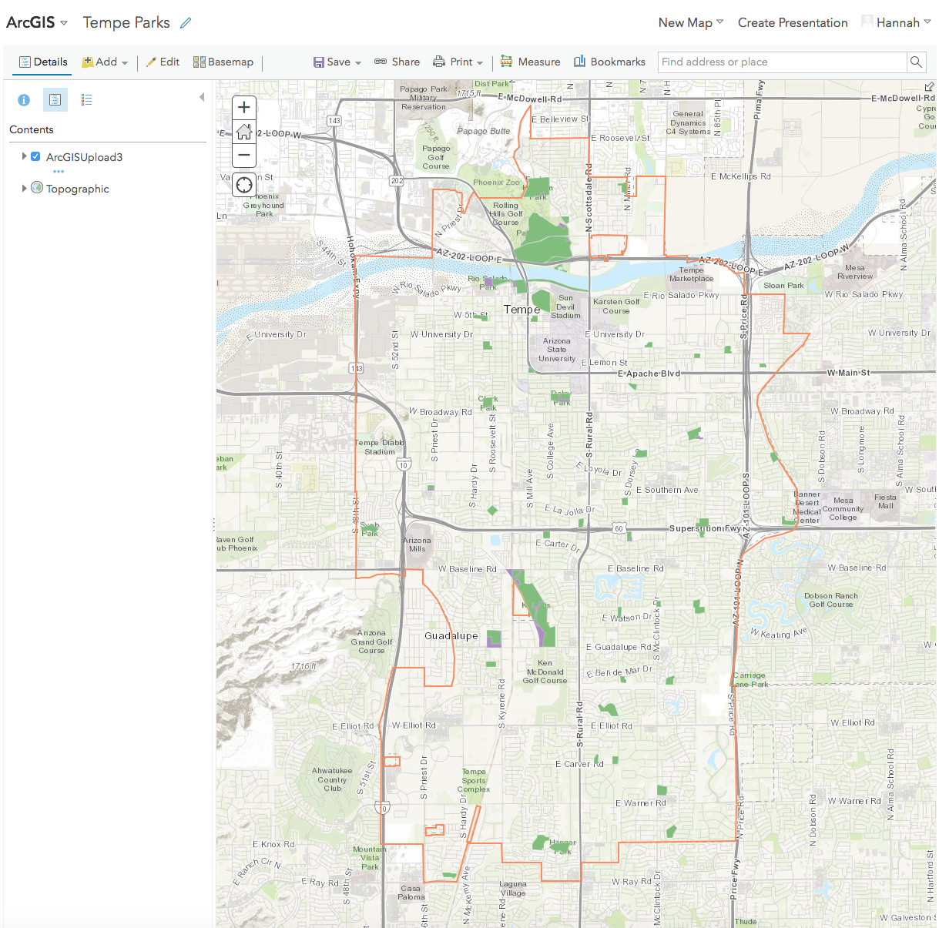
Results: LST of City Parks
Notes:
Speaker:
In order to share the information we were able to acquire on the parks with our partners and the public, we uploaded our Tempe Parks map to ArcGIS Online. The viewer is able to click on a park and a pop-up will appear sharing information on that park such as the mean land surface temperature, number of trees, and the percent of each land cover type. We hope that this makes our collected data easy to explore. (click on hyperlink and show the map online)

Slide 18
Conclusions
There is a strong negative correlation between NDVI and LST, a strong positive correlation between the percentage of impervious land cover and LST, and a strong negative correlation between the percentage tree land cover and LST.
Decreasing the percentage of building and soil land cover and increasing the percentage grass land cover could improve the thermal comfort of parks.
In order to help mitigate the UHI effect, the City of Tempe could focus its efforts on the area west of the AZ Route101and north of US Route 60.
Planting more trees on areas with building land cover could help the City of Tempe achieve its goal of becoming a 20-minute walkable city.
EXAMPLE IMAGE
Notes:
Speaker: Several conclusions were made from our research including: There is a strong negative correlation between NDVI and LST, a strong positive correlation between the percentage of impervious land cover and LST, and a strong negative correlation between the percentage tree land cover and LST. (click) Decreasing the percentage of building and soil land cover and increasing the percentage grass land cover could improve the thermal comfort of parks.(click) In order to help mitigate UHI effect, the City of Tempe could focus its efforts on the area west of the AZ-101 Loop and north of U.S. Route 60 and (click) finally, planting more trees on areas with building land cover could help the City of Tempe achieve its goal of becoming a 20-minute walkable city

Slide 19
Uncertainties & Limitations
Spatial resolution of Landsat imagery limits individual tree identification and closer analysis of parks’ land surface temperatures
Land cover classification includes “tree” class
Difference in weather between years affects the greenness of vegetation and land surface temperature
Image Credits: PowerPoint Icon
Notes:
Speaker: One of the first problems we encountered was finding satellite data at a high enough resolution to analyze LST at the park level and NDVI at the tree level. We originally attempted to use Planet Rapideye satellite imagery, but realized it lacked an thermal band, and so we could not calculate LST with it. Instead, we used Landsat imagery for our calculations, so our analysis wasn’t at as high of resoltuion as we would have hoped (click). Next, when trying to analyze the effect tree cover has on the land surface temperature, the land classification data we used including tree as its own class. Because of this we couldn’t identify for sure what type of land class the trees were located on. (click) An additional limitation was that the difference in weather between years could have affected the greenness of vegetation and the land surface temperature, which is one reason we found the relative change in land surface temperature.
Image Source: PowerPoint icons; (Created by Team)

Slide 20
Future Work
Evaluate a comprehensive ”Heat Score” for each park
Path Analysis for safe corridors between destinations
Identify neighborhoods that are most vulnerable to heat
Target tree placement
Image Credits: PowerPoint Icon
Notes:
Speaker: Looking forward, there is still much to do in order to support the UFMP and help the City of Tempe mitigate extreme heat. To further investigate the thermal comfort of parks, one could evaluate a comprehensive “heat score” using multiple variables including tree density and land cover class in order to identify parks that the City should focus on improving. (click) The next could be analyzing thermal comfort along major arterials in order to identify streets which would benefit from the planting of trees. Finding these streets would help the city reach its goal of becoming a 20-minute walkable city. (click) A next step could be identifying neighborhoods in Tempe that are especially vulnerable to heat by examining socio-economic variables, such as age, race, and household income. This would help the City choose areas in which to focus its heat mitigation efforts (click). As a final step, more field data could be collected in order to try to identify which species of trees provide the best shade at the lowest cost.
Image Source: Made using PowerPoint icons; (Created by Team)

Slide 21
Acknowledgements
Bonnie Richardson – City of Tempe
Braden Kay – City of Tempe
Ariane Middel – Assistant Professor, ASU School of Arts, Media and Engineering
David Hondula – Assistant Professor, ASU School of Geographical Sciences and Urban Planning
Erika Higa – Center Lead, NASA DEVELOP, AZ-Tempe Node
Megs Seeley – Assistant Center Lead, NASA DEVELOP, AZ-Tempe Node
Notes:
Speaker: We would like to sincerely thank you all for coming out to watch us present today. We would especially like to thank Bonnie and Braden from the City of Tempe, as well as our science advisors, Ariane and Dave, and our node leadership, Erika and Megs, for all of their guidance and support.

Slide 22
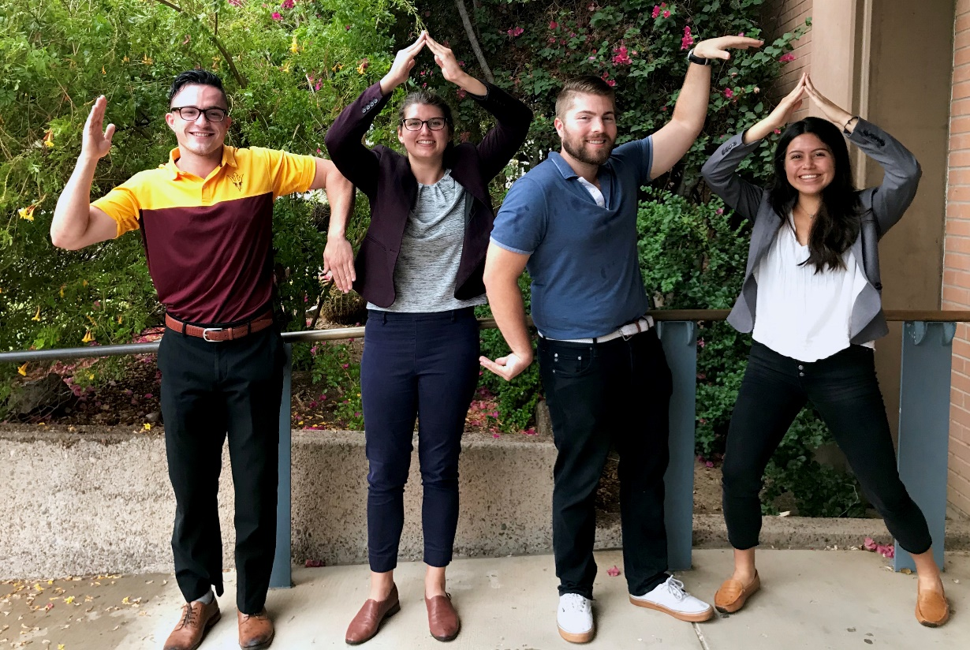
Notes:
Any questions??

