Slide 1
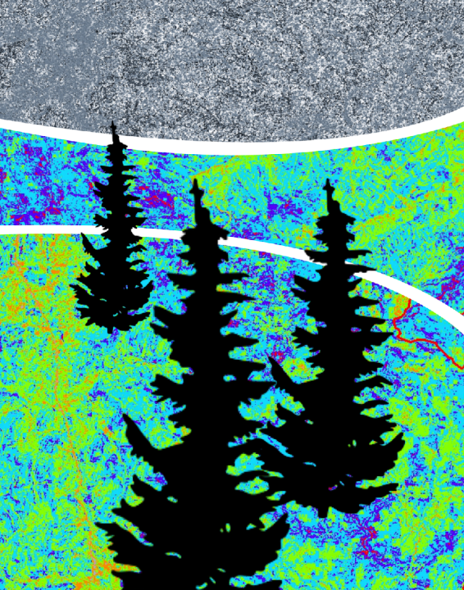
SOUTHERN APPALACHIA
DISASTERS II
Using NASA Earth Observations to Monitor Vulnerability, Wildfire Damage, and Recovery in the Appalachian Forests
Amanda Aragón
Ruth Buck
David Rickless
Jayanta Ganguly
Matthew Hevert
Holly Hutcheson
Yangjiaxin Wei
University of Georgia
2017 Summer
Notes:
This is a the final term of a 2-term project that began in spring 2017 at the UGA node. The first term of this project focused on the physical factors influencing wildfire risk and susceptibility in the Southern Appalachians. This term, we focused on incorporating socio-economic data to better understand what communities will be most affected by future fire events.

Slide 2
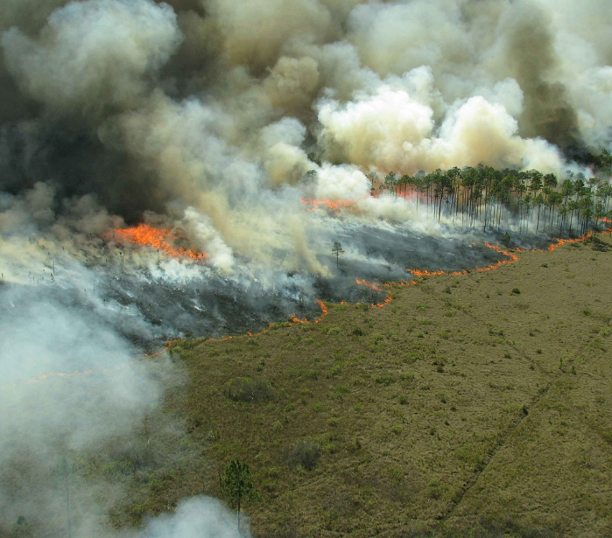
Outline
Project Objectives
Study Area & Period
Community Concerns
Methodology
Results
Conclusions
Limitations
Future Work
Acknowledgements
Image Credit: Public Domain
Image Credit: Monet
Notes:
Here is an overview of today’s presentation.

Slide 3
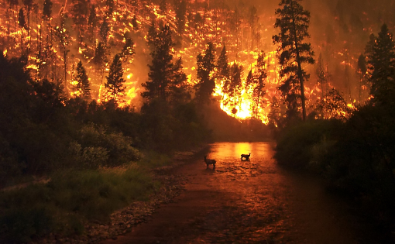
Project Objectives
Analyze vegetation and fire fuel change before, during, and after the fall 2016 wildfires using Landsat 8 OLI, Terra MODIS and ASTER, and Sentinel II MSI data
Create a wildfire vulnerability model based on a range of environmental factors including elevation, vegetation, soil moisture, and land cover type, and socioeconomic factors, such as income, race, and housing
Explore the social and biological factors that may lead to increased wildfire susceptibility in the Southern Appalachian region of the United States
Image Credit: John McColgan
Notes:
The team’s objectives were to analyze temporal vegetation/fuel change in the Southern Appalachian Study Area from 2000 to present using MODIS sensory data and high-resolution Landsat 8 data. The team also explored physical and biological factors that may lead to increased wildfire susceptibility in the Southern Appalachian Study Area.
Create a wildfire risk model based on physical and biological factors that categorizes 30 meter pixels within the study area as high, medium, or low wildfire risk. Establish a framework to incorporate socio-demographic wildfire risk factors into a comprehensive wildfire susceptibility index that includes an analysis of CWPPs, Firewise communities, and heir’s properties
Image Source: https://simple.wikipedia.org/wiki/Wildfire#/media/File:Deerfire_high_res_edit.jpg

Slide 4
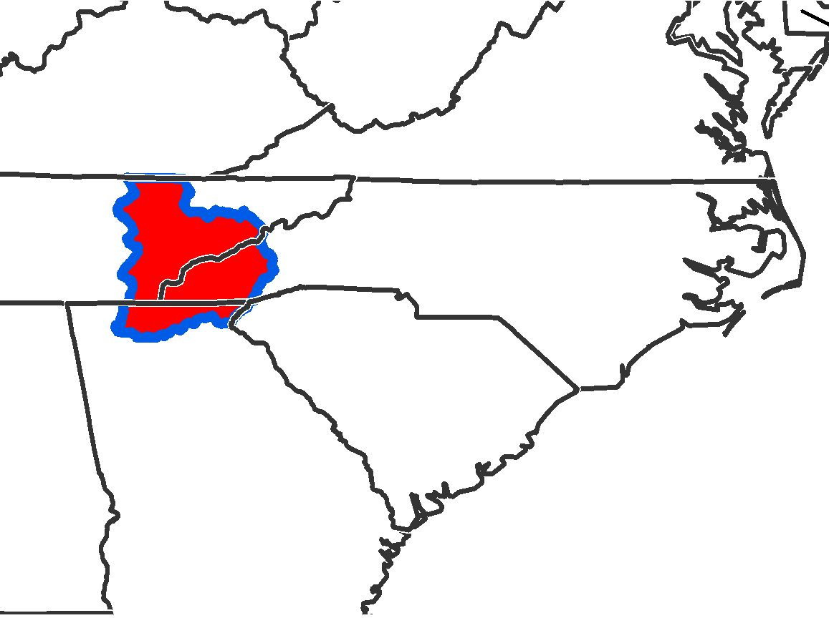
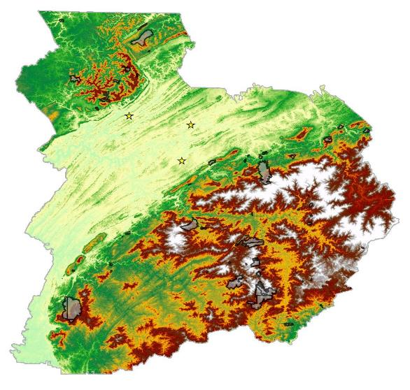
Study Area & Period
KY
VA
TN
NC
Knoxville
Oak Ridge
SC
Maryville
GA
Notes:
The Appalachian mountains are located in the eastern United States and are the oldest chain of mountains in North America stretching more than 1,500 miles from Canada to central Alabama (https://www.nature.org/ourinitiatives/regions/northamerica/unitedstates/northcarolina/placesweprotect/southern-appalachians.xml?redirect=https-301). The study area for this project concentrates on three states that were significantly affected by the fall 2016 fire events. Georgia, Tennessee, and North Carolina had the highest impacts from the fires and require further investigation on a physical and socio-economic level to evaluate the potential for future events and establish a fire vulnerability matrix. Over 15,000 acres burned within the Great Smoky Mountains National Park alone (http://www.nationalparkstraveler.com/2016/11/fires-and-out-great-smoky-mountains-national-park-lead-great-damage-gatlinburg).
There is a need for forest service agencies to have a thorough understanding of the vulnerability, damage, and recovery related to wildfires in remote and economically depressed areas such as the Southern Appalachians. This study observes environmental conditions of the land before, during, and after the fires from October 1, 2016 to December 30, 2016.
This Figure represents phenological differences within our study area and highlights the six major fire events that occurred within our study area.

Slide 5
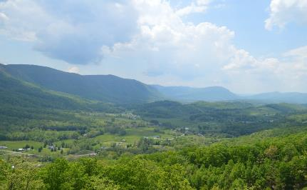
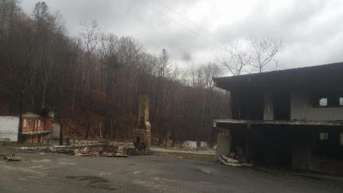
Community Concerns
In November of 2016...
Nearly 60 individual wildfires damaged hundreds of buildings, caused power outages, and led to multiple evacuations
Fires spread by 90 mph winds, low humidity, presence of fuel loads, and drought
Over 15,000 acres burned within Great Smoky Mountains National Park and the adjacent popular tourist areas of Gatlinburg and Pigeon Forge
Image: Matthew Hevert
Notes:
In November 2016, nearly 60 individual wildfires damaged hundreds of buildings, caused power outages, and led to multiple evacuations. Additionally, fires spread by 90 mph winds, low humidity, presence of fuel loads, and drought (http://www.usatoday.com/story/news/nation-now/2016/11/29/tennessee-wildfires-gatlinburg/94591254/). In fact, over 15,000 acres burned within Great Smoky Mountains National Park and the adjacent popular tourist areas of Gatlinburg and Pigeon Forge (http://www.nationalparkstraveler.com/2016/11/fires-and-out-great-smoky-mountains-national-park-lead-great-damage-gatlinburg).
The recent fire events have raised concern over the threat that wildfires have on local communities. Although there have been intensive studies on wildfires and fire ecology, much less attention has been devoted to simultaneously identifying social drivers and physical factors related to the spread of wildfires in this sub-region of the southeastern United States. A portion of this project will focus on “heirs’ properties”, defined as any real property with multiple owners whose names are not explicitly noted on property deeds. It is believed that due to the unclear lack of ownership, mismanagement and poor maintenance of the lands have increased the fuel loads making these areas more susceptible to fires.
Image Source: Matthew Hevert, Gatlinburg, TN 2017
Image Source: https://pixabay.com/en/mountains-virginia-green-fields-773920/

Slide 6
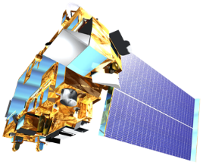
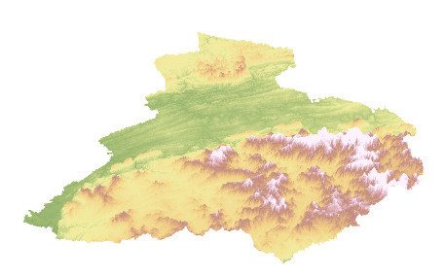
NASA Earth Observations
Landsat 8 OLI
Terra ASTER & MODIS
Notes:
To address the needs of the US Forest Service Southern Research Station, the team decided to implement a Fire Risk model based on pre-fire conditions. For the model input datasets, the team obtained cloud-free Landsat 8 scenes corresponding to the coverage of the study area by path-row and MODIS ForWarn data from 2000 to 2012. The team also downloaded 30m ASTER DEMs for elevation data.
To address the current fire conditions the team obtained scenes from Landsat 8 OLI data to investigate before, during, and after fire conditions and determining the relations to the pre-fire risk model. Both Landsat and ASTER were acquired through the USGS EarthExplorer website. MODIS Data were acquired through ForeWarn.
Credit: NASA

Slide 7
Data Acquisition | Inputs and Processing |  | Output | End Product
 | NDVI (250m) Forest Thrive/Decline | Biological Risk Factors | Fire Risk Model
 | Land Cover NDVI (30 & 10m) NDMI (30 & 10m) NBRI (10m)
 | DEM (30 & 10m) Slope (30 & 10m) Aspect (30 & 10m) | Physical Risk Factors
 | CWPPs FireWise Communities Heirs’ Properties Census Data
 | Global Population Grid National Land Cover Data
Terra MODIS
(ForWarn data)
Biological Risk Factors
Landsat 8 OLI
& Sentinel-2 MSI
Fire Risk Model
Terra ASTER
& NED
Physical Risk Factors
Integrated
Wildfire Vulnerability
Index
Socio-
Economic Data
Social Vulnerability Index
Population Density
Dasymetry of Vulnerable Population
Notes:
The data analysis included three parts: Biological Risk Analysis, Physical Risk Analysis and Social Impact and Risk Analysis. In order to access biological and physical risk factors, the team utilized MODIS, LandSAT 8 OLI and Terra ASTER data; wherein socio-demographic and air quality data were used to evaluate social impacts and risk factors. By classifying the biological and physical risk factors into three categories (High, Medium and Low) and integrating them with social risk factors, the team was able to evaluate wildfire vulnerability using an index (ranging from 0-1).

Slide 8
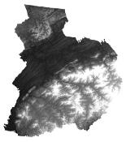
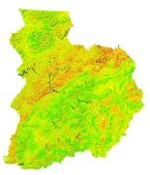
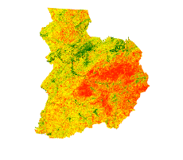
Fire Risk Model
Parameters
Moisture (NDMI)
Vegetation (NDVI)
Landcover Type (NLCD)
Slope and Aspect (DEM)
ForWarn Evergreen and Deciduous Decline
ForWarn
NDVI
NDMI
NLCD
DEM
Scores &
Weight %
Fire Risk Model
Notes:
For the biological and physical risk factors, each of the inputs were assigned different weights and summed in order to categorize each pixel within the study area as High, Medium, or Low risk. Ultimately, social risk factors will be combined with the biological and physical risk factors to create a comprehensive wildfire vulnerability index for the Southern Appalachia study area.
Image Source: https://pixabay.com/en/fire-flame-danger-burn-light-307384/

Slide 9
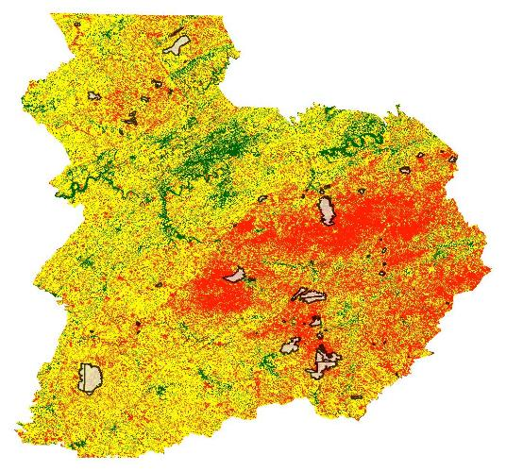
2016 Pre Fire Model
Rank | Pre Fire Model 1 | Weights
1 | Slope | 0.182
2 | NDVI | 0.182
3 | Evergreen Decline | 0.182
4 | Impervious Surface | 0.091
5 | Deciduous Decline | 0.091
6 | NLCD | 0.091
7 | NDMI | 0.091
8 | Canopy | 0.0455
9 | Aspect | 0.0445
 |  | 1
Low
Moderate
High
2016 Fire Perimeters
Notes:
Together, the biological and physical land factors can be combined to assign a high, medium, or low risk rating to each pixel that indicates its susceptibility to wildfires. Some social risk factors that are likely associated with the wildfire susceptibility of an area were also included in the analysis. CWPP and Firewise community point locations and their proximity to fires provide a visual assessment of communities that are likely less susceptible to and better prepared for fires. A comprehensive Wildfire Susceptibility Index was created from processed data and future social indicators will be included into same Index for future community level research and preparedness.

Slide 10
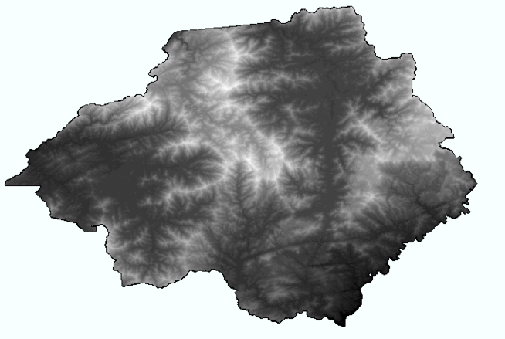
Case Study: Rabun County, GA
MODIS & Sentinel 2 imagery were used to develop local phonological changes (decadal scale) and NDVI/NDMI projections
Established a more comprehensive Wildfire Susceptibility Index for this subset of the Southern Appalachian region
Notes:
Scene selection of Landsat 8 paths were selected with priority of lowest percentage of cloud coverage. From 2000 to 2012, MODIS level sensory data indicating phenoregional decadal change and NDVI was utilized in order to complete comprehensive understanding of health of vegetation in the Southern Appalachian region. Landsat 8 imagery was processed into NDVI and NDMI projections for future analysis of susceptibility risks. Using combined data from MODIS, ASTER, and Landsat 8, the team developed a classification scheme that incorporated a categorical three-tiered fire risk model that evaluates and ranks each pixel as low, medium, or high fire risk based on both physical and biological inputs from our study area. A comprehensive Wildfire Susceptibility Index was created from processed data and future social indicators will be included into same Index for future community level research and preparedness.
Image Source: Terra ASTER DEM

Slide 11
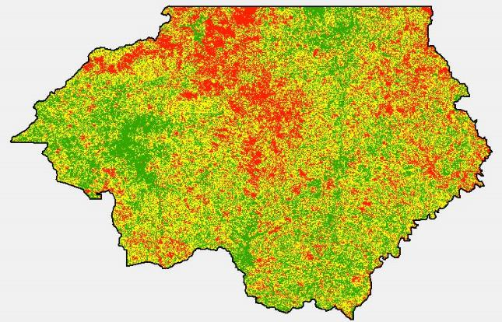
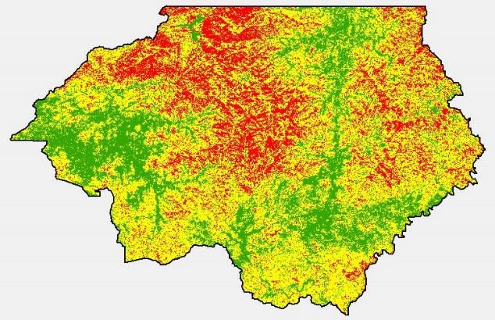
Term 1 Term 2
SAD 1 & SAD 2
Rabun County, GA
Wildfire Risk
Low
Moderate
High
Notes:
The final wildfire risk model does appear to accurately classify our study region into areas of high, medium, and low wildfire risk. The model can be used by the US Forest Service to focus their prevention planning and allocate their resources to areas most at risk for fire events in the near future. Over half of all fire event locations can be characterized by high risk areas. Approximately one percent of the fire perimeters were characterized by low risk areas. Due to the physical and social impacts of the wildfire events, these estimates reflect sound justifications for the level of impact occurred.

Slide 12
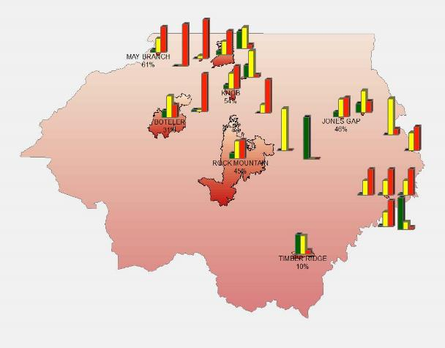
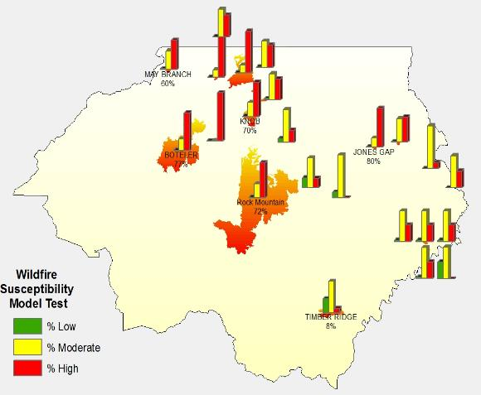
Quality Assessment of Term 1 & Term 2
Quality Assessment of SAD 1
Notes:
The DEVELOP team was able to compare the 2016 wildfire extents with model outputs to generate summary statistics. This allowed the team to gain a better understanding of where these fire events occurred within the context of the model results and what environmental factors represented the perimeter of these events. More than half of the Rock Mountain event was characterized by high risk and nearly thirty six percent possessing medium wildfire risk. Low risk rates were characterized by less than one percent

Slide 13
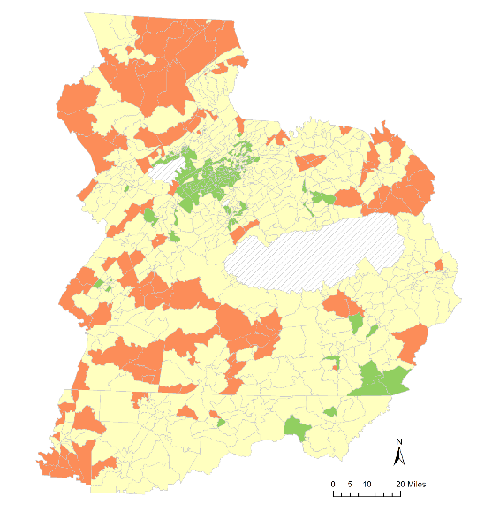
Social Vulnerability Index
Standardized input variables using z-score statistics and then analyzed through Principal Component Analysis
Applied Varimax rotation to Initial PCA solution
Calculated and standardized the social vulnerability score
Assigned a high, moderate, and low vulnerability rating
Low
Moderate
High
Notes:
Together, the biological and physical land factors can be combined to assign a high, medium, or low risk rating to each pixel that indicates its susceptibility to wildfires. Some social risk factors that are likely associated with the wildfire susceptibility of an area were also included in the analysis. CWPP and Firewise community point locations and their proximity to fires provide a visual assessment of communities that are likely less susceptible to and better prepared for fires. A comprehensive Wildfire Susceptibility Index was created from processed data and future social indicators will be included into same Index for future community level research and preparedness.

Slide 14
Results
Wildfire Vulnerability Index
Exploratory analysis identified clusters of high biophysical wildfire risk and high social vulnerability to wildfires.
Suburban areas near Knoxville, TN exhibited low vulnerability, while some rural areas exhibited higher vulnerability.
Low
Moderate
High
Notes:
Biological and physical factors indicate areas of potential fires within the Southern Appalachian area. Models from prefire conditions indicate areas of potential fire risk and are mapped to compare with the actual Fall fires from 2016. The data provided from this term’s analysis of physical wildfire risk factors will provide a great deal of reference and information for future analysis of social wildfire factors as well as impacts of the communities residing in immediate areas. Such factors that have been offered as key areas of research include but are not limited to median income, education attainment, housing infrastructure, age prevalence, presence of heir’s properties, and the presence of CWPPs and other fire mitigation plans.
The results from this project provide our partners with a framework map of biological and physical factors that identify potential wildfire risk. The results will be incorporated with a second term DEVELOP project to address the concerns of how heirs’ properties as a type of land ownership along with other social factors may impact the risk of wildfires in the southeast.

Slide 15
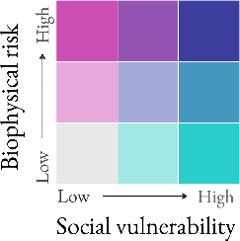
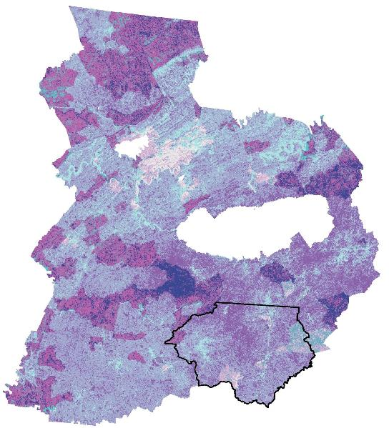
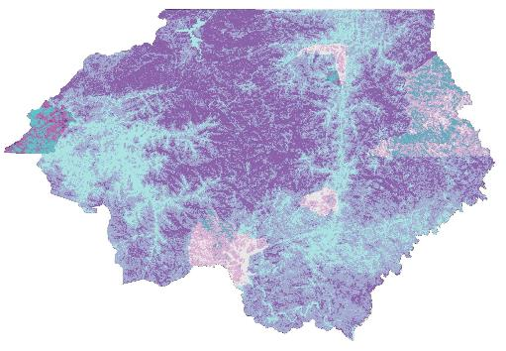
Results
Notes:
Rabun County blowout of 10m pixel resolution
The biophysical fire susceptibility model was found to be highly sensitive to atmospheric correction of satellite imagery.
Exploratory spatial data analysis identified clusters of high biophysical wildfire risk and high social vulnerability to wildfires.
Suburban areas near Knoxville, TN exhibited low vulnerability, while some rural areas, such as White County, GA exhibited higher vulnerability.
Due to insufficient heirs’ property data, no relationship between heirs’ properties and wildfire vulnerability was able to be proven for the study area.

Slide 16
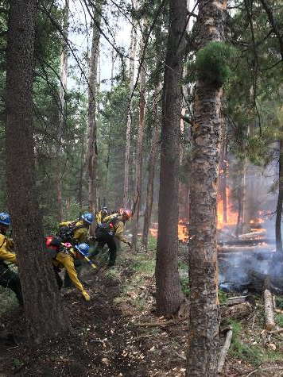
Limitations
Did not account for wind and air particulates that play an important role in the spread of fire
Number of parameters used could affect the overall results
Year-round collection of data could provide further understanding of management strategies
Assumptions of social vulnerability factors could be validated via in situ data collection
Image Credit: Steven Aragón
Notes:
In every project there are always errors and uncertainties. While wind plays an important role in fire dispersion, it is not accounted for in our fire risk model. Air particulates, like wind, could also influence to the directional spread of fires. This data was not used in this model because it could only be uptrained and recorder during the time of a fire event. However, these factors will be considered when addressing the social demographic variables. The number of parameters used could change the model outcomes. Data for this project was collected during fall/winter seasons when fires are most prevalent in this region, a comprehensive collection of year-round data could improve the understand of fire management. The model will be refined through communication with The Forest Service.
Image Source: https://pixabay.com/en/fire-matchstick-house-2086388/

Slide 17
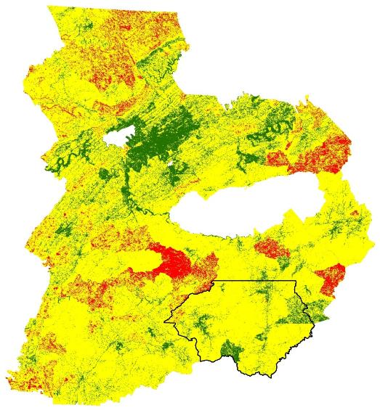
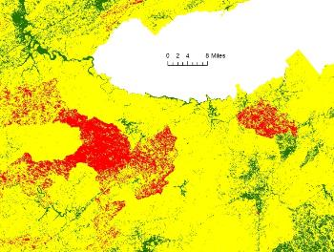
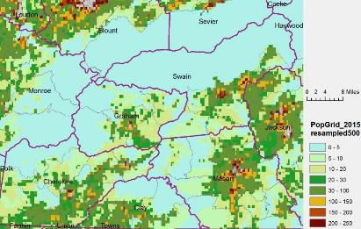
Social & Biophysical Investigation
Notes:
With regard to the social vulnerability index, it is important to acknowledge the modifiable areal unit problem, that is, aggregating demographic data into polygons obscures variation within those areas. To address some of the limitations of the social vulnerability index, a mixed-methods in situ investigation into the social processes specific to our study area would be productive.
To demonstrate this, an in-depth view of population density at a finer resolution is shown here in this dasymetric Integration (500 m) of Social & Biophysical data. Within each block group the spatial distribution of populations can be seen.

Slide 18
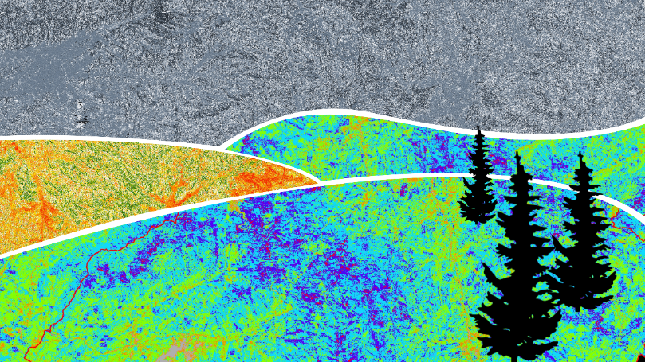
Future Work
Analyze factors that may lead to increased health risk as a result of wildfire
Evaluate air quality before, during, and after a wildfire
Notes:
Due to the wide scope of impacts that occurred from the wildfires in the Southern Appalachian Fires in the latter months of 2016, this term’s, that is Spring and Summer 2017, focus was to analyze and interpret major physical impacts on the landscape using remote sensed data from various satellite sensors. Moreover, due to the limited temporal constraints on the project completion, other factors, specifically social impacts and susceptibility, were not included in the primary conducted research.
Such factors that have been offered as key areas of research include but are not limited to median income, education attainment, housing infrastructure, and age prevalence. This area of research provide a great deal of information that focuses on a different aspect of the impacts of the wildfires in the Southern Appalachian mountains.
(Further Work TBD)
Future work would include the investigation of health and air quality as a result of fires in and around urban areas.

Slide 19
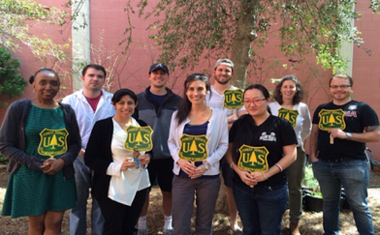
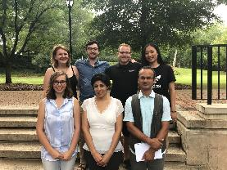
Acknowledgements
Advisors
Dr. Marguerite Madden, UGA Center for Geospatial Research
Dr. Sergio Bernardes, UGA Center for Geospatial Research
Other
Caren Remillard, NASA DEVELOP UGA Center Lead
Christopher Cameron, NASA DEVELOP UGA Fellow
Joshua Willis, Past Contributor
Natalia Bhattacharjee, Past Contributor
Stephen Jordan, Past Contributor
Partners
Cassandra Johnson Gaither, US Forest Service Southern Research Station
Steven Norman, US Forest Service Eastern Forest Environmental Threat Assessment Center
William Christie, US Forest Service Eastern Forest Environmental Threat Assessment Center
Joe O’Brien, US Forest Service Southern Research Station
Notes:
The results from this project have been passed along to our partners at the Forest Service, and we hope they’ll be able to use them to inform their research. In addition to our partners, we’d like to thank all the other folks who have contributed to this project. It has definitely been a team effort.

