Slide 1
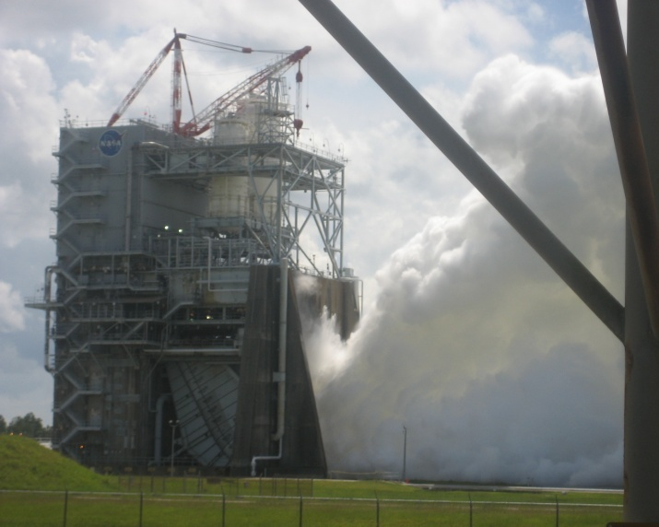


DEVELOP National Program
About NASA & DEVELOP:
History, organization, Personnel

Slide 2
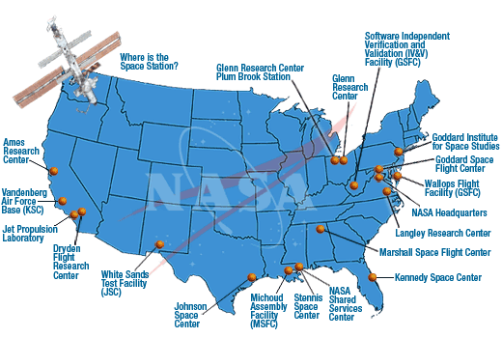
History
NASA History
"An Act to provide for research into the problems of flight within and outside the Earth's atmosphere, and for other purposes." With this simple preamble, the US Congress and President Dwight D. Eisenhower established the National Aeronautics and Space Administration (NASA) on July 29, 1958.
NASA began operations on October 1, 1958, absorbing into itself the earlier National Advisory Committee for Aeronautics (NACA) intact: 8,000 employees, an annual budget of $100 million, three major research laboratories - Langley Aeronautical Laboratory, Ames Aeronautical Laboratory, and Lewis Flight Propulsion Laboratory - and two smaller test facilities.
DEVELOP History
In 1998, three interns at NASA Langley Research Center co-authored the white paper “Practical Applications of Remote Sensing” (Bauer et al., 1998). At that time, the Digital Earth Initiative, a federal interagency project dedicated to creating a virtual representation of the Earth to further human understanding of the world, was piloting an effort to increase public access to federal information about the Earth and the environment. A proposal combining NASA’s Digital Earth Initiative and the students’ paper advocated the formation of a program, and in 1999 DEVELOP was officially formed. Beginning in 2001, new offices were established across the country and expansion has continued to today. DEVELOP is always looking for new opportunities to expand the DEVELOP network and those benefiting from DEVELOP activities.

Slide 3
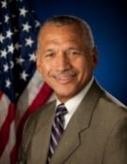
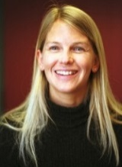
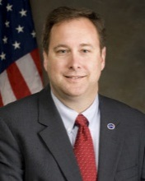
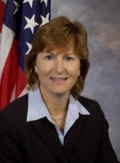
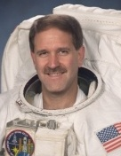
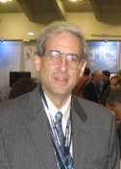
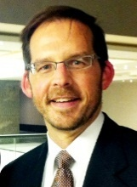
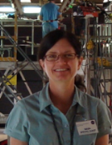
NASA Personnel & Hierarchy
Office of the Administrator
Administrator: Charles Bolden, Jr.
Deputy Administrator: Dava Newman
Associate Administrator: Robert Lightfoot
Deputy Associate Administrator: Lesa Roe
Administrator Staff Offices
Chief Scientist: Ellen Stofan
International & Interagency Relations: Michael O’Brien
Mission Directorates
Science, Associate Administrator: John Grunsfeld
Earth Science, Director: Mike Freilich
Applied Sciences Program, Director: Lawrence Friedl
Capacity Building Program, Program Manager: Nancy Searby
Space Technology, Associate Administrator: Steve Jurczyk
Charles Bolden
Dr. Dava Newman
Robert Lightfoot
Lesa
Roe
Dr. John Grunsfeld
Dr. Mike Freilich
Resources:
  NASA Org Structure w/Names: http://www.nasa.gov/about/org_index.html
  Science: http://science.nasa.gov/
  Earth Science: http://science.nasa.gov/earth-science/
  Applied Sciences Program: http://appliedsciences.nasa.gov/
Lawrence Friedl
Dr. Nancy Searby
NASA Organization Chart: http://www.nasa.gov/about/org_index.html#.VBNBWvldWbM

Slide 4
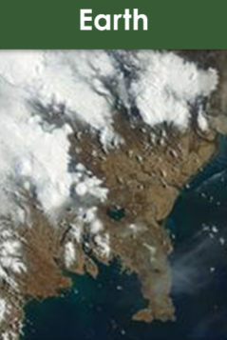

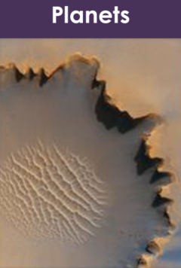
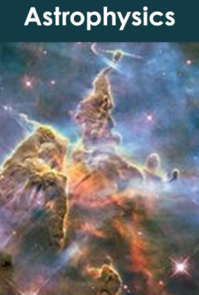
Science Mission Directorate
“Exploring near… and far… for the benefit of all.”
NASA leads the nation on a great journey of discovery, seeking new knowledge and understanding of our planet Earth, our Sun and solar system, and the universe out to its farthest reaches and back to its earliest moments of existence. NASA's Science Mission Directorate (SMD) and the nation's science community use space observatories to conduct scientific studies of the Earth from space to visit and return samples from other bodies in the solar system, and to peer out into our Galaxy and beyond.
Earth
Heliophysics
Planets
Astrophysics
NASA Science Mission Directorate Website: http://science.nasa.gov/

Slide 5
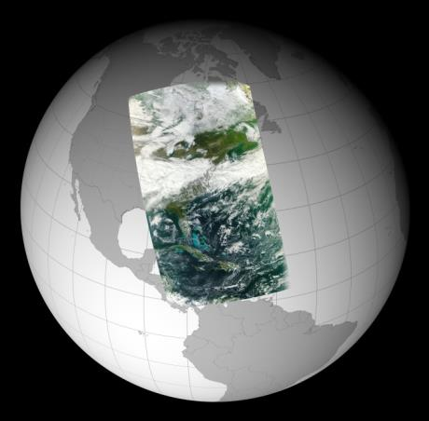
Earth Science Division
“Advancing Earth System Science to meet the challenges of climate and environmental change.”
Earth is a complex, dynamic system we do not yet fully understand, and like the human body, is comprised of diverse components that interact in complex ways. Our planet is changing on all spatial and temporal scales. The purpose of NASA's Earth science program is to develop a scientific understanding of Earth's system and its response to natural or human-induced changes, and to improve prediction of climate, weather, and natural hazards.
Research Encompasses:
The global atmosphere
The global oceans including sea ice
Land surfaces including snow and ice
Ecosystems
Interactions among the atmosphere, oceans, land and ecosystems, including humans
NASA Earth Science Division Website: http://science.nasa.gov/earth-science/

Slide 6

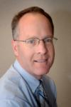
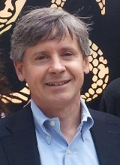
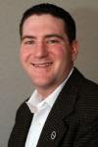
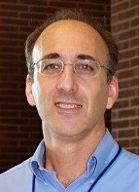
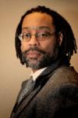
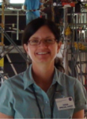

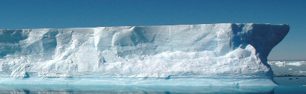
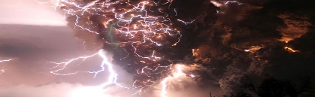
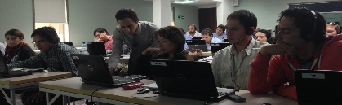


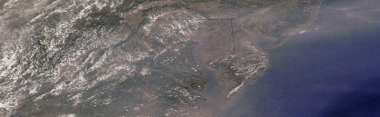
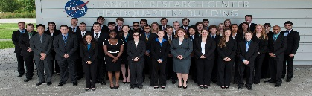
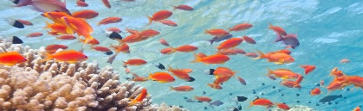
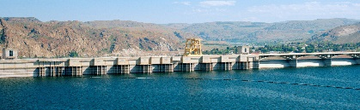

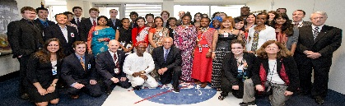
Applied Sciences Program
“Discovering Innovative & Practical Applications of NASA Earth Science”
Lawrence Friedl
Director
Partner with public and private organizations
Discover innovative NASA Earth science applications
Support environmental decision-making activities
Demonstrate practical benefits of NASA Earth science
Help improve the quality of life and strengthen the economy
ASP Program Managers (NASA HQ)
Brad Doorn
Water
Woody Turner
Eco
John Haynes
Health/AQ
David Green
Disasters
Lucien Cox
Operations
Manager
Nancy Searby
Capacity
Building
National Application Areas + Capacity Building Elements
Agriculture
Climate
Disasters
ARSET
Eco Forecasting
Energy
Health & AQ
DEVELOP
Oceans
Water Resources
Weather
SERVIR
Applied Sciences Program Website: www.nasa.gov/applied-sciences

Slide 7

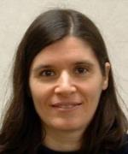
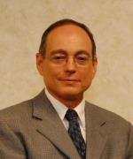
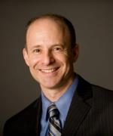
ASP’s Capacity Building Program
Engages current and future decision makers in a spectrum of activities to improve skills and capabilities in the United States and developing countries to access and apply NASA Earth science.
Three elements: ARSET, DEVELOP, SERVIR
(GOMI recently graduated)
Nancy Searby
Program Manager
CBP Element Leads
Ana Prados
ARSET
NASA Goddard
Mike Ruiz
DEVELOP
NASA Langley
Dan Irwin
SERVIR
NASA Marshall
ARSET
Online and hands-on NASA remote sensing training
DEVELOP
Dual workforce capacity building using collaborative feasibility projects
SERVIR
Building international capacity in
developing countries

Slide 8
Where DEVELOP Fits @ NASA
NASA Administrator
Associate Administrator
Mission Directorates
Human Exploration and Operations
Space Technology
Mission Support
Aeronautics Research
Science
Joint Agency Satellite Div.
Heliophysics Division
Earth Science Division
Planetary Science Div.
Astrophysics Division
Applied Sciences Program
Capacity Building Program
You Are Here!
DEVELOP National Program

Slide 9

NASA Chain of Command
NASA Administrator
Charles F. Bolden, Jr.
Deputy Administrator
Dava Newman, Ph.D.
Associate Administrator
Robert M. Lightfoot, Jr.
Charles Bolden
Dr. Dava Newman
Robert Lightfoot
Associate Deputy Administrator
Lesa Roe
Science Mission Directorate
John Grunsfeld, Ph.D.
Earth Science Division
Mike Freilich, Ph.D.
Lesa
Roe
Dr. John Grunsfeld
Dr. Mike Freilich
Applied Sciences Program
Lawrence Friedl
Capacity Building Program
Nancy Searby, Ph.D.
DEVELOP National Program
Mike Ruiz
Lawrence Friedl
Dr. Nancy Searby
Mike
Ruiz

Slide 10
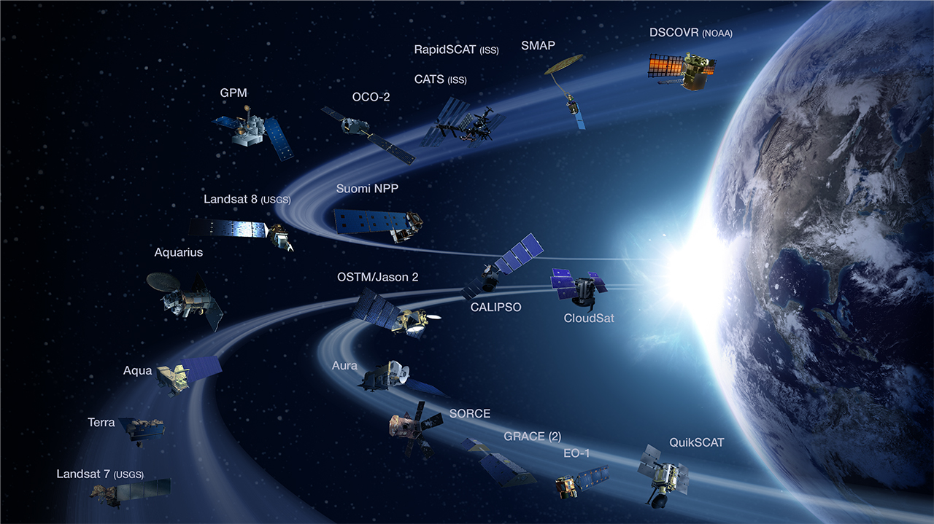
NASA Earth Observing Satellites
NASA Earth observations include a coordinated series of 17 polar-orbiting and low
inclination satellites for long-term global observations.

Slide 11
EO v. EOS
Current NASA Satellite Missions: (aka Earth Observations)
Aqua
Aquarius
Aura
CALIPSO
CloudSat
EO-1
GPM
GRACE
Landsat 7
Landsat 8
OSTM/Jason-2
OCO-2
QuikSCAT
SORCE
SMAP
Suomi NPP
Terra
NASA’s Earth Observing System (EOS): EOS is a subset of the full suite of NASA Earth observing missions focused on long-term global observations of the land surface, biosphere, solid Earth, atmosphere, and oceans to improve understanding of the Earth as an integrated system.
Current EOS Missions:
Aqua
Aura
Landsat 7
Landsat 8
OSTM/Jason-2
QuikSCAT
SORCE
Terra
NASA Earth Science Missions: www.nasa.gov/missions/current/index.html

Slide 12
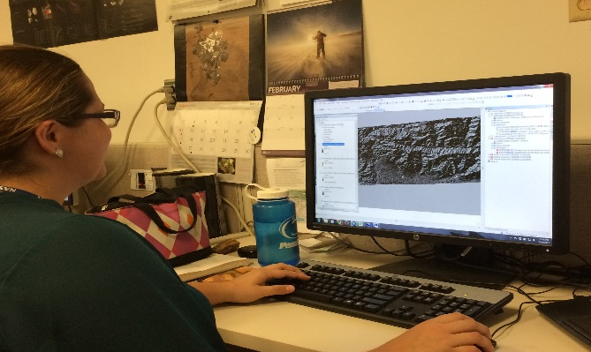
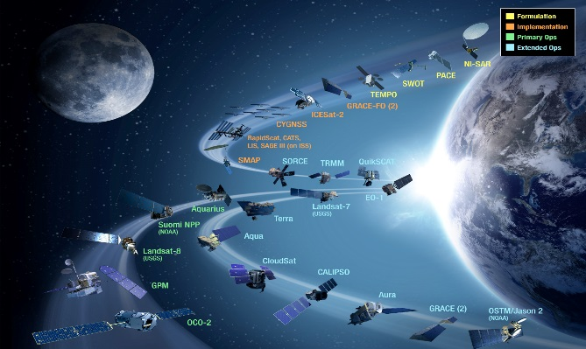
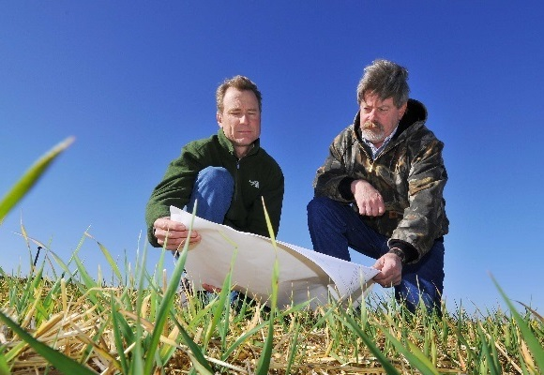
CBP’s DEVELOP National Program
“Shaping the future by integrating Earth observations into global decision making.”
Participants + Earth Observations + Decision Makers
DEVELOP bridges the gap between NASA Earth Science and society, building capacity in both its participants and end-user organizations
to better prepare them to handle the environmental challenges
that face society.
Capacity Building : www.nasa.gov/applied-sciences/capacitybuilding

Slide 13
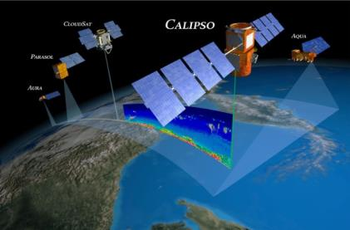
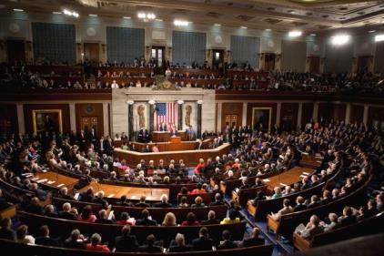
The DEVELOP Elevator Speech
So what is DEVELOP?
DEVELOP, part of NASA’s Applied Sciences Program, addresses environmental and public policy issues by conducting interdisciplinary feasibility projects that apply the lens of NASA Earth observations to community concerns around the globe. Bridging the gap between NASA Earth Science and society, DEVELOP builds capacity in both participants and partner organizations to better prepare them to address the challenges that face our society and future generations. With the competitive nature and growing societal role of science and technology in today’s global workplace, DEVELOP is fostering an adept corps of tomorrow’s scientists and leaders.
NASA’s Applied Sciences’
DEVELOP National Program
Measurements
and Predictions
Communities
DEVELOP’s Website: http://develop.larc.nasa.gov

Slide 14
DEVELOP’s Mission, Vision & Core Values
MISSION
VISION
Integrating NASA Earth observations
with society to foster future innovation and cultivate the professionals of tomorrow by addressing diverse environmental issues today.
Shaping the future by integrating Earth observations into global decision making.
COLLABORATION
Cultivating teamwork, multi-disciplinary solutions, and open communication to bridge the gap between science and society
INNOVATION
Fostering rapid feasibility projects to harness ingenuity and demonstrate the applications of Earth science
PASSION
Pursuing all endeavors with energy, excitement, and enthusiasm to sustain a high level of excellence and respect
DISCOVERY
Exploring the potential of NASA’s investment in Earth science to make the extraordinary possible

Slide 15
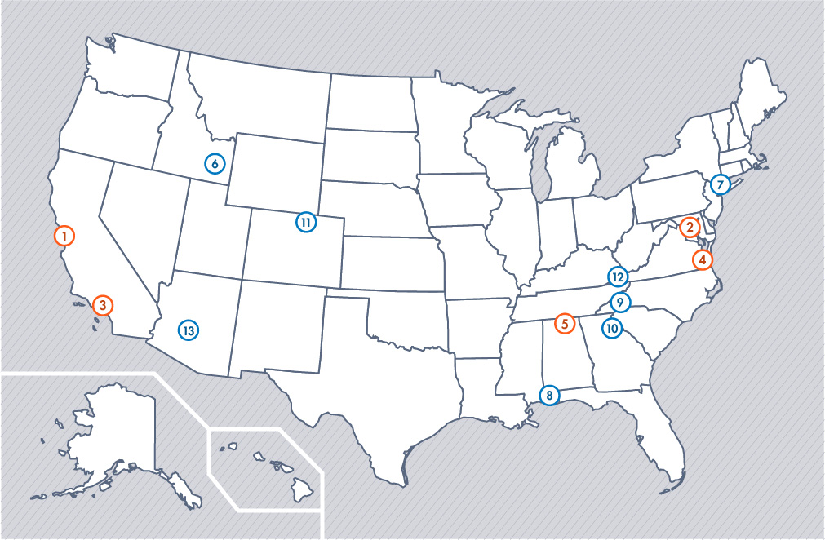
DEVELOP Locations
NASA Center Locations
Can only accept US citizens (exception: MSFC)
Contracted through SSAI, Inc.
Regional Locations
Can accept foreign nationals (exception: NCEI)
Contracted through Wise County, VA

Slide 16
DEVELOP Chain of Command
NPO
National Level
Center Lead
Science Advisor
Mentor
Center Level
Assistant Center Lead
Fellow
Office Level
Project Lead
Project Level
Project Team
Team Level

Slide 17
National POCs
DEVELOP
NPO
Karen Allsbrook
Mike Bender
Lauren Childs-Gleason
Jamie Favors
Lindsay Rogers
Dr. Kenton Ross
Mike Ruiz
Jennifer Tindell
Senior Fellows
Tiffani Miller
Georgina Crepps
DEVELOP
Fellows
Vishal Arya (LaRC)
Emma Baghel (NCEI)
Mark Barker (JPL)
Teresa Fenn (LaRC)
Vickie Ly (ARC)
Ryan Schick (MSFC)
Jordan Vaa (LaRC)
Brittany Zajic (JPL)
Kimberly Berry (WC)
DEVELOP Node Leadership
Ames
Chippie Kislik (CL)
Vickie Ly (ACL)
BLM-ISU
Jenna Williams (CL)
Fort Collins
Brian Woodward (CL)
Goddard
Sean McCartney (CL)
Amanda Clayton (ACL)
IRI
Jerrod Lessel (CL)
JPL
Nick Rousseau (CL)
Brittany Zajic (ACL)
Langley
Emily Adams (CL)
Rebekke Muench (ACL)
Marshall
Leigh Sinclair (CL)
Daryl Ann Winstead (ACL)
Mobile
Tyler Lynn (CL)
NOAA NCEI
Jessica Sutton (CL)
Emma Baghel (ACL)
UGA
Caren Remillard (CL)
Sean Cameron (ACL)
Wise County
Michael Brooke (CL)
Raj Rajappan (ACL)

Slide 18
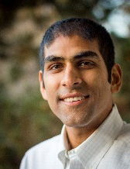
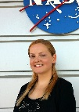
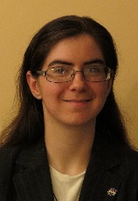
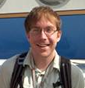
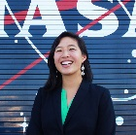
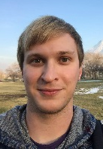
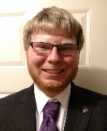
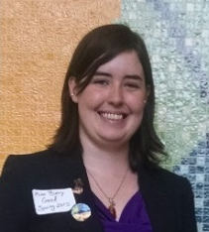
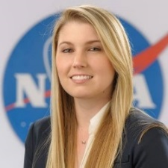
FY15 Fellows Class
What is a DEVELOP Fellow?
A recent college graduate who spends one year with DEVELOP growing both personally and professionally, and contributing to the program as a whole. Each Fellow serves in a dual-role, splitting their time between their node and NPO-related tasks.
Project Coordination Team
Communications Team
Vishal Arya (MCHD)
Emma Baghel (NCEI)
Teresa Fenn (LaRC)
Mark Barker (JPL)
Vickie Ly (ARC)
IT Fellow
Geoinformatics Team
Ryan Schick (MSFC)
Jordan Vaa (LaRC)
Kimberly Berry (WC)
Brittany Zajic (JPL)

Slide 19
Question? Contact…
Contracts & Payroll
Status Reports / Invoices
Schedule Adjustments
Applications
SSAI Personnel Issues
Travel
Deliverables & Deadlines
Conferences & Close Outs
Project Ideas & Requests
Wise Personnel Issues
Export Control
Fellow Class
International Activities
State/Local Govt. Activities
Legislative Affairs
Project Proposals
Partner Engagement
Project Hand-Offs
Contact
Karen Allsbrook
Contact
Lauren Childs-Gleason
Contact
Jamie Favors
Military Engagement
DEVELOPedia
DEVELOP Exchange
DEVELOP Website
Software Release Authority
Software & Hardware
Publications
Social Media
Newsletter
VPS - Videos & Transcripts
Recruiting & Outreach
Microjournal
Socioeconomic Impact Analysis
Tracking Matrics
Results Framework
Partner History/Analyses
Participant/Alumni Survey
Contact
Mike Bender
Contact
Tiffani Miller
Contact
Georgina Crepps

Slide 20

THANK YOU!
Joining the DEVELOP family means being part of NASA’s Legacy.
Learn it. Know it. Live it.

