Slide 1
Your project Website Image will be added to the title slide by the PC Team.
Body text should default to “Black, Text 1, Lighter 25%”
The only font that should be in this presentation is Century Gothic
Delete all red text boxes like this one!

Slide 2

Feel free to expand upon these topics, alter the headings, and change the order of the slides to fit your needs. We prefer descriptive headings over general headings like ‘Results’
Required Content
Study Area
Study Period
Objectives
Partners
Community Concerns
Earth Observations
Methodology
Results
Errors & Uncertainties
Feasibility & Partner Implementation
Conclusions
Acknowledgements
Image Credit: Monet
Notes:
[Insert Speaker Notes]
----------Image Information Below----------
[Photo 1 Identifier]
Image Credit: [insert author] [insert license]
Image Source: [insert URL]
[Photo 2 Identifier]
Image Credit: [insert author] [insert license]
Image Source: [insert URL]

Slide 3
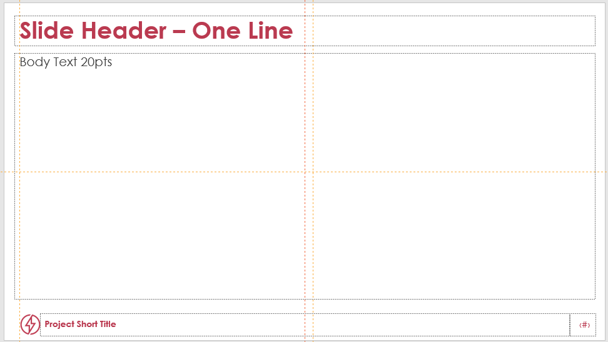
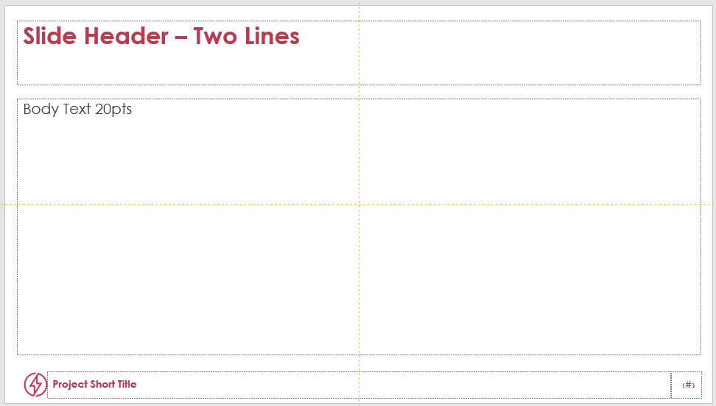
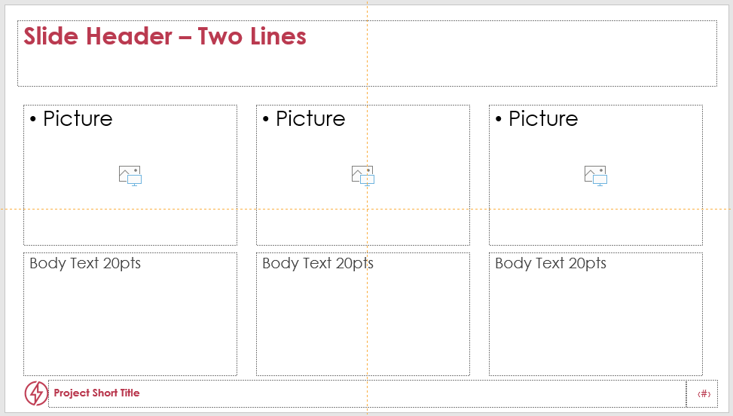
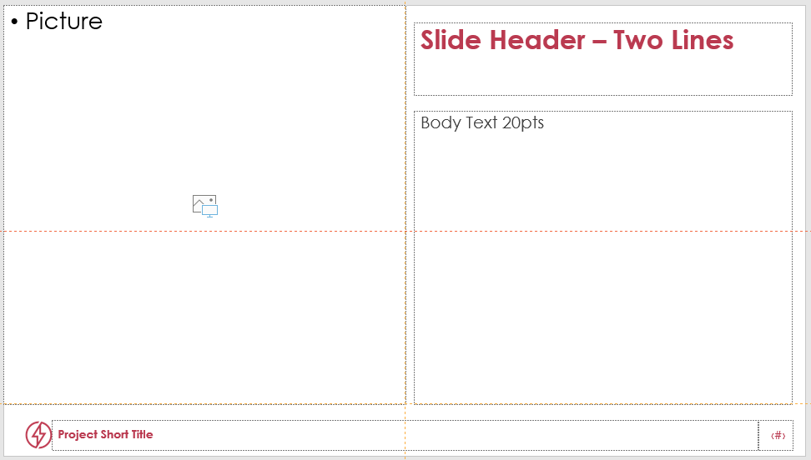
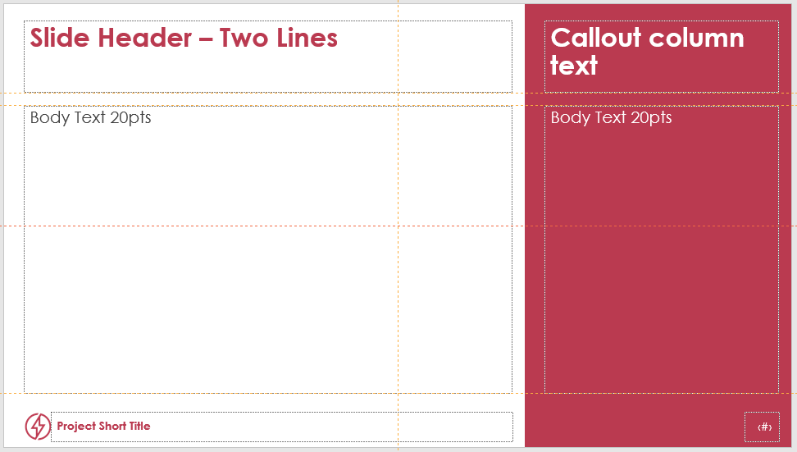

Templates Available
Use these templates as a guide. You may rearrange your content however you like! In the Tools bar, go to Home – Slides – New Slides
1
2
3
4
5
Acknowledgements
Notes:
[Insert Speaker Notes]
----------Image Information Below----------
[Photo 1 Identifier]
Image Credit: [insert author] [insert license]
Image Source: [insert URL]
[Photo 2 Identifier]
Image Credit: [insert author] [insert license]
Image Source: [insert URL]

Slide 4

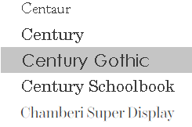
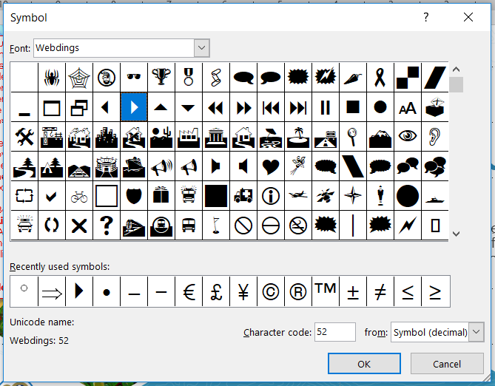
Presentation Guidelines: Fonts
Font is always Century Gothic, including on figures and image captions
Font color is Black, Text 1, Lighter 25%, NOT Black
Font sizing:
  Header text point size should be between 32 and 44 on most slides.
  Body text point size should be at least 20.
  All other text (captions, legend items, image credits) should be no smaller than 10 point type.
Try to use a consistent font size between slides.
The standard DEVELOP bullet style is symbol #52 in the Webdings font. For the browser version of PowerPoint, use the Filled Round Bullets style.
Notes:
[Insert Speaker Notes]
----------Image Information Below----------
[Photo 1 Identifier]
Image Credit: [insert author] [insert license]
Image Source: [insert URL]
[Photo 2 Identifier]
Image Credit: [insert author] [insert license]
Image Source: [insert URL]

Slide 5
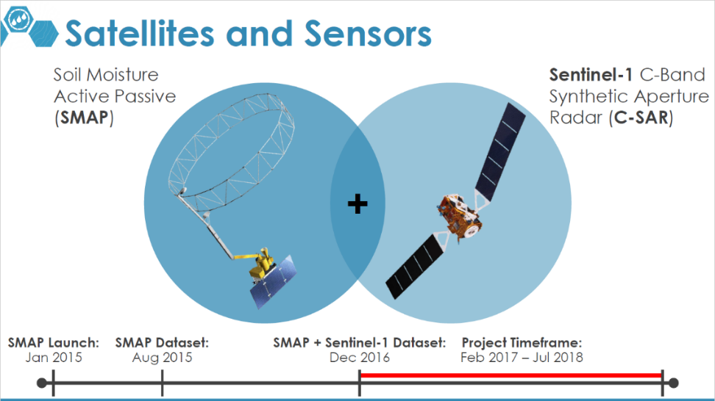
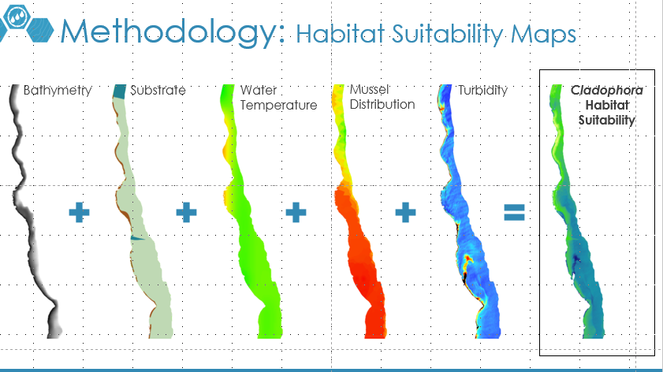
Presentation Guidelines: Tips
Overall, keep text to a minimum.
Include a visual on each slide, if possible.
  Maximize the size of any images, figures, and graphs to fill up the slide
  If you have image borders, which are usually a good idea, make sure they are consistent
Arrange content to minimize white space.
Include full speaker notes for each slide (see below).
  You need to include image information in your speakers notes as well.
Notes:
[Insert Speaker Notes]
----------Image Information Below----------
[Photo 1 Identifier]
Image Credit: [insert author] [insert license]
Image Source: [insert URL]
[Photo 2 Identifier]
Image Credit: [insert author] [insert license]
Image Source: [insert URL]

Slide 6
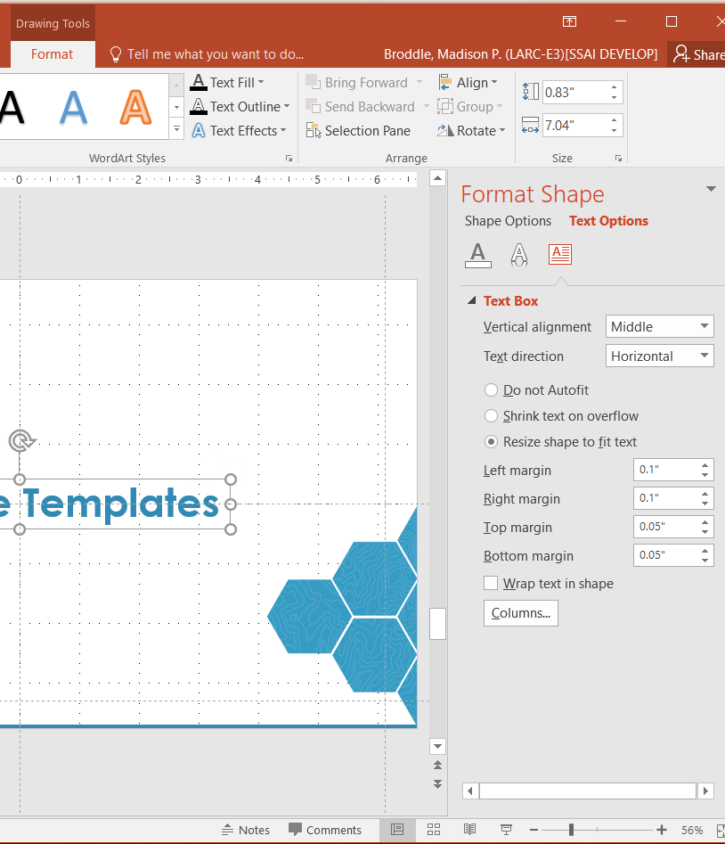
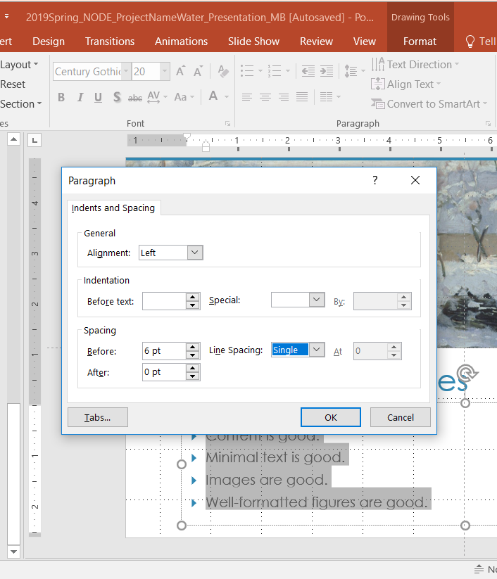
Presentation Guidelines: Tools
The Align Tool
Don’t forget about the distribute spacing tool as well
Text Box Formatting (1)
Shrinking text boxes to fit your text can make it easy to align elements
Line Spacing Formatting (2)
Consistent line spacing can make your presentation look more professional
(1)
(2)
Notes:
[Insert Speaker Notes]
----------Image Information Below----------
[Photo 1 Identifier]
Image Credit: [insert author] [insert license]
Image Source: [insert URL]
[Photo 2 Identifier]
Image Credit: [insert author] [insert license]
Image Source: [insert URL]

Slide 7
Images, Photos, and Logos
Please do not include the image URL in the source text box but rather place it in the notes section below.
If you use a border for your images include it on all photographs to keep your presentation consistent.
Background images are not recommended. If you use one, make sure that your text remains clear and legible.
For images, use the Shadow (Outer) Shape Effect located in the Format Tab in the Drawing Section.
Obtain a media release form from all people in photos that your team has taken!
All image sources should be cited using a consistent format and should be visible on the slide.
On your partner slide, use US Federal logos only. No state, NGO, local and or international government logos, or software logos.
Only use images taken by your team, provided by your partners (as long as you have permission from them), from a Federal Agency or Creative Commons images.
Notes:
[Insert Speaker Notes]
----------Image Information Below----------
[Photo 1 Identifier]
Image Credit: [insert author] [insert license]
Image Source: [insert URL]
[Photo 2 Identifier]
Image Credit: [insert author] [insert license]
Image Source: [insert URL]

Slide 8

Figures and Graphs
Average Annual Mississippi Oyster Landings 2002 – 2015
Keep all images and text boxes editable, including individual elements of flowcharts.
Do not copy/paste graphs or flowcharts as images.
Remember, even graph labels need to be in Century Gothic, Black 25%.
4,500,000
4,000,000
3,500,000
3,000,000
2,500,000
Landings (Lbs)
2,000,000
1,500,000
1,000,000
500,000
Hurricane Katrina
DWH Spill
Bonnet Carré
0
2002 2003 2004 2005 2006 2007 2008 2009 2010 2011 2012 2013 2014 2015
Notes:
[Insert Speaker Notes]
----------Image Information Below----------
[Photo 1 Identifier]
Image Credit: [insert author] [insert license]
Image Source: [insert URL]
[Photo 2 Identifier]
Image Credit: [insert author] [insert license]
Image Source: [insert URL]

Slide 9
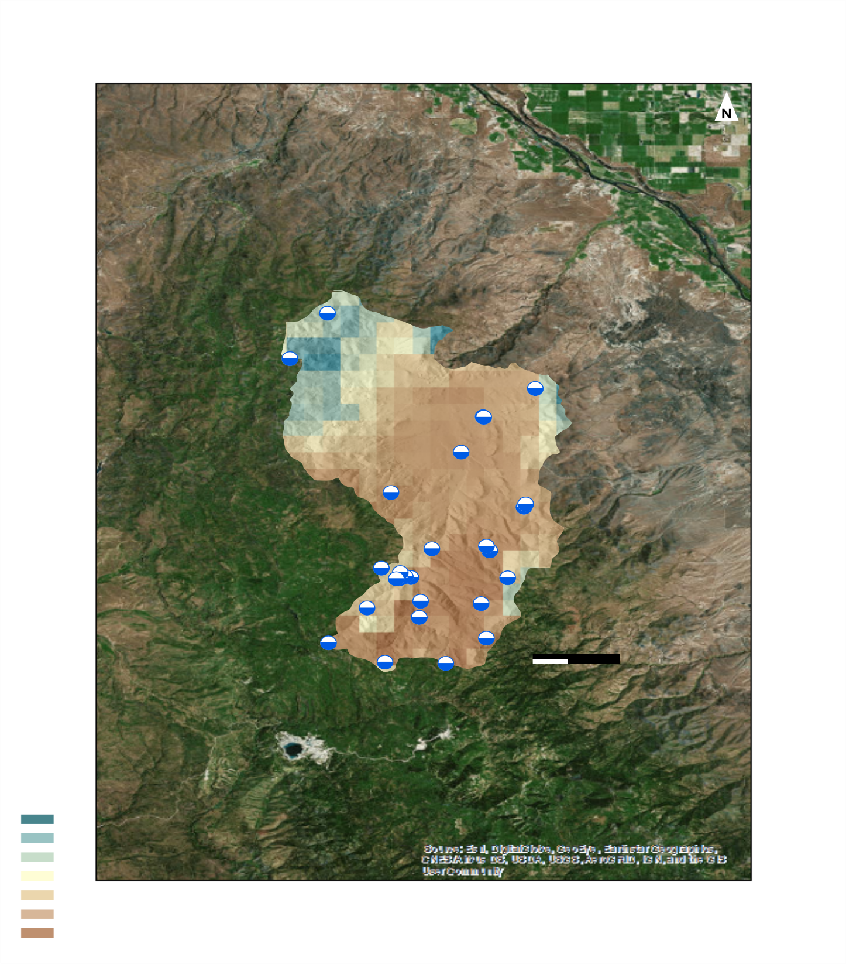



a reference map
What element is missing from this map?
Soil Moisture Validation Sites
Maps
Soil Moisture Value:
0.6
Make sure all text is legible and in Century Gothic font.
Add legends separately so they can be moved or resized.
A scale bar is required for reference on all maps and should not be separate but the scale bar text should be.
A North arrow is required.
Inset maps are suggested to give context to your map’s location.
Cite base layer source in speaker notes.
0
Notes:
[Insert Speaker Notes]
----------Image Information Below----------
[Photo 1 Identifier]
Image Credit: [insert author] [insert license]
Image Source: [insert URL]
[Photo 2 Identifier]
Image Credit: [insert author] [insert license]
Image Source: [insert URL]

Slide 10



Separate and Editable:
The Bad
Bad Example:
Legend is not separate or editable
  Barely legible
North arrow is hard to see
Scale bar is the only thing that is separate
If you can’t read a legend at 100% on your computer screen, your audience won’t be able to read it during a presentation.
The inset map is missing basemap credits.
Notes:
[Insert Speaker Notes]
----------Image Information Below----------
[Photo 1 Identifier]
Image Credit: [insert author] [insert license]
Image Source: [insert URL]
[Photo 2 Identifier]
Image Credit: [insert author] [insert license]
Image Source: [insert URL]

Slide 11

Separate and Editable:
The Bad
Bad Example:
Legend is not separate or editable
  Barely legible
  Never label your legend “Legend”
North arrow is hard to see
No locational context for where this state is located
Notes:
[Insert Speaker Notes]
----------Image Information Below----------
[Photo 1 Identifier]
Image Credit: [insert author] [insert license]
Image Source: [insert URL]
[Photo 2 Identifier]
Image Credit: [insert author] [insert license]
Image Source: [insert URL]

Slide 12
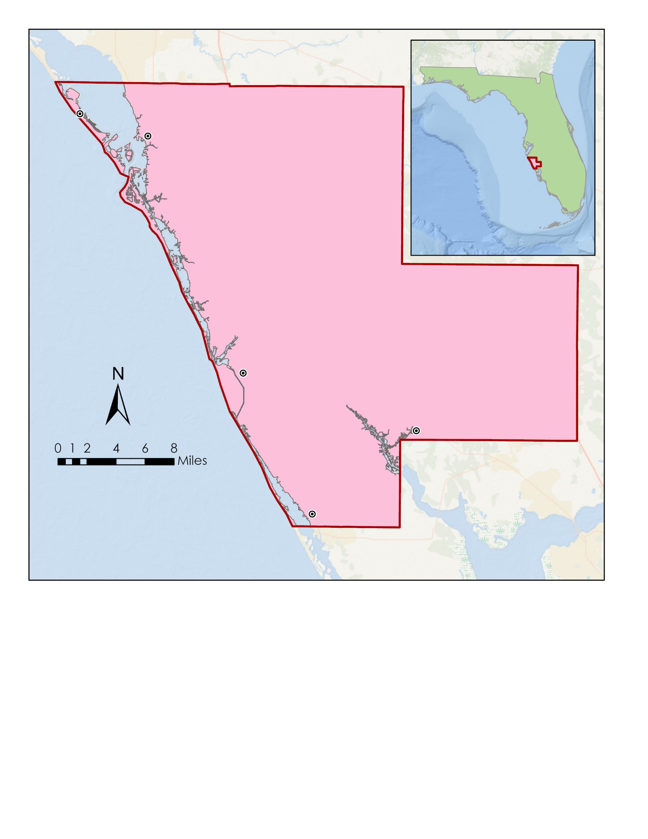
Separate and Editable:
The Good
Longboat Key
Sarasota
Florida
Gulf of Mexico
Good Example:
All text is separate and editable, down to the numbers on the scale bar
  Click on the text in the example map to get a better understanding
North arrow is included
Inset map is included to give locational context
Legend is easy to understand and is not titled “Legend”
Basemap credits are included and all text is removed from the basemap
N
Sarasota County
0
1
2
4
6
8
Miles
Venice
North Port
Sarasota County Boundary
Major Cities
Englewood
Basemap credits: Esri, GEBCO, NOAA, National Geographic, Garmin, Geonames.org
Notes:
[Insert Speaker Notes]
----------Image Information Below----------
[Photo 1 Identifier]
Image Credit: [insert author] [insert license]
Image Source: [insert URL]
[Photo 2 Identifier]
Image Credit: [insert author] [insert license]
Image Source: [insert URL]

Slide 13
List advisors, partners, and others who have contributed in any way to the project.
If your project is a multi-term one, acknowledge past contributors.
If you used ESA data, you need to include the following disclaimer: “This material contains modified Copernicus Sentinel data (insert year), processed by ESA.”
If you used Planet/Maxar data, you need to include the following disclaimer: “This work utilized data made available through the NASA Commercial Smallsat Data Acquisition (CSDA) Program.”
You must use this slide template for your acknowledgement section!
Notes:
[Insert Speaker Notes]
----------Image Information Below----------
[Photo 1 Identifier]
Image Credit: [insert author] [insert license]
Image Source: [insert URL]
[Photo 2 Identifier]
Image Credit: [insert author] [insert license]
Image Source: [insert URL]

