Slide 1
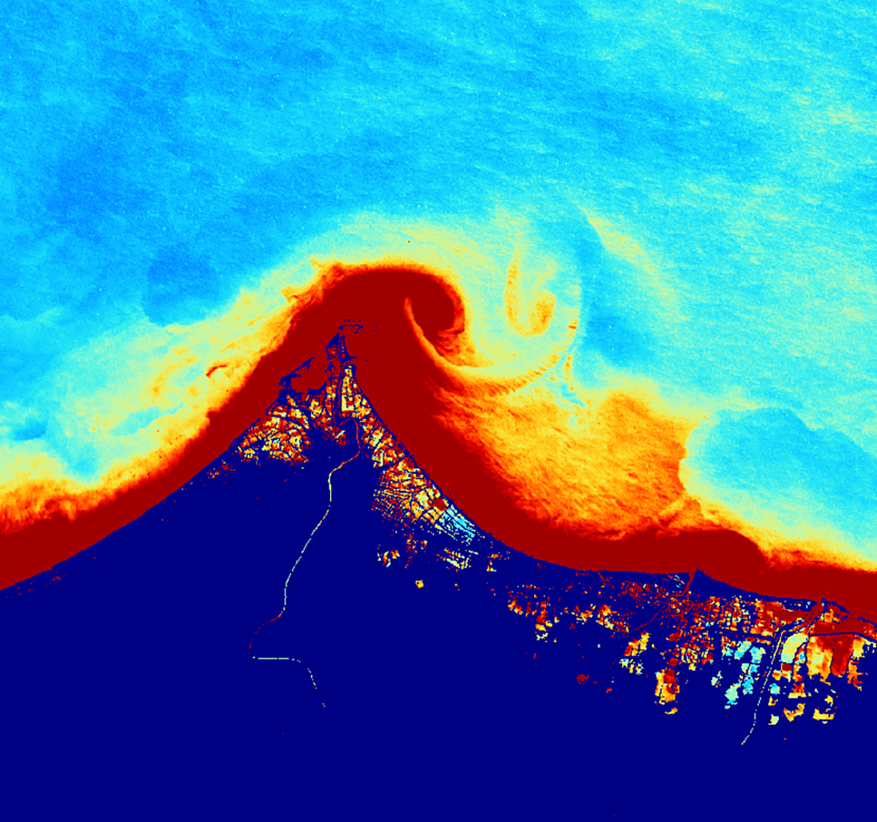
Central Java Disasters
Evaluating Coastal Flooding and Related Marine Turbidity Variations Caused by Extreme Tidal Inundation Events in Central Java, Indonesia
Ahmed Baqai
Dianna Farrell
Erica Issenberg
Nicole Ramberg-Pihl
Massachusetts - Boston | Fall 2019
Notes:
Hello Everyone, thank you for coming.
We are the Central Java Disasters team, working out of the Massachusetts-Boston Node, for the NASA DEVELOP program. DEVELOP is a capacity building program that strives to bridge the gap between local environmental issues and NASA Earth Observations.
Introduce each participant for the Fall 2019 Term: Ahmed Baqai, Dianna Farrell, Erica Issenberg, Nicole Ramberg-Pihl
Today, we are excited to share what we have been working on over the last 10 weeks; Evaluating Coastal Flooding and Related Marine Turbidity Variations Caused by Extreme Tidal Inundation Events in Central Java, Indonesia.

Slide 2
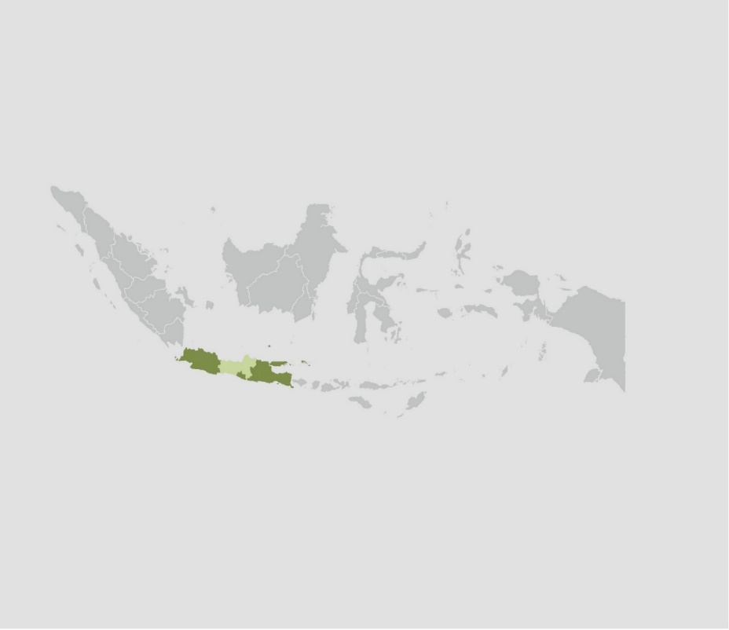
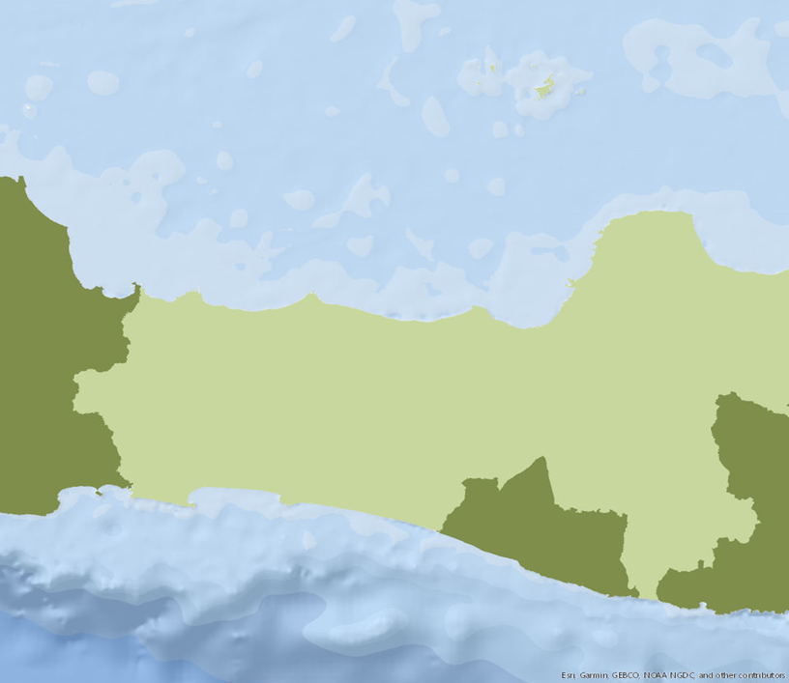
Study Area and Study Period
Pacific Ocean
Pekalongan
Semarang
Java
0
68
136
Kilometers
Indian Ocean
Central Java, Indonesia
Indonesia Archipelago
> 88,000 km of coastline
Study Period
2010-2019
Source: DEVELOP Central Java Disasters Team
Notes:
Our Study Region:
Central Java Province is located in Indonesia.
The Indonesian archipelago consists of over 88,000 km of coastline
In addition to an extensive coastline, Central Java Province is known for having:
Mountainous southern coast
Densely populated northern coastline, with aquaculture, agriculture, and mangrove restoration sites.
We were interested studying the region between Semarang, the capital of Central Java Province, and Pekalongan; as these were major areas of interest due to the high population and factors we just mentioned.
Our study period:
For the last decade
------------------------------Image Information Below ------------------------------
Map Base Layer: GADM maps and data (2018) SpatialPolygonsDataFrame R(sp), separated by districts (https://gadm.org/data.html)

Slide 3
Study Area and Study Period
Source: Google Earth Studio
Notes:
This video provides a glimpse of what the northern coastline looks like near Pekalongon.
What we want you to take away from this slide is the diversity of ecosystems and the amount of aquaculture, agriculture, and urbanization in the region.
------------------------------ Video Information Below ------------------------------
Video Credit: Google Earth Studio, Central Java Disasters, NASA DEVELOP Team
Video Source: Google Earth Studio, Central Java Disasters, NASA DEVELOP Team

Slide 4
Community Concerns
Tidal inundation causes
significant damage to
coastal areas, especially housing and roads
Severe flooding threatens daily life and poses a risk to human safety
Variations in turbidity threaten water resources, marine ecosystems, fisheries, and restoration projects
Source: Juliette Bateman, Dr. Anindya Wirasatriya
Notes:
Due to natural and anthropogenic causes like land subsidence and groundwater extraction Central Java experiencing increased Tidal Flooding and Turbidity Tidal Flooding has caused extensive damage to the northern coast of Central Java.
According to the Ministry of Public Works 2007, 1,337 people killed, Over 200,000 houses and 635 km of roads damaged as a result of tidal flooding
In 2015, 1,000 Ha in Semarang City and 2,116 Ha in Demak were inundated.
The images highlight the extent of the damage and risks they carry. You see houses flooded, way of life disturbed, and stagnant water can lead to severe water illnesses
Changes in Turbidity affect:
water resources
marine ecosystems
fisheries
and restoration projects.
------------------------------Image Information Below ------------------------------
Image Credit: Juliette Bateman
Image Source: Juliette Bateman, Science Advisor, personal image
Image Credit: Dr. Anindya Wirasatriya
Image Source: Dr. Anindya Wirasatriya, Project Partner, personal image
We have written permission to use these images
Image Credit: Juliette Bateman
Image Source: Juliette Bateman, Science Advisor, personal image
We have written permission to use these images

Slide 5
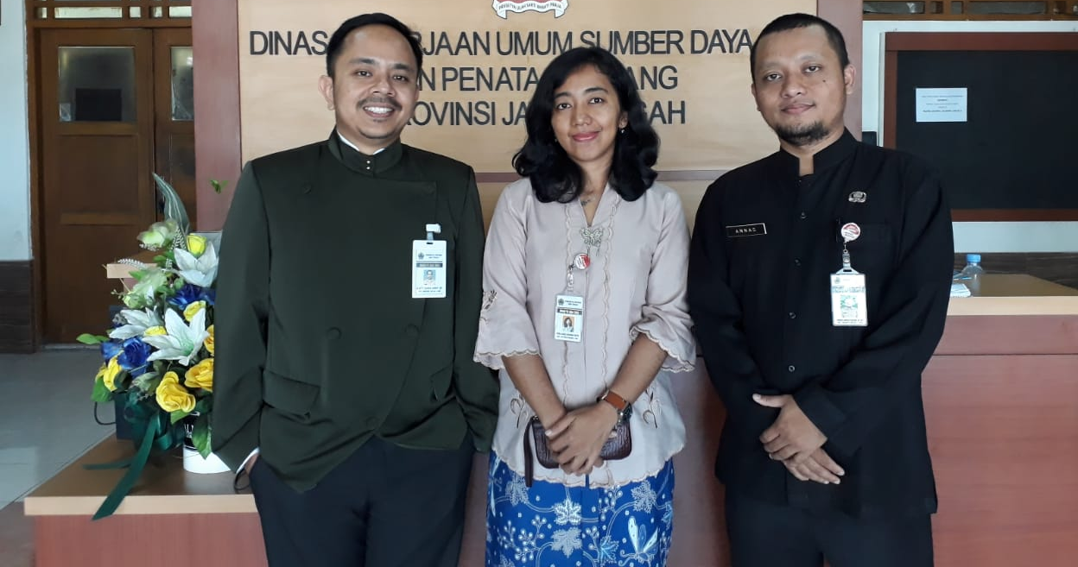
Project Partners
Water Resources and Spatial Planning Office of Central Java Province (WRSPO)
Diponegoro University, Center for Coastal Rehabilitation and Disaster Mitigation Studies (CoREM)
Mr. Army, Ms. Vera Hari Dhamayanti, Mr. Annas Kunaefi
Dr. Helmi
Dr. Wirasatriya
Dr. Pribadi
Source: WRSPO, CoREM
Notes:
For this project, the Massachusetts-Boston team partnered with the Water Resources and Spatial Planning Offices of Central Java Province (WRSPO) and the Diponegoro University, Center for Coastal Rehabilitation and Disaster Mitigation Studies (CoREM). These two organizations are located in the study region and work to monitor and mitigate the impacts of severe flooding and variations in turbidity.
Water Resources and Spatial Planning Offices of Central Java Province (WRSPO) Water Resource Management
Issues like Tidal Inundation
They also look at coastal water quality
Changes in Turbidity that is associated with land loss and storm surges
CoREM - Diponegoro University, Center for Coastal Rehabilitation and Disaster Mitigation Studies.
Research Coastal Degradation and finding solutions to land loss in human settlements
The often pass on information and research to partner organizations
Involved in Coastal Restoration Efforts, Particularly Mangrove Regeneration
------------------------------Image Information Below ------------------------------
Image Credit: WRSPO
Source: WRSPO, Personal
Media Release Forms were signed by all individuals
Image Credit: CoREM
Source: CoREM, Personal Image
Media Release Forms were signed by all individuals
Image Credit: CoREM
Source: CoREM, Personal Image
Media Release Forms were signed by all individuals
Image Credit: CoREM
Source: CoREM, Personal Image
Media Release Forms were signed by all individuals

Slide 6
Objectives
Develop a tidal land cover analysis tool with a user-friendly interface that monitors flooding along the coast of Central Java
Create maps that assess variations in marine turbidity in the Java Sea for the last decade
Improve local management and coastal rehabilitation efforts using Earth observations
Notes:
DEVELOP a tidal land cover analysis tool in Google Earth Engine (GEE) with a user-friendly interface to help end-users (our partners) monitor flooding along the northern coastline in Central Java, Indonesia.
Create marine turbidity estimation maps that allow end users to assess variation in marine turbidity and sedimentation availability over the last 10 years, from 2009 to 2019.
Improve local management and coastal rehabilitation efforts along the northern coast of Central Java using Earth observations. Our hope is that these end-products will help to unify management and research practices in the region.

Slide 7
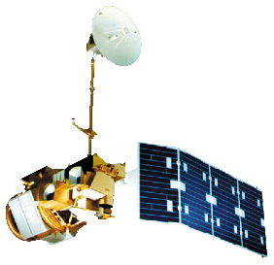
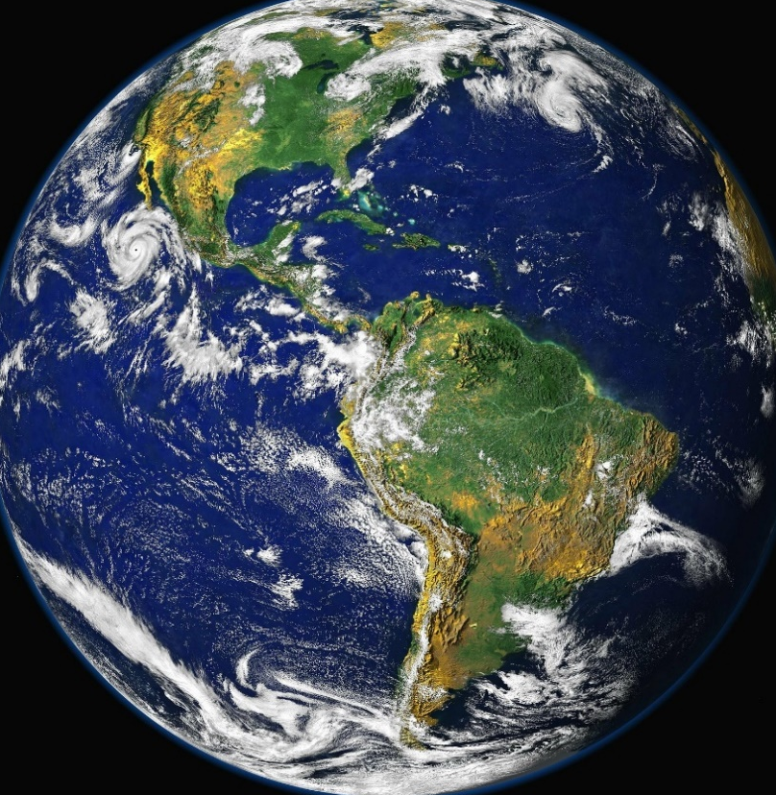
NASA Earth Observations
Landsat 8 OLI
Operational Land Imager
Landsat 5 TM
Thematic Mapper
Landsat 7 ETM+
Enhanced Thematic Mapper Plus
Aqua MODIS
Moderate Resolution Imaging Spectroradiometer
Source: Pixabay
Notes:
For the Central Java Disasters project, we used four different NASA Earth observations: Landsat 5 TM, Landsat 7 EMT+, Landsat 8 OLI, and Aqua MODIS.
Landsat 5 TM, Landsat 7 ETM+, and Landsat 8 OLI were used to create our land cover analysis tool. This data was accessed directly in Google Earth Engine.
All Landsat collections are Level-2 surface reflectance data, which means they have all been atmospherically corrected. All Landsat collections also have a 30 m spatial resolution.
We also used Aqua MODIS to access imagery of the Java Sea from 2010 – 2019. We used Aqua MODIS to create the marine turbidity estimation maps for our project .This data was accessed using the NASA Ocean Color website. We also used Aqua MODIS Level-2 surface reflectance data. Aqua MODIS has a 500 m spatial resolution
------------------------------Image Information Below ------------------------------
Image Credit: Pixaby
Image Source: https://pixabay.com/photos/earth-blue-planet-globe-planet-11015/ (Creative commons license, Pixabay License, Free for commercial use)
Image Credit: Landsat 5 TM (Thematic Mapper) - NASA DEVELOP
Image Source: DEVELOPedia
Image Credit: Landsat 7 ETM+ (Enhanced Thematic Mapper Plus)- NASA DEVELOP
Image Source: DEVELOPedia
mage Credit: Landsat 8 OLI (Operational Land Manager) - NASA DEVELOP
Image Source: DEVELOPedia
Image Credit: Aqua MODIS (Moderate Resolution Imaging Spectroradiometer) - NASA DEVELOP
Image Source: DEVELOPedia

Slide 8
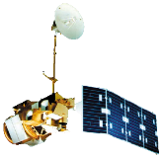
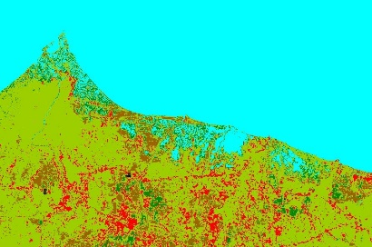
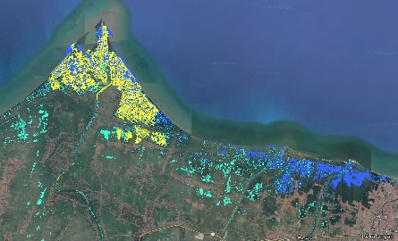
Methodology:
Tidal Land Cover Analysis Tool (TiLCAT)
Data
GEE Processing
Unsupervised Land Classification
Generate Flood and Tidal Threshold
Harmonic Regression with Index
Landsat 5,7,8
JRC Global Surface Water Dataset
Murray Global Intertidal Change Classification
Export to UI
Water, mangroves, urban, vegetation, seasonal aquaculture/agriculture
Mask Surface Water and Intertidal datasets
Baseline and Monitoring Imagery
Source: DEVELOP Central Java Disasters Team
Notes:
Methodology for TiLCAT
Brief Introduction of TiLCAT
TiLCAT is a Google Earth Engine script that uses NASA earth observations, global datasets and remote sensing methodology to monitor coastal flooding events in Central Java, Indonesia.
The core function of this script is the creation of a harmonic regression that compares a monitoring period of interest to baseline imagery to look for areas that deviate from the norm. In our scenario, these would be areas with large / abnormal flooding and tidal inundation events
Three main components of TiLCAT
1). Created an unsupervised land classification of Central Java
- With the purpose for the partners / end users to see which land covers are being impacted by flooding/ tidal inundation events
2). Flood and Threshold Mask
-Consists of three classes: “Always Water,” “Sometimes Water,” and “Tidal Flat Classification”
-Always Water showcases areas with water 12 months out of the year - more or less ‘permanent water’
- Sometimes Water are areas that show water during seasons where flooding usually - hopefully shows typical flooding
3). Run Harmonic Regression with Index
-Harmonic Regression = fits designated harmonics (sins and cosines of different wavelength) using nonlinear regression algorithms. They are often used for time series, especially time series that have multiple seasonal patterns, as they are able to eliminate seasonality and only detect large events that deviate from the seasonal norm.
- Index is the Dependent Variable that is predicted by the harmonic regression – in our case, which areas are experiencing abnormal wetness.
- To detect wetness, we used two different indices – NDMI (normalized difference moisture index) and Tasseled Cap Transformations as the dependent variable.
-Made it in our script so end user can use one or the other
------------------------------Image Information Below ------------------------------
Image Credit: Landsat 5 TM (Thematic Mapper) - NASA DEVELOP
Image Source: DEVELOPedia
Image Credit: Landsat 7 EMT+ (Enhanced Thematic Mapper Plus)- NASA DEVELOP
Image Source: DEVELOPedia
Image Credit: Landsat 8 OLI (Operational Land Manager) - NASA DEVELOP
Image Source: DEVELOPedia
Unsupervised Land Cover Map Created using Base Layer: Landsat 8 OLI (25 June 2019) Imagery, Central Java, Indonesia.
Flood and Tidal Threshold Image Base Layer: Google Earth Imagery (2019). Central Java, Indonesia.
Flood and Tidal Threshold Layers Created Using: JRC Global Surface Water Dataset (2017), (https://data.europa.eu/euodp/en/data/dataset/jrc-gswe-global-surface-water-explorer-v1); Murray Global Intertidal Change Classification (2019), (https://developers.google.com/earth-engine/datasets/catalog/UQ_murray_Intertidal_v1_1_global_intertidal)

Slide 9
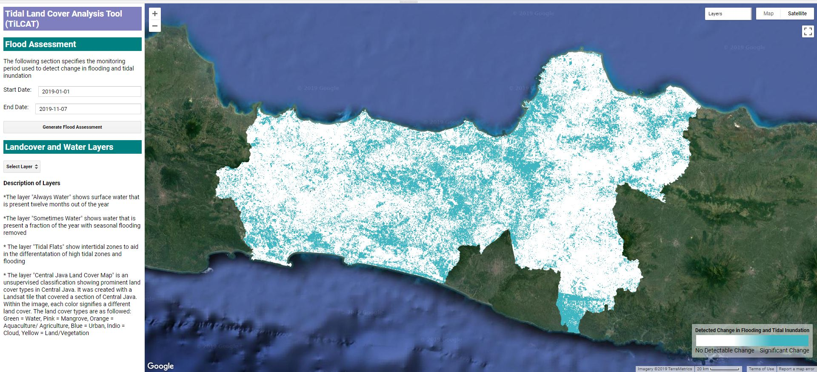
Results:
Tidal Land Cover Analysis Tool (TiLCAT)
Source: DEVELOP Central Java Disasters Team
Notes:
Here is a screenshot of our TiLCAT tool with its UI.
-The left panel allows end users to choose the monitoring period they wish to assess flooding during
-There is an also a dropdown panel where end users can choose which layers they want to see - i.e., the landcover map; different flood masks
Our goal for this tool is to provide our partners with platform where they can assess flooding and tidal inundation events over extended periods of time and multiple places at once. A lot of the research going on in this region is done by field work and collecting in situ data, so we’re hoping the tool can allow end users to monitoring and conduct research at a much larger scale. We are hoping that it can be either used as a research tool for end users, or as a scientific communication tool to showcase the current areas of flooding in Indonesia.
------------------------------Image Information Below ------------------------------
Flood and Tidal Threshold Image Base Layer: Google Earth Imagery (2019). Central Java, Indonesia.
Flood and Tidal Threshold Layers Created Using: JRC Global Surface Water Dataset (2017), (https://data.europa.eu/euodp/en/data/dataset/jrc-gswe-global-surface-water-explorer-v1); Murray Global Intertidal Change Classification (2019), (https://developers.google.com/earth-engine/datasets/catalog/UQ_murray_Intertidal_v1_1_global_intertidal)

Slide 10
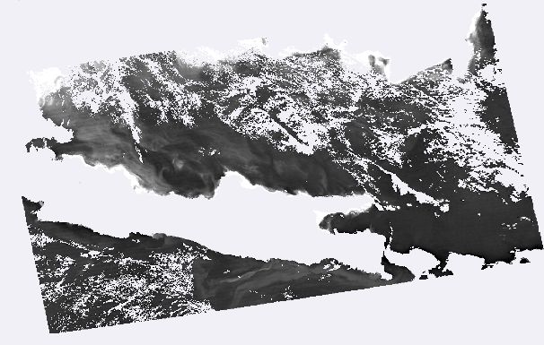
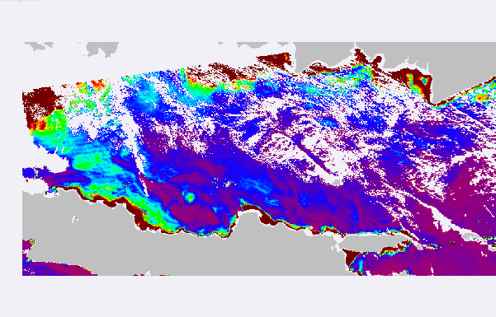
Methodology:
Turbidity Estimation Maps
Ocean Color
SeaDAS Processing
Data Acquisition
Calculate Water Reflectance
Estimate Turbidity
Data Visualization
$$T=\frac{A_{T}^{λ} ρ_{w}\left(λ\right)}{1−\frac{\left.ρ_{w}(λ\right)}{C^{λ}}} \left[FNU\right],$$
Import Aqua MODIS level-2 surface reflectance data into SeaDAS
Using the remote sensing reflectance 645 nm band (Rrs 645 x π)
Dogliotti turbidity
algorithm
Cartographic techniques
Source: DEVELOP Central Java Disasters Team
Notes:
Methodology for Turbidity Estimation Maps:
Project partners will use these maps to assess turbidity along Central Java Coast.
This is important because turbid water impacts water quality, marine ecosystems and fisheries.
Indonesia is experiencing problems with water quality and many people rely on marine ecosystems and fisheries for their livelihood.
Identify scale and frequency of data: Partners are interested in annual turbidity maps for both winter Monsoon season (Jan-Feb) and dry summer season for the past decade.
Partners interested in Monsoon season because increased precipitation and associated flooding and storm surge leads to increased levels and variability in turbidity.
Download Aqua MODIS, 8-day, 500-m, Level-2 Surface Reflectance data from NASA Ocean Color website https://oceancolor.gsfc.nasa.gov/
Upload data into SeaWIFS Data Analysis System (SeaDAS)
Calculated the water reflectance using the 645 nm band, which is in the red part of the visible spectrum.
The image shows the water reflectance band.
To generate turbidity maps, we applied the Dogliotti Turbidity algorithm on the water reflectance band.
Dogliotti algorithm is commonly used to estimate turbidity. The equation is shown here.
Selected the best images from each winter Monsoon season and dry summer season to assemble into a map package for our partners.
Finding images with good coverage in Jan-Feb was difficult. To compensate for limited data availability, we expanded time frame to Dec-Mar.
------------------------------Image Information Below ------------------------------
Image Credit: Aqua MODIS (Moderate Resolution Imaging Spectroradiometer) - NASA DEVELOP
Image Source: DEVELOPedia

Slide 11
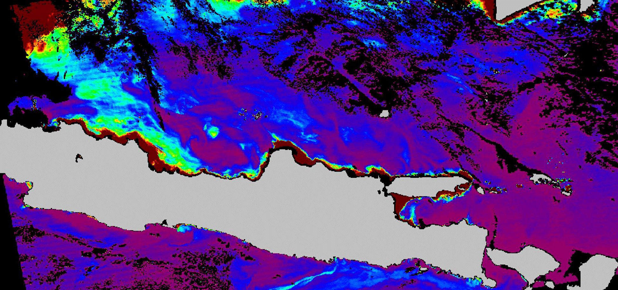
Results:
Turbidity Estimation Maps
Turbidity (FNU)
0
0.5
1
1.5
2
Source: DEVELOP Central Java Disasters Team
Notes:
This time series shows Turbidity for summer months from 2010-2019.
Dark red areas indicate high turbidity levels. Purple (magenta) represents low turbidity levels.
Highest turbidity levels occur along the coast and at the mouths of rivers.
Turbidity decreases further from the shore.
Our final product will contain several turbidity maps from each winter
Monsoon season in the ten-year period, as well as the summer turbidity maps you see here.
Our partners will use this data to assess turbidity and focus restoration efforts in Central Java.

Slide 12
Errors & Uncertainties
TiLCAT
Accuracy validation using ground truthing or in-situ data
Testing multiple indices for best delineating wetness/flooding
Selection of baseline imagery
Turbidity
The monsoon season was the focus of our analyses, as this is the most dynamic season. This resulted in fewer dates and less clear data being available due to extensive cloud cover
Images did not consistently export to the same extent
Notes:
TiLCAT
We were not able to validate the accuracy of the TiLCAT tool using ground truth data since we were not able to travel to Indonesia and collect data on flood conditions. Incorporating ground truth data would help to reduce error and improve accuracy.
Selection of Baseline imagery - The baseline period should not contain copious amounts of flooding. We selected the driest period with the information we had available, however, more research could be done regarding what dates represent the driest period. This would improve the accuracy of the tool.
For the flood monitoring part of the tool, we selected what we feel is the best index for flooding/wetness delineation. There are, however, other indices that we would have like to test and compare results.
Turbidity
We focused on the Monsoon season because increased storminess causes the greatest changes in turbidity, which is what our partners are interested in studying. However, the increased cloud cover caused a lot of gaps in the data.
These gaps introduced error into out trend analysis and makes it difficult to compare turbidity levels from year to year.

Slide 13
Conclusions
TiLCAT
Flooding was detected in the greater regions of Pekalongan, Semarang, and Demak, specifically impacting:
Aquaculture
Seasonal agriculture
Urban Areas
Turbidity Estimation Maps
High turbidity occurs along the coastline and in locations near the mouth of rivers
Turbidity values appear to be highly variable based on both location and season
Notes:
TiLCAT –
Tool allows end users to assess flooding along the coastline of Central Java for the regions and time period that they are interested in examining.
Overall, TiLCAT detected flooding in the in aquaculture areas and seasonal agriculture around Pekalongan, and in urbanized areas surrounding Semarang and Demak
Turbidity Estimation Maps –
These maps allow end users to monitor turbidity in the Java as well as along the coastline.
Overall, we found that high turbidity does in fact occur along the coastline and is especially prominent in areas near the mouth of rivers (where rivers meet the sea).
Furthermore, we found that turbidity values appear to be highly variable with not only location, but with the season.

Slide 14
Future Work
TiLCAT
Generate more sophisticated land cover map delineating classes of water (Ocean, aquaculture, rivers, and lakes)
Specifically focus on flooding impacts to aquaculture and agricultural land
Create buffer to better distinguish where coastal flooding subsides
Turbidity Estimation Maps
Conduct time series analyses to statistically test change in turbidity over time
Conduct analyses to assess how turbidity changes with distance from the shore
Use Level 3 seasonal, monthly, or annually averaged products
Notes:
Future Work:
TiLCAT – Aquaculture is a major part of the economy in this region, and aquaculture ponds are abundant along with coastline. With that being said, future work could strive to generate more robust land cover map that delineates varying classes of water (i.e. ocean, rivers, aquaculture or lakes).
Future projects could also work to assess flooding impacts specially to regions of aquaculture or flooding due to their importance in the region.
Turbidity – We were very interested in conducting statistically analyses to examine how turbidity changed over time in the Java Sea.
We were also interested in analyzing how turbidity changes with as you move away from the shoreline and into the sea.
A future project could incorporate both of these analyses using Level 3 seasonal, monthly, or annually averaged products – which are great because they do not contain any gaps in the data.
I should also note, that these are all objective we would have liked to complete, but unfortunately, they were outside the scope of our timeline.

Slide 15
Partners:
WRSPO: Sakti Kania Army, Vera Hari Dhamayanti, Aswar Annas Kunaefi
Diponegoro University, CoREM: Dr. Anindya Wirasatriya, Dr. Rudhi Pribadi, Dr. Muhammad Helmi
Science Advisors:
Dr. Cedric Fichot (Boston University)
Dr. Valerie Pasquarella (Boston University)
Dr. Magaly Koch (Boston University)
Juliette Bateman (Boston University)
We would like to thank the Massachusetts – Boston Fellow Celeste Gambino for her contributions to the project.
Notes:
We would like to thank our project partners: THE WRSPO and CoREM for their input, knowledge, and contribution to this project.
We would also like to thank the science advisors on this project, Dr. Cedric Fichot, Dr. Valierie Pasquarella, Dr. Magaly Koch, and Juliette Bateman, for their guidance and expertise throughout the Fall 2019 term.
Lastly, we would like to thank the Massachusetts-Boston Fellow, Celeste Gambino, for her contributions throughout the Fall 2019 term.

Slide 16
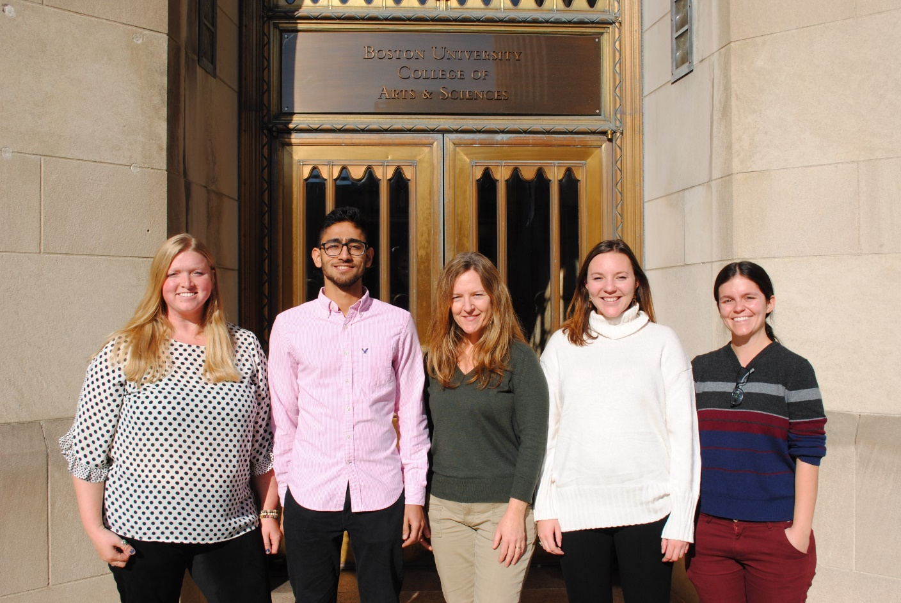
Questions?
Source: DEVELOP Central Java Disasters Team
Notes:
Thank you for listening and we can open the floor up for questions.
------------------------------Image Information Below ------------------------------
Image Credit: NASA DEVELOP MA-Boston Node
Source: NASA DEVELOP MA-Boston Node, Personal Image
We have written permission to use this image

