Slide 1
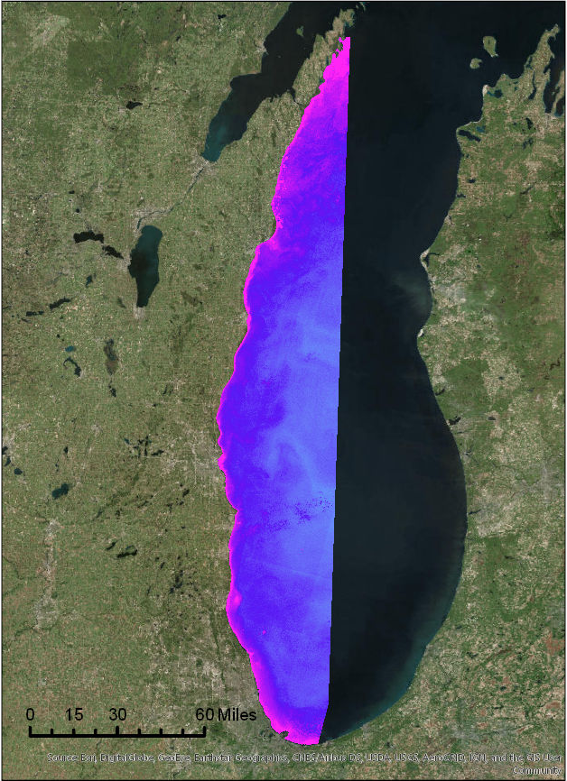
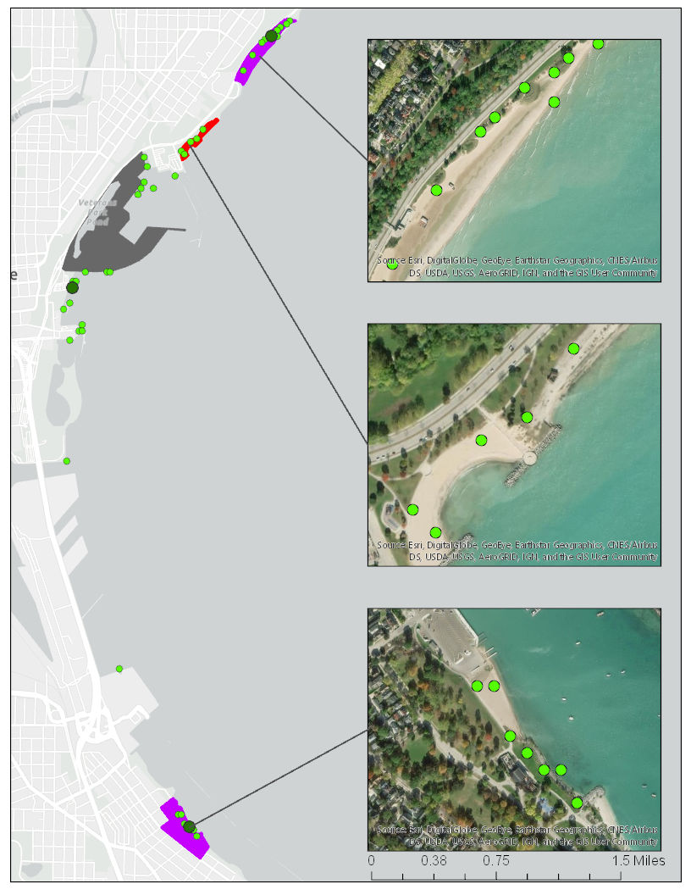
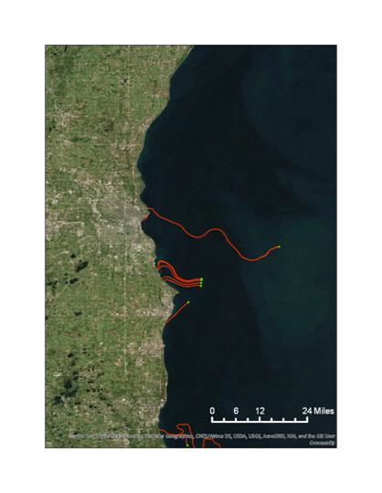
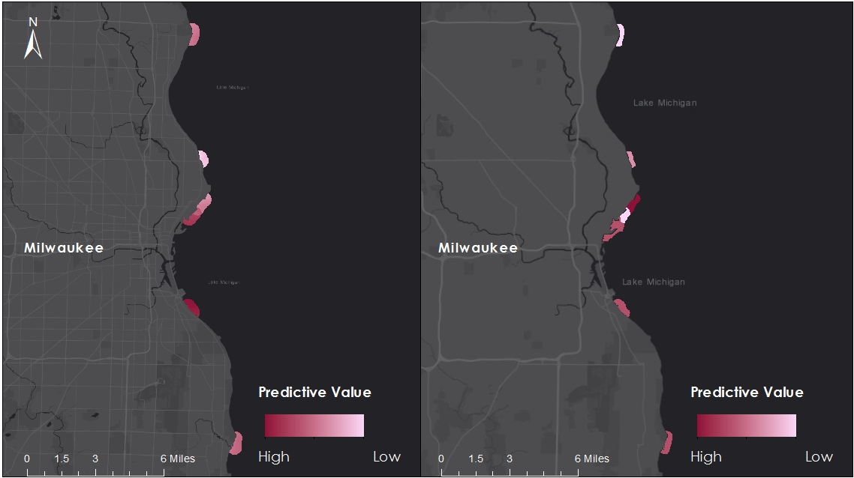
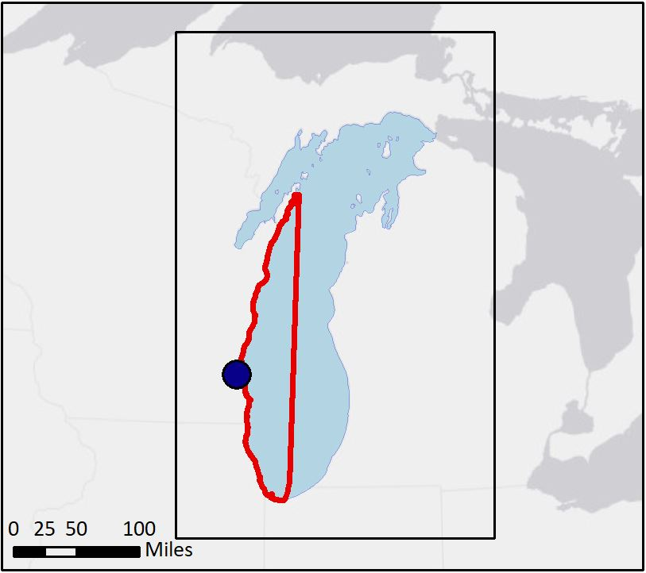
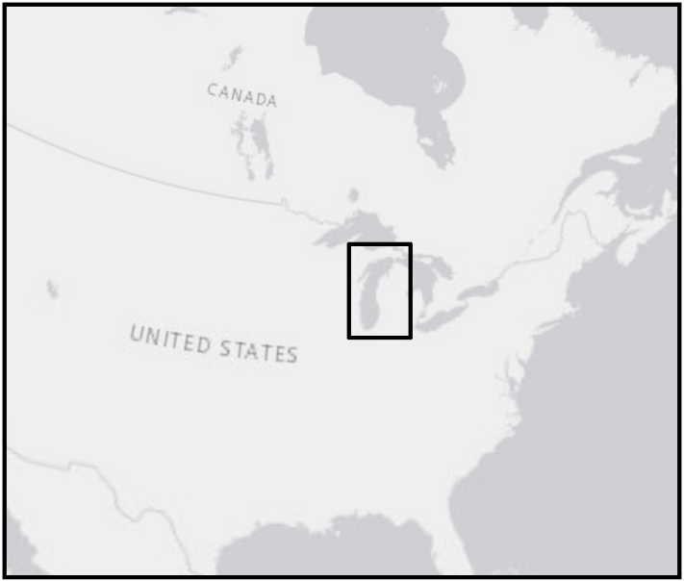



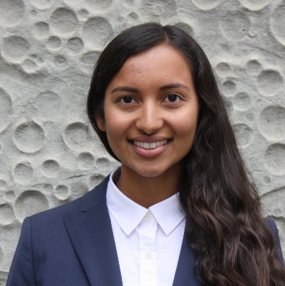
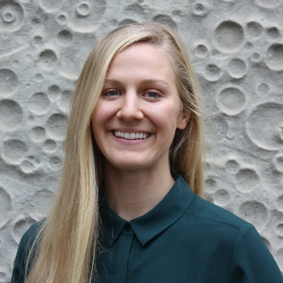
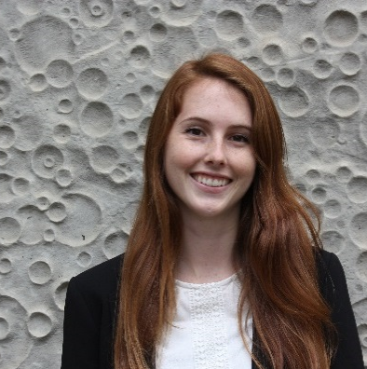
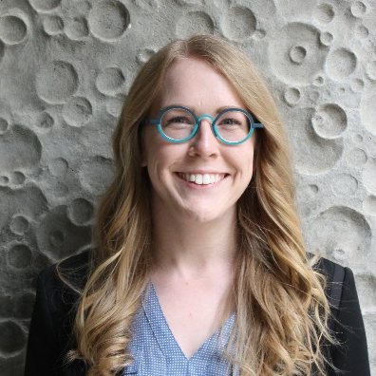
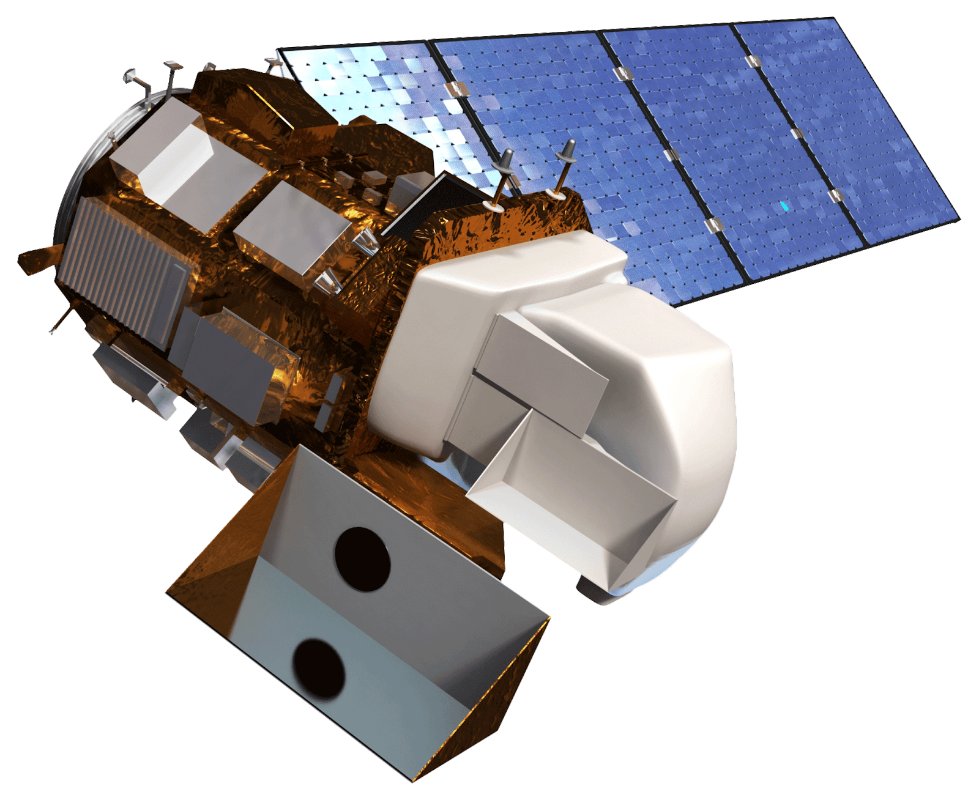
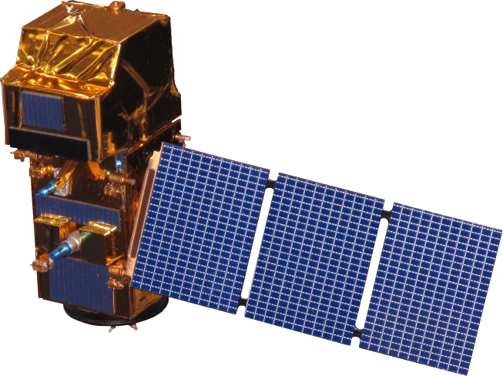
Utilizing Multispectral Satellite Imagery to Monitor
and Predict the Displacement of Cladophora
along the Milwaukee County Shoreline
Abstract
Results
Changing lake conditions, such as rising temperatures and phosphorus cycling by invasive Dreissenid mussels, have made washup of the green macroalgae Cladophora glomerata a consistent problem on beaches in Milwaukee County, presenting a threat to both wildlife and the local economy. Groundwork Milwaukee (GWMKE), a nonprofit organization, seeks to remove Cladophora from beaches along the Milwaukee County shoreline. To aid GWMKE’s cleanup planning efforts, the previous NASA DEVELOP Lake Michigan Water Resources I team created a habitat suitability map for Cladophora and utilized bathymetry, nearshore structures, and population density to create a predictive washup map. Our team continued their work by creating a user-friendly ArcGIS tool that predicts where Cladophora is most likely to wash ashore. The new tool utilized chlorophyll-a spectral signatures as proxies for Cladophora detection from Landsat 8 Operational Land Imager (OLI). Sentinel-2 (MSI) data was also investigated for this purpose, however the results from Landsat 8 more closely matched in situ chlorophyll-a measurements for Lake Michigan. Surface water currents were incorporated to predict Cladophora transport. The tool processed data for the study period of June to September, 2016 to 2018, and the outputs were compared with in situ data of Cladophora washup. With the assistance of the Predictive Washup Tool, GWMKE will be able to more accurately predict the location of Cladophora washup and effectively manage their future cleanup efforts, making the beaches safer and more enjoyable for the community.
Bradford Beach
Predictive Washup Tool
Initial Cladophora Locations*
Cladophora Trajectory
In Situ Observations
Cladophora observed
No Cladophora observed
McKinley Beach
No data
Tool Outputs
Chlorophyll-a
(µg/L)
Highest chlorophyll-a values
≤ 1
Clustered points
South Shore Beach
≤ 2
≤ 5
≤ 10
The map on the left depicts chlorophyll-a values calculated by the O’Reilly band ratio OC2 algorithm from Landsat 8 OLI imagery. The center map compares in situ observations for Cladophora with the output of the Predictive Washup Tool. Inset maps show that some points with high chlorophyll-a values may have been vegetation on land, due to potential inaccuracies in the lake extent estimated by NOAA’s CUSP dataset. The map on the right shows high chlorophyll-a values, estimated to correspond to Cladophora, transported by currents, to generate a Predictive Washup Map.
Phase 1
Phase 2
Objectives
Phase 1
Fall 2018
Detect floating Cladophora from multispectral satellite imagery utilizing chlorophyll-a as an indicator
Compare the efficacy of two multispectral satellite sensors for chlorophyll-a detection
Predict the trajectory of Cladophora transport by modeling seasonal surface water currents
Provide decision-support to project partner by identifying areas where Cladophora is likely to wash ashore
Doctors Park
Phase 1
Doctors Park
Phase 2
Atwater Beach
Bradford Beach
Atwater Beach
Bradford Beach
McKinley Beach
Veterans Park
McKinley Beach
Veterans Park
Study Area
South Shore Beach
South Shore Beach
N
Study Area: Western shore of Lake Michigan in Wisconsin
Study Period: June-September, 2016-2018 (Cladophora sloughing season)
Grant Park Beach
Grant Park Beach
Milwaukee
The map above shows the beaches predicted to experience the most Cladophora washup based upon data from 2016-2017, June through September. The first phase of this project (Phase 1) considered bathymetry, population density, shoreline curvature, and nearshore structures to create a general predictive map of washup. The map on the right (Phase 2) incorporated Cladophora detection using chlorophyll-a as an indicator, and modeled the movement of algal mats with surface water currents.
Study Area
Conclusions
Lake Michigan
Landsat 8 data with the O’Reilly band ratio OC2 algorithm was more successful in detecting chlorophyll-a than Sentinel-2 with the Moses 3 band red-edge algorithm. This limitation could potentially be due to the parameterization of the Moses algorithm to chlorophyll-a measurements in other water bodies. It could also be that the Moses algorithm needs to be adapted more specifically to Sentinel-2.
Chlorophyll-a levels detected in Landsat 8 imagery followed Cladophora washup behavior, suggesting that what was detected could likely be Cladophora.
Incorporating chlorophyll-a and surface water currents generates new insights about Cladophora washup, expanding the predictive model developed by Phase 1 of this project.
Project Partners
Groundwork USA, Groundwork Milwaukee
Methodology
Inputs
Automated Steps in ArcGIS Pro
Output
NASA Earth Observations: Landsat 8 OLI
Chlorophyll-a Algorithms
O’Reilly Band Ratio OC2
Floating Algae Location
Team Members
ESA Earth Observations:
Sentinel-2 MSI
Moses 3 Band Red Edge
ArcGIS Pro Particle Track Tool
Predictive Washup Map
NOAA Modeled Surface Current Data
Current Averages Calculated
Direction and Magnitude of Surface Currents
Jashvina Devadoss
Project Lead
Catherine Breen
Genevieve Clow
Elizabeth Looby
Earth Observations
Acknowledgements
Lawrence Hoffman, GIS Program Manager (Groundwork Milwaukee), Deneine Christa Powell, Executive Director (Groundwork Milwaukee), Dr. Juan Torres-Perez, Science Advisor (Bay Area Environmental Research Institute, NASA Ames Research Center), Dr. Sherry Palacios, Science Advisor (Bay Area Environmental Research Institute, NASA Ames Research Center), Dr. Kenton Ross, Mentor, (NASA Langley Research Center), Joe Spruce (Science Systems and Applications, Inc.), Farnaz Bayat, DEVELOP Center Lead (NASA Ames Research Center), Jerrold Acdan, DEVELOP Project Coordination Fellow (NASA Ames Research Center), DEVELOP Summer 2018 Lake Michigan Water Resources Project Lead, Steven Chao, DEVELOP Summer 2018 Lake Michigan Water Resources Team, Lawrence Fujiwara, DEVELOP Summer 2018 Lake Michigan Water Resources Team, and Ella Golovey, DEVELOP Summer 2018 Lake Michigan Water Resources Team
Landsat 8 OLI
Sentinel-2 MSI
Lake Michigan Water Resources II
California – Ames | Fall 2018

