Slide 1
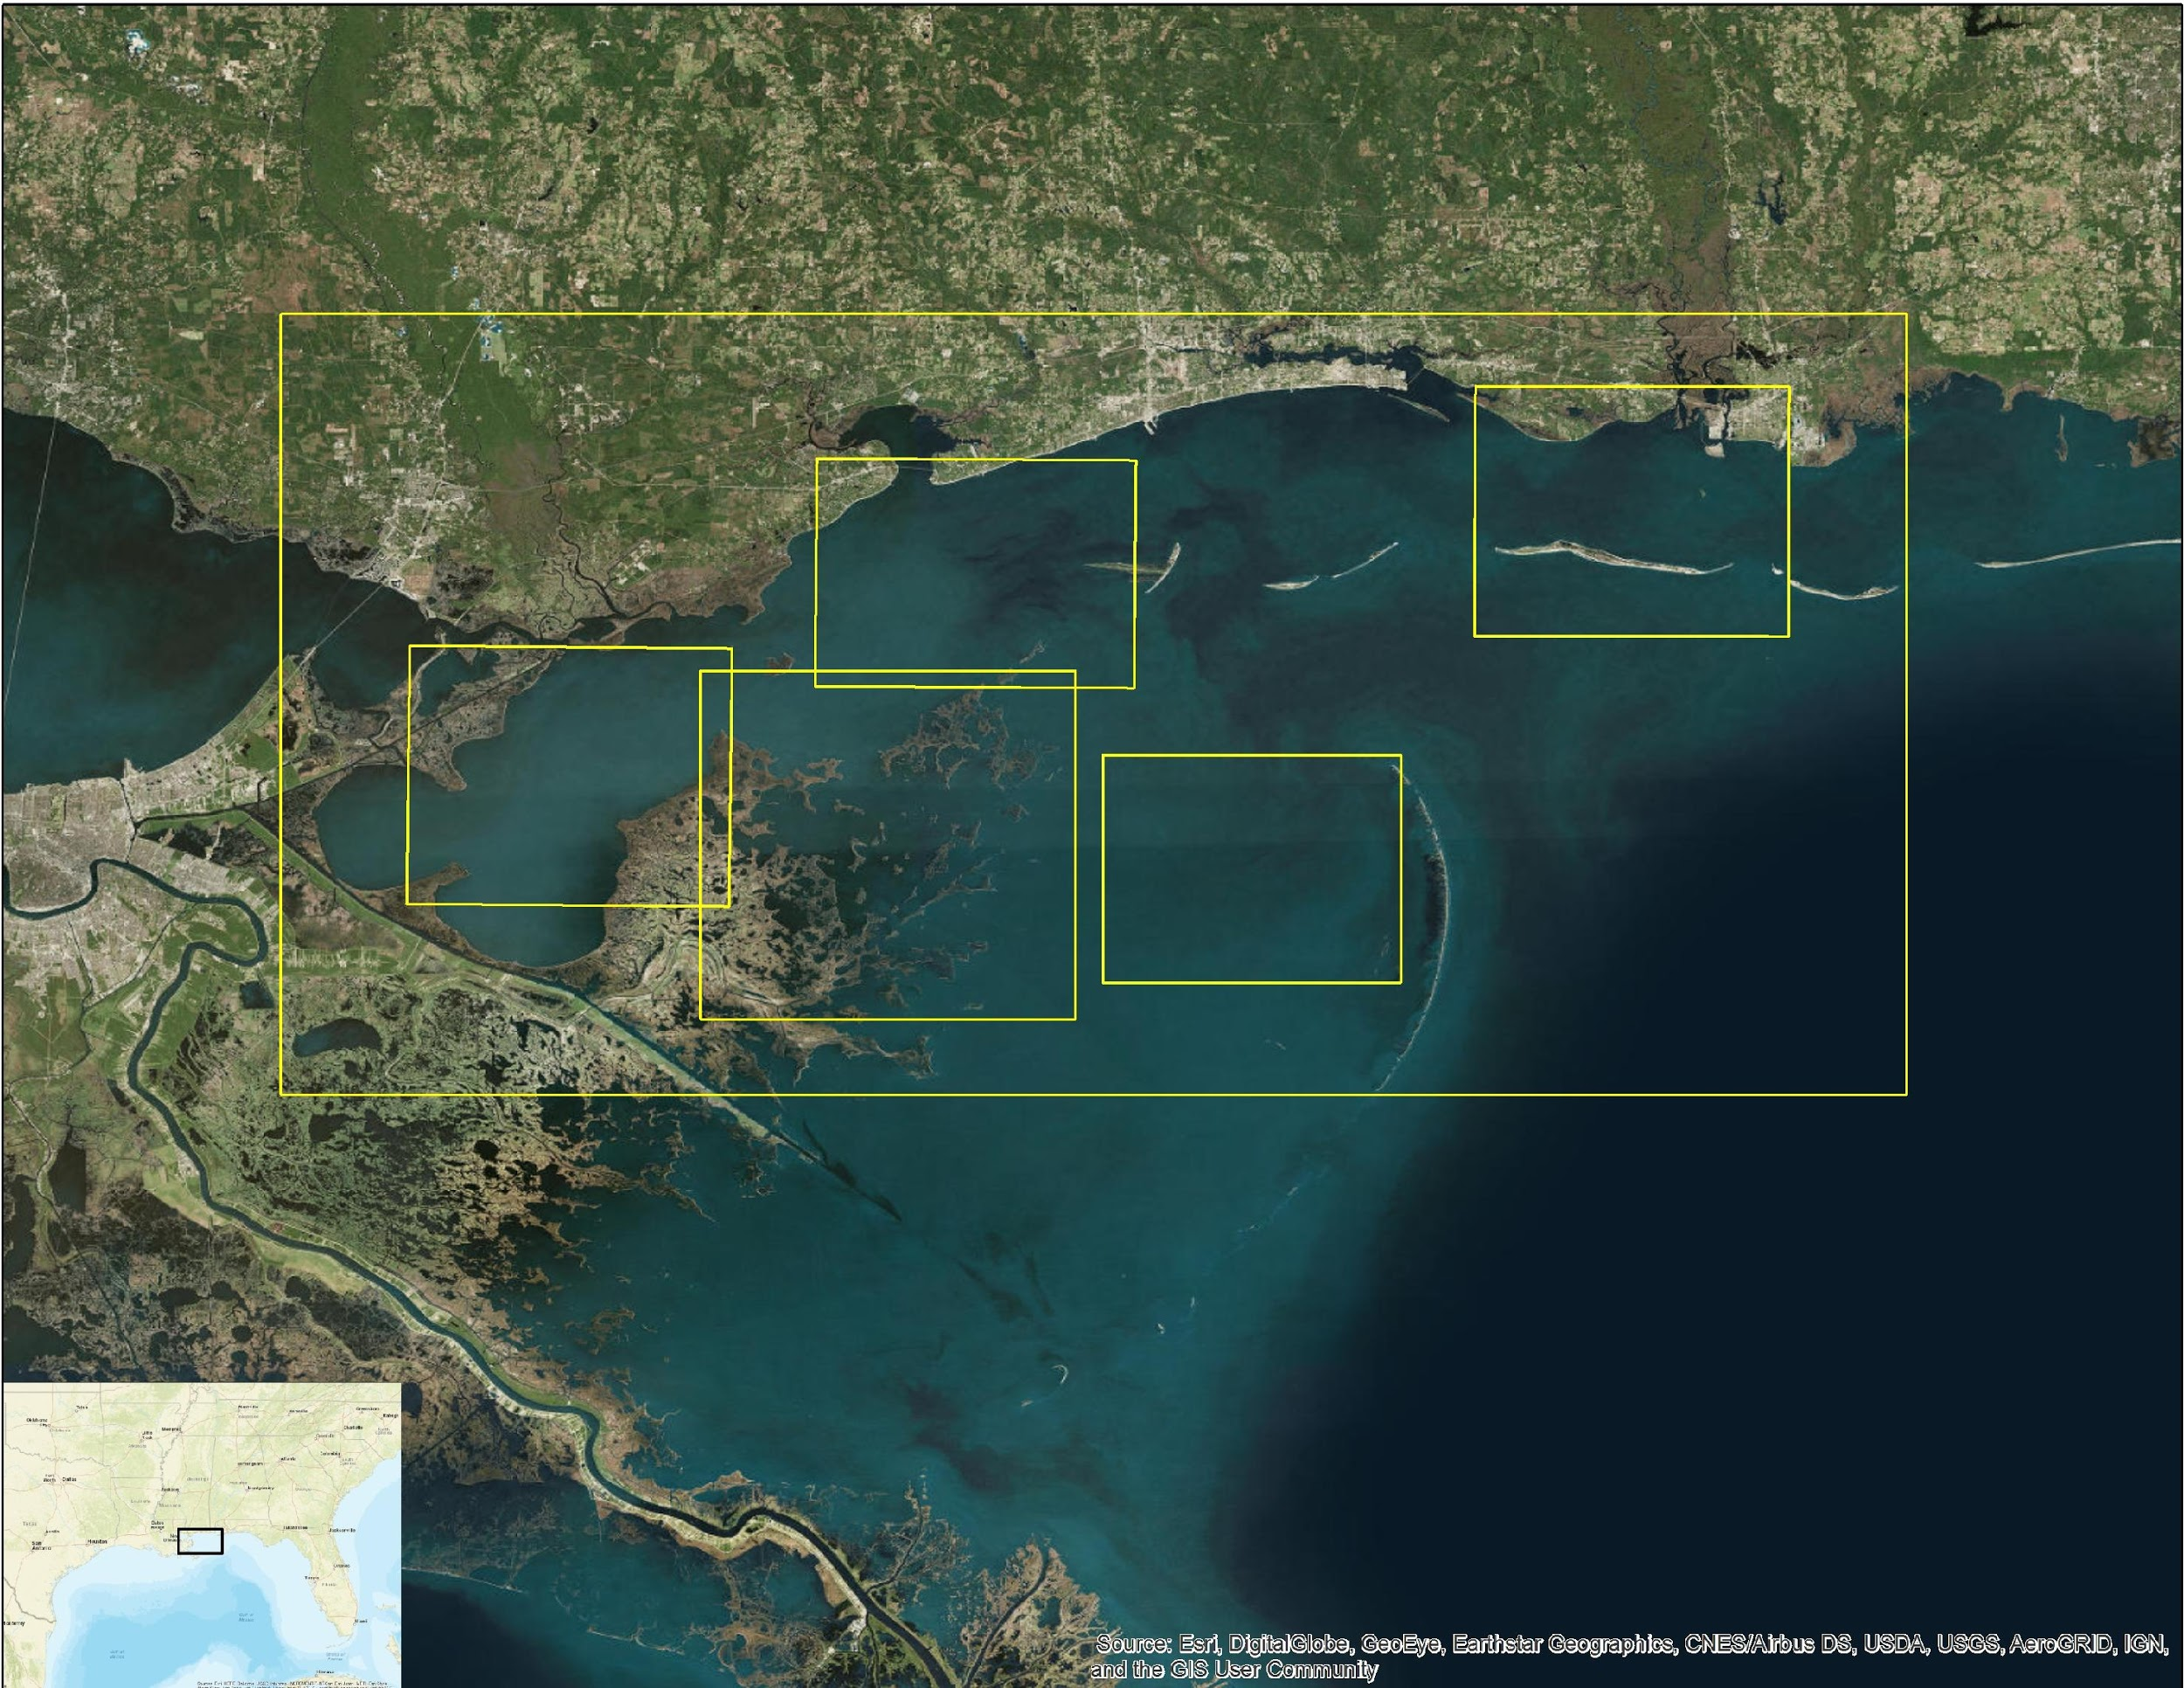
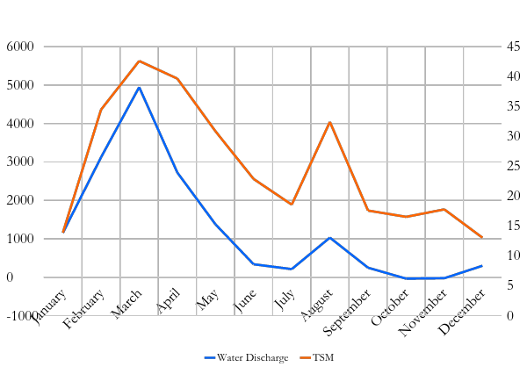
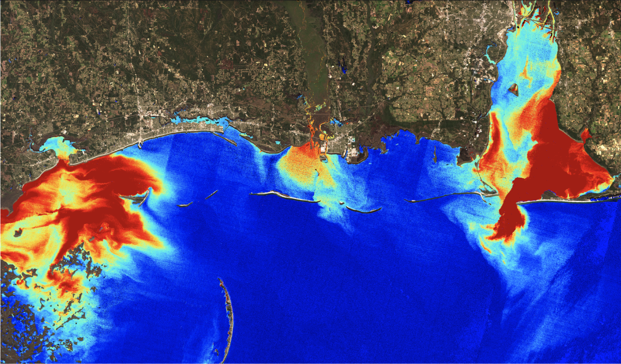
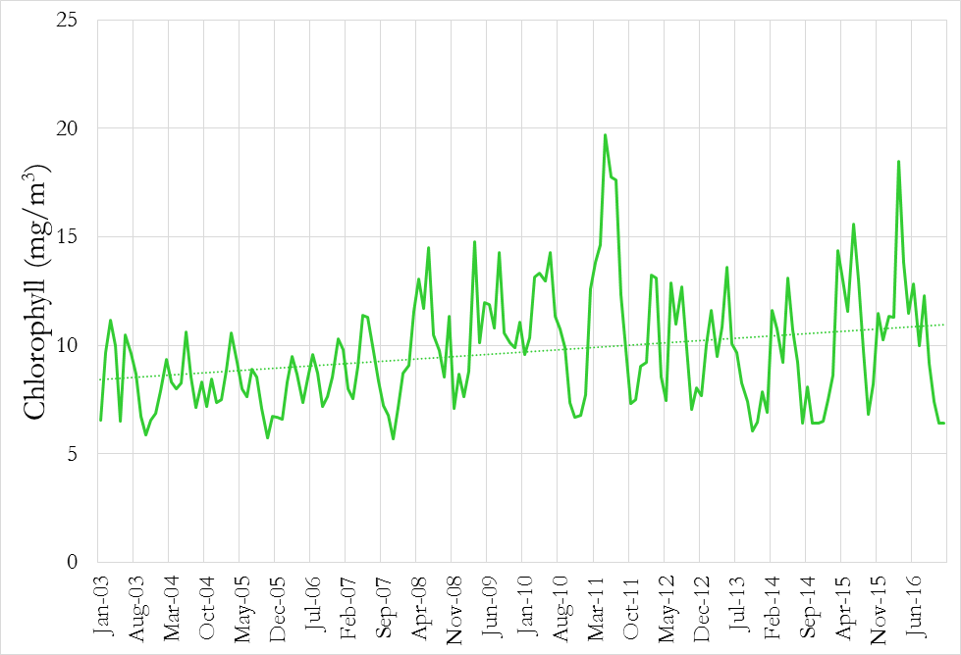
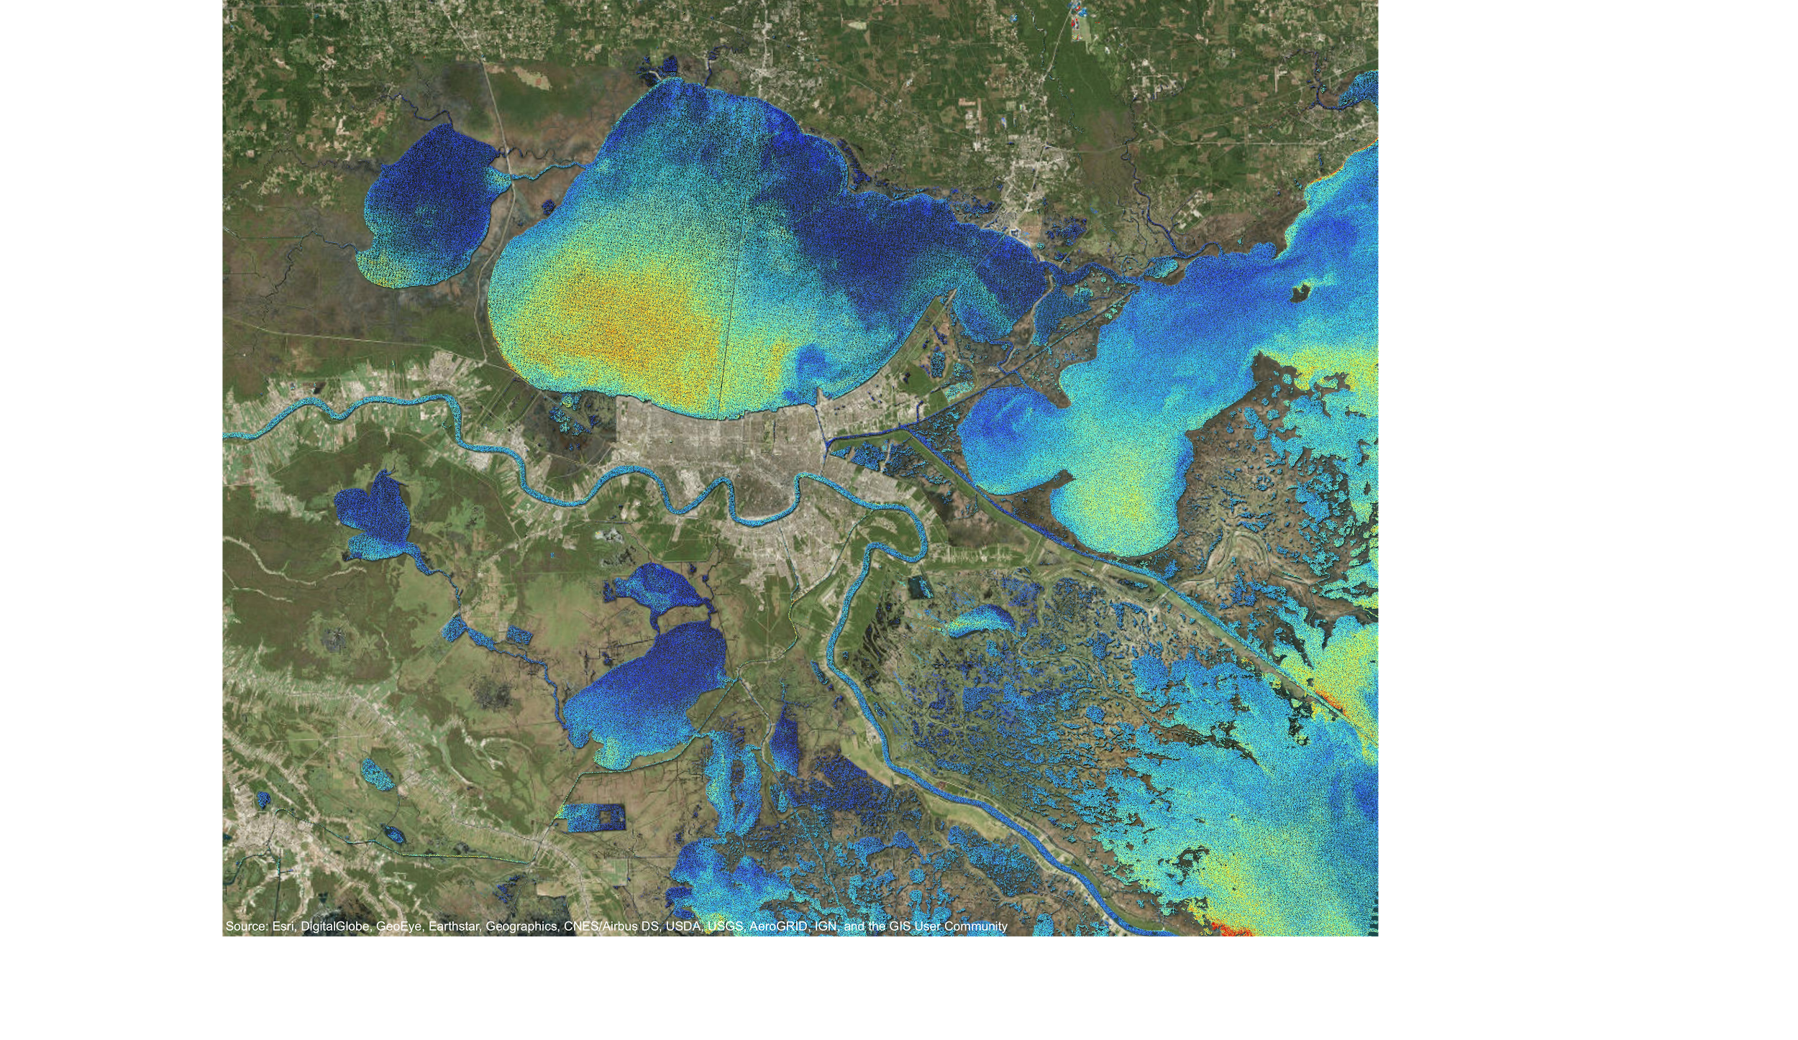
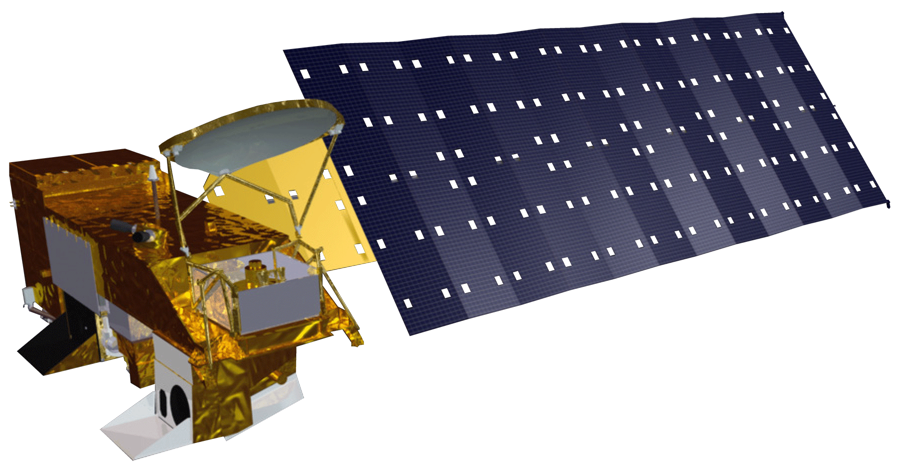
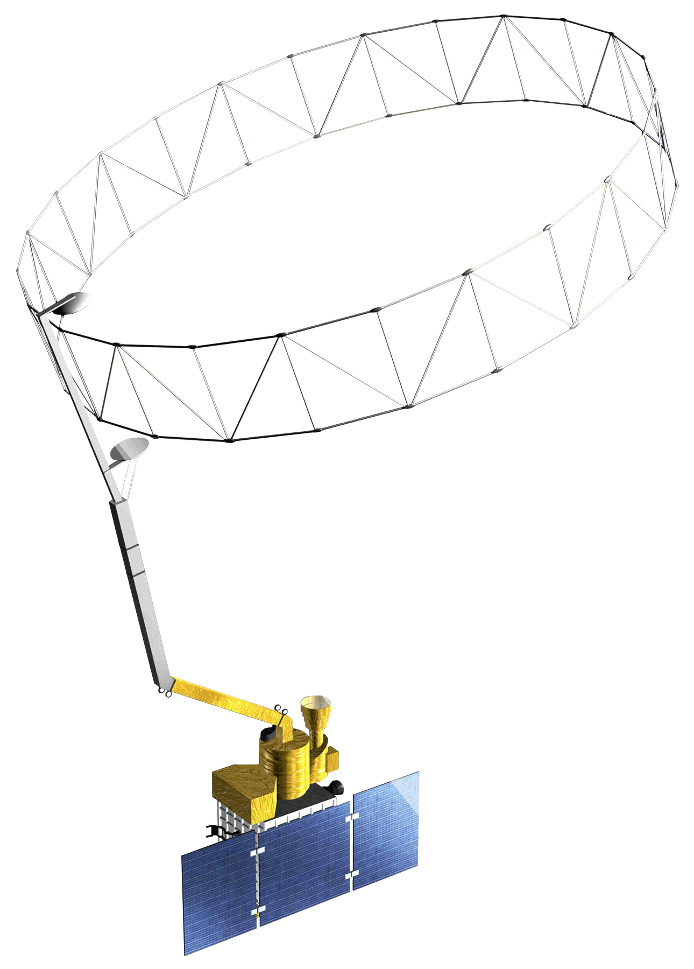
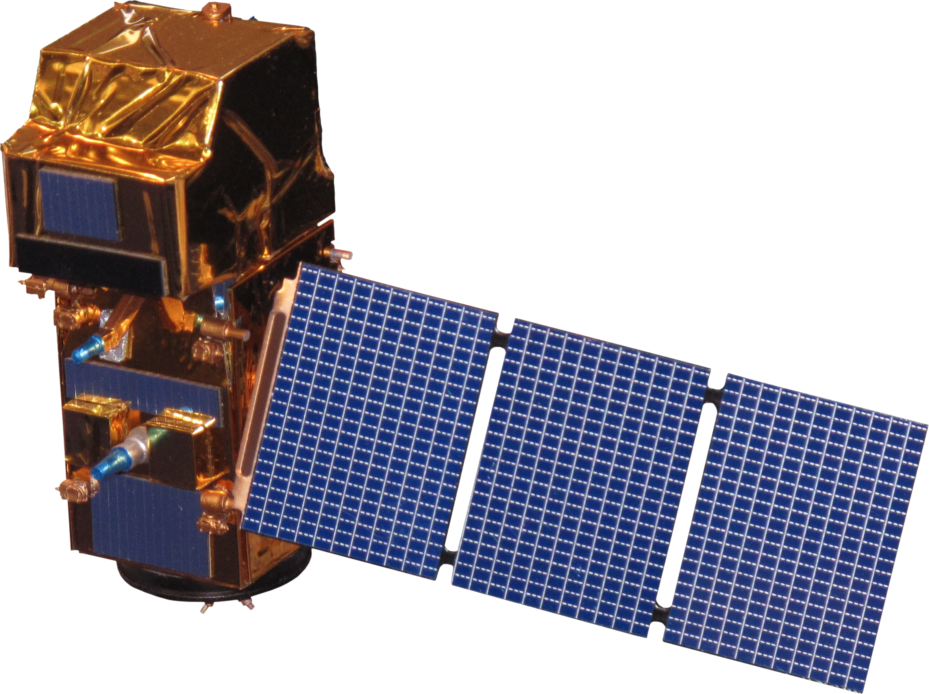
Analyzing the Impact of Environmental Disturbances on Oyster Reef Health
in the Mississippi Sound
Using NASA Earth Observations
Methodology
Abstract
Methodology
Oysters are vital to the environmental health of the Mississippi Sound and a critical part of Mississippi’s economy. Environmental disturbances, such as Hurricane Katrina, major flooding events, and the Bonnet Carré spillway openings, have caused oyster populations to decline and have has negatively affected the water quality and economy of the Sound. Oysters purify water via filter feeding and a decline in their population could lead to increased levels of dissolved solids in the waterways. In collaboration with the Mississippi Department of Marine Resources (MDMR), the team focused on specific case studies of significant disturbances by combining data gathered in the Spring 2017 Term with data on the degradation of marshlands in the area. The team investigated the relationships between extreme weather events, turbidity, salinity, freshwater discharge and diversion, chlorophyll-a, and oyster reef health. These case studies will help inform MDMR about how these factors are interdependent and impact the overall health of the Sound. This information will assist the MDMR in making better-informed decisions in preparing for and managing ecological stressors.
Data Products
Chlorophyll-a, Sea Surface Temperature, Water Discharge, Gage Height, Turbidity, TSM, Oyster Landings, and Salinity
Analysis
Analysis
Correlation analysis of water quality parameters and oyster landings
Added data into ArcMap with focus on the study area
Objectives
Results
Results
Analyze the impact of environmental disturbances on oyster reefs in the Mississippi Sound
Develop a timeline of water quality parameters for the marshes surrounding the Biloxi State Wildlife Management Area
Case Studies
Time Series / Climatology
Results
Annual Oyster Landings in the State of Mississippi
2002-2015
Study Area
Include a map that has easily readable text and a legend. Including the study period is optional.
For ALL images – make sure all text is legible and add legends separately (so they can be moved or resized). If text is not editable, a team member must be available to make changes with a very short turn-around time (hours, not days) after submission.
Water Discharge of the Pearl River vs TSM in the Western Sound 2016
Turbidity Concentration After Flooding Event March 2016
Western Sound
Eastern Sound
Lake Borgne
Biloxi Marsh
Area
Chandeleur
Gulf
Mississippi Sound Water Resources II
0
T Dogliotti 655nm (FNU)
100
Earth Observations
Chlorophyll Concentration in the Mississippi Sound
2003-2016
Chlorophyll Concentration Near Marshlands September, 2006
Landsat 8 OLI & TIRS
Landsat 7 ETM+
0
CHL OC2 (mg m^-3)
10
Aqua MODIS
Landsat 5 TM
Conclusions
Data suggests the variability of water quality parameters has increased over time.
There are indications that the flow of freshwater into the Biloxi Marsh may be increasing.
There are limitations in the availability of remote sensing data in marshlands and coastal regions.
SMAP
Sentinel-2 MSI
Team Members
Project Partners
Mississippi Department of Marine Resources
Acknowledgements
The Mississippi Sound Water Resources II Team would like to thank our partners from MDMR: Scott Gordon, George Ramseur, Charlie Robertson, Karen Clark, and Robert Gruba, as well as our science advisors: Dr. Kenton Ross, NASA Langley Research Center; Benjamin Holt, NASA Jet Propulsion Laboratory; and Dr. Severine Fournier, NASA Jet Propulsion Laboratory. We would also like to thank our Center Lead, Emily Gotschalk, for her hard work and commitment to our success.
Carter Grimm
Team Lead
Rachael Green
Hannah Russ
NASA Langley Research Center – Summer 2017

