Slide 1
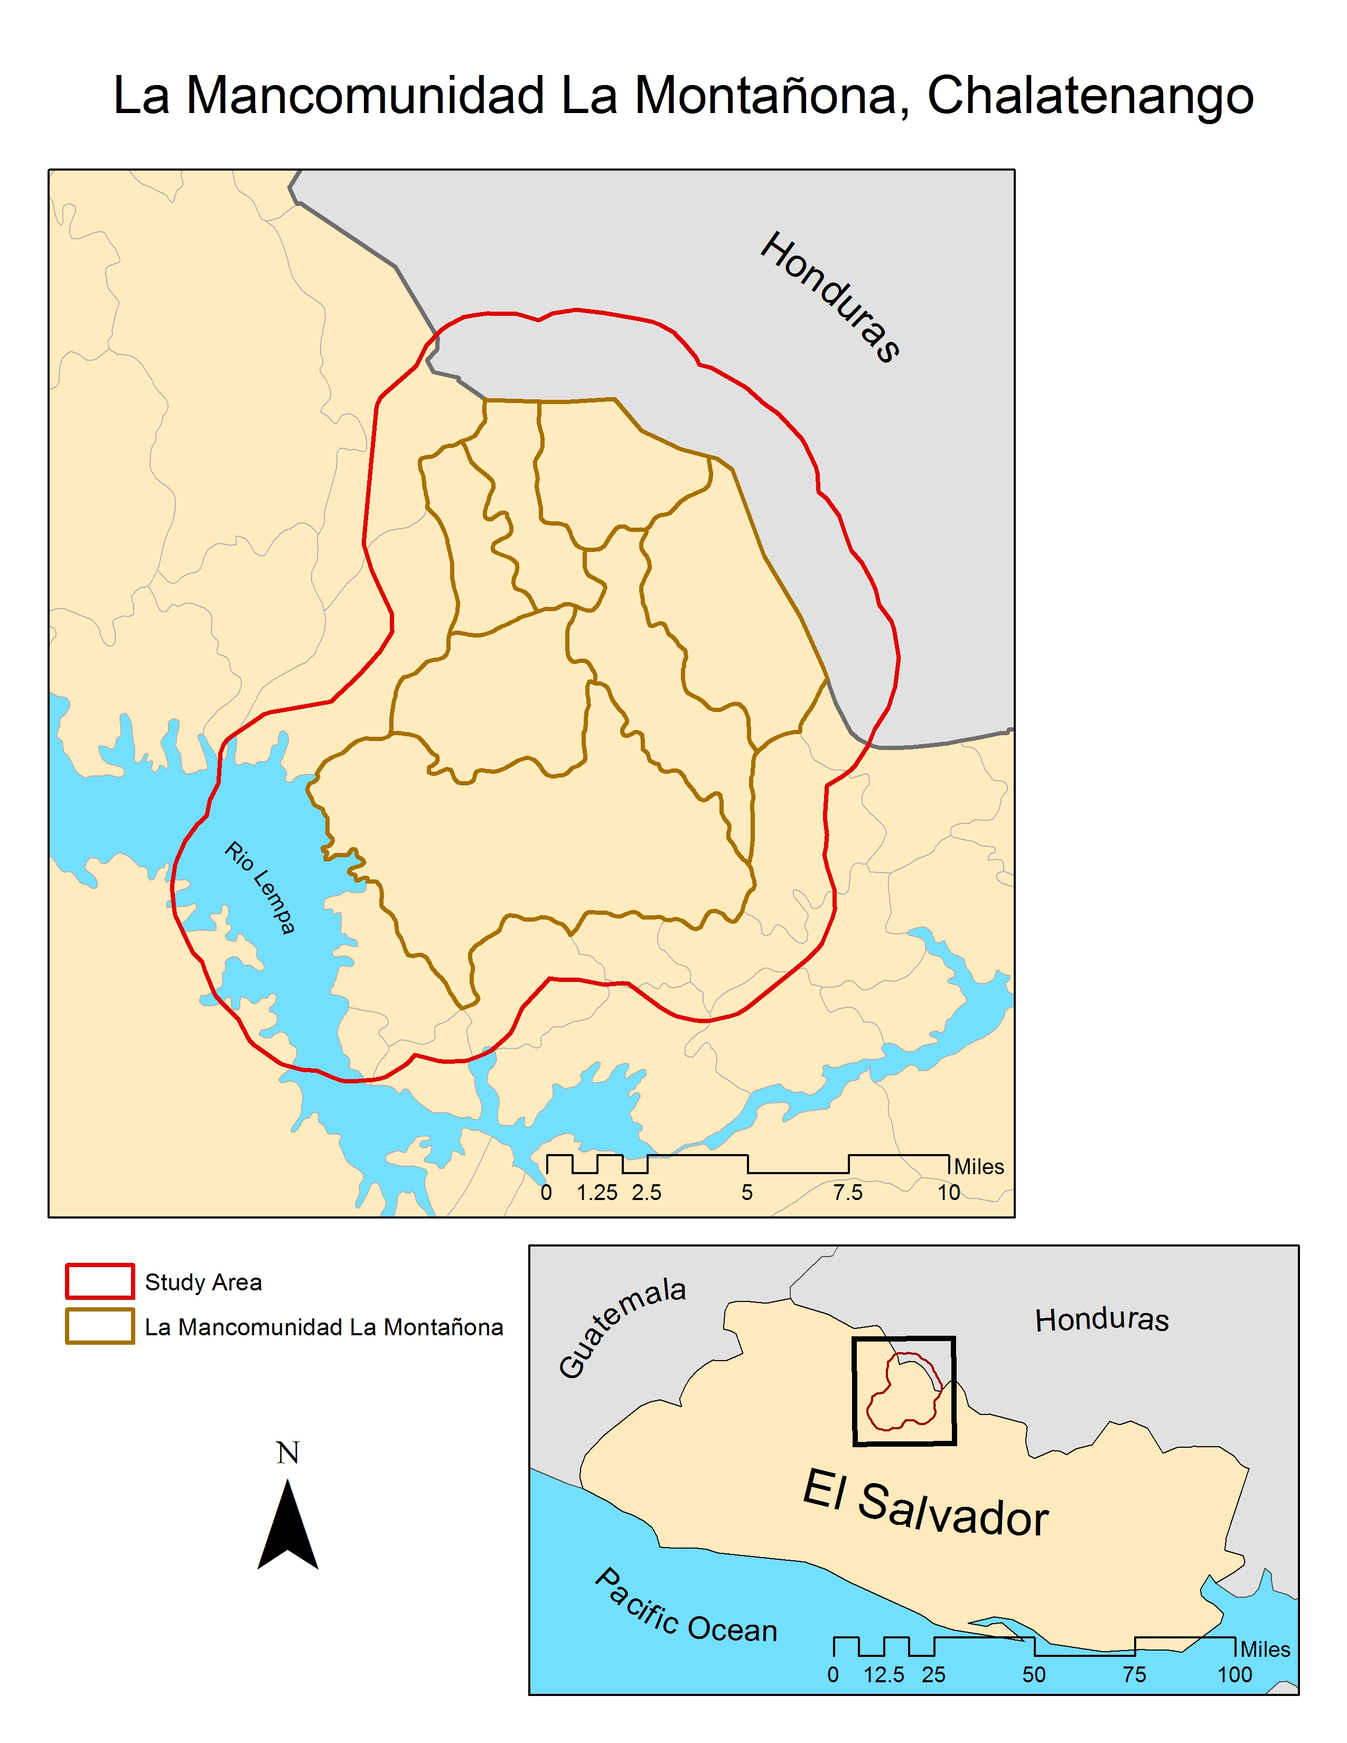
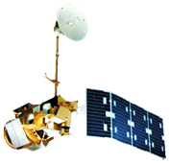
El Salvador Ecological Forecasting
Utilizing NASA Earth Observations to Develop a Historically Based Trajectory of
Deforestation and Degradation in El Salvador
Jordan Ped (Project Lead), Stephen Zimmerman, Courtney Duquette, Susannah Miller, Taylor Dougherty (USAF), Clarence Kimbrell (USAF)
Affiliation(s)
Abstract
Objectives
Study Area
Keep this blank for now.
Body text point size should be at least 24.
Caption text point size should be at least 16.
Feel free to rename, move, and resize sections as needed.
Land Use/Land Cover (LULC) delineating dominant tree species, agriculture and pastoral plots, and urban development
Regional Forest Inventory (RFI) highlighting forest extent, distinction between primary and secondary forests, percent forest cover, and distribution of biomass
Forecasting model
Methodology
DATA ACQUISITION
ABES Project field survey
DATA PROCESSING
END PRODUCT
Landsat Scenes are clipped using python in ArcGIS.
LandTrendr -- Forecasting Model
Data from MARN
DATA ANALYSIS
Un/Supervised classification (LULC). Forest mask & RIF
LULC Time Series: 2014, 2010, 1995 & 1986
QuickBird and RapidEye imagery are resampled in ArcGIS to fit resolution of Hansen and Landsat data
RFI accuracy checked with field surveys, RapidEye, and Hansen data
Earth Observations
Landsat 4-5 Landsat 8
Landsat CDR 4, 5, & 8
Resampled (30 m) QuickBird imagery is utilized to “validate” Hansen data at the regional scale
Hansen dataset is clipped to QuickBird extant.
Project Partners
Collaborator:
The Earth Institute, Columbia University (ABES Project) POC: Dr. Sean Smukler, Assistant Professor & Sean Kearney, PhD student, University of British Columbia
End Users:
La Mancomunidad La Montañona, Chalatenango, El Salvador POC: Arnulfo Alberto, Director
Ministerio de Medio Ambiente y Recursos Naturales (MARN), El Salvador POC: Giovanni Molina, Geo-environmental Information Systems Manager
Hansen Global or PALSAR
This is a rough draft.
Results
Use images.
Make sure that it has some sort of flow, that it makes sense. Show your results in a logical order.
No bullets.
Conclusions
Team Members
Acknowledgements
Use bullets.
Use complete sentences with periods.
Use a professional-looking photo.
Individual headshots are ok, if they aren’t pixelated and are all the same size.
Include a caption that states the team members’ names.
Include anyone who has helped you with the project.
If this is a continuation project, credit the previous team members and contributors.
If you are including affiliations, use DEVELOP as the affiliation for a DEVELOPer or former DEVELOPer—not their school or former school.

Slide 2
ABES Project field survey
Landsat Scenes are clipped using python in ArcGIS.
LandTrendr -- Forecasting Model
Data from MARN
Un/Supervised classification (LULC). Forest mask & RFI
LULC Time Series: 2014, 2010, 1995 & 1986
QuickBird and RapidEye imagery are resampled in ArcGIS to fit resolution of Hansen and Landsat data
RFI accuracy checked with field surveys, RapidEye, and Hansen data
Landsat CDR 4, 5, & 8
Resampled (30 m) QuickBird imagery is utilized to “validate” Hansen data at the regional scale
Hansen dataset is clipped to QuickBird extant.
Hansen Global or PALSAR
ABES Project field survey
Landsat Scenes are clipped using python in ArcGIS.
LandTrendr -- Forecasting Model
Data from MARN
Un/Supervised classification (LULC). Forest mask & RIF
LULC Time Series: 2014, 2010, 1995 & 1986
QuickBird and RapidEye imagery are resampled in ArcGIS to fit resolution of Hansen and Landsat data
RFI accuracy checked with field surveys, RapidEye, and Hansen data
Landsat CDR 4, 5, & 8
Resampled (30 m) QuickBird imagery is utilized to “validate” Hansen data at the regional scale
Hansen dataset is clipped to QuickBird extant.
Hansen Global or PALSAR

