Slide 1
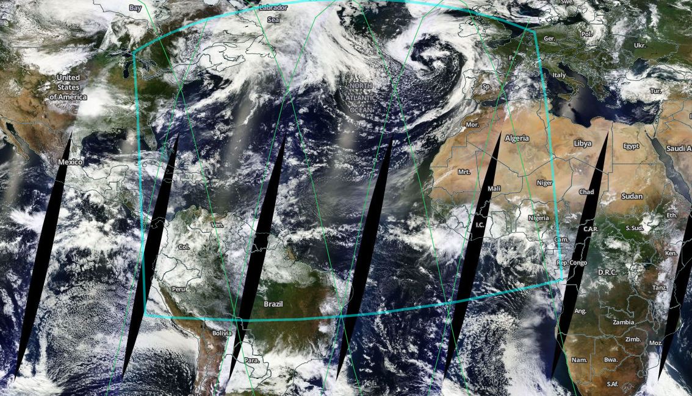
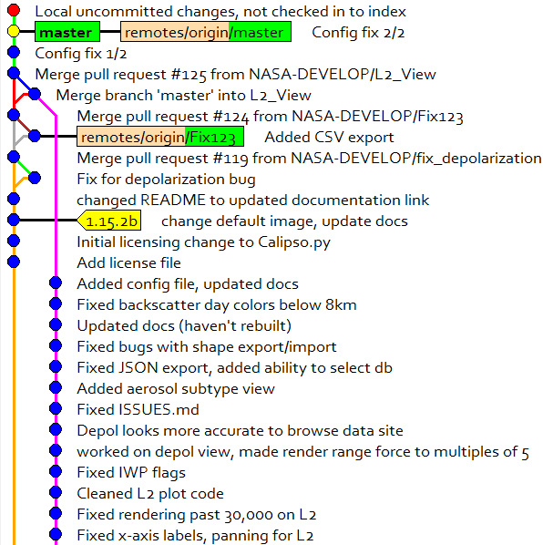
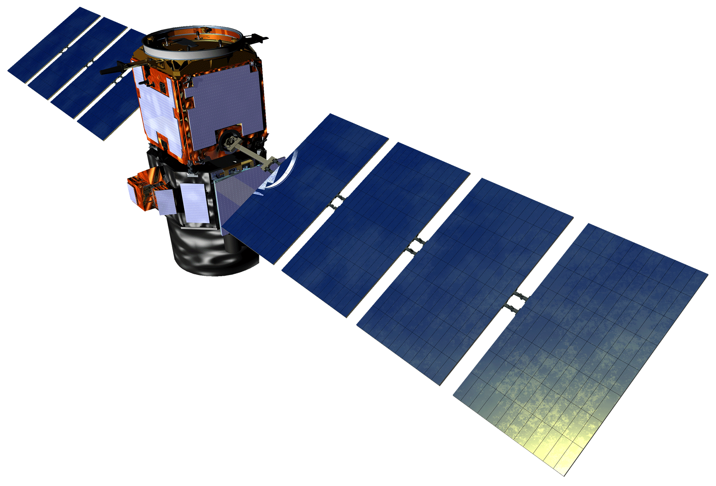
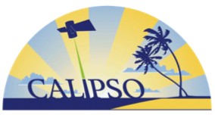
Enhancements to Visualization of CALIPSO
(VOCAL) through Case Studies of Saharan Dust
Abstract
Objectives
The Cloud-Aerosol LiDAR and Infrared Pathfinder Satellite Observation (CALIPSO) satellite’s CALIOP sensor generates vertical LiDAR profiles of the atmosphere at a global scale. Currently, the standard visualization tool for these data is written in Interactive Data Language (IDL), a proprietary language that does not support features for tracking aerosols, selecting data, or sharing those selected sections. This makes working with CALIPSO data difficult for researchers and does not allow them to visually identify aerosol features from these data. Previous DEVELOP teams have built a working version of the Visualization of CALIPSO (VOCAL) software, a Python language replacement for this IDL-based software. During this term, the team enhanced VOCAL by improving the shape drawing tool, adding the capability to view multiple levels of data, and more flexible data inputs and outputs that support a decentralized database. These features will increase the usability of VOCAL, expediting the process of visually identifying features and analyzing the resulting subsets of data. Finally, the DEVELOP team conducted a case study with Saharan Dust transport over the Atlantic Ocean to test the capabilities of the VOCAL software and to produce a database of dust events. The database and case study will help members of the CALIPSO Science Team compare the performance of classification algorithms used to create Level 2 (L2) CALIPSO data products, and will also support preliminary analysis of the atmospheric interactions and consequences related to long range dust transport.
Enhance usability of VOCAL with more intuitive tools
Identify and study Saharan dust events by visually drawing features with Level 1 CALIPSO data products
Produce a database of dust events, compare visual and algorithmic identification, and analyze optical properties
Study Area
Credit: NASA Earthdata Search
Methodology
The study area focused on the Atlantic Ocean between West Africa and Central America and also incorporates portions of the Gulf of Mexico and Mediterranean Sea. The bounding area is denoted in light blue, with a sample of intersecting CALIPSO granules highlighted in green.
Integrate branches from Summer 2016 Term and continue development of VOCAL with version control (git)
Add more dynamic data input and output with MySQL database and csv options
Test and use VOCAL to refine software and study long range dust transport
Acquire CALIPSO Level 1 Standard v4-10 for the summer months of 2014, 2015, and 2016
Earth Observations
CALIPSO Cross-Cutting
Fix bugs in loading data and using polygon draw tool, and update documentation
Visually identify dust events with drawing tool and add shapes to database
Cloud-Aerosol LiDAR and Infrared Satellite Observation (CALIPSO)
Implement Level 2 data product viewing: vertical feature mask, ice/water phase, aerosol subtype
Export shapes and generate histograms and statistics from database of dust transport events
Project Partner
NASA CALIPSO Science Team (NASA Langley Research Center)
Results
Left: The VOCAL software can display Level 1 Depolarization and Attenuated Backscatter data. We used these data to visually identify dust features, as seen by the purple polygon. Right: VOCAL now has the capability to display and interact with Level 2 data products, such as the Vertical Feature Mask. This updated version is now available on GitHub.
Team Members
Acknowledgements
Conclusions
Dr. Charles “Chip” Trepte, NASA Langley Research Center
Dr. Kenton Ross, NASA Langley Research Center
Dr. Kathleen Moore, NASA Langley Research Center
Roman Kowch, NASA Langley Research Center
Britney Hopgood, NASA Langley Research Center
VOCAL now has the functionality to display Level 2 products.
Dust features can be visually drawn and saved with VOCAL.
Results indicate that user-identified shapes exhibit higher backscatter.
William Turner
Collin Pampalone
(Project Lead)
Ryan Avery
NASA Langley Research Center – Summer 2017

