Slide 1

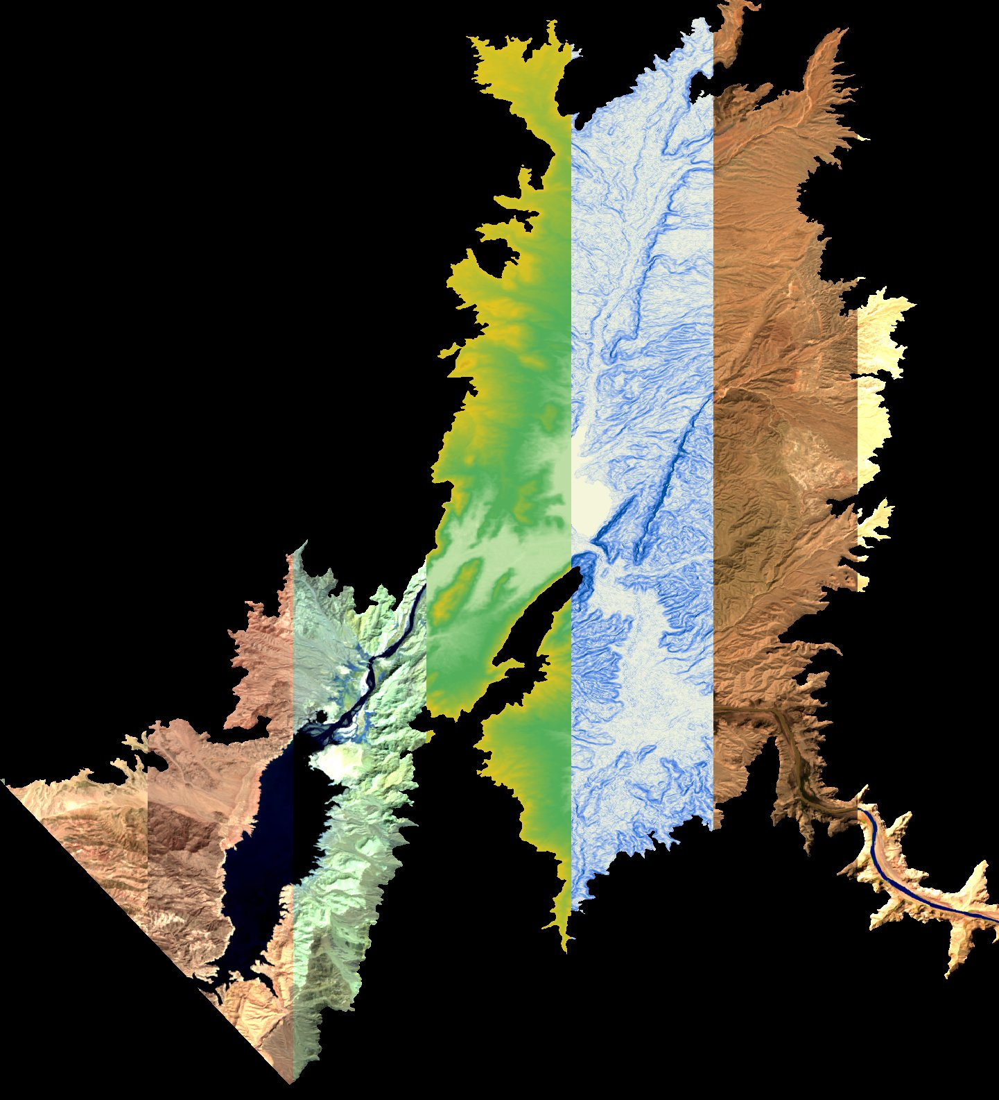
GRAND CANYON WATER RESOURCES
Andrew Phillips
(Project Lead)
Utilizing NASA Earth Observations to Assist the National Park Service in Monitoring Riparian Land Cover Change in the Lower Grand Canyon
Sydney Young
Austin Counts
Christine Stevens
Notes:
Team Introduction

Slide 2

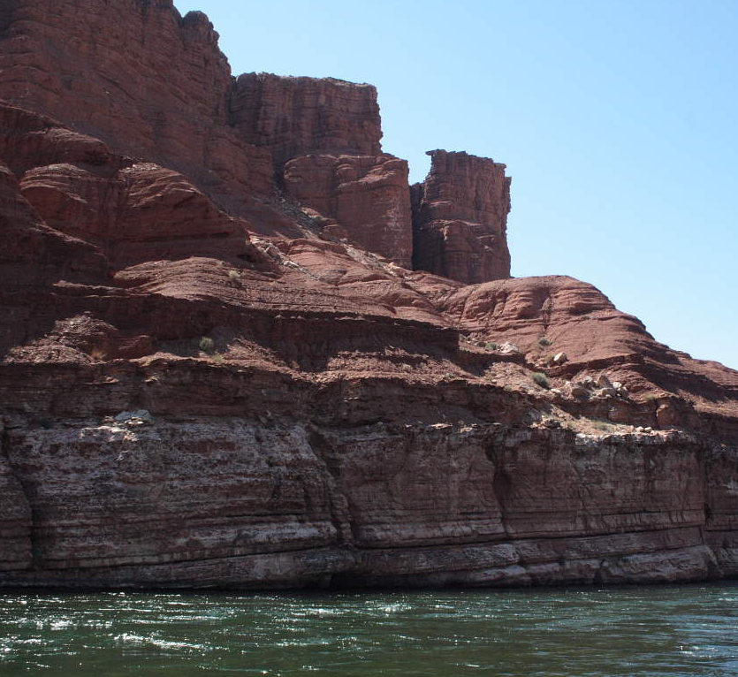
Community Concerns
From 1998 - 2016, Lake Mead’s water level decreased over 130 feet to a record low elevation
Declining water levels expose new areas
of riparian sediment
Exposed sediment can negatively affect
air and water quality and facilitate growth of non-native vegetation
Image Credit: Wayne Ranney
Notes:
Along the Colorado River sits the Lake Mead Reservoir, the largest reservoir in the United States. In 2016, Lake Mead’s water levels dropped drastically to record low elevation.
As a result, new areas of riparian sediment, or sediment along the shoreline, are exposed.
Such exposure has the potential to negatively impact water & air quality, as well as harm surrounding ecological health.
Image url: http://earthly-musings.blogspot.com/2010/09/my-2010-grand-canyon-rafting-trip.html

Slide 3
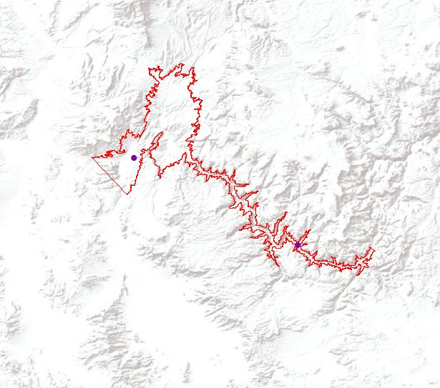
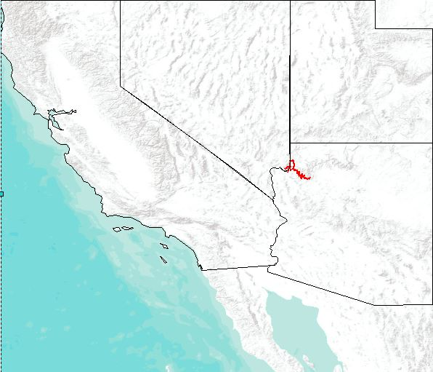
Study Area
Study Area:
Lake Mead &
Lower Grand Canyon
Study Period: 1998 - 2016
South Cove
Separation Canyon
Notes:
Our study focused on Lake Mead & the Colorado River Basin from years 1998 – 2016.
We looked specifically at the Western part of Grand Canyon National Park and the boundaries of Separation Canyon and South Cove (identified on the map).
Image Source: ArcMap basemap (Esri, DeLorme, USGS, NPS, NOAA)

Slide 4

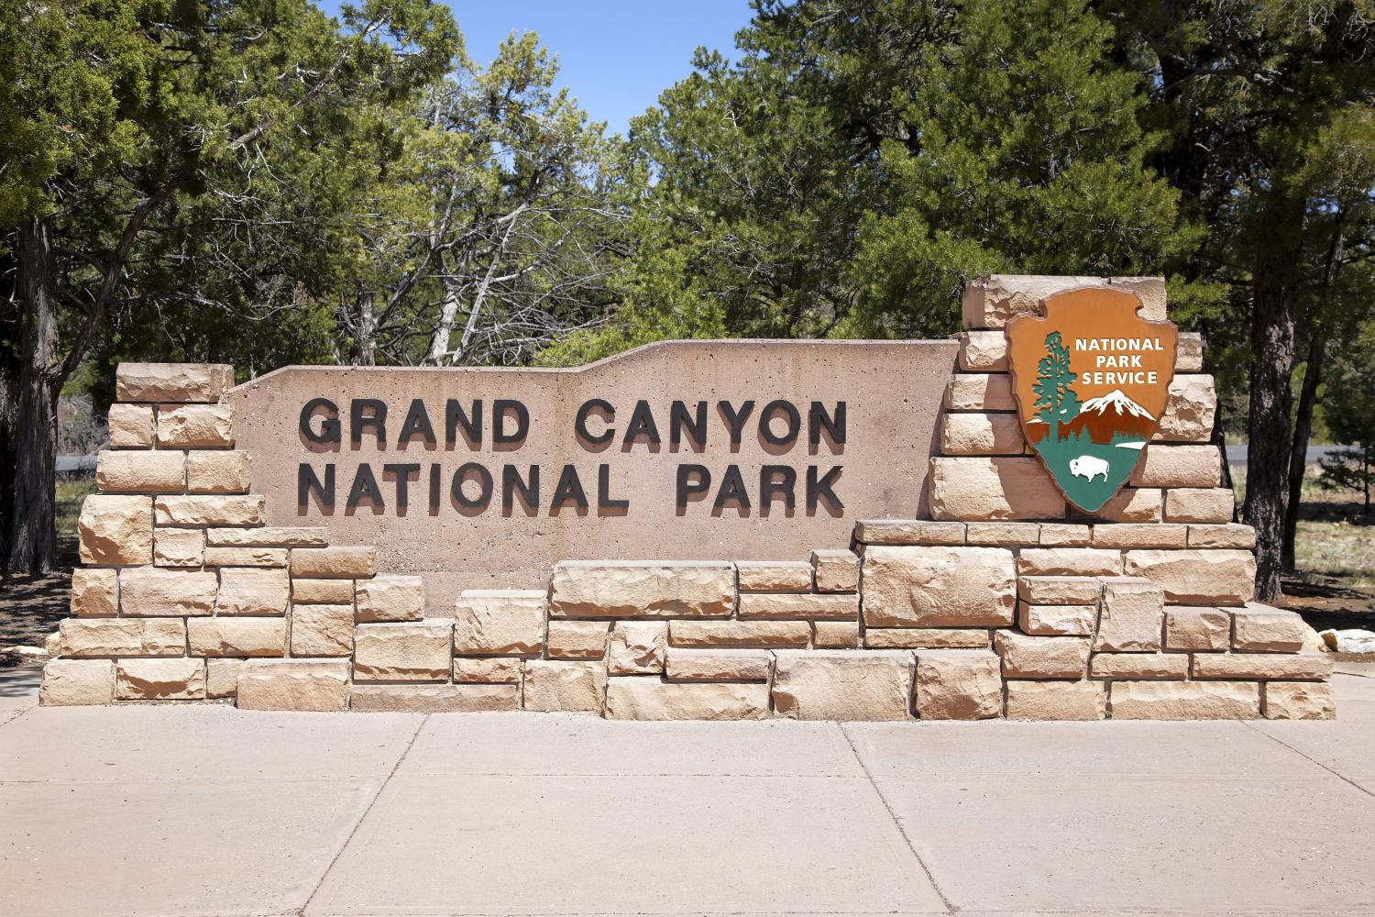
Project Partners
Grand Canyon National Park
Ed Schenk – Physical Scientist
Image Credit: NPS
Notes:
Our team partnered with Grand Canyon National Park to assess land cover changes in the Lower Grand Canyon region using NASA Earth Observations.
Image url: http://cn.depositphotos.com/11914691/stock-photo-grand-canyon-entrance.html

Slide 5
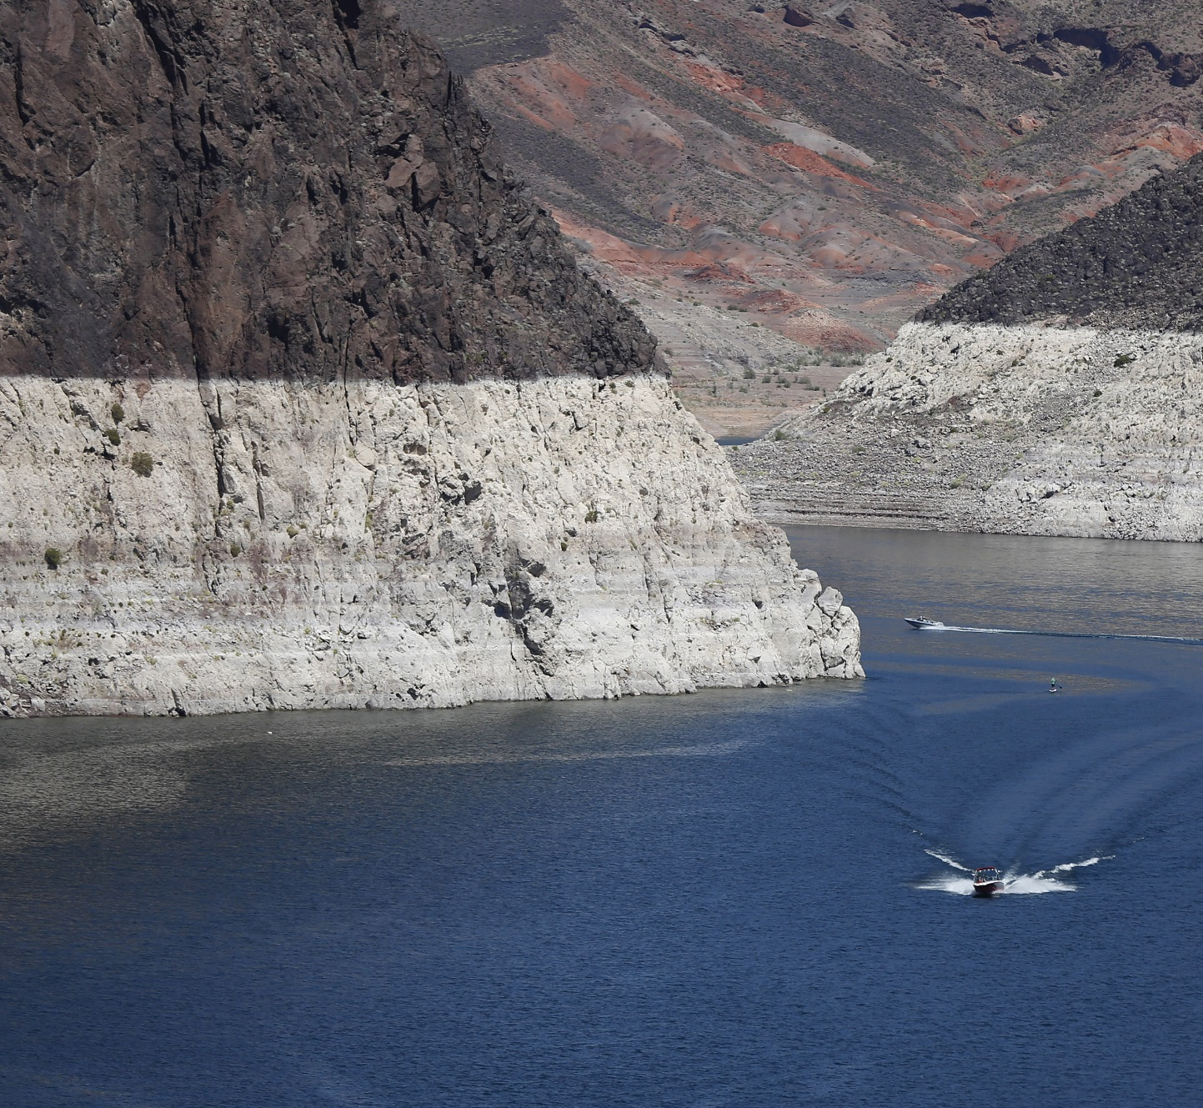
Objectives
Create a replicable land cover classification process to provide a baseline model for ongoing assessments
Provide end-user with land cover and water surface change maps and surface area statistics
Enhance understanding of changing conditions due to drought
Image Source: International Business Times
Notes:
Enhance our partner’s understanding of the impacts of the ongoing drought & how it relates to topics such as
Water surface area
Riparian land cover
Sedimentation
Ecological change
Create an analysis process that can easily be repeated by our end-users
Provide the National Park Service with land cover and water surface change maps and statistics to assess the effects of decreasing water extent on riparian ecology
Image url: http://www.ibtimes.com/lake-mead-2015-photos-show-water-level-nearing-record-low-drought-threatens-southwest-1892211

Slide 6



NASA Earth Observations
Landsat 5 Thematic Mapper (TM)
Spatial resolution: 30m
Landsat 8 Operational Land Imager (OLI)
Spatial resolution: 30m
Terra
(ASTER)
Spatial resolution: 15m
Image Credit: NASA
Notes:
Image source: DEVELOPedia

Slide 7
Methodology
Data
Analysis
End-Products
Water Feature Extraction
Water Surface Change Map & Statistics
Landsat 5
Normalized Difference Vegetation Index
Normalized Difference Water Index
Modified Normalized Difference Water Index
Seasonal Image Composites
Landsat 8
Land Cover Classification
Landsat Bands
Land Cover Change Map & Statistics
ASTER DEM
NDVI
Random Forest Classifier
Elevation & Slope
Training Areas
Accuracy Assessment
Distance to Water
Notes:
Landsat 5 and 8 surface reflectance image scenes were acquired over the study area for every year in the study 1998-2016 except for 2012 where the is a coverage gap.
A DEM product was collected from the ASTER instrument on the Terra satellite
Landsat Surface Reflectance bands include: Blue, Green, Red, NIR, SWIR1, and SWIR2
1. Water Feature Extraction was performed using three different indices for identifying water pixels present in Landsat imagery
An inverse NDVI was calculated using the NIR and red surface reflectance bands to highlight water values
NDWI was calculated using the NIR and green surface reflectance bands
MNDWI was calculated using SWIR1 and green surface reflectance bands
2. Land Cover Classification was performed to quantify and visualize changes in riparian feature classes including water, riparian vegetation, riparian soil, dead vegetation, exposed lake bed, and bare canyon
Inputs into the classification include:
Landsat Surface Reflectance bands include: Blue, Green, Red, NIR, SWIR1, and SWIR2 used to differentiate between moisture content of soil and vegetation
NDVI used to identify variation in plant health to differentiate between live and dead vegetation
Elevation and Slope were derived from the ASTER DEM to more precisely identify classes still affected by water fluctuation in the riparian zone
A slope-weighted water buffer variable (cumulative cost distance to water) was derived to better differentiate between riparian and non-riparian soil types and more accurately differentiate all feature classes
Feature class specific training samples were collected to inform the classifier with input values for each feature class represented
These were divided into training and test sets. The training sets were input directly into the Random Forest Classifier and the test set was used to verify the accuracy of the entire image classification.
Random Forest Classifier
Accuracies were calculated for land cover classification per feature class per classified image year. Accuracy was also calculated for water feature extraction per water index, and for the water pixels extracted using the random forest classification method.
Final water surface and land cover maps were created to visualize the extent of riparian features in the Grand Canyon and their change at various stages of the drought.
Surface area graphs were created to better represent the total and relative change of individual riparian feature classes.

Slide 8
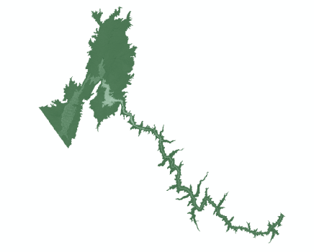
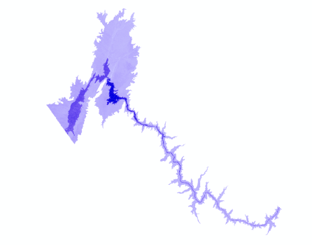
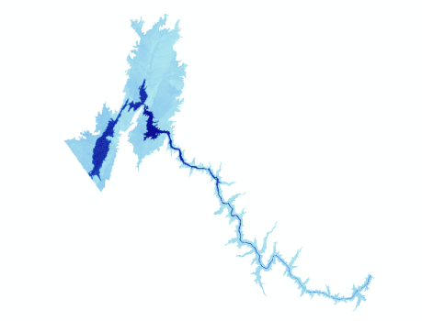
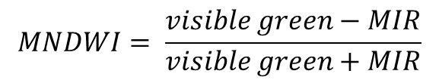
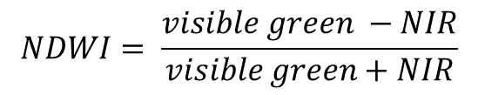
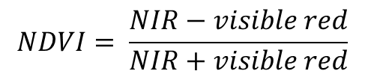
Water Feature Extraction
Normalized Difference Vegetation Index
$$NDVI= \frac{NIR−visible red}{NIR+visible red}$$
Normalized Difference Water Index
$$NDWI= \frac{visible green −NIR}{visible green+NIR}$$
Modified Normalized Difference
Water Index
$$MNDWI= \frac{visible green−MIR}{visible green+MIR}$$
Notes:
Equations for each:
NDVI was calculated using the NIR and red surface reflectance bands to highlight water values
Emphasize “inverse” NDVI: 1. Thresholding and using negative values to extract water = Clarify why this is used for water
NDWI was calculated using the NIR and green surface reflectance bands
MNDWI was calculated using SWIR1 and green surface reflectance bands

Slide 9
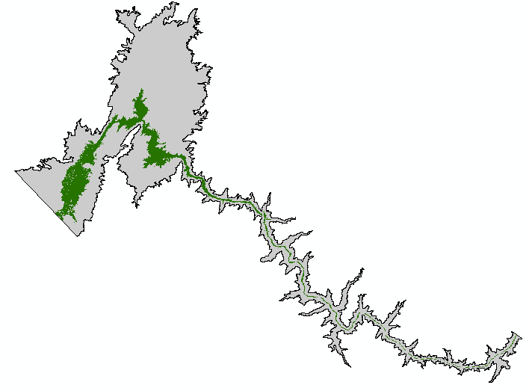
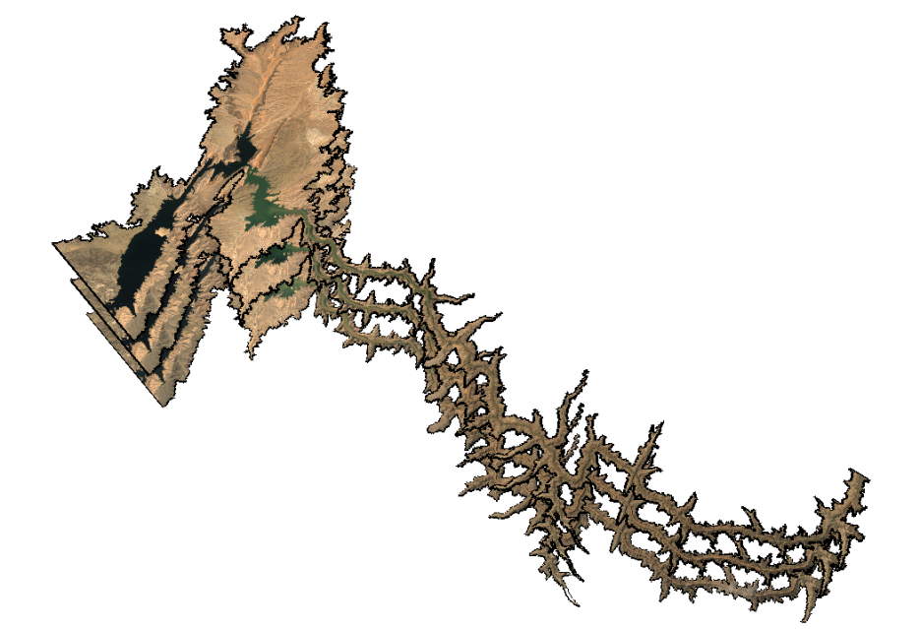
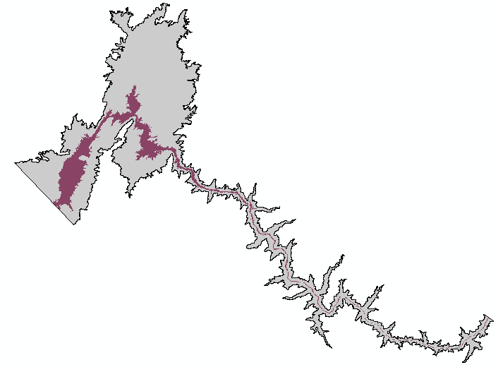
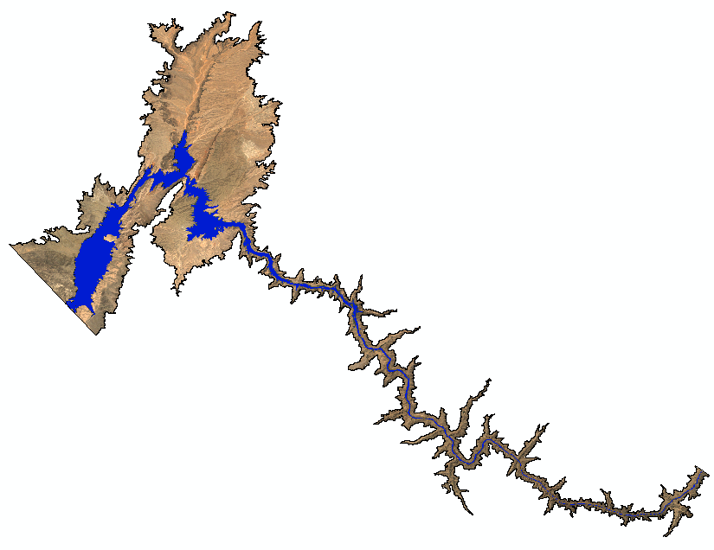
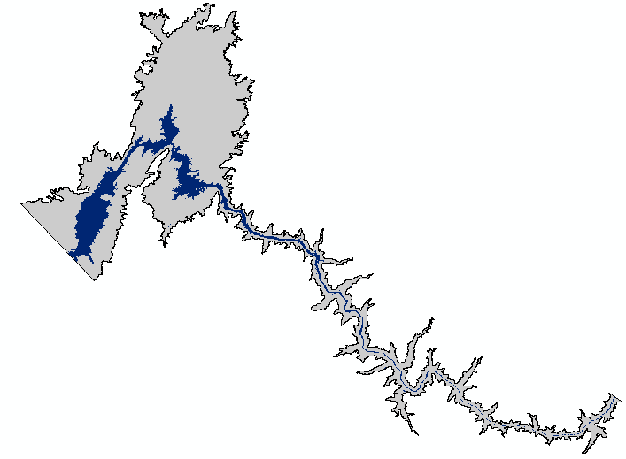
Water Feature Extraction
Landsat
Seasonal
Composite
Water Surface Extent
NDVI
Threshold
NDWI
Threshold
MNDWI
Threshold
NDVI NDWI MNDWI
Notes:
The graphics shown here represent the specific data processing steps taken in order to extract the water features from our study area. We completed this process for each spring season, March 1 – May 31, over our study period.
First, we selected all the spring Landsat images which covered our study area. The size of the collection varied by year as a result of the Landsat sensor acquisition, and so we had anywhere from 2 scenes to 6 scenes for a given season.
After clipping each scene to the boundaries of our study area, we removed the clouds from the image by filtering with the cfmask available in the Surface Reflectance products. We also calculated the Normalized Difference Vegetation Index, Normalized Difference Water Index, and Modified Normalized Difference Water Index for every image in our season.
We then created a seasonal composite image for each index. For the NDVI, we chose the minimum value in order to capture the maximum extent of the water that season, assuming that water has negative values in an NDVI index. For NDWI and MNDWI, we chose maximum values, as water has positive values in those indices.
We then applied a threshold of 0 to each index in order to create a binary water mask. A final water mask was created by taking the mode of the three index masks.
These steps were repeated for each year in the study period.

Slide 10
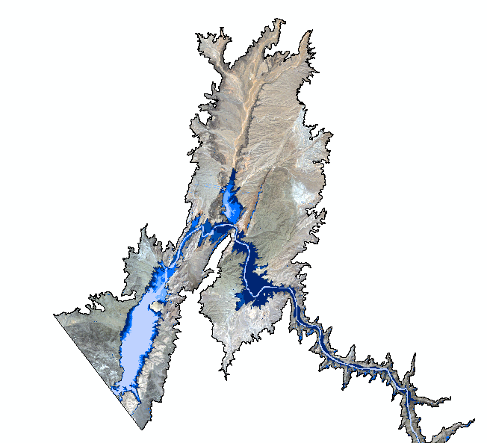
Water Surface Change
Water Extent by Year
1998
2003
2007
2011
2016
Notes:
On this slide you can see the extent of water from five of the years within our study period. It shows that the greatest spatial changes to water throughout the eighteen years occurred in Lake Mead delta.
Image source: NAIP Imagery

Slide 11
Water Surface Area
Notes:
This graph depicts gradual water surface area decrease across the study period.
As expected, our results show the rapidly decreasing water surface area in the lower Grand Canyon. The rate of water loss increased rapidly during the first five years of the drought, then steadily declined.
By 2016, the water surface area was 38% of it’s 1998 extent.

Slide 12
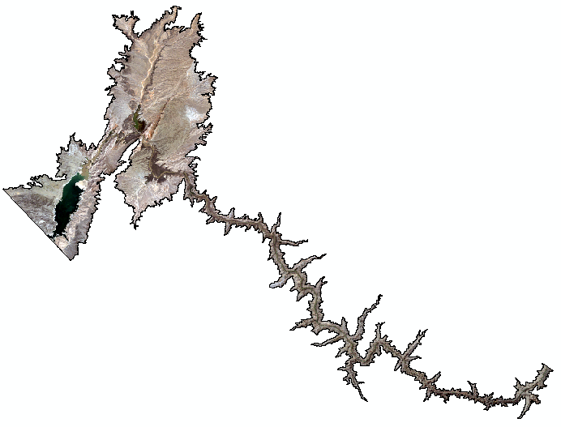
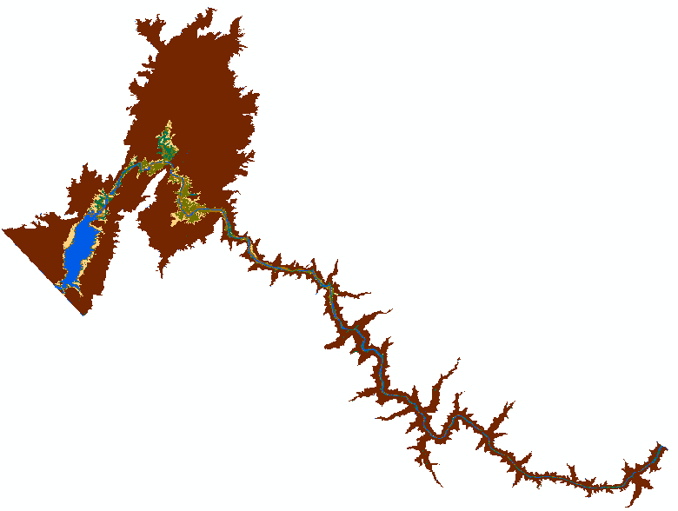
Land Cover Classification
6 Land Cover
Class Types
Water
Riparian Vegetation
Riparian Sediment
Dead Vegetation
Bare Canyon
Exposed Lake Bed
Landsat
Seasonal
Composite
Classified
Image
Notes:
Shown here is the processing required to produce our land cover classification products. This process was applied to 5 spring seasons during our study period – 1998, 2003, 2007, 2011, and 2016.
Same as the Water Feature Extraction, we first selected all the spring Landsat images of our study area, clipped each of them, and removed the clouds using the cfmask algorithm.
We then created a single composite image for the season by taking the median value for each pixel across the scenes.
Once we had produced our composite image, we selected training areas for our classifier. Using Google Earth as reference imagery, we selected more than 20 polygons for each of the six land cover classes, Water, Riparian Vegetation, Riparian Sediment, Dead Vegetation, Exposed Lake Bed, and Bare Canyon.
Next, we divided the training areas. 90% were used to train the classifier, and 10% were used to test the classification accuracy. We also then classified the entire study area.
All these steps were repeated for 1998, 2003, 2007, 2011, and 2016 – with separate training areas for each year.
Image Source: NAIP Imagery

Slide 13
Classifier Inputs
Landsat Bands
NDVI
Elevation and Slope
Distance to Water
Notes:
Landsat Bands
Blue – Soil/vegetation differences
Green – Plant vigor/peak vegetation
Red – Vegetation slopes
NIR – biomass content
SWIR – Soil and vegetation moisture
NDVI
Vegetation health
Elevation and Slope were derived from the ASTER DEM
Increase precision of riparian vs. non riparian feature class identification (Transition between aquatic and terrestrial)
Slope-weighted water buffer
A slope-weighted water buffer variable (cumulative cost distance to water) was derived to improve differentiation between riparian and non-riparian soil types and accuracy of all feature classification

Slide 14
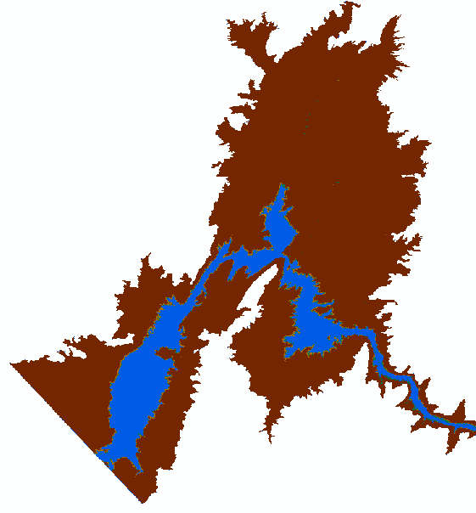
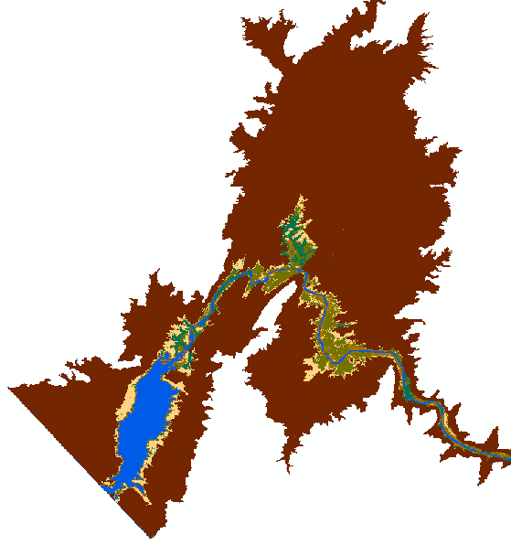

Land Cover Classification
Land Cover Type
Water
Riparian Vegetation
Riparian Sediment
Dead Vegetation
Exposed Lake Bed
Bare Canyon
1998
2016
Notes:
These two land cover classification maps show the difference between the 1998 and 2016 land cover in the lake mead delta.
1998, which is shown primarily as Water and Bare Canyon cover, has an unnoticeable amount of Riparian Vegetation.
2016, however, shows a large decline in Water Surface cover. This has resulted in extensive amounts of Riparian Vegetation, Dead Vegetation, and Exposed Lake Bed

Slide 15
Land Cover Change
1998 - 2016
Water Persists
Water to Riparian Vegetation
Water to Riparian Sediment
Water to Dead Vegetation
Water to Exposed
Lake Bed
Notes:
This chart show the percentages of change between the previous 1998 and 2016 Land Cover Classification maps. A 62% decrease in water surface area!
10% of water became Riparian Vegetation
15% became Riparian Sediment
17% became Dead Vegetation
20% became exposed Lake Bed

Slide 16
Land Cover Change
Dead Vegetation
Exposed Lakebed
Riparian Sediment
Riparian Vegetation
Water
Notes:
Land cover change was calculated for five years in the study. These intervals were chosen based on a steady rate of decrease in water extent and highly variable vegetation in the study period.
Continuously decreasing water extent
Initial increase in riparian sediment exposure along water extent
Vegetative succession and decline on exposed areas of sediment
Gradually dying vegetation with continued water decline
Increasing lake bed exposure at peripheries of original submerged areas

Slide 17
Vegetation Change
1998 - 2016
Cumulative Gain
Cumulative Loss
Intermediate Change
Notes:
One of the changes our partner consistently mentioned to us, was the vegetation trend that has happened over the course of the drought. As water levels decreased, vegetation grew rapidly in the newly exposed riparian areas. However, as the water level continued to decline, the vegetation was left further from the water and died off. Here you can see this trend within the Lake Mead Delta. In green are areas which have vegetation in 2016, where it was not in 1998. In red are areas of 1998 vegetation which were lost over the course of the drought. And in yellow are the areas which had vegetation grow and die between 1998 and 2016.

Slide 18
Accuracy Assessment
Water Feature Extraction
Assessed in 1998, 2003, 2007, 2011, 2016
Land Cover Classification
1998 Accuracy Assessment
Final Mask | 98.8%
NDVI | 98.4%
NDWI | 98.6%
MNDWI | 98.6%
Classification | 99.4%
Average Accuracy | 95.1%
Producer’s Accuracy | 80.1%
Consumer’s Accuracy | 85.2%
Riparian Producer’s Accuracy | 62.4%
Riparian Consumer’s Accuracy | 72.9%
“True Value” areas selected for water and non-water in 1998, 2003, 2007, 2011, and 2016
“True Value” areas selected for every land cover type
Trained on ~90%, tested on ~10%
* Riparian refers to Riparian Vegetation, Riparian Sediment, Dead Vegetation, and Exposed Lake Bed
Notes:
Assessed the Accuracy of the Water Feature Extraction using a selection of training samples for years 1998, 2003, 2007, 2011, and 2016.
Evaluated Land Cover Classification with Bootstrap Aggregation methods.
Roughly 90% in training and 10% in testing.
Producer vs. Consumer
Riparian vs. Non-riparian (former lake v. water and canyon)

Slide 19
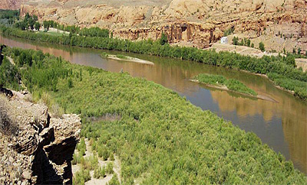
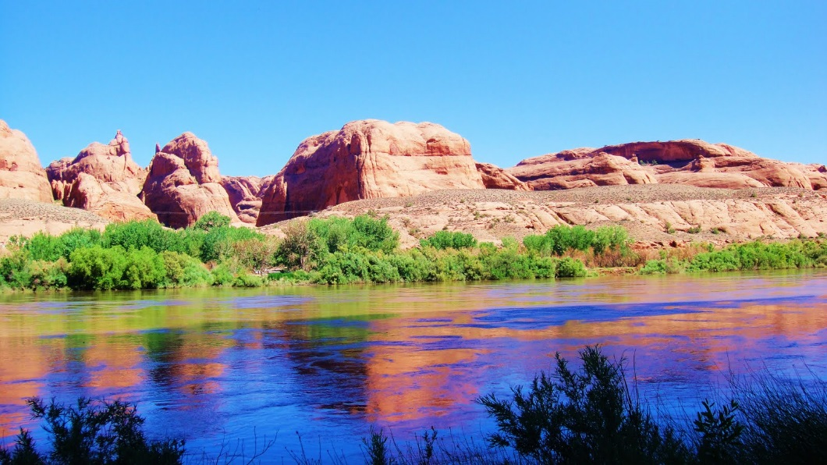
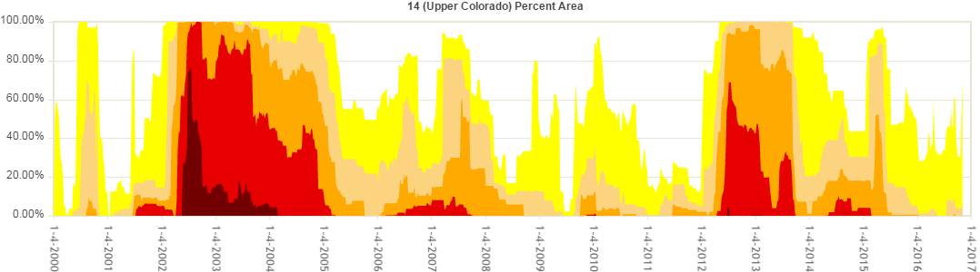
Conclusions
Water surface area decrease correlates closely with drought measurements.
Changes in water surface extent alter the riparian ecosystem.
Image Source: Boomer Pie
Image Credit: US Drought Monitor
Notes:
Water Surface Area
Results indicate persistent decline in water surface area in the lower Grand Canyon with rapid change occurring from 2000 - 2002 at the onset of the drought.
Water surface area changes correlate with high intensity drought periods in the Grand Canyon recorded by the United States Drought Monitor.
Riparian Ecosystem
Exposed sediment provides habitat for aggressive invasive plant species.
Highly variable vegetative cover alters habitats for terrestrial organisms.
Source url: http://3.bp.blogspot.com/-RIkiQo7jxno/TggOPvQuofI/AAAAAAAAAZI/p5S6siZrx3k/s1600/DSC01591.JPG

Slide 20
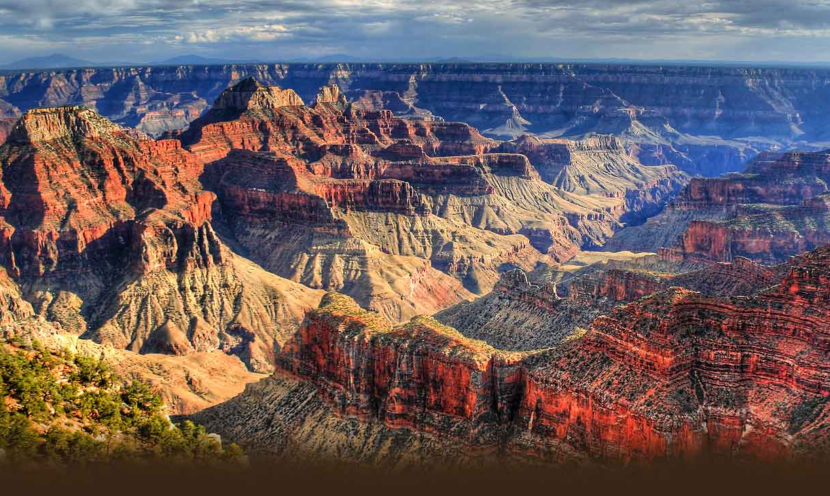
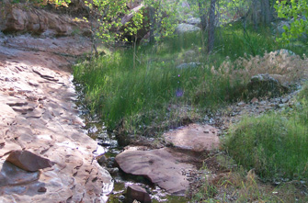
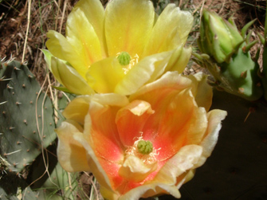
Future Work
Data expansion
Impacts on riparian ecological research
Identification of invasive species locations
Image Source: Grand Canyon National Park
Image Source: National Park Service
Image Source: National Park Service
Notes:
Data Expansion
Ground correction of imagery-derived classification
Apply higher resolution imagery for training and classification
Potential use of new EMR bands as available to quantify finer land cover types
Classify new regions of Grand Canyon National Park
Replicate classification for future time periods as conditions change
Impacts on riparian ecological research
Provide framework for understanding vegetation dynamics and studies on invasive species such as tamarisk.
Examining direct causes of water loss – Precipitation, Snowmelt, Groundwater seepage, Drinking water and irrigation outflows
Calculate water volume in the Colorado River channel using updated bathymetric data and digital elevation models to understand how decreasing water volume could cause increasing concentrations of water contaminants from sediment deposition, municipal sewage and uranium mine runoff. Water volume decrease/constant volume of pollutants = Increase pollutant concentration
Image urls:
http://www.thecanyon.com/grand-canyon-national-park
http://science.nature.nps.gov/im/units/scpn/parks/grca.cfm/

Slide 21

Project Partner
Ed Schenk, Physical Scientist
Grand Canyon National Park
Science Advisors
Bob VanGundy, University of Virginia at Wise
Dr. Kenton Ross, NASA Langley
Dr. DeWayne Cecil, NOAA NCEI
NASA DEVELOP
Wise County Clerk of Court’s Office
Michael Brooke, Center Lead
Kimberly Berry, Assistant Center Lead
Image Credit: NPS
Notes:
The team would like to thank all of those who contributed to the conception, development and completion of this project. Firstly, thank you to Ed Schenk, physical scientist at Grand Canyon National Park, for all the advice and contextual information he contributed. Special thanks to our science advisors, Dr. Kenton Ross, Dr. DeWayne Cecil, and Bob VanGundy, for their continual guidance and expertise during the completion of the project. Also thanks to our Center Lead, Michael Brooke, and Assistant Center Lead, Kimberly Berry, for their facilitation of the project, contacting advisors, and provision of direction throughout the project lifecycle.

Slide 22
Questions?

Slide 23
Water Identified in Classification and not in Water Extraction
Water Identified in Water Extraction and Not in Classification
Notes:
If someone asks, this is a slide comparing the water from the water feature extraction with the water from the classified images

Slide 24
Bootstrap Aggregation
(3) Train the Classifier
Training Samples
(1) Add a Pseudo-random
Number Column
Image
Land Cover Sample Areas
(4) Classify the image
(2) Divide into Training/Testing Set
At least 10% of the pixels must be in testing
Do not split a polygon between sets
Random Forest Classifier
Testing Samples
Classified Image
(5) Assess accuracy of testing areas

