Slide 1
Virginia Water Resources II
Utilizing NASA Earth Observations to
Identify Harmful Algal Blooms in the Chesapeake Bay
Arika Egan (Project Lead)
Jessica Jozwik
Zachary Tate
Tyler Rhodes
Jakub Blach

Slide 2
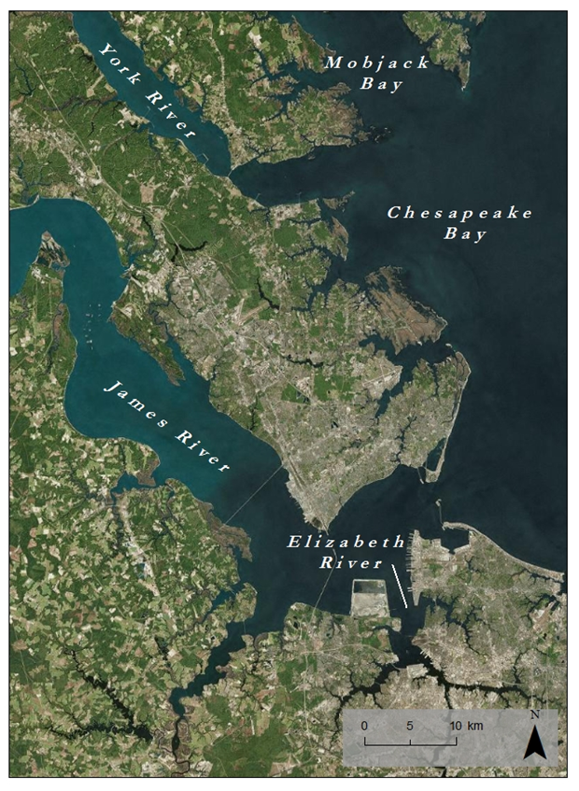
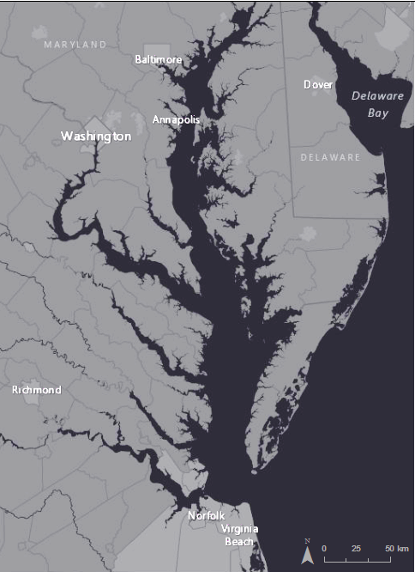
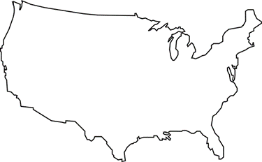
Study Area
Study Area:
Lower Chesapeake Bay
Study Period: August 17th, 2015
Notes:
Our Study Area is comprised of Virginia’s Lower Chesapeake Bay, The James River, The York River, The Elizabeth River, and Mobjack Bay.
We used observational and in-situ data from August 17th, 2015

Slide 3
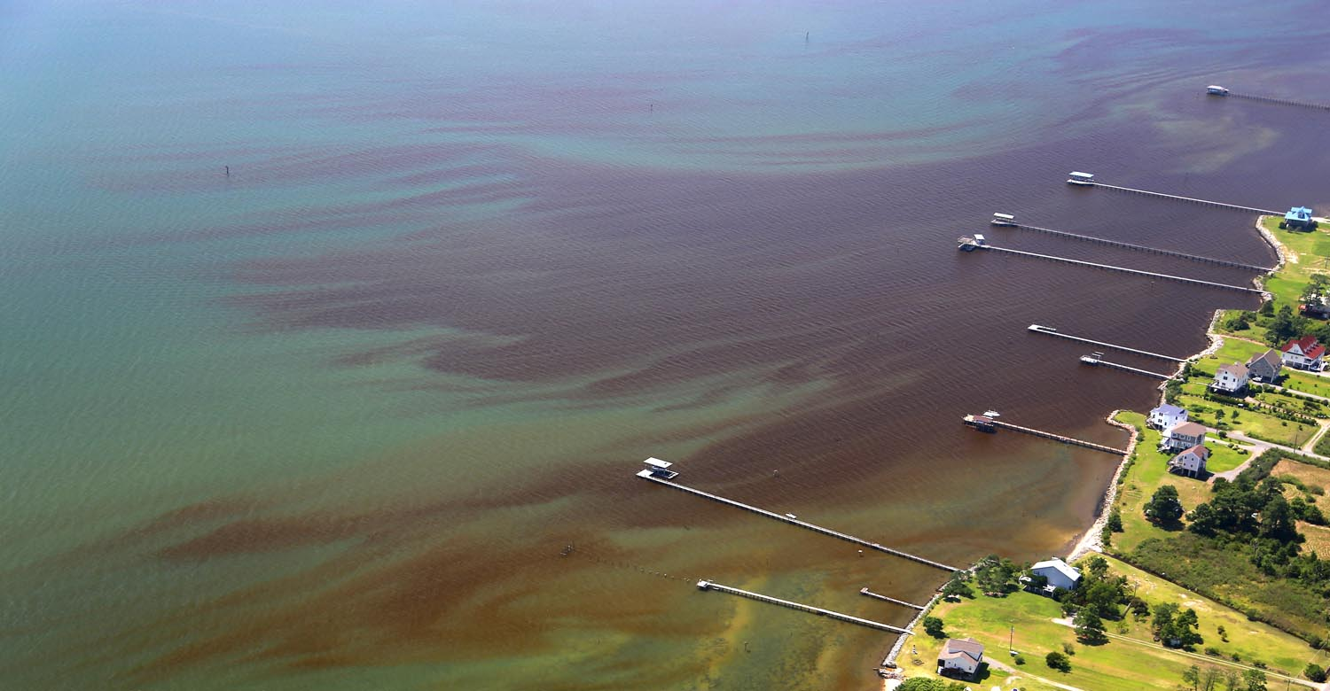
Harmful Algal Blooms (HABs)
Population Growth
Nutrient Runoff
Excessive Growth of Algae
Image Credit: Wolfgang Vogelbein, York River, 8-17-2015
Notes:
The population of the Chesapeake Bay now pushes 18 million people.
Increasing population has lead to an increase in nutrient runoff into the Bay. Agricultural and urban runoff, vehicle emissions, sewage treatment plants, and the burning of fossil fuels all are responsible for nutrient loading in the Chesapeake Bay.
Increased nutrients promote excessive growth of algae.
Image source: Directly provided by VIMS

Slide 4
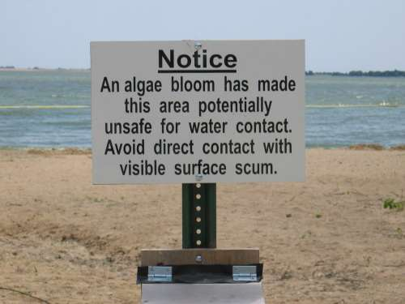
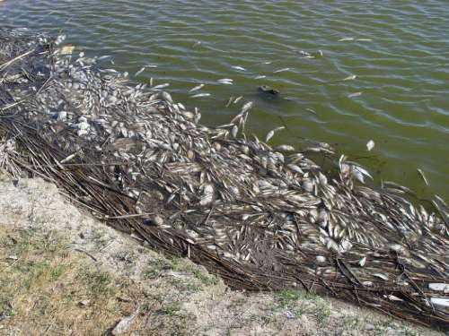
Community Concerns
Degrade water quality
Reduce Sunlight
Deplete oxygen
Produce toxins
Threaten
Fishing industry
Tourism industry
Ecological health
Human health
Jennifer Graham. Harmful Algal Blooms. 10/19/2015
Mike Hooper. Dead Fish Washed Ashore during Golden Alga Toxic Bloom. 10/19/15
Notes:
HABs block the penetration of sunlight through the water column, reducing the amount of available light for photosynthesis and plant growth.
As they die and decompose, they deplete dissolved oxygen in the water that is necessary to sustain animal life.
Certain species produce toxins that can mutate fish, cause human illness, and give off unpleasant smells.
As a result, the fishing industry is harmed, beaches are closed, human health is threatened, and areas of the Bay are less capable of sustaining plant and animal life.
Image credit: Provided directly from VIMS

Slide 5
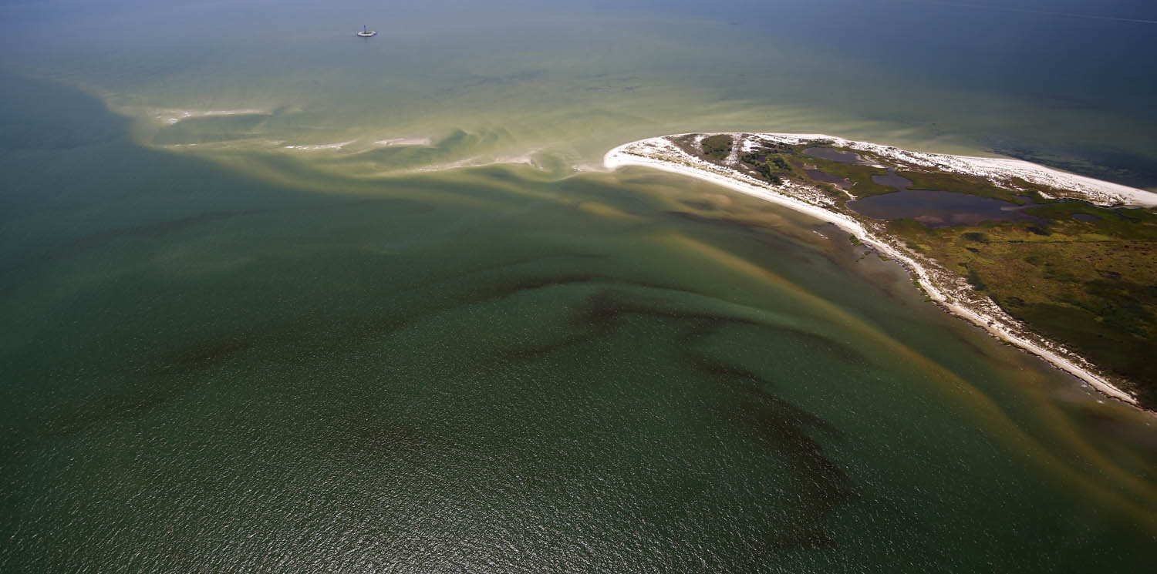
HAB task force
Detect and study
HAB Hotline
Report
VA Health Department
Respond
Current Methods
Image Credit: Wolfgang Vogelbein, York River, 8-17-2015
Notes:
There are two ways HABs are Detected: Through HAB Task Force Testing and Reports to the HAB Hotline
HAB TASK FORCE:
Comprised of VIMS, DEQ, ODU, VA Dept of Health and VA Marine Resources Commission
Responsible for Detecting and studying HABs.
Maintains 20 fixed testing stations throughout the bay. Test water quality parameters and genetic testing of phytoplankton monthly from May-November
24 HOUR HAB HOTLINE
1. Relies on community members to report suspicious smells, colors, or fish kills.
There is currently no reliable method of real-time monitoring of HABs in the Chesapeake Bay. Researches must coordinate data collection cruises to gauge severity and duration of HABs, and must organize costly flyovers to study magnitude of the blooms. We thus seek to remedy this by…
Image Credit: Provided to us directly from VIMS

Slide 6
Objectives
Create
a tool to estimate chlorophyll-a concentrations from Landsat 8 OLI Data
Cultivate
a better understanding of the causes and impacts of HABs
Improve
routine and emergency assessment of HABs
policies and regulations that prevent HABs
Notes:
The goal of this project was to create a python tool to be used in ArcGIS that will produce a map of chlorophyll concentration for the Chesapeake Bay Watershed. It will do this by taking in Landsat 8 data and processing it with an algorithm created during this project.
By identifying the locations of HABs, our partners will be able to analyze the area to better understand the cause of the bloom.
New Landsat imagery of the watershed is produced every week. The speed of this production, combined with the estimation tool, will allow our partners to more effectively monitor HABs when they occur. This is more efficient than the current system of routine monitoring and civilian reports of HABs.
This tool will better help determine the size, duration, frequency, and cause of HABs. These data are important factors in policy writing and can help improve regulations to prevent HABs.

Slide 7
Objectives
Develop
an algorithm to combine Landsat 8, AquaMODIS, and in situ data to estimate chlorophyll-a concentrations
Create
a python tool that processes raw Landsat 8 OLI images and produces a chlorophyll-a chloropleth map
Cultivate
a better understanding of the causes and impacts of HABs
Improve
routine and emergency assessment of HABs
Notes:
The goal of this project was to create a python tool to be used in ArcGIS that will produce a map of chlorophyll concentration for the Chesapeake Bay Watershed. It will do this by taking in Landsat 8 data and processing it with an algorithm created during this project.
By identifying the locations of HABs, our partners will be able to analyze the area to better understand the cause of the bloom.
New Landsat imagery of the watershed is produced every week. The speed of this production, combined with the estimation tool, will allow our partners to more effectively monitor HABs when they occur. This is more efficient than the current system of routine monitoring and civilian reports of HABs.
This tool will better help determine the size, duration, frequency, and cause of HABs. These data are important factors in policy writing and can help improve regulations to prevent HABs.

Slide 8
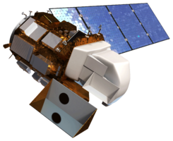
NASA Earth Observations
Landsat 8 OLI
Notes:
Landsat 8 OLI: Downloaded with USGS Earth Explorer. Path 14 Row 34 and Path 15 Row 34 captured our study area. 30m resolution
AquaMODIS: Downloaded from NOAA’s CoastWatch East Coast Node, used to detect chlorophyll-a. 1.4km resolution

Slide 9
First Method
Landsat 8 OLI/TIRS reflectance bands
Aqua MODIS chlorophyll-a
VECOS in situ water quality data
NOAA bathymetry data
Acquisition
Remove land and cloud pixels
Match Landsat and VIMS data
Combine layers into exported table
ArcMap
Run linear and nonlinear regressions
Use best fit regression model as predictive model
R
Chesapeake Bay
Chlorophyll Hotspot Identifier
Python
Notes:
The first attempted method took the following procedure:
True color composites were compiled by dividing the pixel values by 10,000 for bands 1-5 of the Landsat8 data.
Land pixels were removed using a water mask created by calculating the NVDI with bands 4 and 5 to determine density of plant growth. A water mask was created by reclassifying pixels in the NDVI with a value less than 0 (“VALUE < 0”) as 1, and reclassifying all other pixels as “NoData”. This mask was used on the Landsat bands to obtain water-only images.
Clouds were removed using a cloud mask created with the cf_mask_layer from the Landsat CDR data download. Pixels of value 2 and 4 were Reclassified as “NoData”. All other pixels were reclassified to “1”. This mask was applied to the water-only bands, and the result was an image with land pixels and cloud pixels removed.
We imported the in-situ data into ArcMap and used the points of the in-situ as the reference shape file for extracting the pixel values of the Landsat data.
Once the pixel values were extracted, they were saved to a .csv that also included the in-situ chl measurements.
This .csv was imported into R, where the data was plotted on a scatter plot. Linear and nonlinear regression models were run to find a best fit equation.
The equation was used in the python tool to create a map of chlorophyll concentration.

Slide 10
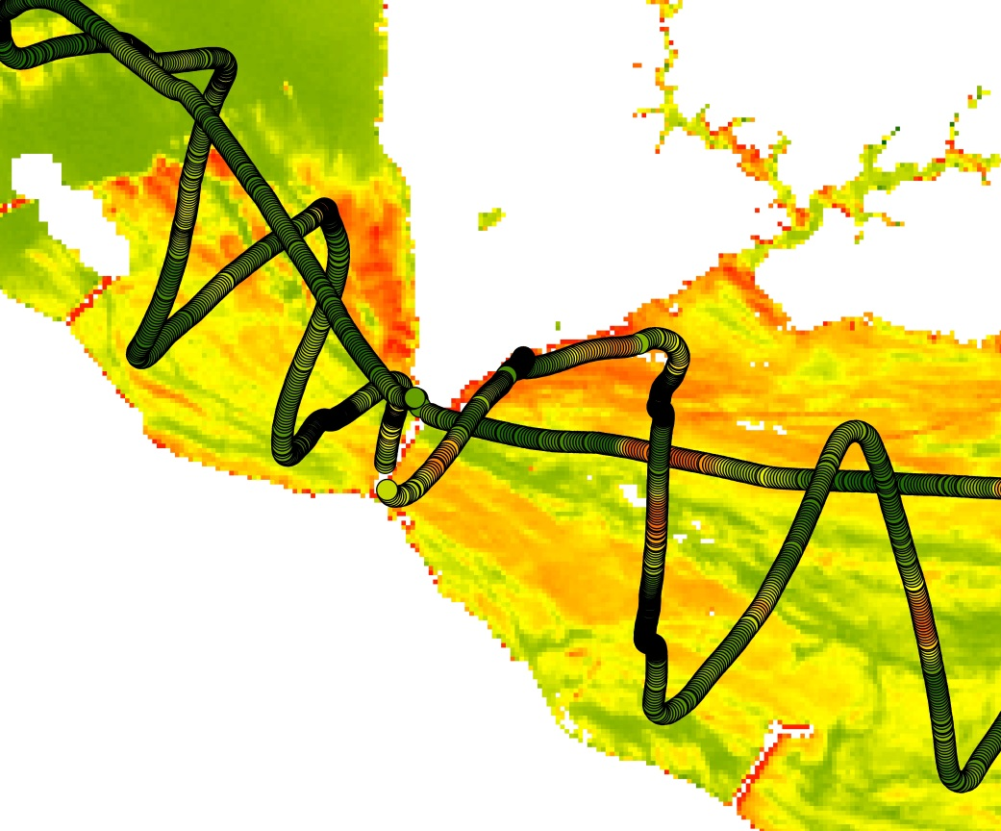
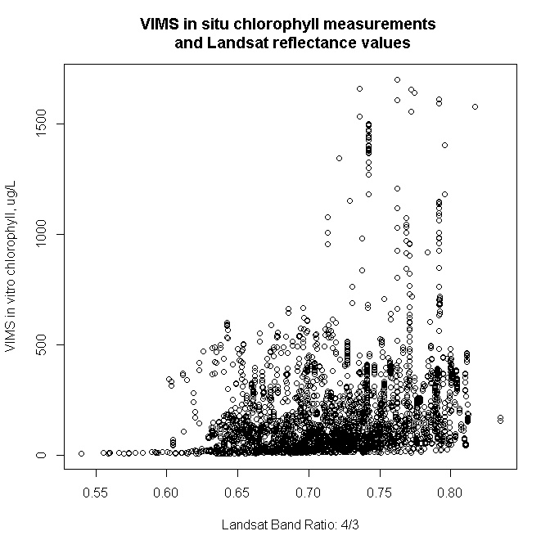
First Method
Lower York River
VIMS and Landsat data inconsistent
Attempted to trim bad data values
Notes:
Notice the data flow trail in the image on the left. Lower chlorophyll values are in green and higher values are in red. The image the dataflow is overlaid on is a color composite of Landsat bands 5, 4, and 3, a typical combination for highlighting chlorophyll. The data does not remotely match up in the image. Even if the 543 composition doesn’t report accurate concentrations, the range of values should report where there is more and less chlorophyll. The Landsat range doesn’t match up with the VIMS range.
When plotting in R, the data was very inconsistent, with R squared values no greater than 0.2.
Image credit: NASA DEVELOP Wise County

Slide 11
First Method
Formula | R² | Adj R² |  | formula | R² | Adj R²
~exp(b1/b2) +b1+ b2+ b3+b4 | 0.1868 | 0.1855 |  | ~exp(b4/b3) +b1+ b2+ b3+b4 | 0.1889 | 0.1877
~exp(b1/b2) +b1+ b2+ b3+b5 | 0.1796 | 0.1783 |  | ~exp(b4/b3) +b1+ b2+ b3+b5 | 0.1884 | 0.1871
~exp(b1/b2) +b1+ b2+ b3+b6 | 0.1613 | 0.16 |  | ~exp(b4/b3) +b1+ b2+ b3+b6 | 0.1905 | 0.1892
~exp(b1/b2) +b1+ b2+ b3+b7 | 0.1621 | 0.1608 |  | ~exp(b4/b3) +b1+ b2+ b3+b7 | 0.1902 | 0.189
~exp(b1/b2) +b1+ b2+b3+b4+b5 | 0.1872 | 0.1857 |  | ~exp(b4/b3) +b1+ b2+b3+b4+b5 | 0.1893 | 0.1878
~exp(b1/b2) +b1+ b2+b3+b4+b6 | 0.1878 | 0.1863 |  | ~exp(b4/b3) +b1+ b2+b3+b4+b6 | 0.1909 | 0.1895
~exp(b1/b2) +b1+ b2+b3+b4+b7 | 0.1877 | 0.1863 |  | ~exp(b4/b3) +b1+ b2+b3+b4+b7 | 0.1907 | 0.1892
~exp(b1/b2) +b1+ b2+b3+b4+b5+b6 | 0.1959 | 0.1942 |  | ~exp(b4/b3) +b1+ b2+b3+b4+b5+b6 | 0.2011 | 0.1994
~exp(b1/b2) +b1+ b2+b3+b4+b5+b7 | 0.1962 | 0.1945 |  | ~exp(b4/b3) +b1+ b2+b3+b4+b5+b7 | 0.2009 | 0.1992
~exp(b1/b2) +b1+ b2+ b3+b4+b5+b6+b7 | 0.1968 | 0.1949 |  | ~exp(b4/b3) +b1+ b2+ b3+b4+b5+b6+b7 | 0.202 | 0.2
Notes:
We ran a total of 171 models using all different kinds of band ratios and different mathematical relationships, including linear, logarithms, and exponentials. The above table is a sample of the models we ran, as well as the best model we found, further showing the inconsistency of the data.
Thus, we could not complete our first method. A best fit equation to describe the data could not be found, and we had to resort to the current methodology, described on the next slide.

Slide 12
Methodology
New method created utilizing band compositions
Landsat bands 5, 4, and 3 to make chlorophyll composition
Landsat bands 4, and 3 to make Normalized Difference Vegetation Index (NDVI) composition
Stretches created in ArcMap for each image and various regions
Lower York, Lower James, upper Chesapeake
Saved as .xml files
Notes:
Due to this data inconsistency and a lack of time, we decided to create some visual choropleth maps using two combinations. One uses the typical 543 band combination highlighting chlorophyll, and one is a display of the NDVI of an image, calculated from bands 5 and 4. We had to mask out pixels corresponding to depths of 2 meters or less, as well as pixels corresponding to high amounts of sediment. Shallow water reflects a lot of light and can be misinterpreted as areas of high chlorophyll concentration.
Default stretches were created for the regions listed and saved as .xml files in ArcMap. These stretches can be directly applied to the final band compositions to highlight chlorophyll concentrations.

Slide 13
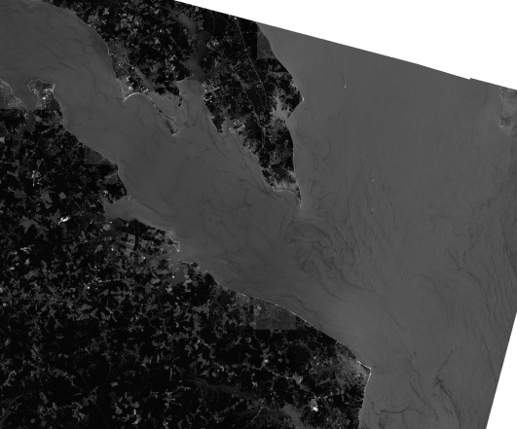
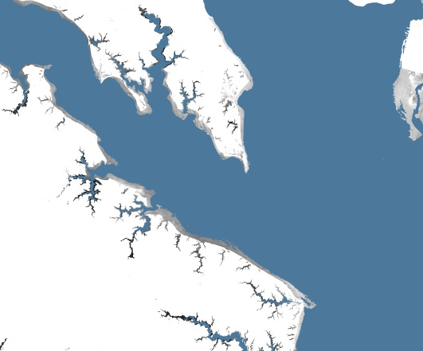
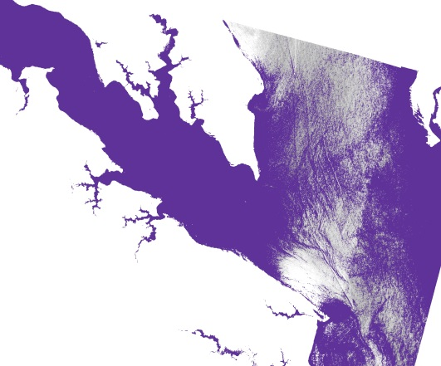
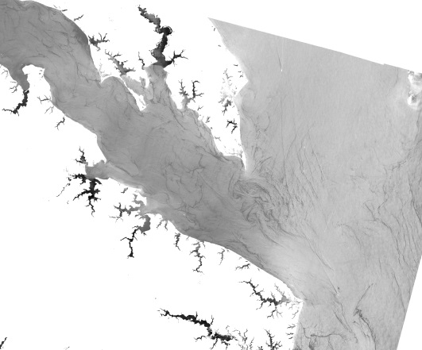
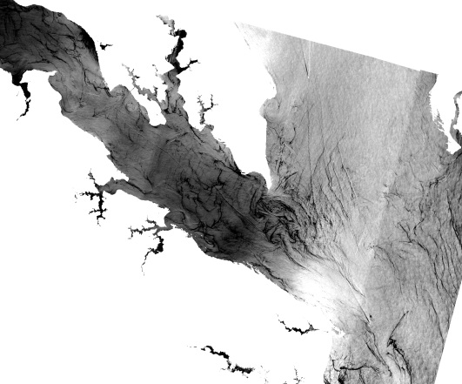
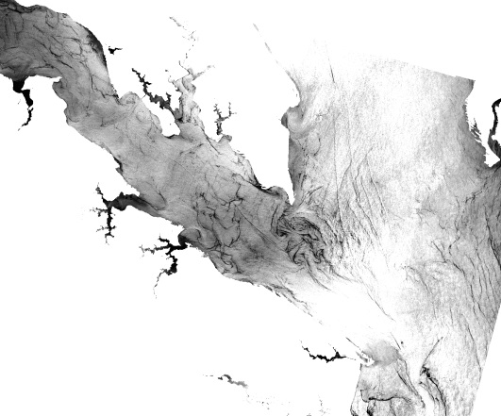
Methodology
1. Land and cloud pixels are removed
2. Shallow (<2m) pixels are removed
3. High sediment concentrations are removed
Notes:
This slide shows the visual representations of the first processing steps outlined in the “first method” section.
We started with Raw Landsat data. The first image on the top left is Landsat 8 Band 1 from August 17th, 2015. Land pixels are removed by creating a water mask with the Normalized difference vegetation index. Clouds are removed using a cloud mask provided by EarthExplorer.
Next, using Bathymetry provided by NOAA, pixels corresponding to a depth of 2 meters or less are removed. The top middle image shows the bathymetry mask over the land and cloud removed image from the bottom left. The result is the bottom middle image.
Finally, high sediment concentrations are removed, using a model that calculated the Normalized Difference Turbidity Index. The top right image shows the sediment mask over the land, cloud, and shallow pixel removed image of the bottom middle. The final result is an image with land, clouds, shallow pixels, and high sediment concentrations removed, shown on the bottom right.
Image credit: NASA DEVELOP Wise County

Slide 14
Results
The final tool takes raw Landsat 8 data and produces two image composites used to identify chlorophyll.
Notes:
We have created a python tool that takes in raw Landsat data, creates a land mask, a cloud mask, a bathymetry mask, and a sediment mask, and creates two image composites.
The image on the right is a true color image composite made from Landsat bands 4, 3, and 2. The image on the left is a final ndvi chlorophyll product of our code.
Image credit: NASA DEVELOP Wise County

Slide 15
Conclusions
Raw Landsat 8 data is taken in by the python code
Two final images are created with chlorophyll concentration gradients
Lower York River
Lower York River
543 Color Composition
NDVI
Notes:
We cross calibrated in situ data with Landsat 8 data, only to find that the data did not match up well enough to form any working algorithm. We instead created a tool that takes in raw Landsat 8 data, removes land, cloud, shallow, and high sediment concentration pixels. It then creates two images of different band combinations. The user can use these final images, apply a preconfigured stretch, and view chlorophyll concentrations.
The above images have the same stretch applied – a 20% clip on the lower end and a 2% clip on the upper end of the values.
Image credit: NASA DEVELOP Wise County

Slide 16
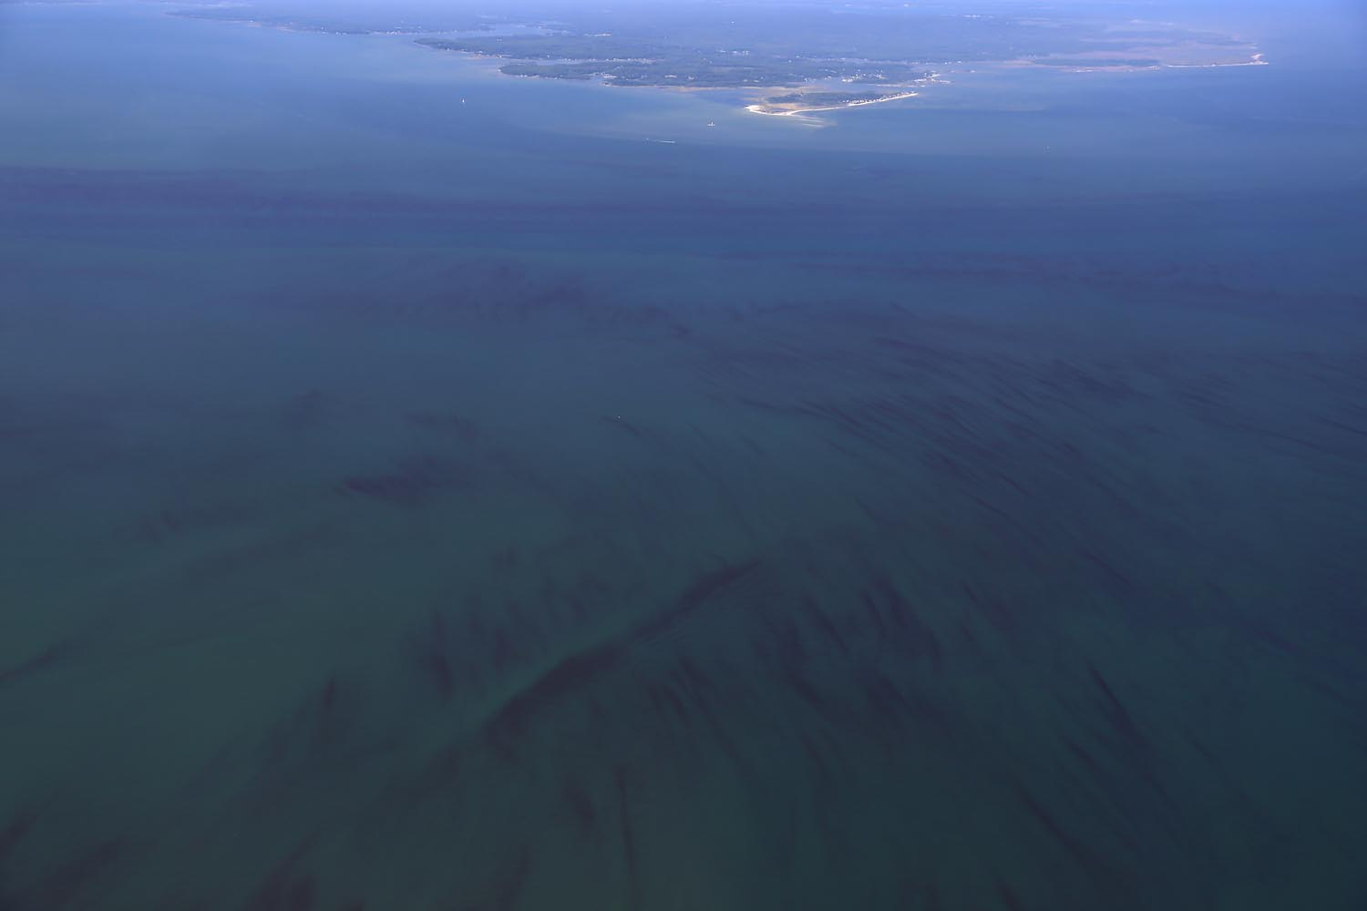
Uncertainties
Code is not calibrated with in situ data
Final images produced are relative chlorophyll concentrations
Uncertain which final image produces better results: NDVI vs 543 color composition
There may be a lot of variety in the best stretch applied to each image.
Wolfgang Vogelbein, York River, 8-17-2015
Notes:
Because the code is not calibrated with in situ data, the displayed results are only relative. They do not provide a prediction gradient. Therefore, the colored values in the images will range from low to high, no matter what the chlorophyll concentration is. For example, on a day with very little chlorophyll through out the whole bay, the areas with the most concentration will be colored red on the final images.
We’re also not sure which image results are better: The NDVI or the 543 color composition. The NDVI is meant to display vegetation, which chlorophyll fits under. The 543 color composition is also meant to display chlorophyll, but it’s typically used on land scenes. We’re not sure how it displays chlorophyll on water.
The preconfigured stretches applied to each image are only a few options out of many. Since the images are visually created, they can be stretched in multiple ways, depending on how much detail is desired. It’s uncertain what the proper stretch should be.
Image credit: Provided directly from VIMS

Slide 17
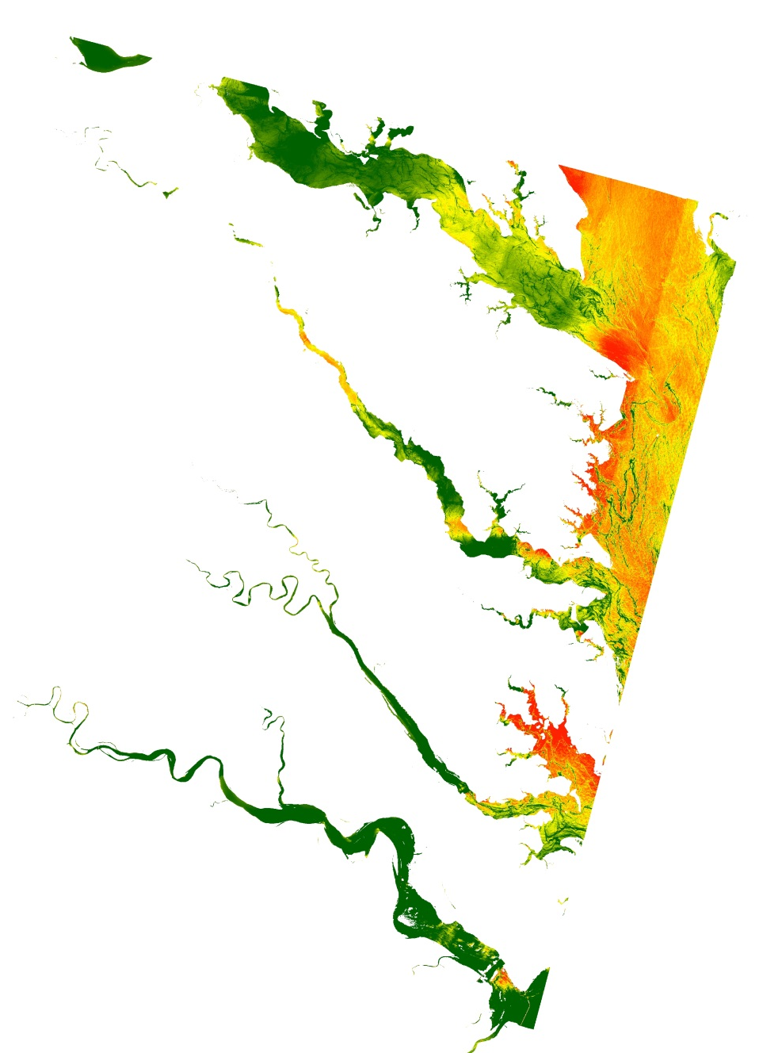
Future Work
Collect more in situ data
Calibrate Landsat 8 Data with in situ data
Create chlorophyll estimation tool
Possibly multiple for various regions
Notes:
Collect more data: There are a number of reasons that we couldn’t find a good model. One reason may be that our sample size was too small. We had about 3500 data points, but compared to the whole region, this is quite small. The resolution also posed an issue. Landsat has 30m pixels, and the flowthrough data had sometimes up to ten points per landsat pixel, depending on the speed of the boat.
One other reason be that we were correlating only landsat reflectance values and in situ data. There may exist many more confounding variables, for example salinity and turbidity, that affect chlorophyll concentration. We did try to control for these, but they ended up providing us with only hundreds of data points.
The ecosystems at different locations in the whole bay are different and hold different species of chlorophyll, so a robust model may be one that is separate for each region.
More data and sampling will be necessary in order to correct for these uncertainties and create the robust model we’re looking for.
Image Credit: NASA DEVELOP Wise County

Slide 18
Acknowledgements
Dr. Kenton Ross, NASA DEVELOP
Robert VanGundy, University of Virginia’s College at Wise
Dr. DeWayne Cecil, Global Science and Technology, Inc.
Advisors
Dr. Kim Reece, Virginia Institute of Marine Science
Russ Baxter, Virginia Deputy Secretary of Natural Resources for the Chesapeake Bay
Will Hunley, Hampton Roads Sanitation Department
Todd Egerton, Old Dominion University
Partners

Slide 19
Acknowledgements
Dr. Sarah Lubkin, University of Mary Washington
Cassandra Morgan, NASA DEVELOP
Melanie Salyer, NASA DEVELOP (Wise County)
Others

