Slide 1
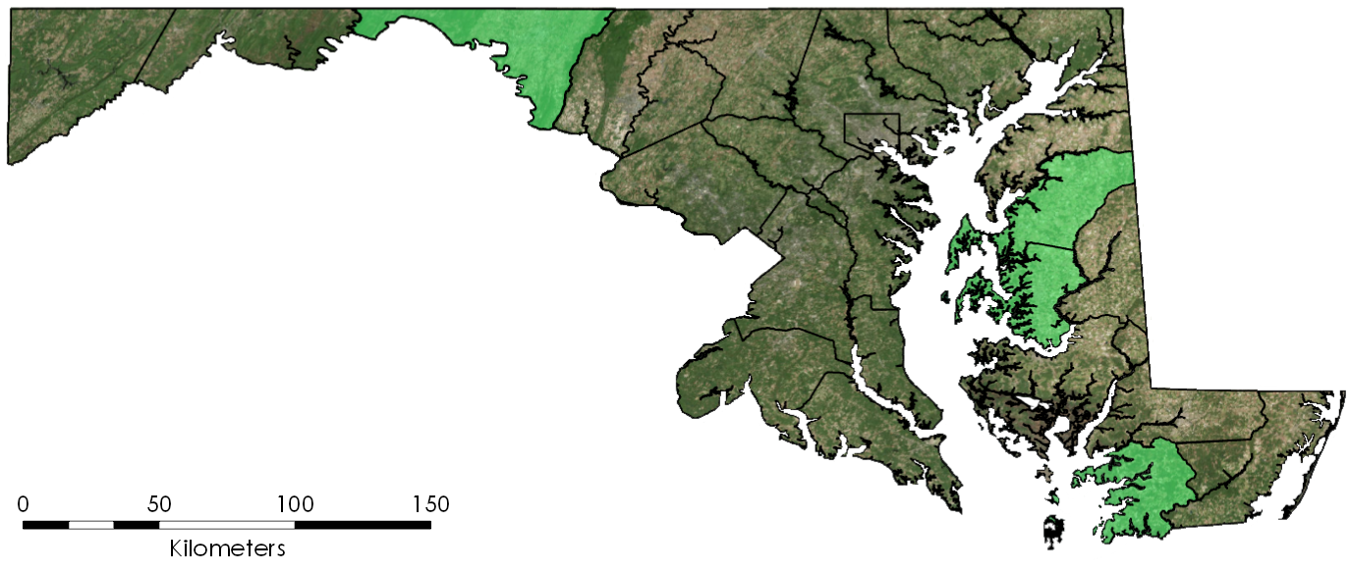
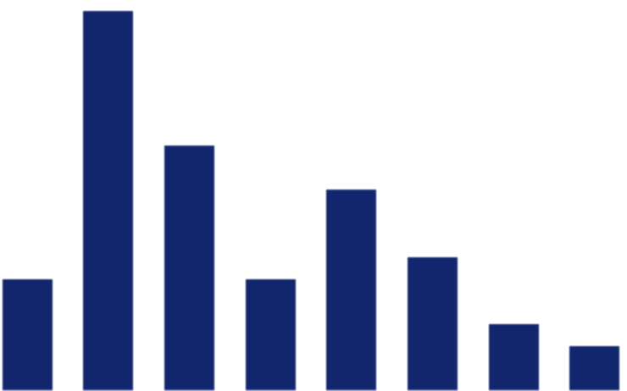
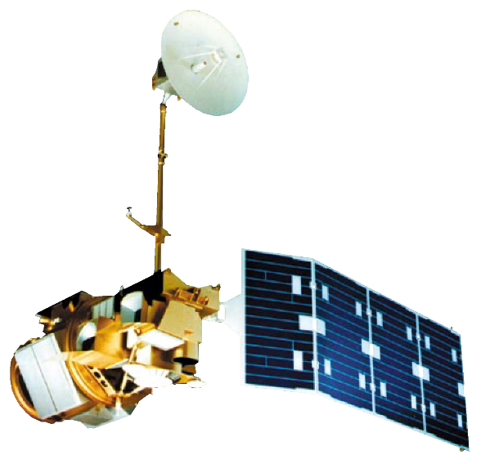
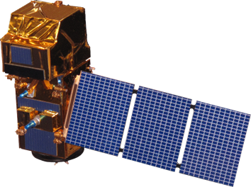
Operational Analysis of Winter Cover Crop Environmental Performance throughout the State of Maryland
Abstract
NDVI
Calculate NDVI for enrolled fields using Google Earth Engine
Performance Metrics
Analysis
Generate histograms and summary tables to analyze data
Percent ground cover
Biomass
Methodology
Winter cover crops increase the sustainability of agricultural lands and the health of surrounding watersheds through erosion control and nutrient retention. The Maryland Department of Agriculture (MDA) incentivizes the planting of winter cover crops in the Chesapeake Bay area via a cost-sharing program that offers subsidies to enrolled farmers. The success of these cover crops is dependent on several factors such as crop species, planting date, and termination date. Using imagery from Landsat 5 Thematic Mapper (TM), Landsat 8 Operational Land Imager (OLI), and Sentinel-2 MultiSpectral Instrument (MSI), a previous DEVELOP team constructed methods that evaluated the performance of Maryland cover crops on the basis of biomass. However, the MDA required more streamlined methods and user-friendly tools to implement the products in their day-to-day operations. The current DEVELOP project aimed to simplify the methods established by the previous team through the creation of a graphical user interface (GUI) using Google Earth Engine to optimize end user analysis of cover crop data. The graphical analysis produced by this GUI aids the MDA by granting further insight into cover crop effectiveness, promoting more informed decision making and improved conservation efforts for the Chesapeake Bay.
Results
NDVI
1
Objectives
Visualize winter cover crop enrollment between 2014 and 2018
Update code to create an interactive, user-friendly, Google Earth Engine GUI for streamlined data analysis
Produce tabular and graphical analysis on performance of fields in winter cover crop program using NDVI to measure biomass and percent ground cover
Provide partners with a tool that facilitates regular analysis of cover crops with selective filtering by plant type, planting date, and other parameters
0
Study Area
20
Number of spring fields in specific NDVI ranges
1
15
10
Frequency
5
2
0
0.25 0.31 0.38 0.44 0.50 0.56 0.63 0.68
Maryland Counties
3
Maximum NDVI
1 – Washington
2 – Queen Anne’s
3 – Talbot
4 – Somerset
Conclusions
Study area
4
This GUI allows users to visualize annual winter cover crop enrollment and filter for specified parameters through an interactive map. Users can select for attributes, run NDVI computations, input calibration equations, and produce graphics to analyze biomass and percent ground cover change over time.
NDVI is positively correlated with biomass and percent ground cover. Crops planted in November had 15% lower NDVI, biomass, and percent ground cover averages than crops planted in September. Thus, early-planted cover crops are more efficient than late-planted.
With the ongoing use of the GUI, the MDA can extend their analysis to all Maryland counties and support improved conservation efforts around the Chesapeake Bay.
Earth Observations
Team Members
Landsat 5 TM
Landsat 8 OLI
Sentinel-2 MSI
Project Partners
Maryland Department of Agriculture, Office of Resource Conservation
USDA, Agricultural Research Service, Hydrology and Remote Sensing Laboratory
USGS, Eastern Geographic Science Center
US EPA, Chesapeake Bay Program
Logan Kline
Project Lead
Julio Peredo
Diane Portillo
Benjamin Whong
Acknowledgements
Thanks to Dr. Sunita Yadev, John Fitz, Sean McCartney, Perry Oddo, and Alison Thieme of DEVELOP for laying the groundwork for this project. Additional thanks to Dr. John Bolten (NASA Goddard Space Flight Center), Dr. W. Dean Hively (USGS Eastern Geographic Science Center), Dr. Greg McCarty (USDA Agricultural Research Service), Dr. Kristofer Lasko (ERDC Geospatial Research Laboratory), and Jason Keppler (Maryland Department of Agriculture) for scientific advising and additional support throughout the project. Special thanks to our mentor and Center Lead, Victor Lenske, for his guidance.
Chesapeake Bay Agriculture II
Maryland – Goddard | Fall 2018

