Slide 1
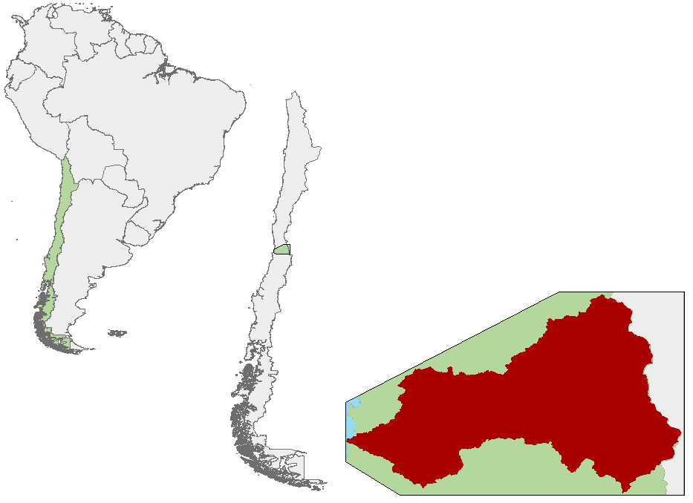
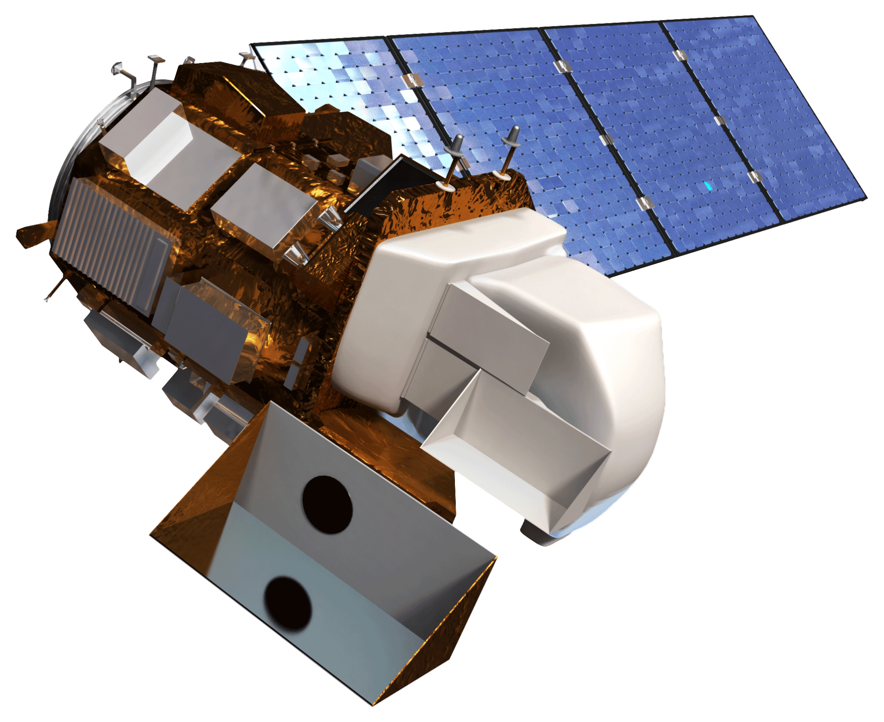
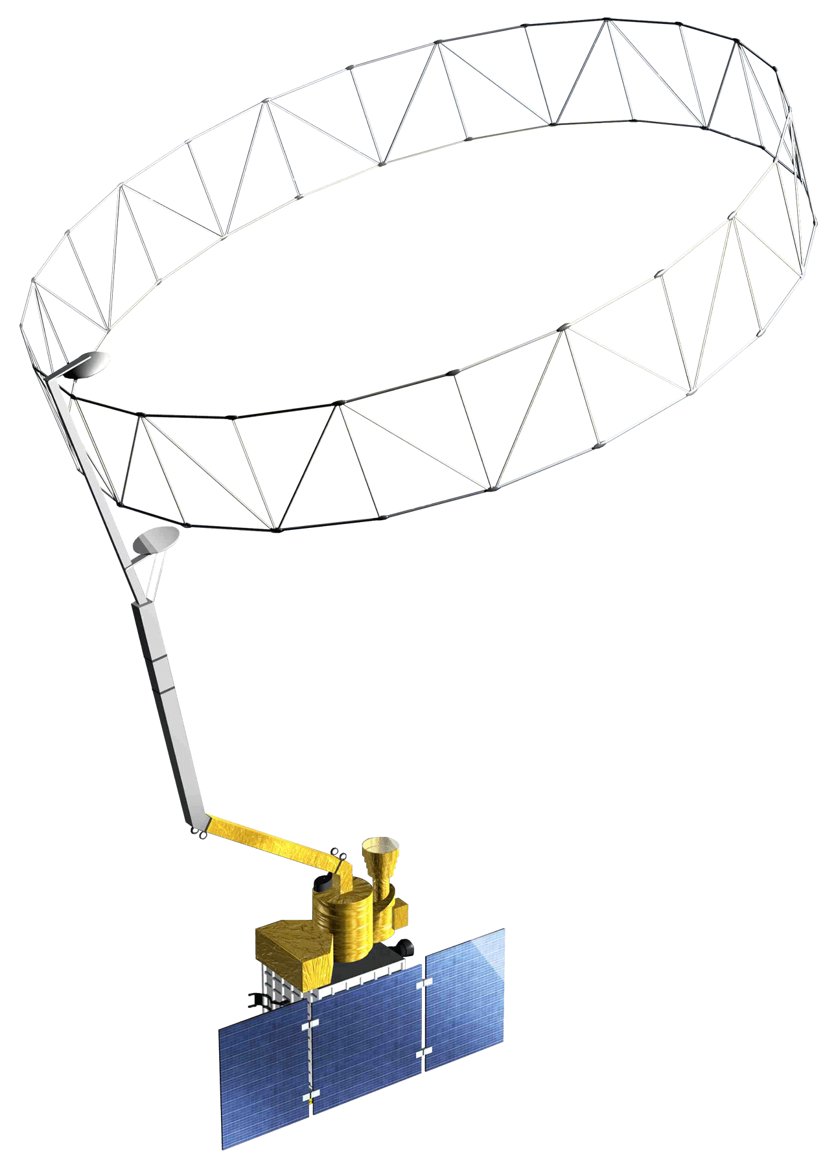
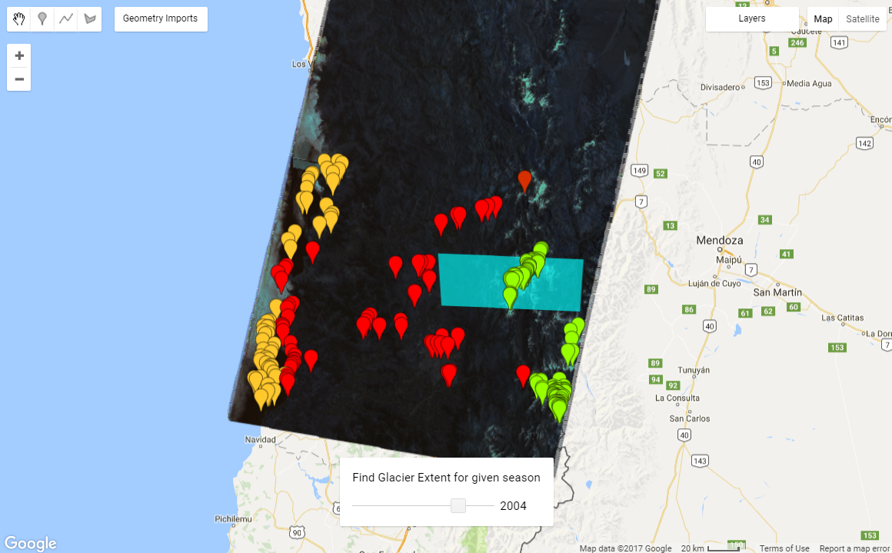
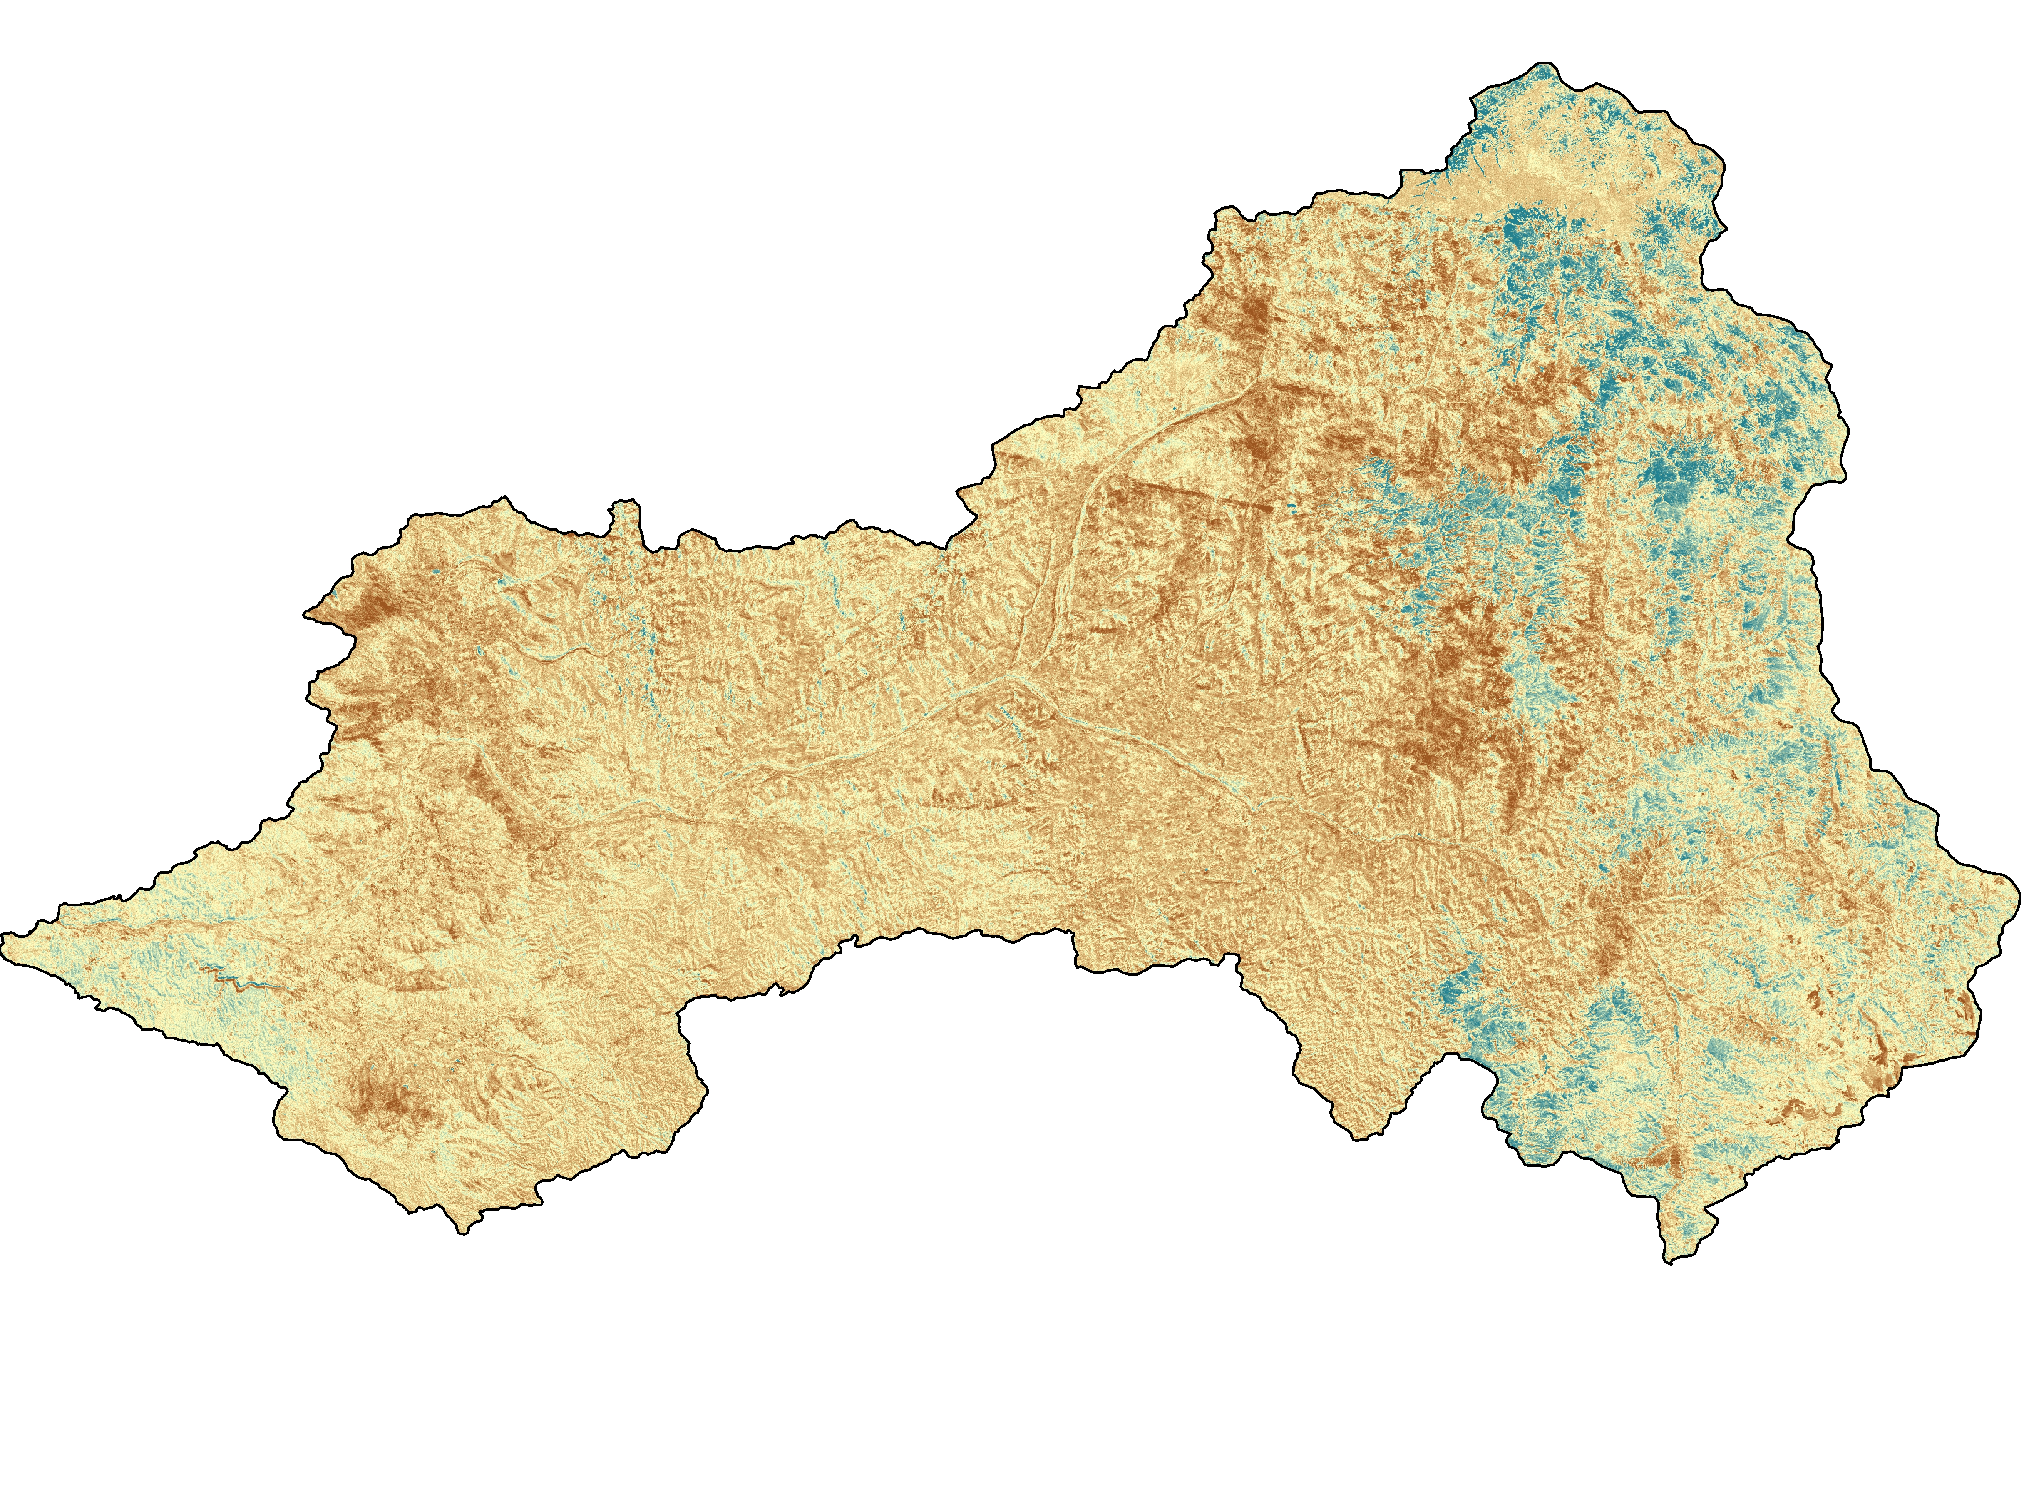
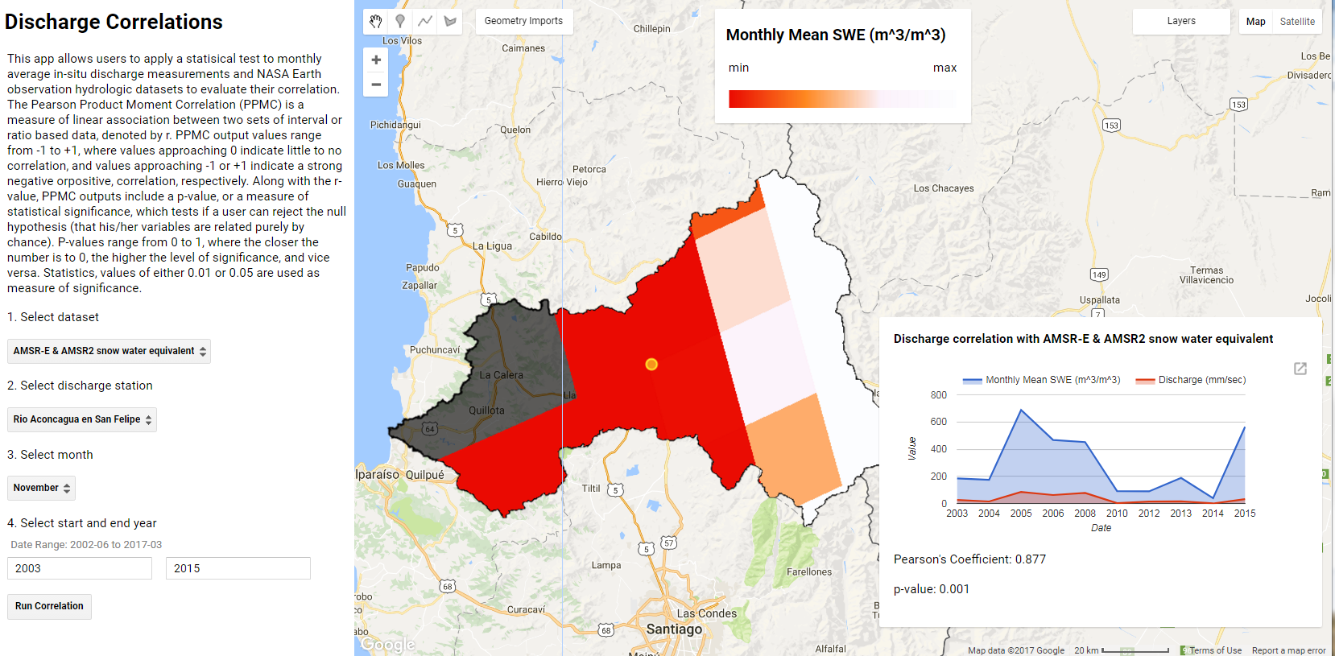
Applications of NASA Earth Observation Imagery in Google Earth Engine to Estimate Glacier Trends and Water Availability in Chile’s Aconcagua Watershed
Abstract
Objectives
The Aconcagua basin in Central Chile, located just north of the capital city of Santiago, is an arid region dominated by the Andes Mountains and heavily dependent on glaciers and seasonal meltwater for water reserves. Due to the orographic nature of precipitation on the basin, rain events occur sporadically in the late autumn and winter months of the year, accounting for 80% of total annual precipitation, while drought conditions prevail in the austral spring and summers. The Mediterranean-type climate supports agricultural practices such as fruit and vegetable farming, which account for 70% of regional water usage. Around the globe, weather intensification and the rising zero-degree isotherm are poised to threaten glacial retreat or complete wastage during the upcoming decades. The Aconcagua basin is especially vulnerable to these changes as a result of its large population, increasing water demands, and reliance on meltwater during the summer months. In response to the concerns articulated by the Chilean Ministry of Agriculture, the research team created a time series of seasonal NDSI from 1988 to 2017 to quantify glacier change using TerrSet software. The team replicated the time series analysis in near-real time with server-side processing using Google Earth Engine and compared the results of the parallel analyses. Google Earth Engine was also used to build a tool that combines NASA Earth observations with in situ discharge data for a comprehensive overview of regional factors affecting agriculture. The analysis tools created provide an enhanced understanding of glacial meltwater and agricultural water usage and can be used to supplement the Chilean Ministry of Agriculture’s water resource management decision making.
Create a time series of the study area from 1988 to 2017, highlighting statistically significant seasonal accumulation or ablation trends in local glaciers
Classify Landsat Imagery using Google Earth Engine and quantify glacial extent on a pixel-to-pixel basis
Correlate in situ river discharge stations in our study area with NASA Earth observations such as snow water equivalent, precipitation, and surface temperature
Study Area
Study Area
Aconcagua River Valley
Chile
South America
Pacific Ocean
Earth Observations
Landsat 4/5 TM
Landsat 8 OLI
Terra MODIS
Aqua AMSR-E
SMAP Radiometer
TRMM
PR, TMI, VIRS
Project Partners
Kilometers
Chile Water Resources II
Methodology
Chilean Ministry of Agriculture
Agricultural Office of the Chilean Embassy
Preprocessing
Analysis
Results
Acknowledgements
Acquired Earth observation imagery, performed atmospheric correction, mosaicked scenes together for study area coverage
Supervised Classification
NDSI Trend Analysis
Correlated in situ data with remotely sensed discharge
Google Earth Engine tools for near-real time glacial extent monitoring, NDSI trend analysis, and discharge correlations
Dr. Juan Torres-Pérez, Bay Area Research Institute
Dr. Kenton Ross, NASA Langley Research Center
Dr. Eduardo Bendek, NASA Ames Research Center
Jenna Williams, NASA Ames Research Center
Garrett McGurk, previous team member
Nick Clinton, Google Earth Engine Developer Advocate
Results
Kendall’s Correlation of Summer Trends
-0.75 0.00 0.80
Figure 1. Supervised hard classification of glaciated area in 2004. Spectral signatures from Landsat imagery are used to differentiate ice from non-ice. The classification and area of glacial can be applied to any year of Landsat coverage. The glaciated area within the blue bounding box is 376.95km².
Figure 2. Kendall’s Correlation conducted on detrended Normalized Difference Snow and Ice Index values from 2000 – 2016. Areas of drastic negative and positive trends lay within the zones of accumulation and ablation of perennial glaciers.
Figure 3. Output of Pearson’s Product-moment correlation coefficient tool relating in situ river discharge measurements (dependent) and important hydrologic indicator environmental variables derived from NASA sensors (independent). The interactive tool lets the user select input parameter to compare.
Team Members
Conclusions
Adapting methodology and functionality from the TerrSet trend analysis provided useful integrations for considering linearly detrended Kendall’s Tau Google Earth Engine outputs. These outputs were used to understand snow and glacial trends in the study area.
Interactive supervised hard classifications in Google Earth Engine give users a rapid and customizable means to visualize and quantify glacial extent in the study area.
Correlation coefficients produced between in situ river discharge stations and each of the independent NASA Earth observation hydrologic datasets allows analysis of relationships between climate variables and water availability.
Mariana Webb
(POC)
Billy Babis
Stuart DeLand
NASA Ames Research Center – Summer 2017

