Slide 1
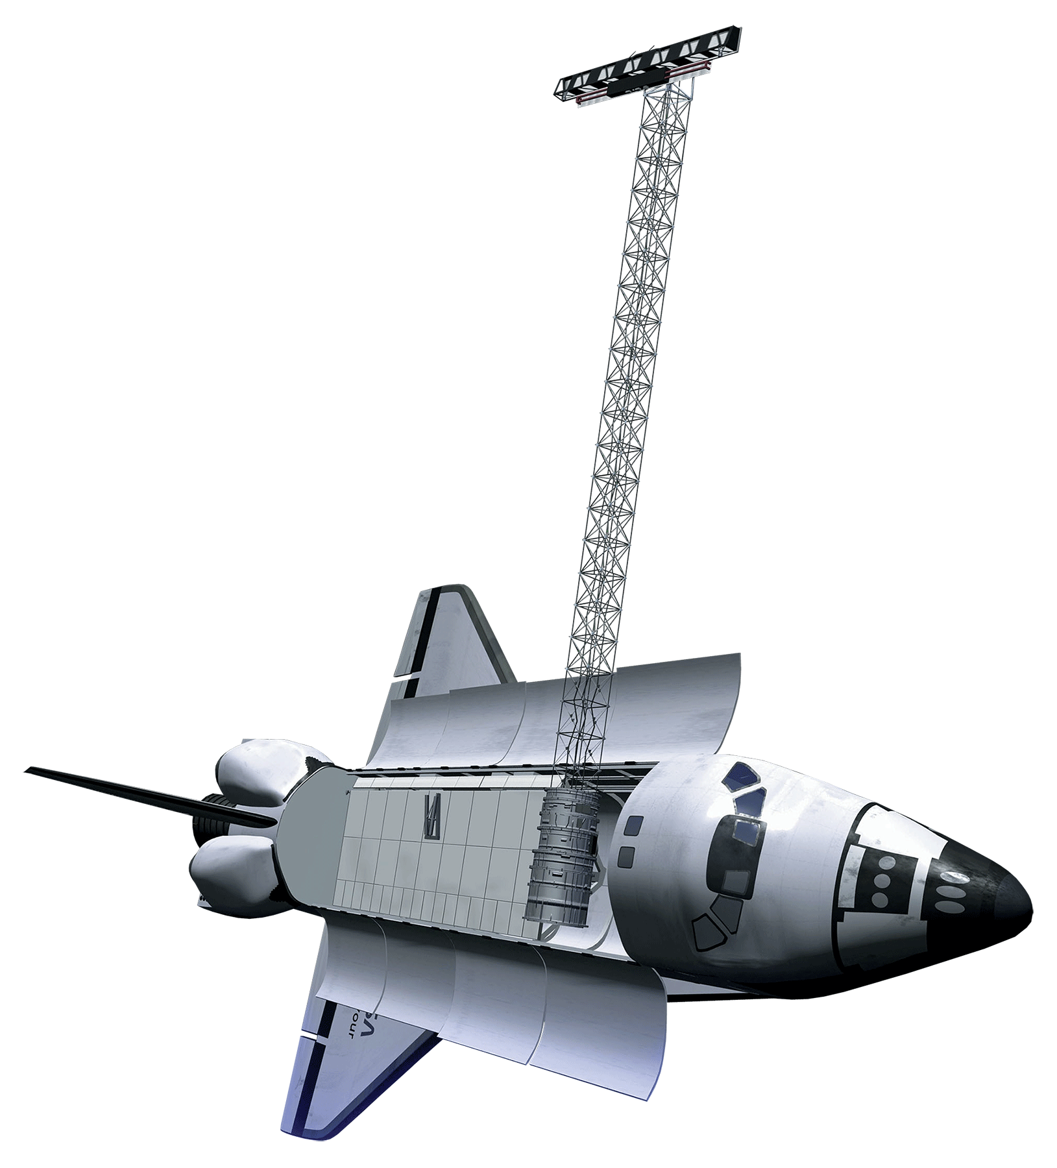
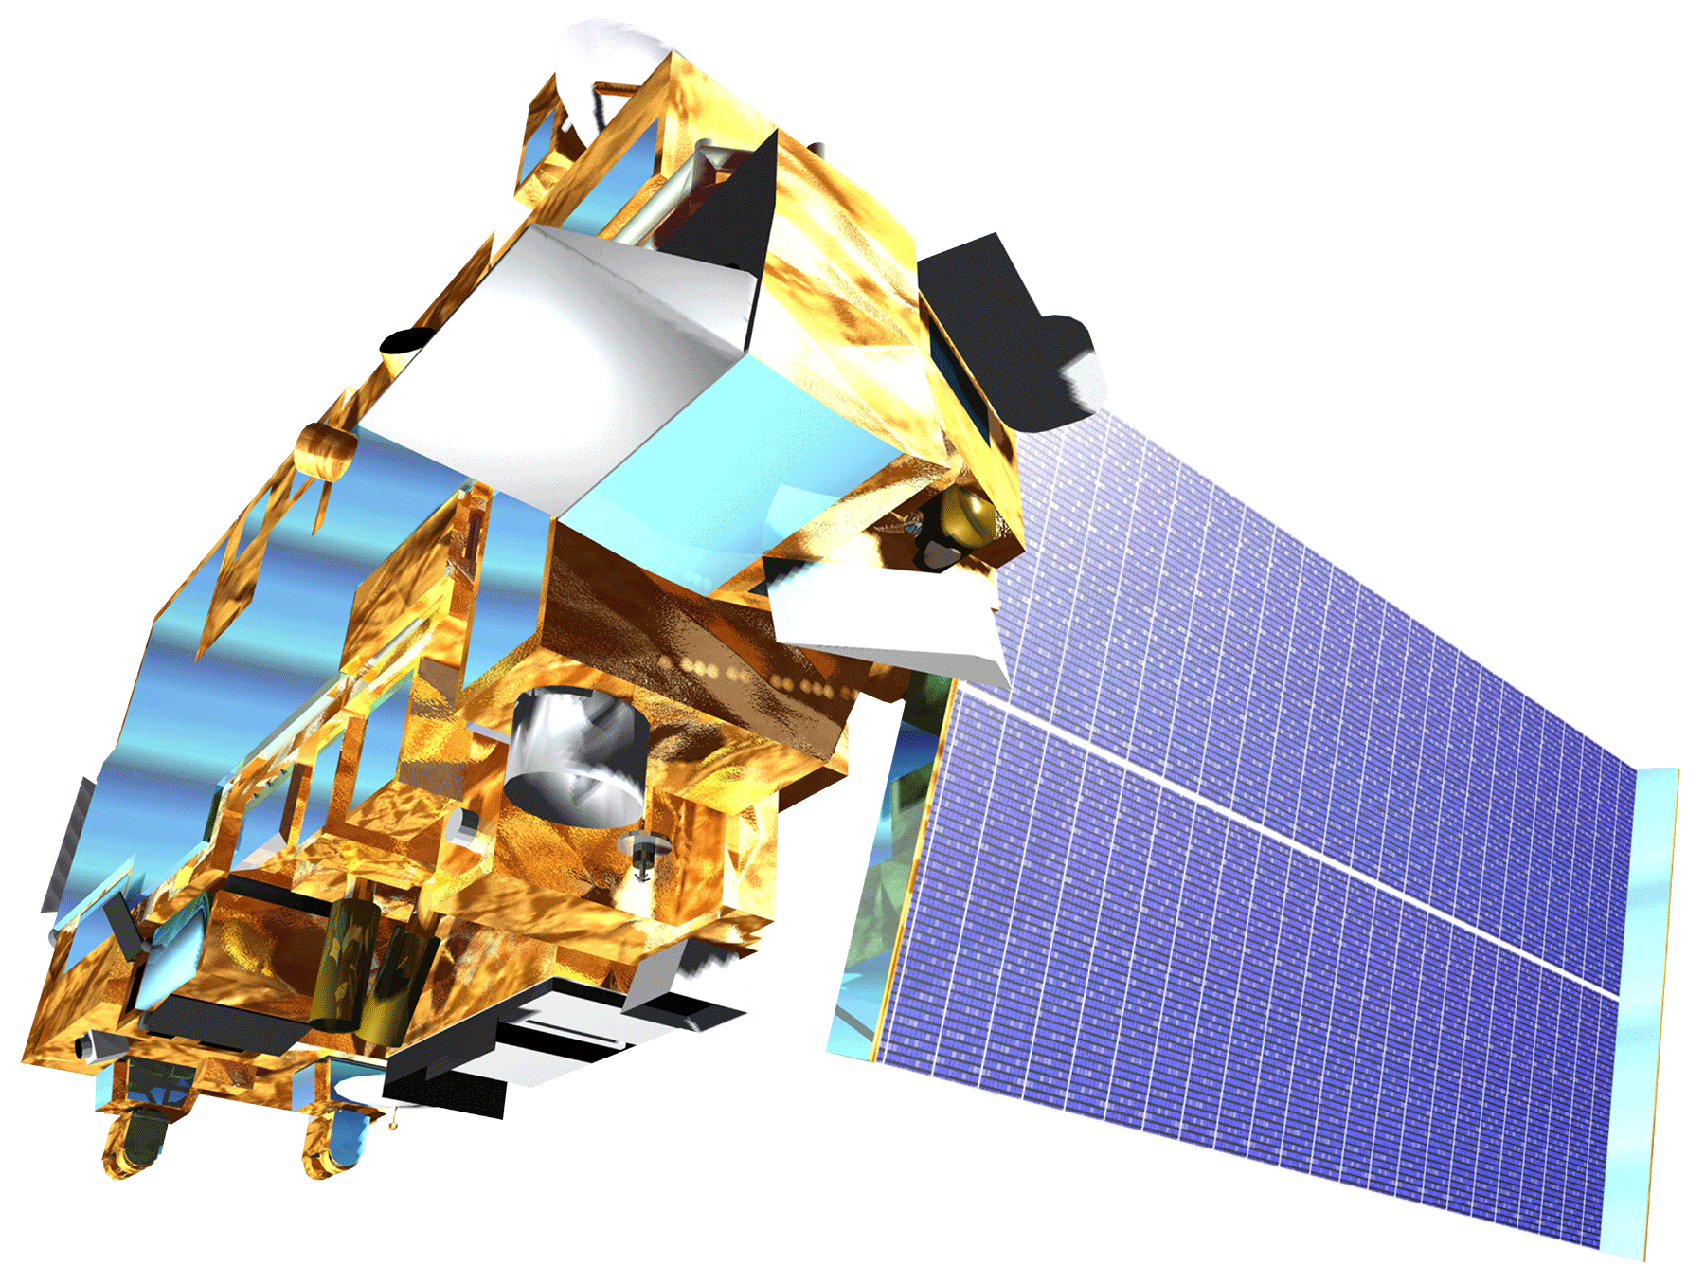
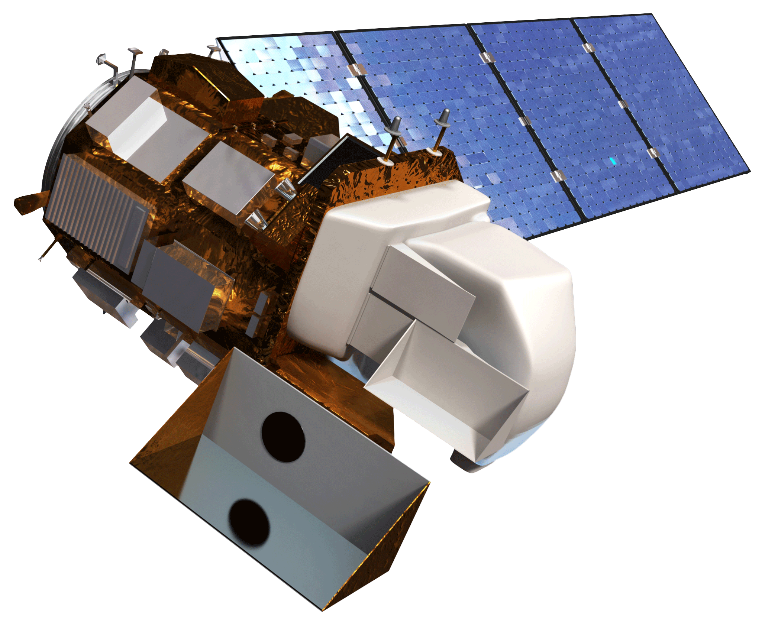
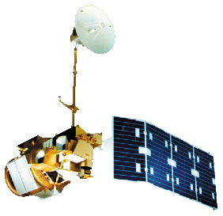
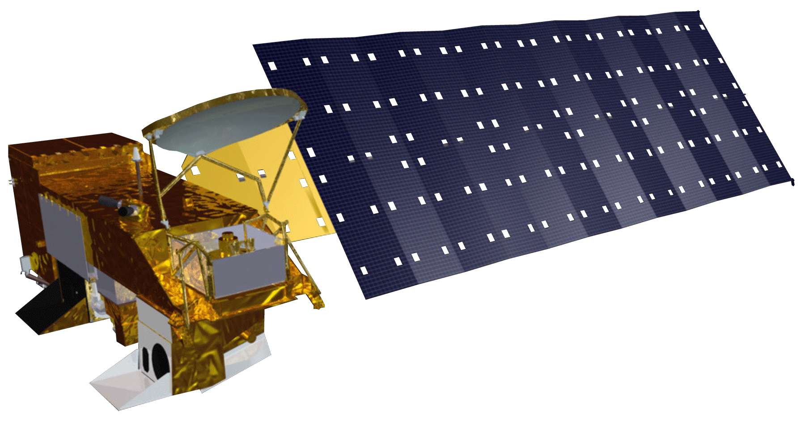
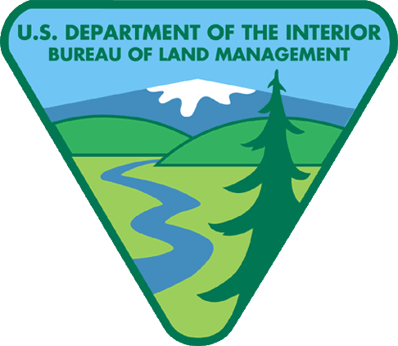
Characterizing Vegetation Type at Pre- and Post- Wildfire Periods Using NASA Earth Observations
Objectives
Study Area
OR
ID
Apply model developed as part of the Summer 2017 term analyzing the Crystal fire to the Jefferson, Henry’s Creek, and Soda fires
Identify correlations between climatic/biophysical conditions and ecosystem recovery
Develop useful tools for land management agencies to quantify recovery and support decisions evaluating recovery methods.
N
Soda Fire
Jefferson Fire
Henry’s Creek Fire
Abstract
8/10 - 8/25 2015
7/13 – 7/15 2010
8/21 -9/1 2016
Methodology
Wildfire is a key driver of ecosystem change in sagebrush steppe ecosystems. Fire-related disturbances can facilitate the propagation of invasive vegetation threatening native wildlife and shaping a fire regime that is increasingly hazardous to adjacent urban communities. Applying the methodology created during the previous DEVELOP term that characterized the 2006 Crystal Fire, we worked to identify correlations between climatic and biophysical conditions and effective recovery of sagebrush-steppe across multiple recent fires (Jefferson, Henry’s Creek, and Soda) in southern Idaho. Our research integrated imagery from NASA’s Landsat 5 Thematic Mapper (TM) and Landsat 8 Operational Land Imager (OLI). In addition, ForWarn spatial phenology products derived from the Terra and Aqua satellite’s Moderate Resolution Imaging Spectroradiometer (MODIS) sensor were used to investigate temporal variation. We used pre- and post-wildfire trends in normalized difference vegetation index (NDVI) and differenced normalized burn ratio (dNBR) values as metrics for recovery in a multiple regression analysis paired with historic climate and fire data. With a refined understanding of how disturbance alters long-term land cover change and future fire regimes of semiarid landscapes, land management agencies will be better equipped to protect plant and animal species from habitat loss and minimize the threat posed to urban areas.
DATA INPUTS
PROCESSING
STATISTICS
END PRODUCTS
Aqua/Terra
MODIS
ForWarn
(NDVI Processing)
Vegetation
cover maps,
BIOMASS
(Batch Input
Operation
iMAge
StatiStics)
Landsat 5, 8
TerrSet
(NDVI, NBR)
Temporal &
Regression
Analyses
SRTM DEM
ArcGIS
(Slope, Aspect)
Results
Jefferson Fire
Southern Idaho Disasters II
2010
2010
Earth Observations
SRTM
Landsat 8 OLI
Landsat 5 TM
Historic Burn Frequency
2015
2015
ΔNBR
Normalized Burn Ratio
High post-fire regrowth
Low post-fire regrowth
Unburnt
Low severity burn
Moderate-low severity burn
Moderate-high severity burn
High severity burn
NDVI
Normalized Difference Vegetation Index
Aqua MODIS
Healthy Vegetation
N
Terra MODIS
Unhealthy Vegetation
Conclusions
Vegetation analysis methods using common ecological variables used to analyze Crystal Fire recovery are insufficient for predicting a vegetation recovery timeline.
Full recovery from Jefferson Fire at 7 years post-fire is not apparent in the data. Recover times occur on a timescale longer than our study allows.
Plateauing of recovery mirrors expectations described in existing literature that illustrates ecological change from sagebrush-steppe to annual grass dominated landscapes.
Burns are becoming more frequent due to increased prevalence of annual grasses in our study areas.
Taking into account floristic and abiotic factors makes control polygons more reliable for comparison to areas within the fire.
Directed sampling techniques provide better representation of sagebrush-steppe than computer generated control areas.
Project Partners
Team Members
Bureau of Land Management, USDA Agricultural Research Service, Idaho Department of Fish and Game, NASA RECOVER Science Team
Acknowledgements
Brandon Crawford
(Project Lead)
Dane Coats
Leah Kucera
Jake Ramthun
Ritaraj Yadav
The Southern Idaho Disasters team would like to thank our contributors for their help. Science Advisors: Keith Weber (GIS Training and Research Center at ISU); Joseph Spruce (NASA Langley Research Center) Partners: Karen Krause, BLM Natural Resource Specialist; Patrick E. Clark, USDA Range Scientist; Scott Bergen, IDFG Principal Wildlife Research Biologist; and Ryan Walker, IDFG Biologist; and the previous DEVELOP team: Austin Counts, Nicholas Olsen, Cassidy Quistorff, Caitlin Toner, and Courtney Ohr.
Idaho – Pocatello
Fall 2017

