Slide 1
Utilizing NASA Earth Observations to Detect Changes in Annual Snowpack Coverage in Intermountain National Parks
NORTHERN GREAT PLAINS WATER RESOURCES II
Kimberly Berry(Project Lead)
Alexander Black
Michael Brooke
Brooke Colley
Aubrey Hilte
Notes:
Good morning, I am Kimberly Berry and I am the Project Lead for the Northern Great Plains Water project. I am also the Assistant Center Lead for NASA DEVELOP at Wise County.
Good (morning/evening). My name is Michael Brooke. I am the Center Lead for the NASA DEVELOP node at the Wise County and City of Norton Clerk of Court’s Office in Wise, VA. I am also a member of the Northern Great Plains Water project.
Good (morning/evening). My name is Alexander Black.
Good (morning/evening). I’m Brooke Colley.
Good morning, I am Aubrey Hilte and I am also a Fellow for NASA DEVELOP at WISE County
Our project uses NASA Earth Observations to detect changes in perennial ice and snow cover over time in the Intermountain Region National Parks: specifically Glacier, Yellowstone, and Grand Teton National Parks.

Slide 2
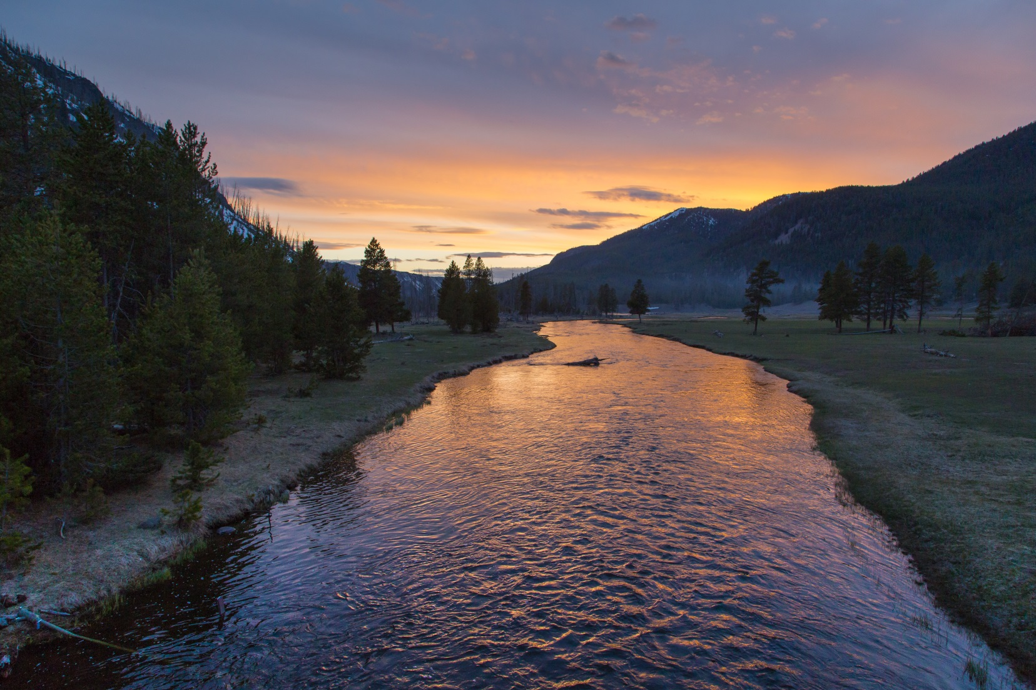
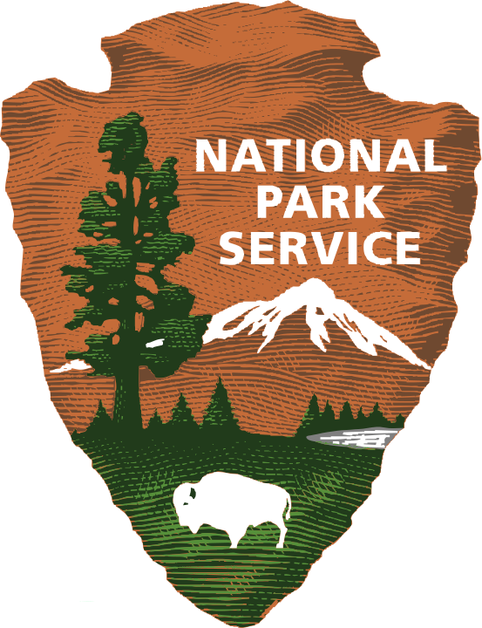
Partner Organization
Image Credit: Kelly Stehman,- RMNP; NPS - Neal Herbert
IMAGE CREDIT: KELLY STEHMAN
Notes:
We worked with the National Park Service on this project. The National Park Service has eighteen locations in the Intermountain Region. The organization was established in 1916 and its mission as defined by the Organic Act of 1916 is to “conserve the scenery and the natural and historic objects and the wild-life therein and to provide for the enjoyment of the same in such manner and by such means as will leave them unimpaired for the enjoyment of future generations.”
Recent changes in climate have resulted in ice and snow melt in the National Parks in the Intermountain region of the Northern Great Plains and, as a result, areas that were previously covered by persistent ice and snow, have been exposed. The team mapped changes in ice and snow cover in the region to detect these areas to assist the National Parks Service.
The project will allow the National Park Service in Yellowstone, Grand Teton, and Glacier National Parks to preserve archaeological sites that were previously ice-bound and restore areas whose vegetative cover and fire regime has been altered. NASA DEVELOP has previously worked with the National Park Service in both the Intermountain Region and across the country, and the two maintain a close and important relationship.
Image source: Kelly Stehman, Rocky Mountain National Park
Neal Herbert, National Park Service

Slide 3
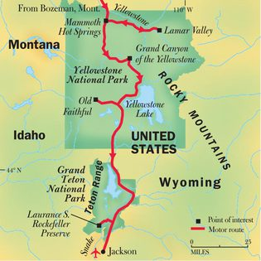
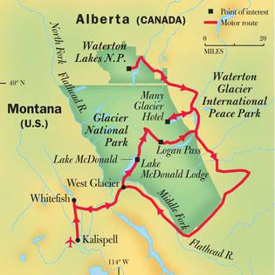
Study Area & Period
Study Areas: Glacier National Park, Yellowstone National Park, Grand Teton National Park
Study Period: January 1979 to October 2016
Yellowstone National Park &
Grand Teton National Park
Glacier National Park
IMAGE CREDIT: KELLY STEHMAN
Image Credit: NPS & The Noun Project
Notes:
Our study areas for this project are Glacier National Park, Yellowstone National Park, and Grand Teton National Park of the Intermountain Region. Changes in climate have resulted in ice and snow met in these parks. These areas are being exposed and have the potential to house archaeological sites that we in turn, marked for the National Parks Service. Our study period spanned from January 1979 through October 2016.
Image Source: NPS
Sergey Demushkin – The Noun Project

Slide 4
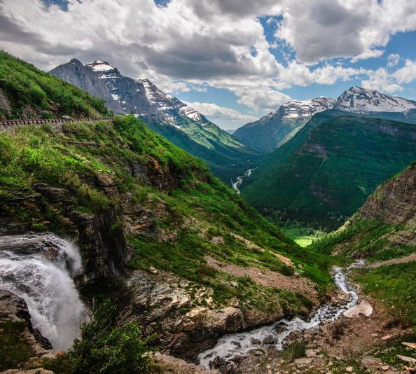
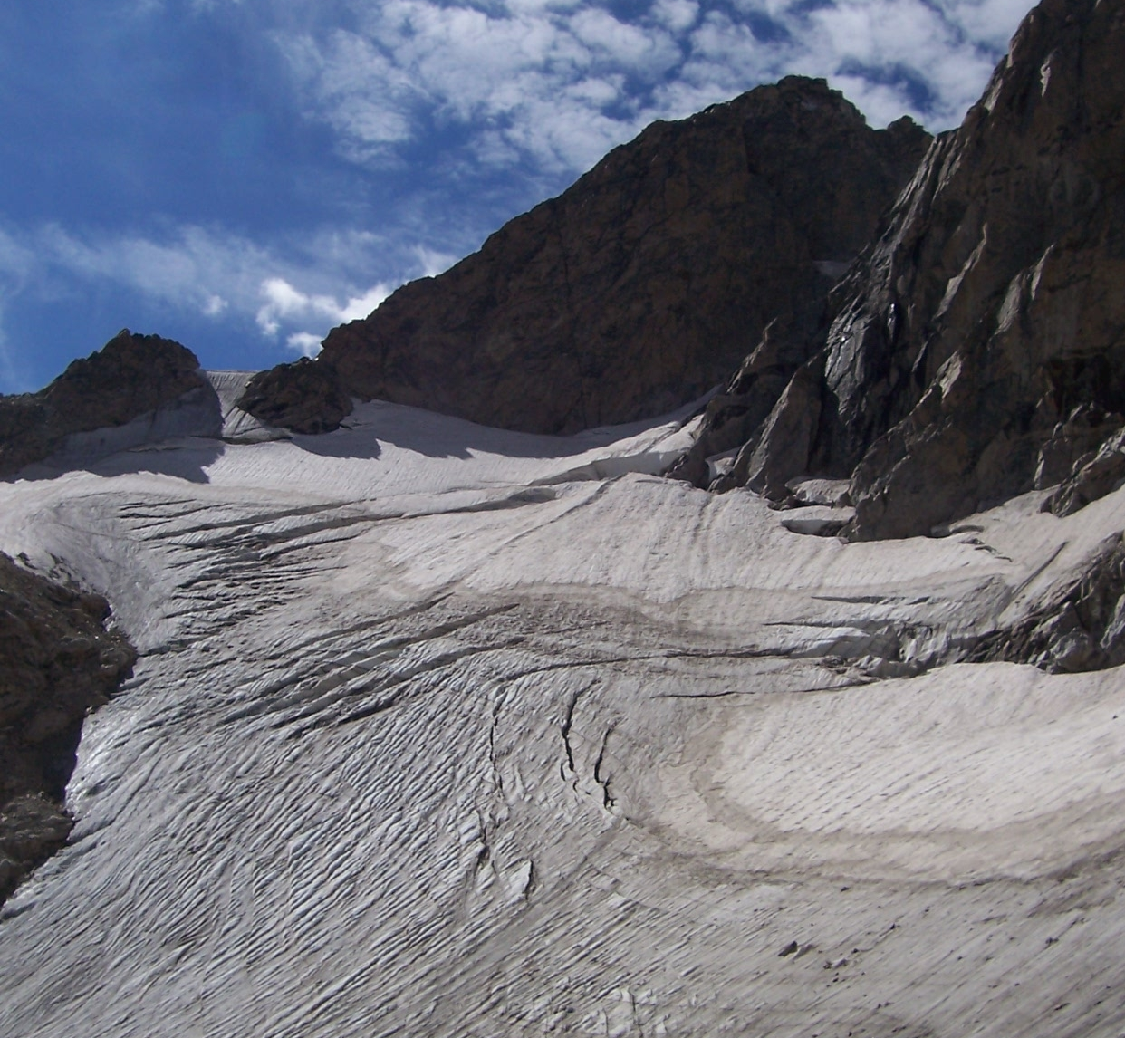
National Park Service
Glacier National Park
50 glaciers
Grand Teton National Park
10 glaciers
Yellowstone National Park
0 glaciers
Image Credit: NPS -Jacob W. Frank
Image Credit: NPS
Image Credit: NPS, Tim Rains
Notes:
Glacier National Park is located in Montana, along the US-Canadian border. Historically used for fishing, hunting, and timber by the Native American Blackfoot Tribe. Officially opened May 11, 1910, the park spans over 1 million acres and ranges from 3,000 – nearly 10,5000 ft. in elevation. Once thought to contain an estimated 150 glaciers, the park has seen 2/3 disappear since 1980.
Grand Teton National Park is located in Northwestern, Wyoming. Established in 1950, the park covers over 300,000 acres of forest ranging from 6,000 – 14,000 ft. in elevation. The Park was formed by the movement of the Teton Fault line and, as of 2011, there are 10 documented glaciers.
Finally, connected by the John. D. Rockefeller Jr., Memorial Parkway, Yellowstone National Park is located just north of Grand Teton. Established March 1, 1872, Yellowstone was America’s first National Park and covers over 2.2 million acres, spanning 5,000 – over 11,000 ft. in elevation. Although the park’s topography suggests glacial presence, there are none remaining. However, the park contains more than 1,800 documented archaeological sites.
Image Credit: NPS – Tim Rains

Slide 5
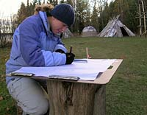
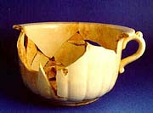
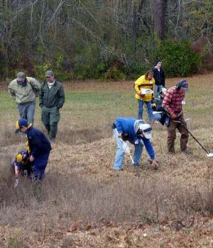
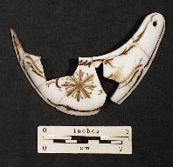
Community Concerns
Changing climate results in ice and snow melt
Changes in vegetative cover and fire regime occur due to receding ice sheets
Receding ice sheets uncover new archaeological sites that must be located and preserved
Image Credits: NPS
Notes:
This project was inspired by several concerns held by the National Parks and surrounding communities.
As the planet continues to warm, glaciers retreat - leaving less perennial ice and snow. The resulting melt creates trickle-down ecological affects on the surrounding landscape. Receding ice sheets expose earth on which new vegetation grows. These changes in vegetative cover can alter the historical fire regime, enabling unpredictable events.
Additionally, receding glaciers have the potential to uncover archaeological sites previously bound by ice and snow. Since the National Park began archaeological research in 1971, a wide array of hunting tools and other artifacts have been found. The history embedded within each park, coupled with the National Park Service mission, motivates Glacier, Grand Teton, and Yellowstone National Parks to preserve the archaeological artifacts from these newly exposed sites.
Image Source: https://www.nps.gov/archeology/sites/npSites/glacierIcePatch.htm - By: R. L. Kelly

Slide 6
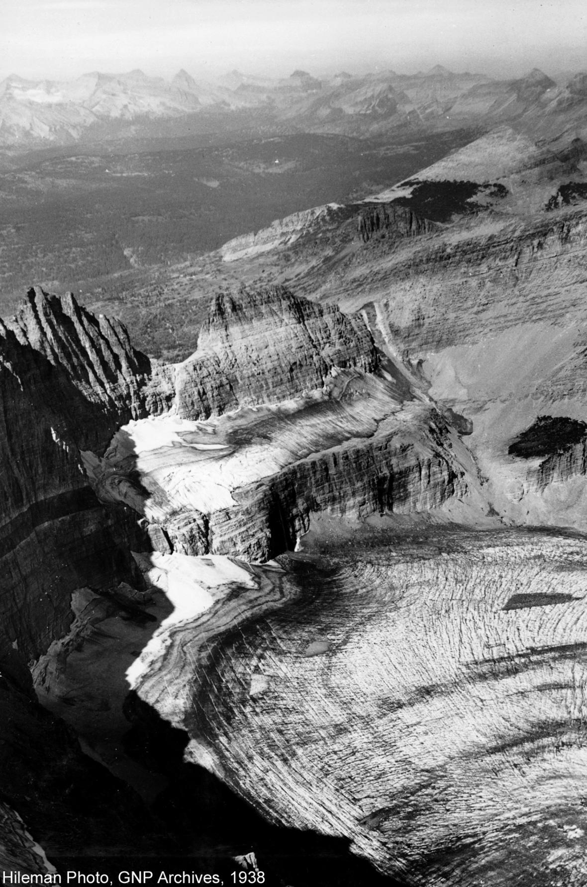
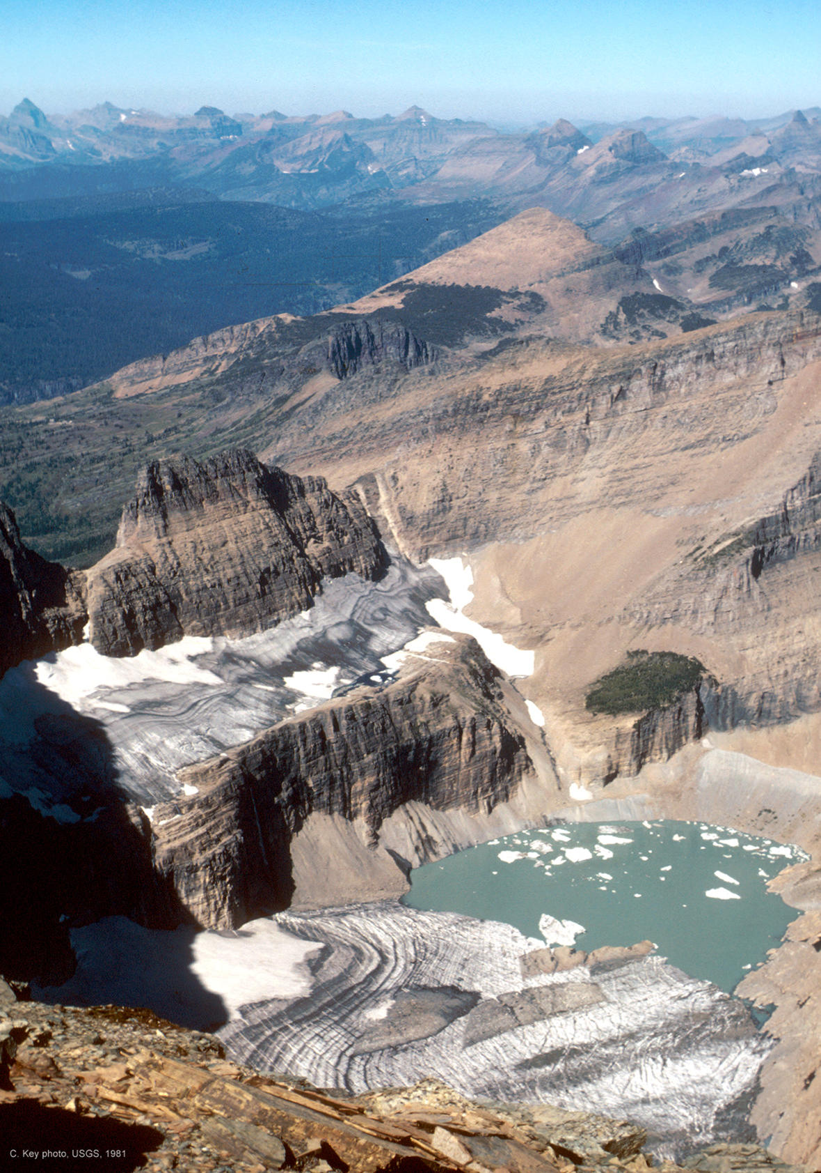
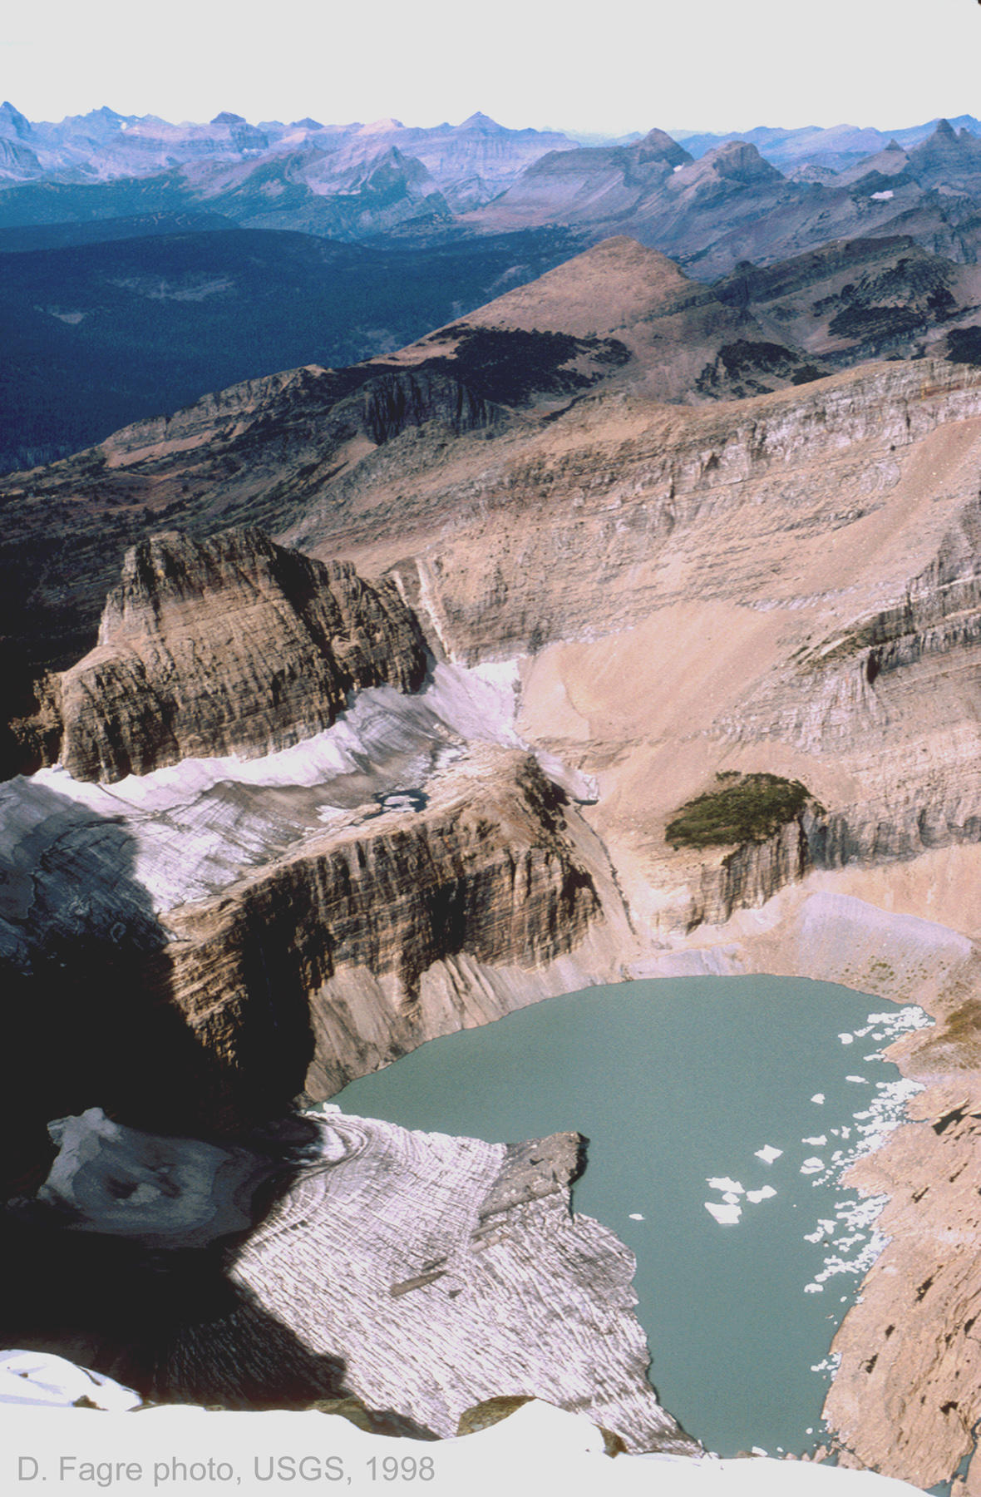
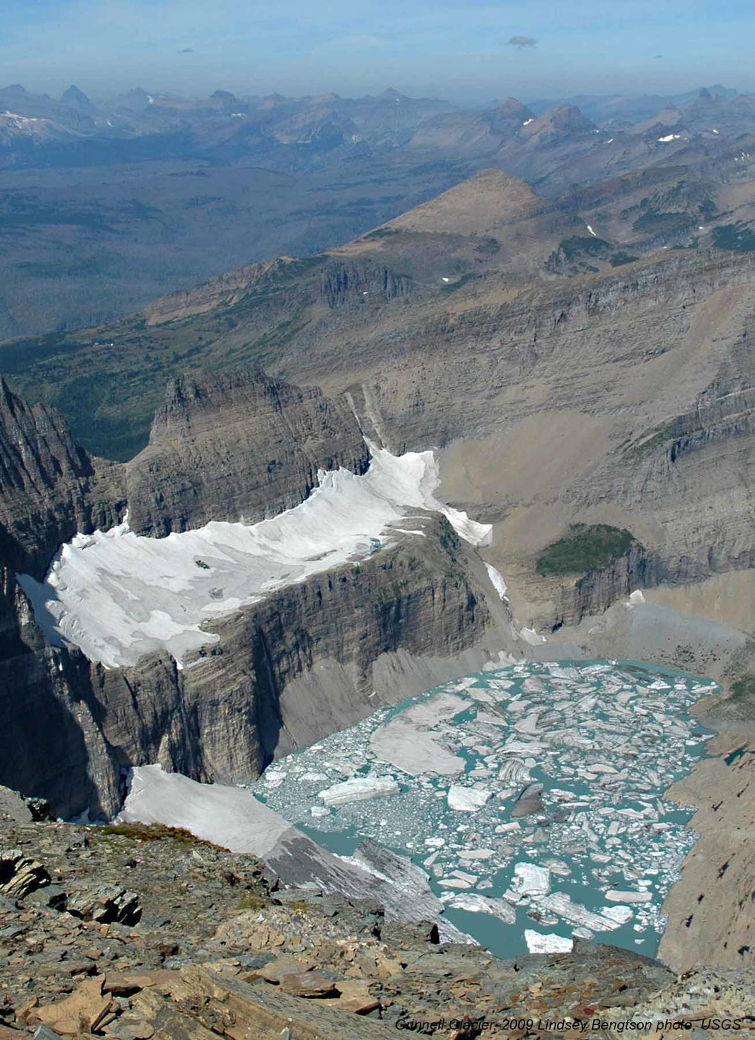
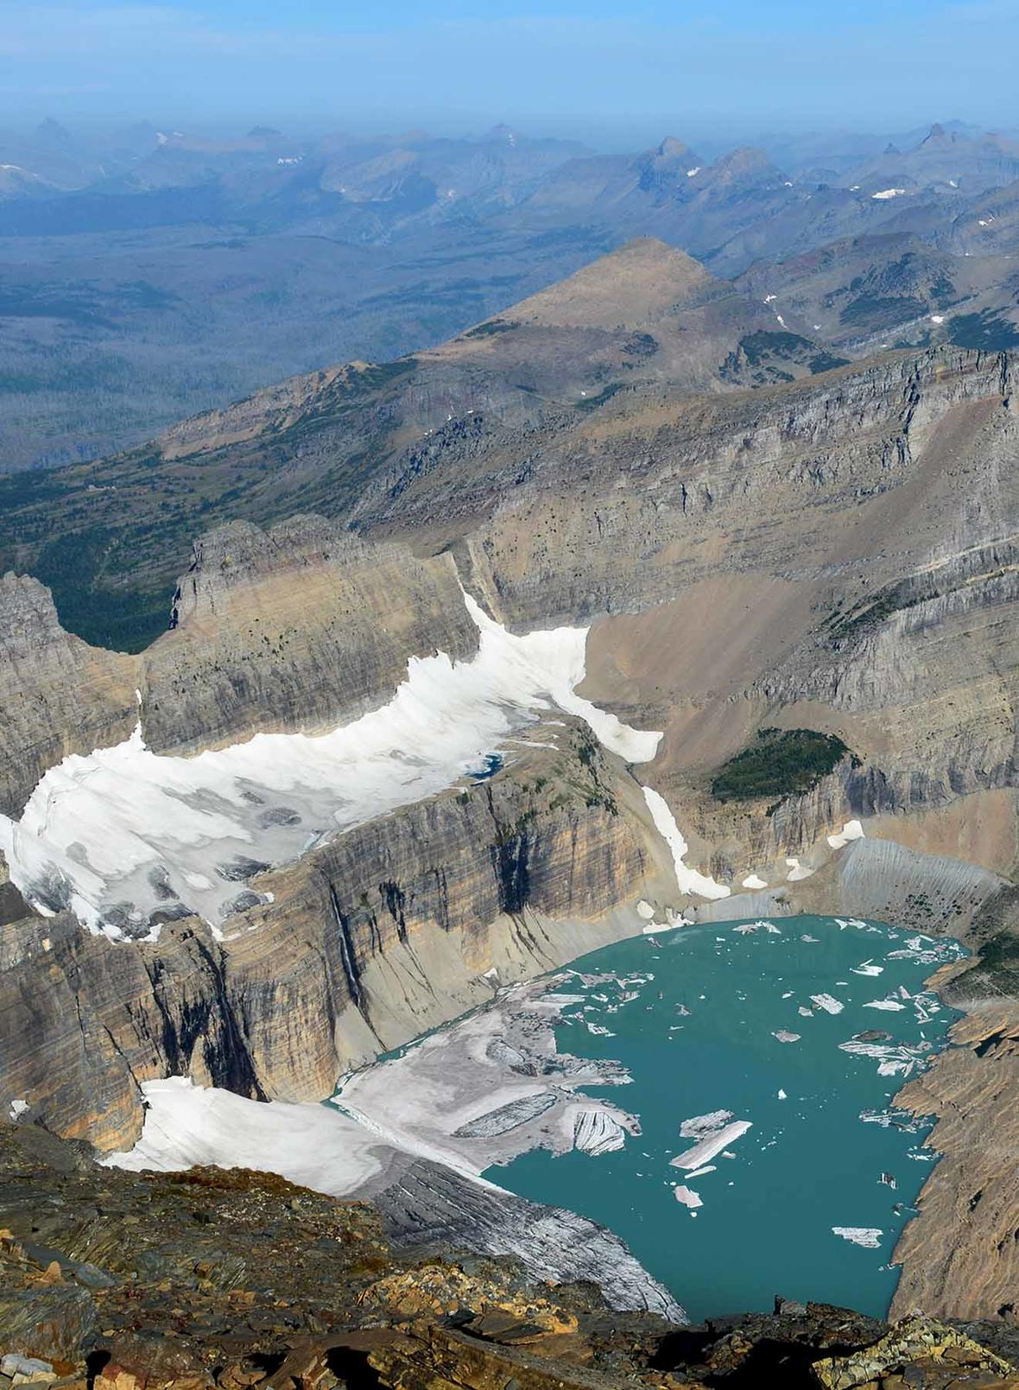
Objectives
1938
1981
1998
2009
2013
Map PISC & detect retreat
Identify vegetative changes
Delineate possible archaeological sites
Image Credit: USGS
Image Credit: USGS
Image Credit: USGS
Image Credit: USGS
Image Credit: GNP Archives T.J. Hileman
Notes:
Recent changes in climate have resulted in ice and snow melt in the National Parks in the Intermountain region of the Northern Great Plains and, as a result, areas that were previously covered by persistent ice and snow, have been exposed.
The team mapped changes in ice and snow cover in the region to detect these areas to assist the National Parks Service in the preservation of archeological sites that were previously icebound and the restoration of areas whose vegetative cover and fire regime has been altered.
A picture is worth a thousand words.
Image Source: GNP Archive – T.J. Hileman USGS

Slide 7
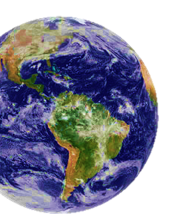
Methodology
Landsat 5 & 8 Imagery Ancillary Data
Google Earth Engine ArcMap
Supervised Classification Index Thresholding
Exposed Area Landcover Map Max Snow Melt Area Map
Data Acquisition
Data Processing
Modeling
Results
Image Credit: The Noun Project & Popular Mechanics
Notes:
The methodology is straightforward. After collecting the required data the team used Google Earth Engine and ArcGIS for data processing. Scripts and models were created in Google Earth Engine to assess the changes in ice and snow cover in classification and thresholding. Our results are PISC area differences, climate analysis charts, and melt area maps for each park.
Image Source: Alexander Cherkinsky, Rebecca Walthall, Ami, &
Andrey Vasiliev – The Noun Project
Popular Machanics

Slide 8
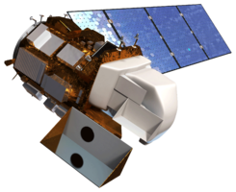
Earth Observations
Landsat 5 Thematic Mapper (TM)
Landsat 8 Operational Land Imager (OLI)
Image Credit: El Pensive De Dinorider
Notes:
This project used NASA Earth observations to detect the recession of ice cover over time in Glacier, Yellowstone, and Grand Teton National Parks.
We used data from Landsat 5’s Thematic Mapper and Landsat 8’s Operational Land Imager to map the ice and glacier positions each year using surface reflectance.
Image Source: El Pensive De Dinorider - http://dinorider.blogspot.com/

Slide 9
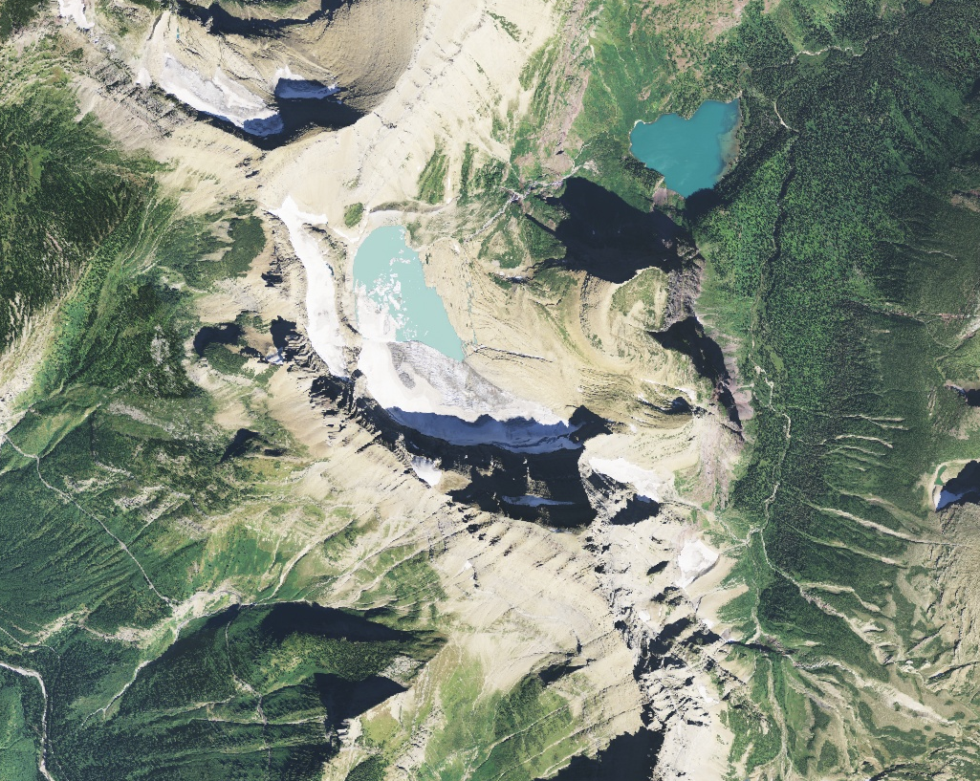
Ancillary Datasets
The National Agriculture Imagery Program (NAIP) from the United States Department of Agriculture (USDA)
National Park Service shapefiles
Glaciers
Rivers
Lakes
Image Credit: NAIP
Notes:
We first began our project by downloading the National Park Service’s Persistent Ice and Snow Cover maps to verify NASA Earth Observation data products
We used imagery from the National Agriculture Imagery Program (NAIP), USGS Stream Gauge Data, and glacier shapefiles for validation.
The lake and river shapefiles were used for threshold refinement of the models.
The University of Idaho’s GRIDMET was used for climatic analysis research.
Image Source: National Agriculture Imagery Program (NAIP)

Slide 10
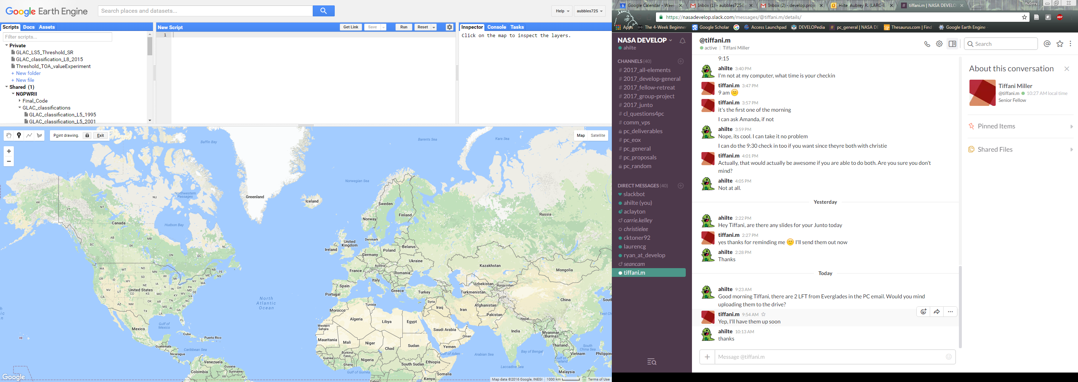
Google Earth Engine
Satellite imagery + geospatial datasets + analysis
= change detection
Rapid and accurate processing
Vast data storage
Simplified cloud management
User friendly, ease of replication
Image Credit: NAIP
Notes:
For all primary analysis the team utilized the Google Earth Engine platform. Earth Engine was preferable because of its Data libraries, fast processing, and repeatable methodology for our partners. The Landsat surface reflectance data was called into a script and filtered to the needed scenes and melting season. From there two models were applied: supervised classification and thresholding.
Image Source: https://code.earthengine.google.com/ - Google Earth Engine

Slide 11
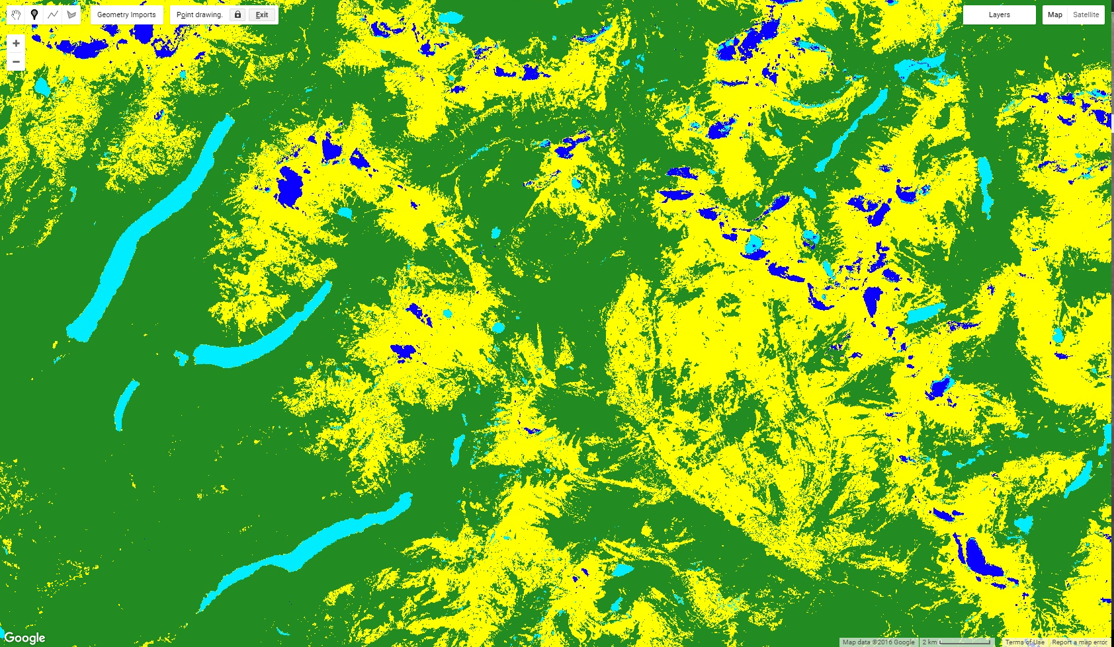
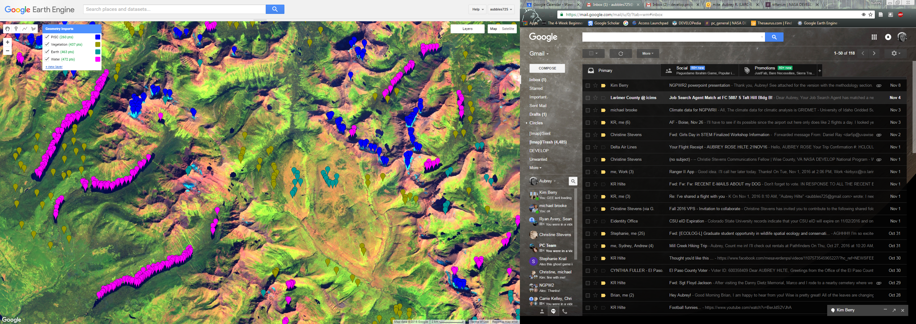
Modeling
Supervised Classification
Notes:
A supervised classification was performed in order to simplify the landscape imagery and identify areas of interest to our team. Over one thousand points collected from each park in 1995, 1999, 2001, 2005, 2011, and 2015, were used to train the model. The resulting classification delineated areas of persistent ice cover, vegetation, bare earth, and water. While this method is highly accurate it is time consuming and computing memory intensive.
Image Source: Google Earth Engine

Slide 12
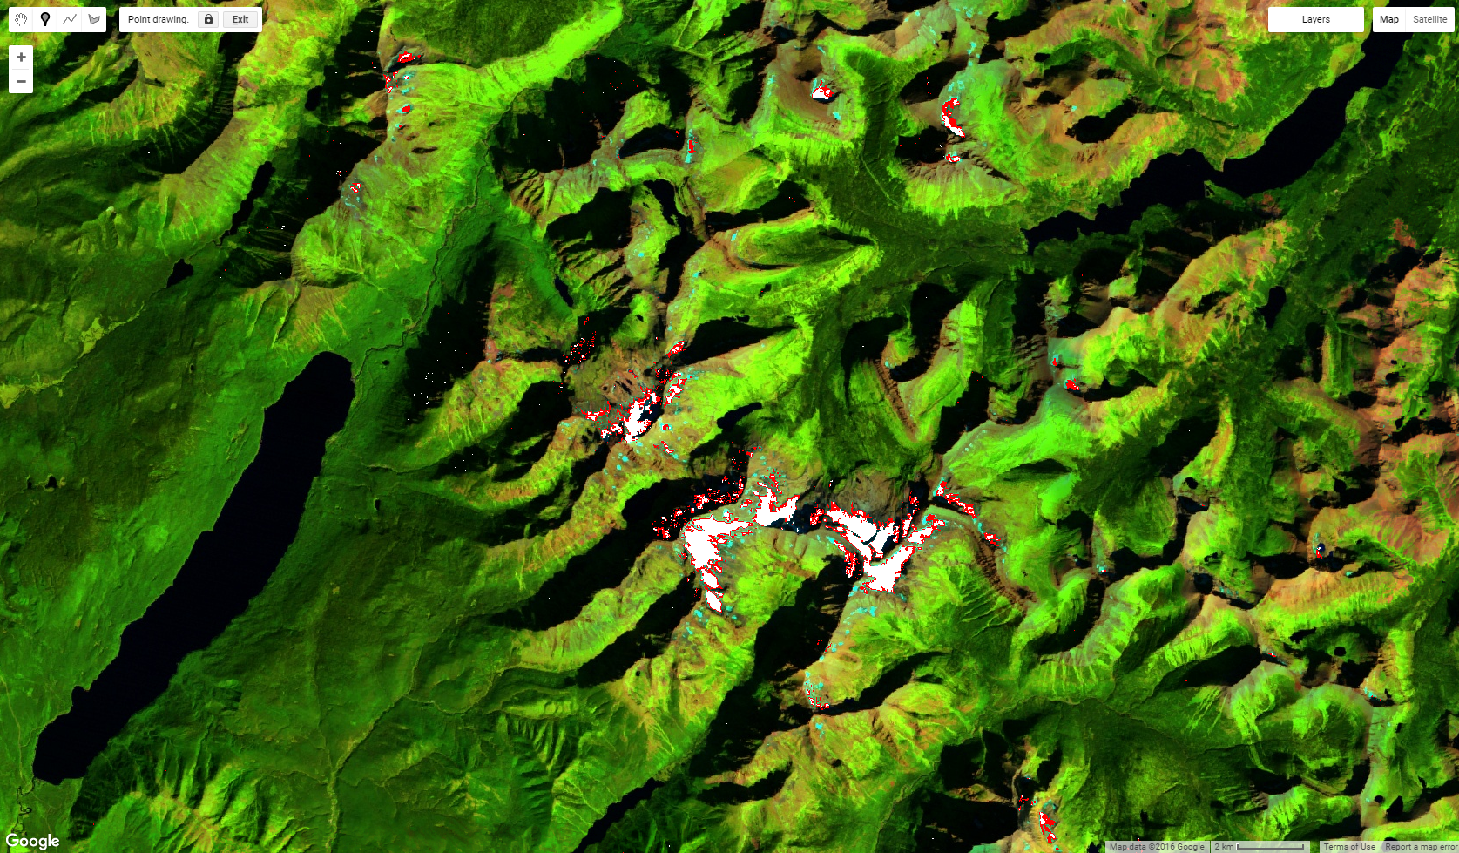
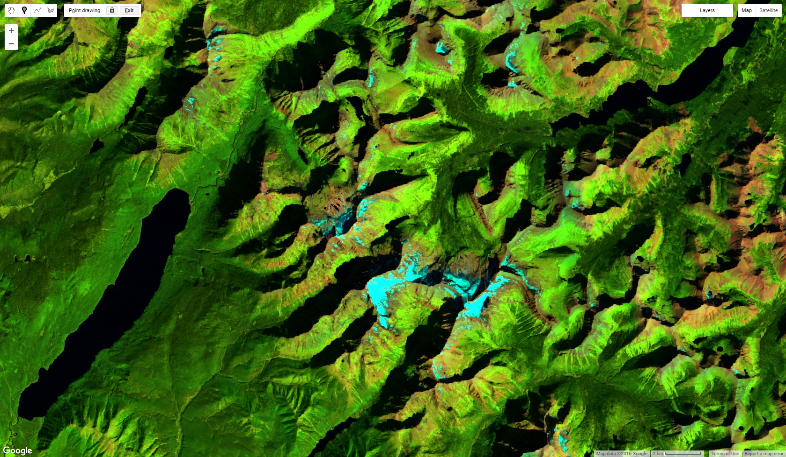
Modeling
Index Threshold Analysis
Notes:
The index thresholding is a much faster method for detecting ice cover. The team used NDVI and NDSI values to locate the ice in each compiled scene. After all of the usable scene were collected the images of the ice cover from each year were exported from Google Earth Engine to ArcMap for validation and final analysis.
Image Source: Google Earth Engine

Slide 13
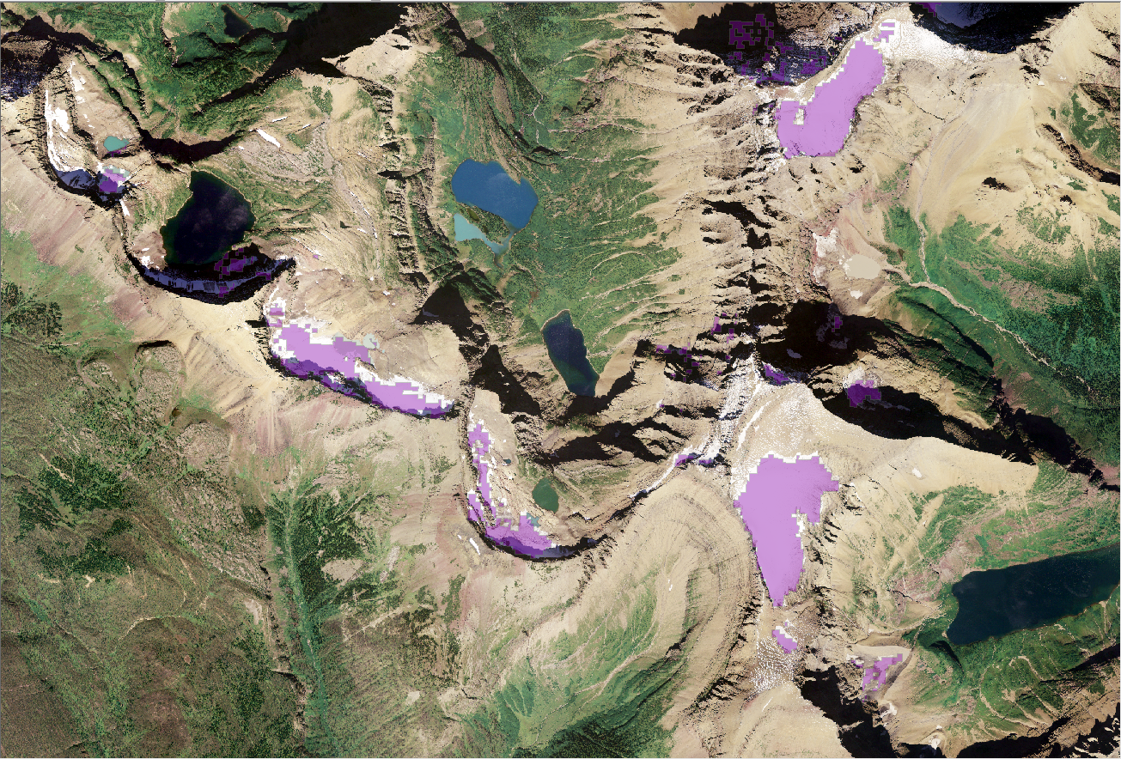
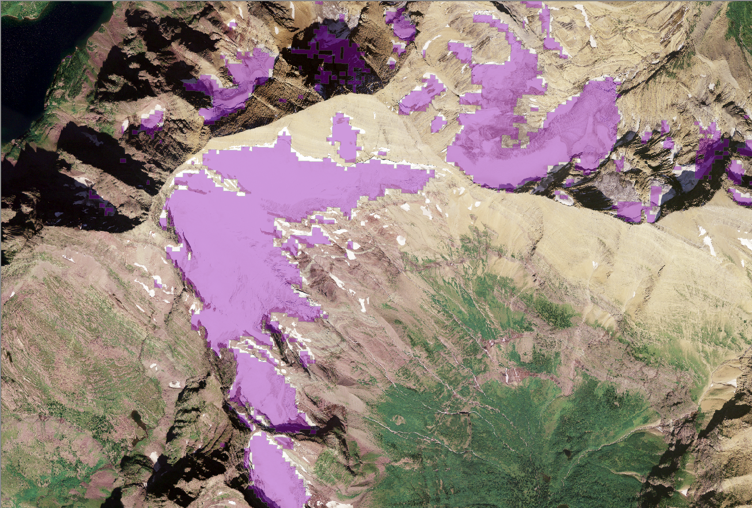
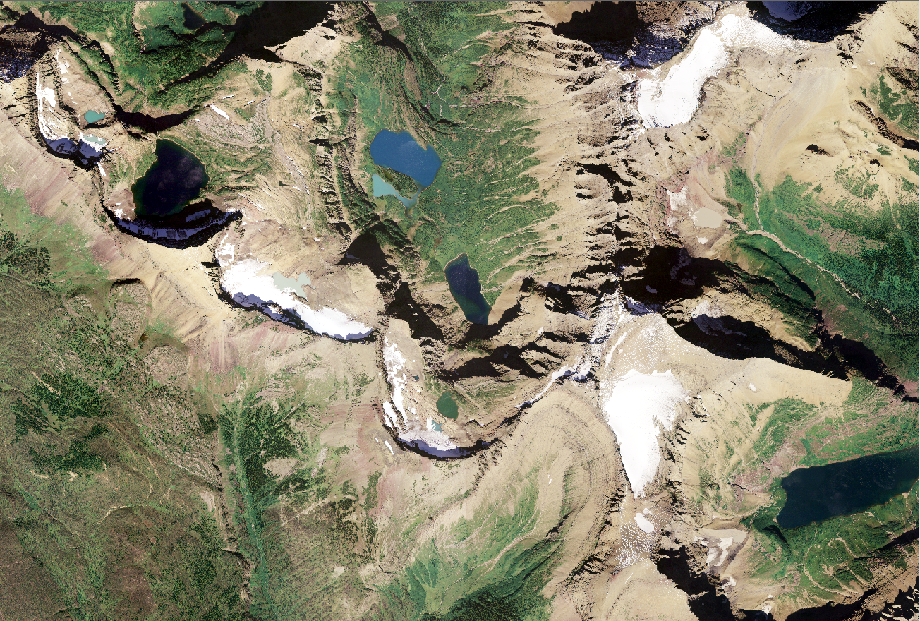
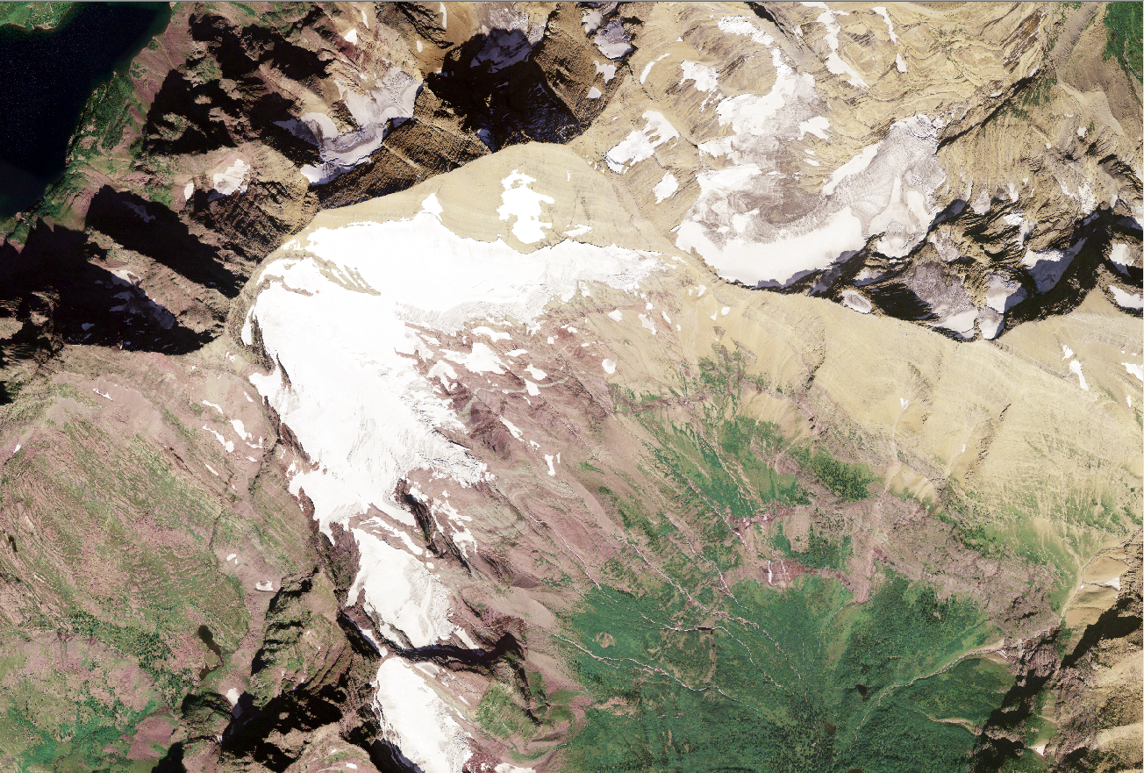
Validation
NAIP
Notes:
The Team’s resulting yearly ice cover data was compared to available NAIP imagery collected at the same time as the Landsat melting seasons used. These images show how well Landsat’s 30 meter resolution did in these areas.
Image Source: Google Earth Engine

Slide 14
Results
Glacier | Grand Teton | Yellowstone
1984-1995: 16,578 acres PISC | 1986-1996: 3,292 acres PISC | 1986-1996: 24 acres PISC
2006-2015: 10,954 acres PISC | 2007-2016: 1,912 acres PISC | 2007-2016: 20 acres PISC
34% Difference in PISC | 42% Difference in PISC | 19% Difference in PISC
Notes:
For the PISC analysis the yearly ice covers were condensed into decadal periods. From there, the yearly ice cover was used to create the percent likelihood of snow over each decadal period. Thus, the team had maps showing the percent likelihood that snow covered a particular pixel in the decadal period. We removed areas with a less than a 30% likelihood of ice cover to account for years with unusually high snowfall.
These are the results: Glacier saw a difference of 34% PISC acres, Grand Teton saw a 42% difference, and Yellowstone saw a 19% difference in PISC area.

Slide 15
Climate Results
GRIDMET
Winter Precipitation
Melting-Month Temperature
Notes:
To investigate the causes of this change in PISC, the team analyzed climate data on a park by park basis. We used Google Earth Engine to process GRIDMET data from the University of Idaho. GRIDMET melds the spatial resolution of PRISM data with the temporal resolution of NLDAS data.
The team specifically analyzed winter precipitation form November to March of each year and spring and summer melting month temperatures form April through September of each year. We analyzed data from 1979 through 2015.
Basemap Source: National Agriculture Imagery Program

Slide 16
Climate
Glacier
Increased November-March precipitation
Warmer
Notes:
First a look at Glacier National Park. From 1979 to 2015 temperatures within the park increased by around 1° C and winter precipitation increased and average of nearly 1 mm/day.

Slide 17
Climate
Teton
Nearly constant precipitation
Warmer
Notes:
Next, to Teton National Park. Precipitation remained nearly constant during our study period while temperature increased by about 0.5° C.

Slide 18
Climate
Yellowstone
Nearly constant precipitation
Warmer
Notes:
And in Yellowstone National Park, wintertime precipitation remained nearly constant and melting month temperatures increased by nearly 1

Slide 19
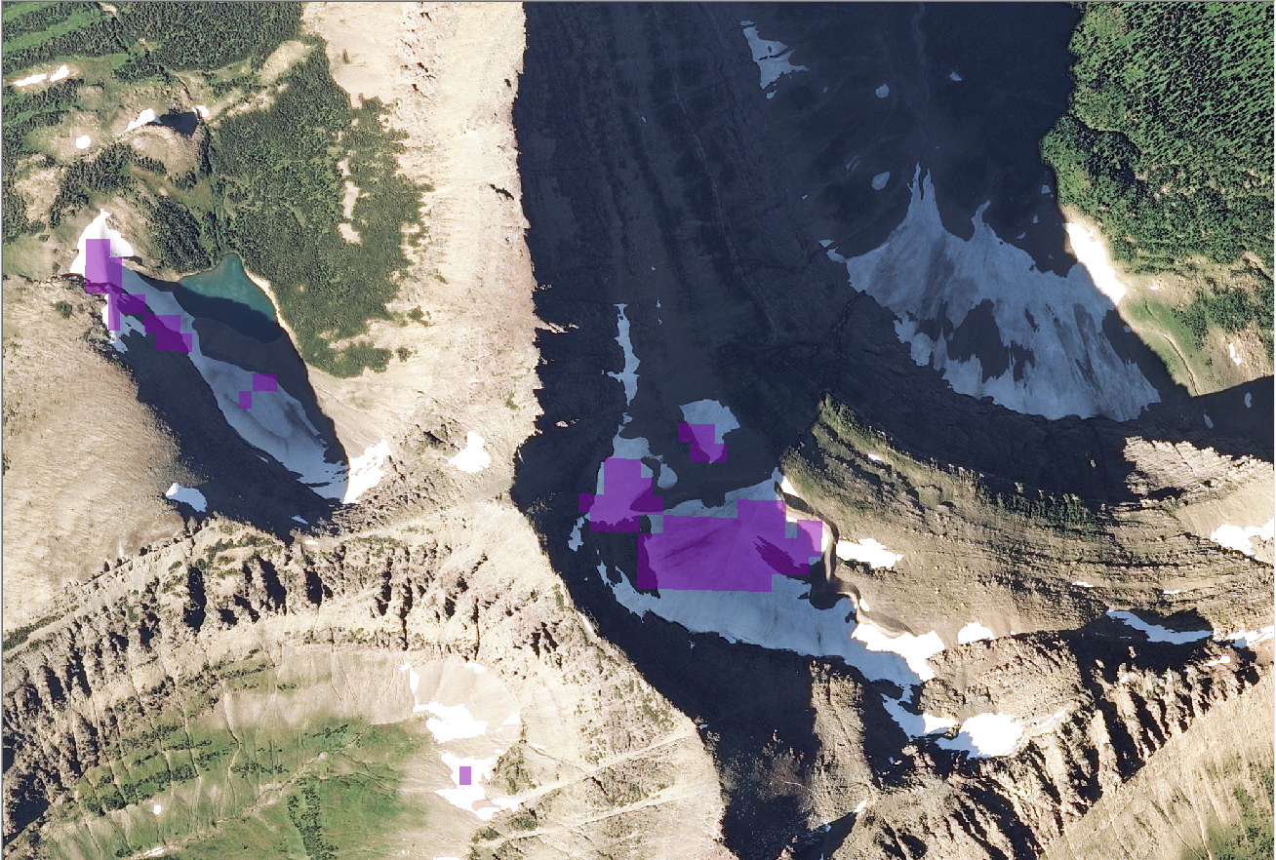
Limitations
Spatial Resolution
Ground Truth
Shadows
Heavy Cloud Cover
Image Credit: NAIP
Notes:
As with any remote-sensing project there were limitations. The spatial and temporal resolution of Landsats 5 and 8 lends itself well overall to the study of small snow and ice patches, but more resolution will always be better.
There is a lack of ground truth data on the thickness of the glaciers. Because of this, making an accurate assessment of glacial volume is not possible.
Shadows presented an issue. Due to the terrain the images had shadowed areas on the north side of the peaks. This causes the PISC to be underrepresented in these areas.
Finally cloud cover was a problem. The clouds caused both false positive PISC areas and caused some years to be totally tossed out of our analysis. In each ten-year period we were luck to get 7 good cloud-free composite images.
Basemap Source: National Agriculture Imagery Program

Slide 20
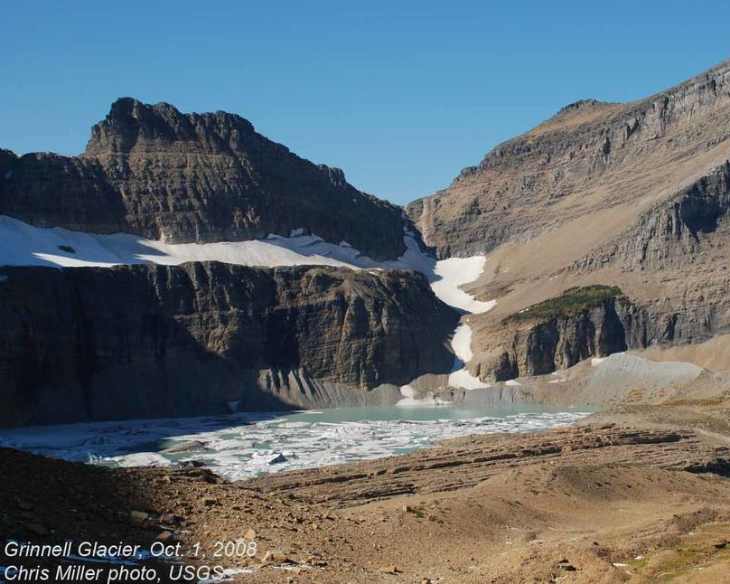
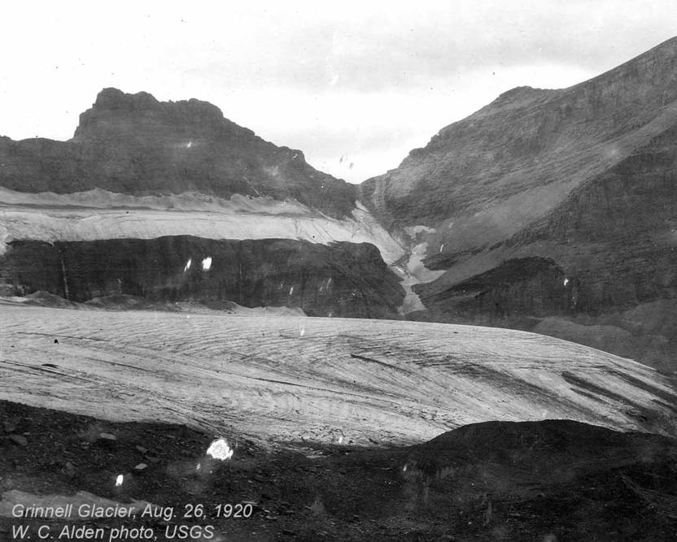
Conclusions
IMAGE CREDIT: NPS
Methodology successful for identifying ice cover and monitoring change
Overall warming trend
Overall decrease of PISC over 31 years
Notes:
Methodology successful for identifying ice cover and monitoring change
Overall warming trend
Overall decrease of PISC over 31 years
Image Source: GNP Archive – W.C. Alden, USGS
Chris Miller, USGS

Slide 21
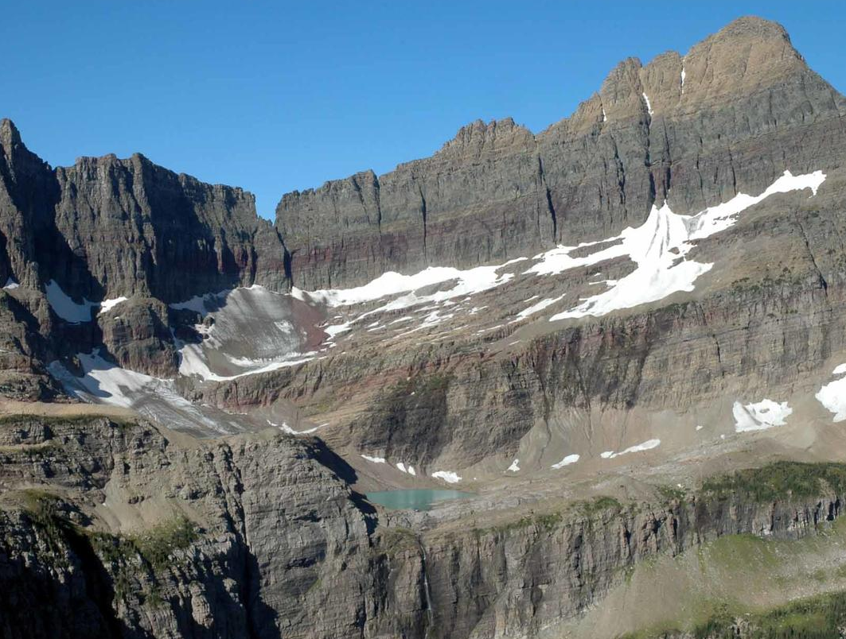
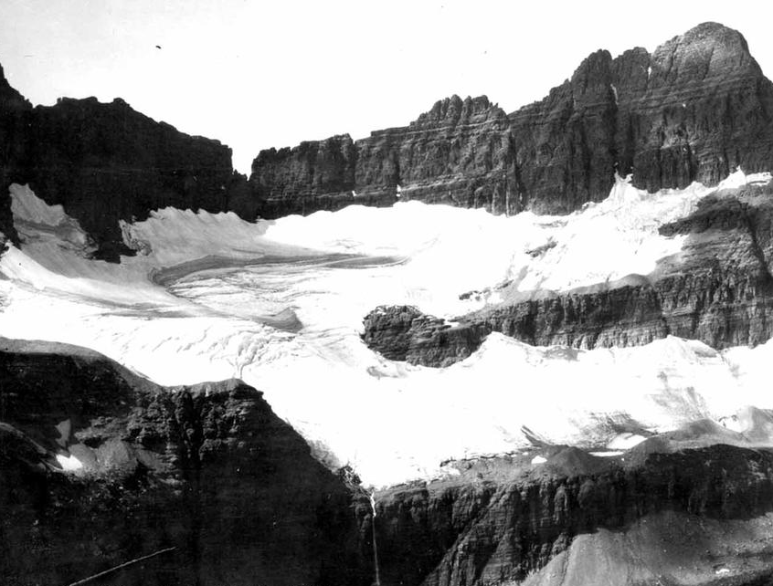
Future Work
Subtract shadows from Google Earth Engine thresholding
Improve water mask in thresholding techniques
Investigate glacial volume difference
Utilize Sentinel-2 for higher resolution imagery
Image Credit: Blase Reardon, USGS
IMAGE CREDIT: NPS
IMAGE CREDIT: NPS
Image Credit: Aldern, USGS
Notes:
Subtract shadows from Google Earth Engine thresholding
Improve water mask in thresholding techniques
Investigate glacial volume difference
Utilize Sentinel-2 for higher resolution imagery
Image Source: GNP Archive – Aldern, USGS
Blase Reardon, USGS

Slide 22
Acknowledgements
Partners
1) Tom Lincoln, Intermountain Region of the
National Park Service
2) Richard Menicke, Glacier National Park
3) Shannon Dennison, Grand Teton National Park
4) Elizabeth Horton, Yellowstone National Park
Science Advisors
1) Dr. Kenton Ross, NASA Langley Research Center
2) Dr. DeWayne Cecil, NOAA NCEI, Global Science and Technology
3) David Selkowitz, USGS Alaska Science Center
4) Bob VanGundy, The University of Virginia’s College at Wise
Image Credit: NPS
Notes:
Thanks everybody!
Image Source: https://www.nationalparks.org/our-work/campaigns-initiatives/national-park-service-centennial - National Park Service (NPS)

Slide 23
Questions?
Notes:
Thanks everybody!

