Slide 1
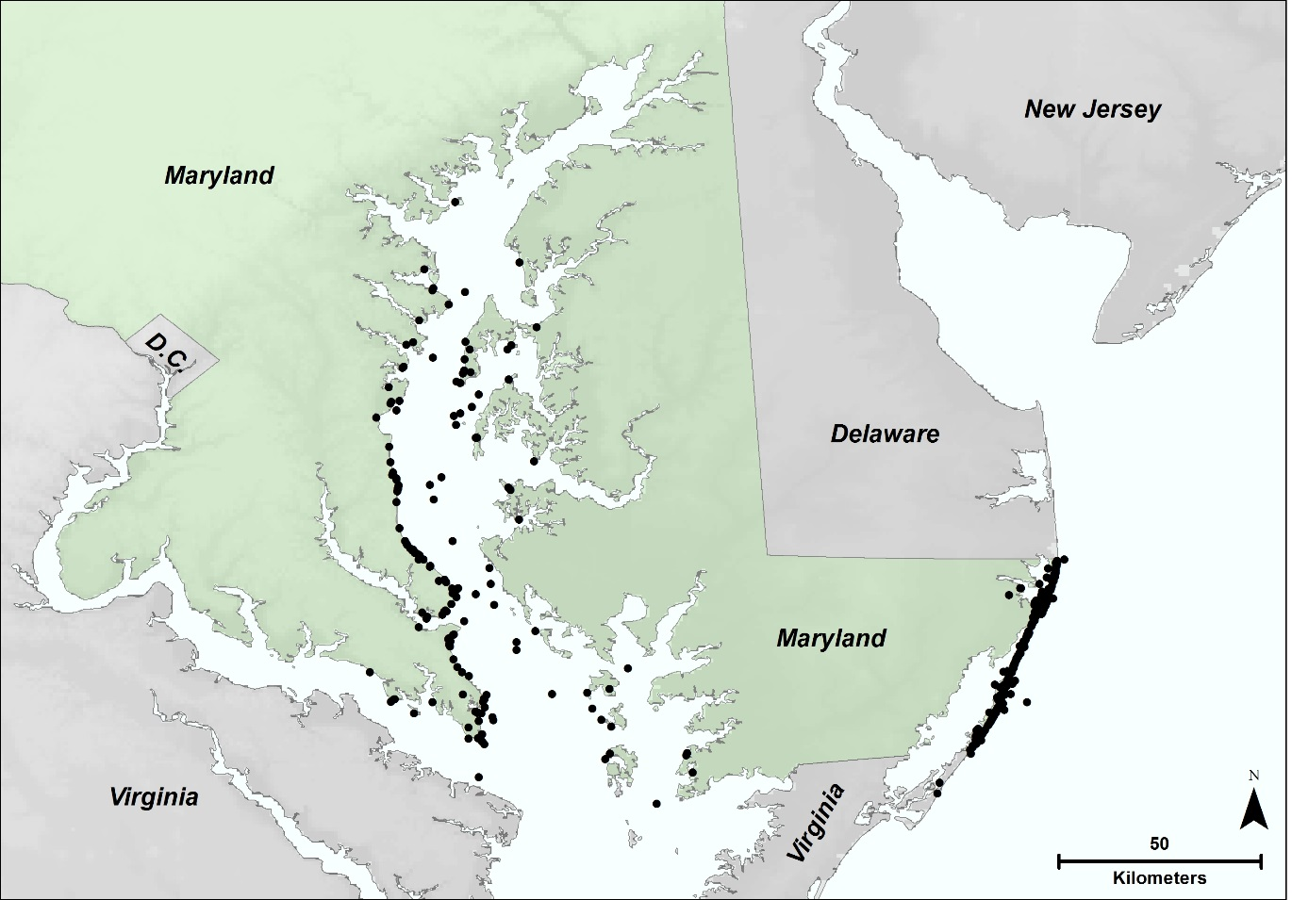
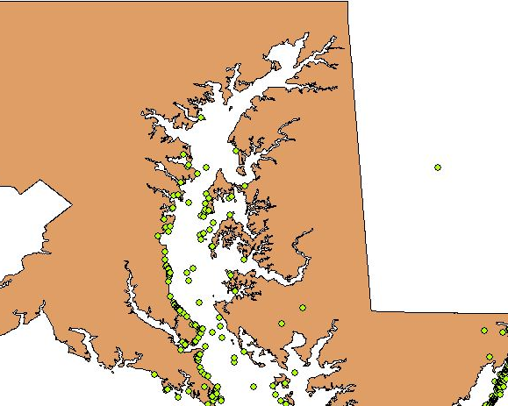
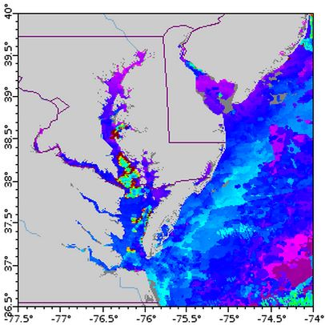
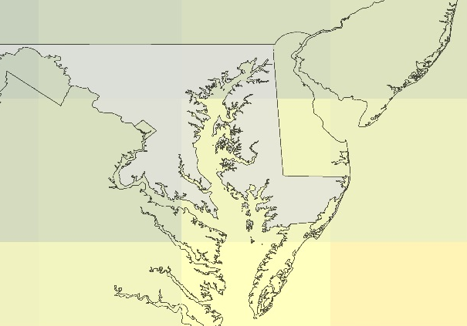
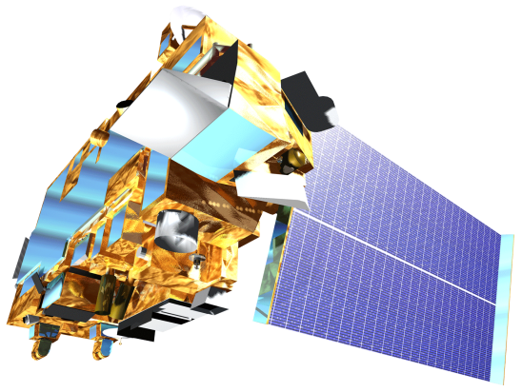
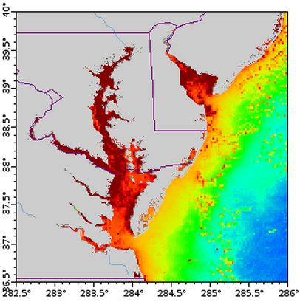
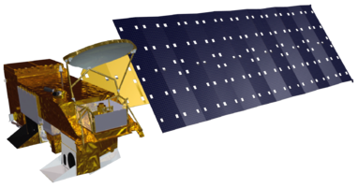
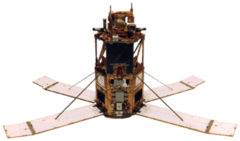
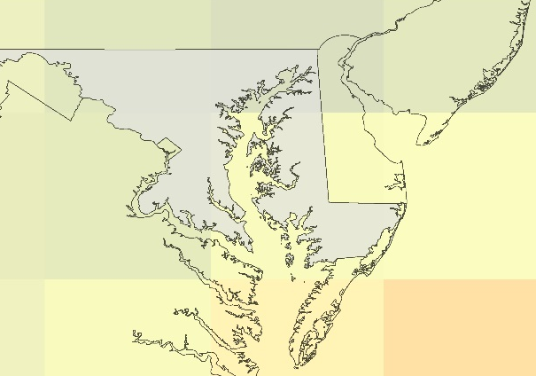
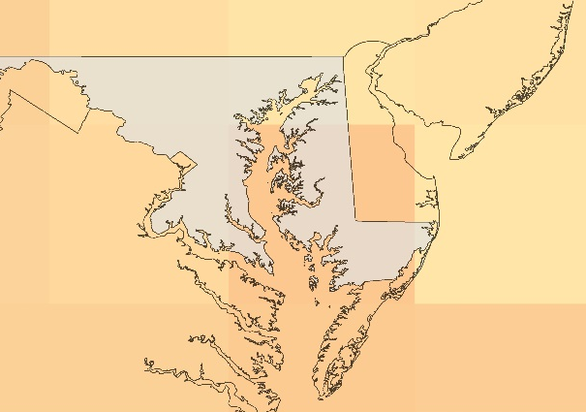
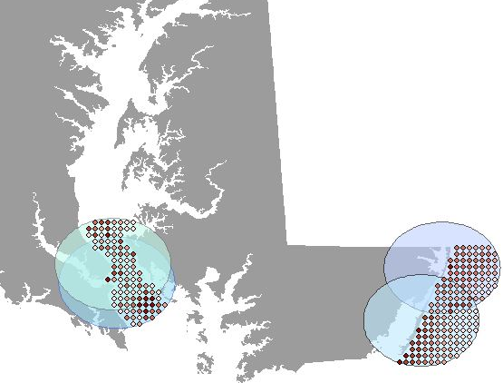
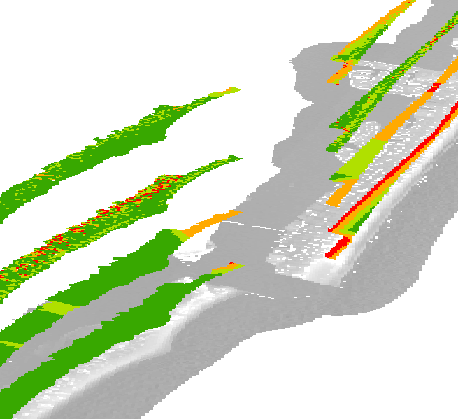
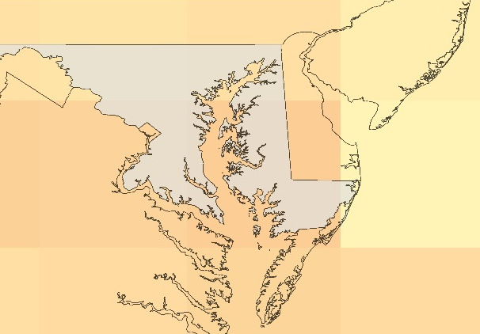
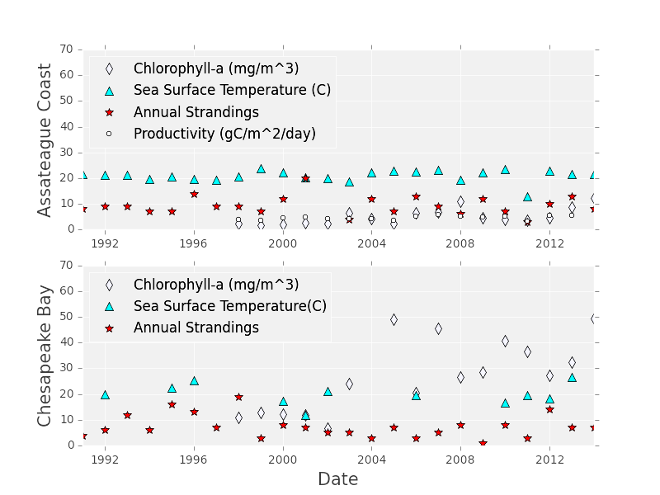
Maryland Ecological Forecasting
Utilizing NASA Earth Observations to Monitor and Strengthen the Survivorship of Maryland’s Sea Turtles
Chris Long (Project Lead), Erica Scaduto, Kiersten Newtoff
NASA DEVELOP National Program at NASA Goddard Space Flight Center
Abstract
Objectives
Keep this blank for now.
Body text point size should be at least 24.
Caption text point size should be at least 16.
Feel free to rename, move, and resize sections as needed.
Analyze relationships between chlorophyll-a and sea surface temperatures with loggerhead strandings
Identify suitable loggerhead nesting beaches along Atlantic coastline
Use climate models to investigate the effect of climate change on stranding prevalence and nesting site locations
Study Area
Methodology
Stranding
Nesting
Nest Forecasting
Data Acquisition
Data Acquisition
Data Acquisition
Maryland’s Chesapeake Bay and Atlantic coasts
Strandings (black dots) from 1991 – 2014
g
Community Climate System Model 3
Four International Panel for Climate Change 4 projections
LiDAR Flight, Derived DEM
WV2 Imagery
TIGER Roads
Layer
2050: Levels constant since 2000
Earth Observations
Sea Turtle Stranding
Sea Surface Temp (SST)
OrbView-2
Terra
Chlorophyll-a (Chla)
Data Processing
2050: B1, declining pop., greener tech
Aqua
Data Processing
DEM, Slope, Aspect, Imagery
Beach Zone
Project Partner
Used SST and Chla 8-day composites from 1-4 weeks prior to strandings depending on
2050: A1B, declining pop., lower fossil fuel use
Maryland Department of Natural Resources
decomposition state
Averaged each parameter within 20 km regions of turtle stranding to account for drifting
Team Members
TIGER Roads, Slope, Beach Zone
Beach Zone Suitability Layers
2050: A2, increasing pop., same fossil fuel use
Results
Stranding
Nesting
Forecasting
(L to R) Erica Scaduto, Chris Long, Kiersten Newtoff
TBD: including % or area of beach, map of best beach, may change based on sea level results and other factors…
When will sea turtles move into our region? How will sex ratios change? How does sea level rise factor in?
Conclusions
Strandings are influenced by XXXXX.
There are lots of potential beaches XXXX.
In XX years, expect an increase in sea turtle activity.
XXX acres of land should be conserved due to sea level rise.
Region | Parameter | Pearson’s r Correlation | p-value
Chesapeake Bay | Chlorophyll-a | -0.2648 | 0.3043
 | SST | 0.2234 | 0.509
Assateague Coastline | Chlorophyll-a | -0.2634 | 0.3071
 | SST | 0.0807 | 0.7078
 | Productivity | 0.1166 | 0.6671
Acknowledgements
Cindy Driscoll (MD Department of Natural Resources)
Amanda Weschler (MD Department of Natural Resources)
Gary Strand (National Center for Atmospheric Research)
Dr. John Bolten (NASA Goddard Space Flight Center)
NASA Goddard Space Flight Center

