Slide 1
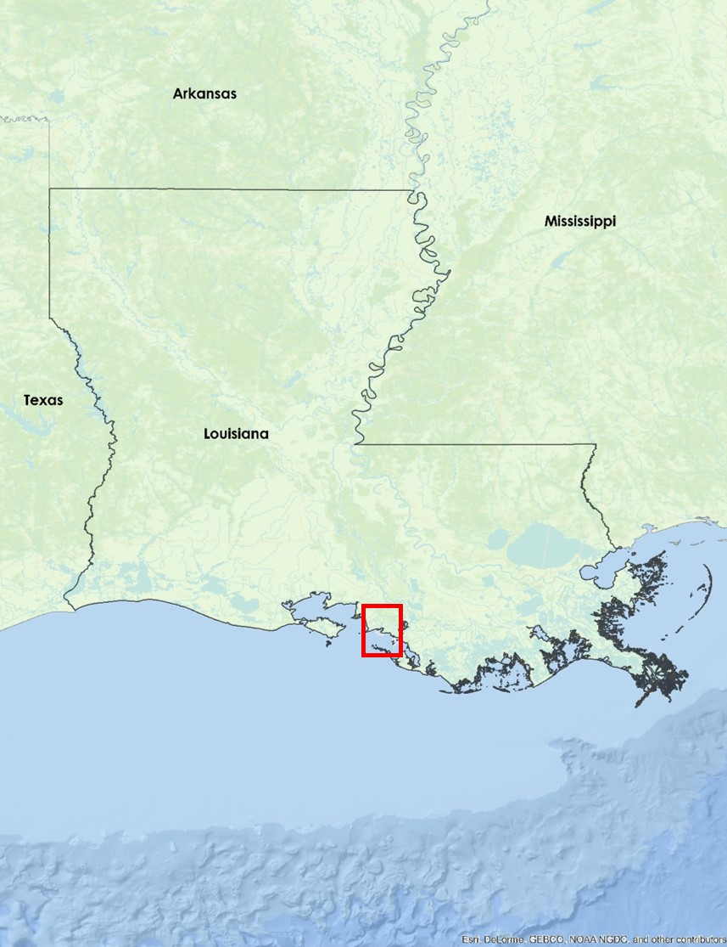
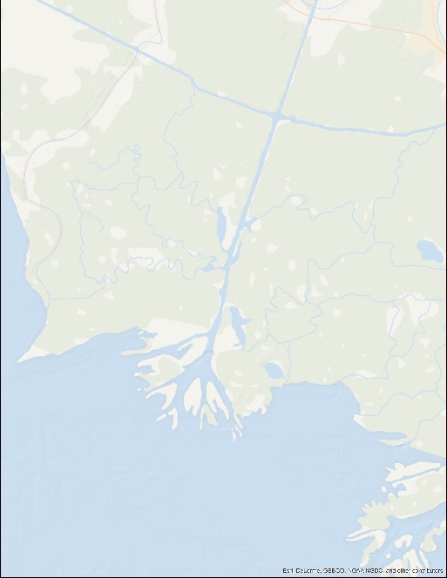
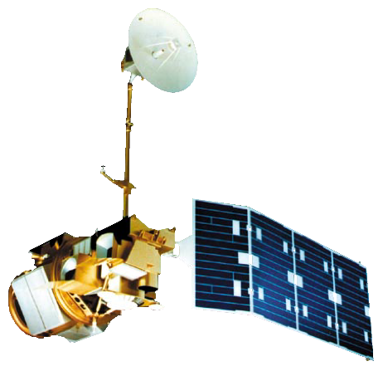
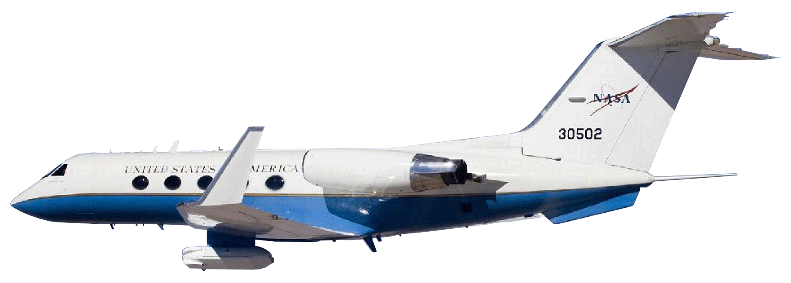
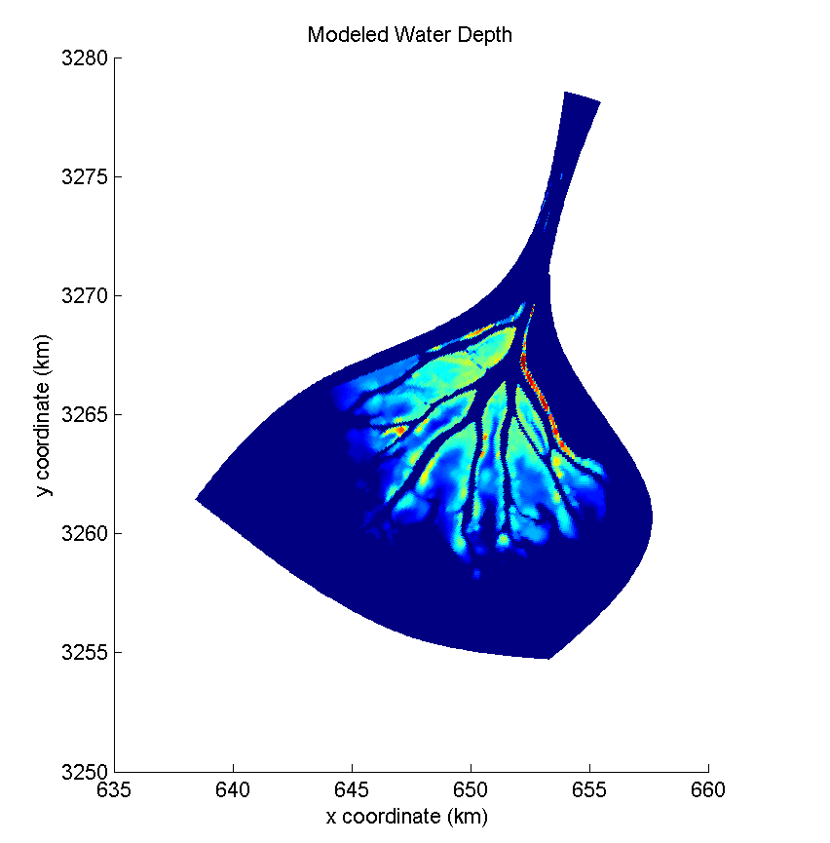
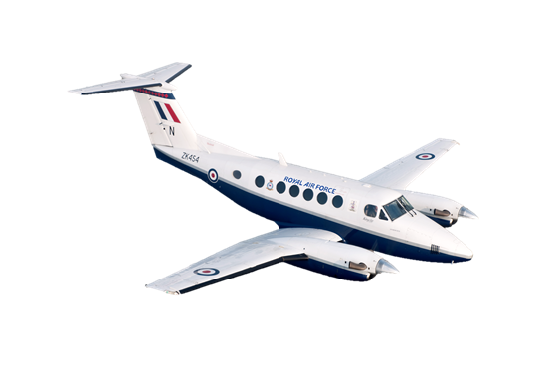
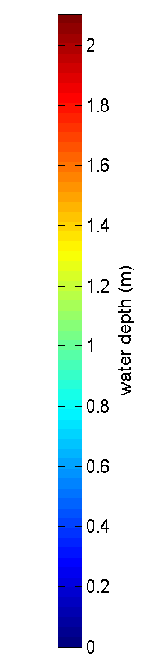
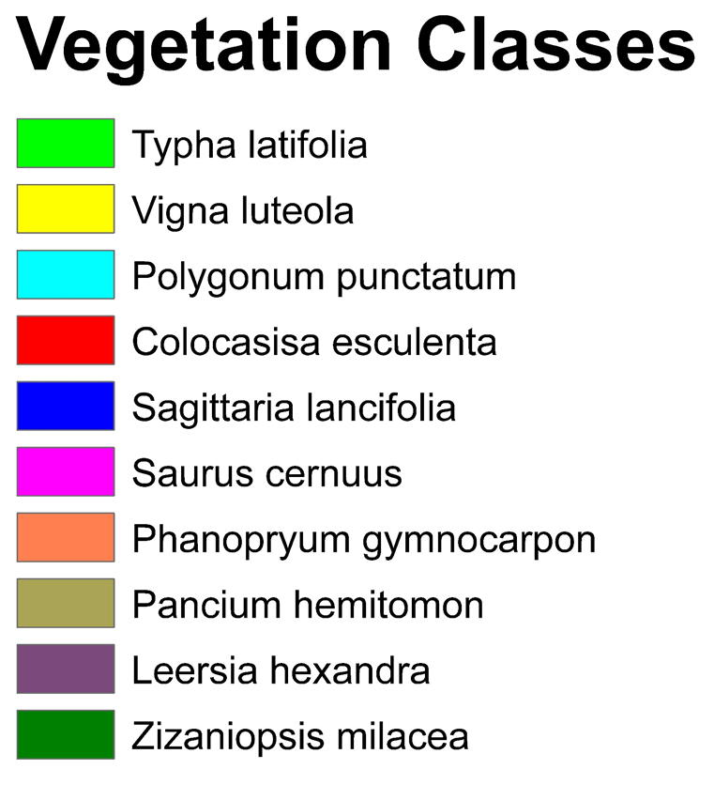
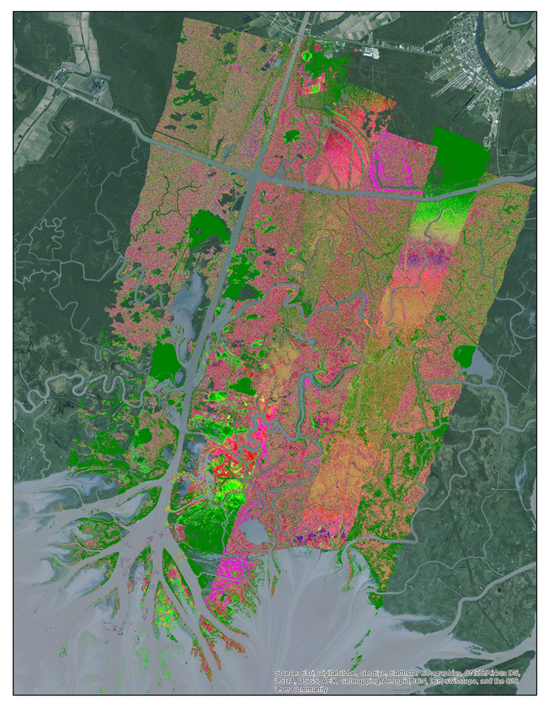

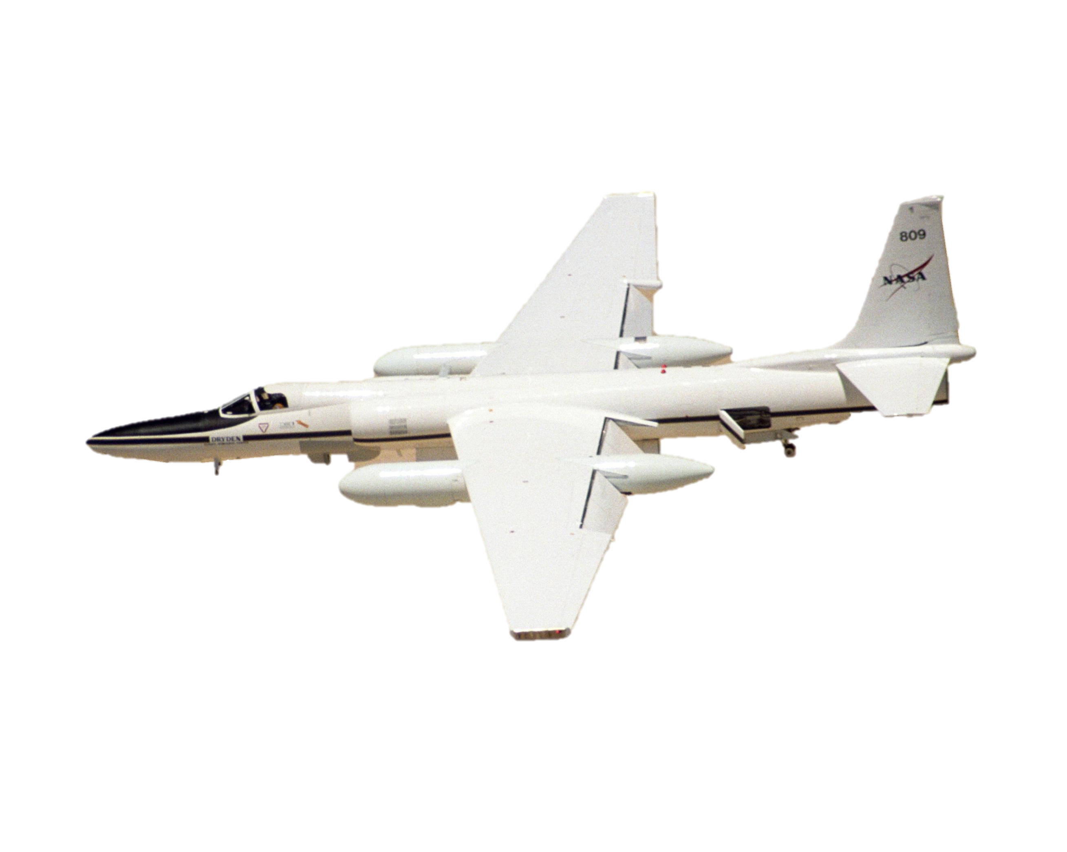
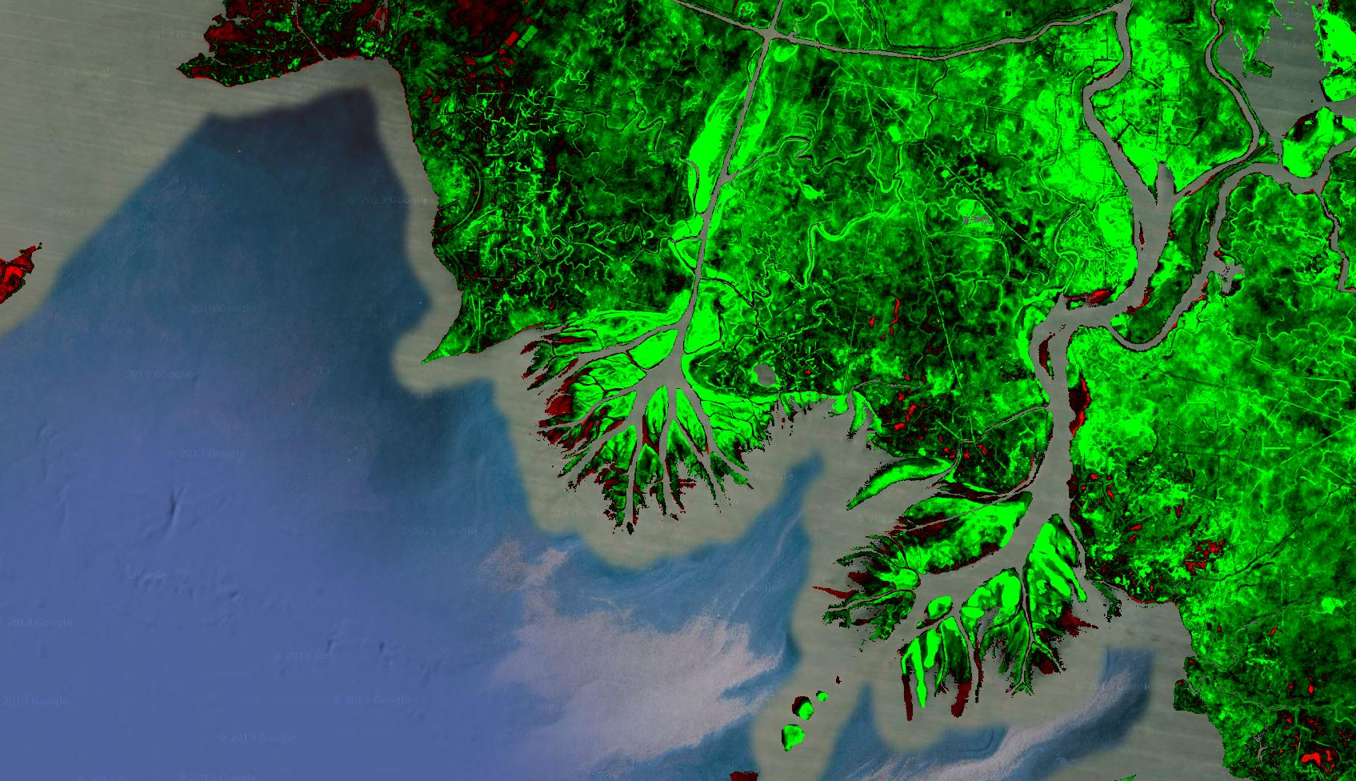
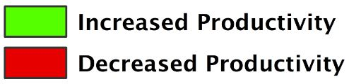
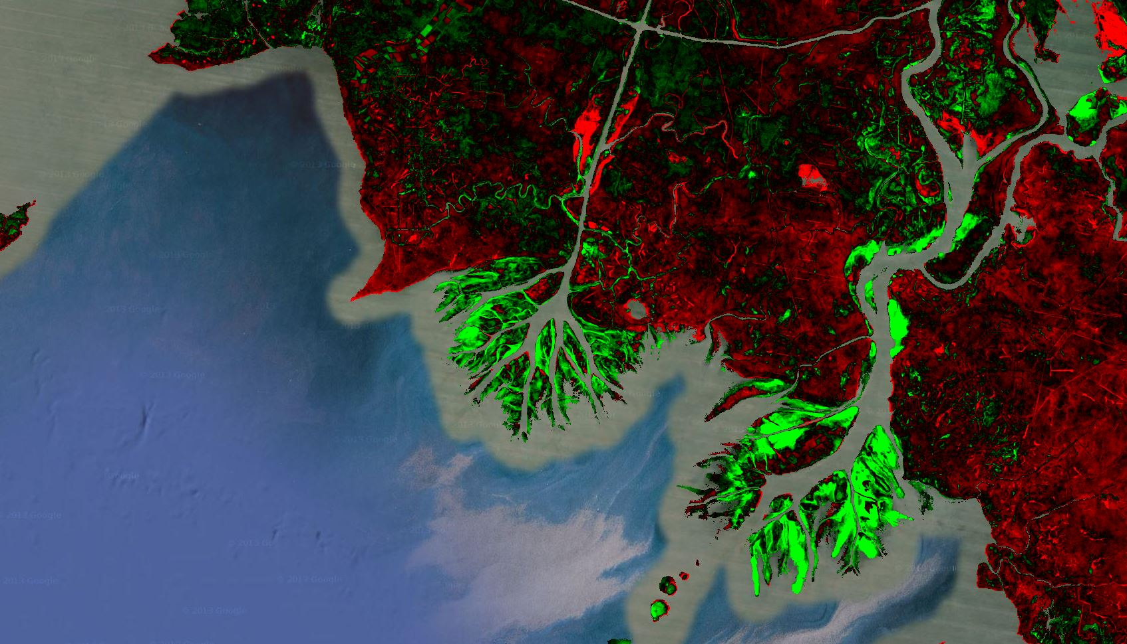
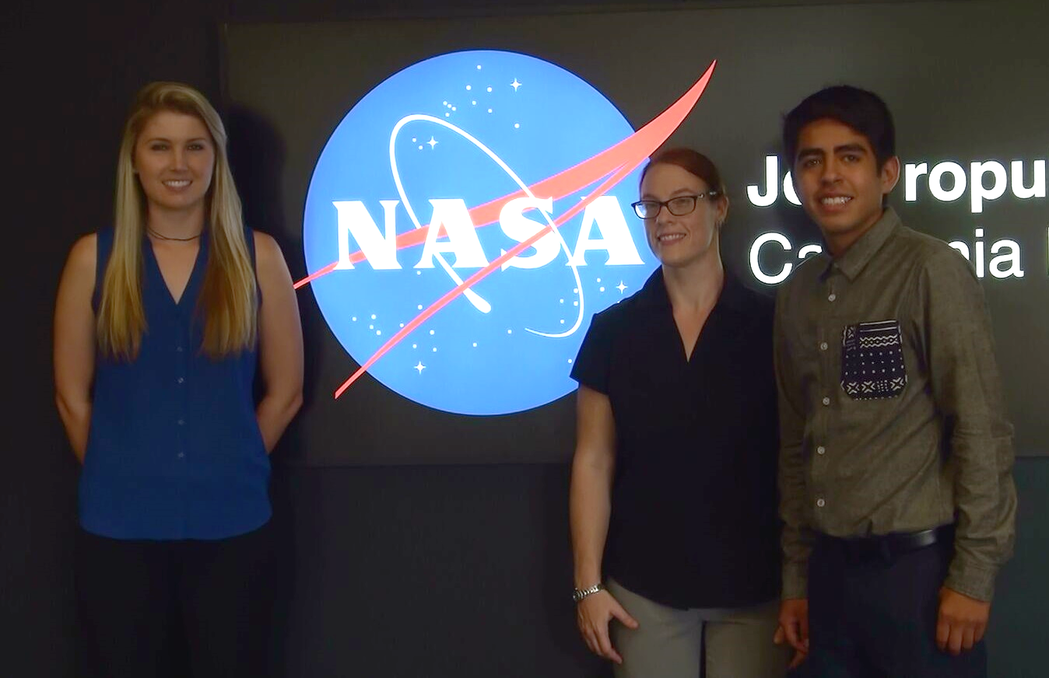
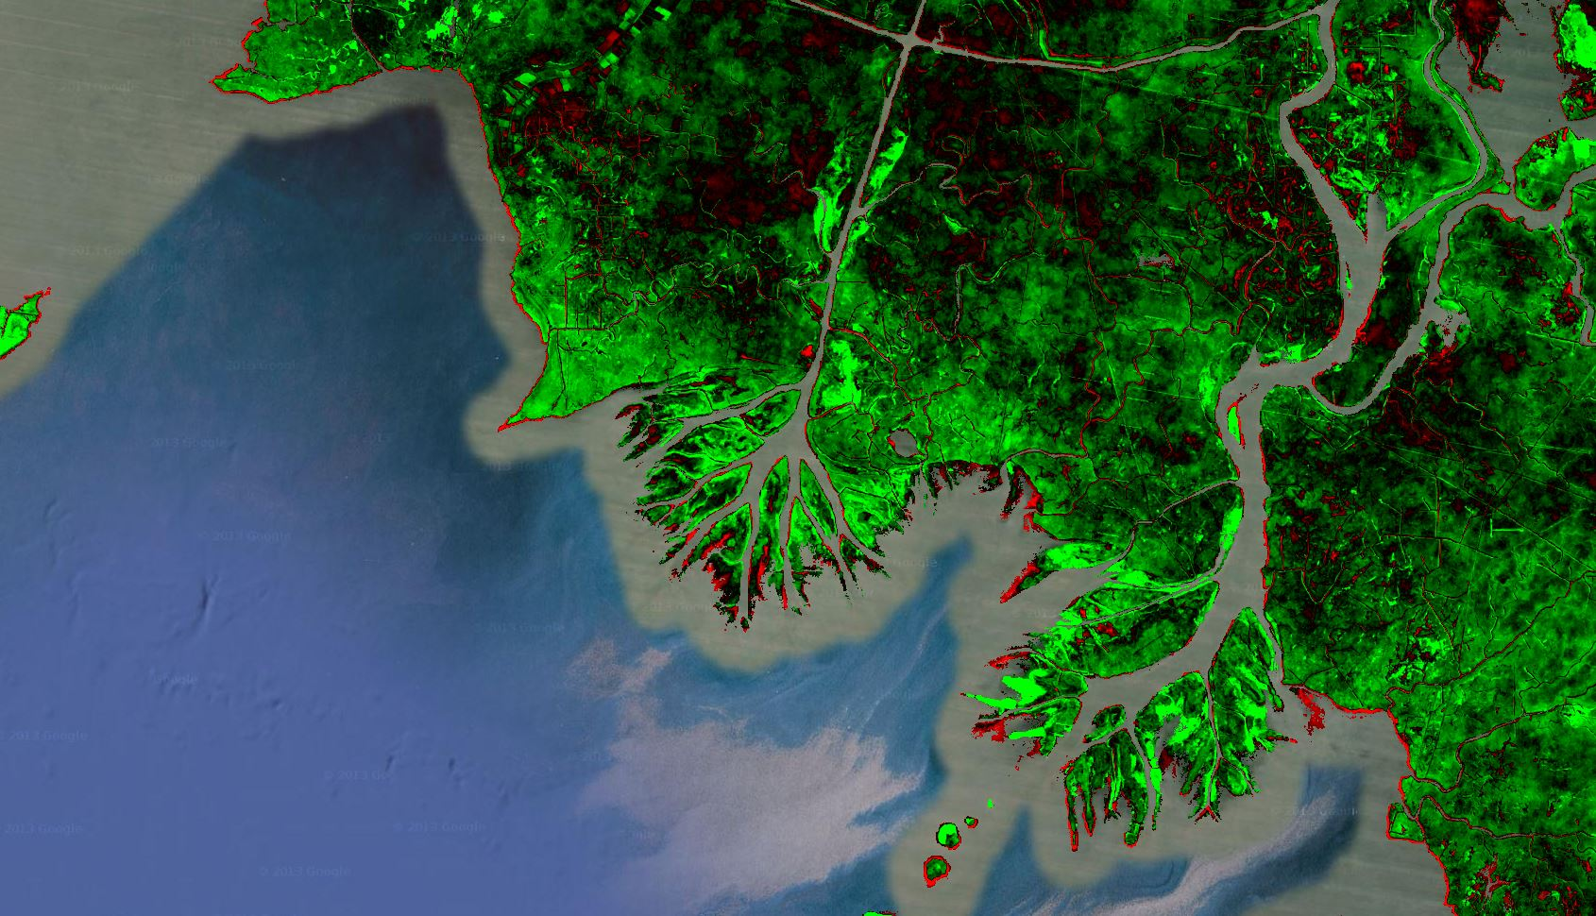
Louisiana Ecological Forecasting
Using UAVSAR, AVIRIS, and AirSWOT to Examine Historic Trends and Model Sediment Transport within the Wax Lake Delta, Louisiana to Inform Coastal Restoration Efforts
Emily Beck (Project Lead), Brittany Zajic, Raul Garcia
DEVELOP National Program at NASA Jet Propulsion Laboratory
Abstract
Objectives
Land loss due to erosion, land subsidence and sea level rise along the Louisiana coast has amounted to 4900 km² since the 1930s (Olea & Coleman, 2014), and an additional 4500 km² could be lost within 50 years if no action is taken (LCMPSC 2012). While most of the coastline is suffering land loss, the Wax Lake Delta has been building at a rate of approximately 5 km² per year since the early 1970s. This study used remotely sensed and in situ data as well as Deltares Delft3D hydrological modeling software to model water flow and sediment transport in the Wax Lake Delta in order to better understand deltaic sediment dynamics and forecast delta formation. Outputs from the model include modeled sediment transport, water flow and an elevation time series. These outputs will be used to inform coastal research by project partners at the Naval Research Laboratory in Mississippi and the Louisiana Universities Marine Consortium, and to direct restoration projects in areas of the coast where marshes are eroding.
Model water flow and sediment transport using Deltares Delft3D
Examine delta formation processes to gain a better understanding of why the Wax Lake Delta is aggregating
Observe and analyze long term delta growth patterns using Google Earth Engine API
Study Area
Methodology
Study Period:
January 1985 –
October 2015
Raster Datasets of Bathymetry
(ArcGIS)
Vegetation Species Classification from AVIRIS
(Exelis ENVI)
Delft3D Hydrological Model
Calibrate Model using AirSWOT Data
Modeled Sediment Transport
Louisiana Wax Lake
Delta
In Situ Data: Vegetation Species, Water Level, Flow Rate
Modeled Water Flow
Earth Observations
Channel Boundary Mask from UAVSAR
(ArcGIS)
UAVSAR
Uncalibrated Delft3D hydrological model output showing modeled water depth in the Wax Lake Delta, LA
Results
Landsat 5 TM
AirSWOT
Landsat 8 OLI
AVIRIS-NG
NDVI Difference Image from Landsat 5 and Landsat 8 using Google Earth Engine API:
Conclusions
Constructed a preliminary hydrological model in Delft3D
Identified ten predominant plant species in the study area using unsupervised ISODATA classification from AVIRIS-NG and in situ data
Detected long term high vegetation productivity in the delta even in years where the surrounding region experienced low productivity
The work in the Wax Lake Delta simulates two space borne sensors that will be launched in 2020
1985 - 1995
Unsupervised ISODATA Vegetation Species Classification
Of AVIRIS Imagery
Acknowledgements
Team Members
Science Advisor Dr. Cathleen Jones, NASA Jet Propulsion Laboratory
Science Advisor Dr. Marc Simard, NASA Jet Propulsion Laboratory
Doug Edmonds, Delft3D
Gwen Miller, DEVELOP at JPL
1995 - 2005
2005 – 2015
Project Partners
Naval Research Laboratory
Louisiana Universities Marine Consortium
Brittany Zajic, Emily Beck, Raul Garcia
NASA Jet Propulsion Laboratory

