Slide 1
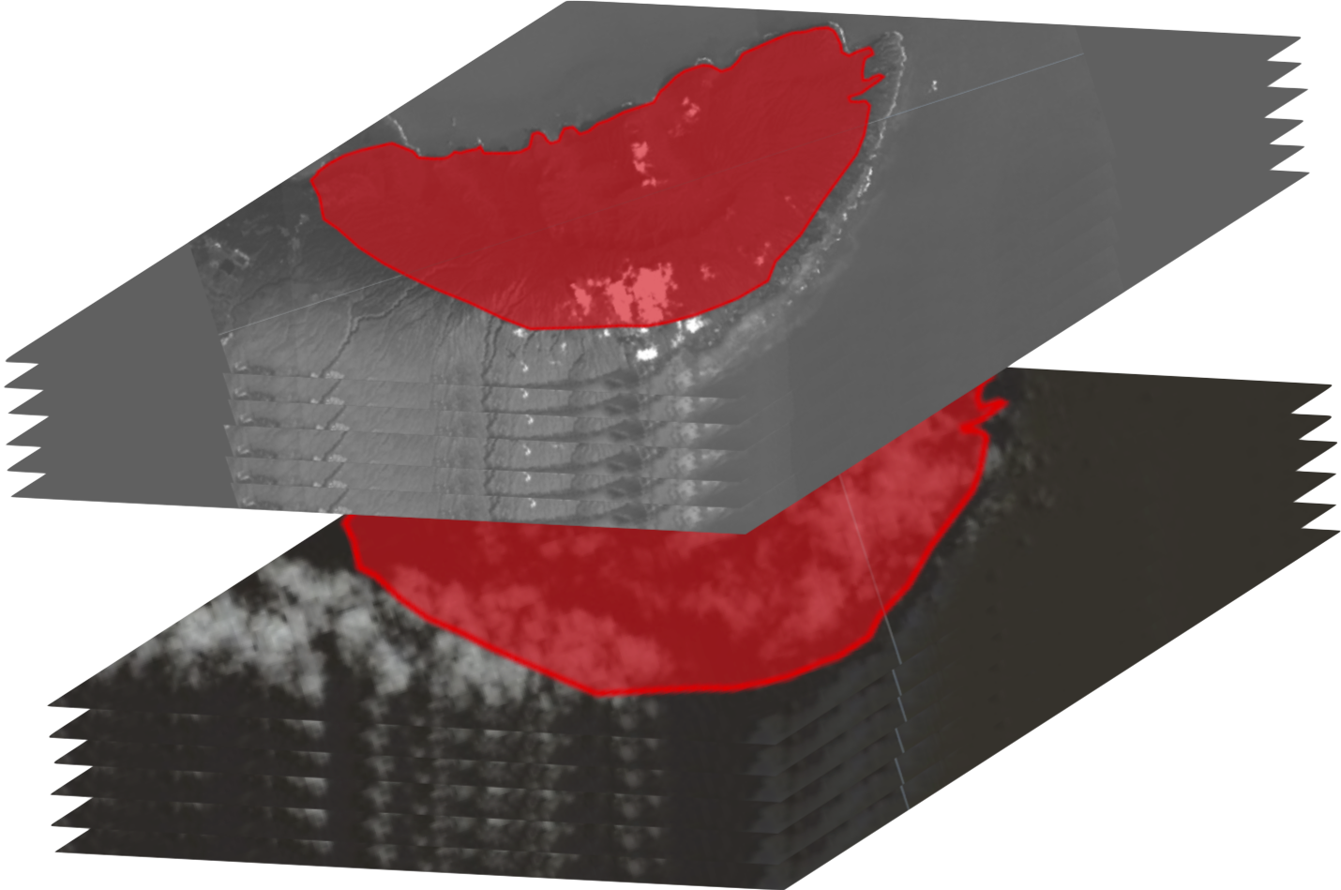
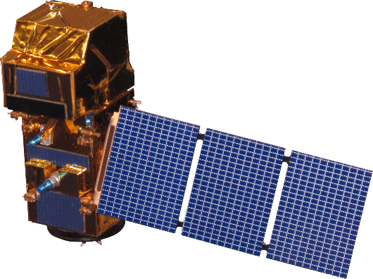
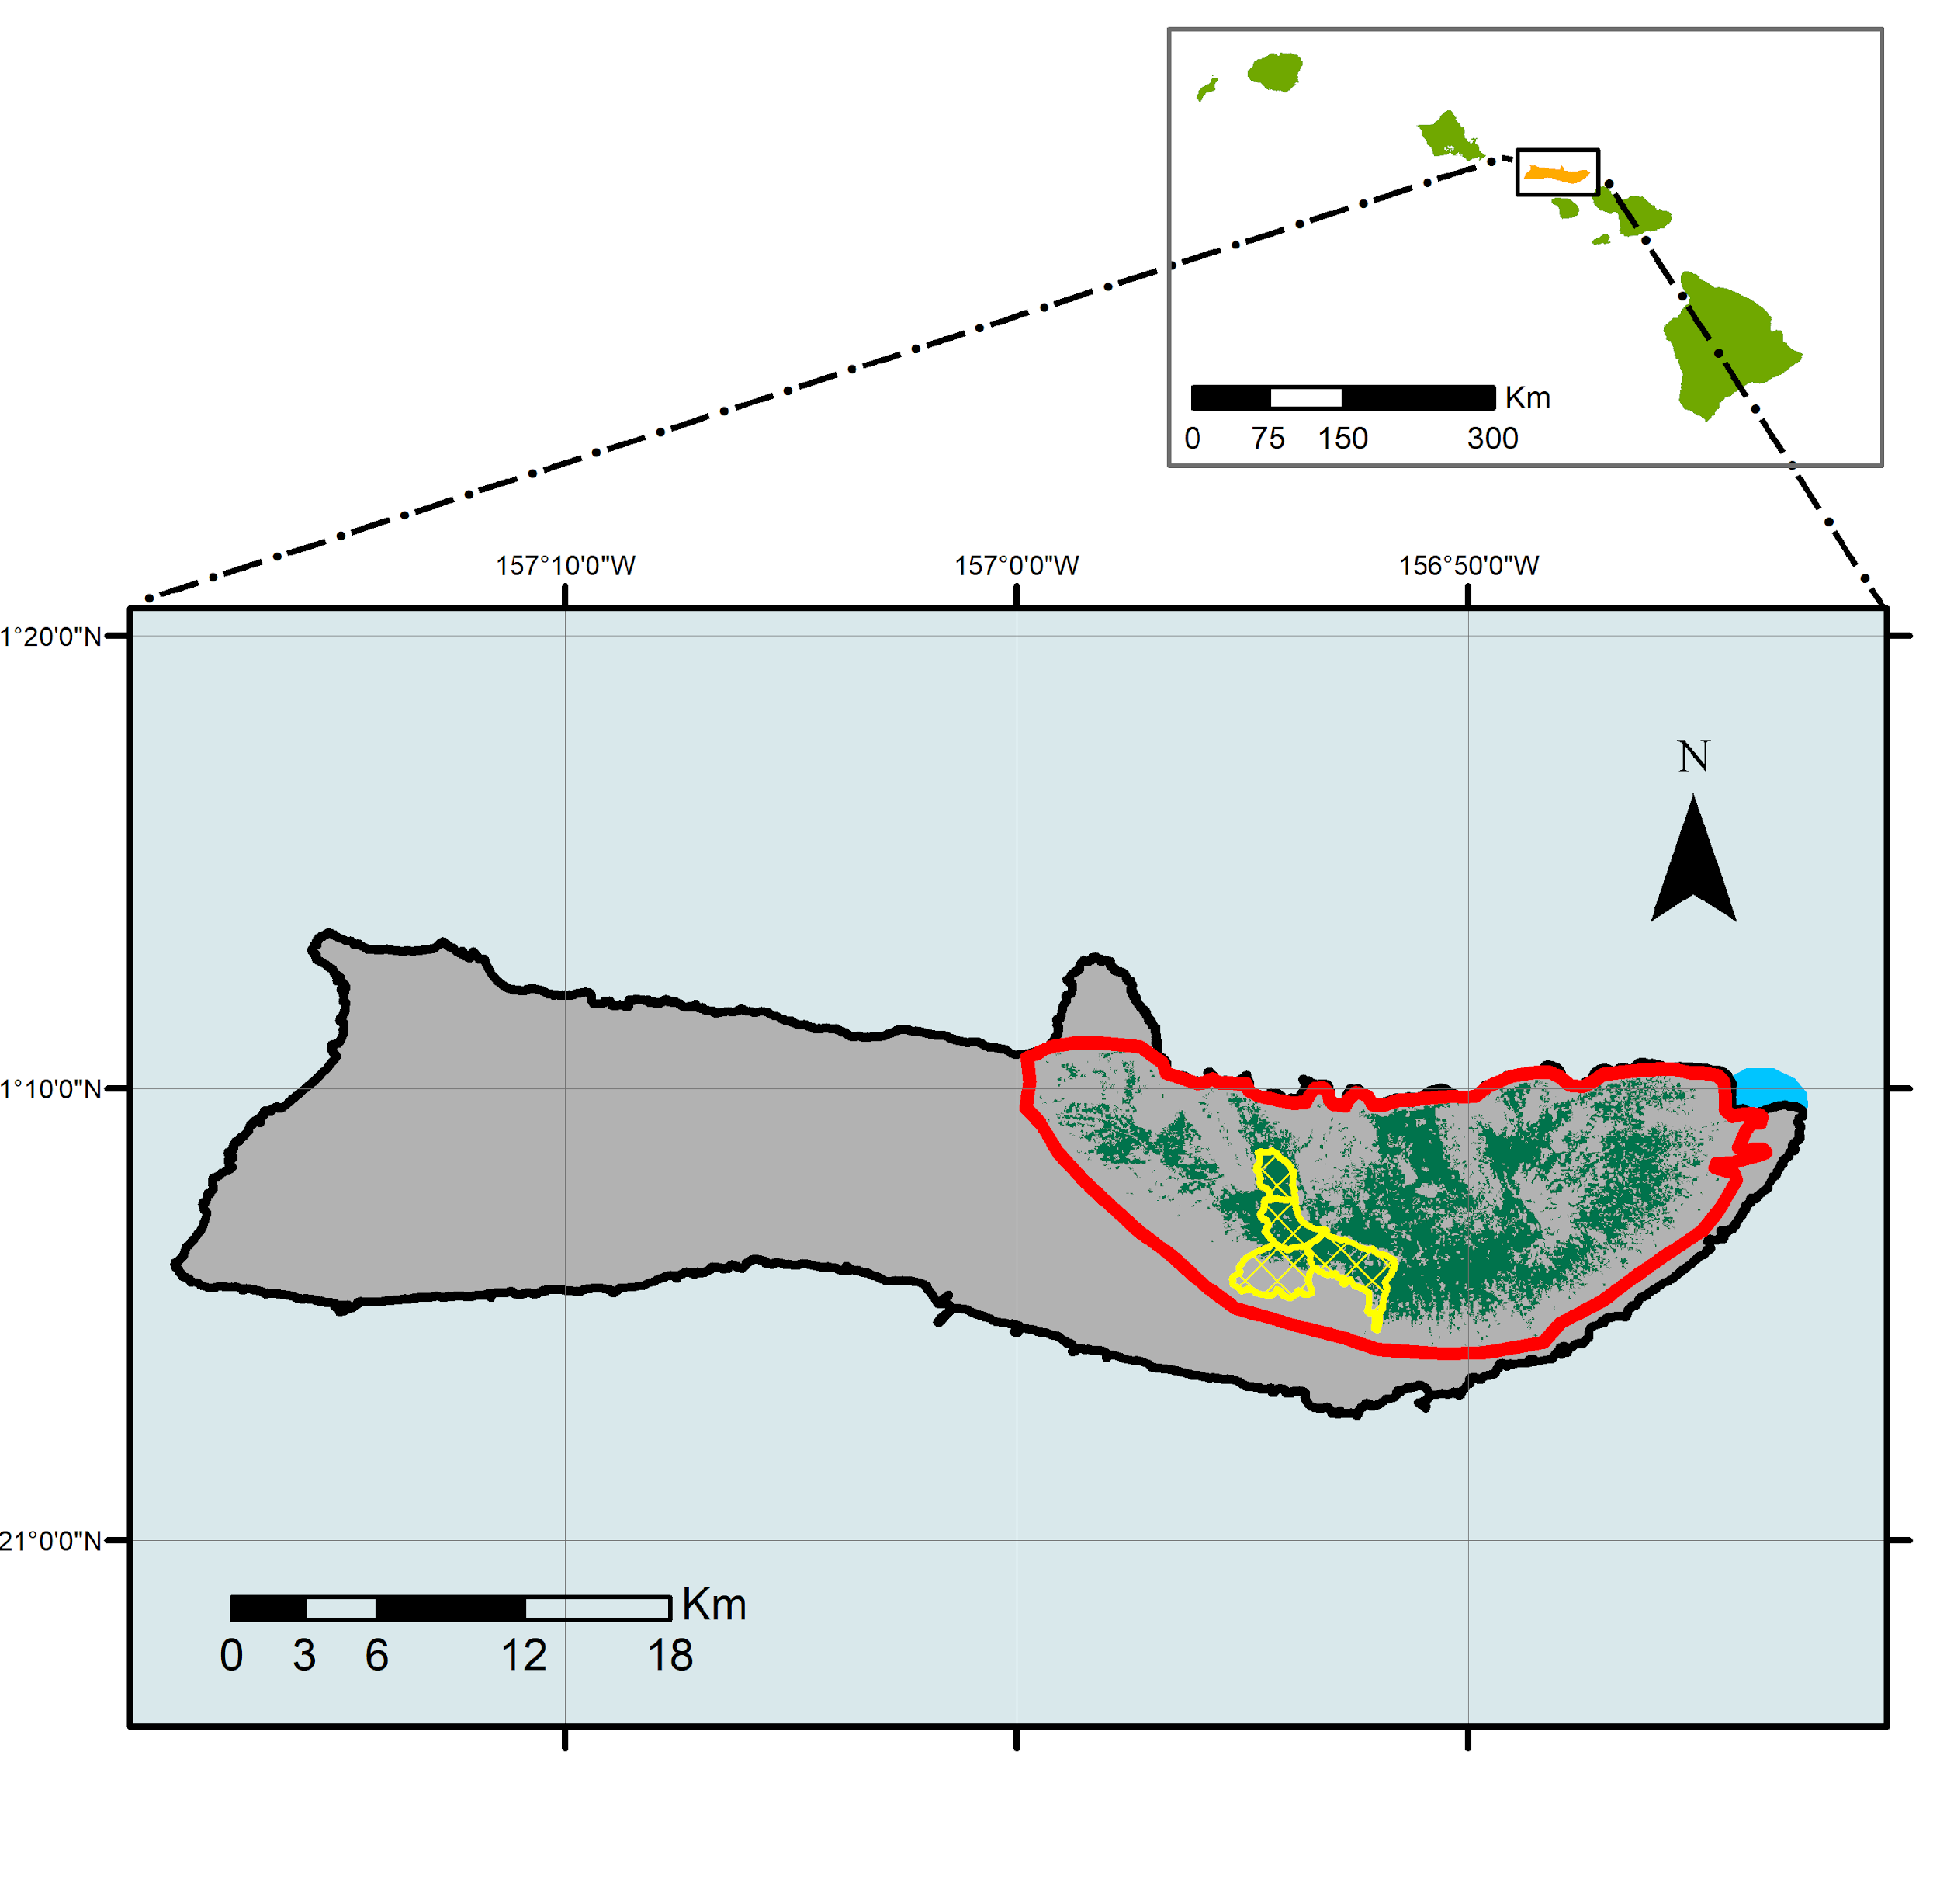
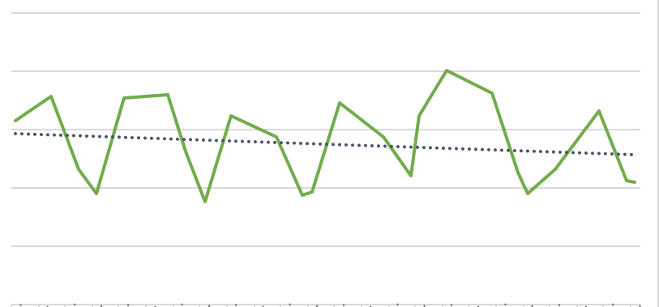
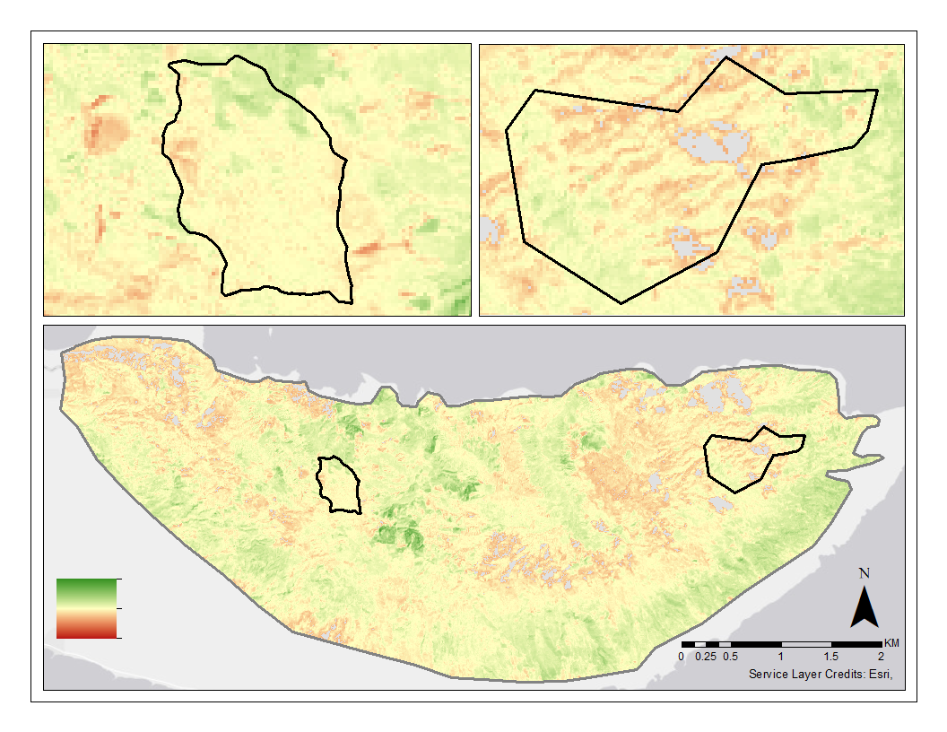
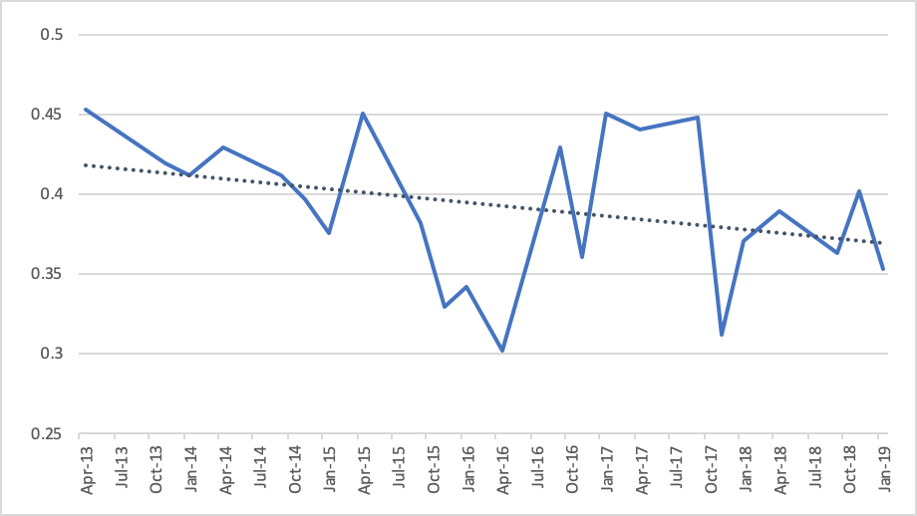
Employing NASA Earth Observations to Map the Impacts of the 'Ohi'a Rust on Forest Health and Coastal Turbidity on Moloka’i, Hawaii
Abstract
The threat of invasive species has impacted fragile forests across the globe; such impacts can be particularly damaging on island ecosystems where a loss in vegetation can lead to increased runoff. In 2017, a fungal pathogen outbreak of Puccinia psidii impacted 'ohi'a (Metrosideros polymorpha) on Moloka’i, Hawaii, caused widespread defoliation and tree mortality. The impacts of this disease have been intensified by invasive ungulates which stress the trees and increase their vulnerability to disease. Our team partnered with The Nature Conservancy and the United States Geological Survey to better understand the impacts of rust outbreak on forest health and resulting changes in watershed dynamics on Molokai. The Nature Conservancy constructed exclosures around the island to protect vital sections of the forest from ungulates, which can overgraze forest understory, damage trees, and increase their susceptibility to pathogen outbreaks. This project assessed the feasibility of using Landsat 8 Operational Land Imagery and Sentinel-2 MultiSpectral Instrument to map the impact of 'ohi'a forest health, evaluate the effectiveness of fenced exclosures, and assess the feasibility of detecting turbid events from 2013 - 2019. Our results demonstrated a general decline in spectral vegetation indices within impacted areas of the forest while within the exclosures vegetation indices improved over time. Additionally, we found that we were unable to significantly distinguish between turbid and non-turbid events. With an increased understanding of the rust outbreak impacts, our partners can make better informed management decisions to conserve the 'ohi'a and maintain its crucial ecosystem services, such as providing habitat, storing water, and maintaining the island’s hydrologic cycle.
Objectives
Methodology
Model Changes in Forest Health
Create Ohi’a forest impact maps & analyze changes over time
Evaluate the impacts of The Nature Conservancy exclosures on forest health
Assess the feasibility of detecting coastal turbidity for big runoff events off the coast of Moloka’i
Forest Health Assessment
Index
Time Series:
Within Exclosures
Filter Image Collections
Calculate Indices
2014
Time
2019
Sentinel-2
MSI
NDVI
Time Series:
Outside Exclosures
NDMI
Index
Earth Observations
RVI
2014
Time
2019
Landsat 8
OLI
Tasseled Caps
Change Detection:
Entire Study Area
Forest Health Indicators
Turbidity Assessment
Landsat 8 OLI
Sentinel-2 MSI
Landsat 8 OLI
Sentinel-2 MSI
Turbid Event
Non-Turbid Event
Study Area
Change
Detection
Ohi’a Study Area
Calculate NDTI
TNC Exclosures
Hawaiian Islands
Results
River Outlet
Moloka’i Water Resources
Ohi’a Forest
NDVI Time Series
NDVI Change Detection 2014-2019
0.50
Exclosure
Exclosure
Comparison Area
0.45
0.40
Mean NDVI
Moloka’i, Hawaii
0.35
0.30
0.25
2013
2014
2015
2016
2017
2018
2019
Year
0.50
Comparison Area
0.45
NDVI Values
0.40
0.5
Mean NDVI
0.35
- 0.5
0.30
0.25
2013
2014
2015
2016
2017
2018
2019
Figure 2: Change detection map illustrates the change in NDVI using greenest pixel composite images from January 2014 and January 2019. Green indicates areas with a positive change in NDVI where red indicates areas with a negative change in NDVI .
Year
Figure 1: A time series of the mean NDVI values calculated from the quarterly greenest pixel composite images from 2013 – 2019 using Landsat 8 OLI.
Project Partners
Conclusions
The data demonstrated minor decreases in NDVI and other indices both in the exclosure and in the comparison area. This decrease is more pronounced in comparison area.
The general trend for NDVI in the exclosure appeared cyclical with a decrease near January of each year, while the comparison area did not show a distinct trend.
Based on the change detection, there was a decrease in NDVI on the eastern portions of our study area, a region that our partners distinguished as particularly impacted by the rust.
We were successful in calculating the NDTI on a river outlet in Molokai, however this index did not perform well over areas with waves.
USGS, Fort Collins Science Center
The Nature Conservancy
Pu’u O Hoku Ranch
Team Members
Acknowledgements
The Moloka’i Water Resources Team would like to thank The Nature Conservancy and the USGS for partnering with NASA DEVELOP to make this research possible.
A special thanks to Dr. Paul Evangelista, Dr. Catherine Jarnevich, Nicholas Young, Peder Engelstad, Dr. Tony Vorster, our Center Lead Kristen Dennis, and the Pu’u O Hoku Ranch for their support throughout this research project.
This material contains modified Copernicus Sentinel data (2016-2018), processed by ESA.
Nicole Pepper
Project Lead
David Fluharty
Sophia Leiker
Caroline Odell
Colorado – Fort Collins| Summer 2019

