Slide 1
Pacific Water Resources
Using NOAA CDRs and Satellite Data to Connect Phases of the El Niño Southern Oscillation (ENSO) with Precipitation across Hawaii and the U.S. Affiliated Pacific Islands (USAPI)
Jessica Sutton
Michael Kruk
Nicholas Luchetti
John Marra
Ethan Wright

Slide 2
Outline
Place holder for imagery from islands
Understanding ENSO
Effects of ENSO
Study Area
Research Objectives
Methodology
Results
Conclusions
Future Research

Slide 3
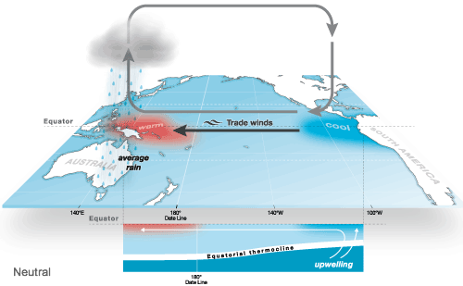
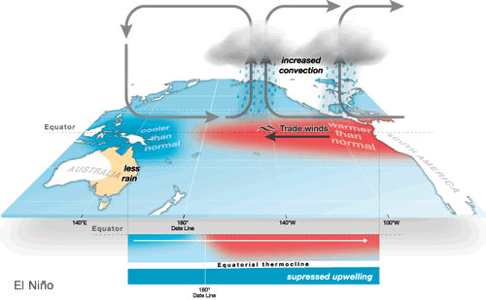
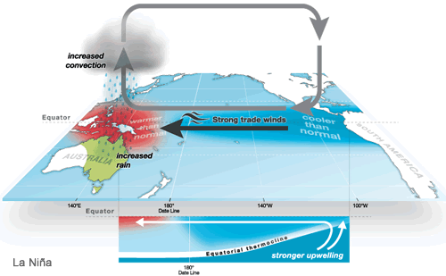
Understanding
ENSO
Interaction between the ocean and the atmosphere
ENSO influences global climate but strongest in Pacific
El Niño – cooler and drier in western Pacific
La Niña - warmer and wetter in western Pacific
Image Credit: http://www.bom.gov.au/

Slide 4
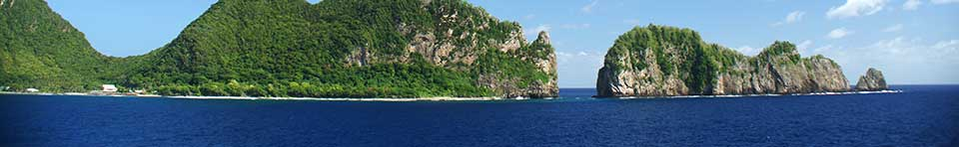
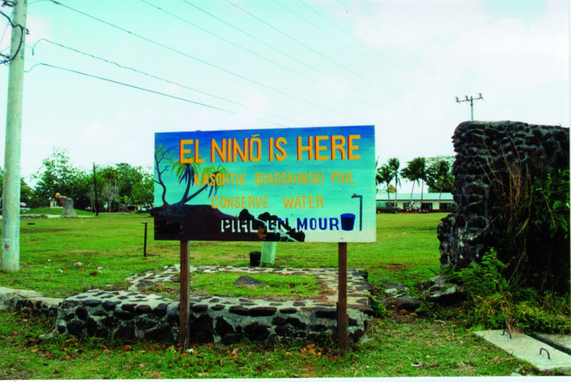
Image Credit: NPS
Effects of ENSO
Varies across the USAPI
El Niño
  Crop losses
  Water rationing
  Wildfires
  Loss of livestock
  Changes in tropical cyclone tracks and frequency.
La Niña
  Large surf and high tides influence surface and ground water.
  Changes in precipitation patterns affect water resources.
Image Credit: NOAA National Weather Service Pacific Region, 1998

Slide 5
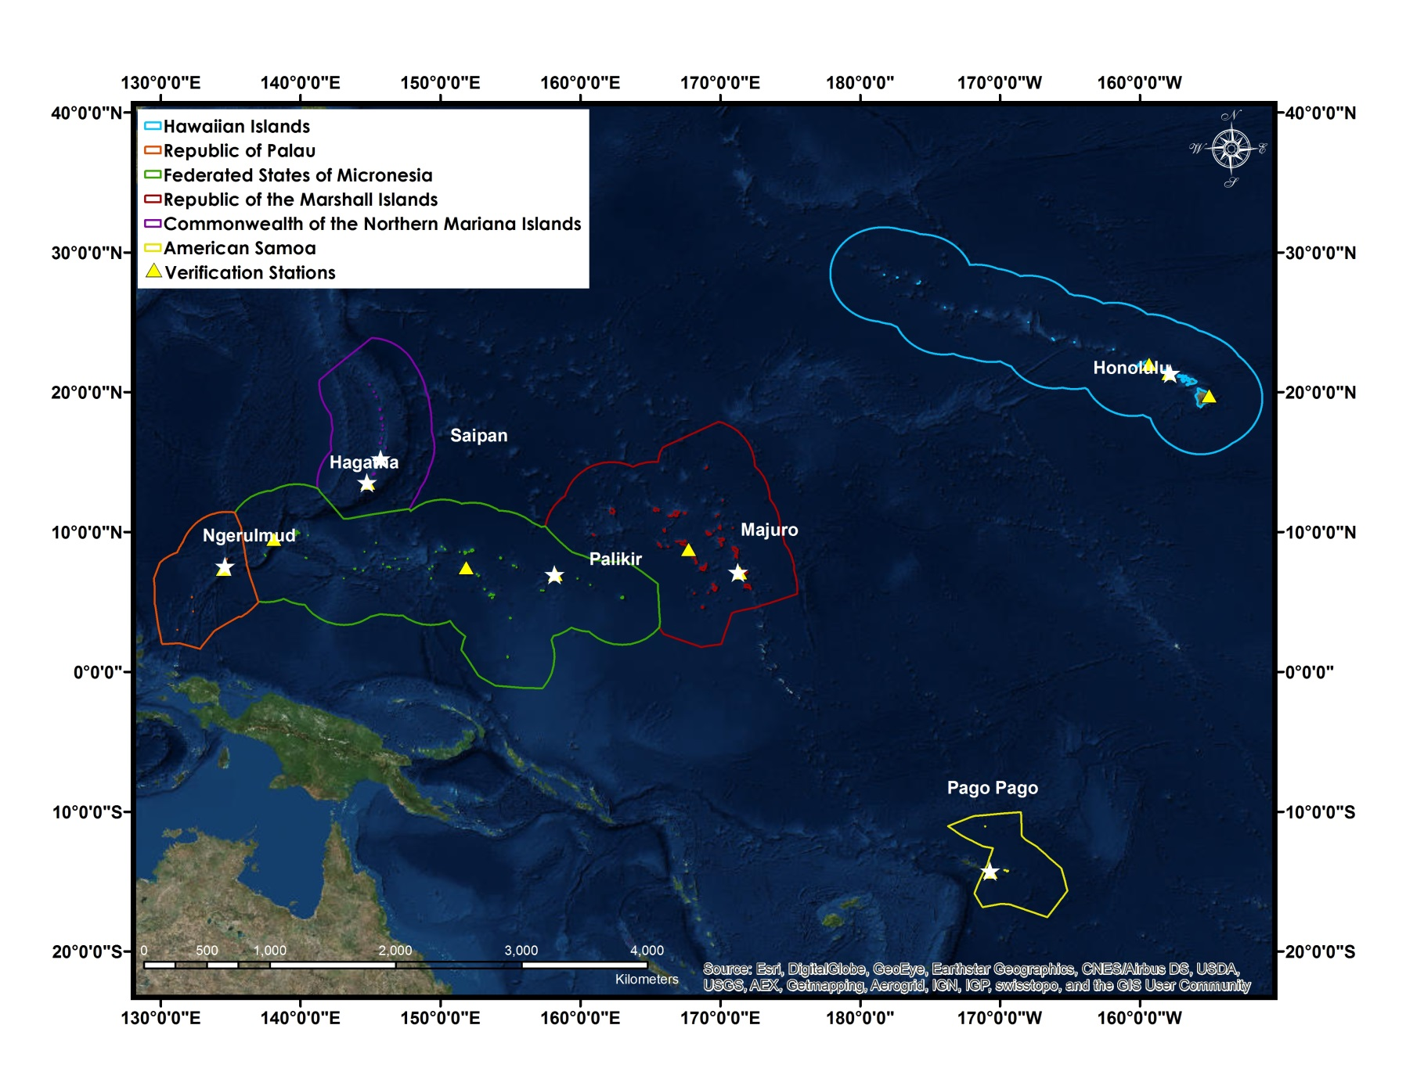
Study Area
Image Credit: Made in ArcGIS using basemap.

Slide 6
Provide an updated ENSO based climatology (1985-2014) of long-term precipitation patterns for each USAPI using the NOAA PERSIANN Climate Data Record (CDR)
Conduct verification analyses with in situ precipitation data
Determine the relationship between PERSIANN CDR precipitation and the seven ENSO phases
Determine precipitation ranges for each USAPI Exclusive Economic Zone (EEZ) during the seven ENSO phases
Research Objectives
Place holder for imagery from islands

Slide 7
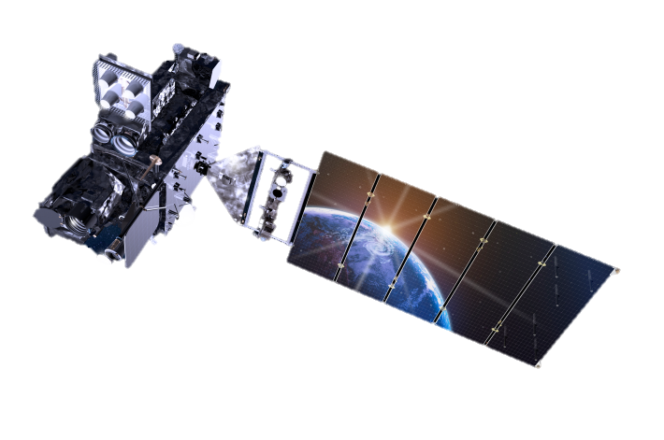
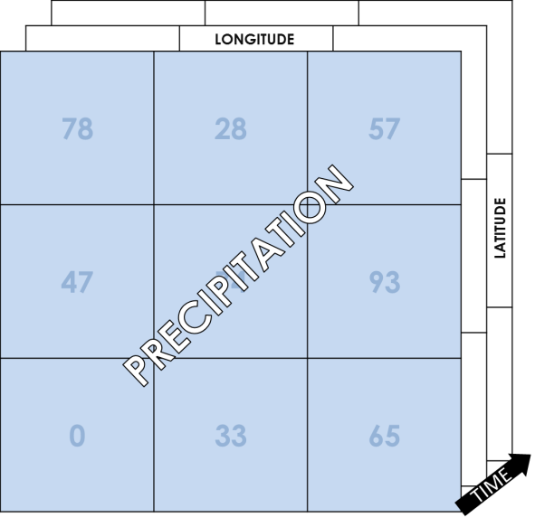
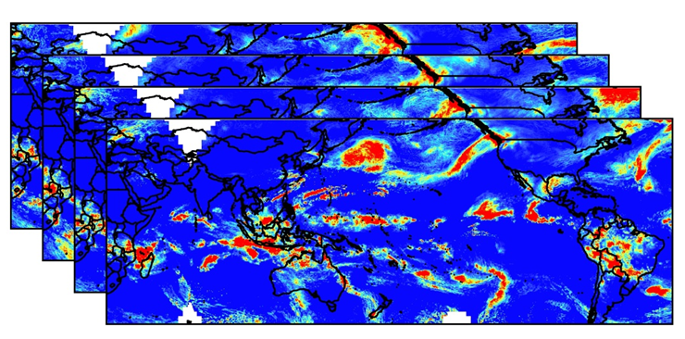
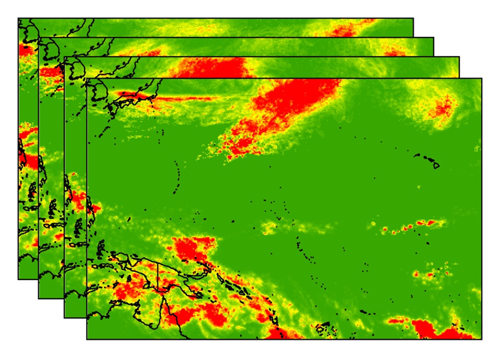
METHODOLOGY: data prep & analysis
1. Download PERSIANN via ftp
PERSIANN specifications
  0.25° resolution
  Global
  Daily
2. Convert NetCDF to raster using R
NetCDF to Raster
3. Clip rasters to study region and sum daily rasters to months then to seasons, and years
MONTHLY
SEASONAL
YEARLY
GLOBAL PERSIANN PRECIPITATION
Clip and sum
Satellite Image Credit: http://www.goes-r.gov/
Notes:
This slide will be animated so that the satellite info, satellite, and steps will come in separately.

Slide 8
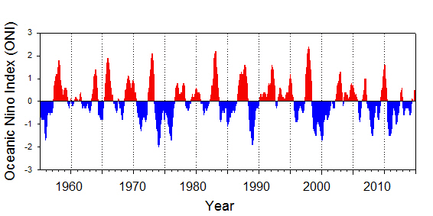
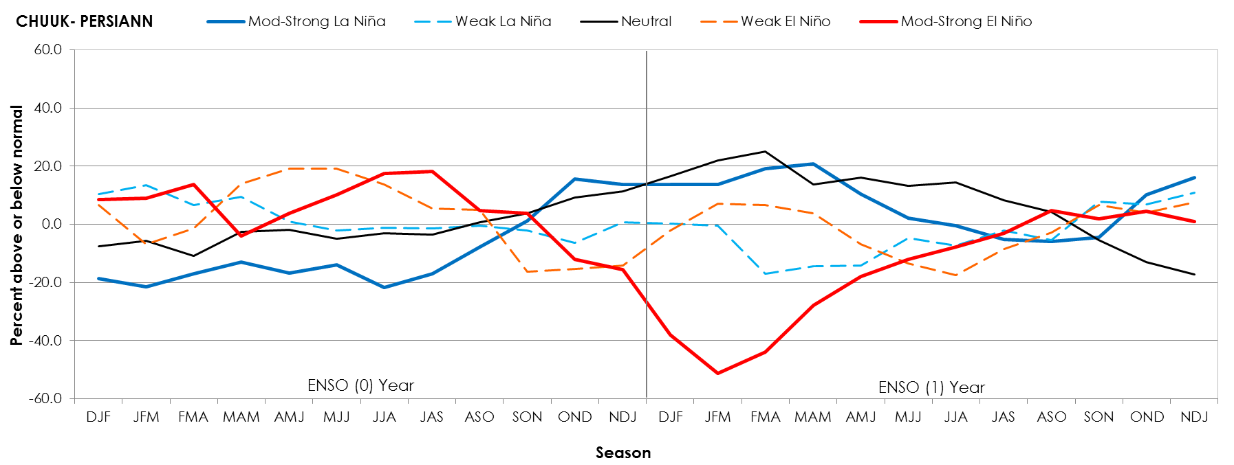
METHODOLOGY: sub-setting by ONI
1. Use the ONI to divide by 5 phases
Neutral -0.5 < ONI < 0.5 | Mod-strong El Niño ONI ≥ 1.0 | Mod-strong La Niña ONI ≤ -1.0 | Weak El Niño 0.5 ≤ ONI <1.0 | Weak La Niña - 1.0 < ONI ≤-0.5
85/86 | 86/87 | 88/89 | 94/95 | 84/85
89/90 | 87/88 | 98/99 | 04/05 | 95/96
90/91 | 91/92 | 99/00 | 06/07 | 00/01
92/93 | 97/98 | 07/08 |  | 05/06
93/94 | 02/03 | 10/11 |  | 08/09
96/97 | 09/10 |  |  | 11/12
01/02
03/04
12/13
13/14
Oceanic Niño Index (ONI)
2. Average every 3 month season for each phase (see example figure below)
Notes:
This slide will be animated so that the satellite info, satellite, and steps will come in separately.

Slide 9
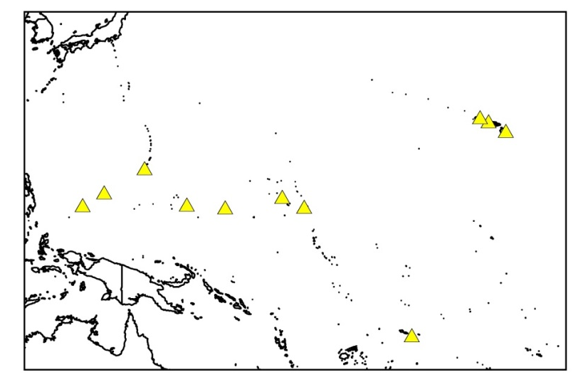
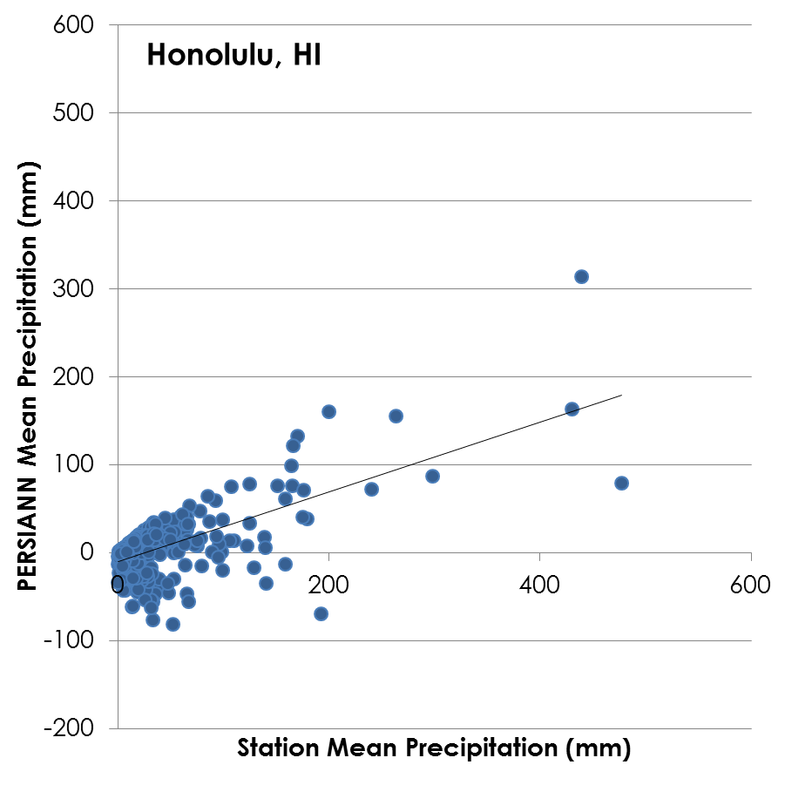
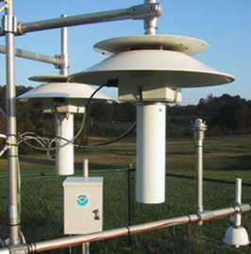
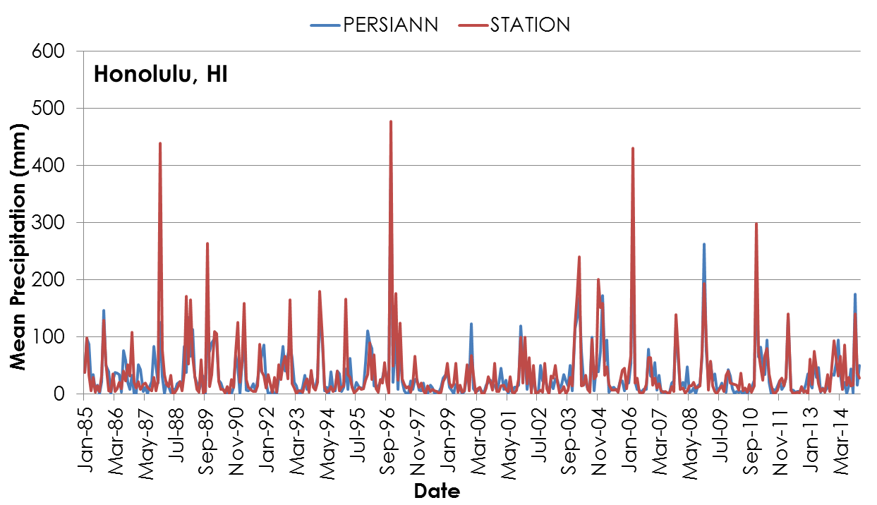
METHODOLOGY: verification using in situ
1. Extract in situ NOAA precipitation data for our study area
2. Average by month, season, and year to compare to PERSIANN precipitation
NOAA STATIONS
LOCATIONS

Slide 10
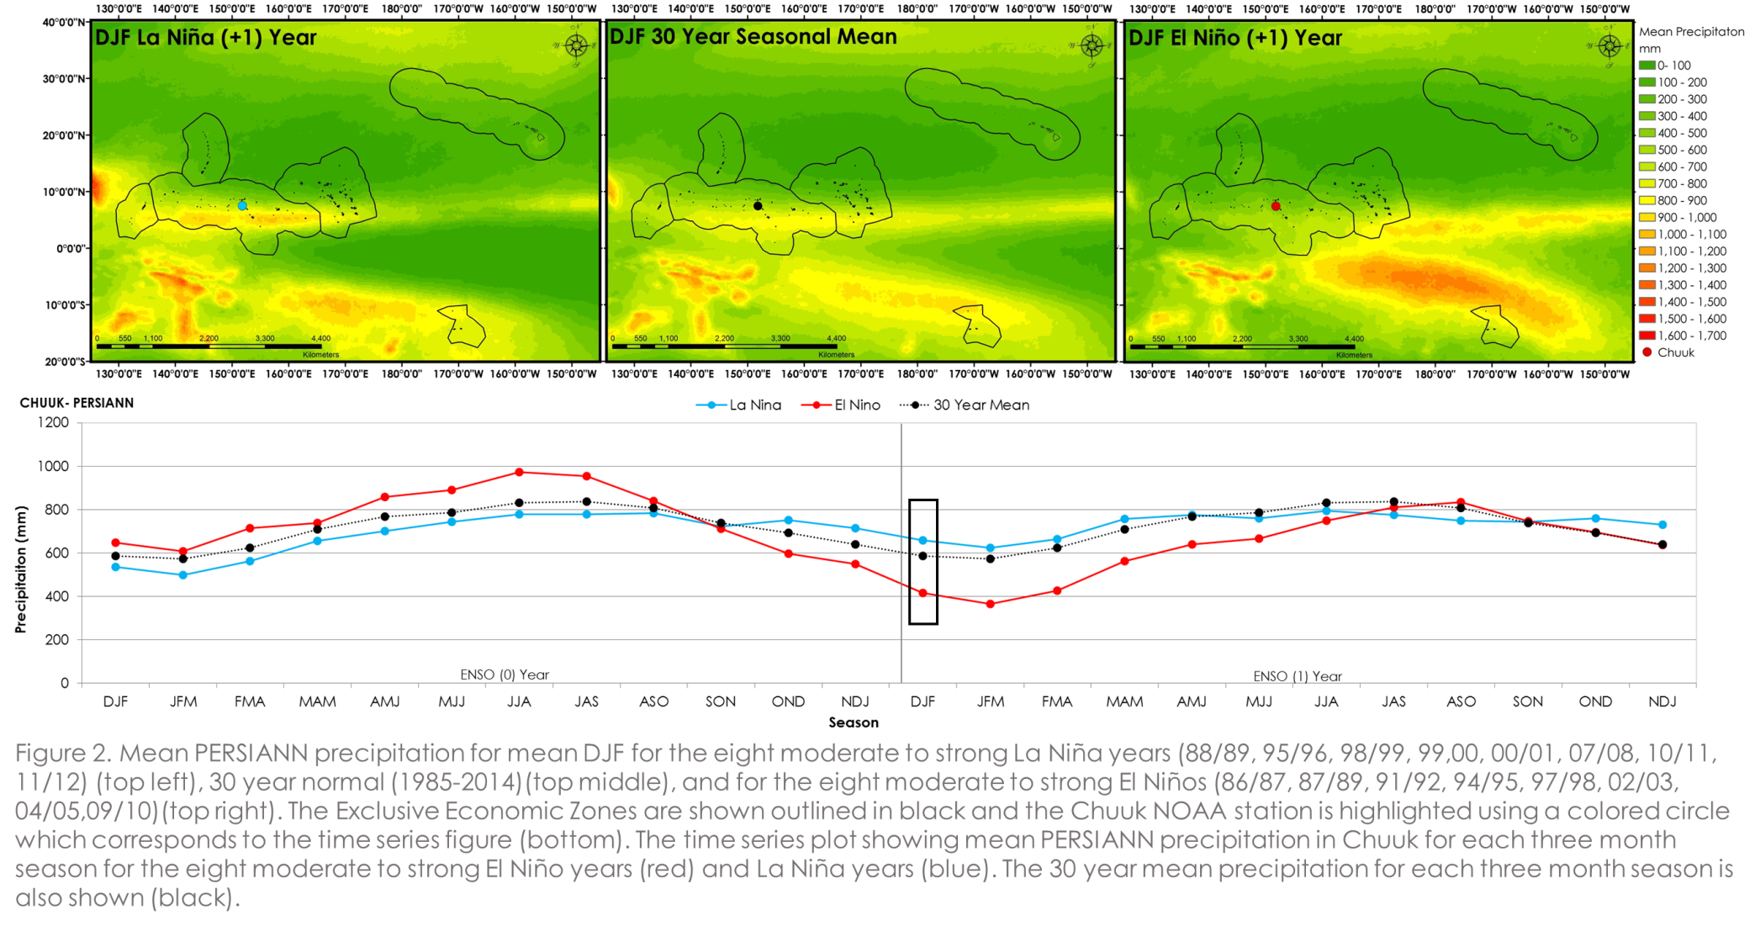
Results
Place holder for animation showing seasonal means and time series graph

Slide 11
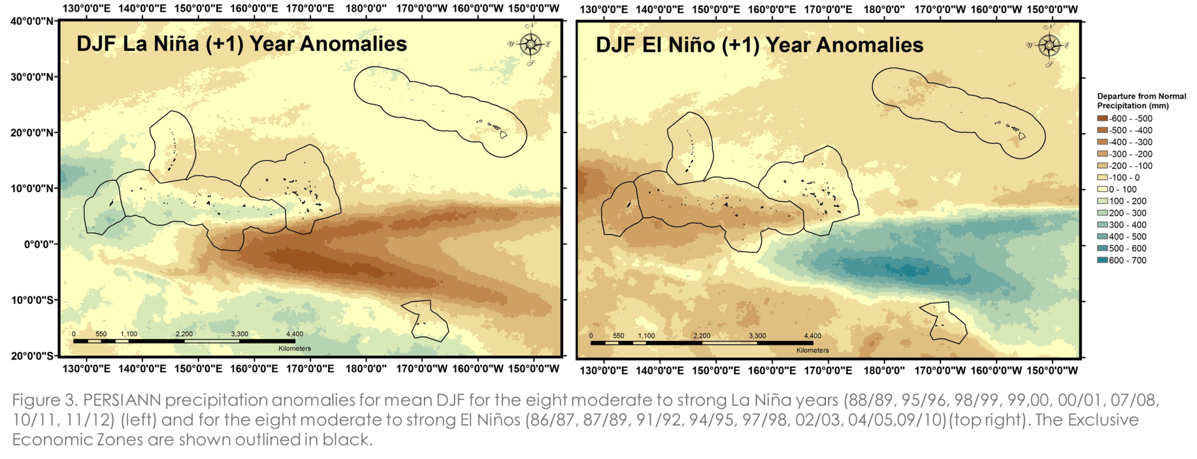
Results
Place holder for animation showing seasonal anomalies

Slide 12
Results
Place holder for maps of ENSO phases

Slide 13
Conclusions
Place holder for images from islands
TBD

Slide 14
Place holder for images of island and climate maps
Future Research
Compare CMORPH, TRMM, and PERSIANN precipitation data
More to come

Slide 15
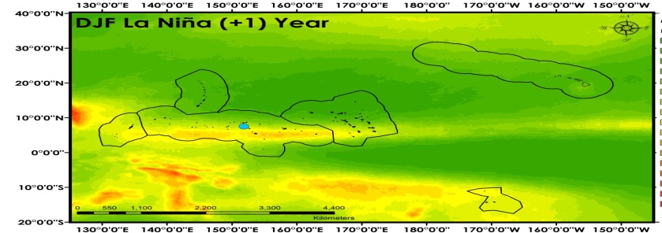
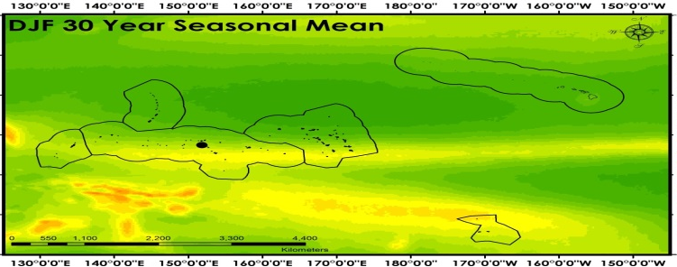
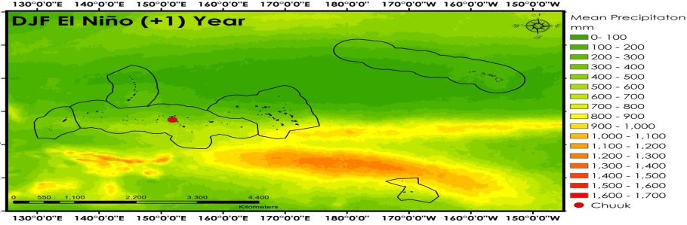
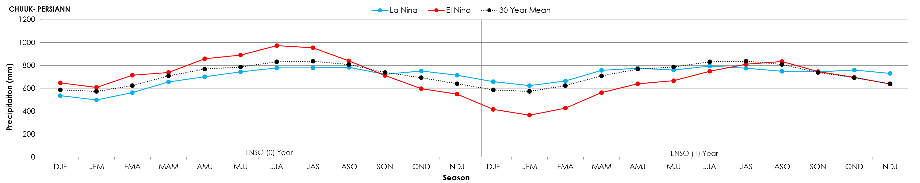
Advisors
Michael Kruk, Pacific Water Resources Product Development
John Marra, NOAA Region Climate Services
Partners
John Marra, NOAA Region Climate Services
Others
Need to finish
Figure 2. Mean PERSIANN precipitation for mean DJF for the eight moderate to strong La Niña years (88/89, 95/96, 98/99, 99,00, 00/01, 07/08, 10/11, 11/12) (top left), 30 year normal (1985-2014)(top middle), and for the eight moderate to strong El Niños (86/87, 87/89, 91/92, 94/95, 97/98, 02/03, 04/05,09/10)(top right). The Exclusive Economic Zones are shown outlined in black and the Chuuk NOAA station is highlighted using a colored circle which corresponds to the time series figure (bottom). The time series plot showing mean PERSIANN precipitation in Chuuk for each three month season for the eight moderate to strong El Niño years (red) and La Niña years (blue). The 30 year mean precipitation for each three month season is also shown (black).

