Slide 1
East Africa Disasters
Assessing Landslide Characteristics and Developing a Landslide Potential Hazard Map in Rwanda and Uganda Using NASA Earth Observations
Leigh Sinclair (Project Lead)
Tyler Finley
Padraic Conner (Co-Project Lead)
Jeanné le Roux

Slide 2
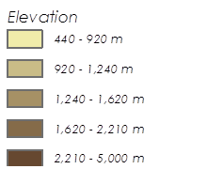
Study Area
This study focused on the East African countries of Uganda and Rwanda.
Uganda has a total area of 236,040 km² with a tropical climate, while Rwanda has a total area of 26,338 km² and a temperate climate.
Notes:
This study focused on the East African countries of Uganda and Rwanda.
Uganda has a total area of approximately 240,000 square kilometers while Rwanda is a much smaller country with a total area of approximately 26,000 square kilometers.
These are neighboring land locked countries located along the equator.
Uganda is mostly characterized as a plateau consisting of savannah covered in elephant grass. The plateau regions are surrounded by mountains with some equatorial forest. Much of the land in Uganda is ideal for growing coffee, bananas, and cotton.
Uganda enjoys access to many inland bodies of water such as the massive Lake Victoria in the southeast and Lake Albert in the west.
Uganda is recognized as having a tropical climate, with temperatures ranging from 16 – 28 degrees Celsius (60 – 80 degrees F). The weather is usually rainy and wet, although there are two dry seasons from December to January and from June to August.
Rwanda is also on a plateau (the East Africa plateau) with land cover characterized by grasslands, hills, valleys, and mountains.
Rwanda’s largest body of water is Lake Kivu along the western border.
Although Rwanda is very close to the equator, it is considered to have a temperate climate due to the countries’ high elevation. Most of the country is 1.5 kilometers (about 1 mile) above sea level and has an average temperature of 20 degrees Celsius (68 degrees F). This temperature stays relatively constant throughout the year.
Rwanda has a rainy season from February to May, and from September to December, coinciding with Uganda’s rainy seasons.
Fun Fact: Uganda and Rwanda are home to the last two populations of endangered mountain gorillas.
Sources:
Painter, Rebekah. "Rwanda." Our World: Rwanda (2011): 1. MasterFILE Premier. Web. 3 June 2015.
White, C. Todd. "Uganda." Our World: Uganda (2011): 1-6. Book Collection: Nonfiction. Web. 3 June 2015.
Service Layer Credits: Esri, HERE, DeLorme, MapmyIndia, OpenStreetMap contributors, and the GIS user community.

Slide 3
Study Period
The study period ranged from January 2010 to the present.
The rainy seasons of each year (Feb-June, Sept-Dec) were of particular interest.
Image credit: Guillaume Lederrey
Notes:
January 2010: as far back as gathered in-situ data goes
Image: https://commons.wikimedia.org/wiki/Rwanda#/media/File:Lake_Kivu_shore_at_Gisenyi.jpg

Slide 4
Source: Wiki Commons
Objectives
Supply updates to SERVIR’s Global Landslide Catalog (GLC)
Create a Landslide Susceptibility Map for the study area
Assess satellite rainfall performance in identifying landslide conditions
Notes:
GLC: online database documenting rainfall triggered landslides around the world. Compiles info on landslides, including date and time occurred, location, size, and fatalities through news reports, published articles, etc.
Satellites: RMM, GPM, CHIRPS
Image: https://commons.wikimedia.org/wiki/File:DirtRoadRwanda.jpg

Slide 5
Community Concerns
Landslides threaten life and infrastructure in Uganda and Rwanda.
A better way of predicting landslide susceptibility is needed since many local people are unable or unwilling to relocate for economic and cultural reasons.
Photograph: Public Domain, Wiki Commons.
Notes:
Landslides threaten life and infrastructure in Uganda and Rwanda.
Some of the most profitable land is located in landslide prone regions. One of example of this is the growth of Arabica coffee in the Mt.Elgon region in Uganda, a hilly area with frequent landslide occurrences and fatalities.
There has been some efforts from the government to relocate people in high risk areas, but these efforts have been met with resistance due to ancestral links to land and fertile soils.
Uganda and Rwanda have a growing populations which place pressure on the land and force people to live in less safe areas.
Poor farming practices are also leading to the loosening of soil which can be a recipe for a landslide when mixed with rainfall.
Sources:
"UGANDA: Learning Lessons from Lethal Landslides." IRINnews. 1 June 2012. Web. 23 June 2015.
Photograph distributed by Wiki Commons (Public Domain).

Slide 6
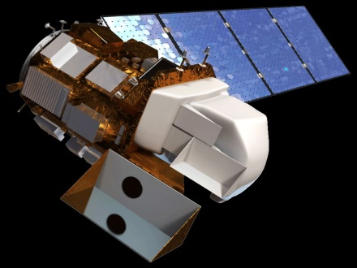
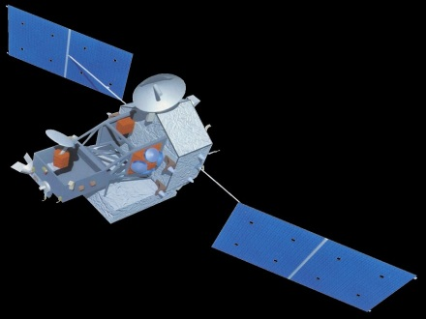
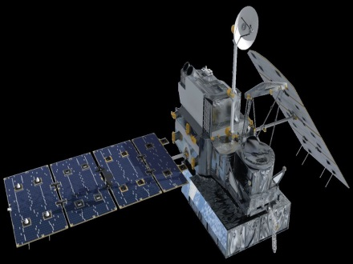
NASA Satellites/Sensors Used
Imaging
Rainfall Measuring
Landsat 8 OLI
TRMM TMPA
SRTM2 C-band
GPM DPR

Slide 7
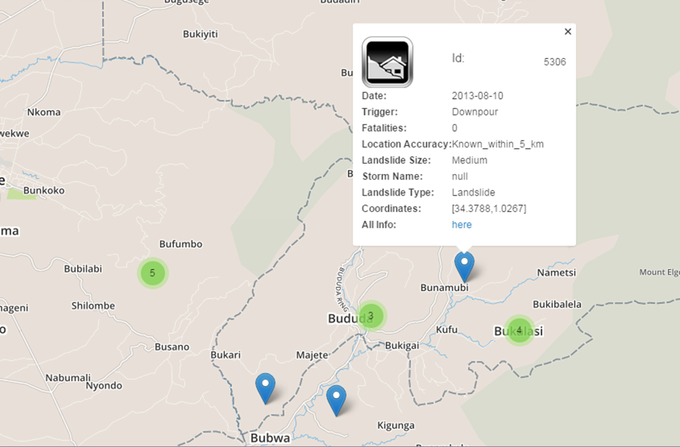
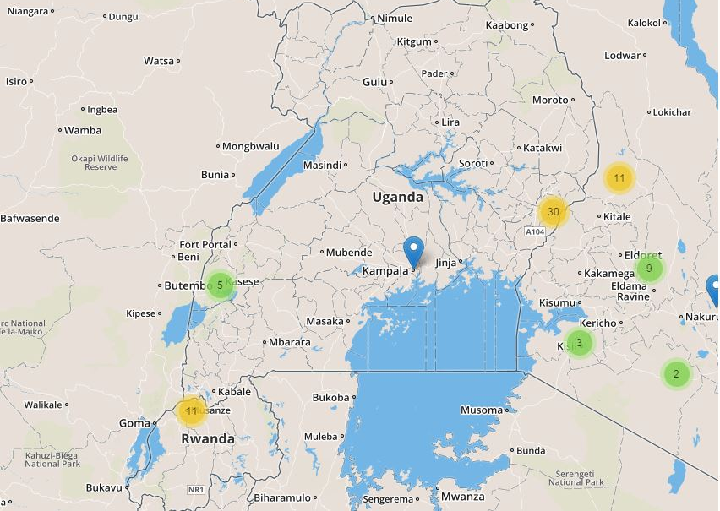
Methodology
Global Landslide Catalog
The Global Landslide Catalog (GLC) was created by Dr. Dalia Kirschbaum of SERVIR.
The GLC was updated with satellite detected landslides and news reports of landslides.
Image credit: NASA
Notes:
The global landslide catalog created by Dr. Daliah Kirschbaum of SERVIR is an online database recording time, approximate location, size, and damages of landslides through the use of news reports and other media. The East Africa disasters project contributed by adding a total of *X* landslides to the catalog. *X* were from satellite observations and *X* were from news reports.
http://ojo-streamer.herokuapp.com/

Slide 8
Methodology
Landslide Susceptibility Map
Elevation
Slope
Distance to Stream
Aspect
Plan Curve
TWI
Distance to Roads
Soil Area Ratio
Road Density
Slope Length
Profile Curve
Precip
Stream Order
Stream Density
Water Basins
Land Cover

Slide 9
Methodology
Landslide Susceptibility Map
Variables
Landslide Susceptibility Map
Reclassify
Landslide Thresholds
Fuzzy Membership
Fuzzy Landslide Thresholds
Fuzzy Overlay

Slide 10
Methodology
Potential Hazard Map: Taking a Look at Population Density
Landslide Susceptibility Map
Potential Hazard Map
Buffer
Landslide Susceptibility Map with 25 km buffer
Intersect
Population Density

Slide 11
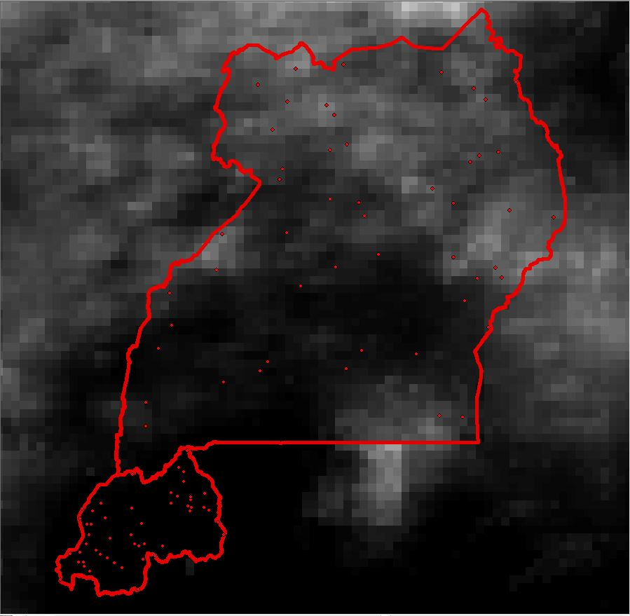
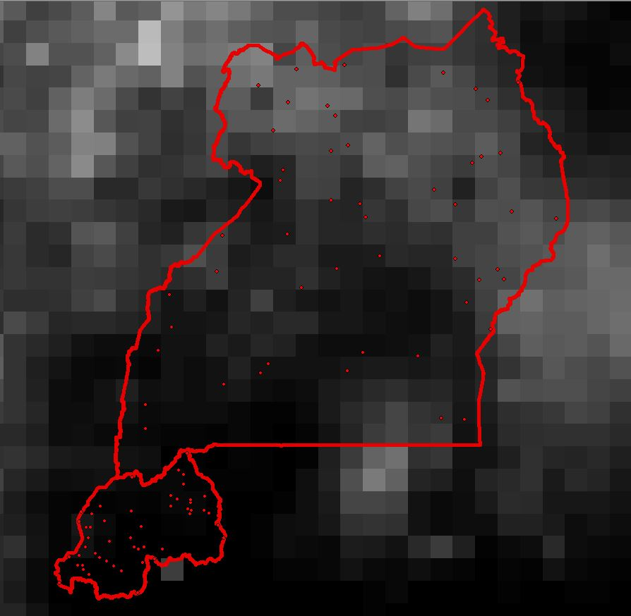
Methodology
Assessment of GPM and TRMM
One hundred random points were generated across the study area for each month over the course of the eleven month period.
TRMM, GPM, and CHIRPS data were collected for each point and correlated using Excel.
Notes:
We generated 100 random points within the study area for each month that TRMM and GPM overlapped. This was a total of *11* months from April 2014 to *February* 2015. We then used ArcMap to collect TRMM, GPM, and CHIRPS data for each point. These were then correlated using Microsoft Excel.

Slide 12
Results
Global Landslide Catalog

Slide 13
Results
Landslide Susceptibility Map

Slide 14
Results
Potential Hazard Map: Taking a Look at Population Density

Slide 15
Results
Assessment of GPM and TRMM

Slide 16
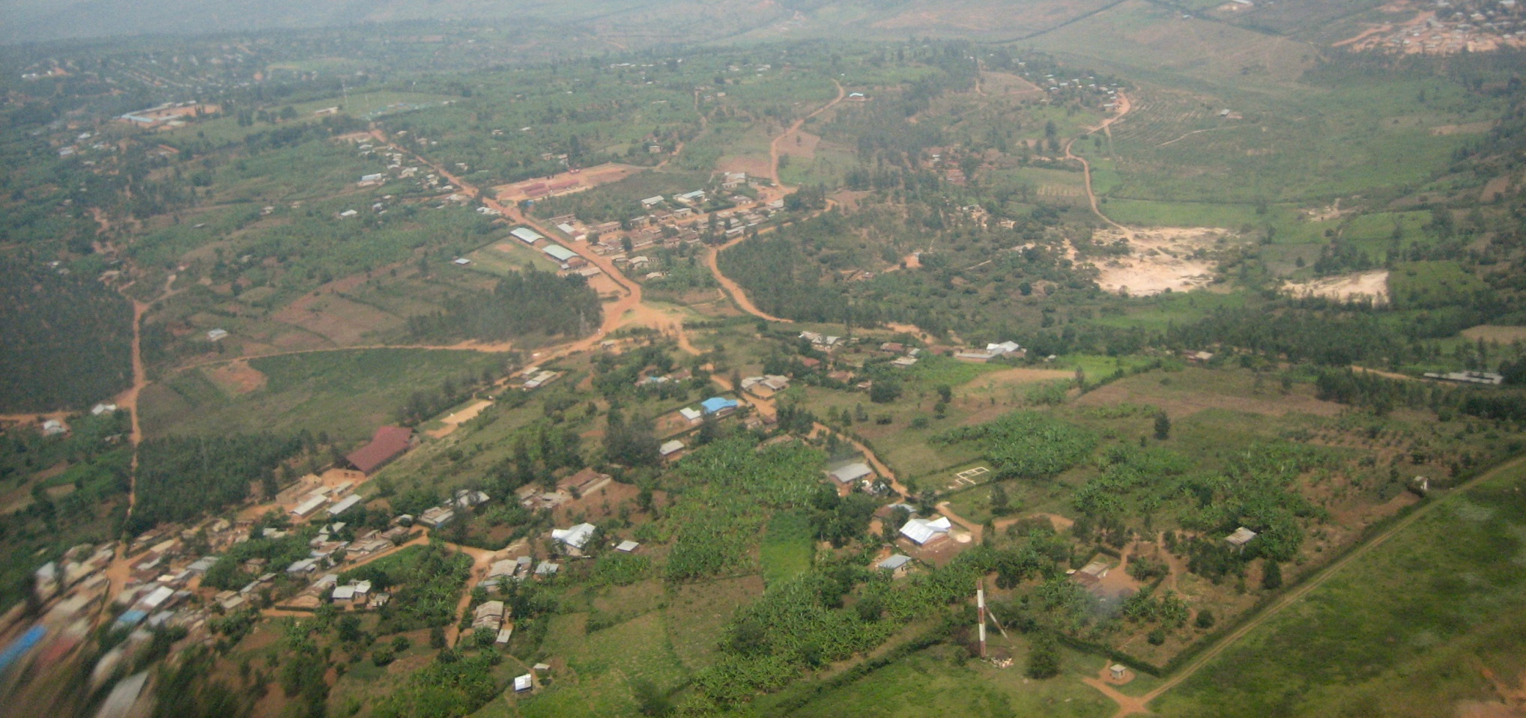
Image credit: Fanny Schertzer
Conclusions
TBD
Notes:
TBD
https://commons.wikimedia.org/wiki/Rwanda#/media/File:Kigali_from_above.jpg
cc Fanny Schertzer https://creativecommons.org/licenses/by-sa/2.5/

Slide 17
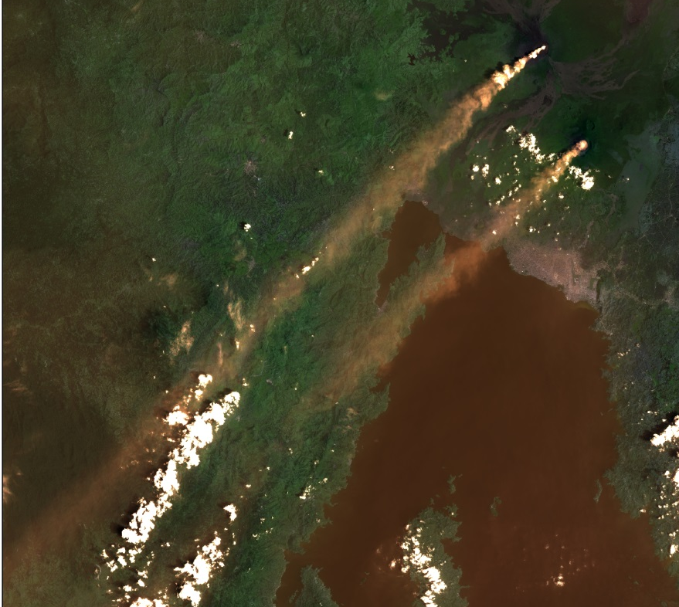
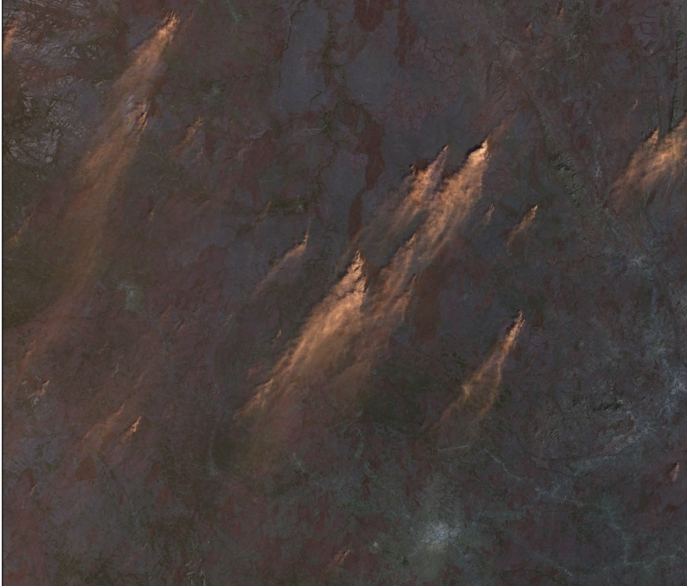
Errors & Uncertainties
Smoke
Clouds
Finding locations
Sample size?
Image credit: Landsat 8 OLI
Notes:
Due to volcanic activity and recurrent brush fires in the East African rift there was a considerable amount of smoke in the Landsat data. There was also difficulty with cloud cover. In addition, small villages named in news articles were frequently not documented on any accessible maps. We had a sample size of *x*. We would have preferred to have a larger sample size but were limited by the number of landslides that could be identified to a specific month of occurrence.

Slide 18
Future Work
Multiple Factor Method
Rainfall intensity-duration threshold for East Africa.
Fires
Watershed cutoff
SMAP
Image credit: Fanny Schertzer
Notes:
This problem was examined using a heuristic method, while SERVIR tackled it using a statistical method. Studies in other regions have used the Multiple Factor Method successfully. This is based on logical operation that incorporates the additive influence of the higher susceptibility level of the instability factors. Another piece of information that could be very useful in future studies of the region would be the rainfall intensity-duration threshold. I found no study that has calculated this for East Africa it would be very useful data. A team could also look at how fires and landslides are related. Effects of potential watershed blockage by landslide could also be examined. This could lead to flooding upstream of the blockage and changes in water availability and quality downstream of the blockage. Additionally, it would be useful to incorporate SMAP data when it becomes available.
https://commons.wikimedia.org/wiki/Rwanda#/media/File:Nyabarongo.jpg
cc Fanny Schertzer https://creativecommons.org/licenses/by-sa/2.5/

Slide 19
Future Work
Future areas of study
Malawi Kenya Tanzania
Image credit: Sebastian Koppehel,
Image credit:, Pumbaa80
Image credit: Sebastian Koppehel,
Notes:
Future areas that could be studied include Malawi, Kenya, and Tanzania which all face the challenge of landslide hazard. Malawi was specifically mentioned for future study by a project partner.
https://commons.wikimedia.org/wiki/Kenya#/media/File:Flag_of_Kenya.svg
https://commons.wikimedia.org/wiki/Malawi#/media/File:Flag_of_Malawi.svg
https://commons.wikimedia.org/wiki/Tanzania#/media/File:Flag_of_Tanzania.svg

Slide 20
Advisors
Dr. Jeffrey Luvall, NASA at NSSTC
Dr. Robert Griffin, University of Alabama in Huntsville
Partners
Eric Anderson, NASA SERVIR Coordination Office at MSFC
Dr. Dalia Kirschbaum, SERVIR Applied Sciences Team at NASA GSFC
Denis Macharia, Regional Centre for Mapping of Resources for Development
Others
Hannah Ballard, SERVIR Intern
Angela ?, SERVIR Intern

Slide 21
Questions
Image credit:Denelson83
Notes:
At this time if anyone has any questions we would be happy to try to answer them.
https://commons.wikimedia.org/wiki/Question_mark#/media/File:Circle-question.svg

Slide 22
Backup Slide: Methodology
Elevation
Downloaded SRTM2 tiles covering study area and mosaicked together in ArcMap
Slope
Created in ArcMap using Slope tool
Distance to Stream
ArcMap “Euclidian distance” tool
Notes:
SRTM2 data was downloaded from Earth Explorer, re-projected to a projected coordinate system (WGS 1984 Web Mercator Auxiliary Sphere), then mosaicked together in ArcMap using Mosaic to New Raster tool
Slope: Spatial Analyst extension

Slide 23
Backup Slide: Methodology
Landslide Susceptibility Map
Aspect
Created in ArcMap using Aspect tool
Plan Curvature
Created in ArcMap using SRTM DEMs and Curvature tool
Topographic Wetness Index

Slide 24
Backup Slide: Methodology
Landslide Susceptibility Map
Distance to Roads
Created in ArcMap using roads and boundaries shapefiles with Euclidean Distance tool
Soil Area Ratio
Road Density

Slide 25
Backup Slide: Methodology
Landslide Susceptibility Map
Stream Order
ArcMap “stream order” tool
Stream Density
ArcMap “focal statistics” tool
Water Basins
Land Cover
Point elaboration

Slide 26
Backup Slide: Methodology
Landslide Susceptibility Map
Slope Length
Power(“flow accumulation raster”*[cell resolution in meters]/22.1,0.4)*Power(Sin(“slope raster in degrees”*0.01745))/0.09, 1.4)*1.4
Profile Curvature
Created in ArcMap using SRTM DEMs and Curvature tool
Precipitation
Notes:
Slope length-LS factor
Slope length (LS) factor is a combination of slope length and slope angle that represents the effect of slope length on erosion. It is calculated with the following equations:
L=(m+1)(A/22.1)m
Where,
L is the slope length factor at some point on the landscape,
λ_A is the area of upland flow,
m is an adjustable value depending on the steepness of the slope,
22.1 is the unit plot length.
S=(sin(0.01745xdeg)/0.09)n
Where,
θ is the slope in degrees,
0.09 is the slope gradient constant, and
n is an adjustable value depending on the soil’s susceptibility to erosion
These equations were combined and input into “Raster Calculator” in ArcMap. Values for m and n were taken from published literature to give good results in high spatial variability (Oliveira et al. 2013) (Lui et al. 1999) The final equation as entered in to “Raster Calculator” was:
Power(“flow accumulation raster”*[cell resolution in meters]/22.1,0.4)*Power(Sin(“slope raster in degrees”*0.01745))/0.09, 1.4)*1.4

