Slide 1
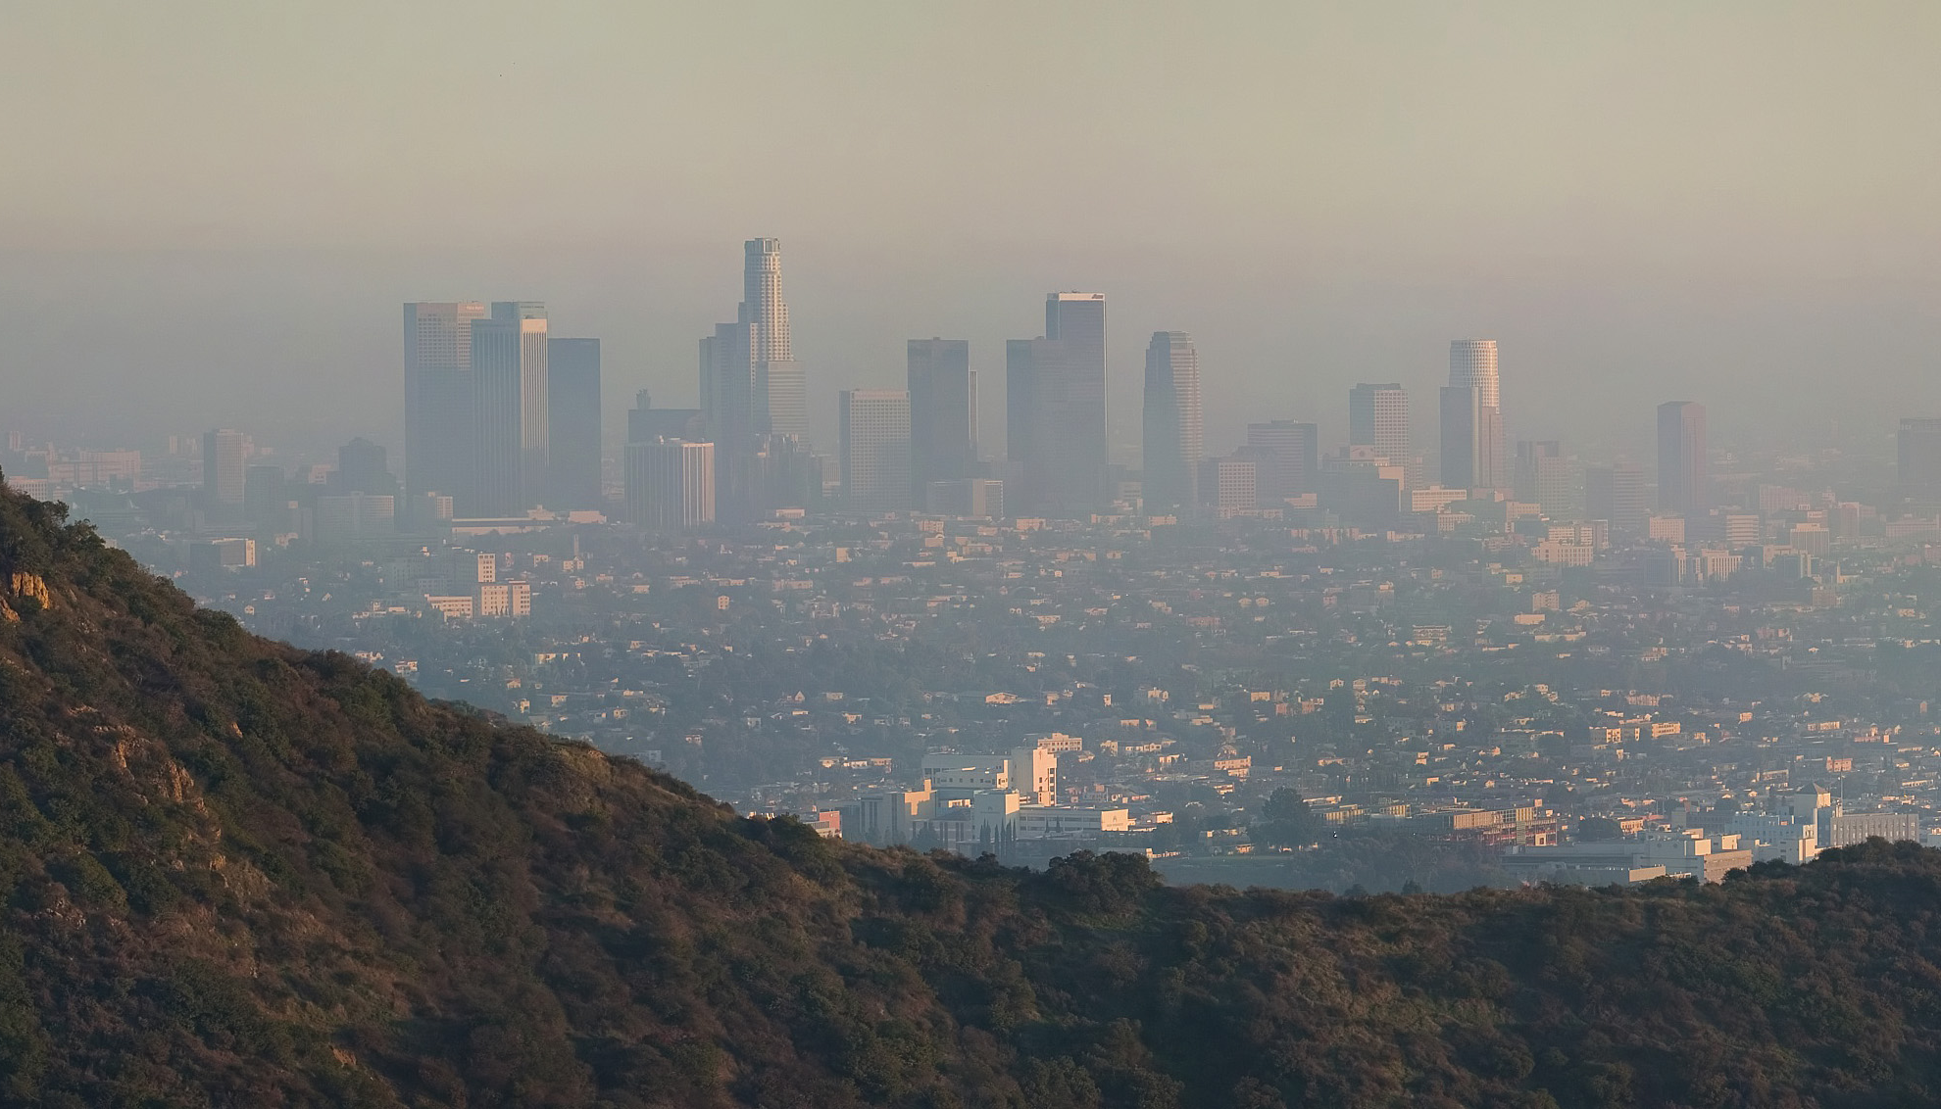
Los Angeles Health & Air Quality
Identifying Urban Emission Patterns in the Los Angeles Megacity
NASA Earth Science Division’s DEVELOP National Program
Annual Earth Science Applications Showcase
NASA Headquarters Washington, D.C.
July, 30th 2015
NASA Jet Propulsion Laboratory
California Institute of Technology
Talha Rafiq¹ (Project Lead), Isis Frausto-Vicencio², & Valerie Carranza²
¹California State University, Long Beach, ²University of California, Los Angeles
Photo courtesy of DAVID ILIFF. License: CC-BY-SA 3.0

Slide 2
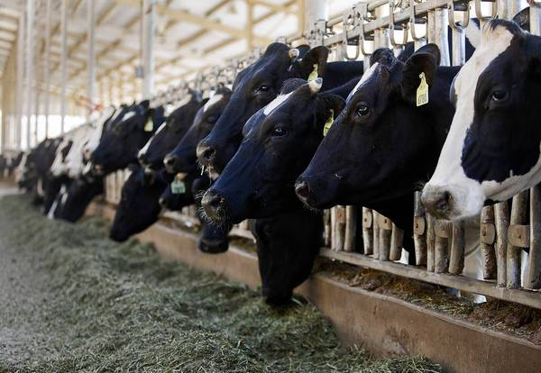
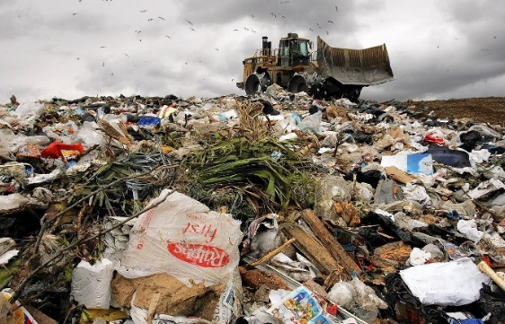
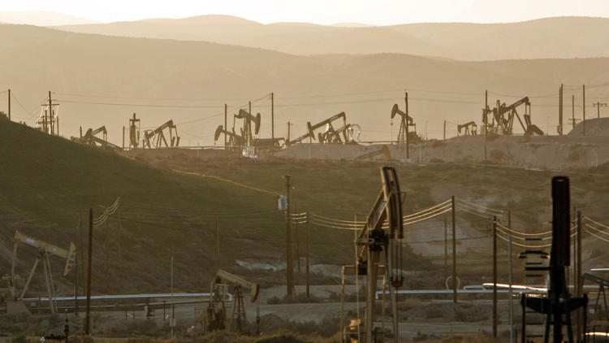
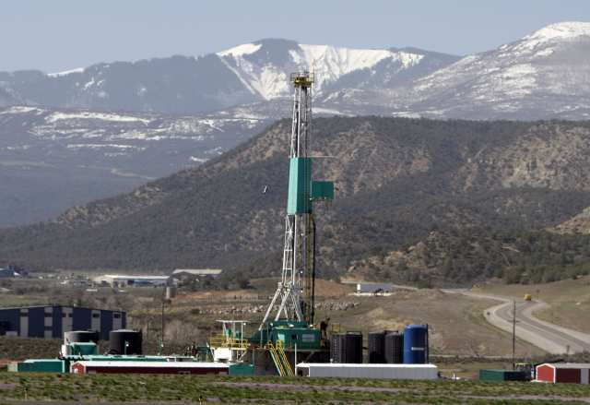
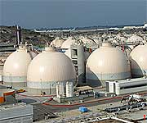
Methane
21lbs CO₂
1lb CH₄
=
Photos courtesy of Los Angeles Times/ LA Sewers

Slide 3
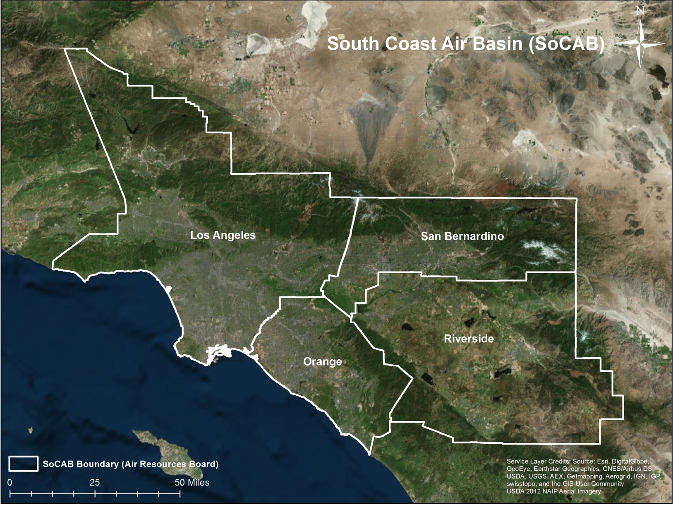
Megacities Carbon Project
Photos courtesy of NASA JPL Megacities Carbon Project

Slide 4
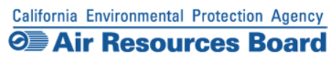
Source | 2012 SoCAB Total (Gg CH₄/year)
Landfills | 171.3
Oil & Natural Gas | 87.4
Livestock-Dairy | 77.3

Slide 5
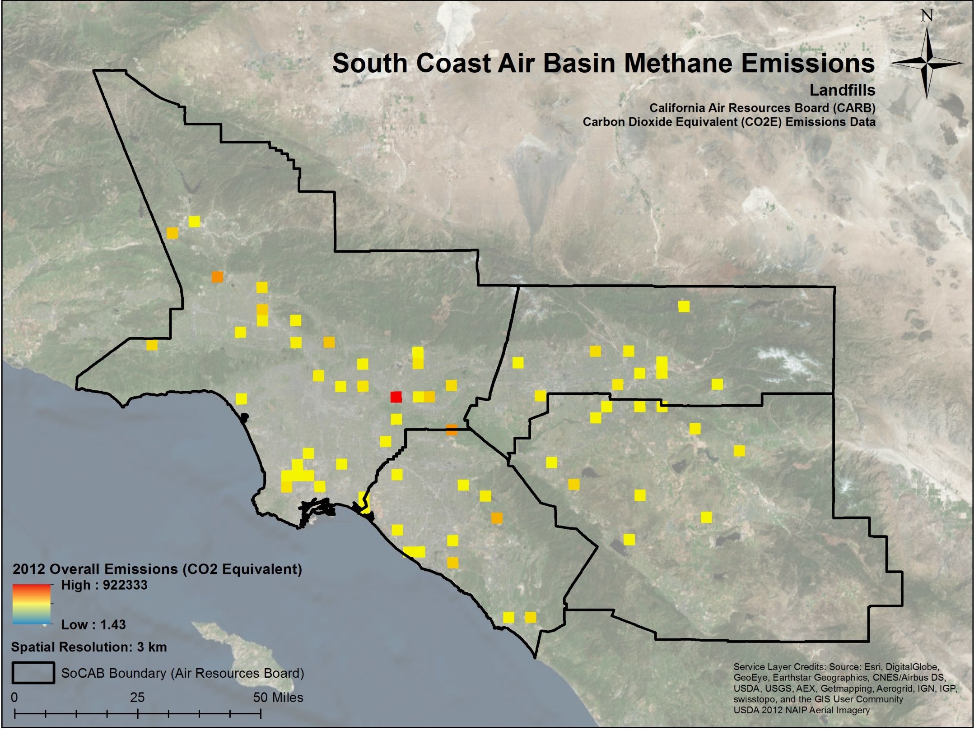
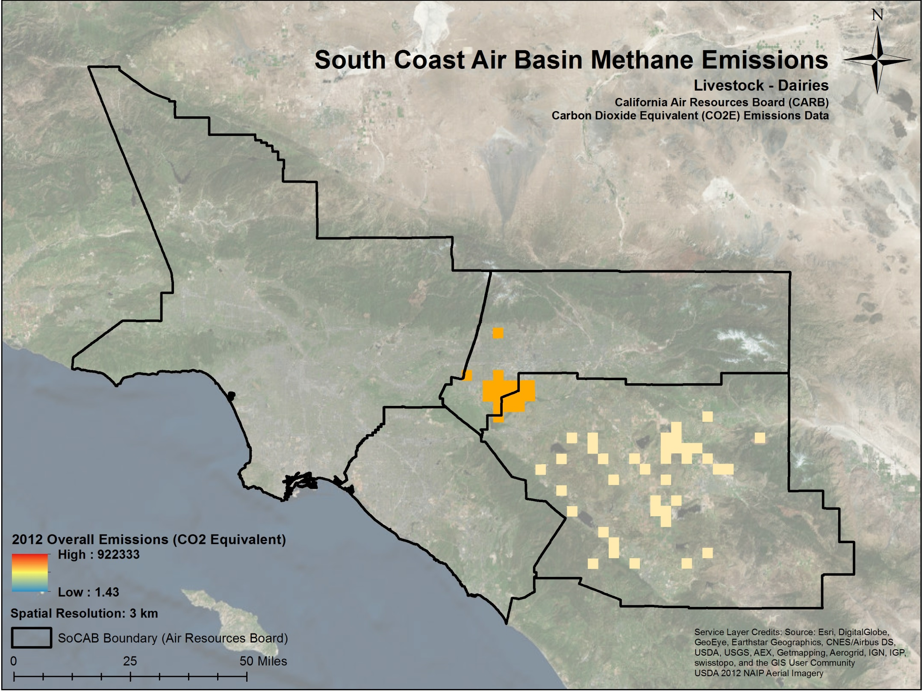
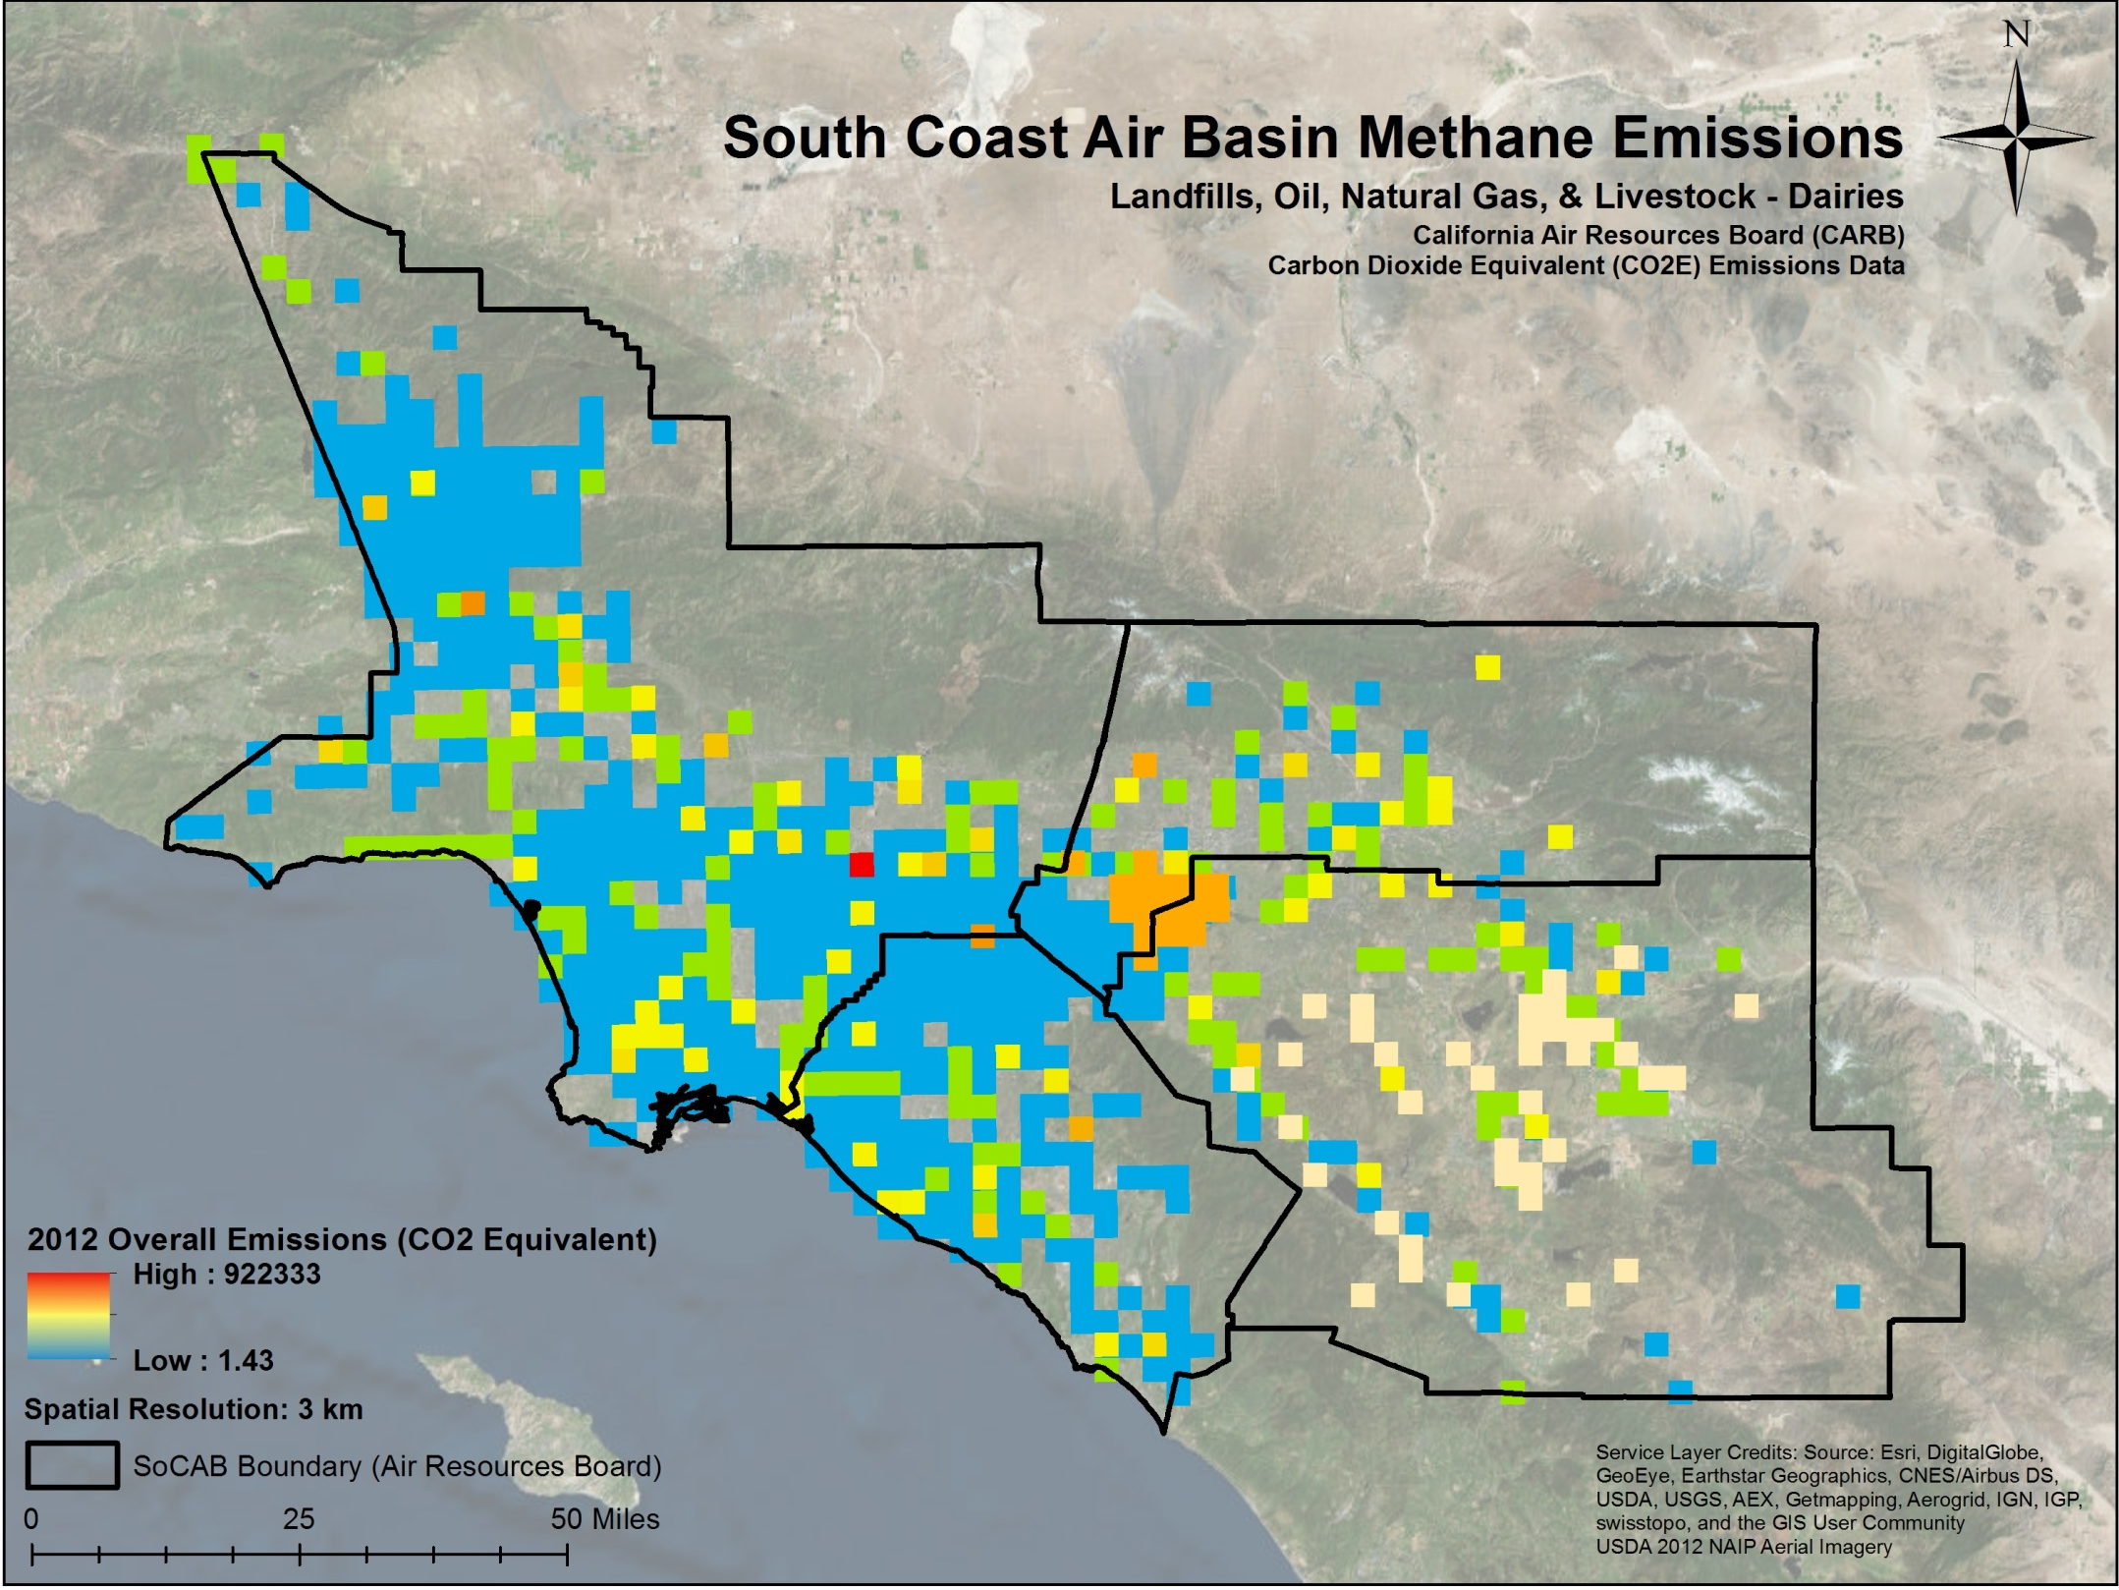
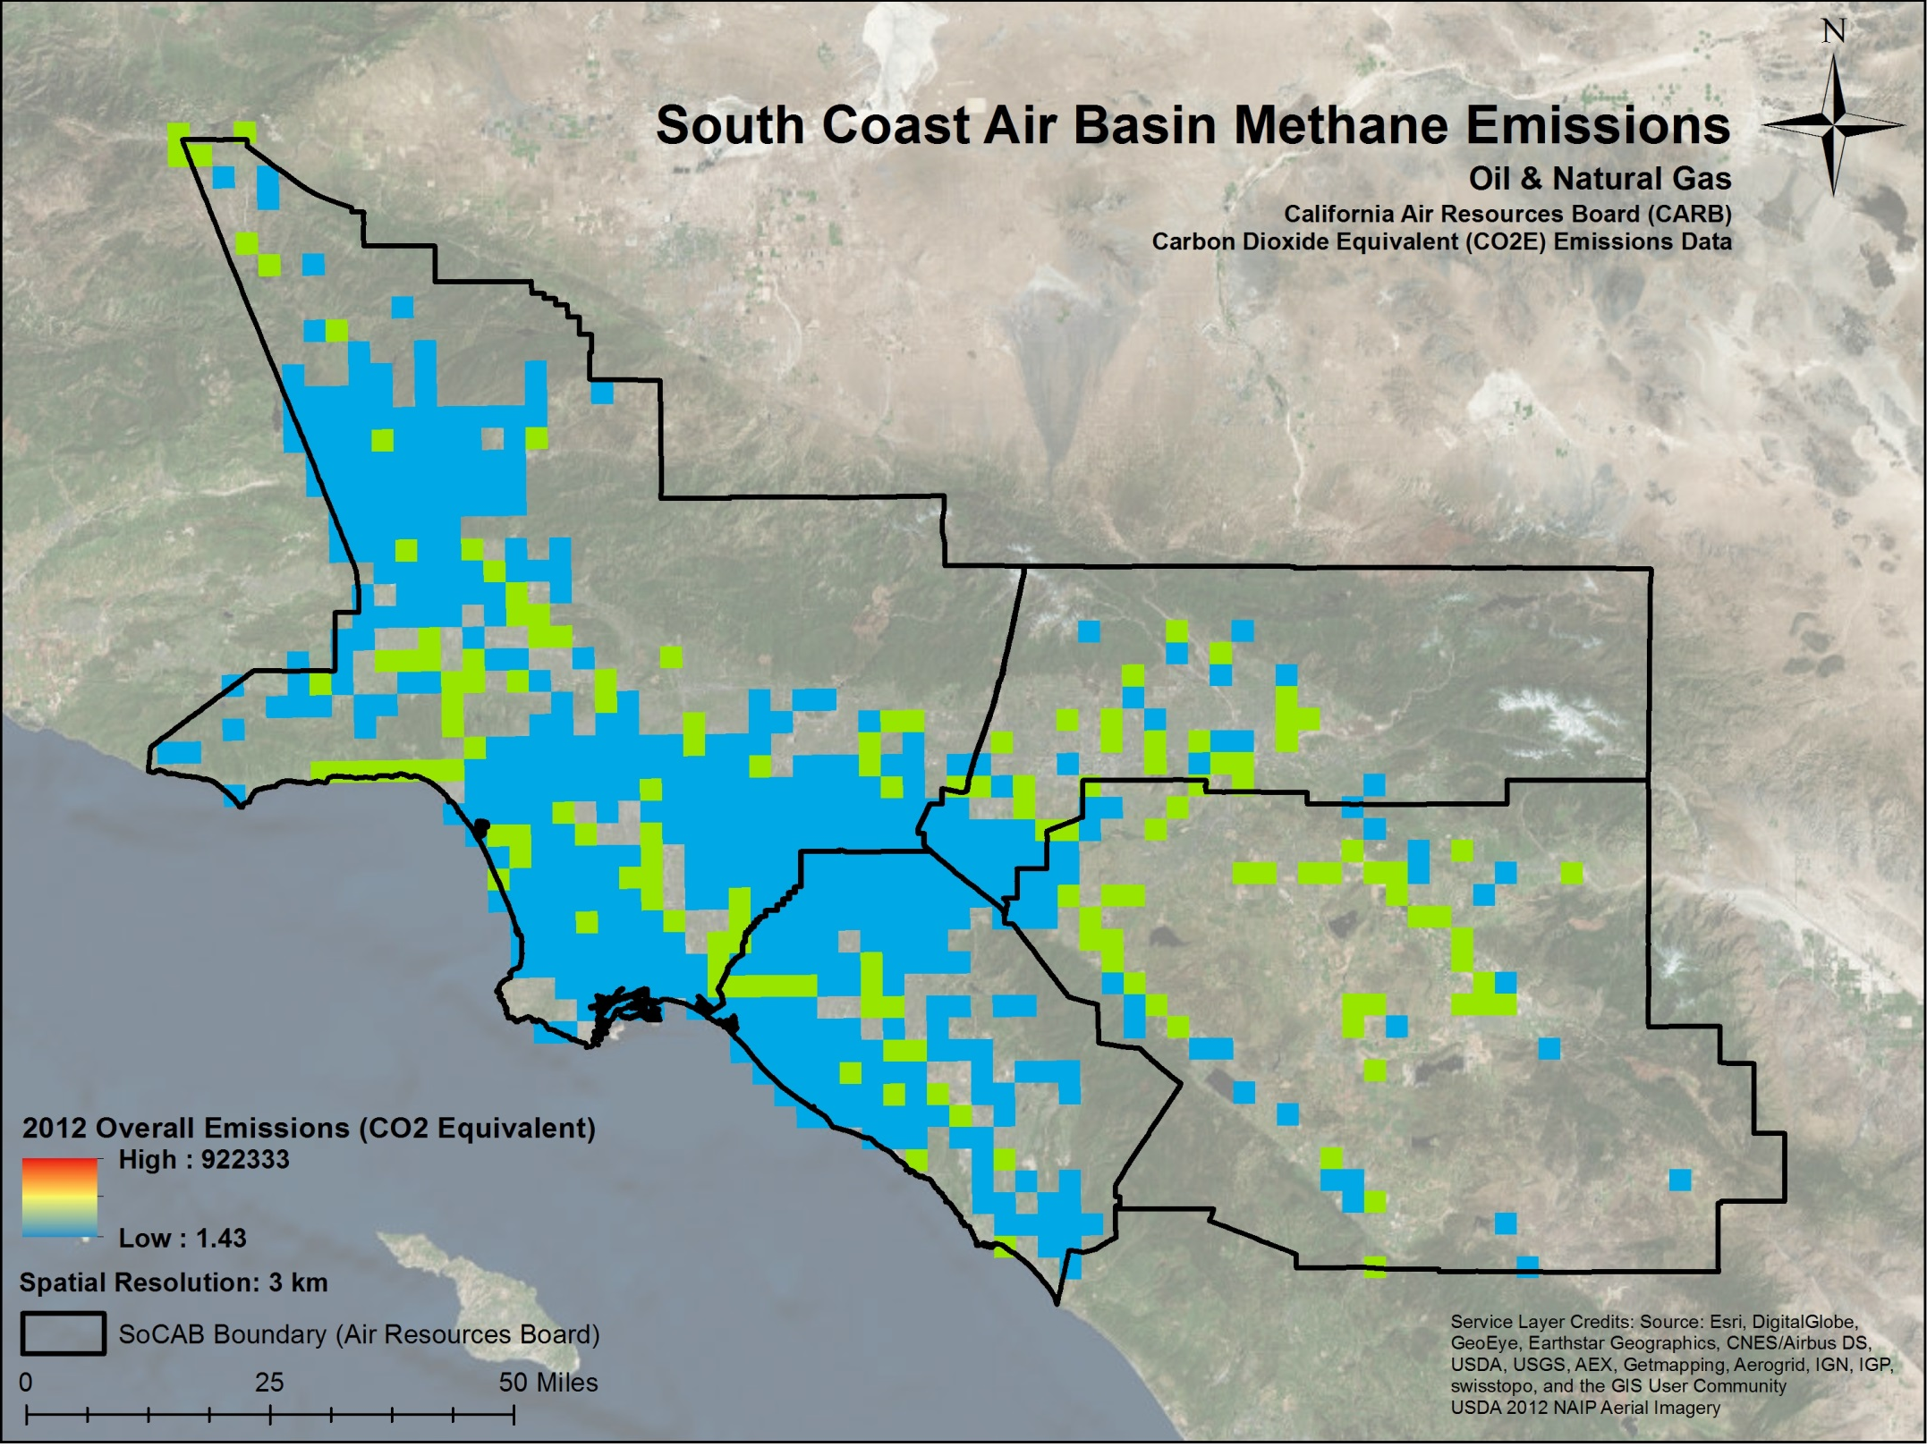

Slide 6
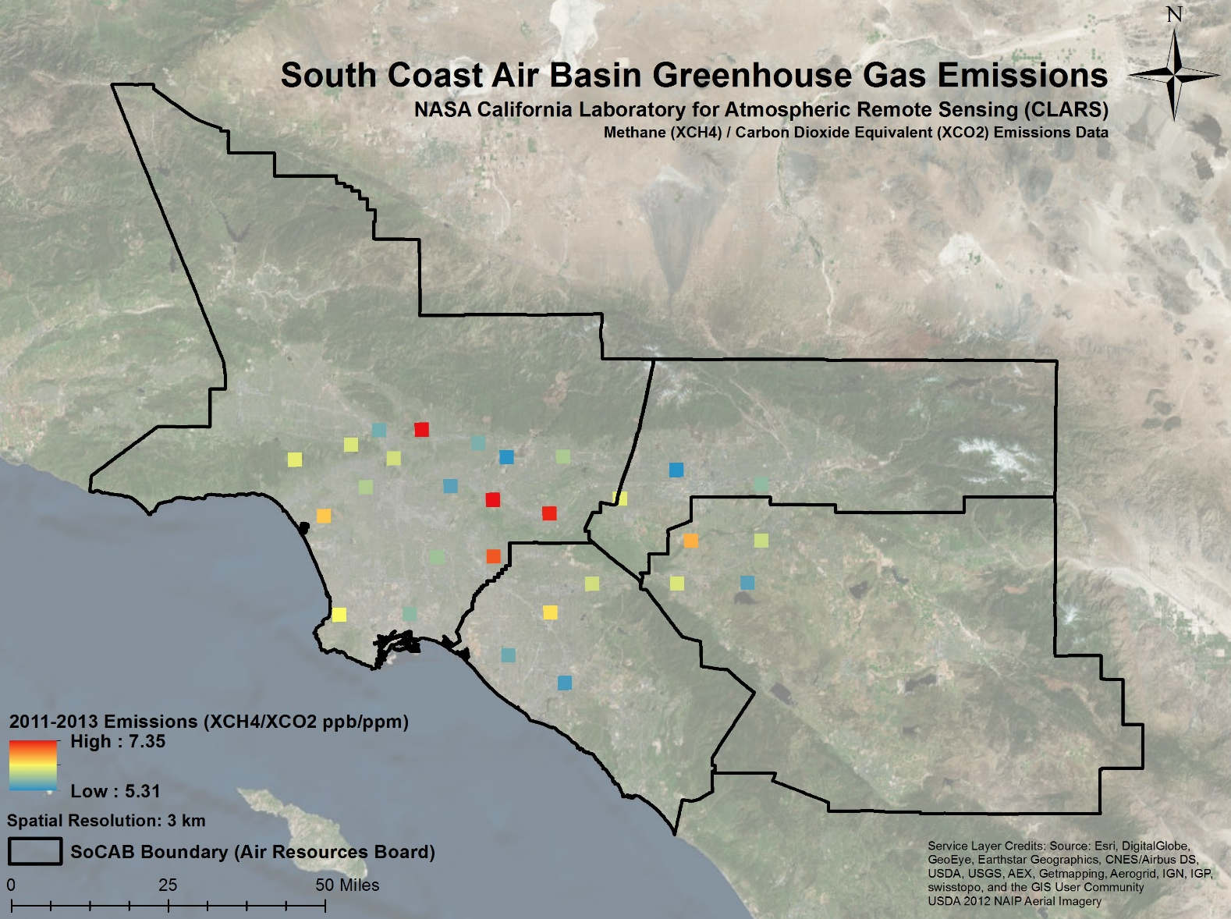
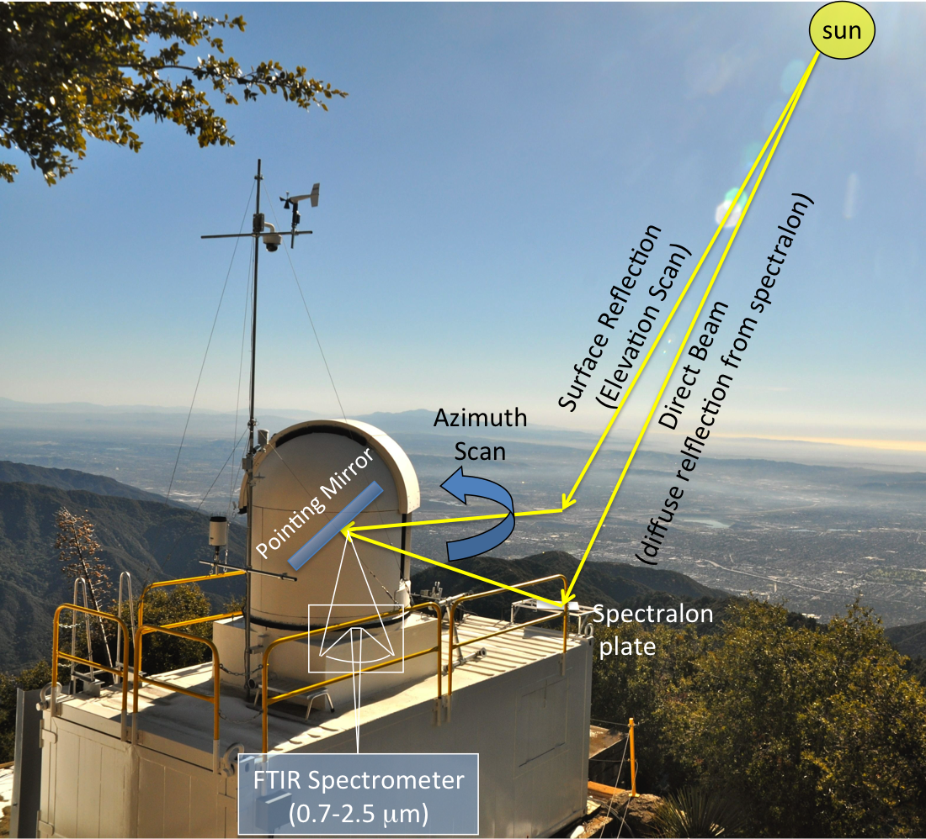
NASA California Laboratory for Atmospheric Remote Sensing (CLARS)
Mt. Wilson Observatory
Photo courtesy of NASA JPL Megacities Carbon Project

Slide 7
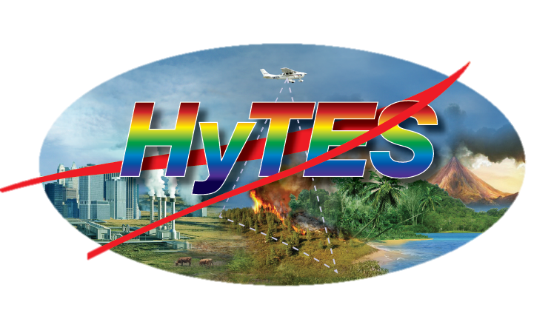
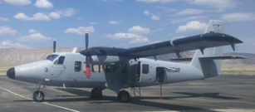
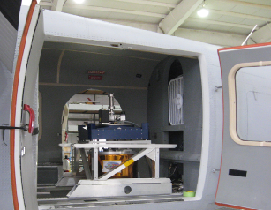
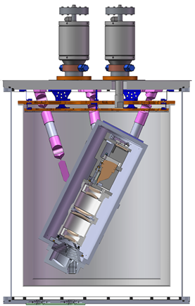
NASA Hyperspectral Thermal Emission Spectrometer (HyTES)
Photos courtesy of NASA JPL

Slide 8
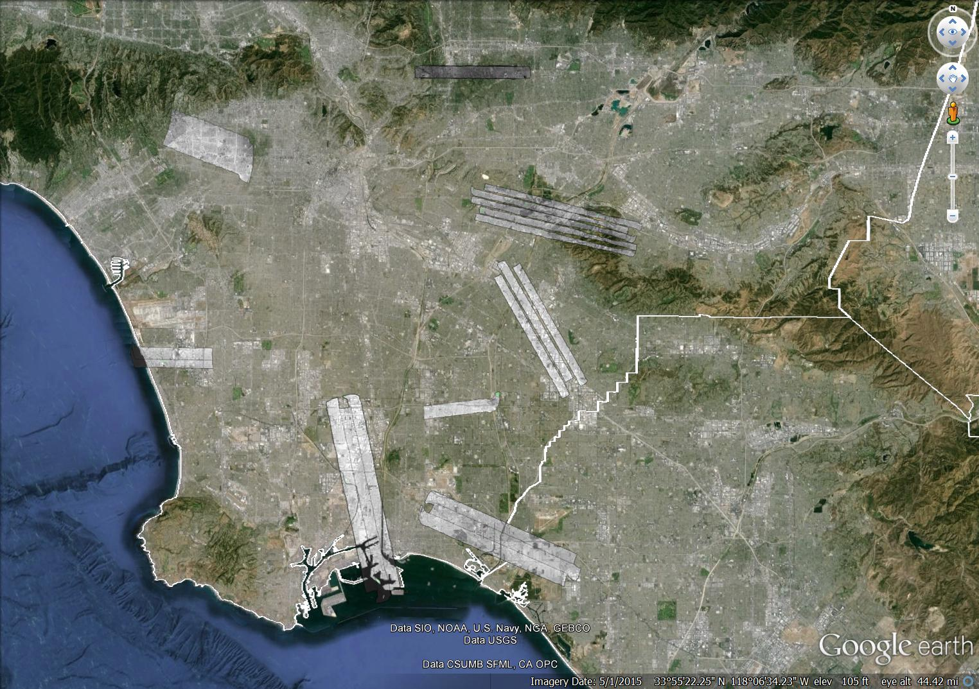
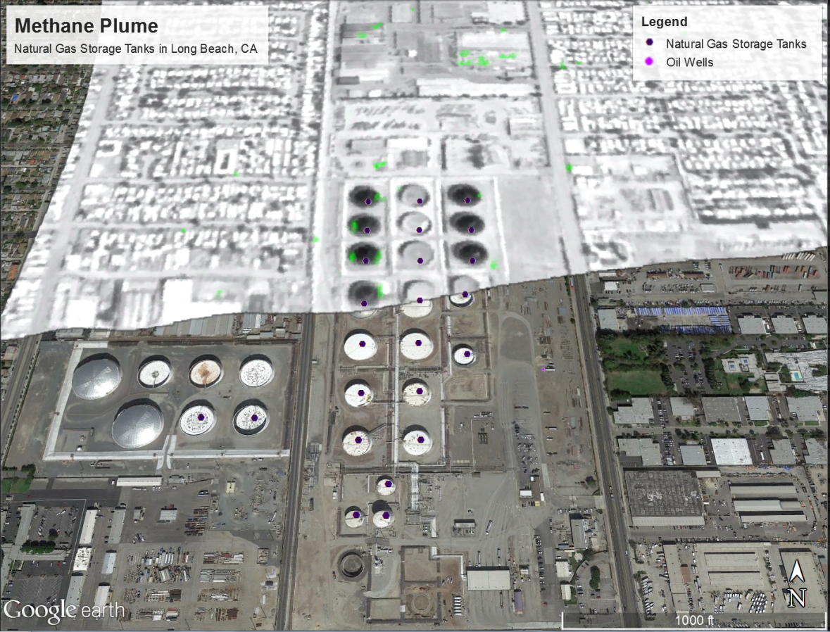
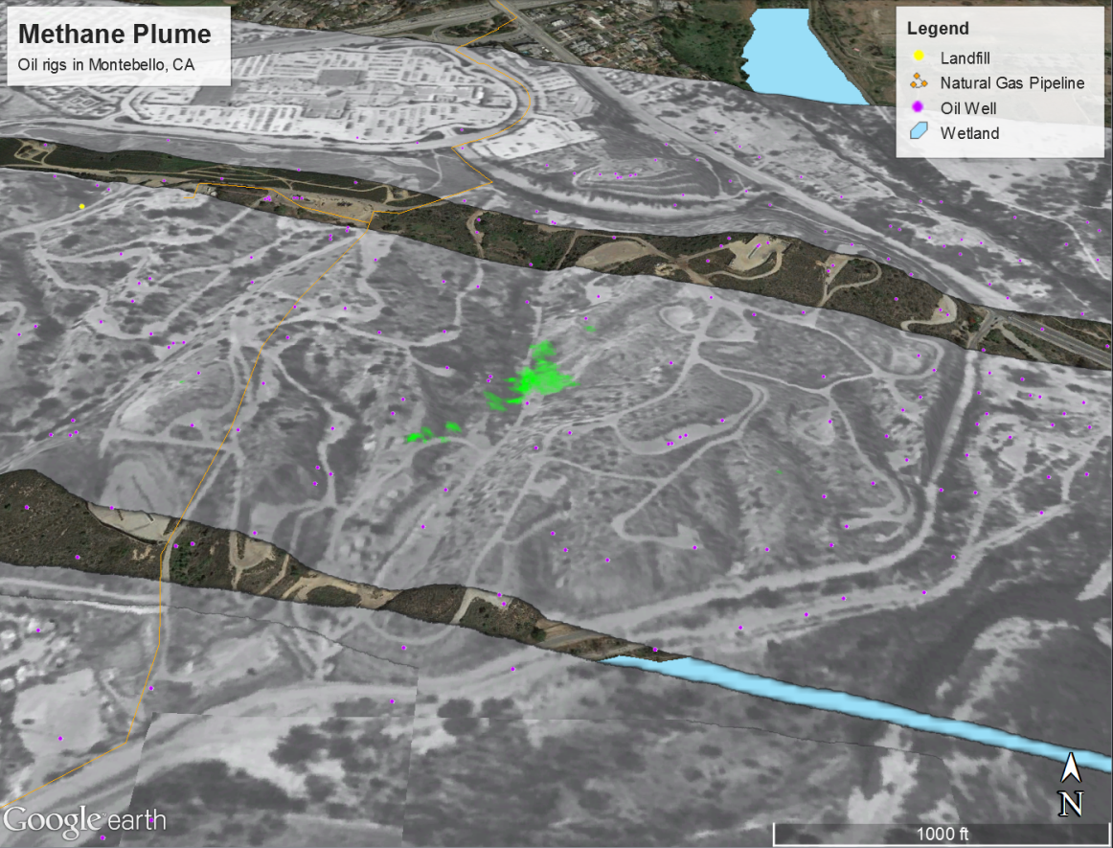
NASA Hyperspectral Thermal Emission Spectrometer (HyTES)

Slide 9
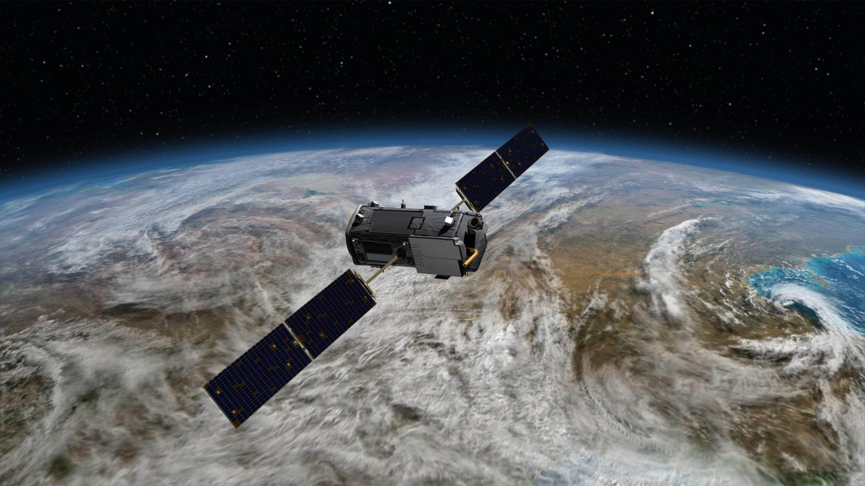
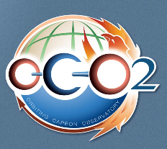
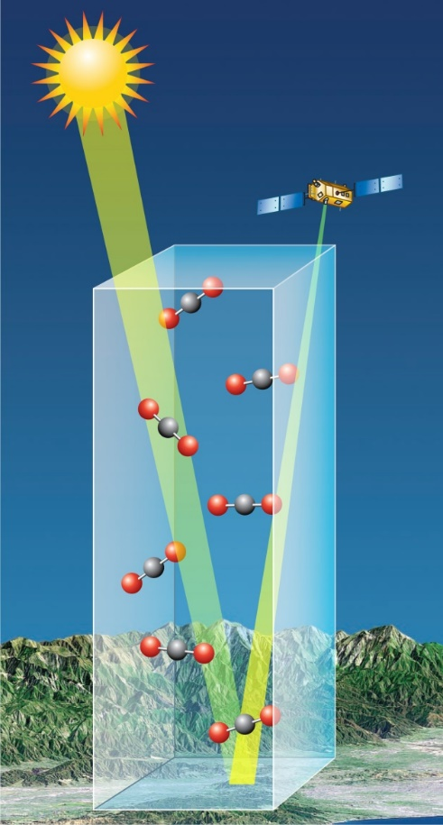
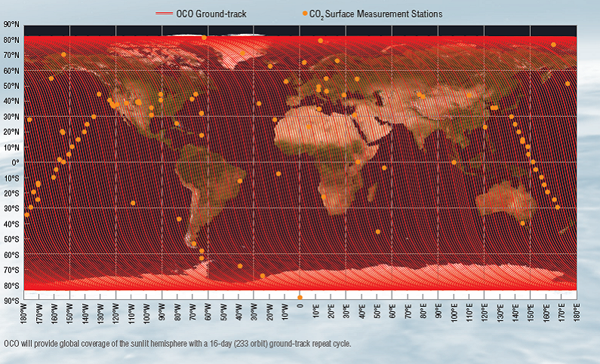
NASA Orbiting Carbon Observatory - 2 (OCO-2)
Photos courtesy of NASA JPL

Slide 10
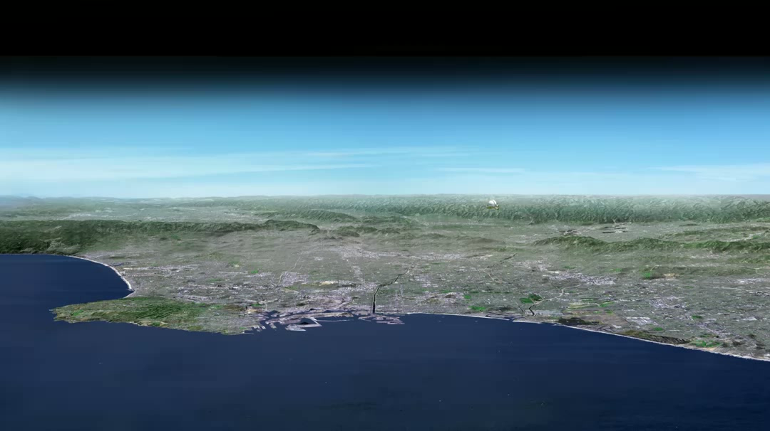
Animation courtesy of NASA JPL Megacities Carbon Project

