Slide 1
North Mexico Ecological Forecasting
Using NASA Earth Observations to Monitor and Manage Ocelot Habitat Loss in North Mexico
Ryan Schick (Project Lead)
Leigh Sinclair
Padraic Conner
Maggi Klug

Slide 2
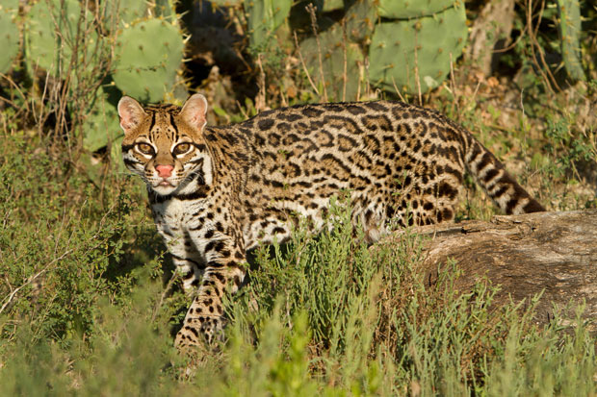
Image credit: USFWS
Background
Ocelots are medium sized, nocturnal wild cats
Have a range from Argentina up to the southeastern tip of Texas
Live in areas such as thornscrub, tropical forests, and wetlands
Notes:
Ocelots are a medium sized, primarily nocturnal wild cat that can be found from Argentina to the southeastern tip of Texas and southern Arizona. Ocelots live in a variety of habitats including thornscrub, tropical forests, and even wetlands.
Image from USFWS: http://www.fws.gov/news/blog/index.cfm/2015/2/9/Private-Landowners-Help-the-Ocelot-and-the-Aplomado-Falcon

Slide 3
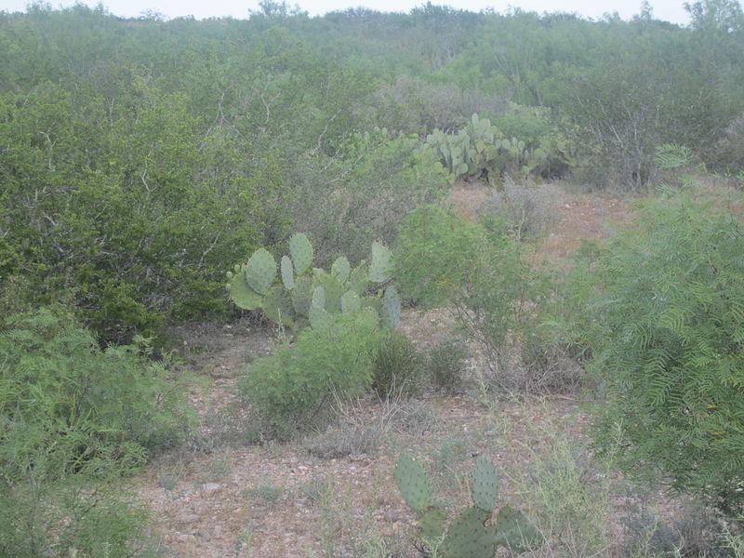
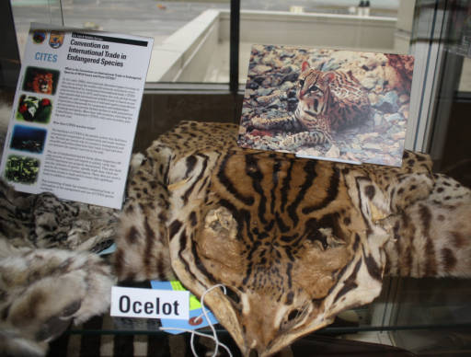
Community Concerns
Ocelots are listed on the Endangered Species Act in the United States
Rapid urban development leads to isolation and inbreeding
Over 95% of Tamaulipan brushland habitat in northeastern Mexico has been eliminated
Image credit: Billy Hathorn
Image credit: USFWS
Notes:
Ocelots are listed on the Endangered Species Act in the United States, where the total population is less than 100. Rapid urban development destroys habitat, causing habitat fragmentation, leading to isolation and inbreeding. This inbreeding reduces the survival and fertility of ocelot offspring. In northeastern Mexico, over 95% of Tamaulipan brushland habitat has been eliminated by urbanization and agriculture.
Image (left) from Wikipedia Commons: https://en.wikipedia.org/wiki/Shrubland#/media/File:Scrub_brush_vegetation_in_south_TX_IMG_6069.JPG
Image (right) from USFWS: http://digitalmedia.fws.gov/cdm/singleitem/collection/natdiglib/id/12489/rec/3

Slide 4
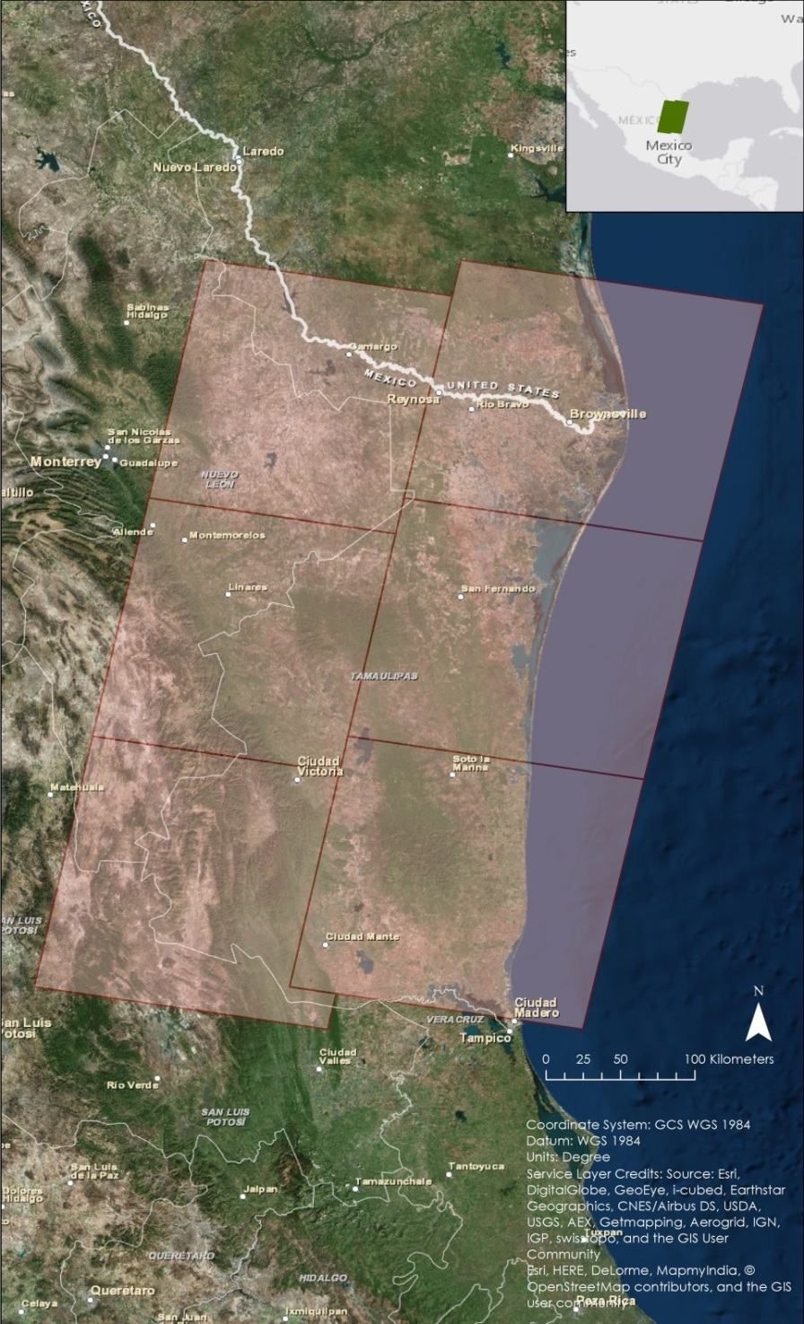
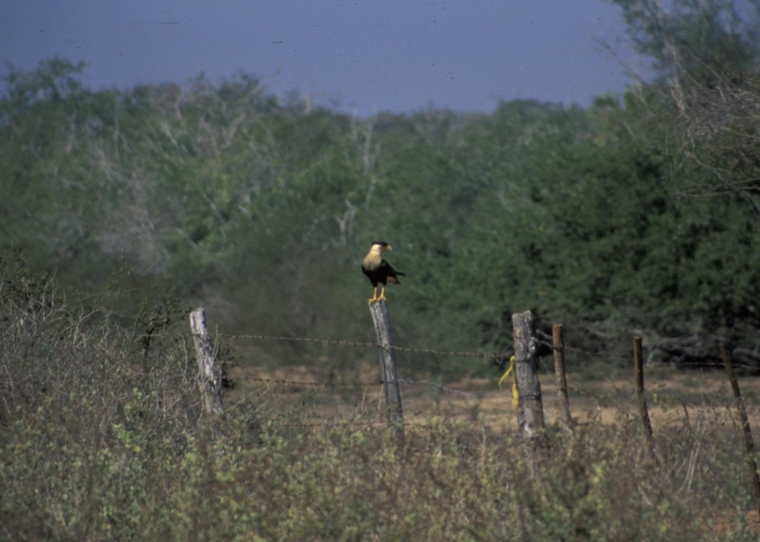
Study Area
Northeast Mexico
Tamaulipas
Eastern Nuevo Leon
Northeastern San Louis Potosi
Image credit: Marcel Holyoak
Notes:
The study area for this project was northeast Mexico, specifically the states of Tamaulipas, eastern Nuevo Leon, and northeastern San Louis Potosi. Habitats within this area consist of dense, woody vegetation, low tropical forest, and ebony-glasslands.
https://www.flickr.com https://creativecommons.org/licenses/by-nc-nd/2.0/ Image has been cropped.

Slide 5
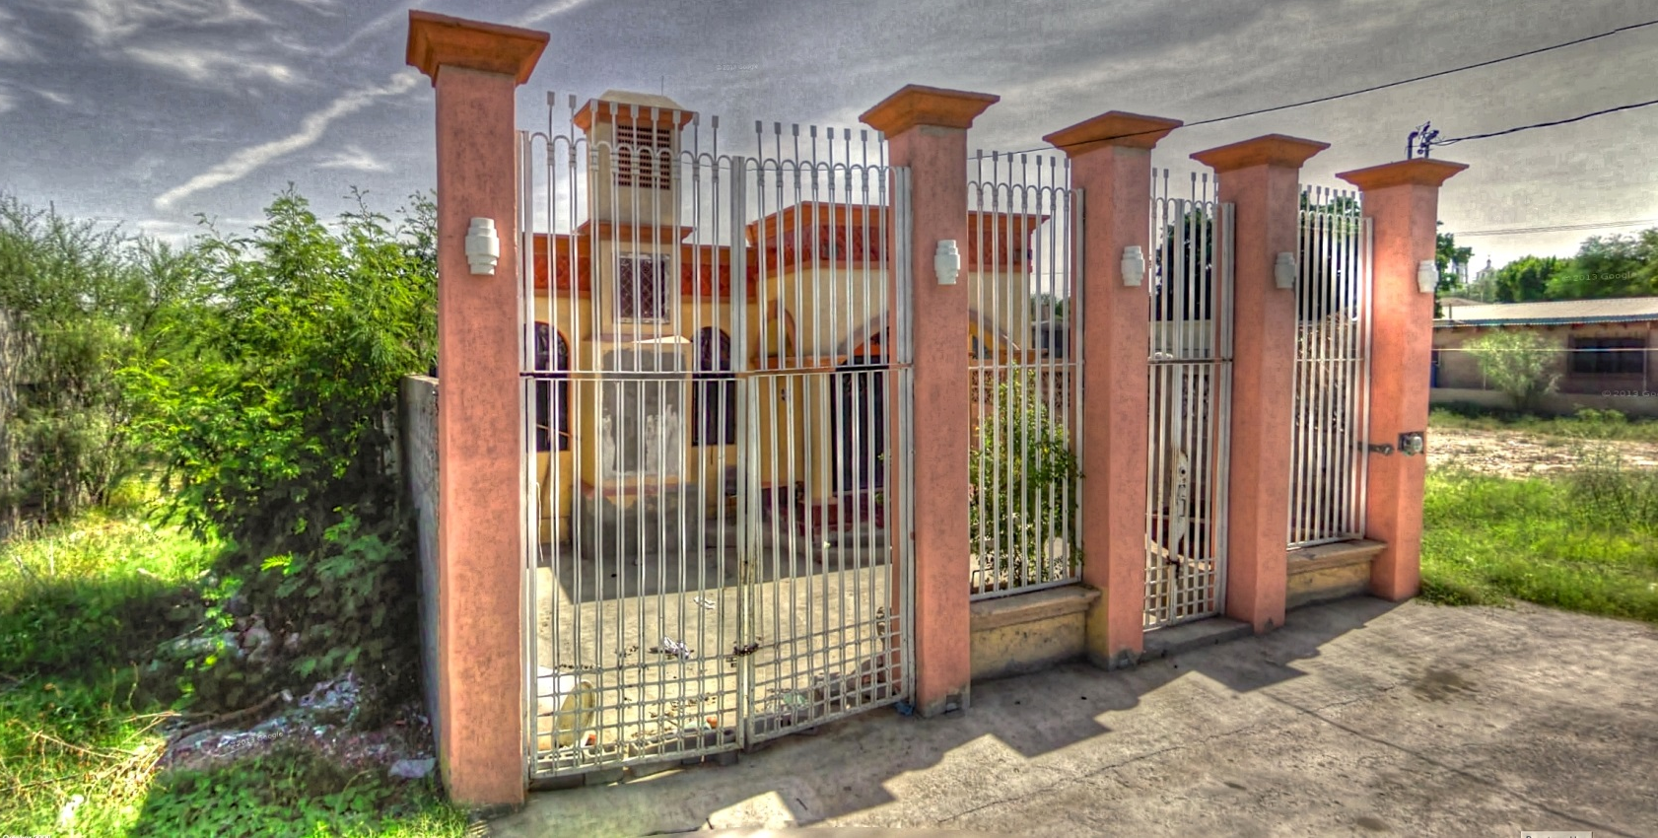
Study Period
1996
2004
2014
Image credit: Kevin Dooley
Notes:
The study period for this project was 1996 to 2014 with a focus on the years 1996, 2004, and 2014. These years were selected to show how urbanized and agricultural areas have changed over approximately the last 20 years. Data was downloaded between the months of December and March (April if necessary), as this is the dry season of the study area. This not only limited cloud cover in the imagery but also the amount of vegetation, which allowed for estimation the minimum suitable habitat available for ocelots.
https://www.flickr.com https://creativecommons.org/licenses/by/2.0/ Image was cropped.

Slide 6
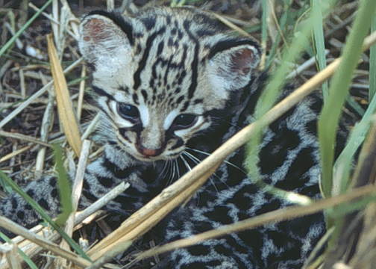
Project Partners
Ken Kaemmerer, Pittsburg Zoo & PPG Aquarium
Dr. Josh Gaspard, Pittsburg Zoo & PPG Aquarium
Michael Tewes, Caesar Kleberg Wildlife Research Institute at Texas A&M University-Kingsville
Dr. Humberto Perotto, Caesar Kleberg Wildlife Research Institute at Texas A&M University-Kingsville
Nanette Bragin, The Denver Zoo
Mitch Sternberg, South Texas Refuge Complex
Dr. John Young Jr, Texas Department of Transportation
Dr. Arturo Caso, SEMARNAT
Dr. Arturo Flores-Martinez, SEMARNAT
Dr. Tyler Campbell, East Wildlife Foundation
Image Credit: USDA
Notes:
This project partnered with ten people from seven different organizations, in both the United States and Mexico.
Image from Wikimedia Commons: https://commons.wikimedia.org/wiki/File:Ocelot_kitten_texas_thornscrub.jpg

Slide 7
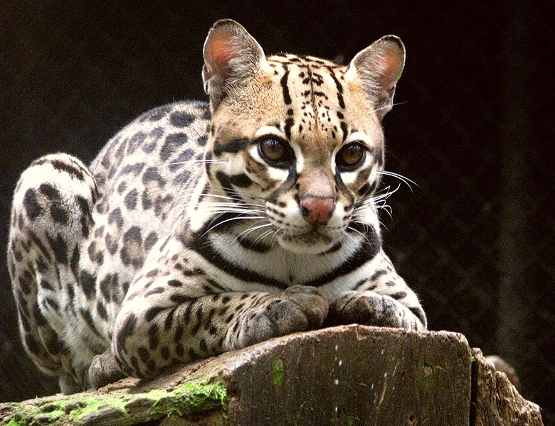
Image credit: Ana Cotta
Objectives
Create Habitat Probability maps
Create Future Habitat Probability maps
Create Percent Cover graphs
Create Road Risk maps
Notes:
There were four primary objectives for this project. First, to create habitat probability maps to show areas likely inhabited by ocelot populations. Second, create future habitat probability maps to estimate habitat growth or loss. Third, create percent cover graphs to assess the percent of ocelot habitat within the study area. Finally, create road risk maps to identify areas of road that intersect probable ocelot habitat.
Image from Wikipedia Commons: https://commons.wikimedia.org/wiki/File:Ocelot_(Leopardus_pardalis)-8.jpg

Slide 8
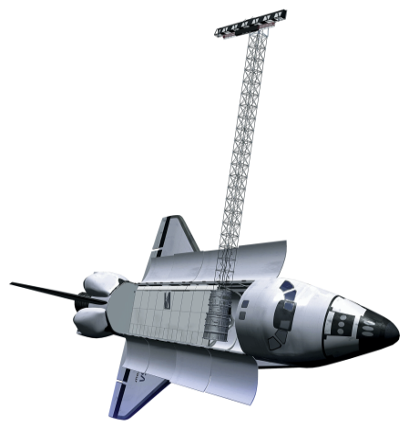
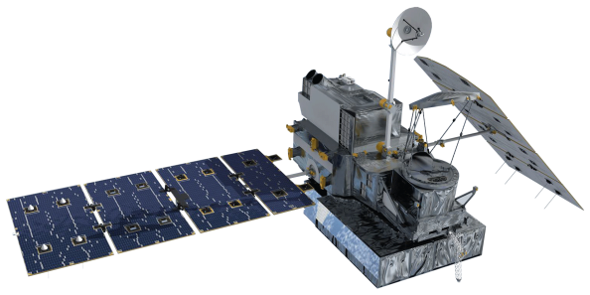
Satellites and Sensors
Landsat 5 TM
SRTM-v2
Landsat 8 OLI
Suomi NPP VIIRS
Notes:
Satellites and sensors used for this project included Landsat 5 Thematic Mapper, Landsat 8 Operational Land Imager, Suomi NPP VIIRS, and Shuttle Radar Topography Mission Version 2. Landsat 5 and Landsat 8 Level 1 data were used to create land cover classifications. Suomi NPP VIIRS data were downloaded to calculate spectral vegetation indices, specifically NDVI, to verify land cover classifications. Finally,SRTM_V2 Digital Elevation Model data were acquired for use in MaxEnt and Fuzzy Logic.

Slide 9
Methodology
Variables
Distance to streams
Areas of Forest and Scrub Brush
Slope
Protected Areas
Elevation
Climate data
Fuzzy Memberships
Fuzzy Overlay
Maximum Entropy Model
Road Networks
Habitat Probability Maps for 1996, 2004, and 2014
Habitat Percent Cover Graphs
Road Risk Maps for 1996, 2004, and 2014
Future Habitat Probability Maps for 2050 and 2070
Notes:
Distance to streams, areas of forest and scrub brush, and slope were used for the Fuzzy Logic model. Those three variables plus protected areas, elevation, and climate data were used in the MaxEnt model. Both Fuzzy Logic and MaxEnt produced habitat probability maps for 1996, 2004, and 2014, but only MaxEnt was used for future habitat probability maps, which were created for the years 2050 and 2070. The habitat probability maps were then used to generate habitat percent cover graphs. Finally, they were overlaid with road networks to create road risk maps for 1996, 2004, and 2014.

Slide 10
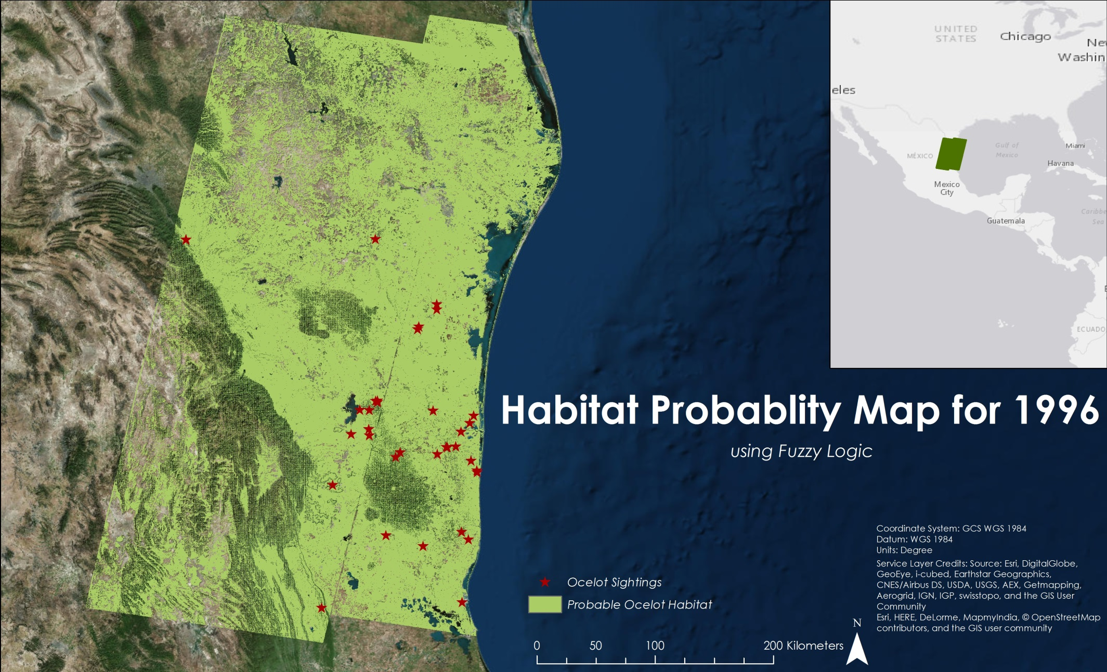
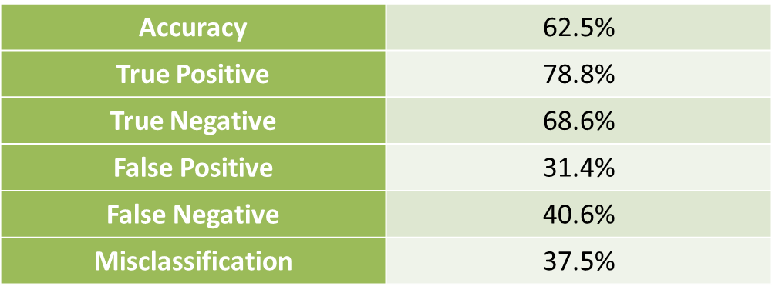
Habitat Probability – 1996
Notes:
This is the 1996 Habitat Probability Map using the Fuzzy Logic Model. As you can see, the ocelot habitat covers a majority of the study area. We performed an error matrix to determine how accurate the map is, and it showed that this map has an accuracy rate of 63%.

Slide 11
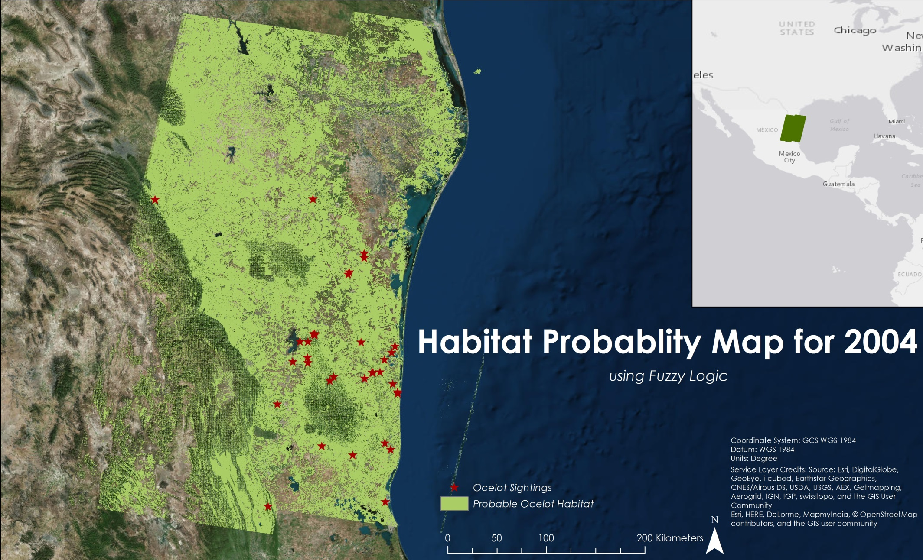
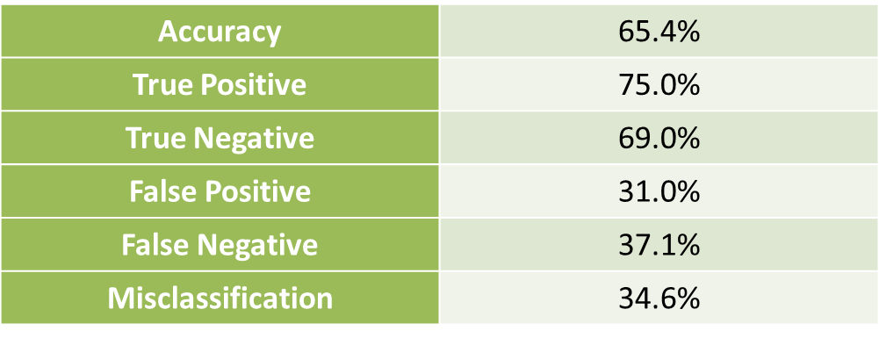
Habitat Probability – 2004
Notes:
We did this again for 2004. There was a slight decrease in ocelot habitat from 1996. This map had an accuracy rate of 65%.

Slide 12
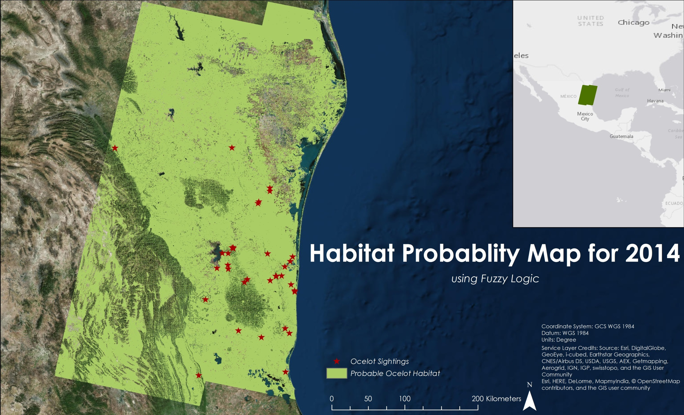
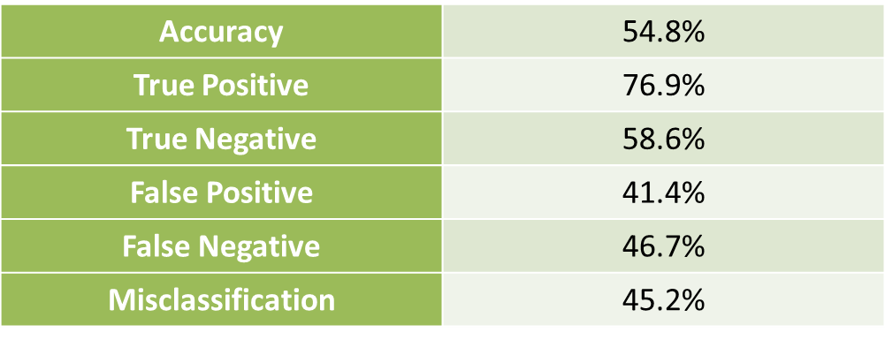
Habitat Probability – 2014
Notes:
Finally, this is the 2014 Habitat Probability Map. This showed a habitat increase from both 1996 and 2004. The error matrix showed an accuracy of 55%.

Slide 13
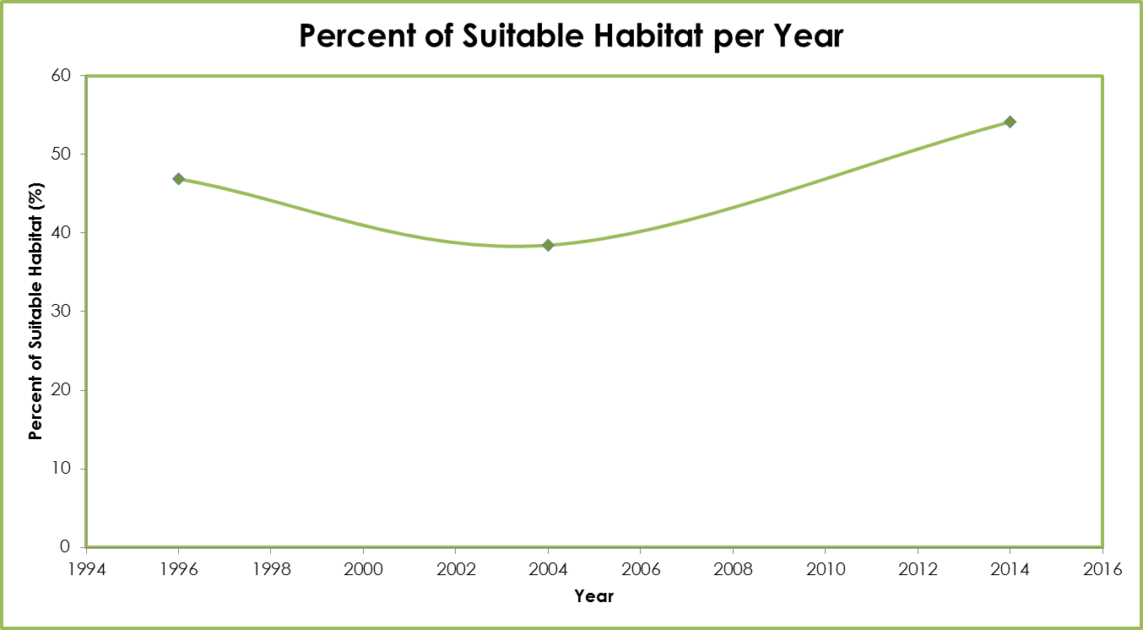
Percent Cover Graph
Notes:
This is the Percent Cover Graph showing the amount of ocelot habitat over the study area. There was a decrease in habitat from 1996 to 2004, and a habitat increase from 2004 and 2014. In 2014, the ocelot habitat covered 54% of the study area.

Slide 14
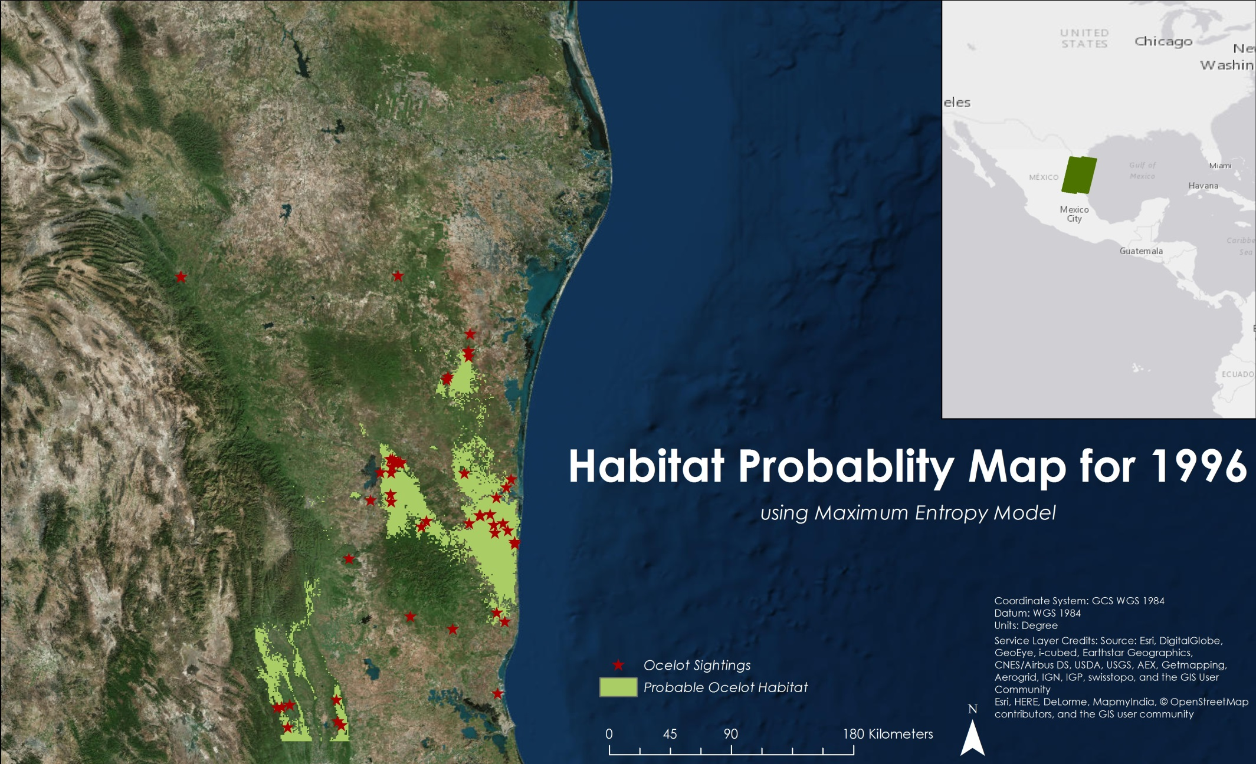
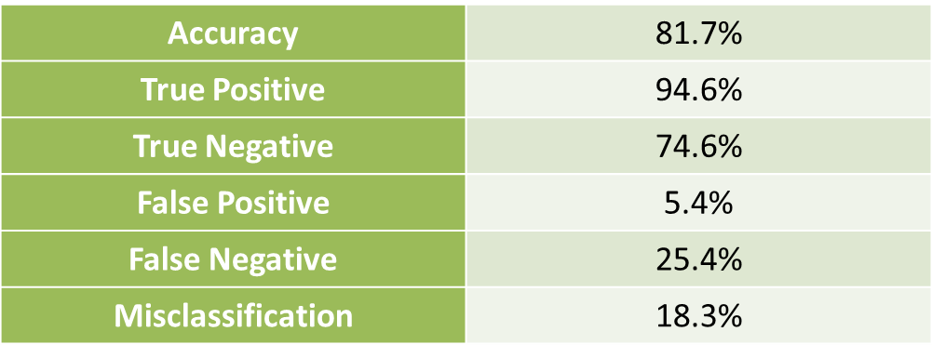
Habitat Probability – 1996
Notes:
This is the 1996 Habitat Probability Map using the Maximum Entropy Model. As you can see, the output of this shows the ocelot habitat covers a smaller amount of the study area than the previous maps. The error matrix for this showed an accuracy rate of 82%.

Slide 15
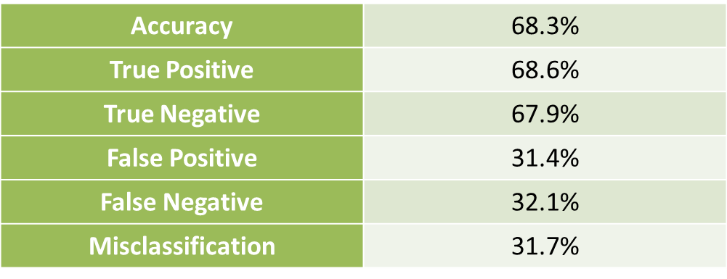
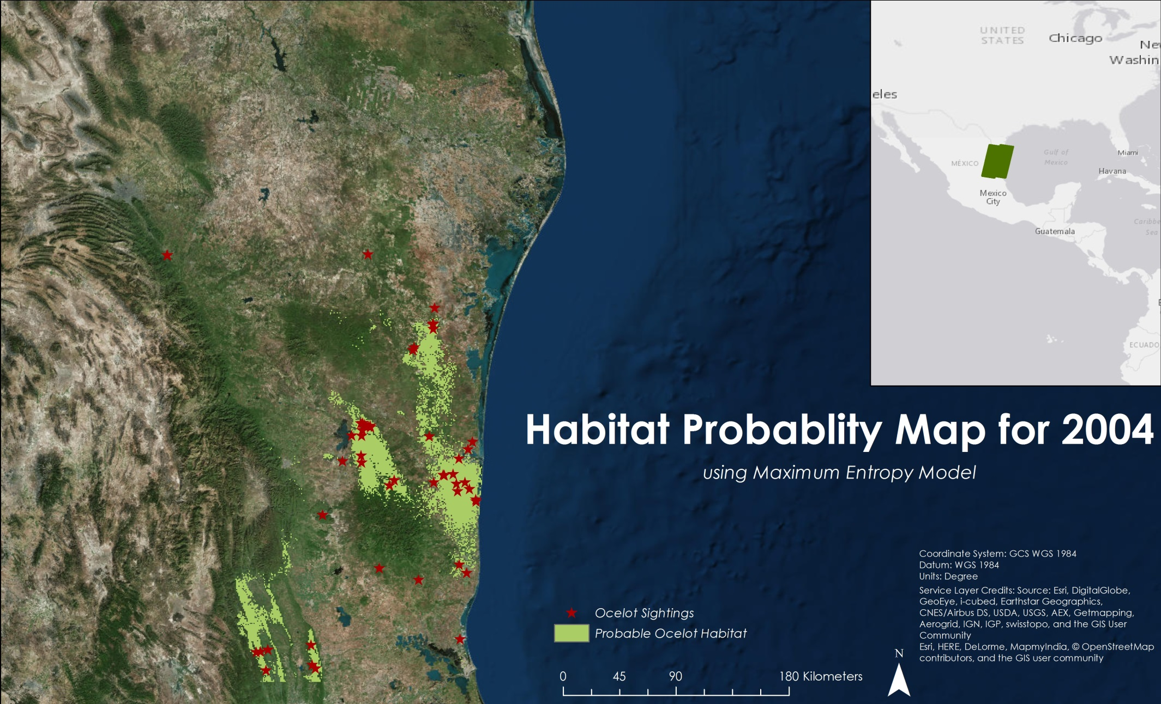
Habitat Probability – 2004
Notes:
For 2004, the ocelot habitat did not change much, but there was a slight decrease in habitat. This map has an overall accuracy of 68%.

Slide 16
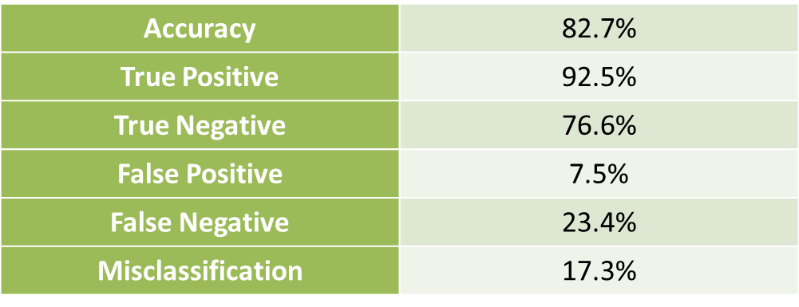
Habitat Probability – 2014
Notes:
Again, for 2014 there was not much change of ocelot habitat, but there was a slight increase. The error matrix showed an overall accuracy of 83%.

Slide 17
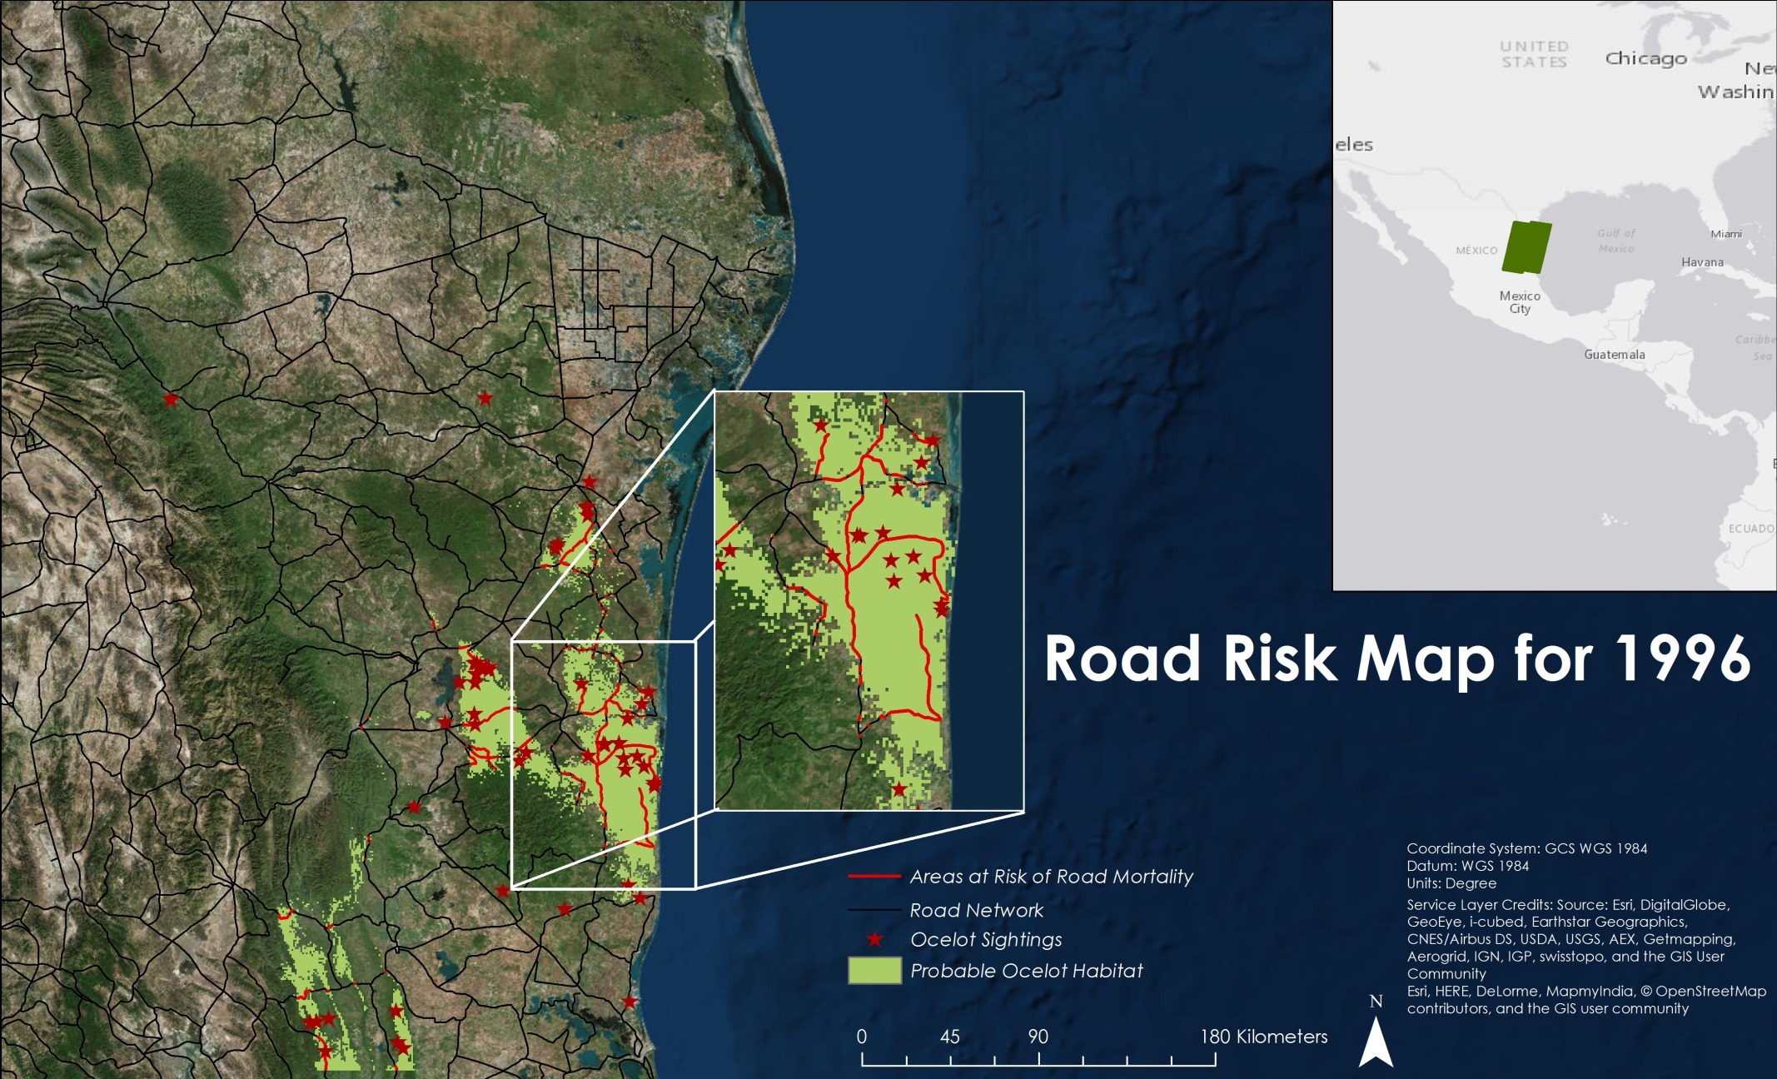
Road Risk – 1996
Notes:
Road Risk maps were created by intersecting Mexican roads with the results found in the MaxEnt model that show the most probable habitat which are of values over 0.5 on a scale from 0 to 1. For 1996 the total length of roads that intersect ocelot habitat was 544.3 kilometers.

Slide 18
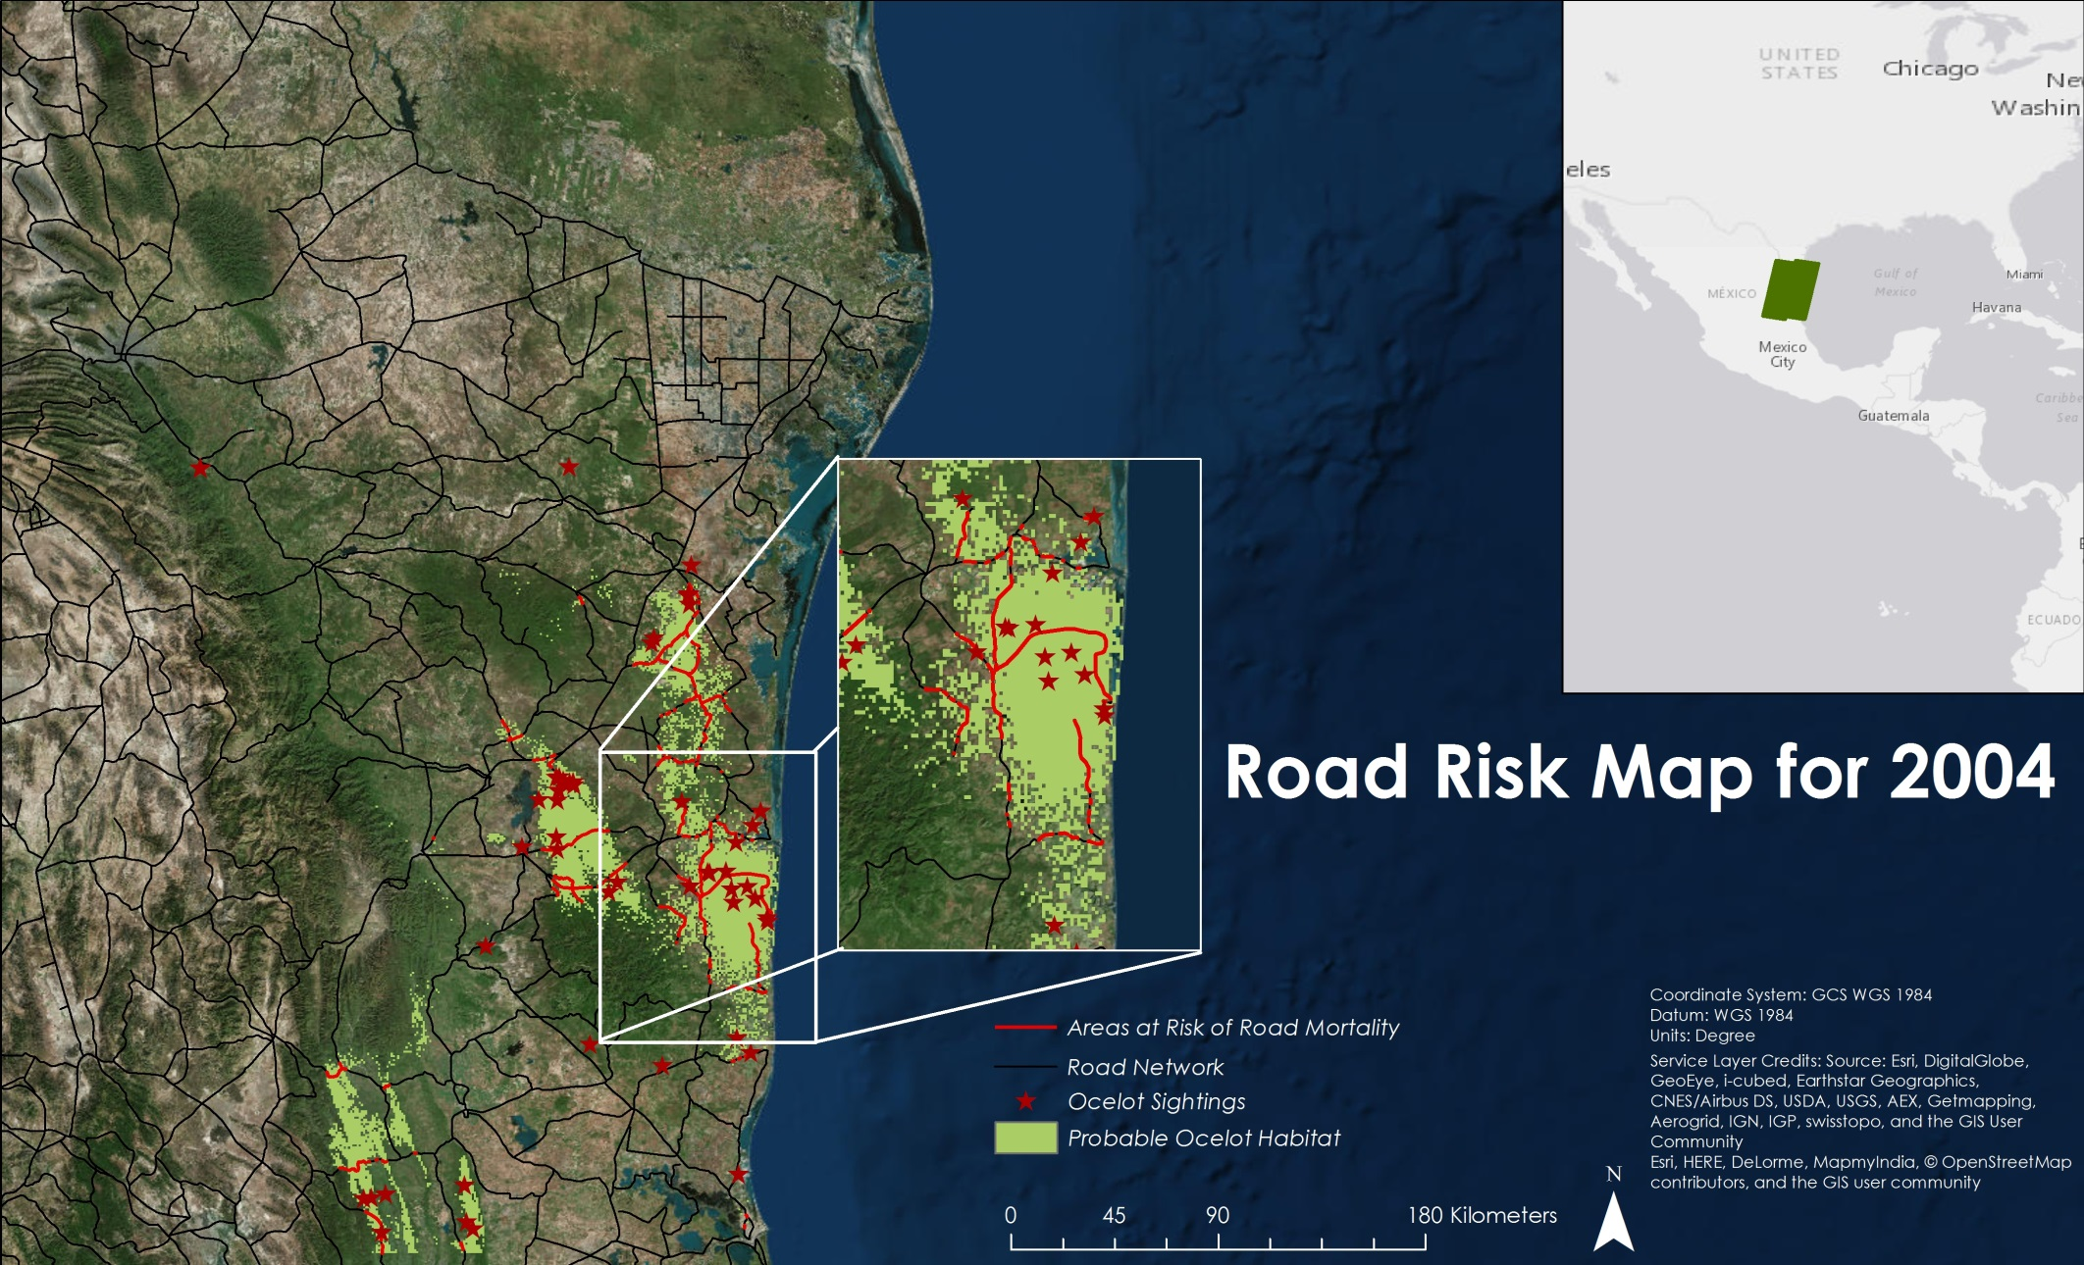
Road Risk – 2004
Notes:
The total length of road risk decreased in 2004 to 495.2 kilometers mainly due to the fact that the MaxEnt model showed a decrease in habitat, so less roads are intersecting.

Slide 19
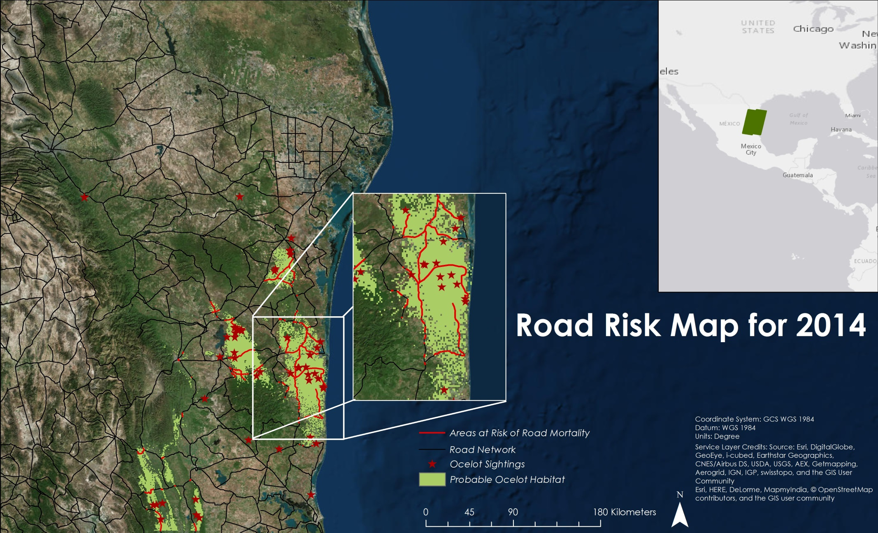
Road Risk – 2014
Notes:
Then for 2014 the total road length decreased again to 486.3 kilometers.

Slide 20
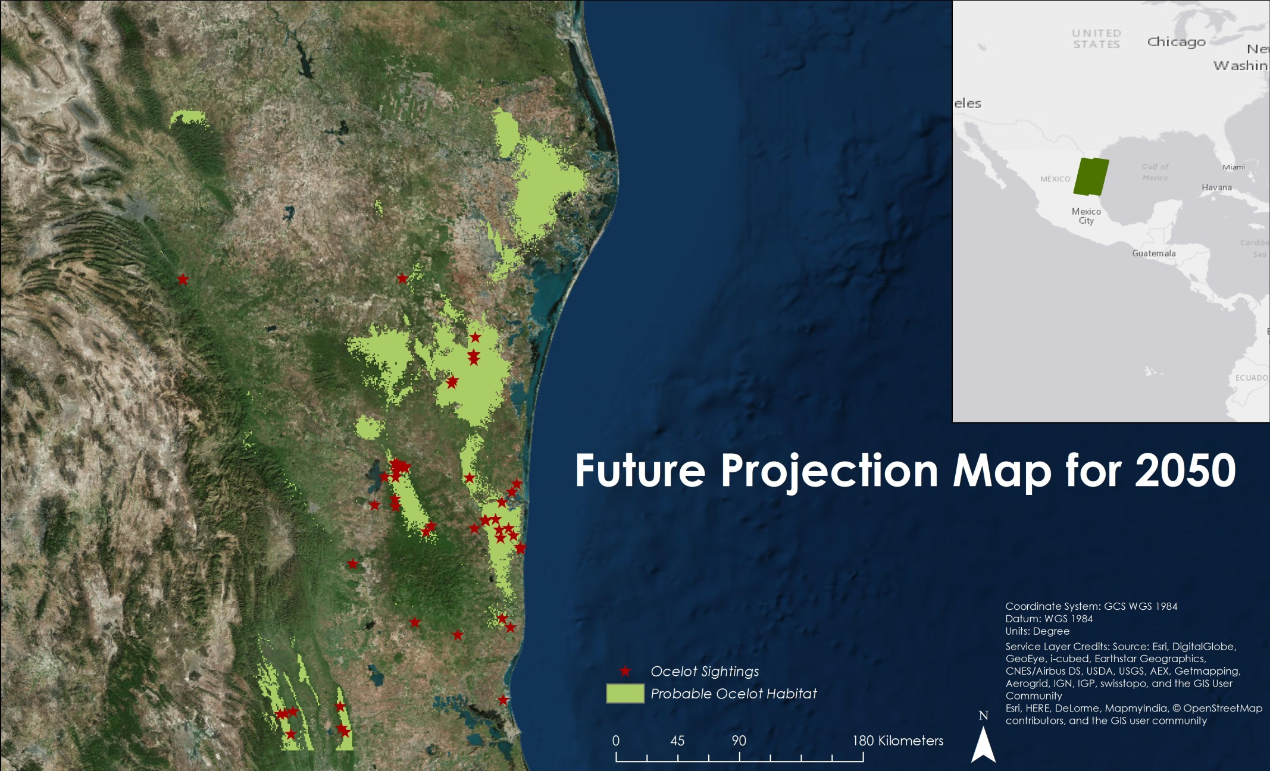
Future Projection – 2050
Notes:
Future projection maps were created for the years of 2050 and 2070 using NASA GISS-E2-R climate prediction model. These maps show the representative concentration pathway 8.5 model which represents the situation of greenhouse gases rising through the end of the century. By 2050, there is predicted to be increased precipitation and winter temperatures for this area of Mexico, which allows for a growth in vegetation that ocelots use as habitat.

Slide 21
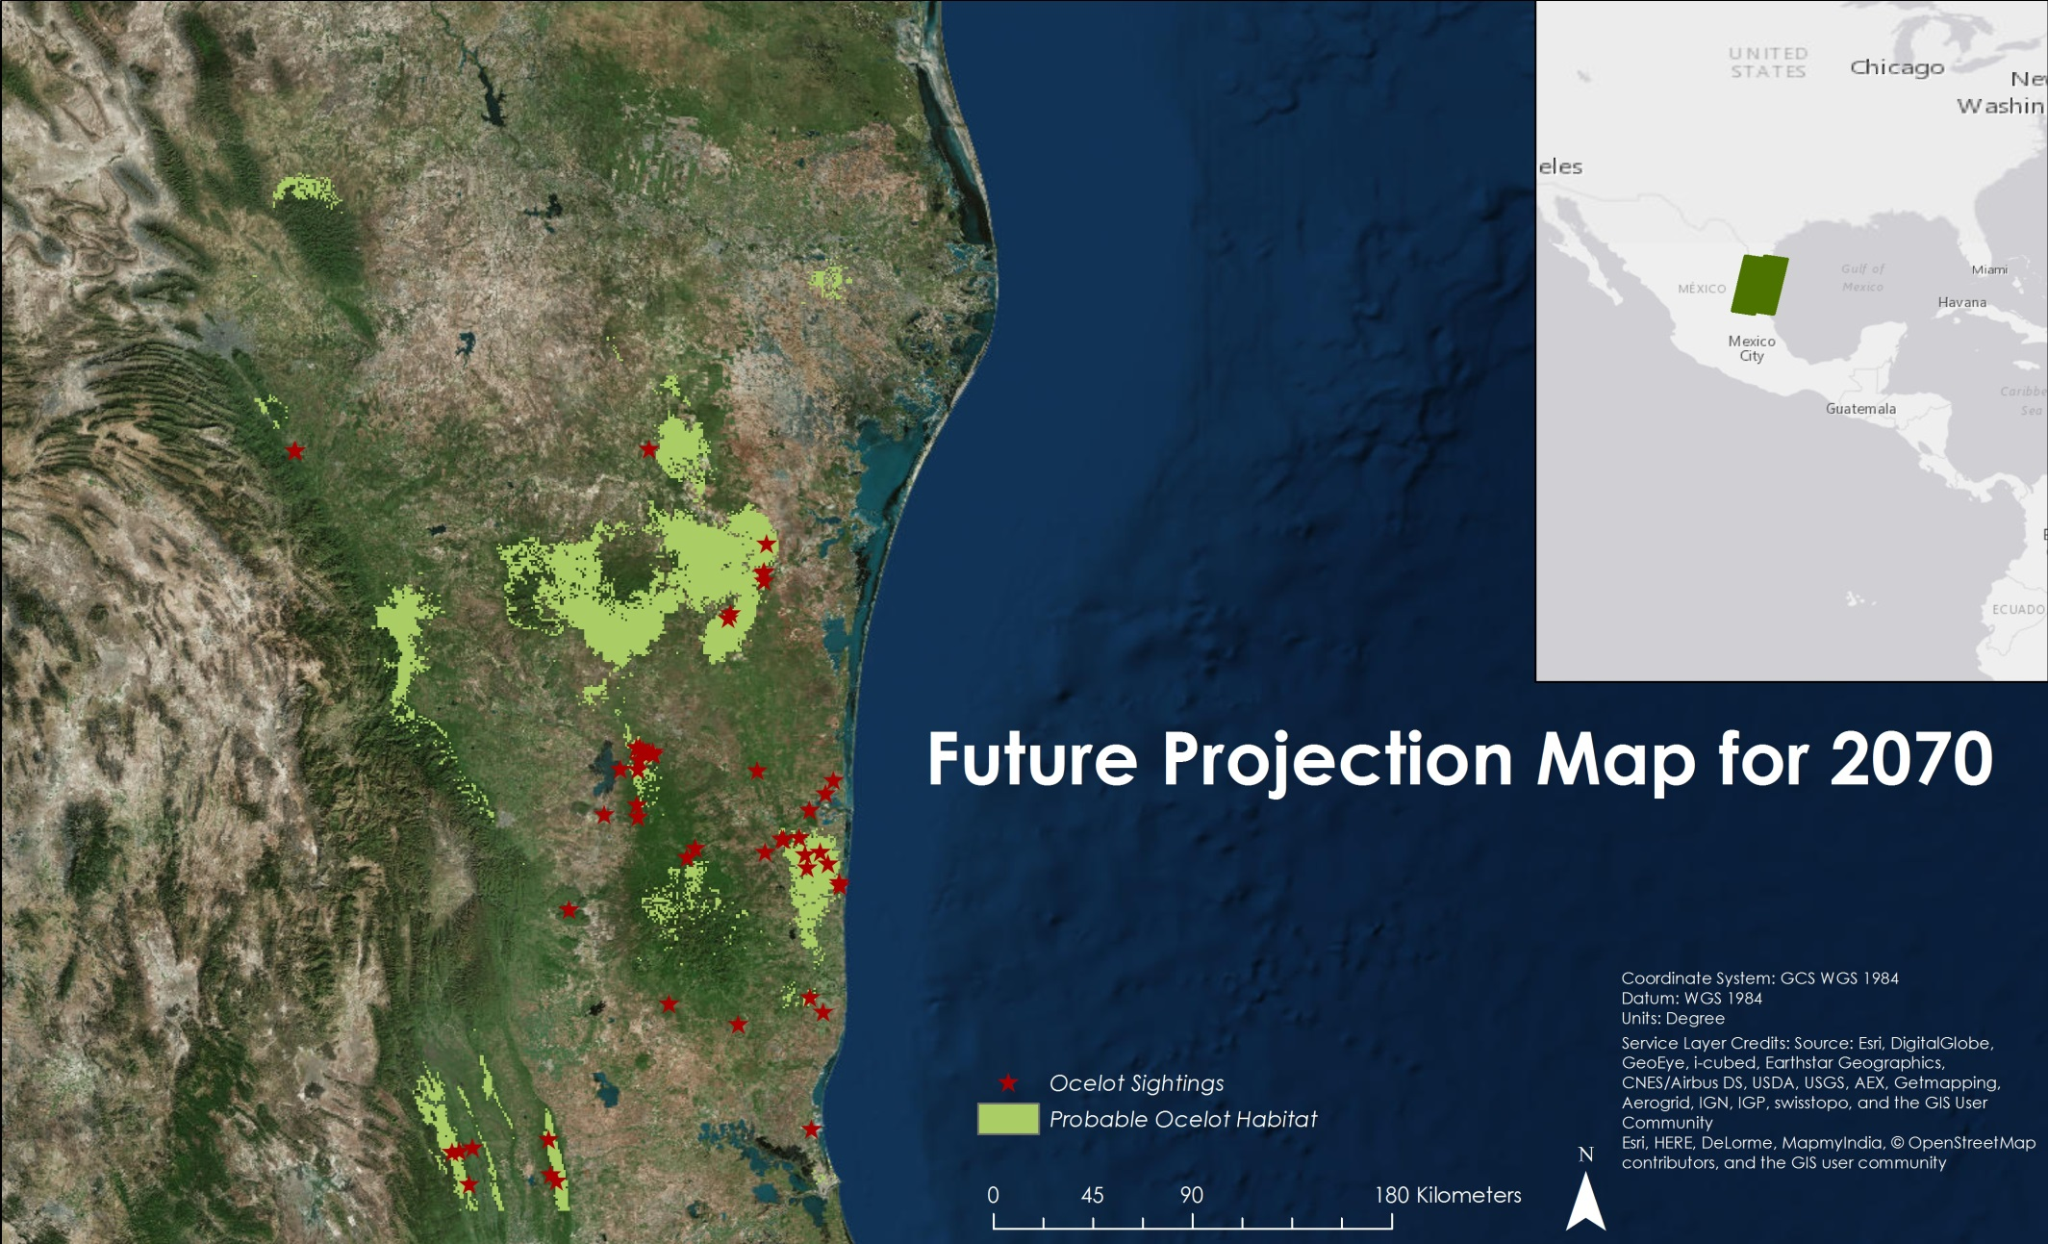
Future Projection – 2070
Notes:
Then between 2050 and 2070 there was predicted to be a decrease in suitable ocelot habitat based on the same climate model.

Slide 22
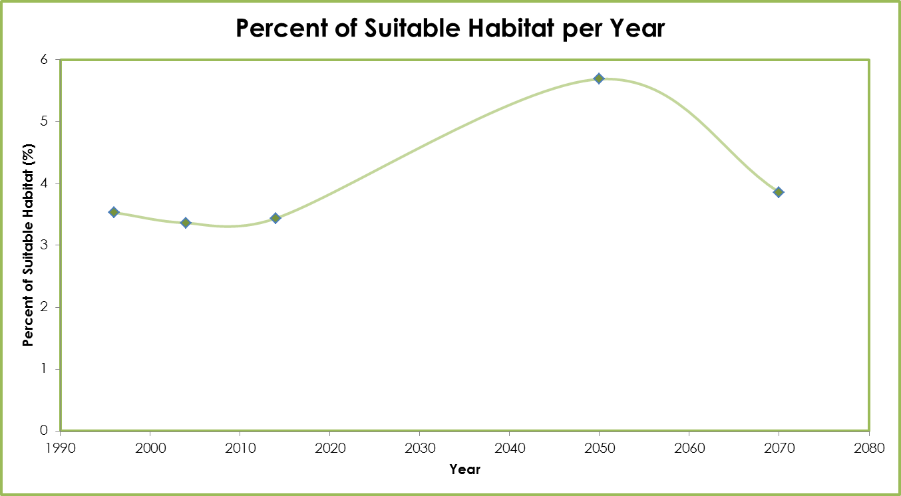
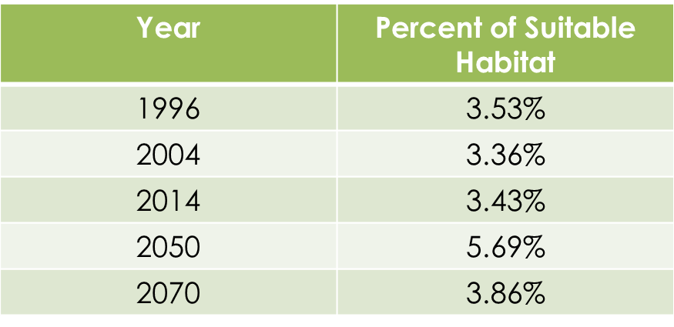
Percent Cover Graph
Notes:
This is a percent cover graph that shows the percentages of suitable ocelot habitat for the study period and for future years based on the MaxEnt model. There was found to be a decrease in suitable ocelot habitat between 1996 and 2014 , then a predicted increase in habitat by 2050 by about 2.3%, and finally a predicted decrease of about 1.8% in habitat by 2070

Slide 23
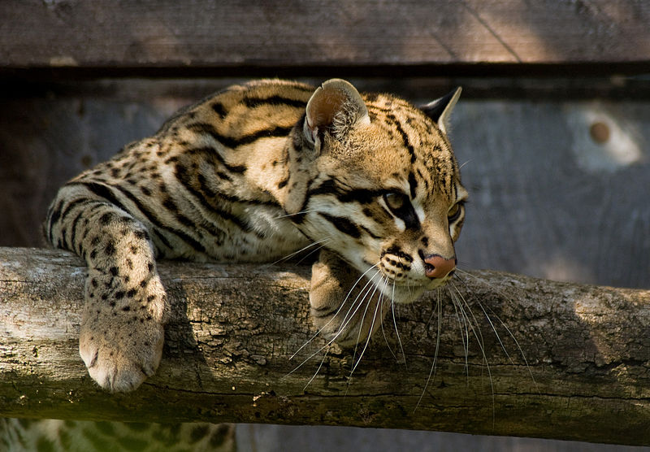
Image Credit: Spencer Wright
Conclusions
Fuzzy Logic outputs showed an overall increase in habitat between 1996 and 2014 while MaxEnt showed an overall decrease
MaxEnt output was more accurate than Fuzzy Logic output for all three years
Future habitat is expected to increase from 2014 to 2050 but then decrease between 2050 and 2070
Notes:
The fuzzy logic output showed that there was to be a net increase in ocelot habitat while the MaxEnt showed an overall decrease for the study period. However, the MaxEnt proved to be more reliable because it had an accuracy ranging from about 70-80% whereas the Fuzzy logic had about a 55-65% accuracy. And finally for future years, there was predicted to be a dramatic increase in habitat by 2050 and a decrease by 2070, solely based on climatic factors.
Image from Wikimedia Commons: https://commons.wikimedia.org/wiki/File:Ocelot_Santago_Leopard_Project_2.jpg

Slide 24
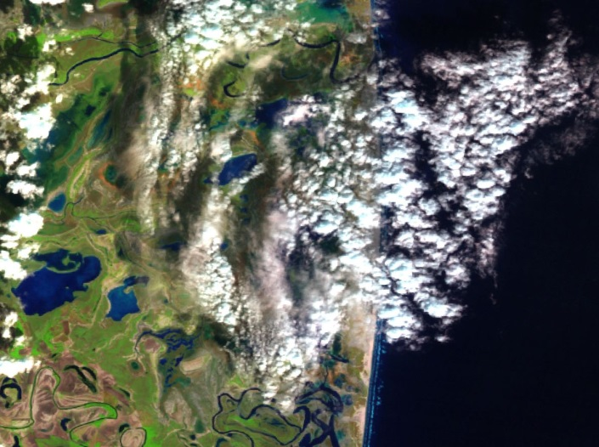
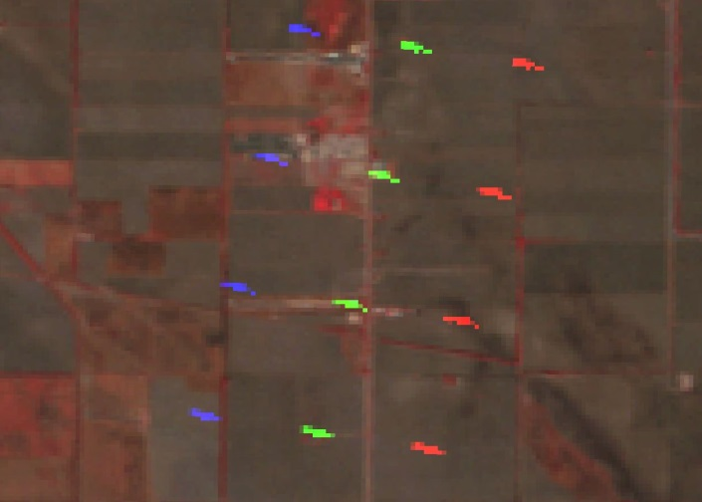
Errors and Uncertainties
Cloud cover
Repeating dashes of erroneous data
Amount of in-situ data
Future projections did not include urban growth or land cover change
Notes:
Uncertainties were caused by the presence of clouds in the Landsat images. This caused some of the data to be misclassified or not classified at all. There were also repeating dashes of erroneous data in some of the Landsat imagery, leading to further errors in the land classifications. Also, more in-situ data would be beneficial to get a better idea of what habitat the ocelot prefers. When creating the future projections, the model did not include both urban growth and land cover change.

Slide 25
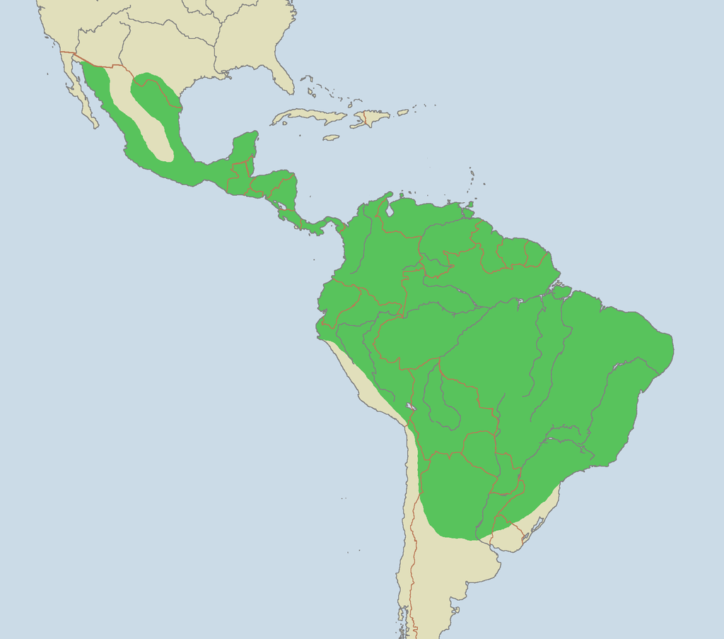
Future Work
Expand study area to Central America
Location of additional ocelot habitat will aid translocation
Use of the SLEUTH model to create potentially more accurate future habitat projections
Current ocelot habitats:
Borders:
Rivers:
Image credit: Laurascudder
Notes:
Future work for this project will include using the Habitat Probability Maps to assess ocelot habitat in Central America where the ocelot populations are more prominent. Additionally, the gathering of more location data will aid in translocation of ocelots. Additionally, the gathering of more location data will aid in translocation of ocelots and the restoration of their habitats. Finally, the use of the SLEUTH model can be used to better assess future habitat populations.
Image from Wikipedia Commons: https://commons.wikimedia.org/wiki/Leopardus_pardalis#/media/File:Ocelot_range.png

Slide 26
Advisors
Dr. Jeffrey Luvall, NASA at NSSTC
Dr. Robert Griffin, University of Alabama in Huntsville
Partners
Ken Kaemmerer, Pittsburg Zoo & PPG Aquarium
Dr. Josh Gaspard, Pittsburg Zoo & PPG Aquarium
Michael Tewes, Caesar Kleberg Wildlife Research Institute at Texas A&M University-Kingsville
Dr. Humberto Perotto, Caesar Kleberg Wildlife Research Institute at Texas A&M University-Kingsville
Nanette Bragin, The Denver Zoo
Mitch Sternberg, South Texas Refuge Complex
Dr. John Young Jr, Texas Department of Transportation
Dr. Arturo Caso, SEMARNAT
Dr. Arturo Flores-Martinez, SEMARNAT
Dr. Tyler Campbell, East Wildlife Foundation
Others
Daryl Ann Winstead, NASA DEVELOP
Christina Fischer, NASA DEVELOP
Amberle Keith, DEVELOP Alumni
Kaushik Narasimhan, DEVELOP Alumni
Timothy Klug, University of Alabama in Huntsville GRA
Notes:
We would like to thank our advisors, Dr. Jeffrey Luvall and Dr. Robert Griffin, for their guidance and support. We would also like to thank all of our project partners for their guidance, data, and support for this project. Finally, we would like to thank the Texas and Arizona Ecological Forecasting team.

Slide 27
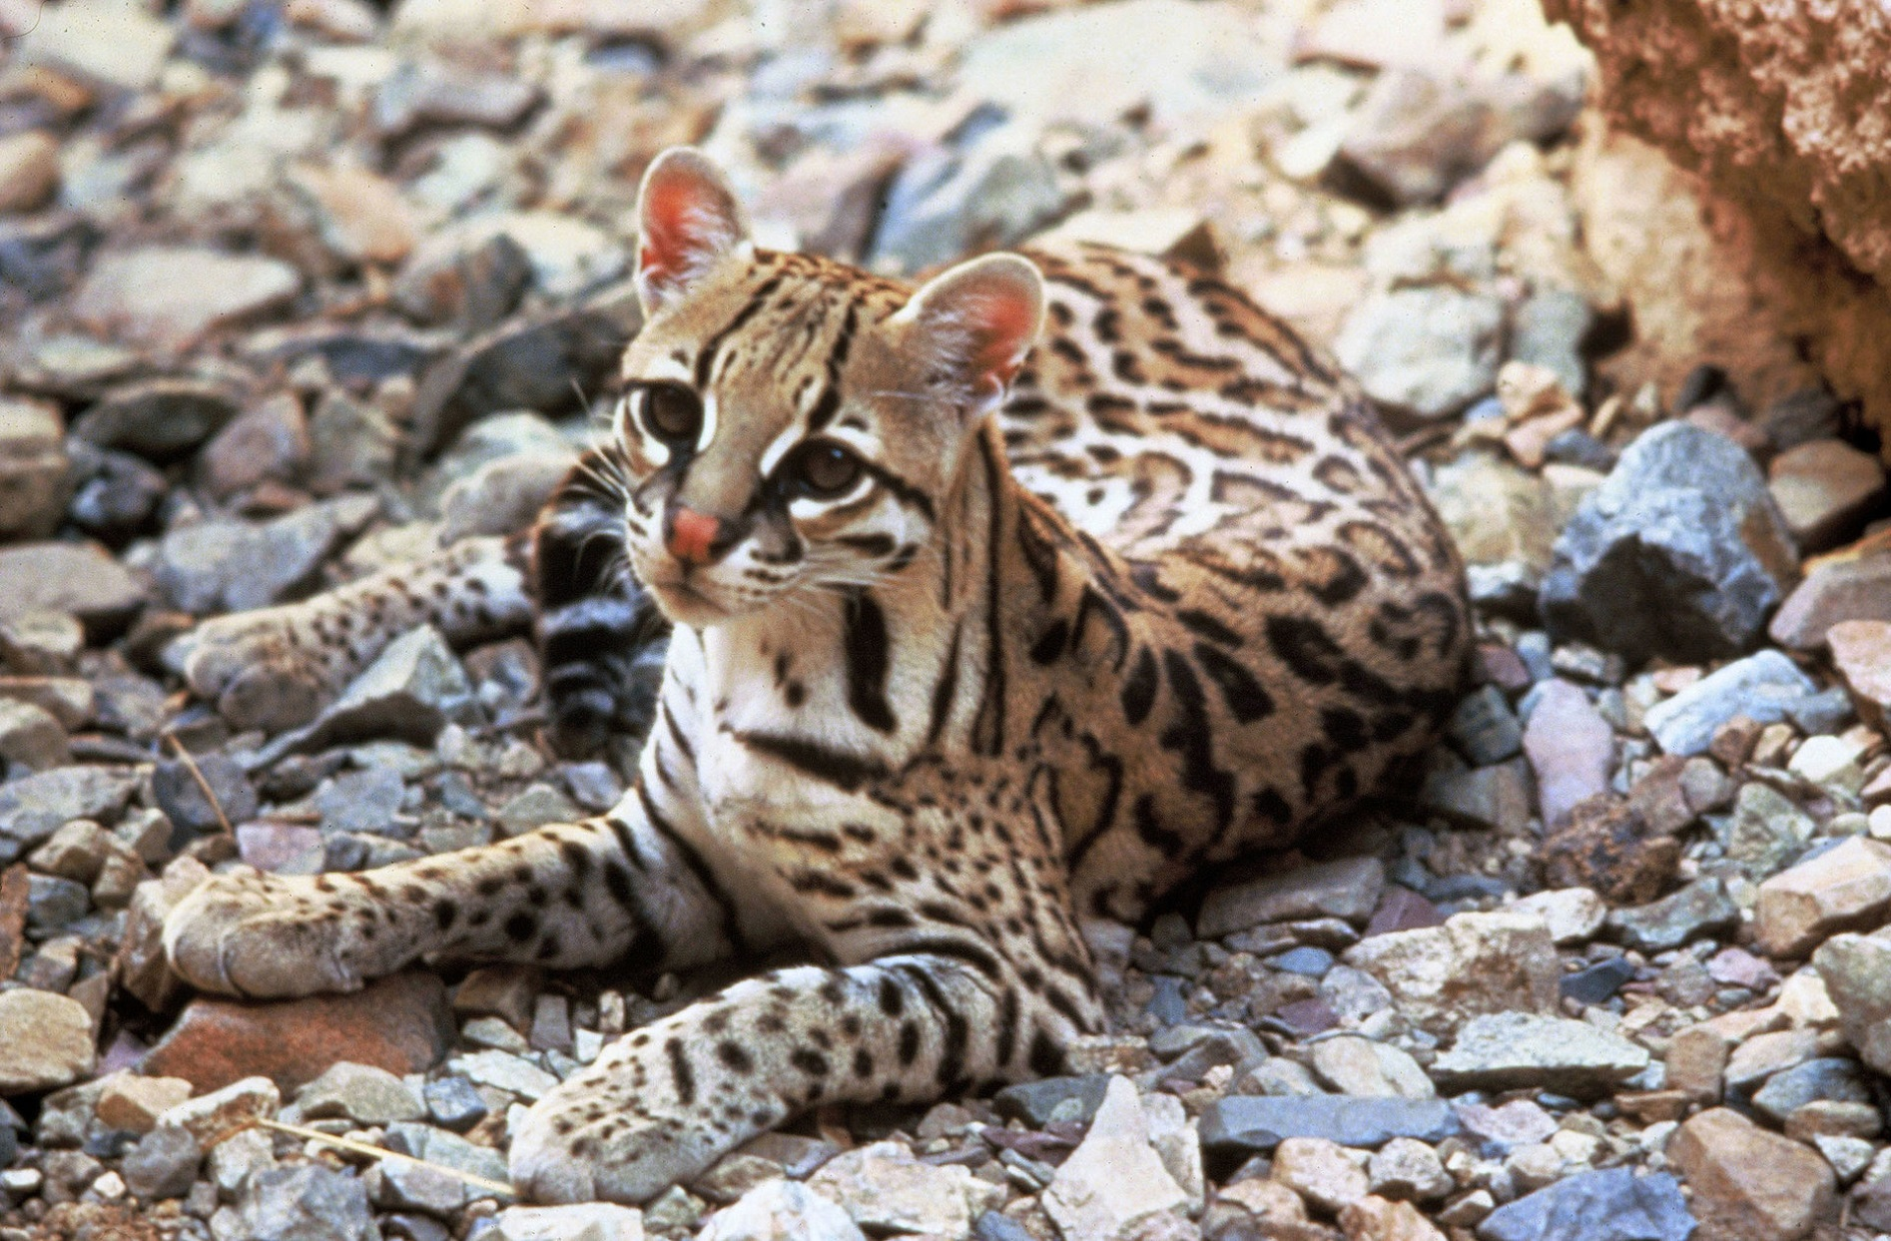
Questions?
Image credit: Tom Smylie
Notes:
Are there any questions at this time?
Image from Wikipedia Commons: https://commons.wikimedia.org/wiki/Leopardus_pardalis#/media/File:Ocelot.jpg

