Slide 1
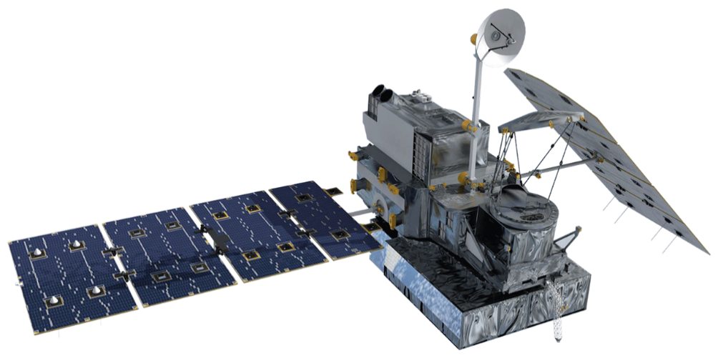
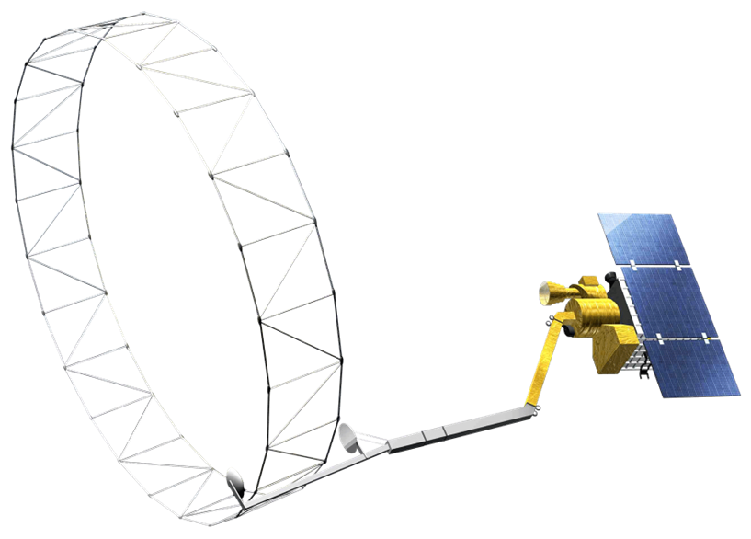
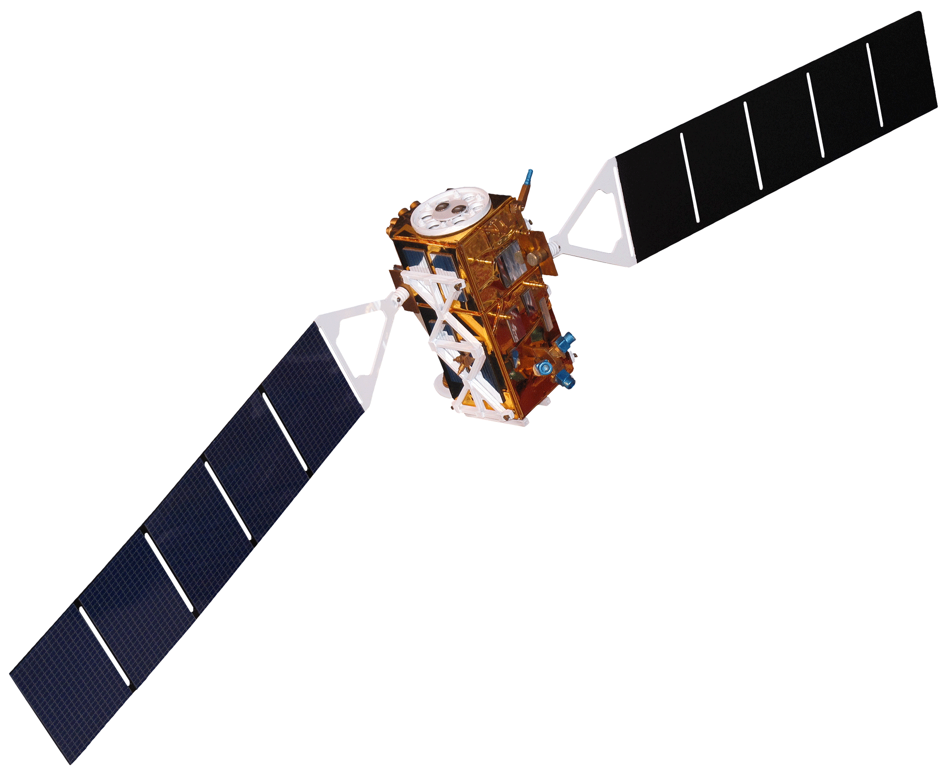
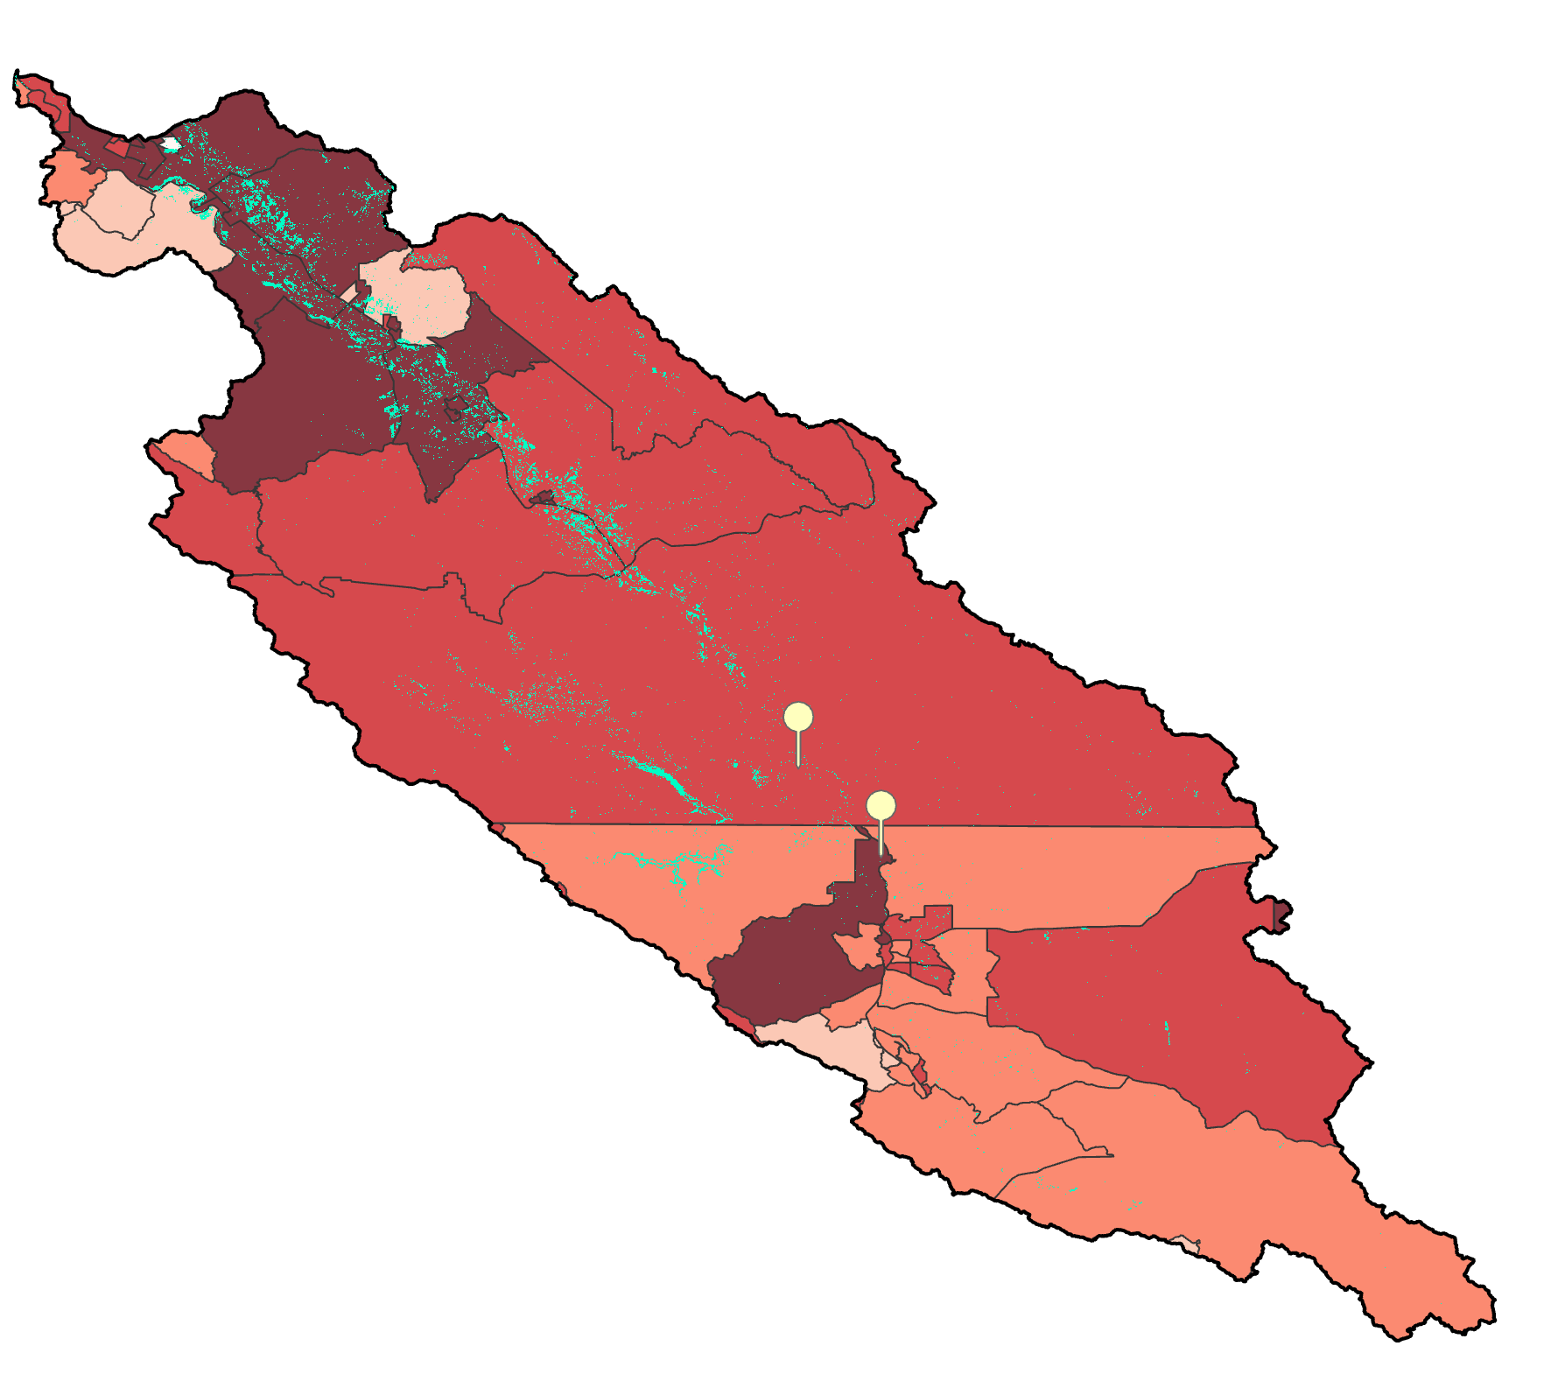
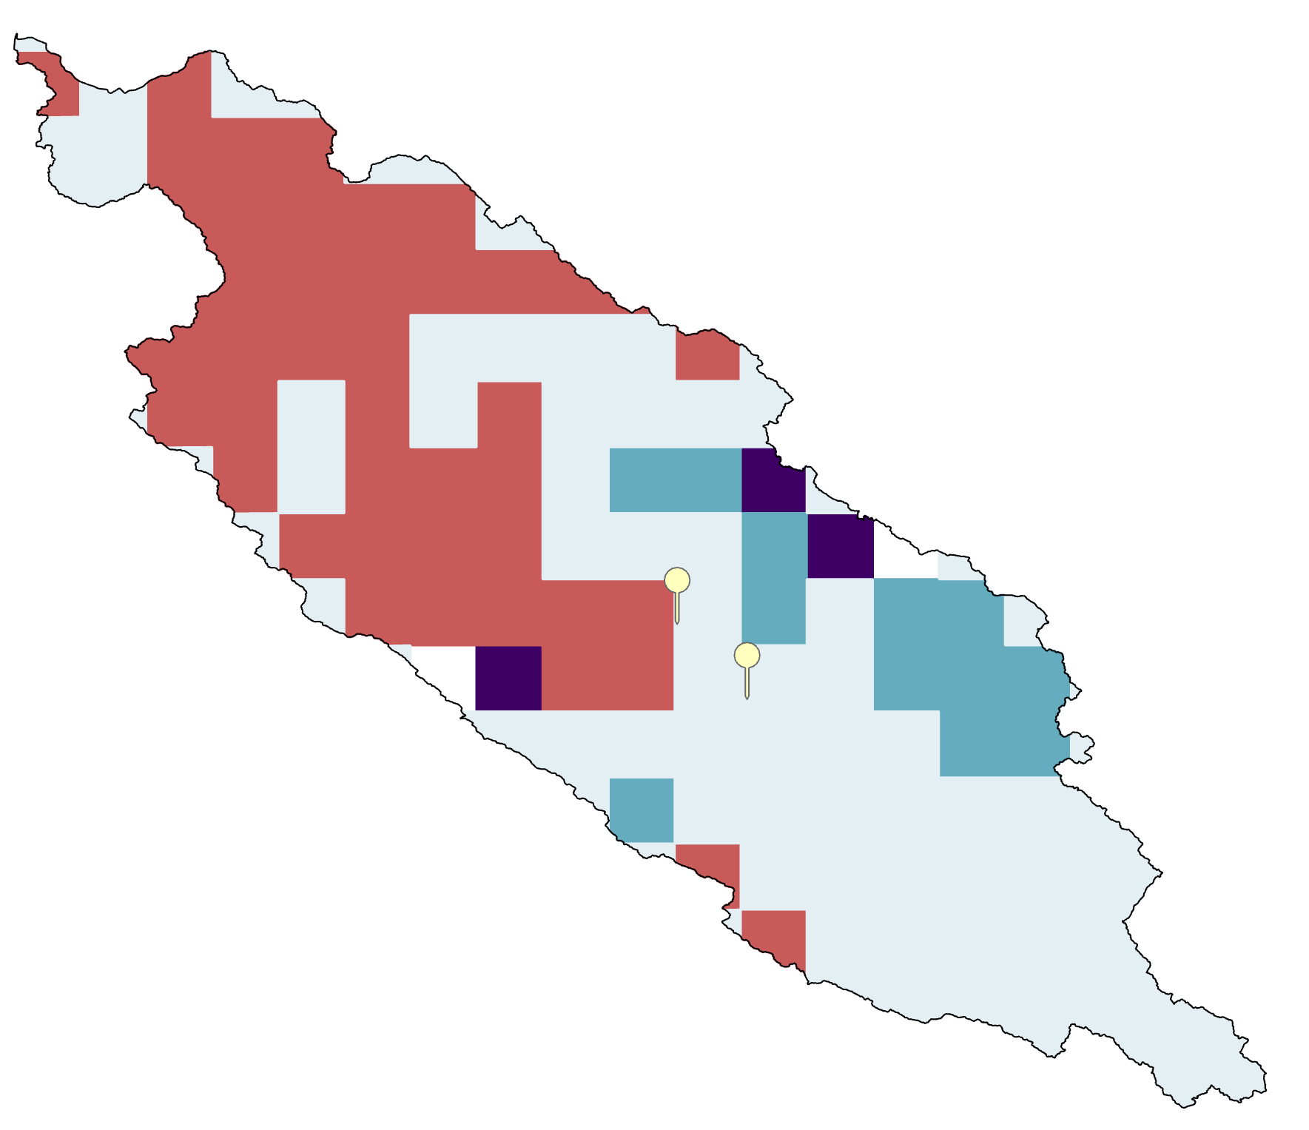
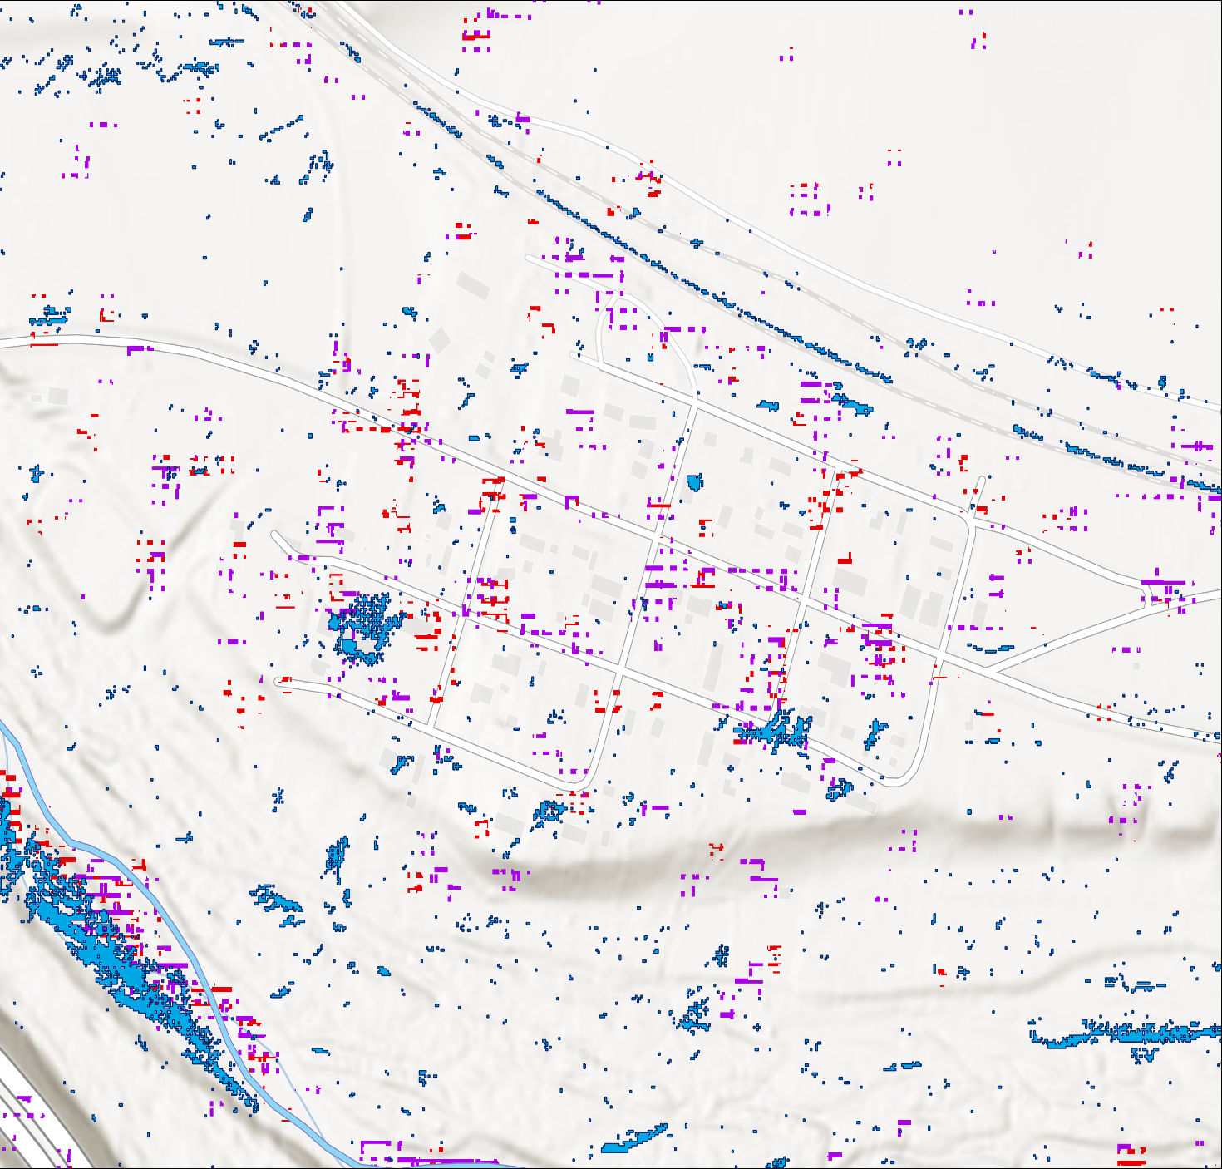
CENTRAL CALIFORNIA DISASTERS
Incorporating Satellite-Derived Precipitation and Soil Moisture Products into Flood Preparedness and Emergency Management in California
Motives & Objectives
Can satellite precipitation and soil moisture data help the State of California prepare for and manage flooding disasters?
Precipitation
Atmospheric rivers brought excessive rainfall in Winter 2022-23
Soil Moisture
Higher soil moisture increases pluvial flooding risk
Land Cover & Elevation
Elevation and changes in land cover affects flood behavior
Vulnerability
Communities face unequal flood risks
Global Precipitation Measurement Core Observatory (GPM Core)
Soil Moisture Active Passive (SMAP)
Sentinel 1 C-Synthetic Aperture Radar (C-SAR)
Results & Key Takeaways
N
0
25
50 Km
Basemap Credit: Esri Community Maps Contributors, California State Parks, © OpenStreetMap, Microsoft, Esri, TomTom, Garmin, SafeGraph, GeoTechnologies, Inc, METI/NASA, USGS, Bureau of Land Management, EPA, NPS, US Census Bureau, USDA, USFWS
Possible Flood Inundations from two events
Levels of Vulnerability
No Data
High Rainfall
0 – 25%
Possible Soil Saturation
25% - 50%
High
50% - 75%
Low
Low
High
75% - 100%
The State of California may incorporate soil moisture and precipitation values in their flood assessment models.
Team Members
Partners & Acknowledgments
The team would like to thank everyone who made this project possible:​
Partner: MD Haque (California Department of Water Resources)
Science Advisor: Dr. Venkataraman Lakshmi (University of Virginia)
Lead: Isabel Lubitz (NASA DEVELOP)
Special thanks for technical expertise: Dr. Venkataraman Lakshmi’s PhD Lab Group
Abhinav Banthiya
Project Lead
Shagun Sengupta
Chanice Brown
Jan Hery
Pop-Up Project | Spring 2024

