Slide 1
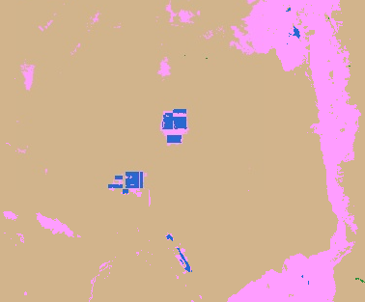
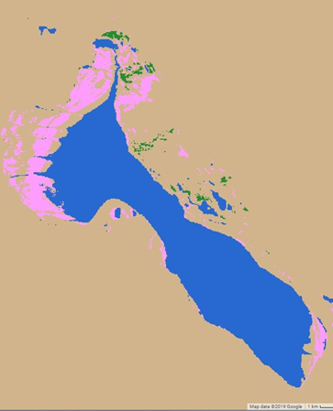
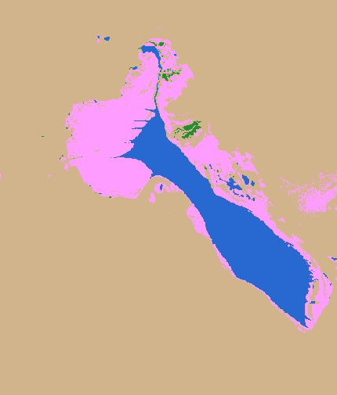
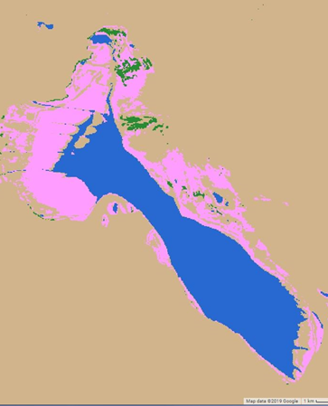
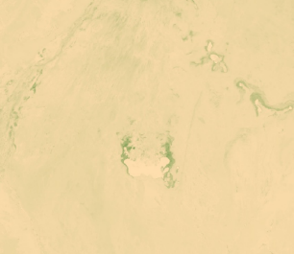
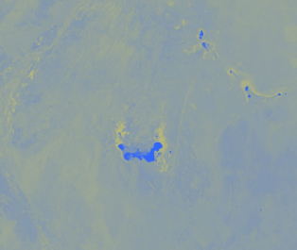
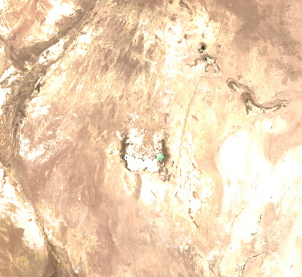
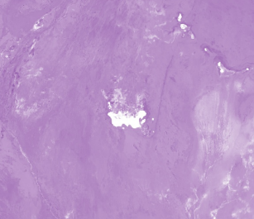
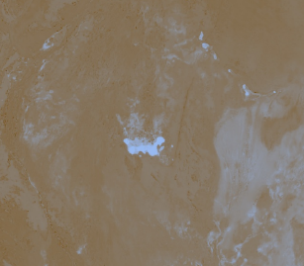
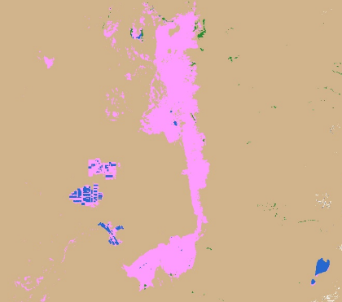
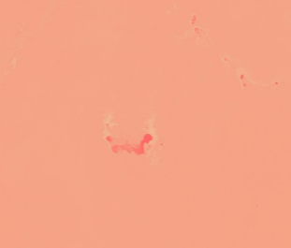
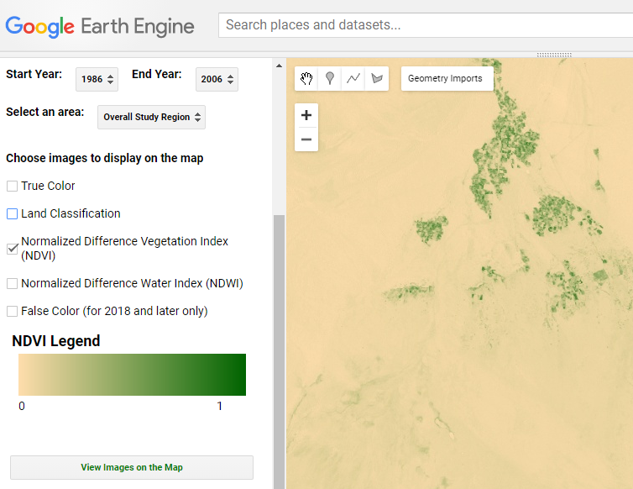
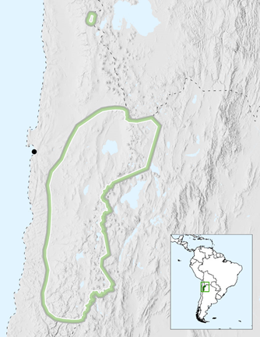
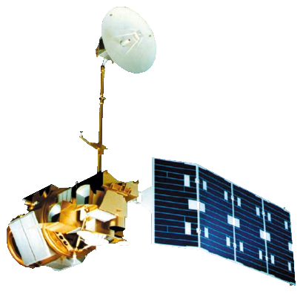
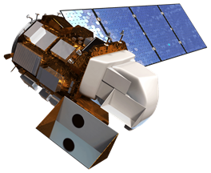
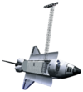
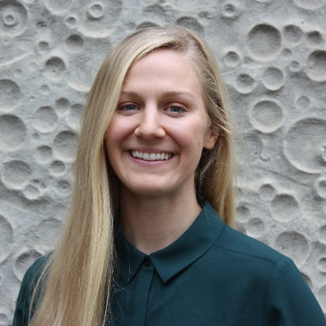
Monitoring the Extent and Distribution of Saline Systems in Chile’s Atacama Desert Utilizing NASA Earth Observations
Abstract
Objectives
Chile Water Resources
Saline systems, consisting of salt flats, ponds, and marshes, provide vital water resources to northern Chile’s Atacama Desert, one of the driest regions in the world. Mining is extensive in the Atacama, which contains 30% of the world’s lithium reserves and is abundant in potassium and boron. The groundwater that feeds into salt marshes and ponds is extracted in large volumes for mining operations, limiting the availability of water for local indigenous communities and ecosystems. The Chile Water Resources team at NASA Ames Research Center, in collaboration with la Universidad de La Serena, partnered with Servicio Nacional de Geología y Minería (SERNAGEOMIN), a Chilean national agency, to create a Saline Analysis Tool (SalT) in Google Earth Engine (GEE) to monitor the extent and distribution of these remote saline systems. The tool incorporates Earth observations from Landsat 5 Thematic Mapper (TM), Landsat 8 Operational Land Imager (OLI), Landsat 8 Thermal Infrared Sensor (TIRS), and Shuttle Radar Topography Mission (SRTM). SalT outputs include a land classification map for each year and charts displaying how Normalized Difference Vegetation Index (NDVI) and Normalized Difference Water Index (NDWI) have changed over the study period. The tool was used to analyze changes in the Atacama from 1986 to 2018, and outputs were compared to precipitation and temperature data for the final analysis. The ability to visualize how these saline systems have changed over time will help SERNAGEOMIN understand the regional impacts of mining operations and changes in climate.
Classify land types throughout the Atacama Desert using multiple spectral indices
Analyze how the extent and distribution of Atacama Desert saline systems have changed over time
Provide decision-making support to project partners by creating a Saline Analysis Tool (SalT) in GEE that can be used in future years to monitor the extent and health of saline systems
Results
Barren/Other
N
N
N
Vegetation
Water
Salt
Snow
1986
5 km
2000
5 km
2018
5 km
Methodology
N
Figure 1 (above). The extent of water in artificial mining pools has significantly increased in Salar de Atacama since 1986.
Figure 2 (left). Some natural saline lakes, such as Salar de Tara, show signs of decreasing water levels.
Google Earth Engine – Saline Analysis Tool (SalT)
Outputs
Spectral Indices
Charts of NDVI and NDWI over time
NDVI
1986
2000
2018
1 km
NDWI
Land Classification
Landsat 5 and Landsat 8 imagery
NDSI
(snow)
NDWI (Standardized)
NDVI (Standardized)
Precipitation (Normalized)
NDSI
(soil)
Calculate thresholds for land cover types
Time Series Maps
Precipitation (Normalized)
Barren/Other
NDSI
(salinity)
Vegetation
Water
Salt
Snow
Figures 3 (upper left) and 4 (above). NDWI and NDVI show no significant trend over time. Some variation may be due to total annual precipitation. NDWI and NDVI were standardized to make values more consistent across sensors.
NDVI, NDWI, Normalized Difference Snow Index (NDSI), Normalized Difference Soil Index (NDSI), and Normalized Difference Salinity Index (NDSI) were used to classify Landsat imagery in Google Earth Engine, along with elevation data from SRTM.
Study Design
Earth Observations
N
Study Area
Landsat 5 TM
Years:
1986 to 2012
Figure 5 (left). SalT was created with a graphical user interface in GEE to make NASA Earth observations more accessible to users without coding experience.
Antofagasta
Landsat 8 OLI & TIRS
Years:
2013 to present
Conclusions
140 km
SRTM
Thresholding of multiple spectral indices accelerated the ability to classify through time without training points for each year.
Overall NDWI and NDVI values show no significant trends, although some study sites indicate that water levels are changing.
The Saline Analysis Tool (SalT) enables rapid generation of land classification, NDVI, and NDWI maps over a 30 year time period and can be used for future monitoring by the partner organization.
Year: 2000
Study Area
Atacama Desert in Northeastern Chile
Study Period
Years: 1986 to 2018
Months: September to November (greenest season in the Atacama)
Project Partners
Team Members
Servicio Nacional de Geología y Minería (SERNAGEOMIN) (Chile)
Universidad de la Serena, Chile
Acknowledgements
Paula Olea Encina, Geographer (SERNAGEOMIN), Dr. Ricardo Cabezas, Professor (La Universidad de La Serena, Chile), Dr. Juan Torres-Perez, Science Advisor (Bay Area Environmental Research Institute, NASA Ames Research Center), Dr. Kenton Ross, Science Advisor (NASA Langley Research Center), John Dilger, Science Advisor (Spatial Informatics Group, LLC), Farnaz Bayat, DEVELOP Center Lead (California – Ames Node), Jerrold Acdan, DEVELOP Project Coordination Fellow & Assistant Center Lead (California – Ames Node)
Genevieve Clow
Project Lead
Catherine Breen
Gina Cova
Monica Zhang
California – Ames | Spring 2019

