Slide 1
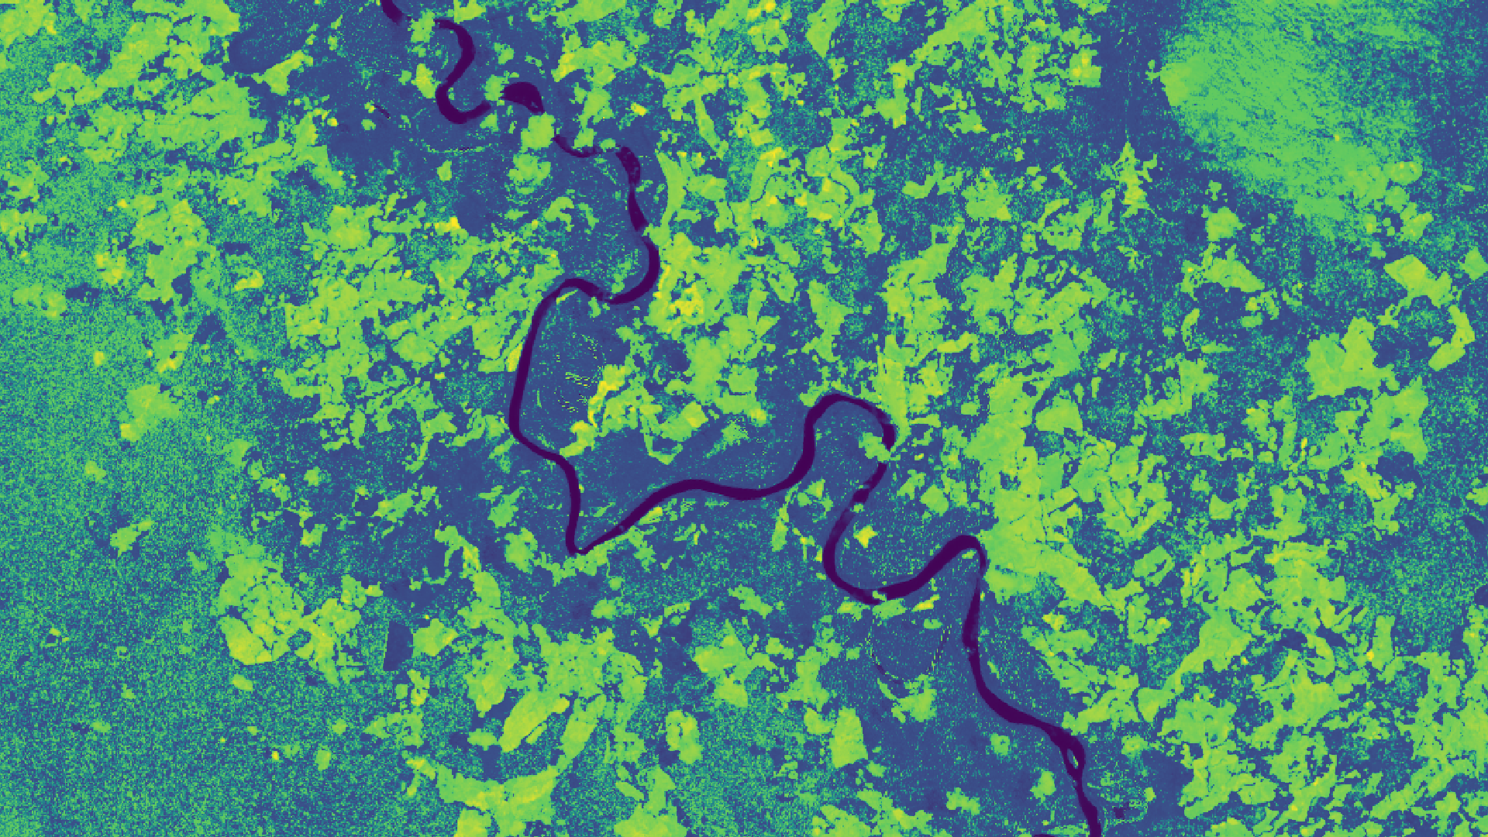
2018 Summer | Virginia-Langley
COLOMBIA ECOLOGICAL FORECASTING
Validating the Effectiveness of the NASA Open Data Cube on Augmenting Deforestation Analysis in Colombia
Ryan Theurer
William Crowley
Megan Link
Shaifali Prajapati
Thomas Richards
Notes:
Your project Website Image should be placed behind the hexagon grid. An example image has been placed in this position for your reference. Delete the example image, insert your image, right click your image and select the “Send to Back” option. Position and adjust the size of your image so that it lines up with the provided margin rulers.

Slide 2
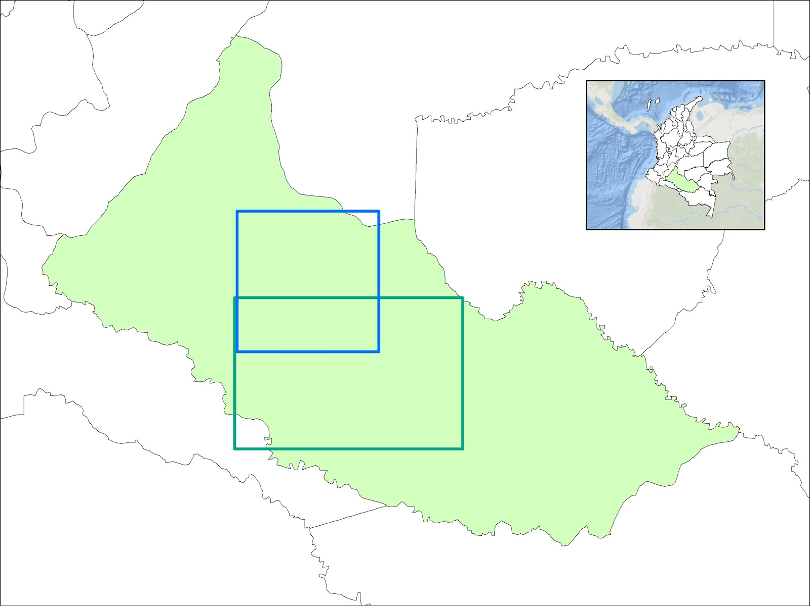
Caquetá, Colombia
Study Area: Caquetá, Colombia
Spans 34,350 mi² of rainforest
Study Period: 2000 – 2018
Caquetá has the highest deforestation rates in Colombia
Caquetá
Colombia
Sentinel Extent
Landsat Extent
Notes:
-Caquetá is a department or sub region of Colombia located in the south-western portion of the country embedded in the Amazon rainforest that spans 34,350 square miles.
-We examined data within Caquetá from 2000 to 2018 due to it having the highest rates of deforestation in the country, with 400 square kilometers of forest being lost in 2014 alone.
-The two square outlines within Caquetá represent the different satellite data extents available to us.

Slide 3
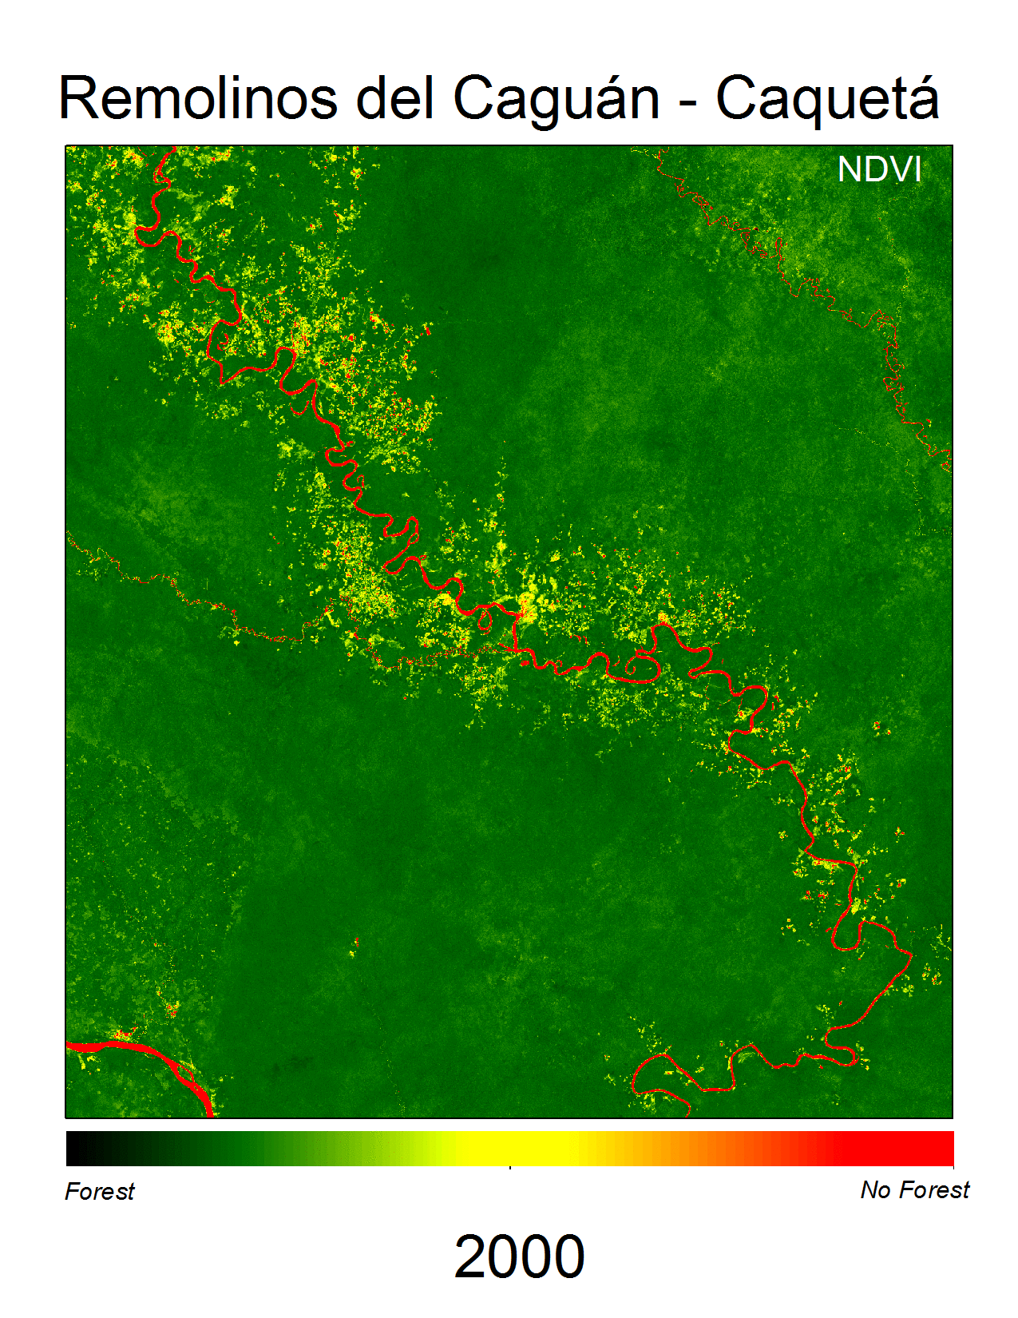
Community Concerns
Remolinos del Caguán-Caquetá
Project Partners:
IDEAM (Institute of Hydrology, Meteorology, and Environmental Studies)
University of the Andes
Tropical deforestation has negatively impacted Colombia’s rainforests
Monitoring sudden changes in forest cover are necessary for IDEAM to compile reports for stakeholders and international organizations
Forest
No Forest
Notes:
-During the term, we worked with the Colombian Institute of Hydrology, Meteorology, and Environmental Studies known as IDEAM, as well as the University of Andes to help them use Earth Observations for deforestation.
-Tropical deforestation is a major problem for tropical countries like Colombia, as increased deforestation leads to biodiversity loss, environmental degradation, and releases increasing amounts of carbon dioxide which accelerates climate change.
-This NDVI time lapse provided by IDEAM highlights areas of deforestation around one of the rivers in Caquetá and how these deforested areas have been expanding since 2000.
-These increases in deforestation are due to agricultural expansion and land clearing for pasture, illegal mining and timber harvesting, and forest fires.
-Monitoring deforestation patterns is necessary for IDEAM to create reports for international organization, but mapping out sudden changes in small areas is difficult and expensive.
Image source(left): Flickr/crustmania
GIF source(right): IDEAM/Rivera

Slide 4
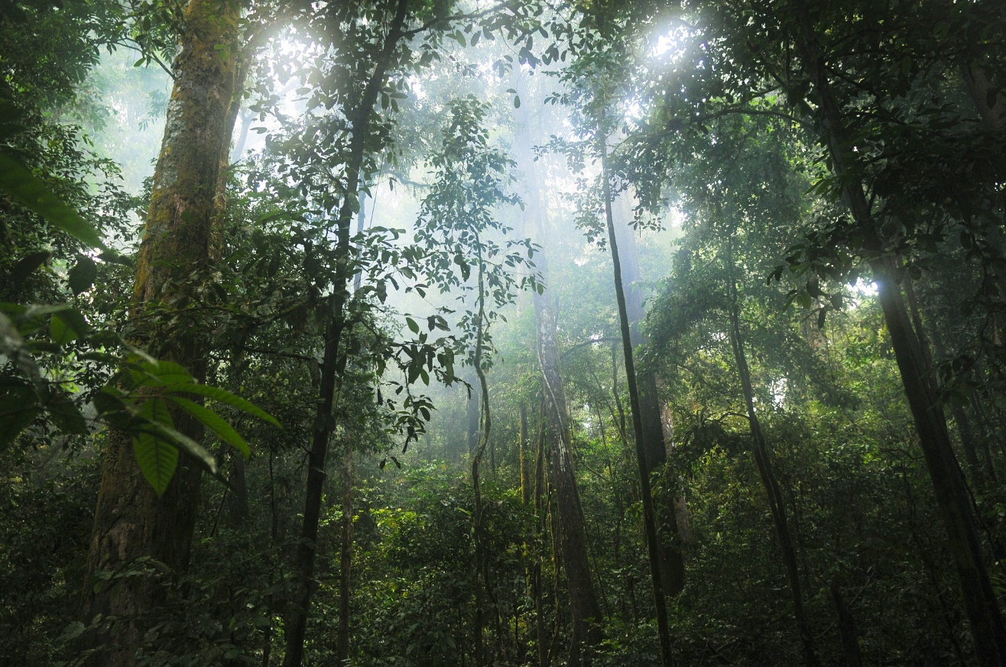
Objectives
Support IDEAM in its implementation of the Colombian Open Data Cube
Assess the Open Data Cube’s land change detection algorithms
Deliver a technical report to IDEAM that will assist them in the use of these algorithms
Notes:
-Our team’s objectives for this project was to support IDEAM in its implementation of their Colombian Data Cube, test the land change algorithms and vegetation indices within their Open Data Cube interface for deforestation detection, and deliver a technical report and users guide to IDEAm that will help them use the Data Cube for deforestation in the future.
-Image Source: Pixabay/Stokpic

Slide 5
EO Satellites and Sensors
Landsat 7: Enhanced Thematic Mapper Plus (ETM+)
Landsat 8: Operational Land
Imager (OLI)
Notes:
-We utilized the Landsat 7 Enhanced Thematic Mapper Plus (ETM+), the Landsat 8 Operational Land Imager (OLI), as well as the Sentinel-1 C-band Synthetic Aperture RADAR (C-SAR) within the Open Data Cube extents.
-Image Source- Google;https://static1.squarespace.com/static/597dff41414fb54a4c56a37b/t/59a4e612c534a545651e1cfb/1513616849785/Earth-Horizon+Space.png?format=1500w
For our study area, we utilized the Open Data Cube extents, which featured Landsat 7, Landsat 8, and Sentinel satellite data.

Slide 6
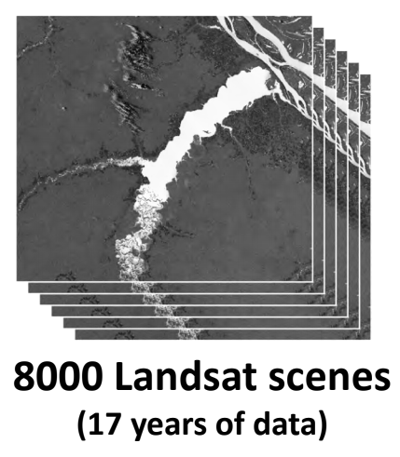
The Open Data Cube
The Open Data Cube is an open source project which came from the need to better manage data
Benefits:
Provides open source and freely accessible data
Exploitation architecture that increases the impact of efficiency of EO satellite data
8x data compression
8000 Landsat Scenes
1000 Data Cube storage units (1°x 1° x 1yr)
Notes:
-The Open Data Cube is an open source and freely accessible exploitation tool that organizes satellite data by compiling individual satellite images, where latitude and longitude make up the cube surface. These layers are then stacked on top of each other based on a time dimension (such as months or years) to make a “3 dimensional” array of scenes formatted into a cube storage
-By doing this, satellite data is easily compressed which allows for a faster and more efficient process.
-The Open Data Cube initiative is an open source project headed by the Committee on Earth Observation Satellites (CEOS) that aims to make the ever increasing amount of satellite data more manageable and easier to access
-Image source( all images): CEOS Open Data Cube_African Regional Data Cube Training Workshop day 1_Killough

Slide 7
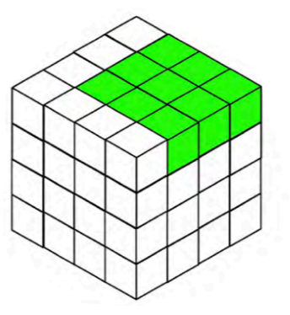
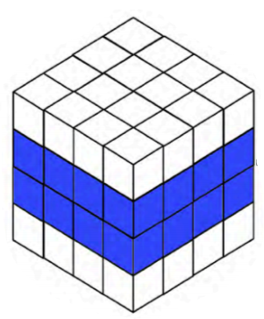
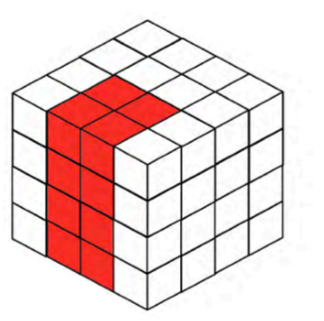
The Open Data Cube
Latitude
Longitude
Data taken from various satellites from over 17 years of data(e.g. Landsat 5/7/8)
Data cube is sampled through time slices
Pixels within Data Cube are processed, aligned, and compressed for data analysis
Data is either utilized through the online user interface or jupyter notebooks
Time
Selecting a Single Time Slice
Creating a Mosaic
(NDVI, Most/Least Recent Pixel)
Creating a Time Series
(PyCCD-Land Change, WOFS-Water Change)
Notes:
-Through this interface, people will be able to work directly with data, eliminating the need to download copies and work separately.
-These compressed images remove the need to download individual scenes for analysis and allow the user to sample multiple scene areas at once over time to create analysis products more quickly and efficiently. This is especially important for developing countries, where it is not technically feasible or financially affordable to consider traditional local processing and data distribution methods.
-Overall, the data cube provides connections between data, applications and users.
-Image Source: CEOS Open Data Cube_African Regional Data Cube Training Workshop day 1_Killough

Slide 8
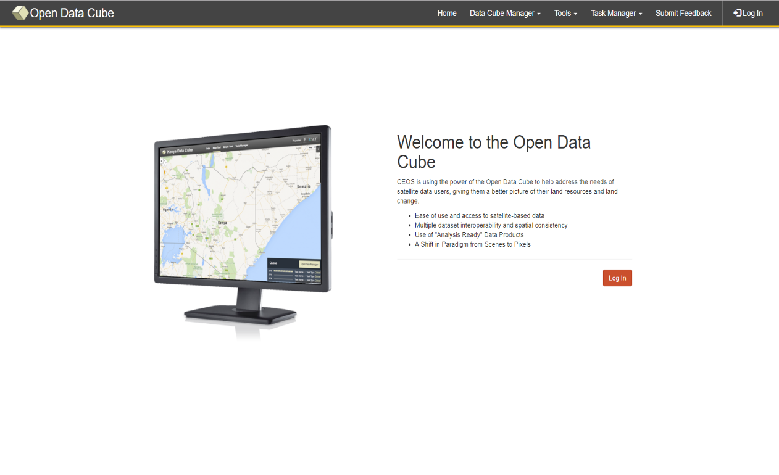
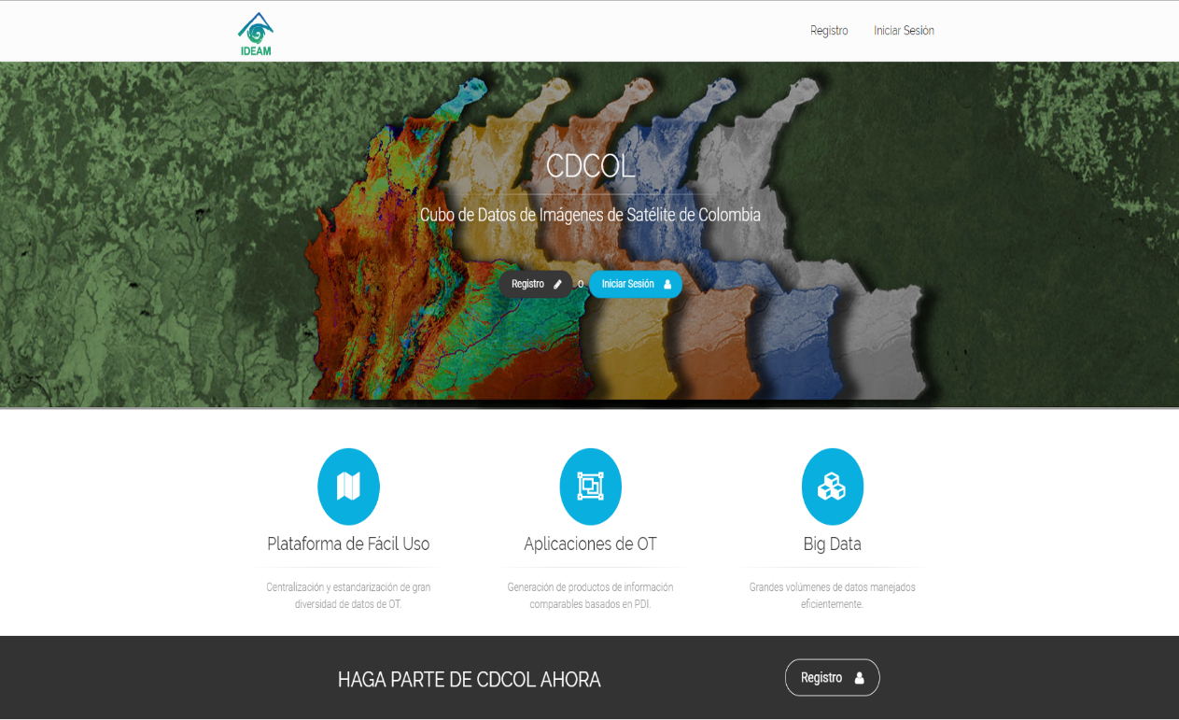
The Algorithms
We can run a variety of algorithms within the cube to create different products
These algorithms utilize a range of different bands, ratios, and satellites in order to create a product
The created products are then run through a confusion matrix for validation
Notes:
-There are algorithms embedded in the Open Data Cube software that allow anyone to analyze data with. For our project, our team looked at the Python Continuous Change Detection algorithm or PyCCD, the NDVI anomaly, and the NDVI Standard Deviation algorthms to examine changes in vegetation cover and greeness that would indicate deforestation.
-Image Source: The Open Data Cube/CDCol

Slide 9
Methodology Workflow
Earth
Observation
Acquisition
Landsat 7 ETM+
Landsat 8 OLI
Sentinel 1 C-SAR
Open Data Cube
Colombia Data Cube
NDVI Anomaly
NDVI STD
PyCCD
PCA
End Products:
Confusion Matrix Validation
Deforestation Maps
Notes:
-Earth observation data from Landsat 7, 8, and Sentinel-1 are ingested into the Open Data Cube and Colombian Data Cube and formatted for analyses. Within the cube and jupyter notebooks, the data was analyzed by running NDVI Anomaly, NDVI Standard Deviation, and PyCCD. These results were then compared to validation data provided to us by IDEAM by running the results through a confusion matrix, which examines points in each layer and sees if they are matched correctly. Our deforestation maps created from the algorithms and the confusion matrix results were produced and handed off to IDEAM.

Slide 10
Analysis and Results

Slide 11
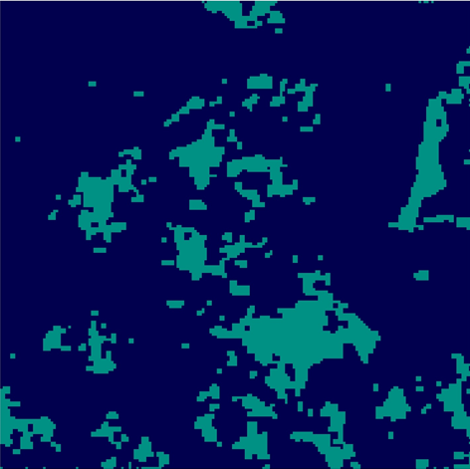
PyCCD – Land Change Map
Python Continuous Change Detection (PyCCD)
Takes 10+ years of data and detects the change in land over that time
This display is the volume change detection map
.81
no
change
change
Lat
.76
-74.67
Long
-74.62
Notes:
-PyCCD looks at time series data over 10 or more years and creates a sinusoidal pattern that follows the range of values that are normal for that pixel.
-When a major change or break in this pattern occurs, it records this change and displays it on the map, shown here in light blue.
-It does not detect what kind of changes, so it is not deforestation specific but detects all land change

Slide 12
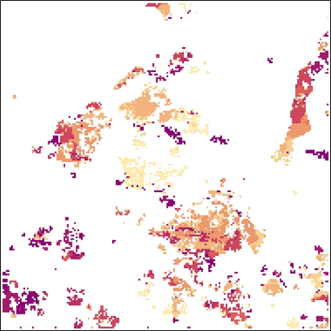
PyCCD – Time Scale Map
.81
PyCCD also produces a time scale map
Shows when land change occurred for each pixel of change
2015
2014
2013
2012
2011
2010
2009
2008
2007
2006
Lat
.76
-74.67
Long
-74.62
Notes:
-PyCCD not only displays how many time a land pixel has changed over time but can also detect the time it was first changed.
-This allows to see when the pixel changed to see when certain land areas were changed or deforested to better detect patterns or trends

Slide 13
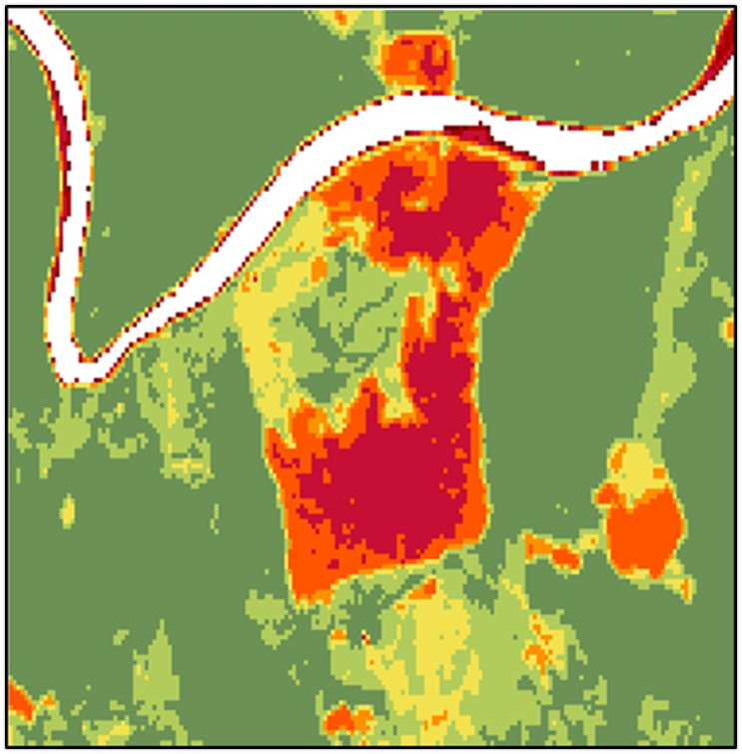
NDVI Standard Deviation
.81
Forest
Normalized Difference Vegetation Index (NDVI)
A baseline for each month is determined by measuring NDVI over a set time
The ODC is used to visualize monthly NDVI deviation
1.00 - 0.80
0.80 - 0.60
0.60 - 0.40
0.40 - 0.20
0.20 - 0.00
Lat
0.00 - -0.20
-0.20 - -0.40
-0.40 - -0.60
-0.60 - -0.80
-0.80 - -1.00
.76
Deforestation
-74.67
Long
-74.62
Notes:
-NDVI Standard Deviation uses a baseline NDVI value that is pre set and determines a standard deviation value for the baseline.
-Later images are compared to this baseline value and change is determined by how much the NDVI standard deviation has changed over the analysis period, with negative changes in the NDVI shown in red while positive changes in the standard deviation shown in green.

Slide 14
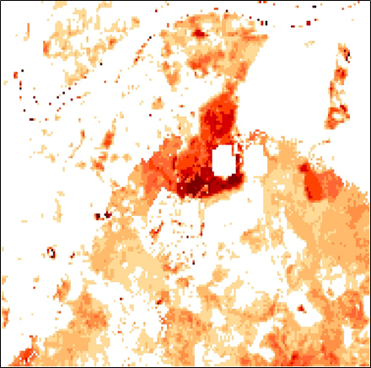
NDVI Anomaly
.81
Forest
Takes three parameters:
A single scene to check for anomalies
A list of scenes used to form the baseline
A percentage threshold and mosaic method
0.2-0.25
0.25-0.3
0.3-0.35
0.35-0.4
0.4-0.45
Lat
0.45-0.5
0.5-0.55
0.55-0.6
0.6-0.65
0.65-0.7+
.76
-74.67
Long
-74.62
Deforestation
Notes:
-NDVI anomaly works similarly, where a baseline NDVI value is chosen and later images are compared to this baseline with a change threshold to account for seasonal and weather variation to see how much the NDVI has changed.
-More drastic changes are shown in dark red where smaller changes are shown in orange, white indicates no significant change.

Slide 15
Results
Precision - How many selected items (points of deforestation)are relevant.
Recall - How many relevant items are selected.
Variable | NDVI - STD | NDVI - Anomaly | PyCCD
Precision | 0.82 | 0.70 | 0.24
Recall | 0.81 | 1.00 | 0.14
F-Score | 0.81 | 0.83 | 0.18
Sample Size | 396 | 396 | 396
Notes:
-Results

Slide 16
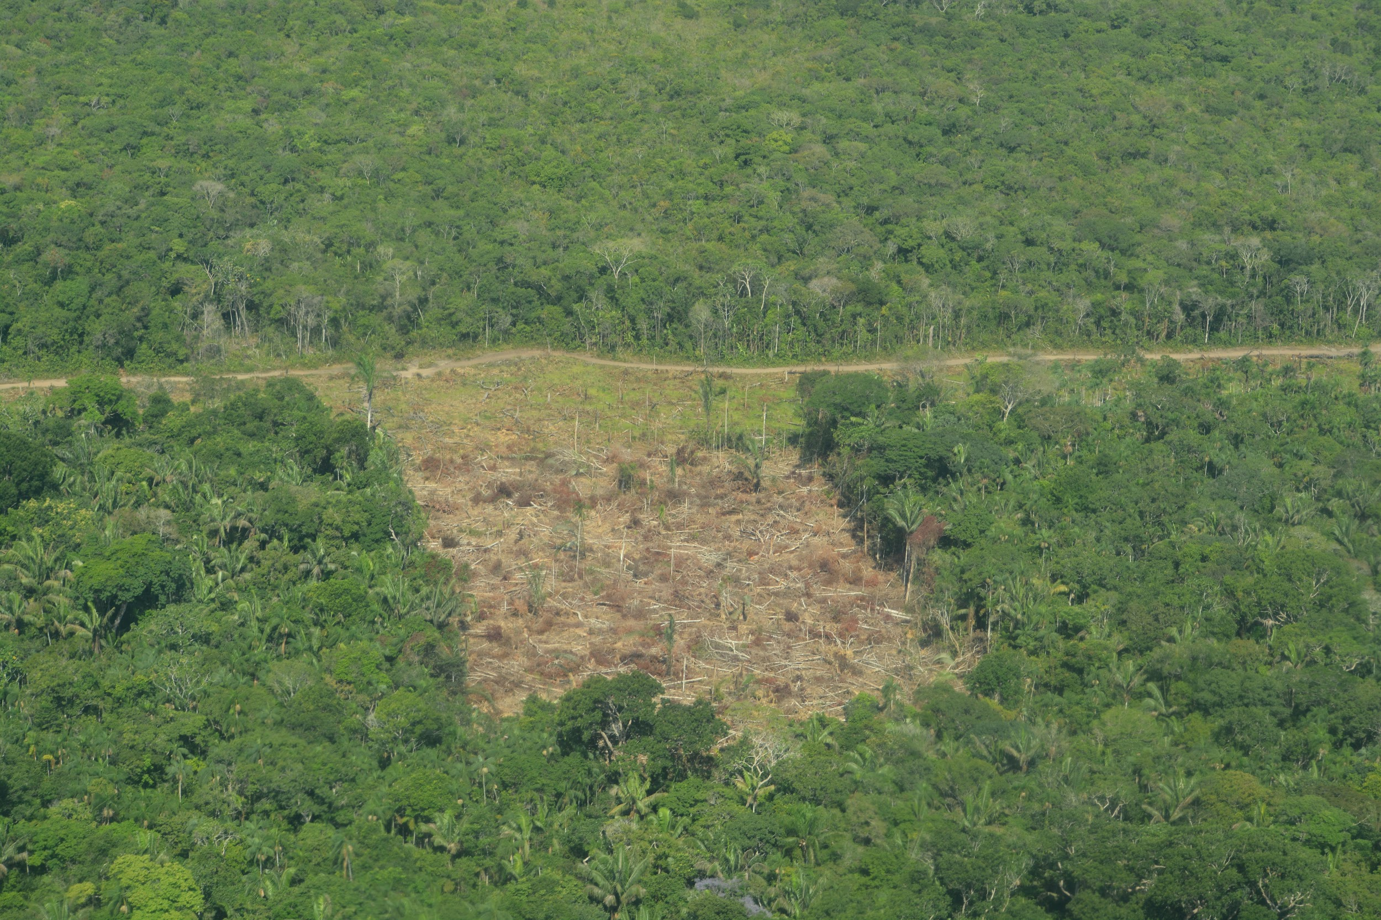
Conclusion
NDVI performed better in our study region than our other algorithms
Continue to refine the Colombian Data Cube
Aid in Colombia’s goal for zero net deforestation by 2020
Notes:
Our Vegetation indices performed better than the land change algorithms because PyCCD could only use Landsat-7 data which has banding issues as well as it’s inability to penetrate cloud cover. In the future, Sentinel-1 data could be used to go beneath cloud coverage for more satellite imagery and data.
Our methodologies and workflows can be implemented through IDEAM and the Colombian Data Cube to maximize efficiency and accuracy for detecting deforestation.
Our work with Colombia can be used to help monitor deforestation areas to slow down the process and contribute to Colombia’s goal for zero net deforestation by 2020.

Slide 17
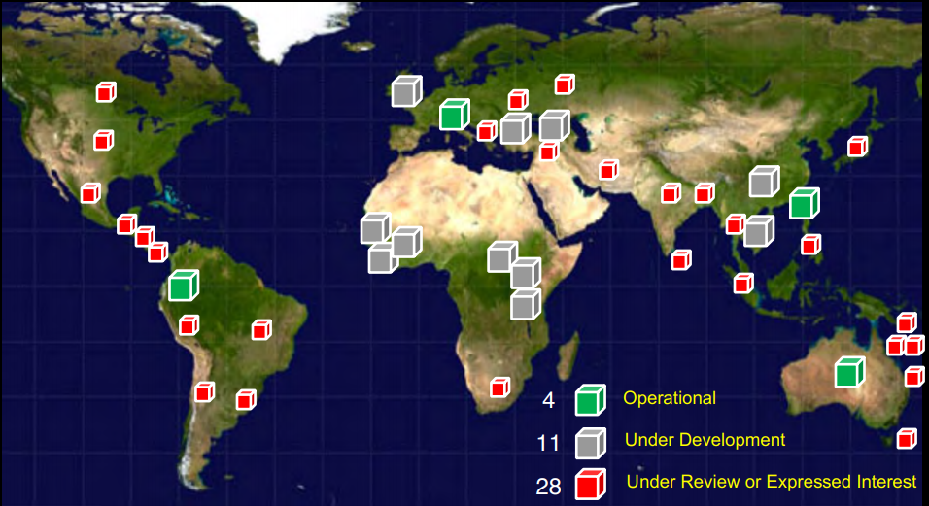
Future Work and Applications
Continue to expand the Open Data Cube with new algorithms and datasets
Additional algorithms and dataset testing
Notes:
CEOS has a goal to implement the Open Data Cube to 20 countries by 2020. Currently, 11 countries are under development and 28 have expressed interest, with more areas becoming interested in the Data Cube every day. Our work with deforestation can be applied to these new areas as well as these areas implementing new algorithms or refining ours to maximize the effectiveness of the Data Cube.
In the future, work outside of deforestation analysis can be applied in the Open Data Cube. There are already projects involving flood testing and vegetation monitoring, which will continue to make the Open Data Cube more accessible and convenient for regionis all over the world to contribute to.
-Image Source: CEOS Open Data Cube_African Regional Training Workshop day 1_ Killough

Slide 18
Acknowledgements
Science Advisor
NASA Langley Research Center:
Dr. Brian Killough
Dr. Kenton Ross
Partners
IDEAM (Institute of Hydrology, Meteorology, and Environmental Studies):
Pilar Lozano Rivera
NASA DEVELOP
Center Lead:
Jonathan O’Brien
University of the Andes:
Dr. Harold Castro
Team Members
Ryan Theurer
Project Lead
William Crowley
Project Member
Megan Link
Project Member
Shaifali Prajapati
Project Member
Thomas Richards
Project Member
Notes:
-We would like to thank our science advisors, Dr. Brian Killough, Dr. Ross, and the CEOS support team for their help through this process.
-We would like to thank our project partners at IDEAM and Pilar Rivera for allowing us to help them tackle the problem of deforestation, as well as Dr. Harold Castro at the University of Andes for providing support for the project.
-Lastly, we would like to thank everyone at Langley and DEVELOP for their guidance and support throughout the term and providing us with the opportunity to work with these wonderful people for this very unique project.

