Slide 1
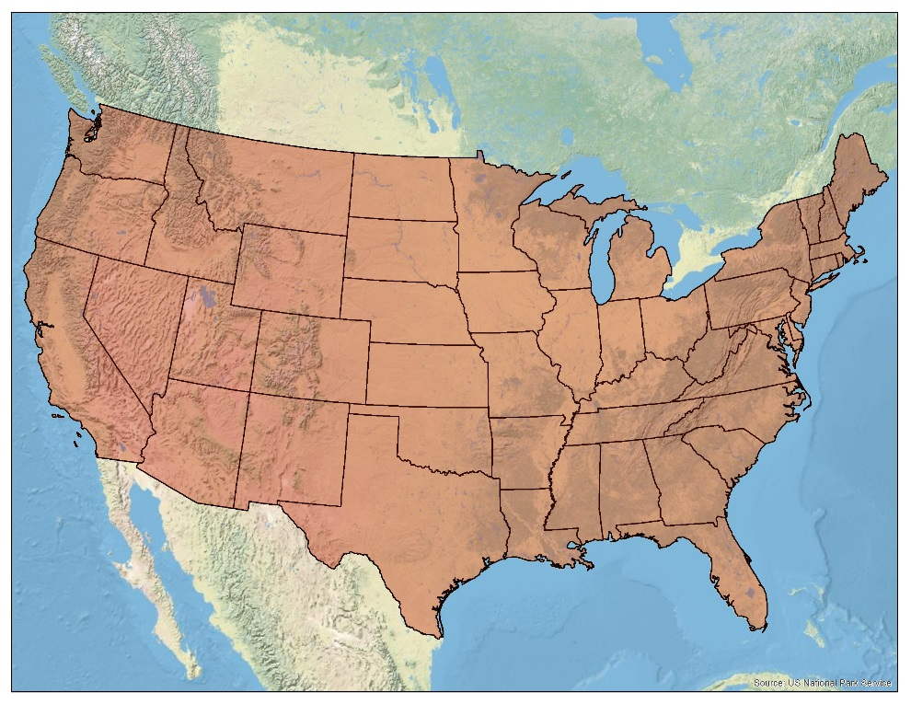
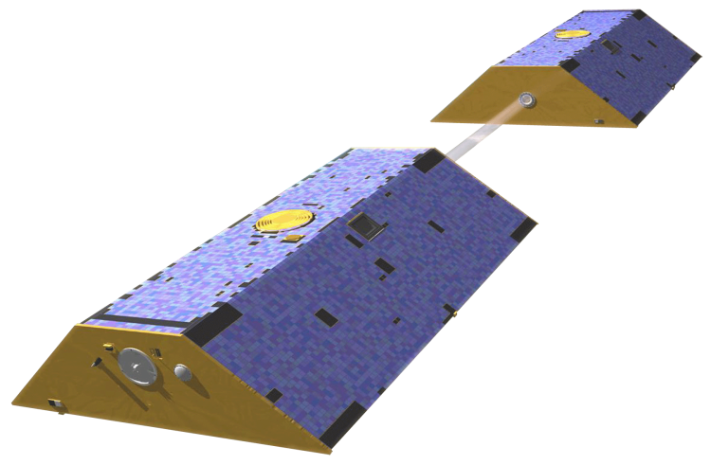
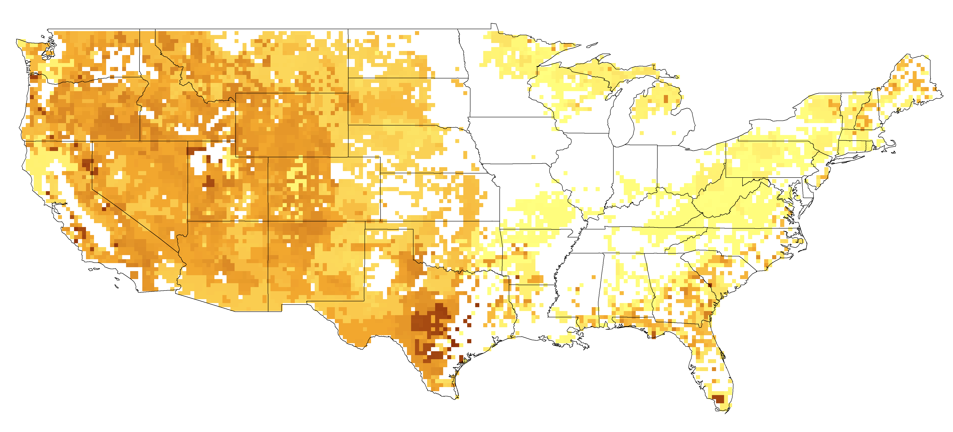
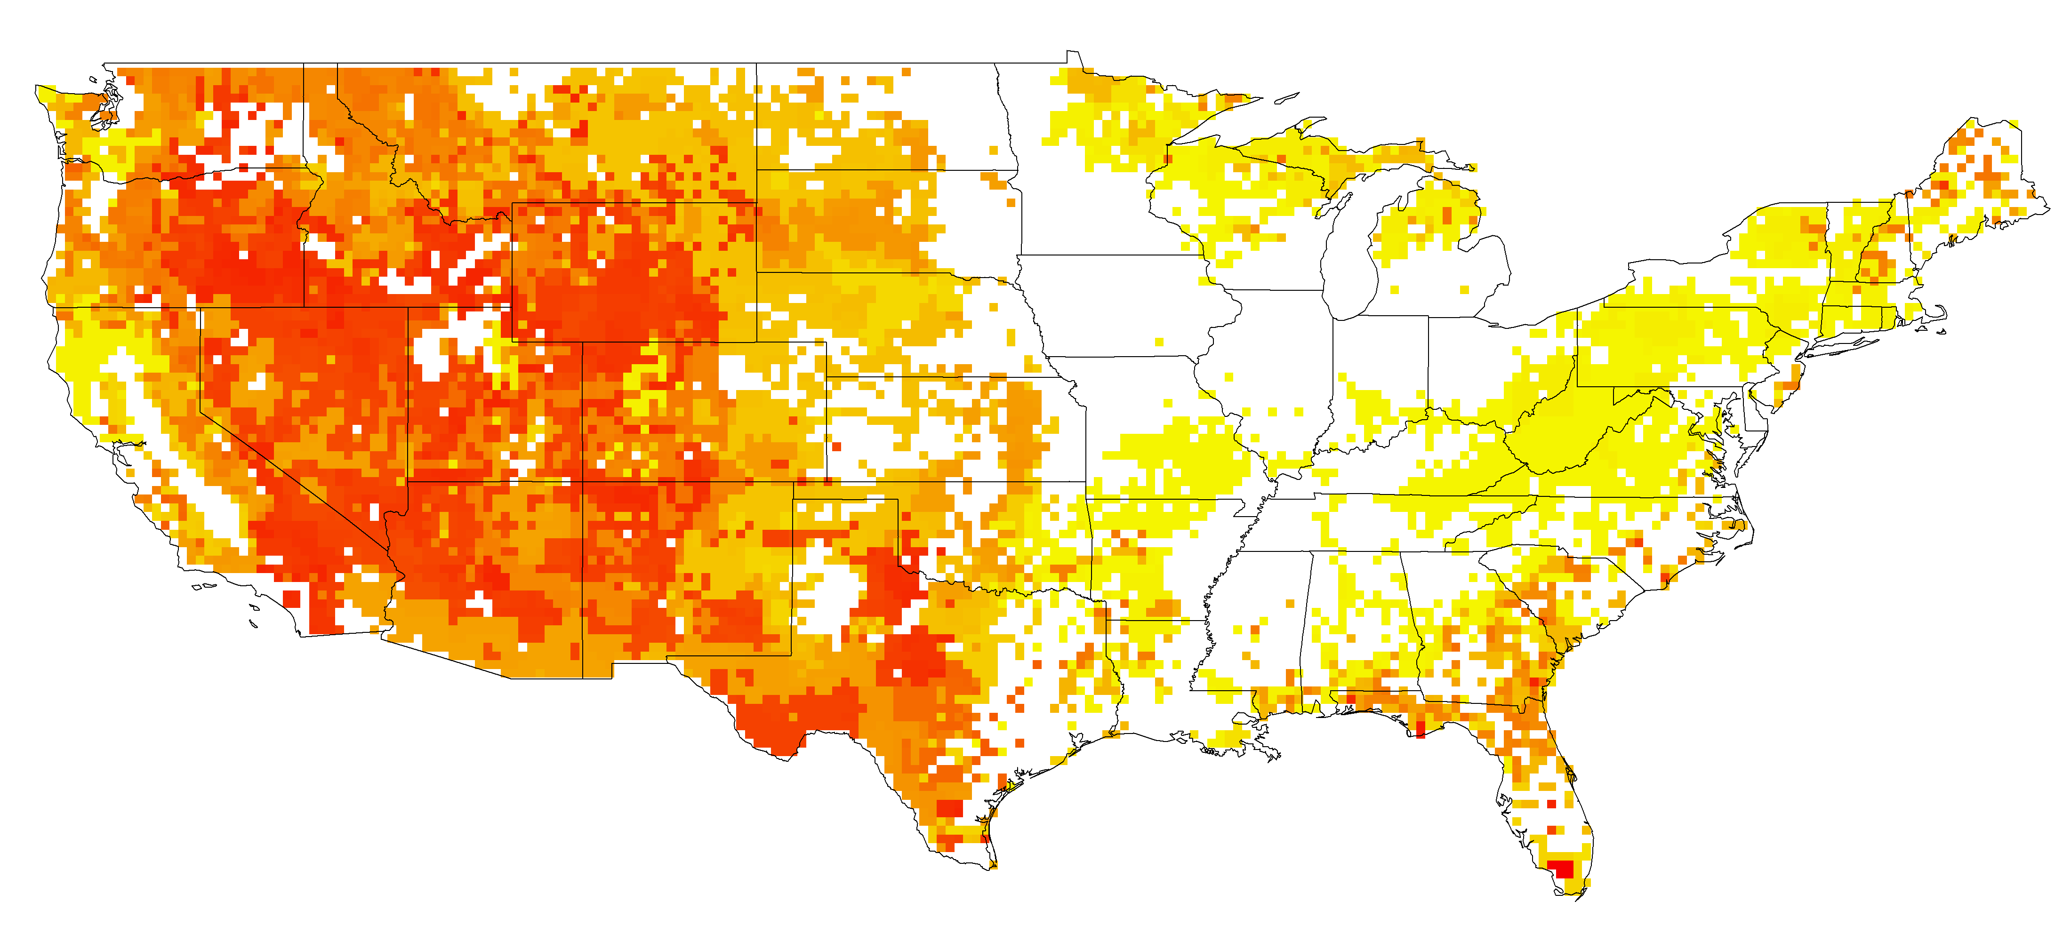
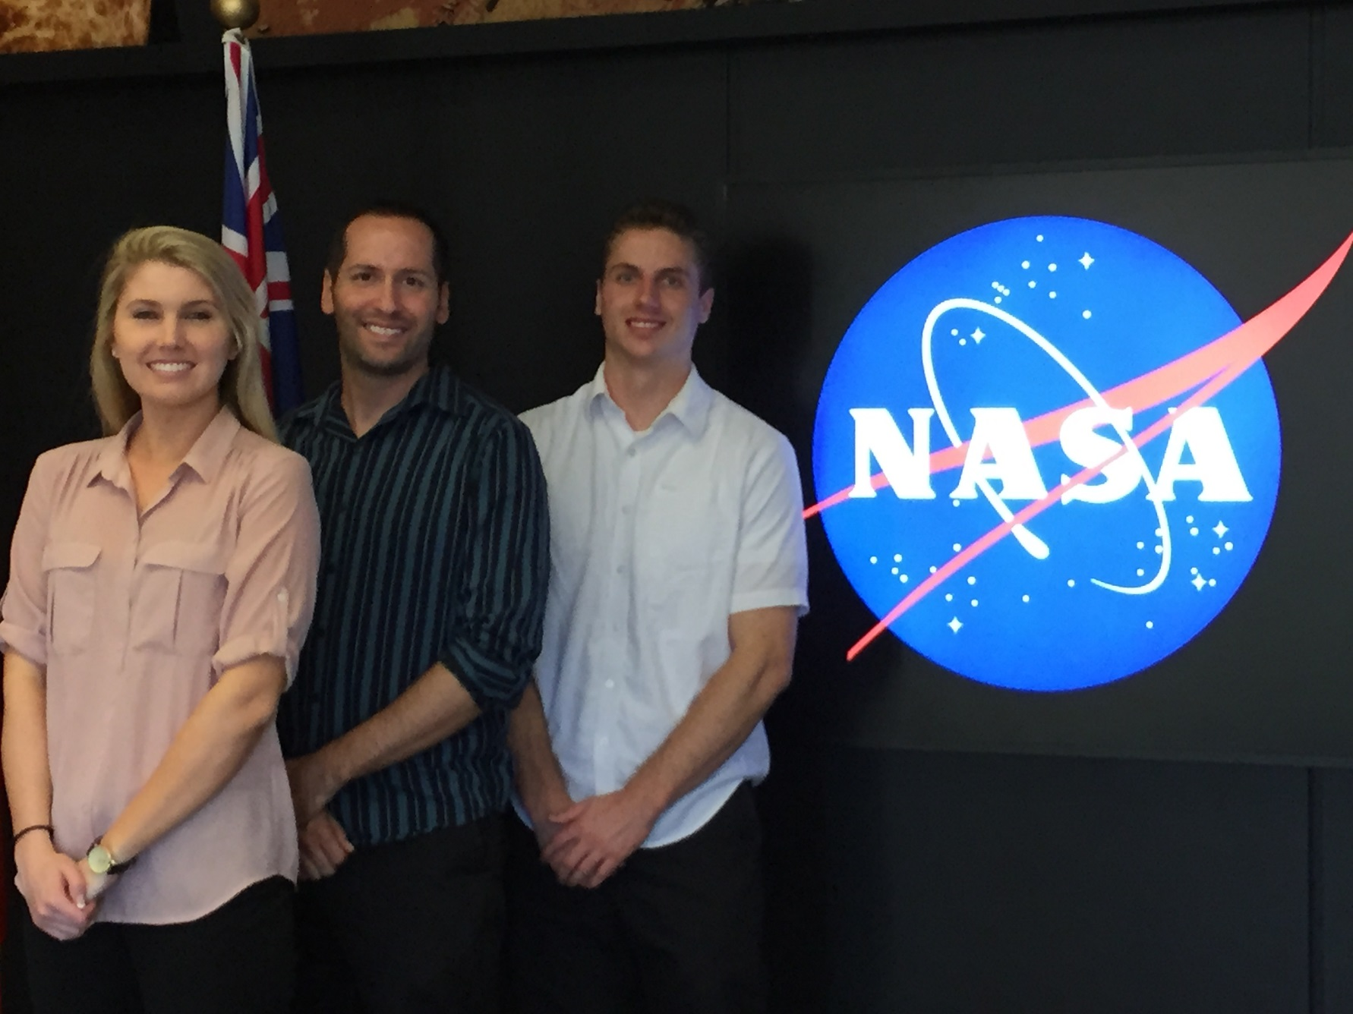

U.S. DISASTERS II
Using GRACE-derived water and moisture products as a predictive tool for wildfire potential in the contiguous United States
Brittany Zajic (Project Lead), Daniel Jensen, Nick Rousseau
NASA DEVELOP National Program at NASA Jet Propulsion Laboratory
Abstract
Objectives
.
Understanding the relationship between wildfire potential and soil moisture in the United States has been difficult to assess, with limited ability to determine areas that are at high risk. This limitation is largely due to complex environmental factors at play and the lack of necessary remotely-sensed products. Drought conditions and accompanying low Fuel Moisture Content (FMC) have historically led to disastrous wildfire outbreaks causing economic loss, property damage, and environmental degradation. Thus, developing a programmed toolset to assess the relationship between soil moisture—which contributes greatly to FMC—and fire potential, can aid in determining overall wildfire risk. To properly evaluate these parameters, we used data assimilated from the Gravity Recovery and Climate Experiment (GRACE) and data from the Fire Program Analysis fire-occurrence database (FPA FOD) to determine the extent to which soil moisture affects wildfire activity. Through these datasets, we produced annual probability and predicted burned area maps at a coarse resolution of 0.25 degrees for the contiguous United States. These predictive fire products and toolsets proved the viability of this methodology, allowing for more GRACE-derived water parameters, MODIS vegetation indices, and other environmental datasets to be incorporated in the future to refine the algorithm for fire risk. Additionally, these products will allow for assessment at a national-scale for early fire management by providing planners and responders with a predictive tool to better employ early decision-support to areas of high risk for each region’s annual fire season.
To quantify relationships between assimilated GRACE data and wildfire data by land cover type on a national scale
To create an algorithm in Python that will serve as a tool for fire predictive services
To determine if assimilated GRACE data is a promising tool for predicting wildfire potential across the contiguous United States
Methodology
Study Area
Surface Soil Moisture
Assimilated GRACE Data
(NASA GSFC Terrestrial Hydrology Program)
Annual Average
Soil Moisture January – April
(Python)
Contiguous United States
Wildfires
Fire Program Analysis Fire-Occurrence Database
(USDA Forest Service)
Annual Total Burned Area
(ArcGIS, Python)
Predictive Algorithm
(Python)
Wildfire Probability and Predicted Burned Area
Annual Total Number of Wildfires
(ArcGIS, Python)
Earth Observations
Land Cover
National Land Cover Database 2011
(USGS)
Gravity Recovery and Climate Experiment (GRACE)
Resample and Reclassify
(ArcGIS)
Results
Conclusions
May 2008 – April 2009 Predicted Fire Season
*Class G Fire = Over 5000 acres burned
High coefficient of determination values across many fire size classes and land cover types indicate a strong relationship between soil moisture and wildfire
GRACE can be considered a useful tool for assessing wildfire probability and predicting wildfire
Wildfire predictive capabilities using NASA Earth Observation Systems can be refined and expanded with MODIS vegetation indices and SMAP soil moisture data in order to better serve fire response management
Team Members
Acknowledgements
Project Partners
We would like to thank our Science Advisor, Dr. John T. Reager (NASA JPL), for his guidance on this project.
We would like to thank Mark Finney, Chuck McHugh, and Everett Hinkley from the USDA Forest Service for their involvement in providing direction and information regarding wildfires in the United States.
We would also like to thank Dr. Matt Rodell of the NASA Terrestrial Hydrology Program at Goddard Space Flight Center for his help in attaining and utilizing the assimilated GRACE data.
We would lastly like to thank Max Baldridge, a contributor on the first phase of this project.
United States Department of Agriculture,
Forest Service — Remote Sensing Applications Center
NASA Terrestrial Hydrology Program
Brittany Zajic, Nick Rousseau, Daniel Jensen
NASA JET PROPULSION LABORATORY

