Slide 1
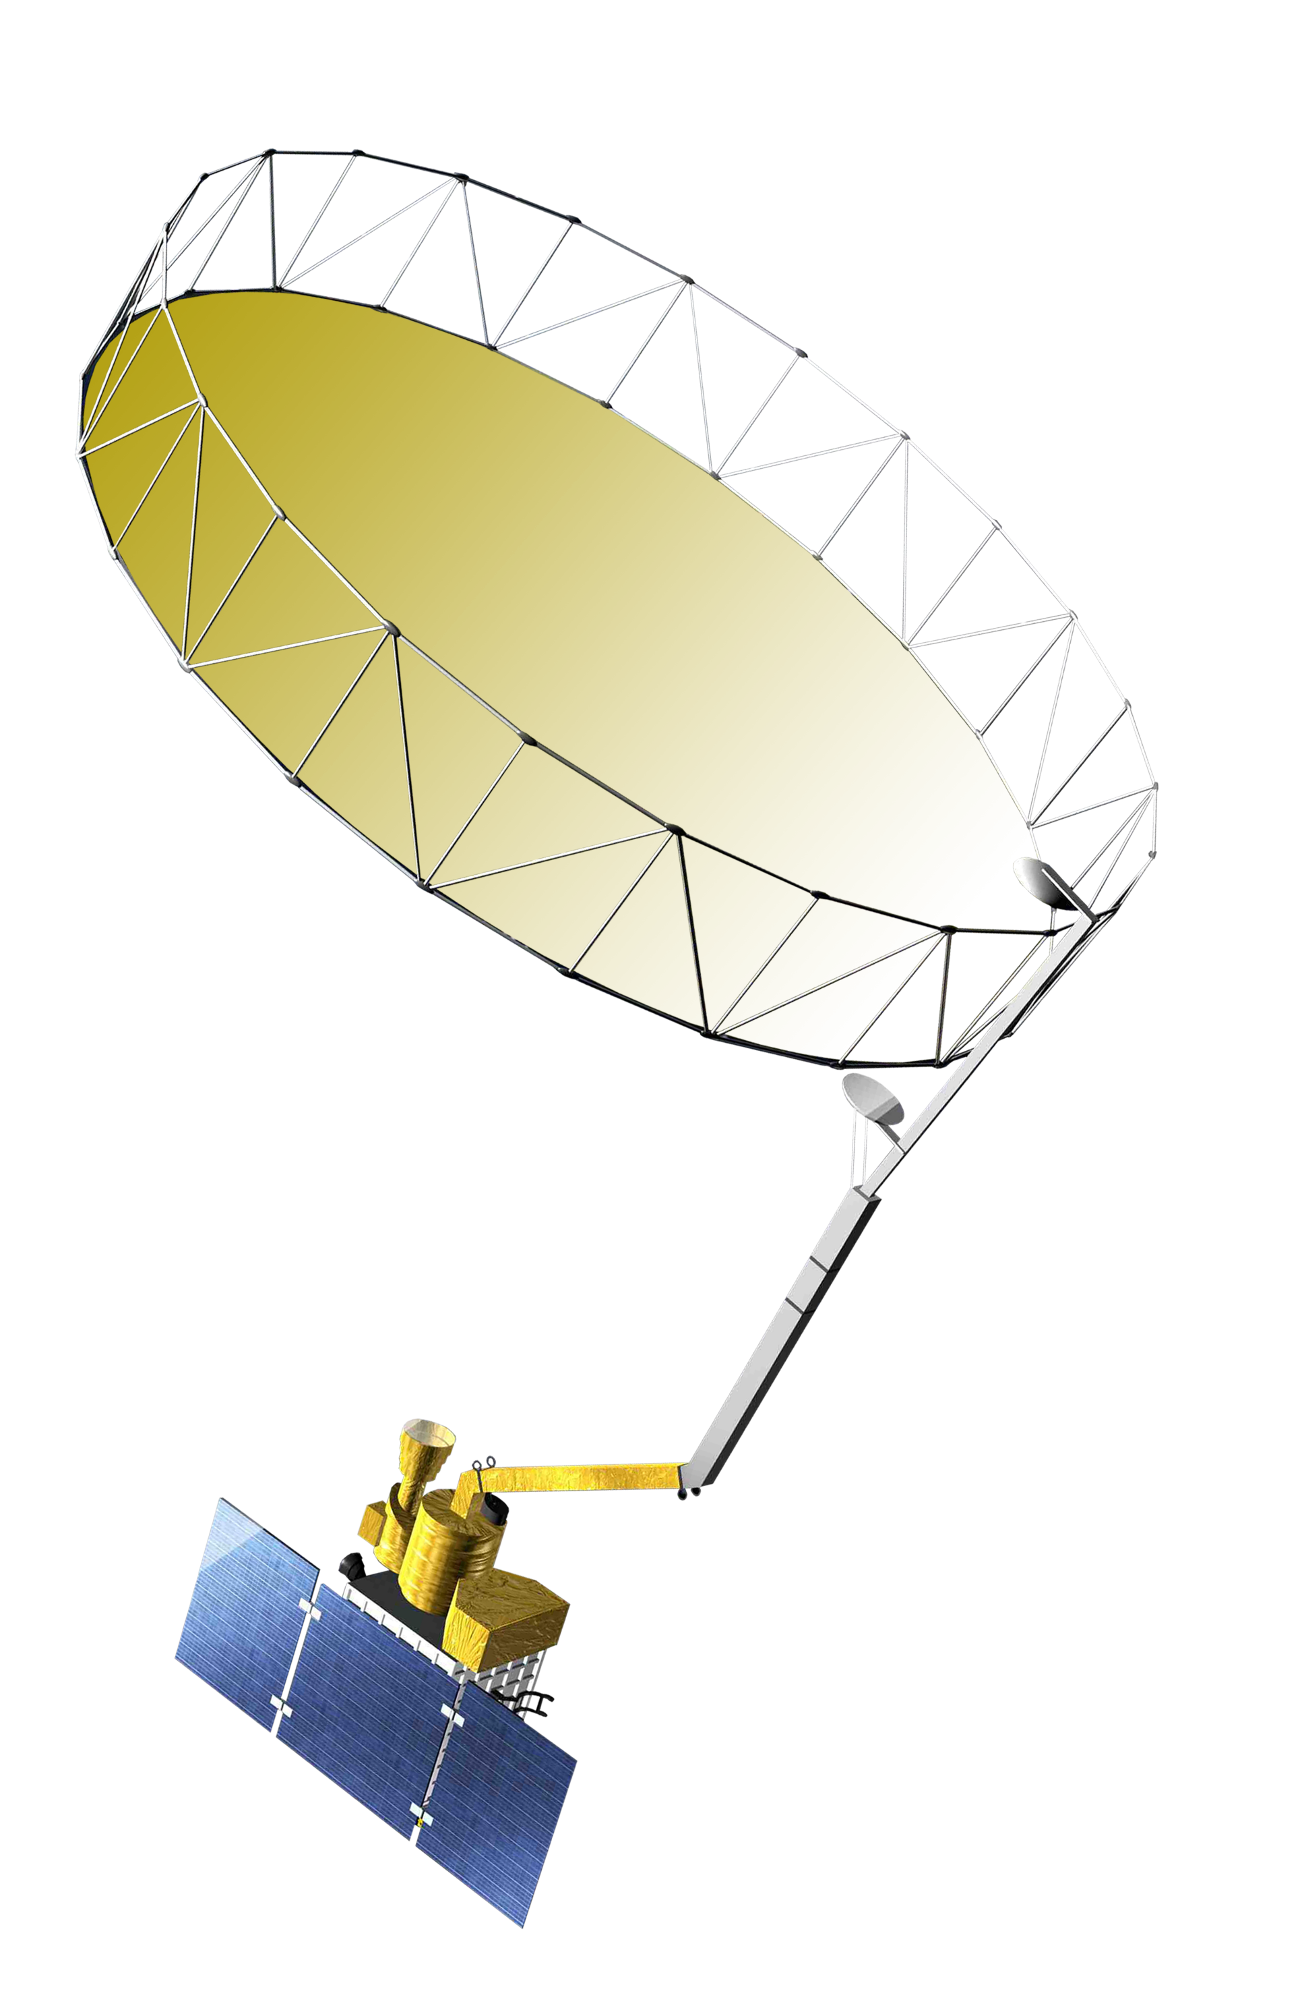
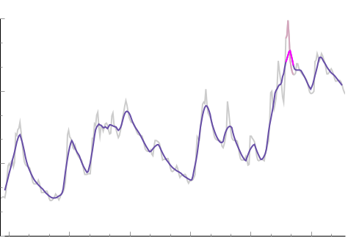
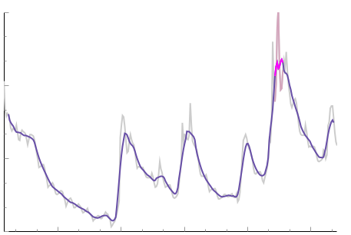
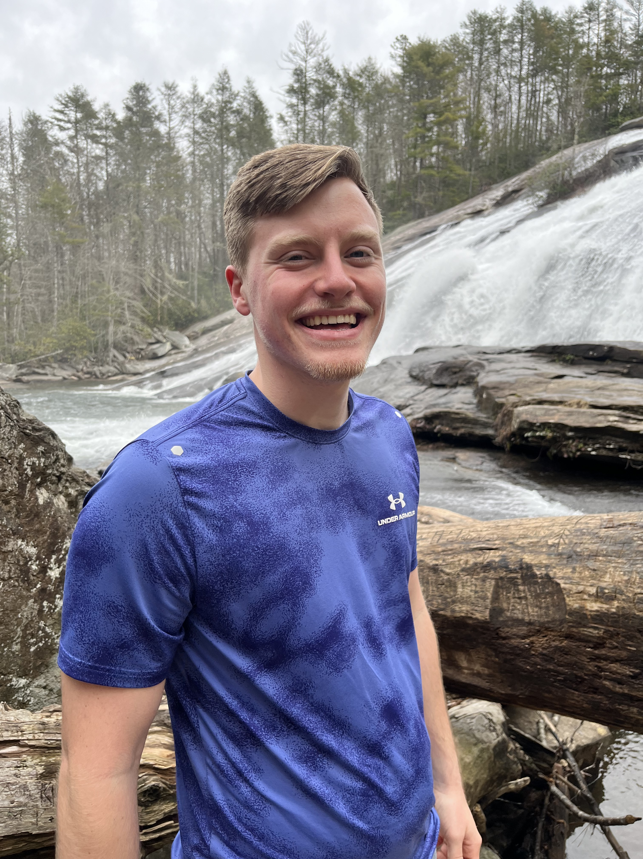
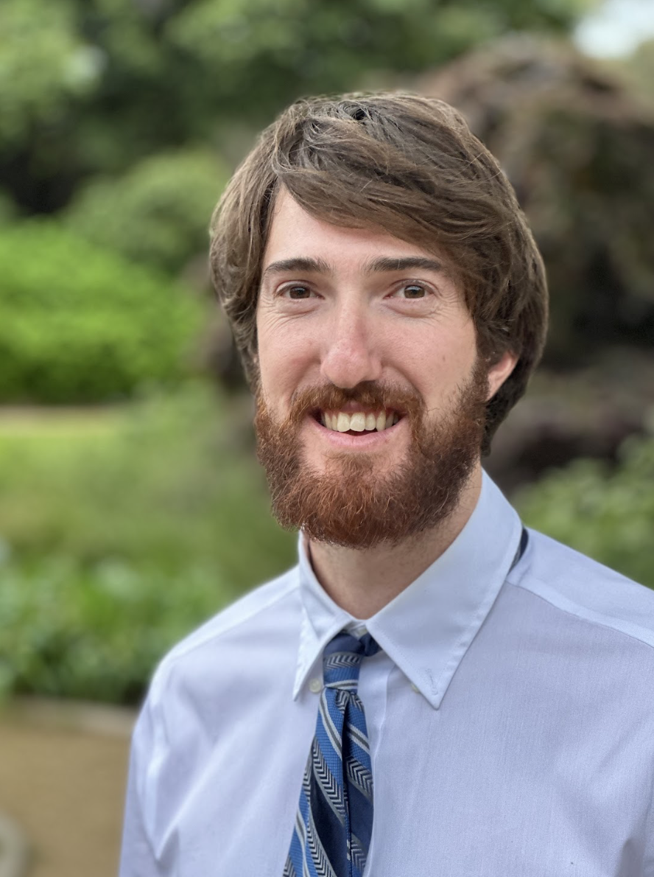
Kentucky Disasters
Multi-Hazard Approach to Mapping Flood Susceptibility and Vulnerability in Kentucky
Project Synopsis
Study Area
The study area for this project is the entire state of Kentucky. The state’s major rivers and elevation are shown.
Satellites
Flooding is the most common and costly natural disaster in Kentucky, with major flood events in 2022 and 2023 highlighting the need for flood risk assessment. We mapped flood risk in Kentucky using a multi-hazard approach that considered two dimensions of risk: flood susceptibility and flood vulnerability. Flood susceptibility aimed to represent areas of the state that would be more likely to flood in the event of uniform rainfall based on physical geography. Flood vulnerability sought to locate communities that may experience more severe impacts from flooding based on socioeconomic factors. We additionally analyzed NASA Soil Moisture Active Passive (SMAP) observations of surface soil moisture to explore the utility of SMAP observations for future analysis of flood risk. Our maps provide a valuable resource that can be shared with emergency managers and assist our partners in their mission to increase community resilience.
Elevation
0
50 km
High
SMAP
L-Band Radiometer
Low
Objectives
Rivers
LOCATE areas that are susceptible to flooding based on physical characteristics ​
IDENTIFY frontline communities based on socioeconomic data
ASSESS community flood
risk by combining flood susceptibility and vulnerability
EXAMINE soil moisture
prior to two recent major flooding events
SOCIOECONOMIC
Poverty
Limited English-Speaking Population 65 and Over
Population Under 5
Disability
Mobile Homes
No Internet Access
No Phone Service
No Computer Access
Population Density
ANTECEDENT SOIL MOISTURE
Methodology
SMAP Level 4 Surface Soil Moisture Band for one month preceding each flood event
Distance to Rivers
30%
FLOOD SUSCEPTIBILITY
FLOOD
RISK MAP
FLOOD VULNERABILITY
Mean soil moisture timeseries for approximate
flood areas
Topographic Wetness Index
25%
Reclassified datasets
on 1–5 scale and combined using Analytical Hierarchy Process weights
Reclassified datasets on 1–5 scale and combined using unweighted average
Land Cover
14%
Flood
Susceptibility
Map
Flood
Vulnerability
Map
Hydrologic Groups
12%
INFFRASTRUCTURE
Drainage Class
11%
Bridges
Fire Departments
Hospitals
ANTECEDENT SOIL MOISTURE PLOTS
Karst Areas
5%
Distance to Mines
3%
Results
FLOOD SUSCEPTIBILITY
FLOOD VULNERABILITY
ANTECEDENT SOIL MOISTURE
Higher
0
100 km
Higher
0
100 km
EASTERN KENTUCKY 2022
Three-Hourly SMAP L4
Model Output
Lower
Lower
0.4
0.3
24-hour running average
Mean Surface Soil Moisture
(proportion by volume)
0.2
July 28th, 2022
(peak flood)
0.1
07/10/22
07/24/22
FLOOD RISK
06/26/22
Risk
WESTERN KENTUCKY 2023
Three-Hourly SMAP L4
Model Output
Higher
0.4
Vulnerability
0.3
24-hour running average
Lower
Mean Surface Soil Moisture
(proportion by volume)
Lower
Higher
0.2
July 19th, 2023
(peak flood)
Susceptibility
0
100 km
0.1
06/25/23
07/09/23
07/23/23
Project Partners
Conclusion
Kentucky Climate Center​
National Weather Service Forecast Offices at Jackson, KY and Paducah, KY
We demonstrated the feasibility of using aerial, satellite, and ground-based measurements to assess flood risk for the state of Kentucky.
Further analysis of antecedent soil moisture could yield insight into its influence on flooding in Kentucky.
Our maps can provide an additional dimension of flood preparedness to emergency managers and enhance community outreach efforts for our partners.
Team Members
Acknowledgements
We would like to thank our Center Lead Katie Caruso, Impact Analysis Fellow Maya Hall, Lead Science Advisor Molly Woloszyn, and the DEVELOP National Program Office for all their support. Additional thanks go to our science advisors, Dr. Olivier Prat and Dr. Brian Nelson, for their guidance, as well as our project partners, Dr. Jerald Brotzge at the Kentucky Climate Center, Jane Marie Wix and Peter Geogerian at the NWS Jackson office, and Mary Lamm at the NWS Paducah office, for their valuable insight. Thanks to Dr. Andrew Day, Dr. Venkataraman Lakshmi, and Jim Noel for contributing their expertise to the Analytical Hierarchy Process. Thanks to Dr. David Wolock for his insight into TWI. We would finally like to thank Dr. Ben Tobin, Ian Horn, and Kent Anness
for assistance with data acquisition.
Jaydi Swanson
Claire Beezley
Jason Reynolds
Daniel Feinberg
Project Lead
North Carolina – NCEI | Spring 2024
Conclusions

