Slide 1
WESTERN MONTANA
Ecological Forecasting II
Enhancing Habitat Suitability Modeling of Mustelid Species and Contaminant Monitoring in Western Montana Using NASA Earth Observations
Chelsea Morton, Amanda Bosserman, Caden O'Connell, & Rylee Tomey
Maryland – Goddard
Notes:
Hello all, we are from the Western Montana Ecological Forecasting II team and appreciate you joining us for the Fall 2021 DEVELOP closeout with the Goddard node. My name is Chelsea Morton, and I am joined by Amanda Bosserman, Caden O'Connell and Rylee Tomey. During this 10-week term, we created refined Habitat Suitability Models for mustelid species to guide detection dog surveys for contaminants monitoring via collected scats in Northwestern Montana's rivers. Additionally, we generated precipitation anomalies and topographic maps.

Slide 2
Introduction
Western Montana's rivers support the livelihoods of people and health of biological ecosystems
The levels of contaminants in Montana rivers are only just being explored
Semi-aquatic mustelids, North American river otter and mink, serve as reliable bioindicators of ecosystem health
Image Credit: Karen Roe
Notes:
Western Montana's river systems provide essential resources that support the livelihoods of people and the health of biological ecosystems. These rivers supply clean water to local communities and provide habitat for semi-aquatic wildlife species such as North American river otter and American mink.
Environmental contaminants threaten the health of both people and wildlife. The status of contaminants in Montana's rivers is only at the forefront of being explored, and as urbanization continues to encroach on natural ecosystems, these contaminants will likely increase in abundance.
River otter and mink are species well suited to monitor the bioavailability of contaminants in river ecosystems, given their largely aquatic diet and ongoing exposure to anthropogenic contaminants.
------------------------------Image Information Below ------------------------------
•Image Credit: Karen Roe
•Image Source: https://search.creativecommons.org/photos/c7a1da4b-aad0-4225-9474-cc0cea1470c0
(Licensed under CC BY 2.0)

Slide 3
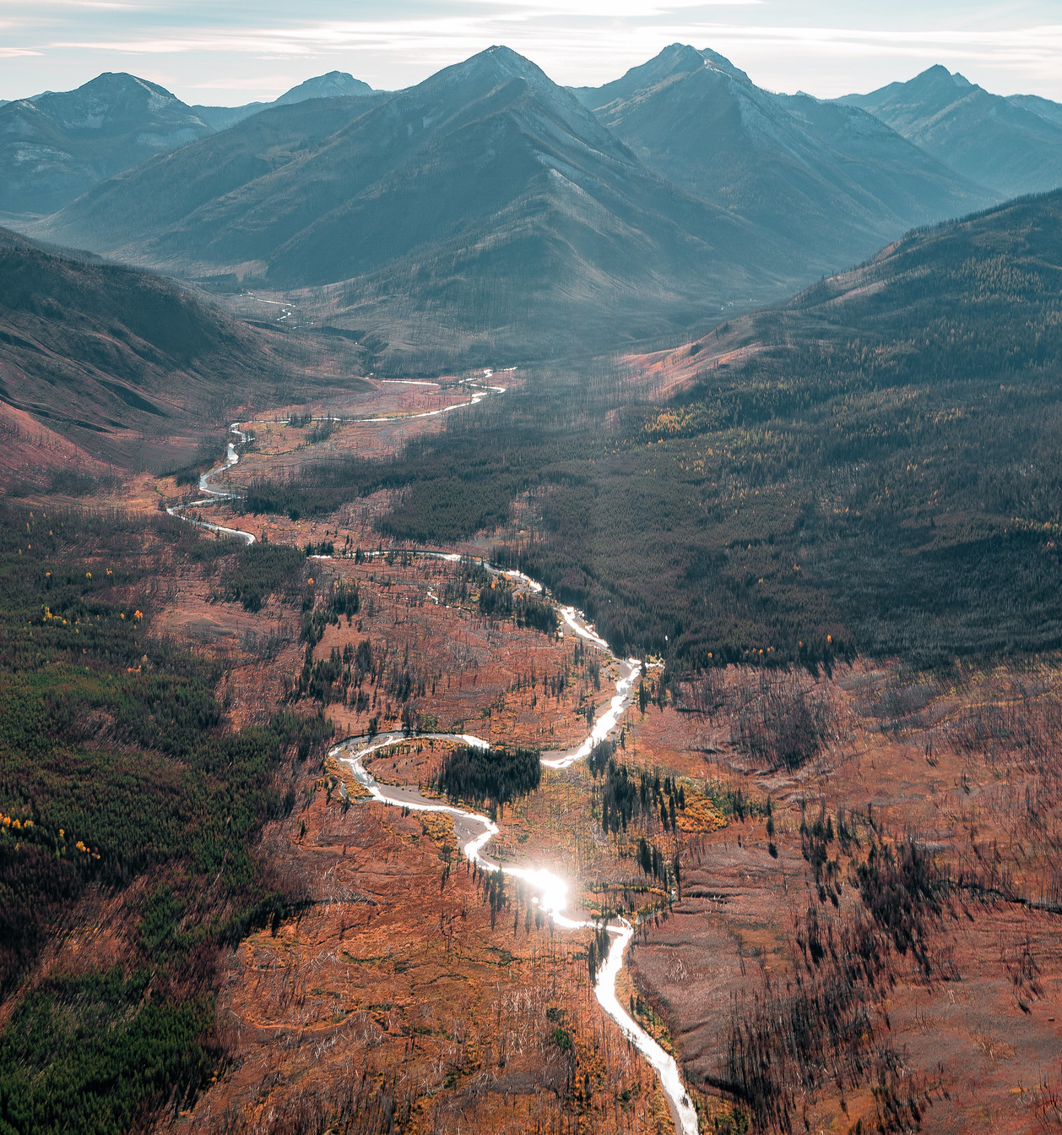
Community Concerns
Contaminants can remain in the environment for extended periods of time
Exposure to contaminants can negatively affect vital bodily systems of humans and animals
Urbanization will likely increase the prevalence of contaminant sources in western Montana
Image credit: Your Forests Your Future
Notes:
Even in trace amounts, exposure to contaminants such as brominated flame-retardants (BFRs), heavy metals, and pharmaceuticals can result in neurological, endocrine, and reproductive impairments in animals and humans.
These chemicals do not break down easily, which facilitates faster movement up the food chain and bioaccumulation in apex predators.
Anthropogenic contaminant sources (wastewater plants, wastewater effluent, increased use of flame-retardants, and runoff from urban areas) are likely to increase as urban areas expand in the study area.
The lack of knowledge regarding the presence and impact of contaminants on these rich ecosystems hinders the ability of policymakers and land managers to implement appropriate conservation or mitigation strategies.
------------------------------Image Information Below ------------------------------
•Image Credit: Your Forests Your Future
•Image Source: U.S. Forest Service
Image URL: https://www.flickr.com/photos/usforestservice/46609246585/in/photostream/ (License public domain)

Slide 4
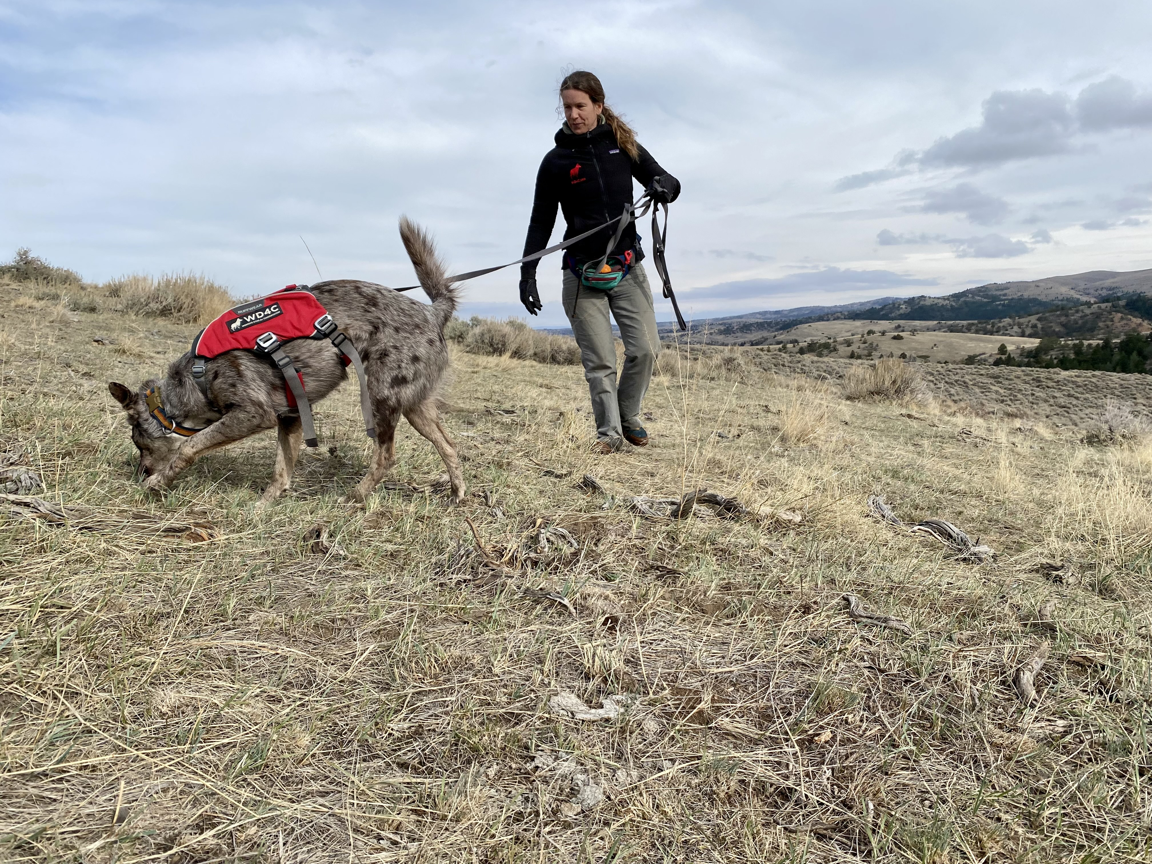
Partners
Working Dogs for Conservation
Virginia Institute of Marine Science
Image credit: Ngaio Richards
Image credit: M. LaGuardia
Point of Contact:
Dr. Ngaio Richards
Forensics and Field Specialist
Point of Contact:
Dr. Mark LaGuardia
Senior Marine Scientist
Notes:
We partnered with Working Dogs for Conservation (WD4C) and the Virginia Institute of Marine Science (VIMS)
WD4C is a Montana-based nonprofit organization that uses detection dogs’ remarkable sense of smell to protect wildlife and wild places. Dr. Ngaio Richards from Working Dogs for Conservation has used detection dogs to locate scat of mink and otter for the purpose of contaminant monitoring in western Montana’s river systems. WD4C would like to incorporate NASA Earth observations to streamline identification of scat detection survey areas.
The Virginia Institute of Marine Science is one of the largest marine research and education centers in the world. Dr. Mark LaGuardia from the Virginia Institute of Marine Science collaborates with WD4C to conduct the laboratory analysis of the scat samples collected in the field for contaminants.
------------------------------Image Information Below ------------------------------
•Image Credit: Ngaio Richards
•Image Source: Working Dogs for Conservation (provided by partners with permission to use).
•Image Credit: Mark LaGuardia
•Image Source: Virginia Institute of Marine Science (provided by partners with permission to use).

Slide 5
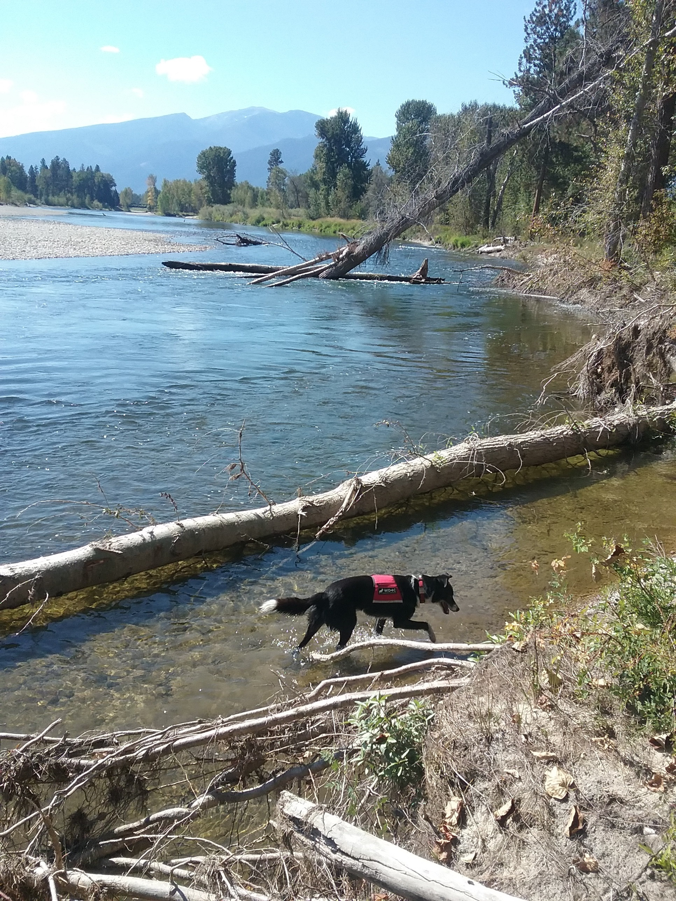
Objectives
1. Generate refined habitat suitability models for mink and otter in expanded study area for years 2013-2020
2. Create refined future habitat suitability models for mink and otter in expanded study area projected to 2040
3. Produce survey site accessibility maps for aiding dog-based field surveys
4. Calculate precipitation anomalies and topographic maps
Image credit: Ngaio Richards​
Notes:
We had four objectives for this project.
First was to generate refined current habitat suitability models for mink and otter in an expanded study area for years 2013-2020.
The second objective was to create refined future habitat suitability models for mink and otter in an expanded study area projected to 2040.
Our third objective was to produce survey site accessibility maps displaying viability of survey locations based on recreational river use and accessibility factors.
Our final objective was to compose maps displaying precipitation anomalies in relation to topographic characteristics to aid in further monitoring river system contaminants.
------------------------------Image Information Below ------------------------------
•Image Credit: Ngaio Richards
•Image Source: Working Dogs for Conservation (provided by partners with permission to use)
•Image Credit: Icons: PowerPoint

Slide 6
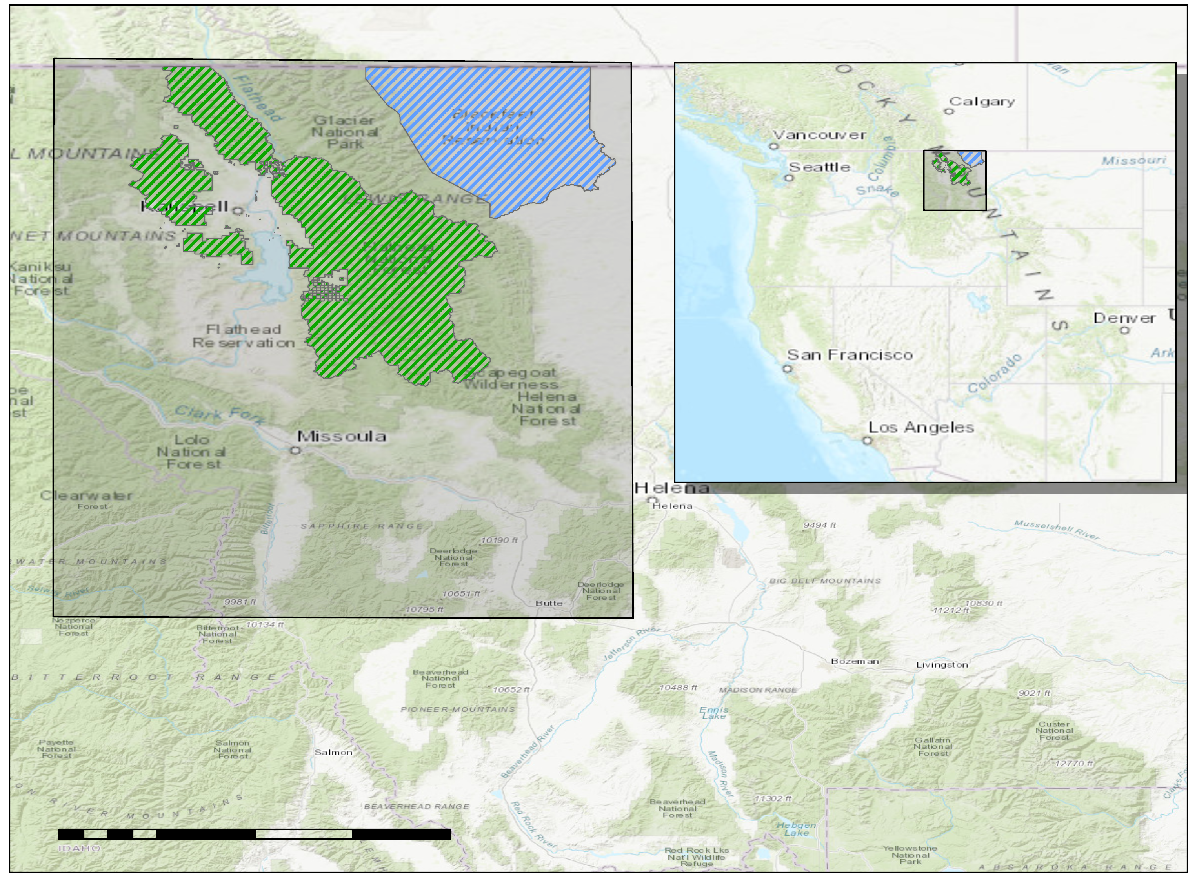
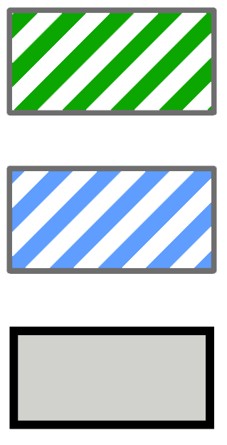
Study Area and Period
Study Area:
Northwestern Montana
Expanded study area includes 82,955 km² region of Flathead National Forest and Blackfeet Indian Tribal Reservation
Study Period:
N
September – November
2013 – 2020
Flathead National Forest
Blackfeet Reservation
Study Area
37.5
75
112.5
150
0
18.75
Miles
Notes:
Our study region expanded from the efforts of the Spring 2021 Western Montana Ecological Forecasting term, which encompassed an 82,955 km2 region, including Flathead National Forest and Blackfeet Nation Tribal Lands.
The team focused on the autumn months, from September to November, as the streamflow is generally lower during this time and the partners can safely conduct their surveys with the detection dog teams. Our study period utilizes data from the years 2013-2020 to incorporate partner field data beginning in 2013.

Slide 7
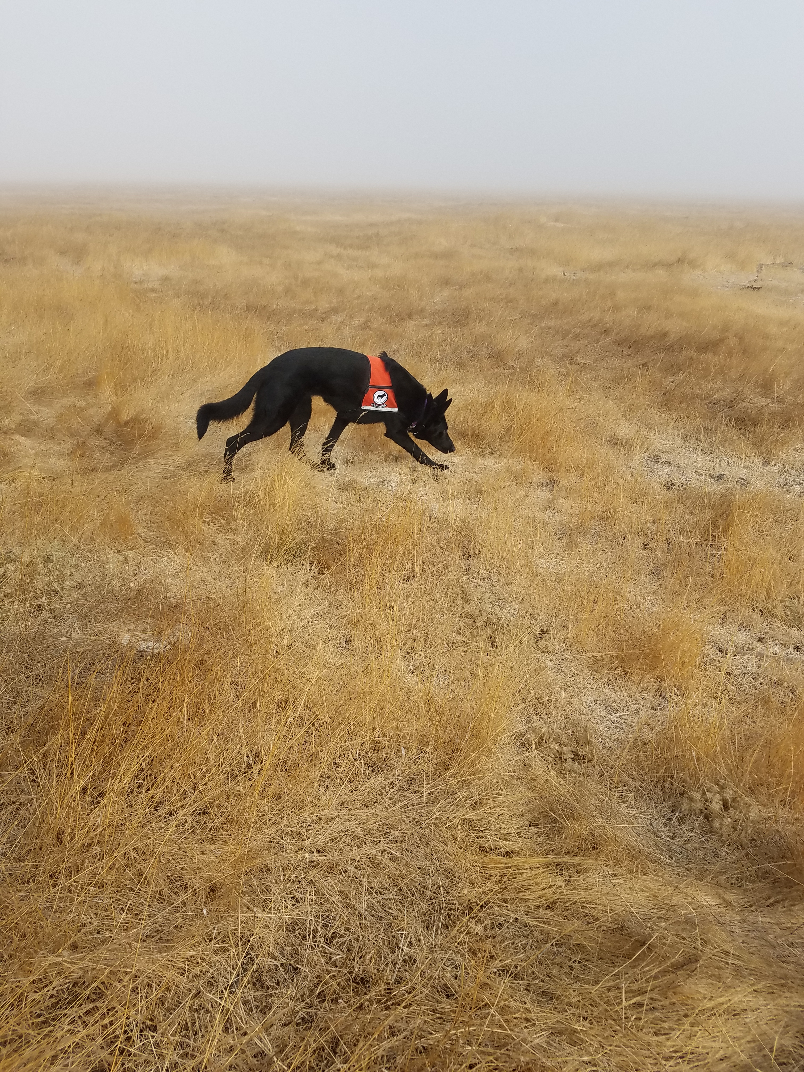
Field Data
We obtained species occurrence data from:
Working Dogs for Conservation Field Surveys
Global Biodiversity Information Facility (GBIF)
Montana National Heritage Program Observational Database
Image credit: Ngaio Richards
Notes:
The team gathered species occurrence points from 3 different sources:
Working dogs for Conservation provided us with mink and otter occurrence points that were collected in the field during autumn months during 2013-2020.
Additionally, we obtained observational data points from GBIF database and the Montana National Heritage Program Geodatabase.
------------------------------Image Information Below ------------------------------
•Image Credit: Ngaio Richards
•Image Source: Working Dogs for Conservation (provided by partners with permission to use)

Slide 8
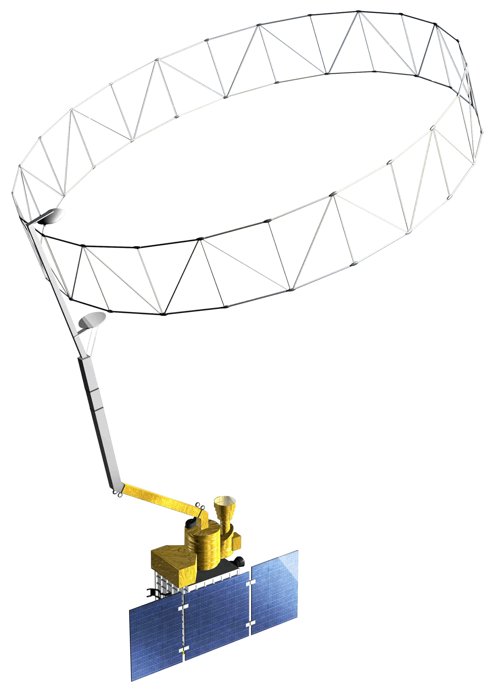
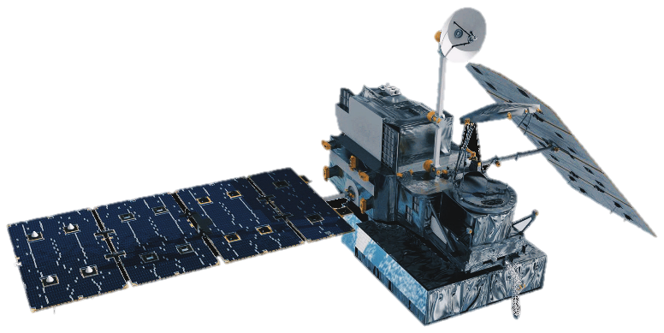
NASA Satellites & Sensors Used
Terra MODIS
Moderate Resolution Spectroradiometer
(2013-2020)
SMAP
Soil Moisture Active-Passive
(2013-2020)
GPM IMERG
Global Precipitation Measurement
(2013-2020)
SRTM
Shuttle Radar Topography Mission
(2013-2020)
Image credit: NASA
Notes:
*Amanda*
We used various NASA satellites and sensors to collect predictor variable data for our habitat suitability models.
We gathered normalized difference vegetation index (NDVI) information from Landsat 8 Operational Land Imager (or OLI).
We used Terra Moderate Resolution Spectroradiometer (MODIS) for land surface temperature and burned area variables.
We obtained precipitation information from Global Precipitation Measurement (GPM IMERG) satellite.
We utilized the Shuttle Radar Topography Mission (SRTM) for topographic variables.
------------------------------Image Information Below ------------------------------
Background Image:
Image Credit: NASA Image Gallery
Image Source: https://www.nasa.gov/image-feature/earth-enveloped-in-airglow
All satellite images:
Image Credit: NASA

Slide 9
Current Habitat Suitability Model Workflow
Data Acquisition
Sensors
Environmental Predictors
Data Analysis
End Product
SMAP
Soil Moisture
Terra MODIS
Land surface temperature
GEE
GPM IMERG
Precipitation
Analysis in Arc GIS Pro
Current habitat suitability maps
SRTM
Elevation, slope, and aspect
Analysis in SAHM*
National Hydrography Dataset
USGS
National Land Cover Database
USDA
PRISM (Temperature Data)
*Software for Assisted Habitat Modeling
Notes:
Here is our general workflow for creating the current habitat suitability models for mink and otter.
The team collected Earth observation data using Google Earth Engine (GEE). We used the aforementioned NASA satellites and sensors to gather our predictor variables that were used in our data analysis. We also used ancillary datasets such as NHD, NLCD and PRISM to construct maps and prepare datasets for modeling. Some data analysis and processing were conducted in ArcGIS Pro. All data was then loaded into SAHM, which was developed to expedite habitat modeling and to help maintain a record of the various input data, pre- and post- processing steps, and modeling options for building habitat suitability models. Within SAHM we utilized the Random Forest algorithm to produce the suitability models.

Slide 10
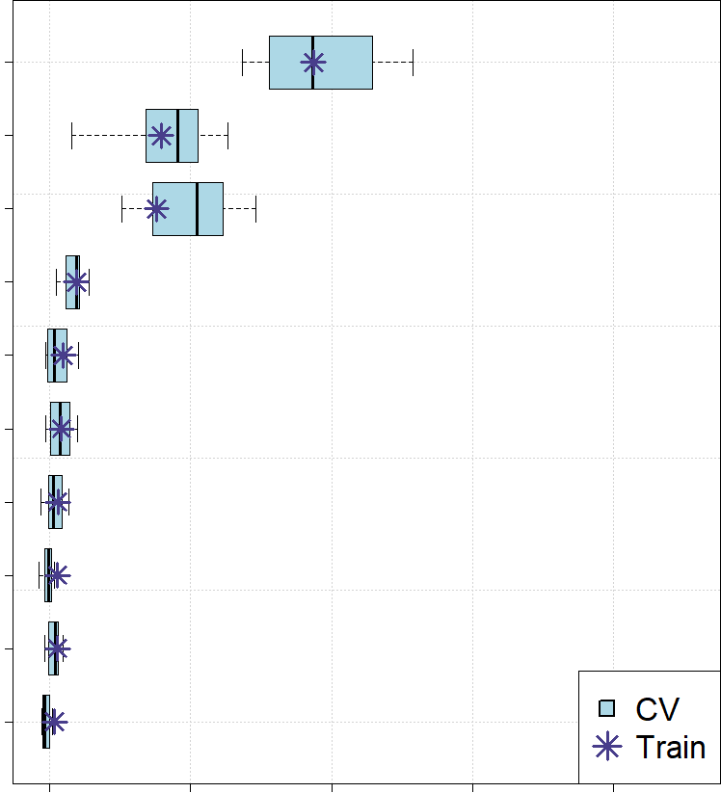
Results: Current Habitat Suitability Models
Correlated variables over .70 were removed
Importance using the change in Area Under the Curve (AUC) when each predictor is permuted
Final Predictor Variables
Distance to River
Elevation
National Land Cover Data (NLCD)
Slope
Minimum Vapor-pressure Deficit
Minimum Temperature
Soil Moisture
Eastness
Aspect
Northness
Distance to River
Elevation
NLCD
Slope
Variable
Minimum VPD
Minimum Temp.
Soil Moisture
Eastness
Aspect
Northness
CV
Train
0.00
0.05
0.10
0.15
0.20
Importance
Notes:
We analyzed a correlation matrix that was generated by SAHM, which shows the correlation between predictor variables using the maximum of the Pearson, Spearman and Kendall coefficients. When two variables were correlated above 0.70, we removed the variable with the lowest deviance explained.
Our final predictor variables for the current habitat suitability model were distance to river, elevation, land cover, slope, minimum vapor pressure deficit, minimum temperature, soil moisture, eastness, aspect and northness.
This plot shows the importance of variables for our current model with the variables on the y-axis and the variable importance on the x-axis. Distance to river was the most important variable for habitat suitability, followed by elevation and land cover. Mink and otter occurrence was higher at lower elevations and within evergreen forests.

Slide 11
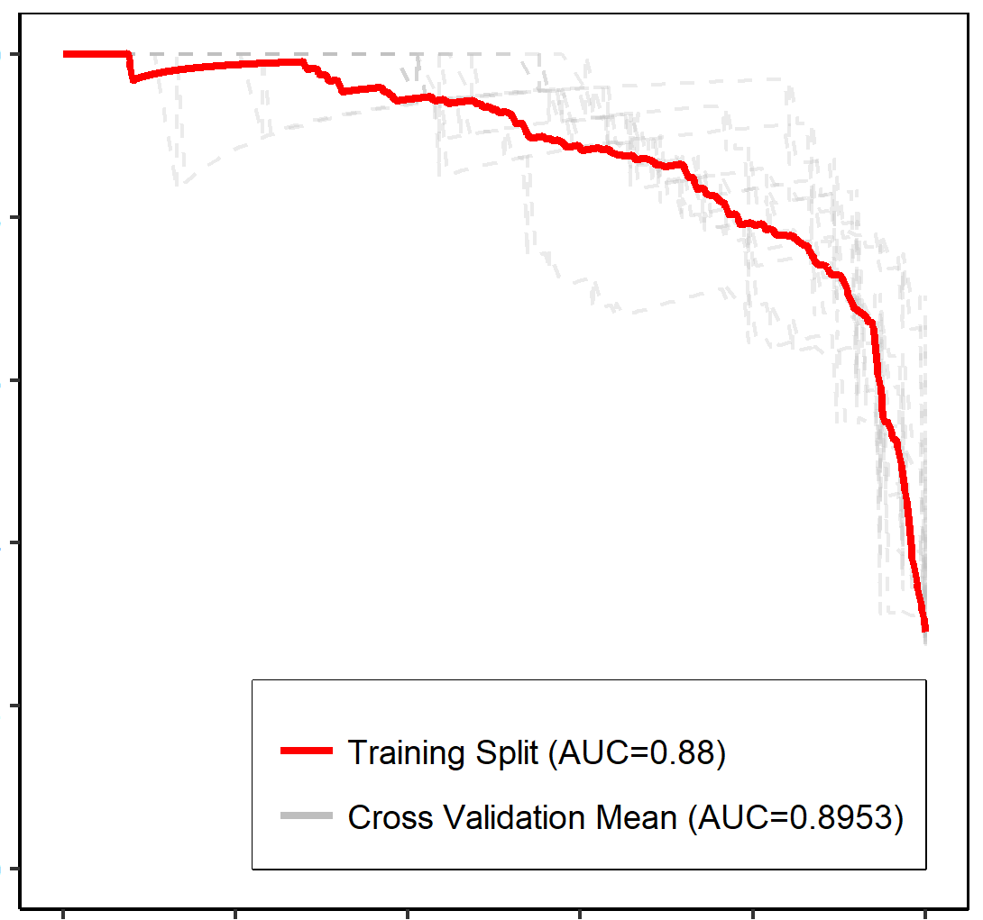
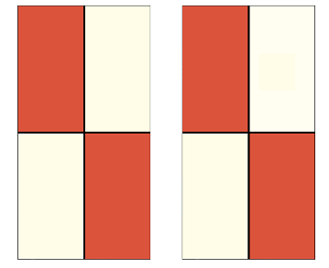
Results: Current Habitat Suitability Models
AUC-PR Plot
Confusion Matrix
for Training Data
Confusion Matrix for
Cross Validation Data
1.0
0.8
339
(TP)
118
(FP)
310
72
Presence
Presence
0.6
Precision
Predicted
0.4
Absence
46
(FN)
882
(TN)
Absence
75
928
Training Split (AUC=0.88)
0.2
Training Split(AUC=0.88)
Cross Validation Mean (AUC=0.89)
Cross Validation Mean (AUC=0.8953)
0.0
Presence
Absence
Presence
Absence
Observed
0.0
0.2
0.4
0.6
0.8
1.0
Recall
Correctly Classified = 88.2%
Correctly Classified = 89.4%
Correlation Coefficient: 0.77
Notes:
The confusion matrix in addition to curve produced by the AUC plot are important in determining how the model is performing and the model's ability to discriminate between presence and absence points.
As our models were trained with presence-only data, we used the Area Under the Curve Precision-Recall score, or AUC-PR, to evaluate the performance of the model. We considered scores between .9 and 1 to be excellent and scores between .8 and .9 to be good. Our model had an AUC-PR score of 0.88, indicating that our model had a good performance.
The confusion matrix shows the number of predicted and observed values in each of the presence and absence classes and is also useful in determining the performance of the model. In this figure, the color scale is based on the column totals so that if all presences are classified as presence and all absences are classified as absence, the diagonal items will be red, and the off diagonal will be white.

Slide 12
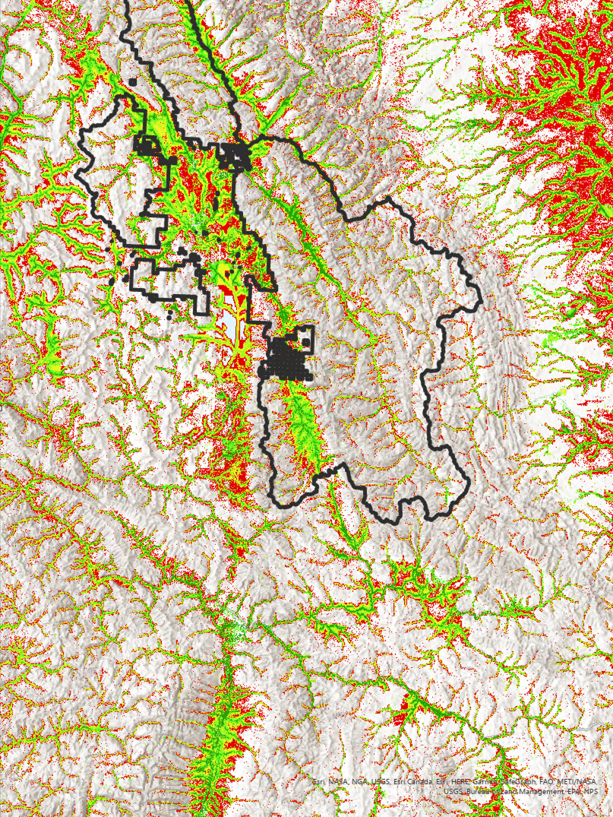
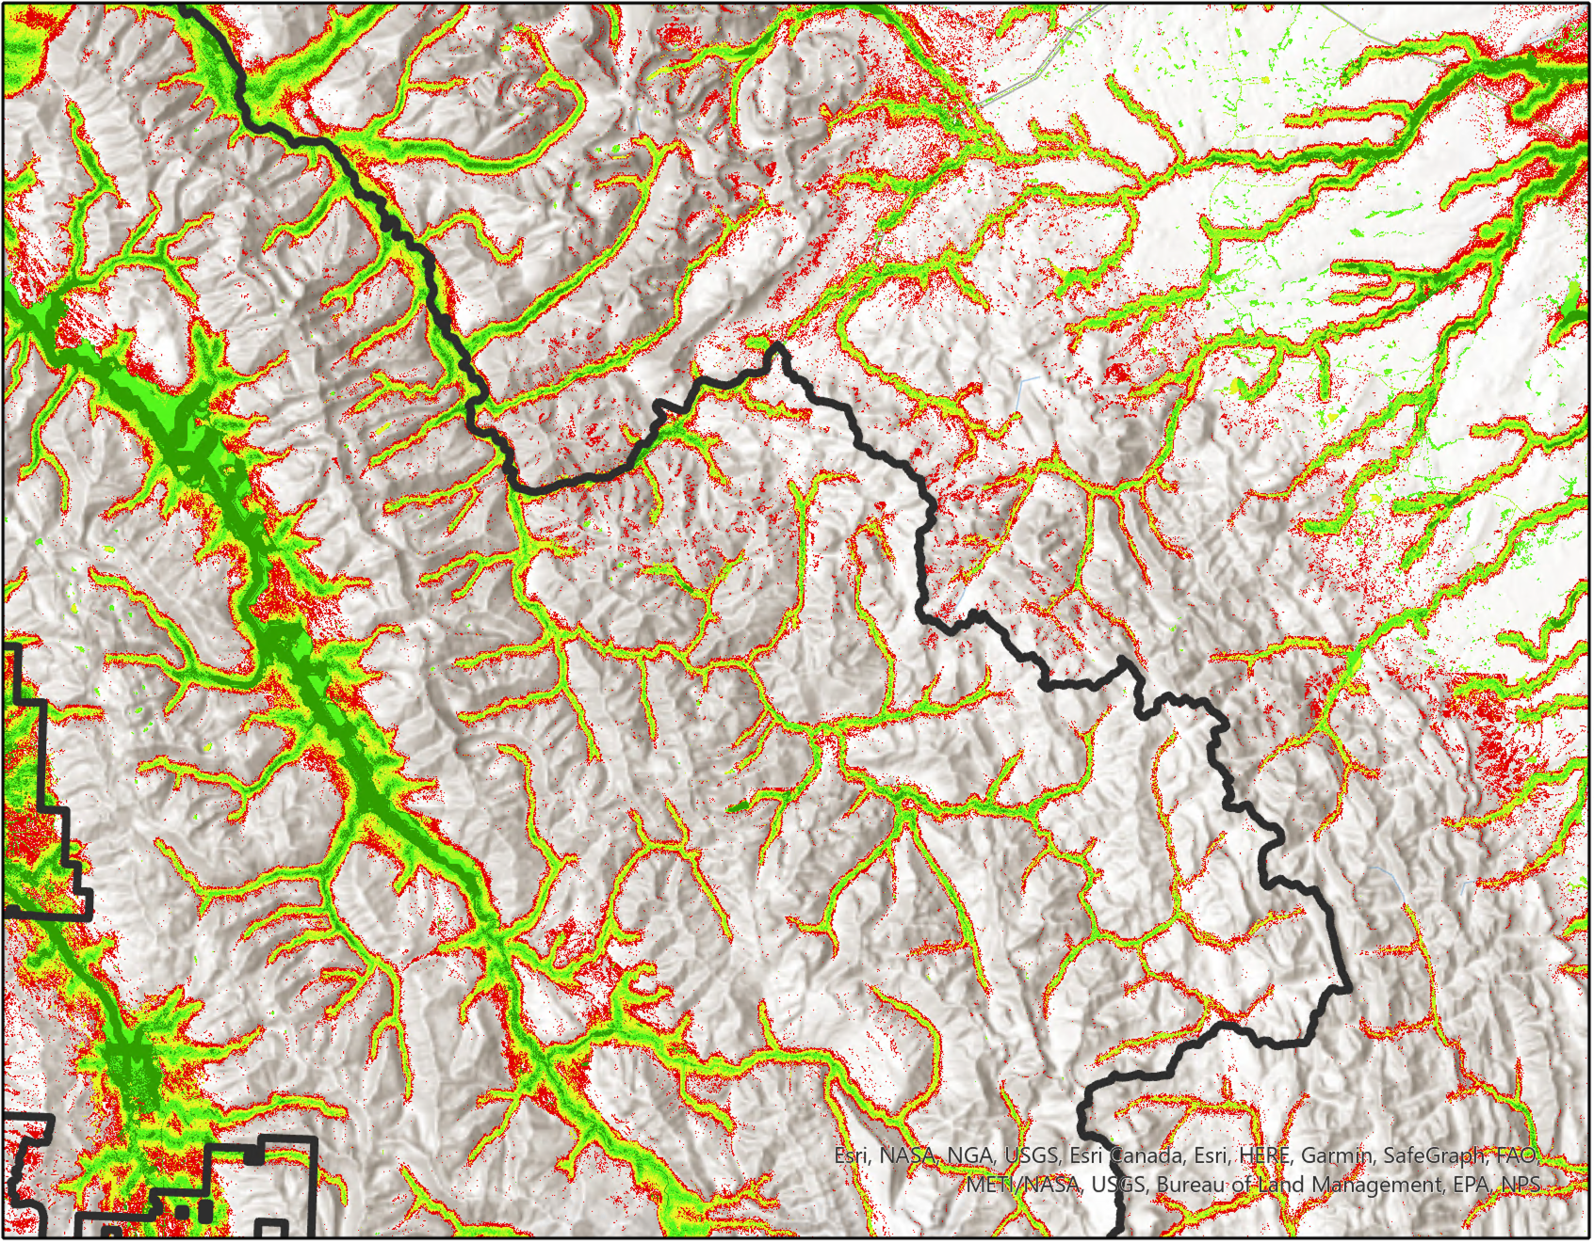
Results: Current Habitat Suitability Maps
% Habitat Probability
78 - 100
62 - 78
46 - 62
31 - 46
18 - 31
Flathead National Forest
0 2.5 5 10 15 20
N
Miles
Notes:
Here we show our habitat suitability maps for mink and otter. The probability maps for our current model shows the probability of a species occurrence given the sampling design of the field data, with red indicating low probability and green indicating high probability.
Within the larger study area, you can see that suitable habitat generally outlines rivers. However, in the zoomed-in version of a section of Flathead National Forest on the right, you can see how suitability differs depending on other variables. Highly suitable habitat generally corresponded with the presence of evergreen forest and lower elevation.
------------------------------Image Information Below ------------------------------
Basemap Credit: ArcGIS Pro
Basemap Sources: Esri, HERE, Garmin, SafeGraph, FAO, METI/NASA, USCS, Bureau of Land Management, NPS, Airbus, USGS NGA, CGIAR, NCEAS, NLS, OS, NMA, Geodatastyrelsen, GSA, GSI, and the GIS User Community

Slide 13
Projected Habitat Suitability Model Workflow
Data Acquisition
Environmental Predictors
Data Analysis
End Product
Maximum Annual Temperature
Analysis in R Studio
Future habitat suitability maps
WorldClim
Minimum Annual Temperature
Analysis in SAHM
Average Annual Precipitation
Notes:
The team downloaded projected and historical bioclimatic variables from the WorldClim website to produce the future habitat suitability maps. The predictors variables we were able to use were maximum and minimum annual temperature as well as annual precipitation. This data was averaged over the time periods of 2010-2018 and 2021-2040. To combine the averaged rasters, we utilized R studio where we used a raster stacking function within the Raster Library. This data was then loaded into SAHM to create a training model as well as a future model that projects these climate variables into the future, generating future habitat suitability models for mink and otter.

Slide 14
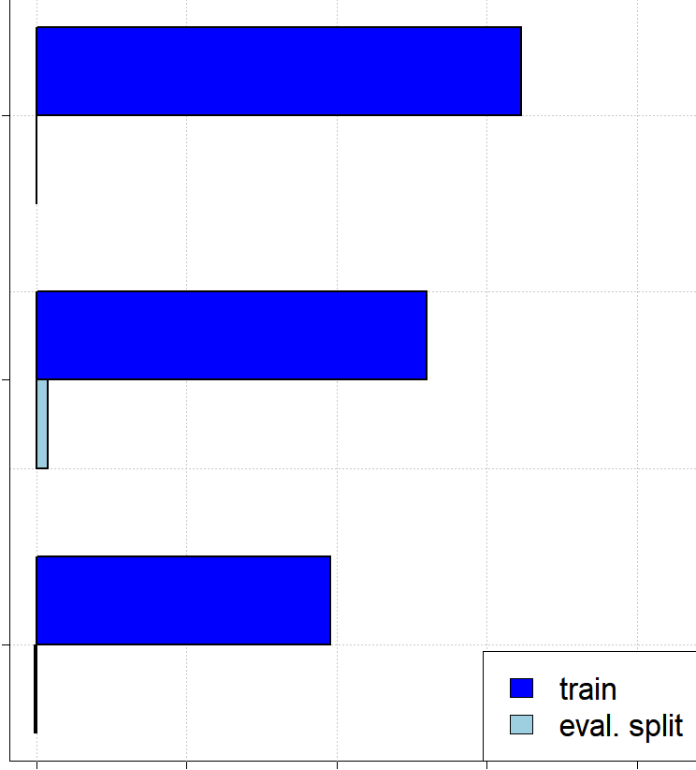
Results: Projected Habitat Suitability Models
Importance using the change in Area Under the Curve (AUC) when each predictor is permuted
Final Predictor Variables
Maximum Temperature
Precipitation
Minimum temperature
Maximum temp.
Variable​
Precipitation
Minimum temp.
Train
Eval. Split
0.0
0.1
0.2
0.3
0.4​
Importance​
Notes:
For our projected habitat suitability models, maximum temperature, minimum temperature and precipitation were included as final predictor variables. As we previously mentioned, AUC-PR scores can be used to determine a model's accuracy. In this variable importance plot, the variables are on the y-axis and the variable importance is on the x-axis.

Slide 15
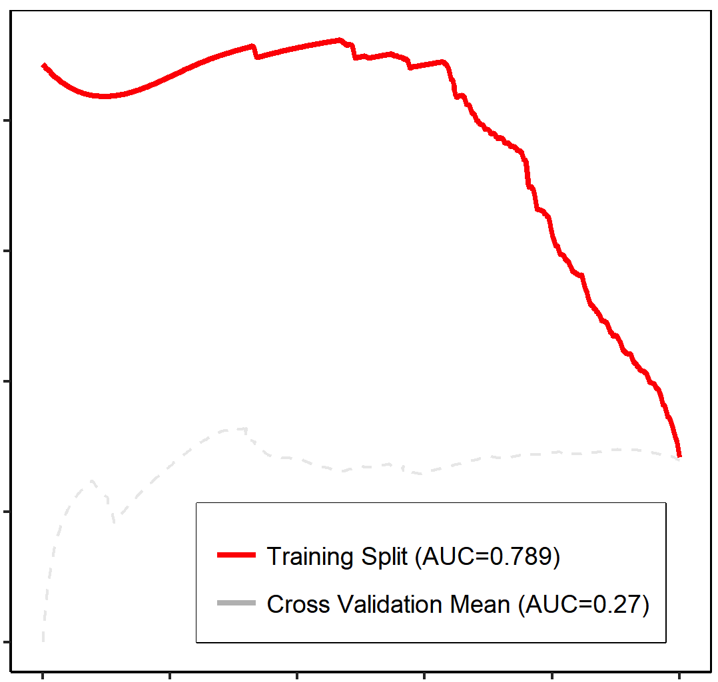
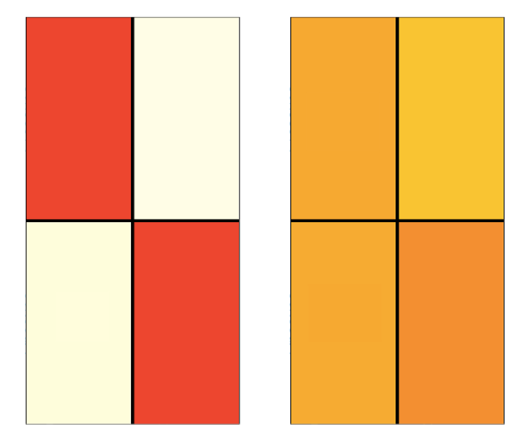
Results: Projected Habitat Suitability Models
Confusion Matrix for Training Data
Confusion Matrix for Applied Model
AUC-PR Plot
0.8
309
(TP)
199
(FP)
180
510
Presence
Presence
0.6
Precision
Predicted
0.4
76
(FN)
801
(TN)
0.2
Training Split(AUC=0.78)
Cross Validation Mean (AUC=0.27)
Absence
Absence
205
490
0.0
Presence
Absence
Presence
Absence
0.0
0.2
0.4
0.6
0.8
1.0
Observed
Recall
Correctly Classified = 80.1%
Correctly Classified = 48.4%
Notes:
The AUC-PR score was again used to evaluate the future model for accuracy, as well as the confusion matrix to indicate how successful the model was in predicting mink and otter presence and absence. We utilized current climate variables to train the model in order to project these variables into the future. For this trained model we had an AUC-PR score of 0.78. However, when this model was projected into the future, the AUC-PR score dropped to 0.27, which indicates the difficulties of the model to project these variables into the future.
As for our confusion matrix, it did a fairly good job at predicting the presence of mink and otter using our training data. When this model was applied to the future however, the accuracy is decreased in predicting presence and absence.
Our results represent some of the challenges with projecting habitat suitability models into the future. The data that was downloaded from the WorldClim database was on a coarse scale and only using 3 variables to predict habitat suitability over such a large study area likely contributed to the low accuracy of our future models.

Slide 16
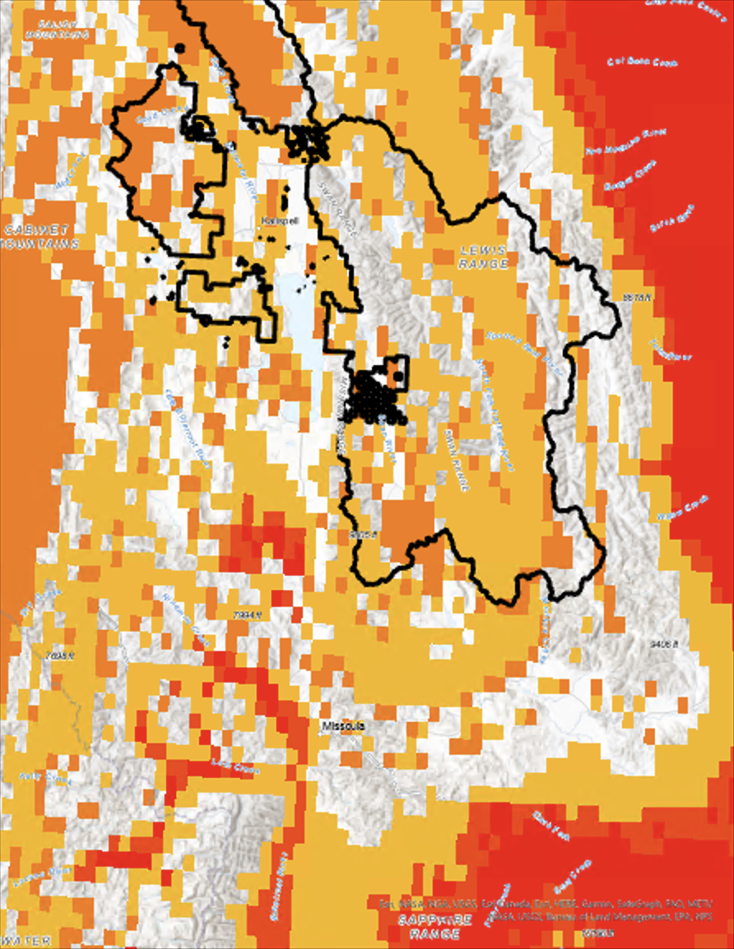
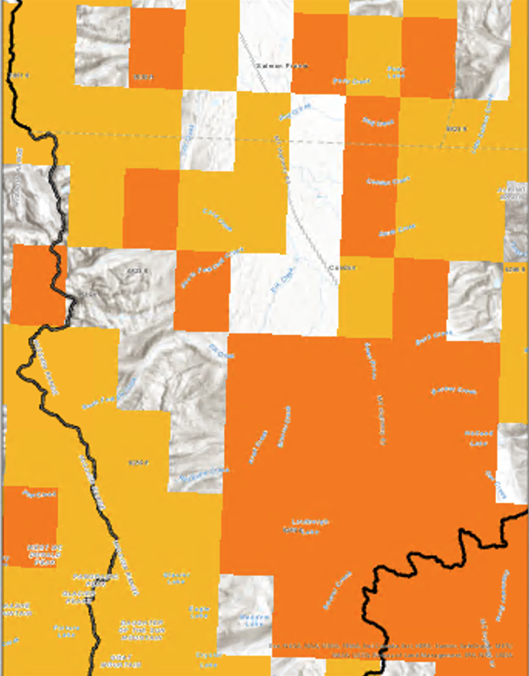
Results: Projected Habitat Suitability Maps
% Habitat Probability
4 - 12
12 - 23
23 - 42
42 - 51
Flathead National Forest
0
10
N
40
0
1.25
3
Miles
Miles
Notes:
In the future probability map, yellow indicates high probability and red indicates low probability. As you can see, the future model has relatively coarse resolution and lacks obvious river patterns. The low performance of the future model can be attributed to several factors. The team was only able to use three predictor variables in this model. Flow metric and land cover data was able to be downloaded. However, when this data was loaded into SAHM the models failed. Another factor is the coarse resolution of the climate data itself. In future projects, more variables with finer resolutions would help produce more detailed and accurate results.

Slide 17
Site Accessibility, Precipitation Anomalies & Topographic Map Workflow
Data Acquisition
Sensors
Current habitat suitability maps
Data Analysis
End Product
Ancillary Data
Site Accessibility Maps
Proximity tools in ArcGIS Pro
OSM
GEE
GPM IMERG
Precipitation
Precipitation Anomalies & Topographic Maps
Visualized using ArcGIS Pro
SRTM
Elevation, slope, and aspect
Notes:
The team collected Earth observation data using Google Earth Engine (GEE) to produce site accessibility maps, precipitation anomalies and topographic maps.
Our partners were interested in specific sources of contamination and river drainage, especially within the Blackfeet Tribal Lands. We used Open Street Map data and overlaid the points of interest on our habitat suitability maps. We included distance to roads to inform the partners of accessible sites in relation to recreation use and human activity. We also included emergent herbaceous wetland areas, as our partners were concerned around riverbank vegetation and slope at survey locations.

Slide 18
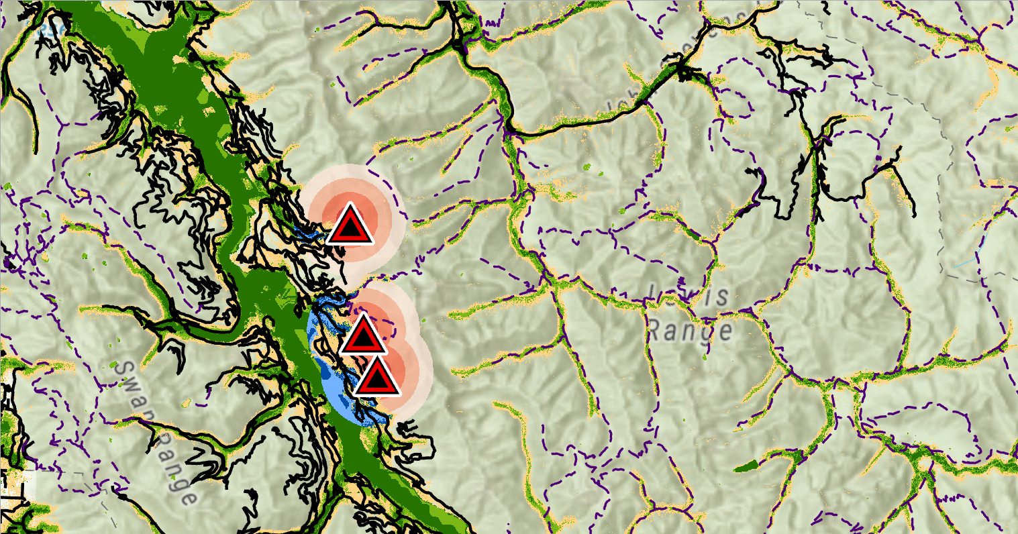
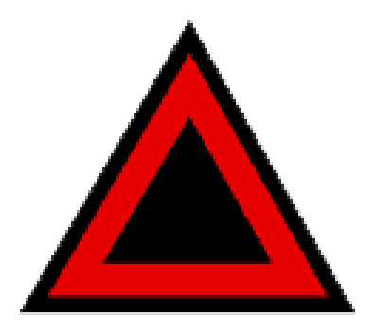
Results: Site Accessibility Maps
Contamination Radius:
0 - 0.5 Miles
0.5 - 1 Miles
1 - 1.5 Miles
1.5 - 2 Miles
N
Contaminated Suitability:
51% - 74%
74% - 100%
Symbols:
Hiking Trail
Road
Problematic Mine
0 2.5 5 10 Miles
Notes:
Here we show our site accessibility maps to further inform survey site selection by WD4C. As you can see in the location in the inset map, there is a high habitat probability for mink and otter nearby potential contaminant sources in Flathead National Forest and around Blackfeet Tribal Lands. Here we see environmentally-hazardous mining sites, represented by the red triangles, with tiers of distance each representing a half mile from the contamination site. The contaminated high and medium suitability habitat are shown in light and dark blue respectively. Hiking trails and roads are included to help partners plan routes to surveying locations.

Slide 19
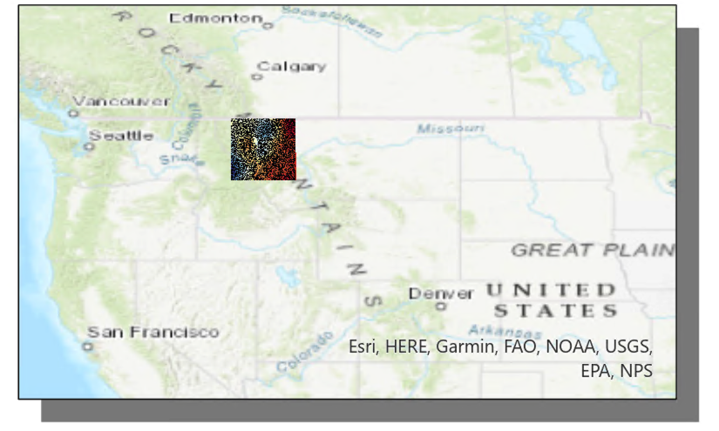
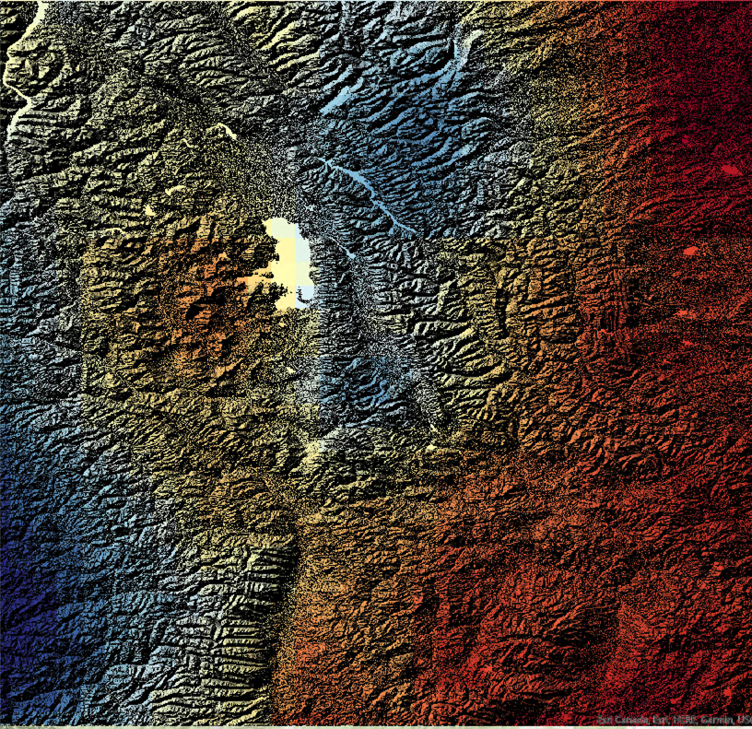
Results: Precipitation Anomaly Map Overlaid onto Topographic Map
Precipitation Anomalies (mm/year)
367.92
-227.76
N
0 15 30 60 90 120
Miles
Notes:
Precipitation anomalies were calculated using GPM IMERG precipitation data and hill shaded digital elevation models (DEM) data. The anomalies display precipitation differences from mean precipitation for September, October and November from 2013 to 2020. Blue indicates high anomalies (more precipitation), while the red depicts low anomalies (less rain). When focusing on the Blackfeet Tribal lands in the upper right corner, you can see that this area experiences drought anomalies. Areas shaded in blue may be better surveys sites when attempting to identify areas of water contamination due to runoff or erosion.
Units for anomalies = mm/year

Slide 20
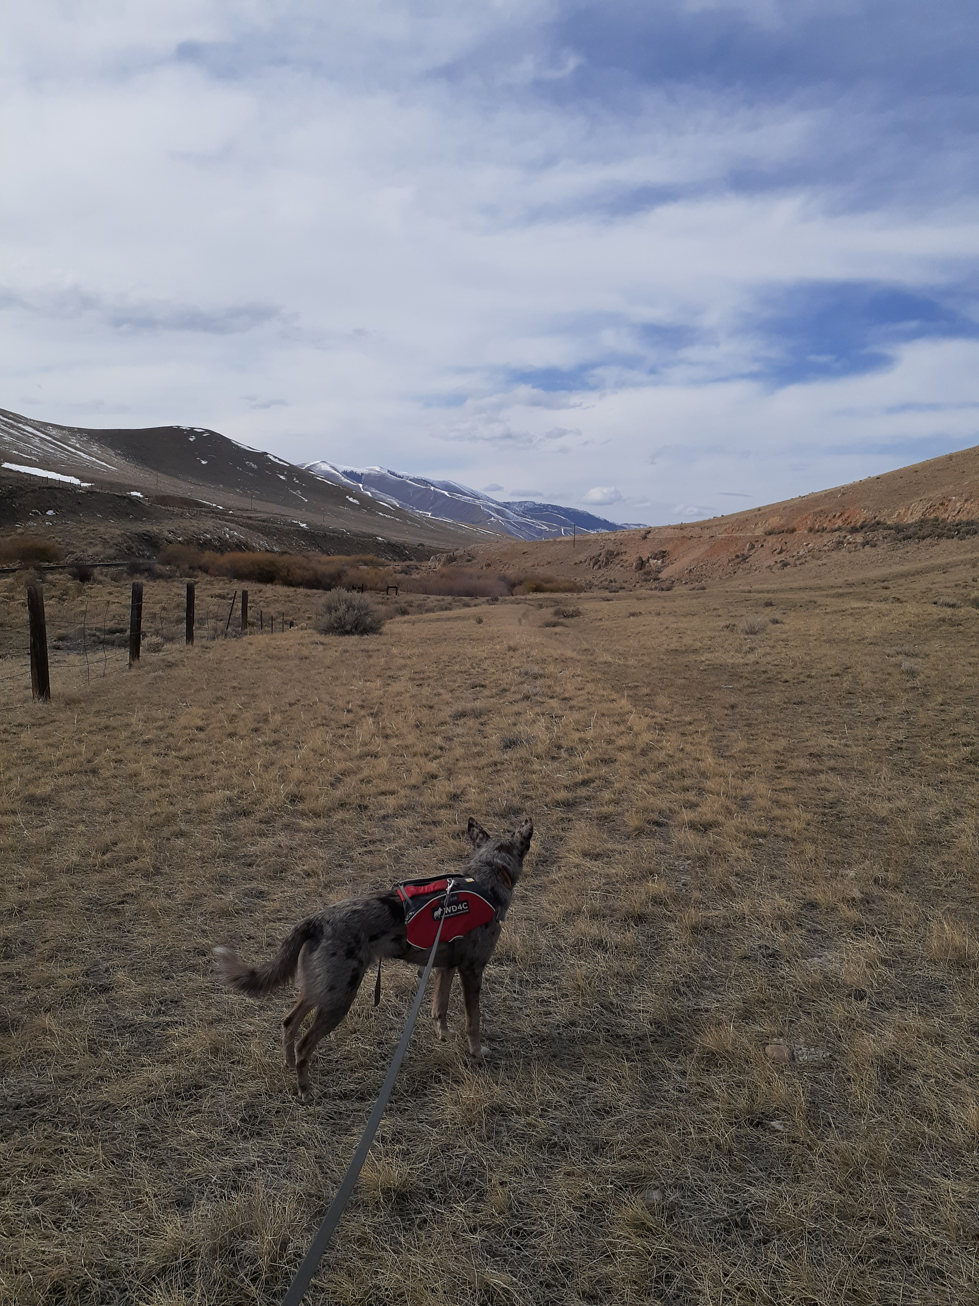
Errors and Uncertainties
The model was trained with presence-only data
Sampling data collected from several different sources
Limited access to additional contamination sources (e.g., illegal dumping sites)
Obtaining climate data at finer resolution could result in more accurate projected models
Image credit: Ngaio Richards
Notes:
The team ran into a few errors and uncertainties in the project. Though our current model produced relatively accurate results, there is inherent difficulty when working with presence only data. This can be due to the absence of validation data with true absence and presence points. Using simulated data for these points can be a useful tool, but they sometimes fail to fully reflect the noise and complex structure involved in ecological data. We also used presence data from several different resources including citizen observations. There are likely some errors in this sampled data that should be considered. When attempting to identify areas of contamination, the team looked for data on illegal waste disposal sites but were unable to obtain this information. This contamination source could be contributing significantly to the bioaccumulation of chemicals in mink and otter. And finally, the projected models would greatly benefit from and increase in predictor variables as well as resolution.
------------------------------Image Information Below ------------------------------
•Image Credit: Ngaio Richards
•Image Source: Working Dogs for Conservation (provided by partners with permission to use).

Slide 21
Conclusions
Distance to river, elevation and land cover were the most important factors for predicting mink and otter habitat
Projected habitat suitability models had low accuracy and were only based on climate variables
Site accessibility maps show access and entry points for aiding WD4C field surveys
Satellite data can add variables to habitat suitability models that may not be measurable in the field
Image credit: Ngaio Richards
Notes:
Overall, we concluded several main outcomes from this project.
Distance to river, elevation and land cover were important variables in determining suitable habitat. Higher probability areas often corresponded with less distance to river, low elevation and evergreen forests.
Projected habitat suitability models had low accuracy in predicting future habitat suitability for mink and otter in the expanded study area. It is likely that this is because these models were based only on climate variables and on a very coarse scale.
Site accessibility maps will be useful in guiding survey site selection and safe navigation for scat sampling done by the partners and detection dogs.
Satellite data can be used to supplement field data in habitat suitability models. This data is useful as it may come from variables that are challenging or impossible to measure in the field.
------------------------------Image Information Below ------------------------------
•Image Credit: Ngaio Richards
•Image Source: Working Dogs for Conservation (provided by partner with permission to use).

Slide 22
Partners
Dr. Ngaio Richards
Forensics and Field Specialist; Working Dogs for Conservation
Dr. Mark LaGuardia
Senior Marine Scientist; Virginia Institute of Marine Science
Science Advisors
Dr. Allison Howard
University of Georgia
Dr. John Bolten
NASA Goddard Space Flight Center
Joseph Spruce
Science Systems and Applications, Inc.
Western Montana Ecological Forecasting I
Anna Winter
Kergis Hiebert
Kjirsten Coleman
Madeleine Gregory
Special Thanks
Dr. Nicole Ramberg-Pihl
Lead/Fellow, NASA DEVELOP GSFC Node
SAHM Point of Contact
Dr. Peder Engelstad
Colorado State University
Notes:
We would like to thank our science advisors: Dr. Allison Howard from the University of Georgia, Dr. John Bolten from NASA Goddard Space Flight Center, and Dr. Joseph Spruce from Science Systems and Applications, Inc.; our partners: Dr. Ngaio Richards from Working Dogs for Conservation, and Dr. Mark LaGuardia from the Virginia Institute of Marine Science; Peder Engelstad for his extensive help with the SAHM software; and our fellow Nicole Ramberg-Pihl.

