Slide 1

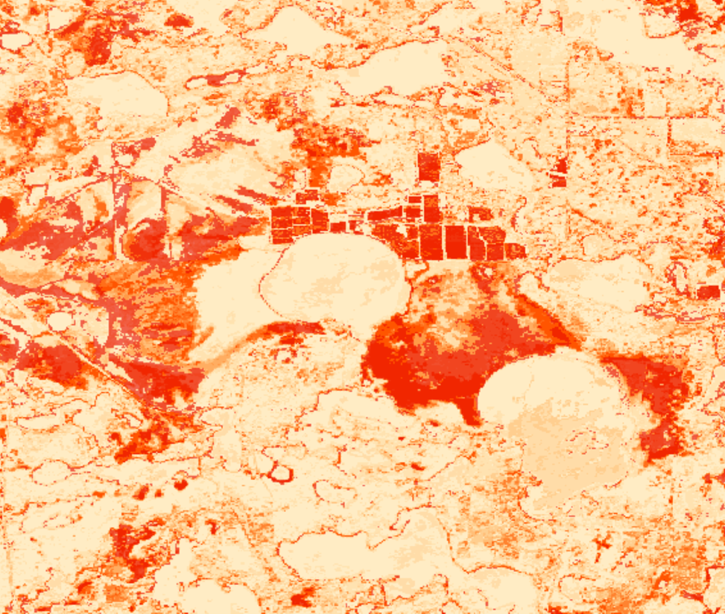

2018 Fall | Colorado
WISCONSIN AGRICULTURE &
FOOD SECURITY
Employing NASA Earth Observations to Model Distributions of Wild Crop Relatives, in support of USDA ARS Genetic Resource Conservation Efforts
Eli Simonson
Anastasia Kunz
Vanesa Martin
Nicole Pepper

Slide 2
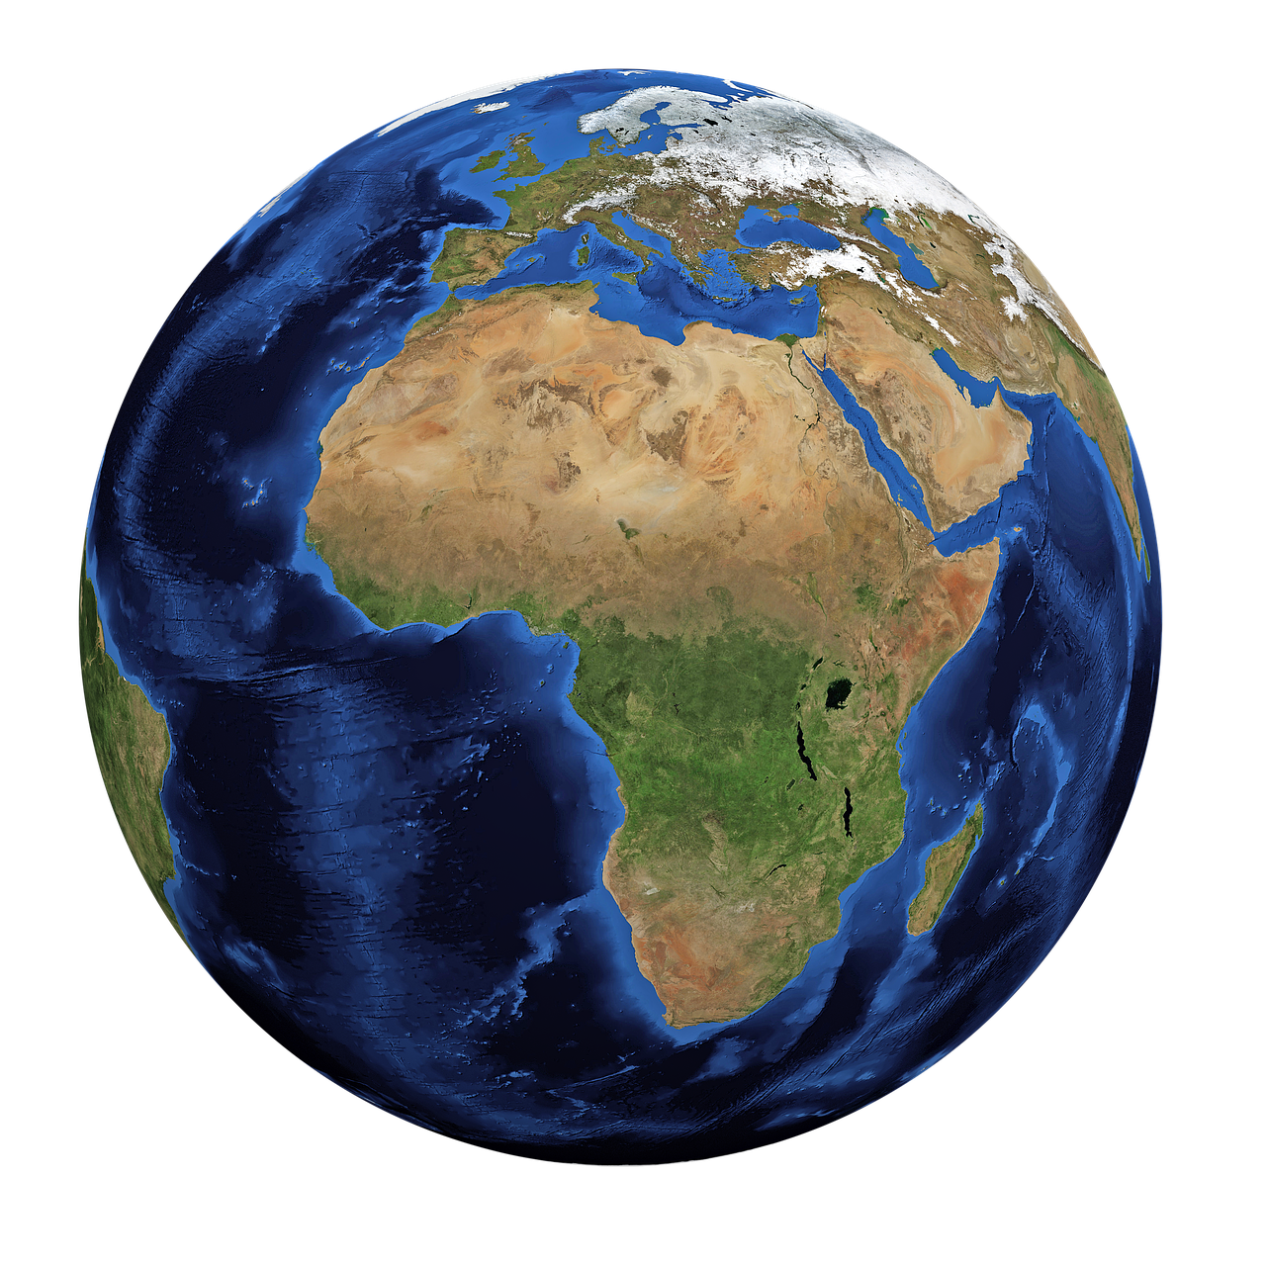
Can we see cranberries from outer space?
Photo Credit: Pixabay
Notes:
Can we see cranberries from outer space?
That was essentially the question that the US Department of Agriculture, Agricultural Research Service posed to our NASA DEVELOP Team.

Slide 3



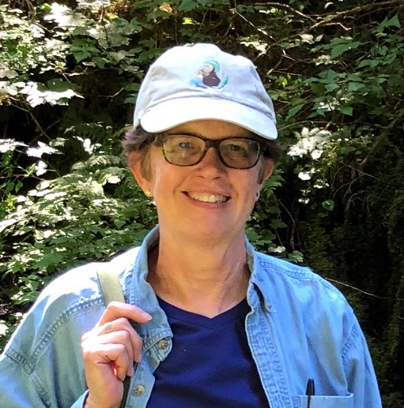
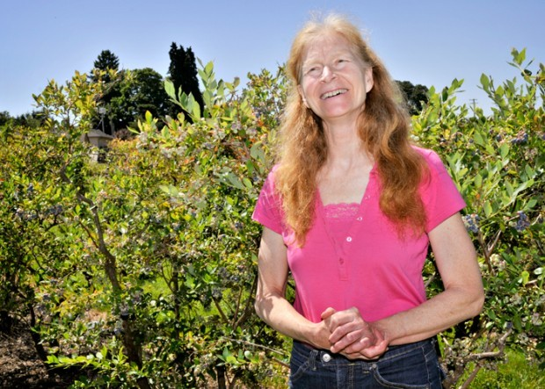
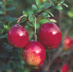




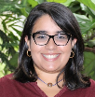
Project Partners
US Department of Agriculture, Agricultural Research Service,
National Plant Germplasm System
US Department of Agriculture,
Forest Service, Chequamegon- Nicolet National Forest
University of Wisconsin-Madison, Department of Horticulture
Notes:
The USDA ARS NPGS is interested in this question as a way to better locate and preserve crop wild relatives.
Waiting for Stephanie Green and Karen Williams to provide a headshot

Slide 4
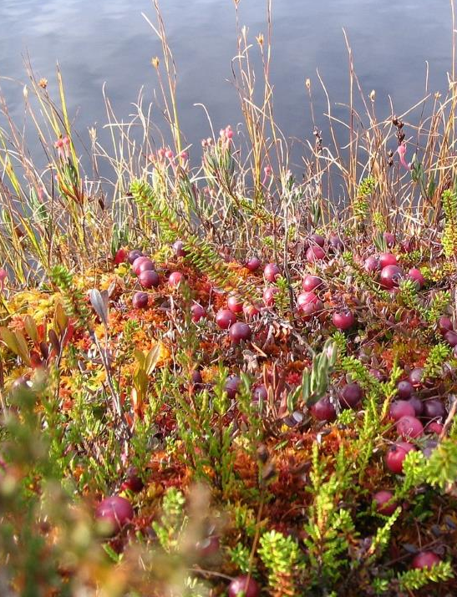
Introduction
Crop Wild Relatives (CWRs)
These plants are genetic relatives of cultivated crops.
In their natural habitats, CWRs continue to adapt to environmental changes.
CWRs’ unique traits can be used to improve food security and increase agro-economic productivity.
Photo Credit: Pixabay
Notes:
What are crop wild relatives? They are plant species such as wild cranberries, are genetically related to domesticated crops. In their natural habitats, these plants continue to adapt to the environment, and have traits that are often lost in the domestication process. These traits can be bred back into crops to improve nutrition, yield, and resilience such as resistance to pests or disease.

Slide 5
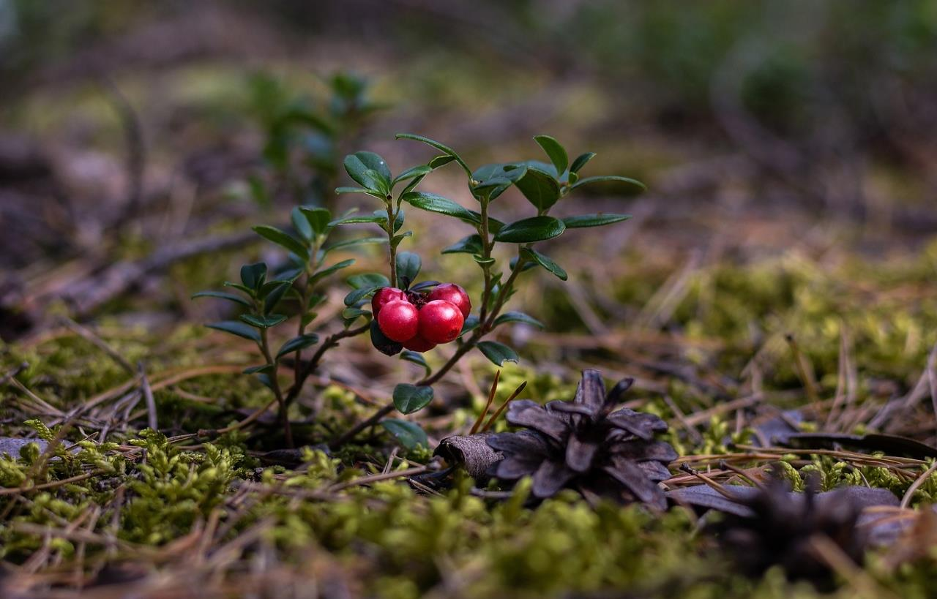

Community Concerns
CWRs comprise nearly 2,000 plant species native or naturalized to North America north of Mexico.
Photo Credit: Pixabay
Notes:
… And many of these species are threatened by habitat degradation.
(Khoury et al. 2018)
“FLORA OF NORTH AMERICA - Introduction Flora of North America.” n.d. Accessed September 26, 2018. and Khoury, Colin K., Stephanie Greene, John Wiersema, Nigel Maxted, Andy Jarvis, and Paul C. Struik. 2013. “An Inventory of Crop Wild Relatives of the United States.” Crop Science 53 (4):1496. https://doi.org/10.2135/cropsci2012.10.0585.

Slide 6
Community Concerns
The USDA ARS is tasked with collecting, preserving, and making available for research an array of these CWR species.
Photo Credit: Pixabay
Notes:
This brings us back to the USDA ARS’s goal of better documenting these species to preserve their genetic diversity. The USDA sends researchers out into the field to collect habitat information and seeds for the seedbank. More accurate habitat distribution maps will save the USDA time and money, and allow them to sample from a wider geographic range.

Slide 7
Community Concerns
It is necessary to improve conservation efforts for cranberries (Vaccinium spp.) due to their low genetic diversity and scarce representation in gene banks.
Photo Credit: Pixabay
Notes:
Specifically in this study, we are focusing on cranberries which are under represented in gene banks. These species, and other CWRs, are important to locate and preserve in their natural habitat. Accurate distribution maps can help the USDA highlight key areas of species prevalence for conservation.

Slide 8
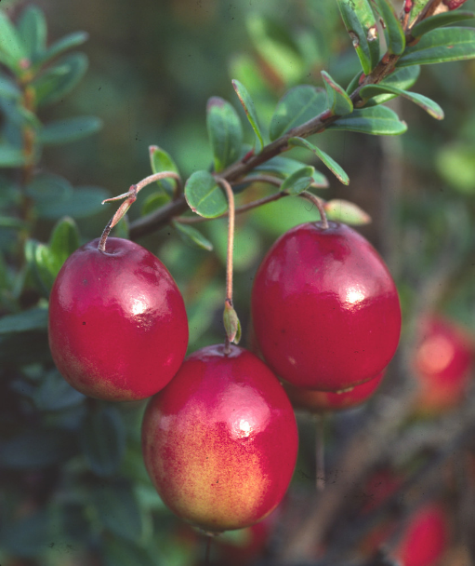
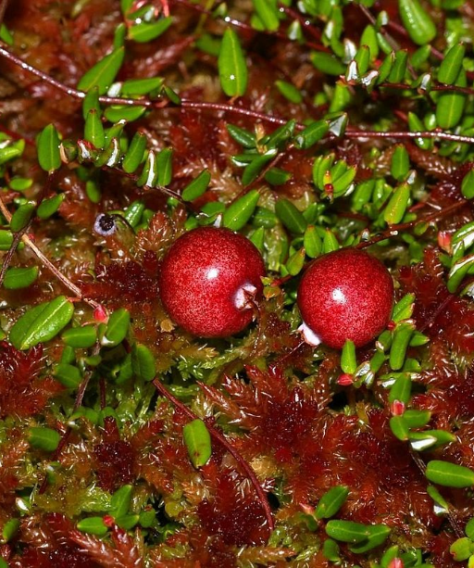
Focal Species
Largeleaf Cranberry
(Vaccinium macrocarpon)
◄◄◄
Littleleaf Cranberry
(Vaccinium oxycoccos)
► ► ►
Photo Credit: Dorothy Long
Photo Credit: Christian Fischer
Notes:
Interestingly, one of these species, Vaccinium macrocarpon, or the largeleaf cranberry, which is the domestic variety we are familiar with, has low genetic diversity. This makes it especially important for conservation efforts. The other focal species, vaccinium oxycoccos, has much higher genetic diversity.
We are focusing on these species because they are co occurring, and occur in unique acidic peat bog habitats. They also have important phenologic changes where their foliage changes color in the fall from green to red.

Slide 9
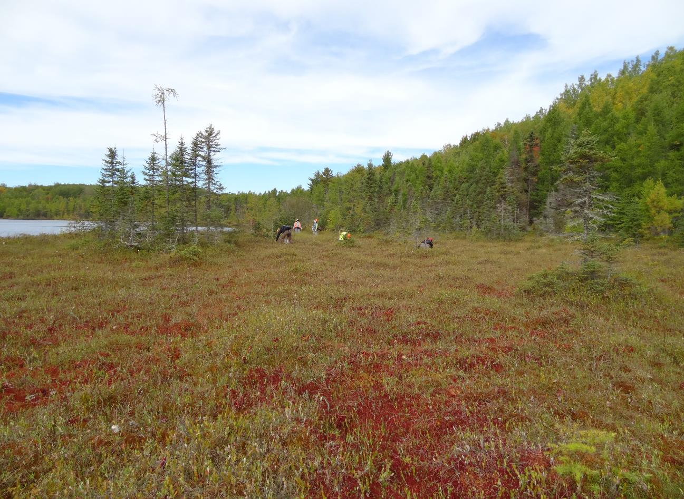
Project Objectives
1. Satellite Detection Modeling
2. Habitat Distribution Modeling
3. Integrated Modeling
Utilize NASA Earth observations to detect largeleaf and littleleaf cranberry populations
Employ habitat distribution models and compare efficacy of model iterations
Integrate spectral variables into habitat distribution models
Photo Credit: Linda Parker, USFS
Notes:
to address these community concerns and partner objectives we divided our study into 3 sections. First we looked to see if we could use NASA Earth observations to detect these populations at all. Next we employed habitat distribution models mirroring our partner’s current methodology and formulated habitat distribution models of our own. Finally we wanted to integrate these two methodologies and test the feasibility of detecting cranberries using earth obsv in our models.

Slide 10
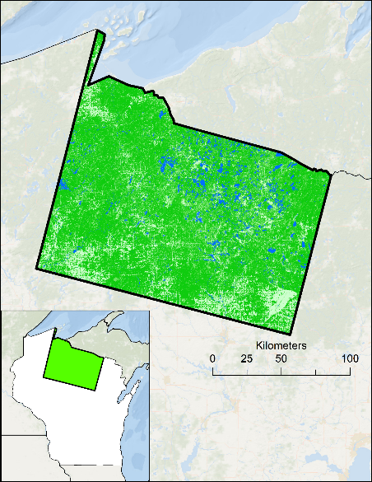
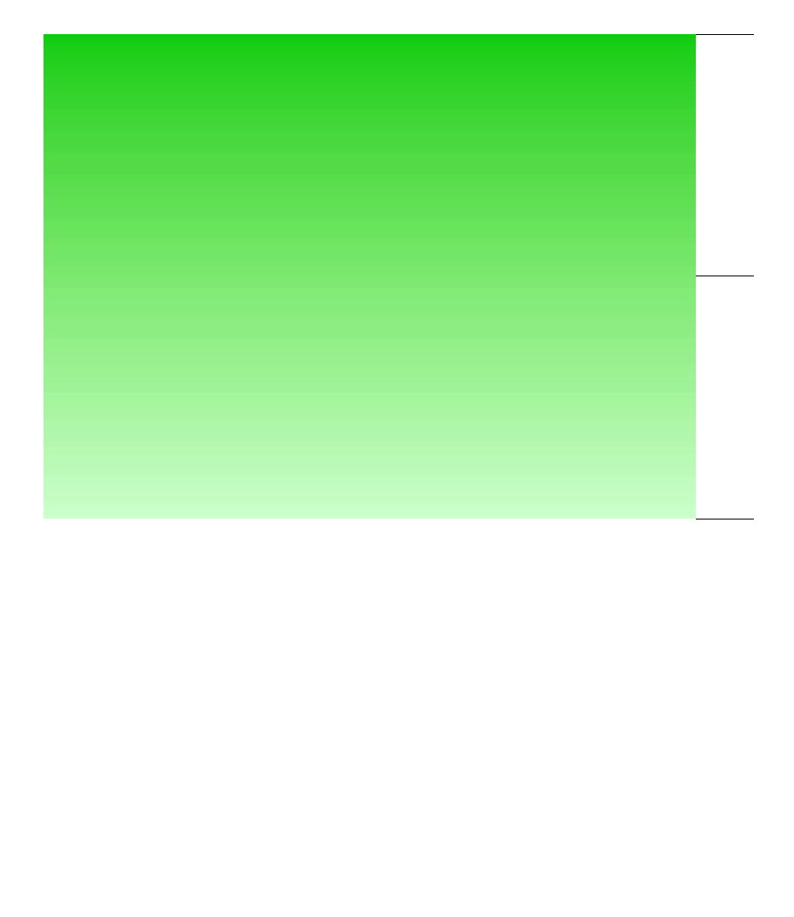
Study Area – Wisconsin: Path 25, Row 28
Study Period: 2017
Landscape: Fertile plains, sand and peat bog, and mixed wetland forest
                Wetland and bog habitats across the state create ideal growing conditions for Vaccinium spp. populations
      Wisconsin is the nation’s leading producer of cranberries, constituting 60% of national product
MI
P25 R28
Study Area
IA
WI
State Boundaries
Waterbodies
100% Forest Cover
MN
IL
0 % Forest Cover
Notes:
To assess the current distribution of our focal species, we focused on a single landsat scene predominantly located in northern Wisconsin. This area also overlaps with the Chequamegon Nicolet National Forest, and has wetland and bog habitat that is conducive for the growth of these two vaccinium species.
Landscape Info - (Wisconsin Historical Society, 2018)
Production facts - (Wiscran, 2018)

Slide 11
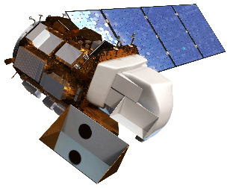
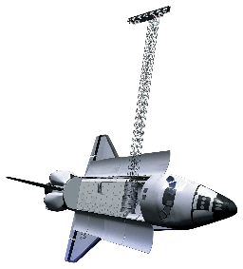
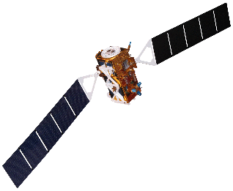
Earth Observations Utilized
Landsat 8
Operational Land Imager
(2013-2017)
Shuttle Radar Topography Mission
Topographic Variables
(2000)
Sentinel-1 C-SAR
Synthetic Aperture Radar
(2017)
All data is available via Google Earth Engine
Photo Credit: Pixabay
Notes:
We incorporated data from the Shuttle Radar Topography Mission (SRTM), Landsat 8 Operational Land Imager, and Sentinel 1 Synthetic Aperture Radar into our species distribution models

Slide 12
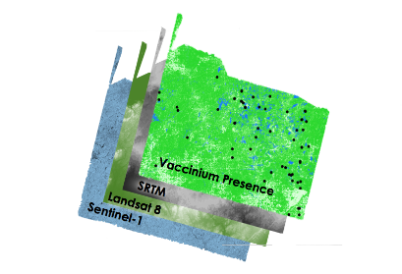
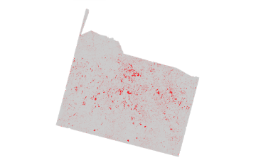
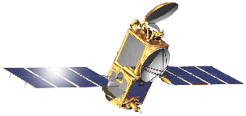
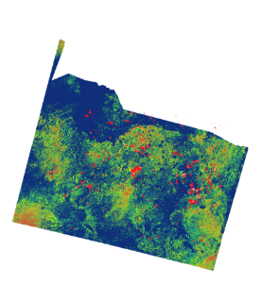
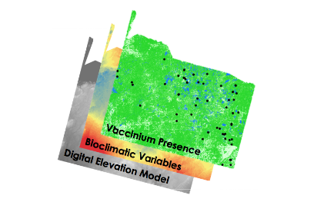


Methodology
Satellite Detection Modeling via GEE
Model Output
Integrated Model
Habitat Distribution Modeling via SAHM
Model Output
Notes:
Our methodology can be broken down into three parts. We decided to apply several different modeling approaches to address out partner objectives.
*Discuss main differences between Detection and HDM*
First, we applied satellite detection modeling in Google Earth Engine. This involves combining species presence data with satellite data to produce an output of detected cranberry habitat. Next, we applied habitat distribution modeling using a software for assisted habitat modeling, or SAHM. This involves combining species presence data with bioclimatic and topographic variables to produce an output that shows predicted suitable habitats of our focal species. Finally, we produced an integrated HDM that incorporated relevant spectral data.

Slide 13
Deriving Spectral Variables
Median Value of Surface Reflectance
Landsat
Satellite Detection Modeling
Phenological Approach
Across different seasons: Summer & Fall (2017)
Time Series
Habitat Distribution Modeling
Environmental Niche Approach
Across the entire Landsat 8 collection (2013-2018)
Notes:
A large component of our methodology involved deriving spectral variables. We did this by calculating the median value of surface reflectance across a specific time series of Landsat imagery. For the satellite detection modeling, we wanted to best match the phenology of our focal species which flowers in the Summer and turns red in the fall. Therefore we created spectral variables to align with the Summer and Fall of 2017. For Habitat Suitability Modeling, which takes an environmental niche approach, we wanted to create spectral variables that are comparable to bioclimatic variables which are typically averages across several decades. Therefore, we calculated median composites using the entire Landsat 8 collection.

Slide 14

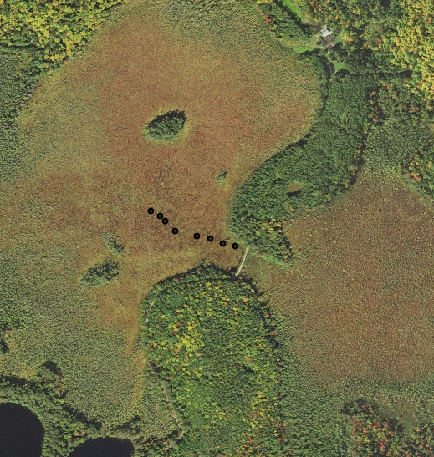
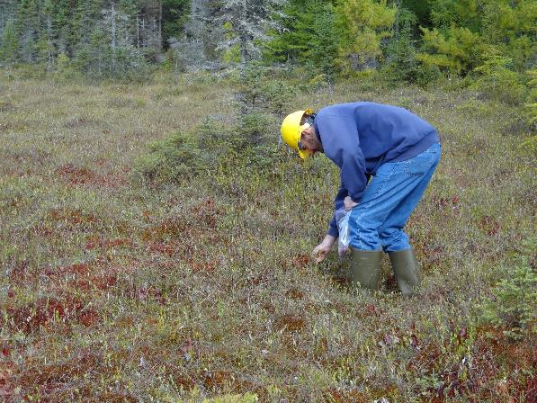
Insights from the Field
Known Presence
USDA NAIP, acquired September, 2017
Photo Credit: Linda Parker, USFS
Notes:
We used known presence data of wild cranberries species to as a way to understand which landscapes are characteristic of suitable cranberry habitat. This data was incorporated into our modeling methods, however these points are often not collected for remote sensing applications. Therefore, they are not optimal for capturing the unique spectral signature of the focal species.

Slide 15
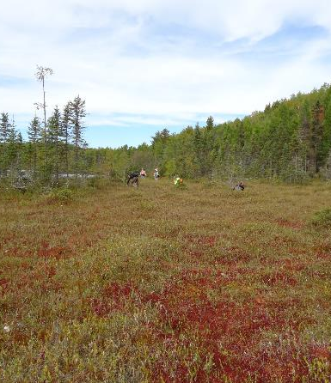
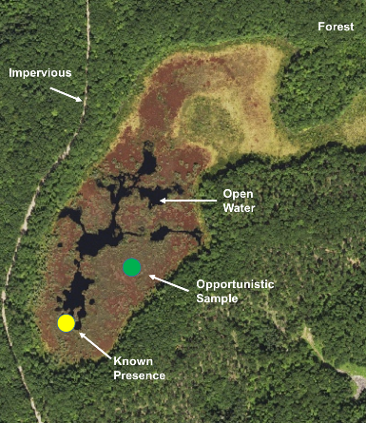
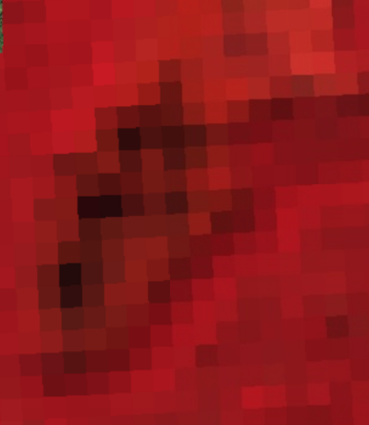
Ocular Sampling
In-Field Presence Locations
NAIP Imagery
(1m resolution)
Landsat 8 Imagery (30x30m resolution)
&
Photo Credit: Linda Parker, USFS
Acquired September, 2017
False Color Median Composite, Fall 2017
Photo Credit: Linda Parker, USFS
Notes:
That is why we were interested in creating our own presence data using ocular sampling. This involves using high resolution imagery from the National Agriculture Imagery Program to visually determine where new presence points should be placed. We determined where to place these points based on insights from our partners.

Slide 16
Analysis & Results
Notes:
Similar to the methodology, our Analysis and Results were divided into two main sections, Satellite Detection Modeling and Habitat Distribution modeling.

Slide 17
Satellite Detection Model Output
Cranberry Presence Locations
150 Presence Points, 150 Absence
    user-generated
Input Data
Satellite Derived Variables
Red Band, Summer
Green band, Fall
SWIR Band, Fall
NDVI, Summer
RandomForest
Notes:
Of which, I will be first be discussing the outputs for our detection component. For this modeling approach, we performed a RandomForest model using a combination of presence locations and satellite derived variables as input data. As previously mentioned by Eli, this model used our user-generated points. Making it 150 presence points and 150 absence points. Below these points , you will see a list of the 4 variables that were used for our final detection model. These variables were selected via Variable Selection Using Random Forest, or commonly known as VSURF.
*Talk about the variable pruning process....its in the notes but add language as well
-Mayer,Tim
These were the variables
Phenology of focal species was considered (vegetation color change in Fall) after discussion with our partners.
Variables were selected Utilizing VSRUF or the variable selection using random forest
You will see later that satellite derived surface reflectance products provided the most explanatory power for detecting our focal species
Interesting that differenced variables (spectral change due to phenology) did not come up as important
Phenological approach: looked at the seasonality
Summer
July-August
Fall
September-October
Winter
January-March

Slide 18
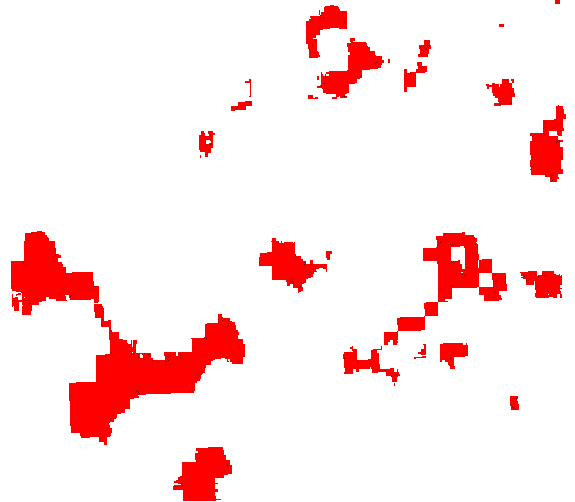
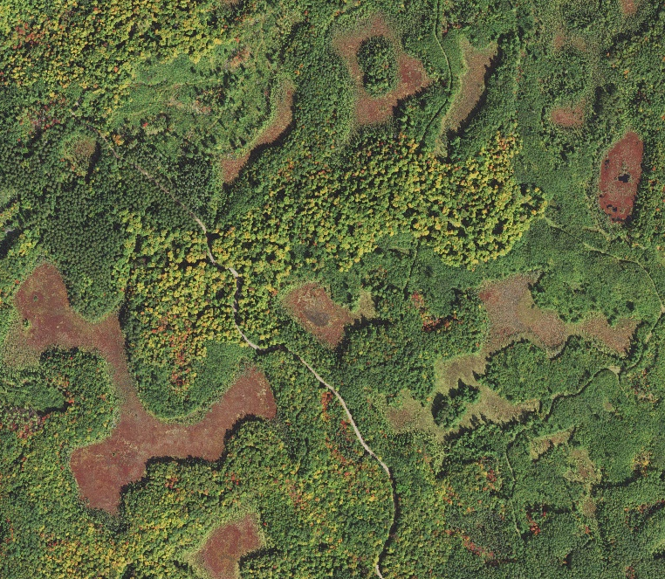
Satellite Detection Model Output
Acquired September, 2017
NAIP imagery over land cover that is characteristic of cranberry habitat
Classified imagery (grey = cranberry absence AND red = cranberry presence)
Notes:
Here is an zoomed in extent of our final detection model output. On the left is a high resolution image, from NAIP. Through collaborating back and forth with our cranberry experts over at the USDA, we’ve established that would expect these deeper, red, lowlying areas to be characteristic of wild cranberry habitat. Now, on the right, you can then compare this image with our binary model output of the same extent. In this case red indicates cranberry habitat presence and grey indicates cranberry absence. Now if you overlay the binary model on top of the landscape you can see that, it is generally picking up this habitat that we believe to have cranberries. What is important to note here is that we say that we are detecting “habitat” rather than “species”. This is because at this 30 by 30 meter resolution it is unavoidable that we are picking up other surrounding vegetation within these models. My team had a discussion with our partners to essentially confirm what other species we would likely be picking up in these outputs, highly likely, they said that these models may also be picking up on sphagnum moss as well as other members of the Vaccinium genus, both of which happen to be co-occuring with our focal species. So while these outputs may not be exclusively pure to the cranberry species, they are typical to what you would expect to see in the wild.
Variables incorporated into Rf model: Red Summer, NDVI Summer, Green Fall, SWIR Fall, Radar Winter (VH polarization)
Variable selection procedures (VSURF, rfUtilities, correlation analysis) were utilized to select important spectral predictors

Slide 19
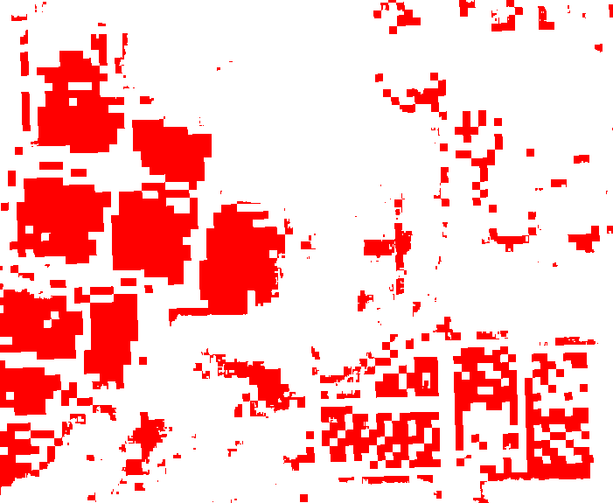
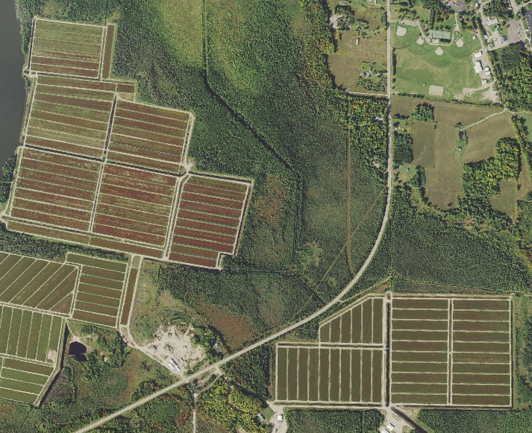
Applicability to Commercial Cranberry
Acquired September, 2017
NAIP imagery over commercial cranberry (Wisconsin DNR)
Classified commercial cranberry
Notes:
This next set of images is interesting because it can be used to further validate our detection models. On the left you can see this NAIP image of a comemrcial cranberry bog, as identified by a map layer from the Wisconsin Department of Natural Resources. It is important to note that we did not use any commercial bogs to shape our models.
The output on the right demonstrates the reliability in detecting true cranberries within these bogs, because the model was successful in indepently identifying this presence.
Though these two examples of our binary output models show relatively successful outputs, It is also important to highlight that within these models there is still room for refinement as there is noise that both over and underestimates cranberry habitat throughout our model.
Good oppurtunity to tlak about how adidng a mask in the future work to remove road etc. can further stregthen the output
-Mayer,Tim
***more than just cranberry
Good examples of over and under predicting
**room for refinement

Slide 20
Can we see cranberries from space?
How can we incorporate these spectral variables into the methods that our partners currently use?
YES!
Notes:
Can we see cranberries from outer space?
Yes!
So now we would like to talk about how

Slide 21
Habitat Distribution Model Comparison
 | Dataset-Derived Presence Points |  |  |  | User-Generated Presence Points
# of Data Points | AUC | TSS | Sensitivity | Specificity | AUC | TSS | Sensitivity | Specificity
20 50 100 150 | 0.61 0.73 0.79 0.84 | 0.14 0.33 0.52 0.53 | 0.64 0.69 0.81 0.81 | 0.5 0.64 0.71 0.72 | 0.74 0.81 0.89 0.89 | 0.47 0.37 0.52 0.57 | 0.76 0.76 0.85 0.85 | 0.7 0.6 0.67 0.73
Notes:
We tested several different parameters for our models, and we used 4 different types of statistical outputs to measure the robustness of the models. Area under the curve, True Skill Statistic, Specificity, and Sensitivity. For the most part, these have to do with how well the model was able to predict that presences were presences and absences were absences. Some of the parameters we changed included the type of input data we used (user-generated vs dataset-derived), and the number of presence points we used. As you can see, our user-generated points performed better statistically, and our spatial outputs corroborated that finding. After finding this out, our partner at the USDA was interested in finding out the minimum number of points he would need to generate in order to have a robust prediction model, and we determined that at a minimum, 100 points would be needed.

Slide 22
Habitat Distribution Model Comparison
Model Runs | MaxEnt |  |  |  | Random Forest
Variable Combination | AUC | TSS | Sensitivity | Specificity | AUC | TSS | Sensitivity | Specificity
WorldClim + Topographic | 0.92 | 0.67 | 0.77 | 0.90 | 0.99 | 0.91 | 0.96 | 0.95
ClimateNA + Topographic | 0.89 | 0.60 | 0.74 |  | 0.99 | 0.93 | 0.97 | 0.95
WorldClim + Topographic + NDMI | 0.96 | 0.81 | 0.90 | 0.91 | 0.99 | 0.90 | 0.93 | 0.97
ClimateNA + Topographic + NDMI | 0.95 | 0.79 | 0.88 | 0.91 | 0.99 | 0.91 | 0.95 | 0.97
Final Model Comparison | 0.99 | 0.90 | 0.93 | 0.98 | 0.99 | 0.97 | 0.97 | 0.99
No
Spectral Variables
0.86
Including
Spectral Variables
Notes:
After changing several parameters on several MaxEnt and RF models, these are some of our statistical outputs. As you can see, our RandomForest models generally outperformed our MaxEnt models statistically (though the numbers all around were rather robust.) WorldClim is a global database of climate data. We also wanted to see whether we could improve upon the RandomForest model by including bioclimatic variables derived from ClimateNA rather than WorldClim, given that ClimateNA has a finer resolution than its counterpart (30m vs 1 km) and ClimateNA is specifically for North America. We found only a negligible increase in our numbers for the RandomForest models. However, some spatial outputs more clearly demonstrated the difference that the finer resolution had on our probability maps. ALSO important was the addition of a single spectral variable (in this case, NDMI) to our models. Simply adding this single spectral variable significantly increased the quality of our models, which otherwise only have coarse bioclimatic and topographic data to go off of. Topographic data was also not important in this region given its flat nature. The jump in quality is definitely more visible in our MaxEnt models than it was in our RandomForest models, which is something we aren’t sure how to explain. However, our spatial outputs clearly demonstrate the difference in refinement between models with the spectral variable and those without it.
Interesting that Inclusion of NDMI improves MaxEnt but not Rf models
Discuss how statistics aren’t everything on this slide? While we used statistics to compare our models, we also compared spatial outputs (transition to next slide)

Slide 23
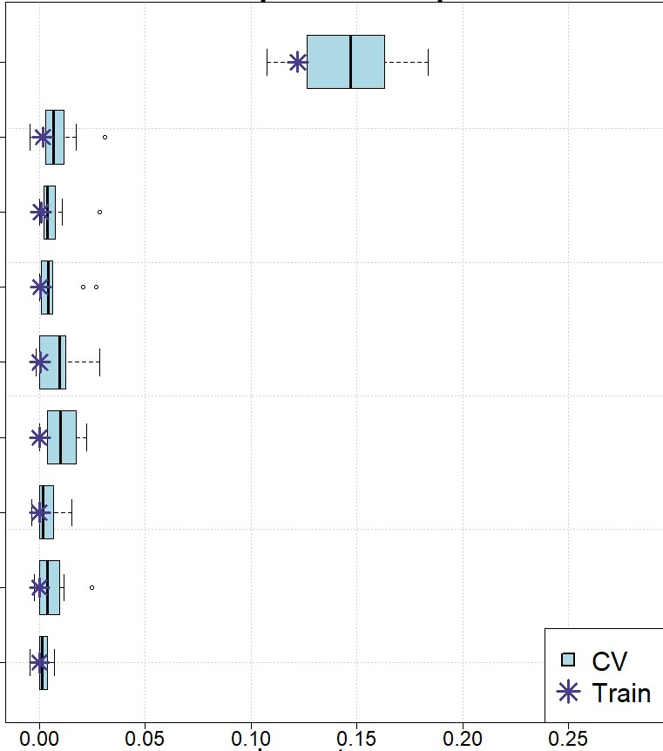
Variable Importance Assessment
Variable Importance
Normalized Difference
Moisture Index
RandomForest model using Worldclim, topographic, and one spectral variable
Precipitation of
Warmest Quarter
Precipitation of
Driest Month
Mean Diurnal
Temperature Range
Variables
Elevation
NDMI was more important than bioclimatic and topographic variables across model iterations
Mean Temperature
of Coldest Quarter
Temperature
Seasonality
Mean Temperature
of Wettest Quarter
Precipitation of
Wettest Month
Importance
Notes:
Another one of the statistical outputs that these models generate is variable importance in the form of box-and-whisker plots. These clearly show that first of all, most of our variables were actually pathetic in their significance to the model (which is part of the reason we are skeptical of the robustness of our statistical outputs), but our 1 spectral variable (NDMI) stands out in the crowd. We believe this probably has to do with the fact that the other variables have a far more coarse resolution, and our study area was limited to one Landsat scene. Given that this NDMI is Landsat-derived, it helps to refine the results in the probability map a lot more, whereas it’s entirely possible that some of the bioclimatic variables seen here might be so coarse that they have the same value for the entire extent of our study area.
Discuss influence of extent on the variable importance (i.e. little variation in values of bioclimatic predictors across our extent)
rf_worldclim_ndmi (ndmi comparison)
RandomForest using Worldclim, topographic, and one spectral variable

Slide 24
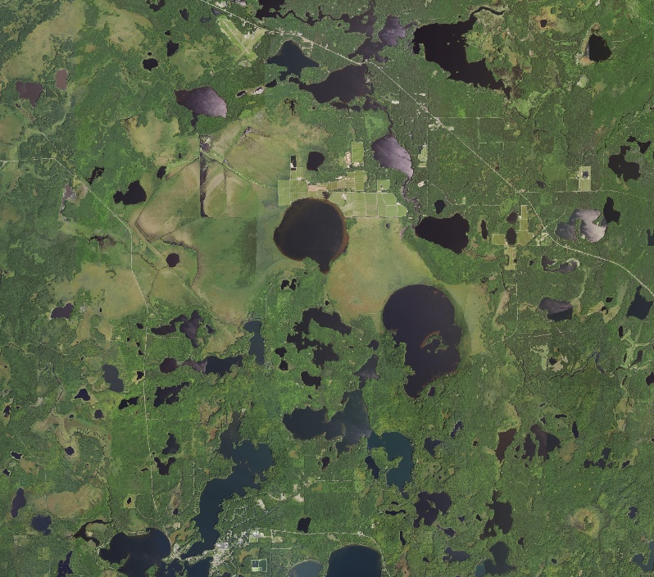
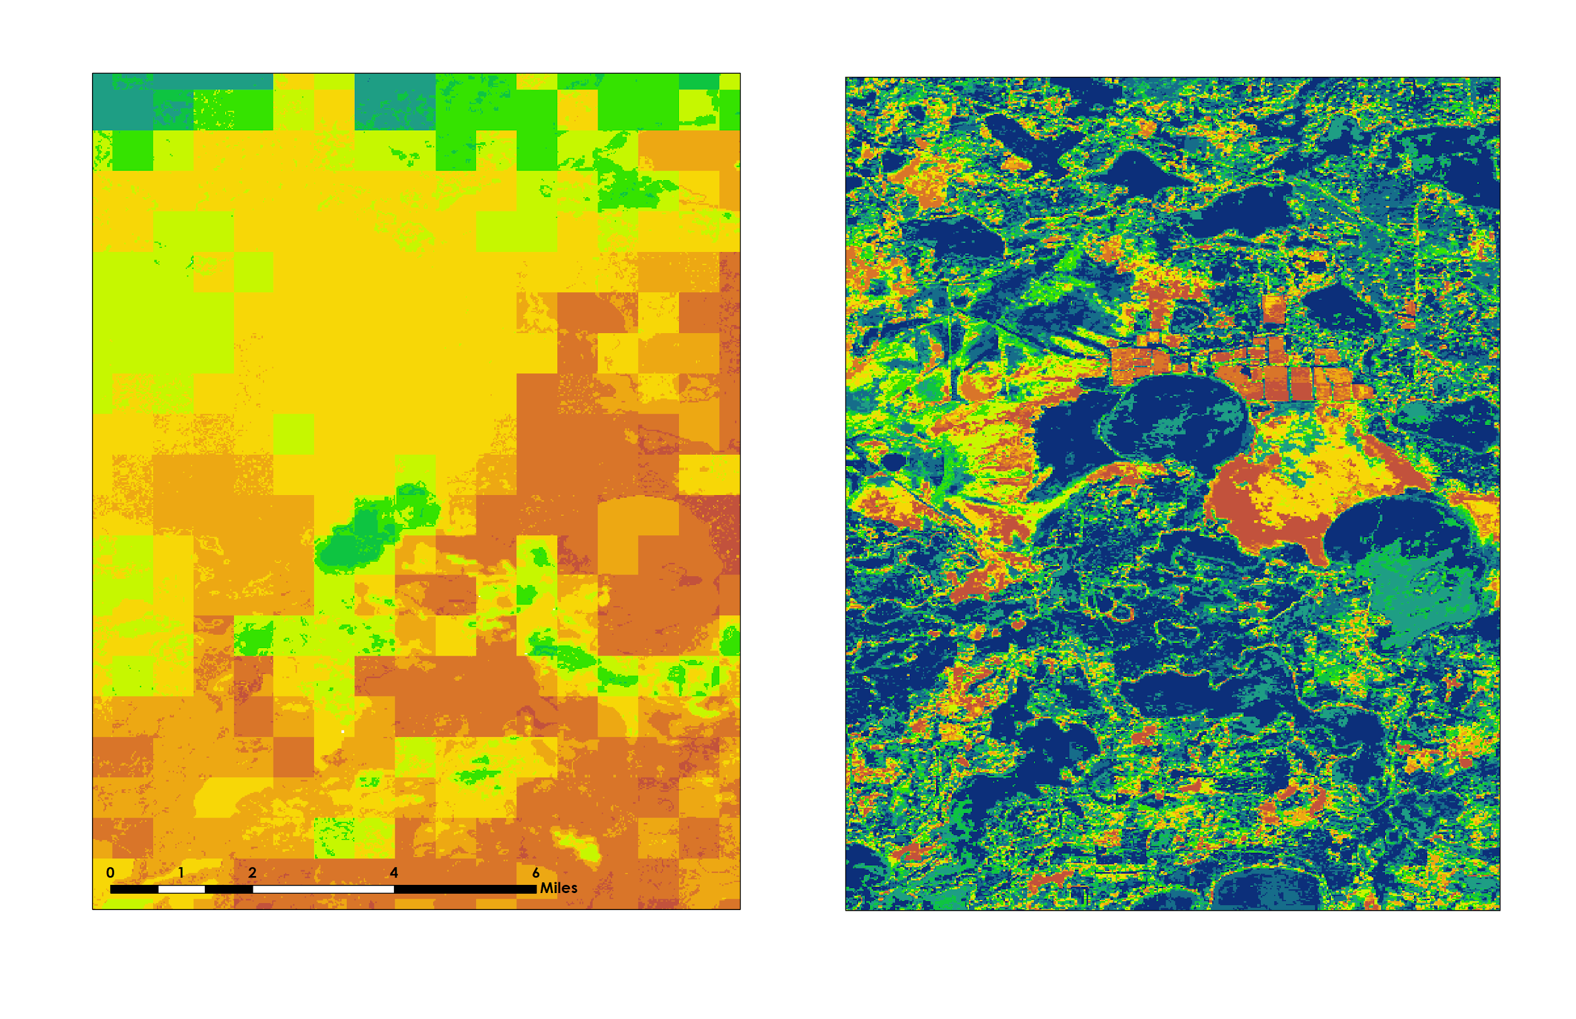
Habitat Distribution Model Outputs
Acquired July-August, 2017
NAIP High Resolution Imagery
RandomForest model using Worldclim, topographic variables, and no spectral variables
RandomForest model using Worldclim, topographic variables, and spectral variables
Notes:
These images speak for themselves! We are showing the exact same scene here, but the coarse image contains no spectral data. Current USDA practices also don’t include spectral data, and they use dataset-derived presence points rather than user-generated ones. Overall, our input data and our inclusion of spectral variables is clearly a way to produce higher-quality models.
What variables were used in these models?

Slide 25
Project Limitations
Geographic Scale
Mixed Signals
Notes:
Geographic Scale: This study was a feasibility analysis that focused on detecting wild cranberry across a single Landsat scene, and we found that two principal implications resulted from such a narrow scope. First, the topographic and climatic range across our study site had relatively low variation. The combination of a limited geographic scale and the relatively coarse resolution of our bioclimatic variables may have resulted in the model relying disproportionately on Landsat-derived spectral variables to predict cranberry habitat. When compared to environmental variables, variation in spectral reflectance can be relatively substantial from pixel to pixel across a small area. This is likely due to more abrupt variations in land cover. As such, it will be interesting to see how the explanatory power of spectral variables translates when applied to a larger extent and matched with a more diversified range of climatic and topographic variables.
Mixed Signals:
It is important to reiterate that we may indeed be getting mixed signals. The cranberry habitat detected by our models, at its 30 by 30 meter resolution, inevitably included other vegetation. Our partners at the USDA and USFS confirmed that other species that were likely detected throughout our models could include sphagnum moss and other members of the Vaccinium genus, all of which are co-occurring species. And that’s not necessarily a bad thing, it’s jsut important to note that what we are seeing in our detection component is not purely cranberry.

Slide 26
Project Conclusions
1. Satellite Detection Modeling
2. Habitat Distribution Modeling
3. Integrated Modeling
Spectrally derived variables improved habitat distribution model outputs
Successfully detected cranberry habitat
Predictor variable inputs influence the accuracy of distribution models
Photo Credit: Linda Parker, USFS
Notes:
explanatory power of Spectral variables

Slide 27
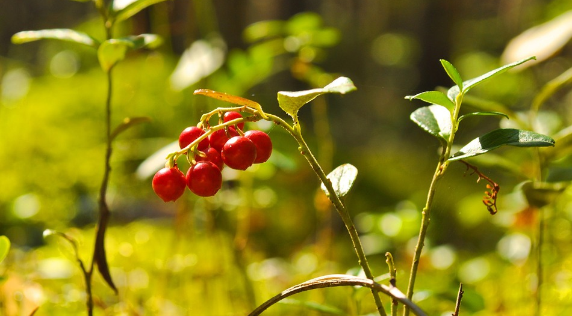
So what next?
Photo Credit: Pixabay
Notes:
Photo: Pixabay - https://pixabay.com/en/berry-cranberry-red-nature-wild-71704/
Partners over at the USFS Chequamegon-Nicolet National Forest and the University of Wisconsin-Madison have expressed interest in Point/model validation. Future work will also look to scale up models geographically and to other CWRs. With better models and better predictions of crop wild relatives, the USDA will be able to save both time and money, because they can be more confident in the areas that they send their researchers to.

Slide 28
Acknowledgements
The Wisconsin Agriculture and Food Security team would like to thank our partners over at the USDA and USFS for engaging with NASA DEVELOP to make this research possible. In addition, we’d like to acknowledge the European Space Agency for providing open source data.
A special thanks to Tim Mayer (CO Node Center Lead), Nick Young (Science Advisor), and Dr. Colin Khoury (USDA ARS) for working closely with our team throughout this research project.

