Slide 1

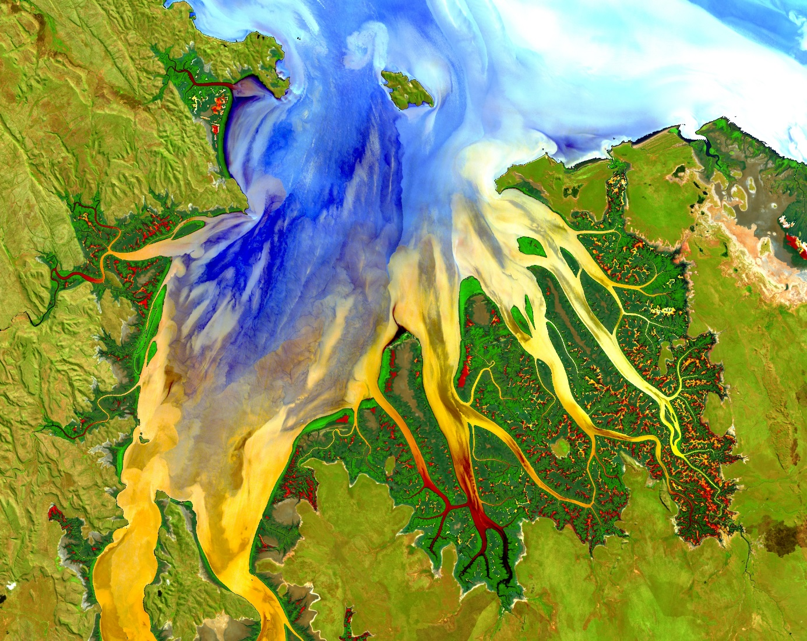
Your project VPS Image should be placed behind the top aperture shape. An example shape has been placed in this position for your reference. Delete the example VPS image, insert your image, right click your image and select the “Send to Back” option. Position and adjust the size of your image so that it lines up with the provided margin rulers.
Delete this text box.
PROJECT SHORT TITLE
Team Member 1
LONG TITLE LONG TITLE LONG TITLE LONG TITLE LONG TITLE LONG TITLE LONG TITLE LONG TITLE LONG TITLE LONG TITLE
Team Member 2
Team Member 3
Team Member 4
Team Member 5
Team Member 6
Notes:
Your project VPS Image should be placed behind the top aperture shape. An example shape has been placed in this position for your reference. Delete the example VPS image, insert your image, right click your image and select the “Send to Back” option. Position and adjust the size of your image so that it lines up with the provided margin rulers.

Slide 2

Components
Study area
Study period
Objectives
Community concerns
NASA satellites/sensors used
Methodology
Results
Conclusions
Errors & uncertainties
Future work
Acknowledgements
Backup slides
Required Statement
The slides provided in the template are just a starting point for teams. Feel free to expand upon these topics, alter the headings, and change the order of the slides to fit your needs.
Image Credit: Monet

Slide 3
Components II
Header text point size should be between 40 and 60 on most slides.
Body text point size should be at least 20.
Use Century Gothic.
Keep text to a minimum.
Try to use a consistent font size between slides.
Image Credit: Monet
Notes:
Image Source: http://commons.wikimedia.org/wiki/File:Claude_Monet_-_The_Magpie_-_Google_Art_Project.jpg

Slide 4
Image Credit: Monet
General Guidelines III
Include speaker notes for each slide (see below).
Include a visual on each slide, if possible.
Arrange content to minimize white space.
Notes:
These notes should be thorough enough for someone not familiar with the project to clearly present the material.
Image Source: http://commons.wikimedia.org/wiki/File:Claude_Monet_-_The_Magpie_-_Google_Art_Project.jpg

Slide 5
Maps & Logos
Maps
Import the legend separately.
Make sure all text is legible and not grouped.
Cite base layer source in speaker notes.
Logos
US Federal logos only.
No state, NGO, local and or international government logos, or software logos.

Slide 6
Photos & Figures I
You may only use images taken by your team, provided by your partners (as long as you have permission from them), from a Federal Agency, from the new DEVELOP stock imagery collection on DEVELOP’s Flickr page, or Creative Commons images.
Obtain a media release form from all people in photos that your team has taken — no children!
All image sources should be cited using a consistent format and should be visible on the slide.

Slide 7
Photos & Figures II
Please do not include the image URL in the source text box but rather place it in the notes section below.
If you use a border for your images include it on all photographs to keep your presentation consistent.
Keep all images and text boxes ungrouped, including individual elements of flowcharts.
Background images are discouraged. If you use one, make sure that your text remains clear and legible.

Slide 8
List advisors, partners, and others who have contributed in any way to the project.
If your project is a multi-term one, acknowledge past contributors.
Choose one of the two following slides as an acknowledgements page. Feel free to modify them as needed to fit your content.

