Slide 1
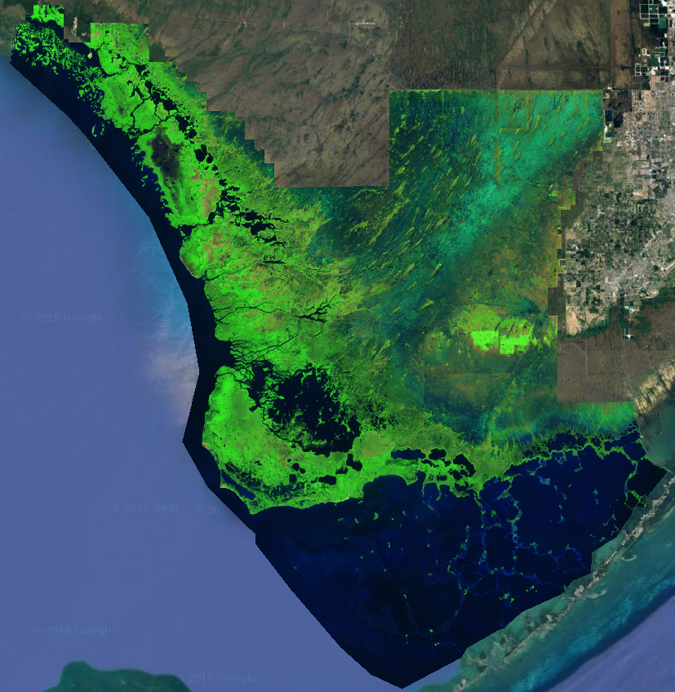
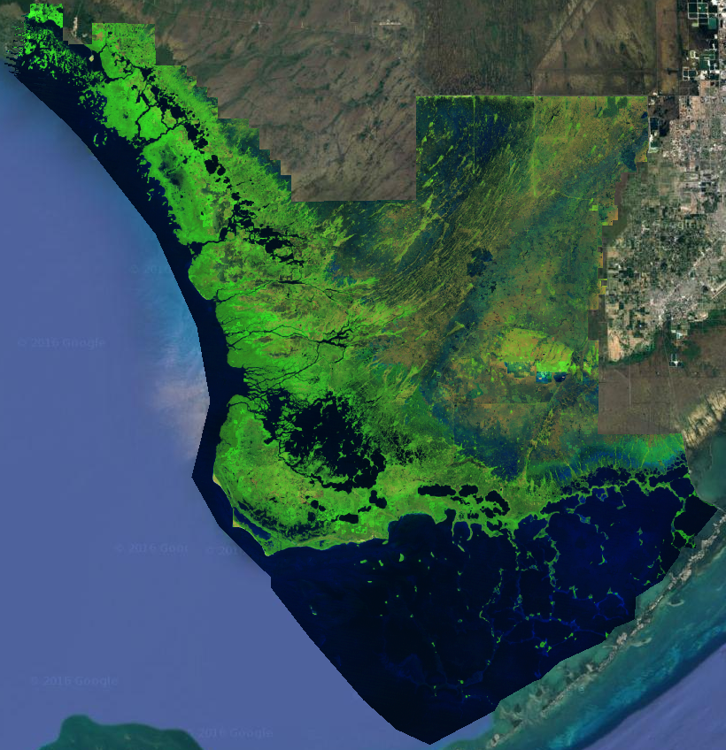
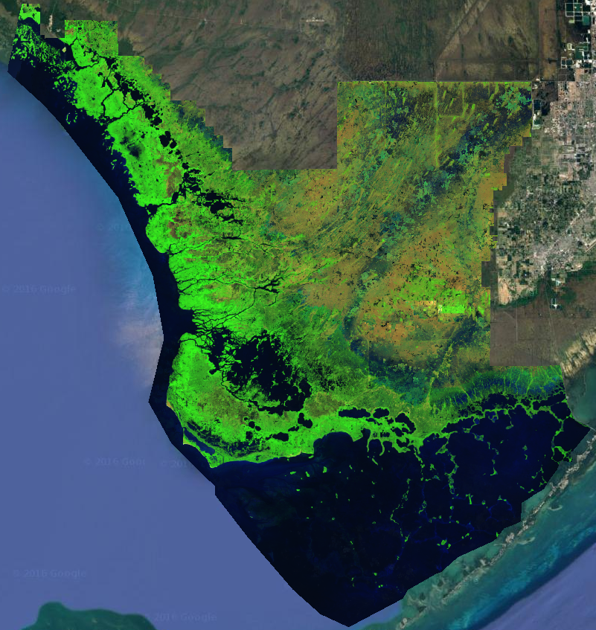
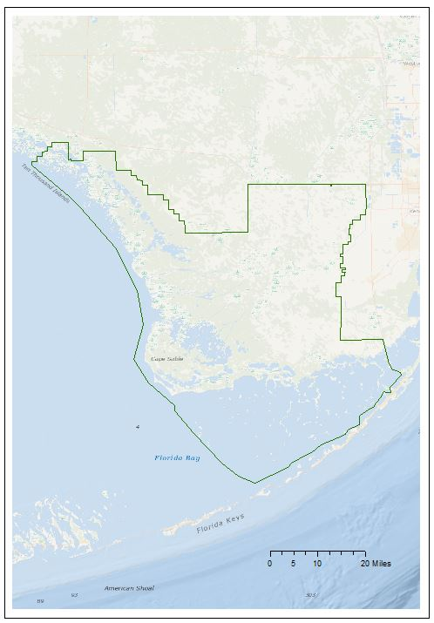
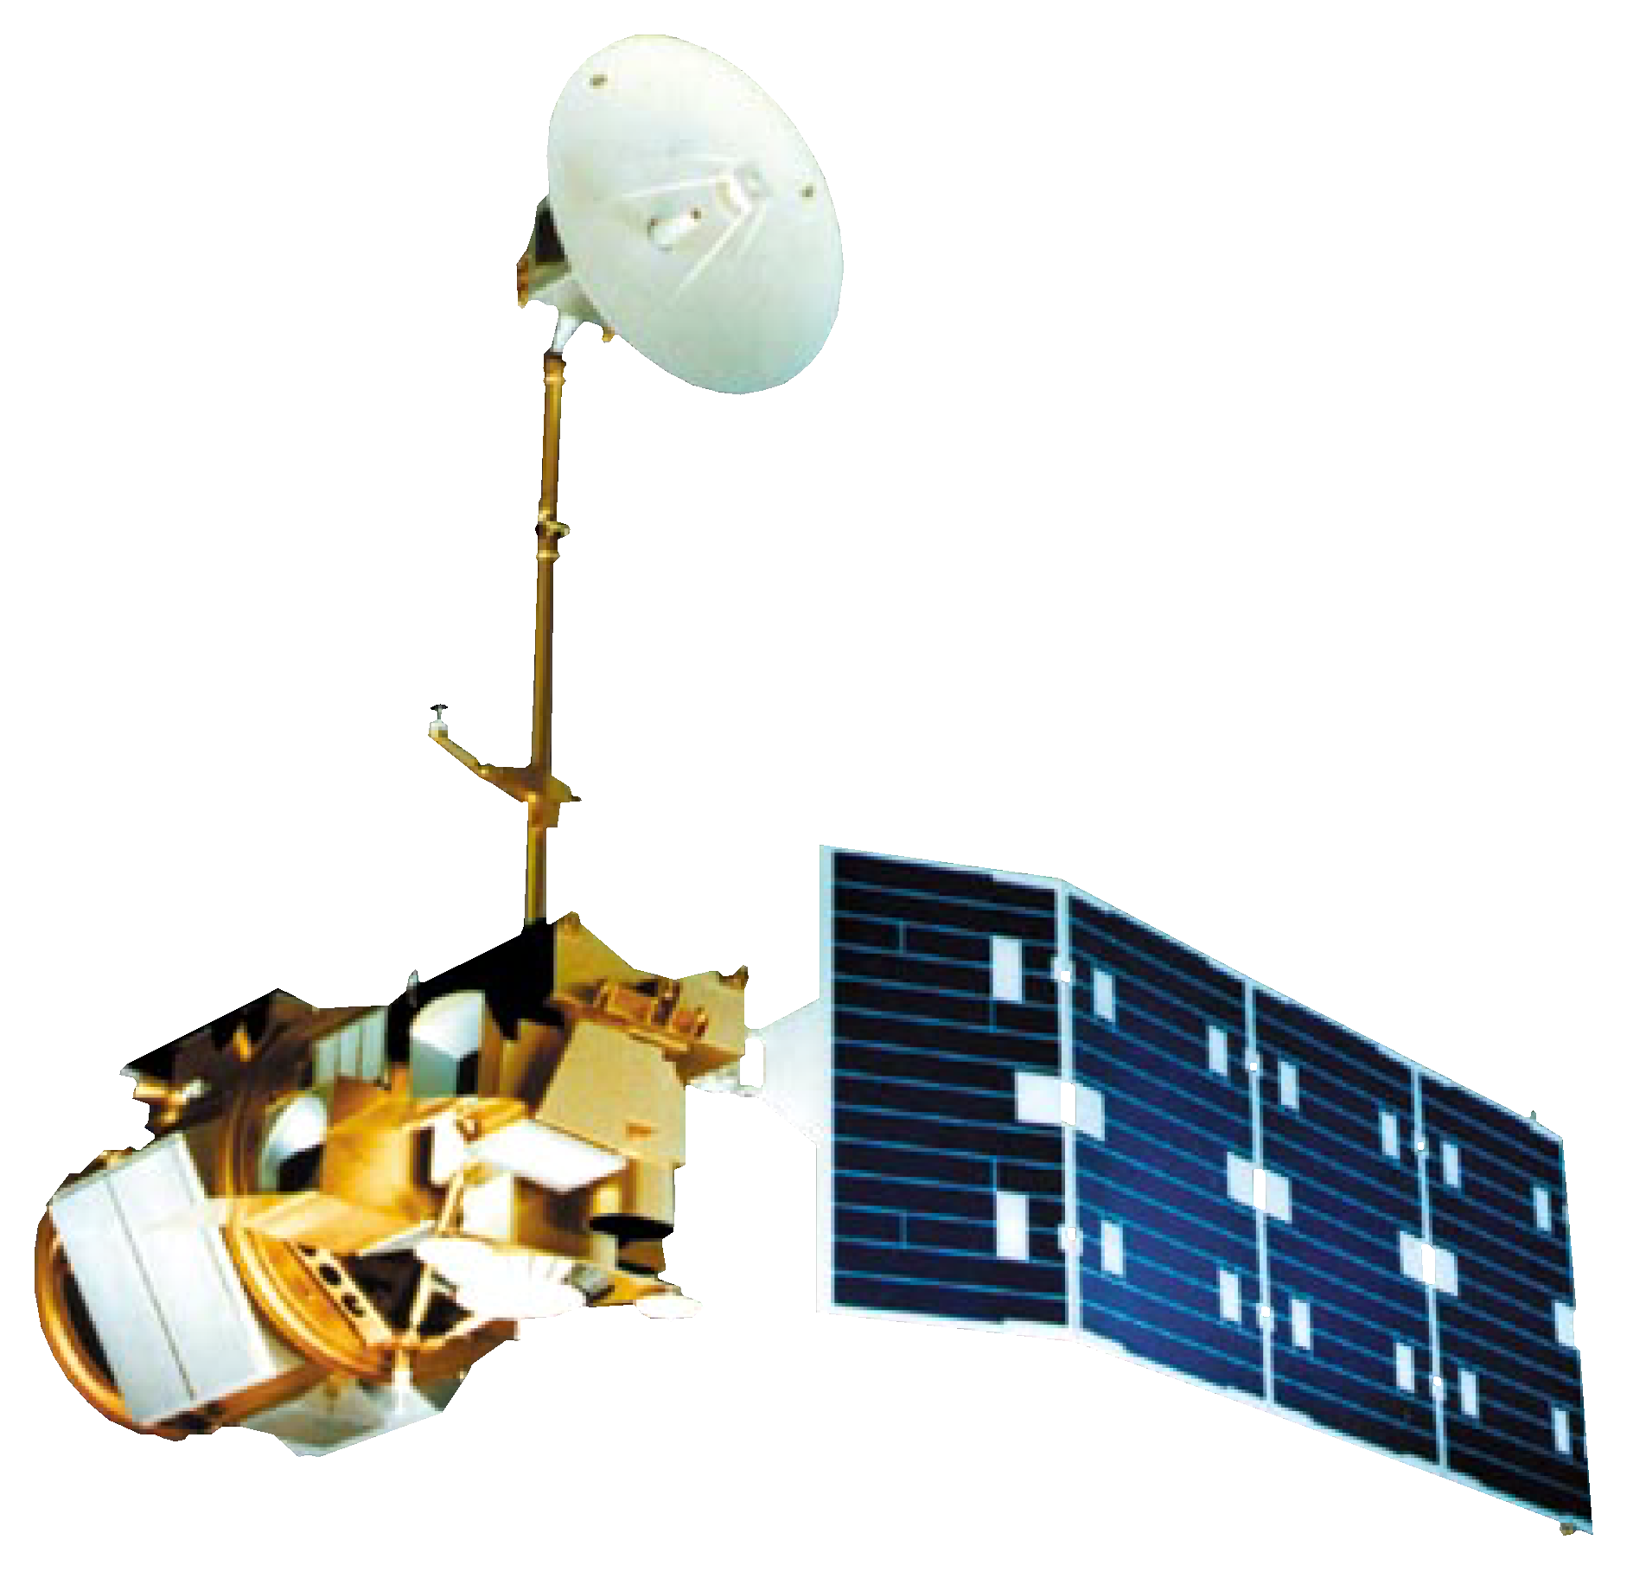
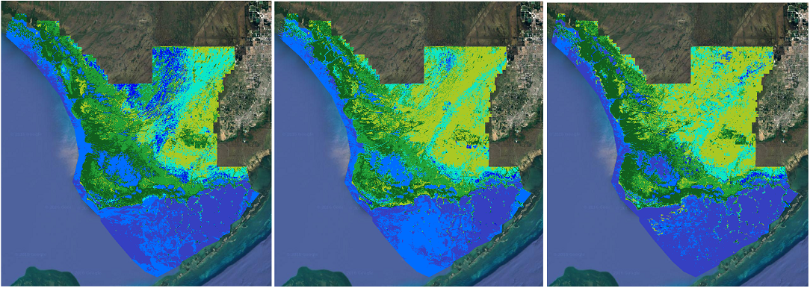
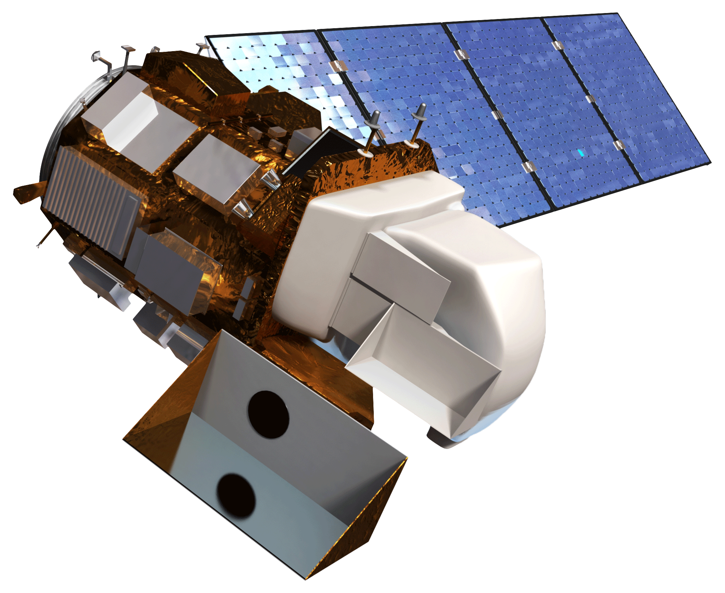
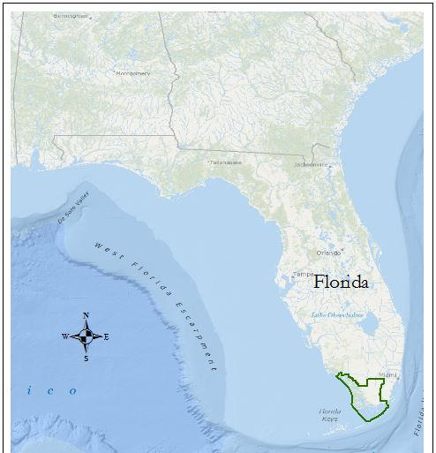









Improving the Capacity of Everglades
National Park to Monitor Mangrove Extent
using NASA Earth Observations
Data Acquisition
Data Processing
Results
Abstract
Methodology
Mangroves act as a transition zone between fresh and salt water ecotones by moderating salinity levels. This transition gives way to marshlands that depend on larger quantities of freshwater. Furthermore, mangroves offer specialized habitats for endemic species and provide shoreline stabilization, critical to a region besieged by tropical storms. In an attempt to restore a measure of the earlier balance in the Everglades coastal wetlands, effort has been made to return a portion of freshwater flow that had been diverted from the ecosystem. The National Park Service requires a way to track the resulting changes in growth and distribution. The DEVELOP research team utilized Google Earth Engine and satellite imagery from Landsat 5 and 8 to select, classify, and map mangrove and marsh regions in 1995, 2005, and 2015. These maps will aid in the creation of forecasted models.
Landsat 5
Landsat 8
Vegetation Maps
Fmask Cloud Removal
Stratified Random Sampling
Annual Image Aggregation
Supervised Classification
Classification Validation
Forecasting to 2025
Results
Study Area
Earth Observations
Everglades National Park, Florida
Classification Short Wave Infrared Composite
Landsat 5
Everglades Ecological Forecasting
1995
2005
2015
Landsat 8
Dense Forest
The images above demonstrate the decadal change of the Everglades National Park. Row 1 displays annual Landsat aggregations in a shortwave infrared composite. Row 2 demonstrates the change in vegetation based on the classification methodology created by the team.
Forest Scrub
Objectives
Dry Marsh
Wet Marsh
Conduct a spatial analysis using NASA Earth observations and Google Earth Engine.
Utilize a subset (10-15%) of the coastline to monitor changes in 1995, 2005, and 2015.
Create a replicable methodology that will classify mangrove-marsh extent and transition in the Everglades National Park.
Map the extent of change that has taken place and use the data to forecast future changes to the mangrove-marsh zones.
Water
Conclusions
Based on the training data the team provided for the classifier, the method ran with 85% overall accuracy in the 20 year period. These results, in conjunction with the accessibility of the platform, determine Google Earth Engine to be an effective tool for the classification of the Everglades. The methodology will provide a base for future terms to forecast vegetation patterns.
Team Members
Project Partners
Acknowledgements
Jed Redwine - National Park Service,
Everglades National Park
Dr. Hans-Peter Plag - Group on
Earth Observations(GEO) Blue
Planet Initiative (BPI)
and Old Dominion
University, Mitigation
and Adaption Research
Institute (MARI)
Dr. Kenton Ross
NASA DEVELOP National
Program Science Advisor
Brittany Zajic
NASA DEVELOP
Geoinformatics Fellow
Noel Gorelick
Engineer at Google
Dr. Marguerite Madden
University of Georgia
Donnie Kirk
Project Lead
Caitlin Toner
Emily Gotschalk
Rachel Cabosky
Candace Kendall
Brad Gregory
Any opinions, findings, and conclusions or recommendations expressed in this material are those of the author(s) and do not necessarily reflect the views of the National Aeronautics and Space Administration. This material is based upon work supported by NASA through contract NNL11AA00B and cooperative agreement NNX14AB60A.
NASA Langley Research Center – Summer 2016
Notes:
Acknowledgements
Include anyone who has helped you with the project.
If this is a continuation project, credit the previous team members and contributors.
If you are including affiliations, use DEVELOP as the affiliation for a DEVELOPer or former DEVELOPer—not their school or former school.
Include the following legal text: This material is based upon work supported by NASA through contract NNL11AA00B and cooperative agreement NNX14AB60A.

