Slide 1
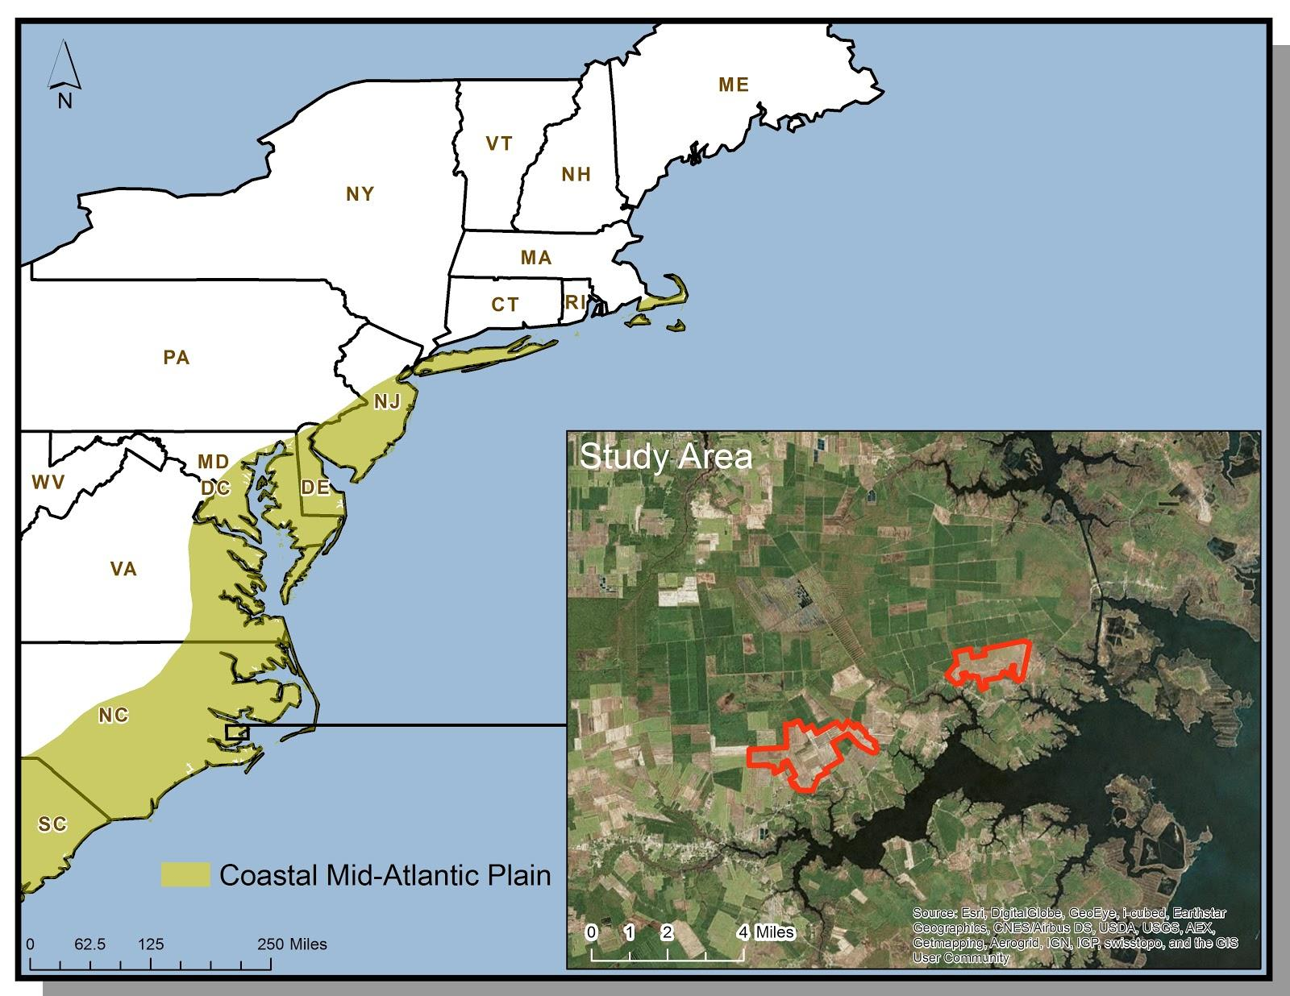
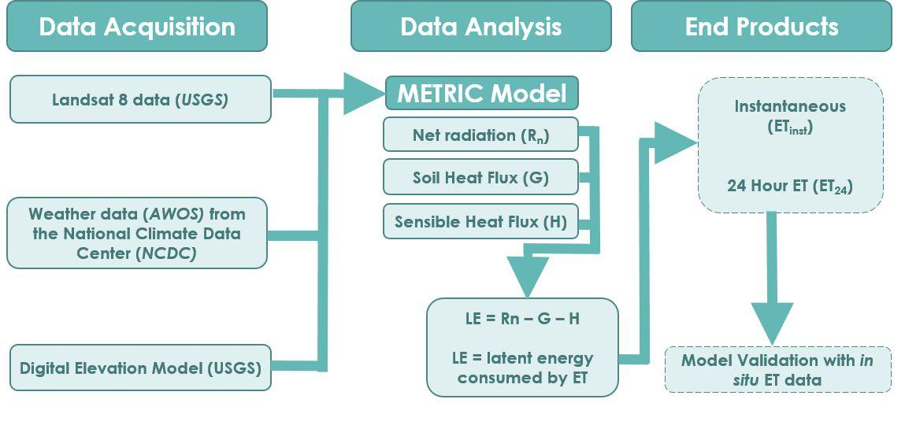
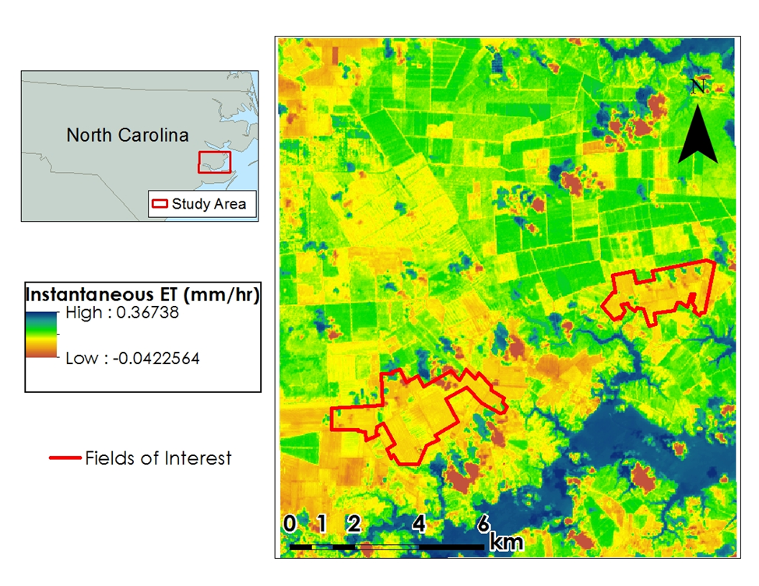
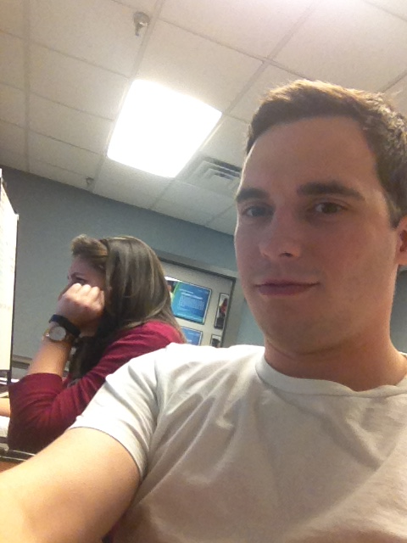
Coastal Mid-Atlantic Water Resources III
Using the METRIC model to Estimate Evapotranspiration for Coastal Mid-Atlantic Region
Kent Sparrow
Jamie VanderHeiden
NASA Langley Research Center & Patrick Henry Building
Crop irrigation accounts for a considerable amount of water use in the Coastal Mid-Atlantic region. Better understanding of how much water farmers need to irrigate their fields will help decrease both water waste and the economic burden for farmers. The Mapping Evapotranspiration at High Resolution with Internalized Calibration (METRIC) model is a powerful tool that calculates evapotranspiration (ET) based on localized data. Executable from a Python script, the model can be used as a decision support tool that allows farmers to make more-informed decisions about when irrigation is necessary. METRIC estimates ET using a series of equations where local input variables are acquired from Landsat 8 sensors, a United States Geological Survey (USGS) survey-based Digital Elevation Model (DEM), and local weather conditions. While METRIC derived ET estimates are beneficial for irrigation purposes, it can also provide state officials with a useful means of drought monitoring. Utilizing data from NASA Earth observations in the Coastal Mid-Atlantic region will contribute to a large-scale, more-complete, understanding of the water consumption behavior in an area that can be used for both policy and individual agricultural decisions.
To develop an operational, user-friendly, METRIC model for calculating ET₂₄ rates in the Mid-Atlantic coastal plain.
Provide end users with a handoff model, executable from Python Toolbox, to assist in efficient irrigation planning
Landsat 8 OLI/TIRS
NDVI
SAVI
The Python script written to run the METRIC model successfully calculated ET₂₄ using Landsat 8 imagery, AWOS weather data, and a DEM.
The validated METRIC model was packaged into a tool, available in ArcToolbox, through a software release process.
METRIC is now a useful tool for calculating ET₂₄ to improve irrigation planning and drought monitoring for the agriculture industry.
The use of the METRIC model will be beneficial to government officials and private industries involved in the agriculture industry.
Future work will need to focus on incorporating weather model data into the methods of Allen et al. (2007) to create a predictive scheme for ET₂₄ values.
LAI
Jamie Vanderheiden
Kent Sparrow
Digital Harvest
Young Kim, General Manager
Virginia Secretary of Natural Resources
Molly Ward, Secretary
Travis Hill, Deputy Secretary
Virginia Secretary of Technology
Karen Jackson, Secretary
Virginia Secretary of Agriculture & Forestry
Todd Haymore, Secretary
Virginia Department of Environmental Quality
David Paylor, State Water Commission
DEVELOP Program National Science Advisor
Dr. Kenton Ross
DEVELOP Program International Lead
Jamie Favors
Summer 2014 Coastal Mid-Atlantic Water Resource DEVELOP Team
Fall 2014 Coastal Mid-Atlantic Water Resources Team

