Slide 1
Southeast Ecological Forecasting
Utilizing NASA Earth Observations and Proximal Remote Sensing To Map the Spatio-temporal Distribution of Hydrilla verticillata
Shuvankar Ghosh (Project Lead)
Peter Hawman (Co-Project Lead)
Wuyang Cai
Pradeep Kumar Ragu Chanthar
Elizabeth Dyer
Notes:
From the University of Georgia NASA DEVELOP node

Slide 2
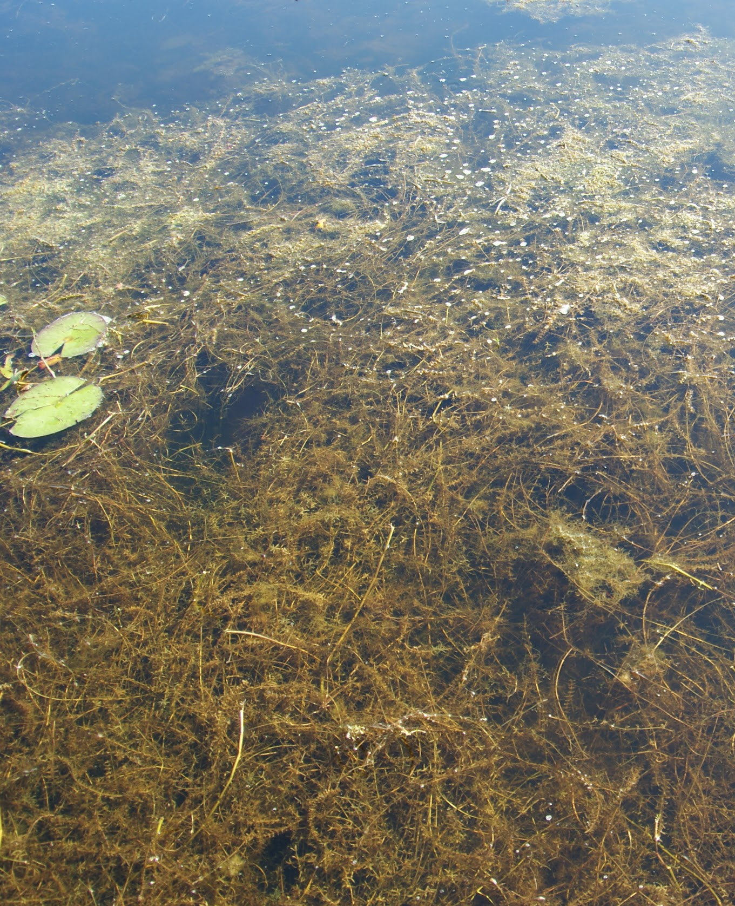
Hydrilla verticillata
Invasive aquatic plant
Native to Asia, Australia and Africa
Introduced in Florida in the 1950s
Spread to 25 states
Image Source: Dr. Susan Wilde
Notes:
Hydrilla verticillata is an invasive aquatic plant in the southeastern US.
Native to Asia, Australia and Africa, hydrilla was introduced to the U.S. in the 1950s when it was sold in freshwater aquarium stores in Florida. Since then it has spread up the eastern seaboard and west to California and Washington State reaching 25 states.

Slide 3
Hydrilla verticillata
Invasive aquatic plant
Native to Asia, Australia and Africa
Introduced in Florida in the 1950s
Spread to 25 states
Credit: Dr. Susan Wilde
Notes:
Hydrilla verticillata is an invasive aquatic plant in the southeastern US.
Native to Asia, Australia and Africa, hydrilla was introduced to the U.S. in the 1950s when it was sold in freshwater aquarium stores in Florida. Since then it has spread up the eastern seaboard and west to California and Washington State reaching 25 states.

Slide 4
Community Concerns
Outcompetes native plants
Clogs boat motors disrupting transport and recreation
Creates hazardous swimming conditions
Obstructs water withdrawal
Picture of hydrilla from one of our field trips?
Notes:
Hydrilla outcompetes native plants creating a thick mat which blocks sunlight leading to anoxic conditions, as well as changing the nutrient balance in the water body.
These thick mats clog boat motors disrupting transport and recreation and cause hazardous swimming conditions.
Additionally, hydrilla obstructs water withdrawal for drinking water, irrigation, and power generation in reservoirs.

Slide 5
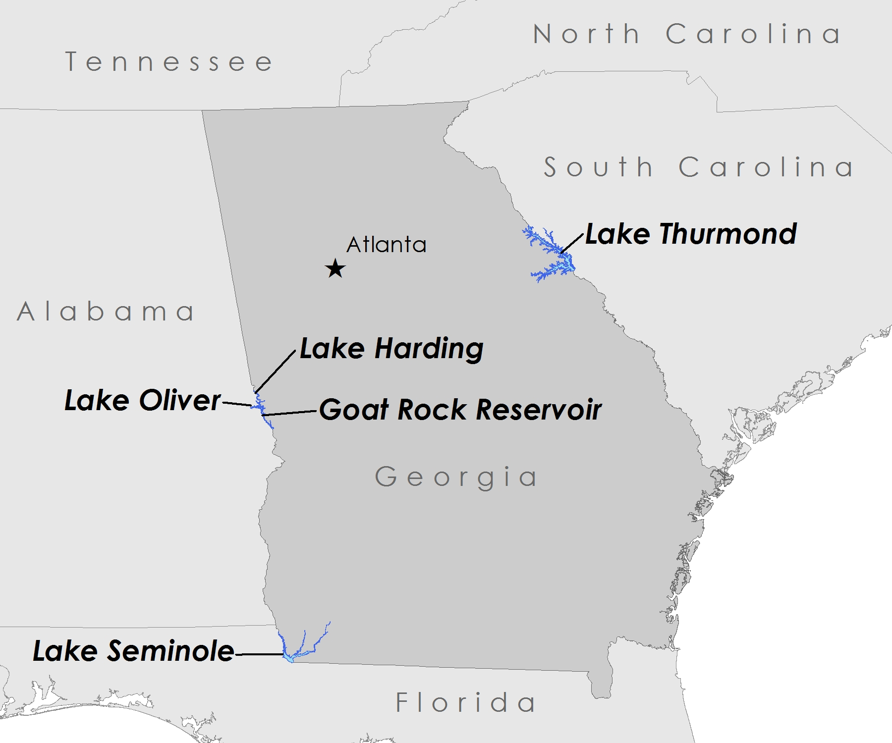
Study Areas
Reservoirs:
Lake Strom Thurmond
Lake Seminole
Lake Harding, Lake Oliver, and Goat Rock Reservoir
Study Period: 2013 - present
Notes:
This study focused on five reservoirs located in Georgia and bordering Alabama, Florida, and South Carolina
Lake Seminole is a United States Army Corps of Engineers reservoir and they have been trying to control hydrilla in this location for over 50 years.
Lake Thurmond is another USACE reservoir that has been dealing with invasive hydrilla.
Lake Harding, Lake Oliver, and Goat Rock Reservoir are Georgia Power reservoirs along the Chattahoochee River. Recently in 2013, Georgia Power experienced a rapid development of hydrilla in Lake Harding and Lake Oliver, which spread to Goat Rock Reservoir in 2014.

Slide 6
Partners
Joseph W. Jones Ecological Research Center
Conduct studies on water quality in the lower Flint River and Lake Seminole, focusing on invasive species
Georgia Power Company
Responsible for protecting and restoring 17 reservoirs in GA
Henry County Water Authority
Hydrilla infestation was discovered in two of their newly constructed drinking water reservoirs
Notes:
This project partnered with 3 end-users.
The Joseph W. Jones Ecological Research Center is located in south Georgia north of Lake Seminole. One of their main focuses of study is water quality issues in the lower Flint River and Lake Seminole. Their research team was interested in incorporating remote sensing to better understand the phenological characteristics and seasonal distribution of hydrilla.
Georgia Power Company is responsible for protecting and restoring 17 reservoirs in Georgia. They are concerned with the spread of hydrilla in their lakes and the negative impacts it poses to water quality.
The Henry County Water Authority hydrilla in two of their reservoirs in 2010. They are concerned by the effects hydrilla recreation for fisherman and waterfowl hunters.

Slide 7
Objectives
Create
a time series hydrilla distribution map
Develop
a model partners can use to evaluate hydrilla distribution in the future
Notes:
We created hydrilla distribution maps through time of the study areas in the Southeastern United States by utilizing remote sensing data from multiple sources. Then we assessed the seasonal spatio-temporal distribution of hydrilla.
We developed a model using Landsat 8 OLI and in situ field data. Our partners will be able to use this model to determine hydrilla distribution in the future.

Slide 8
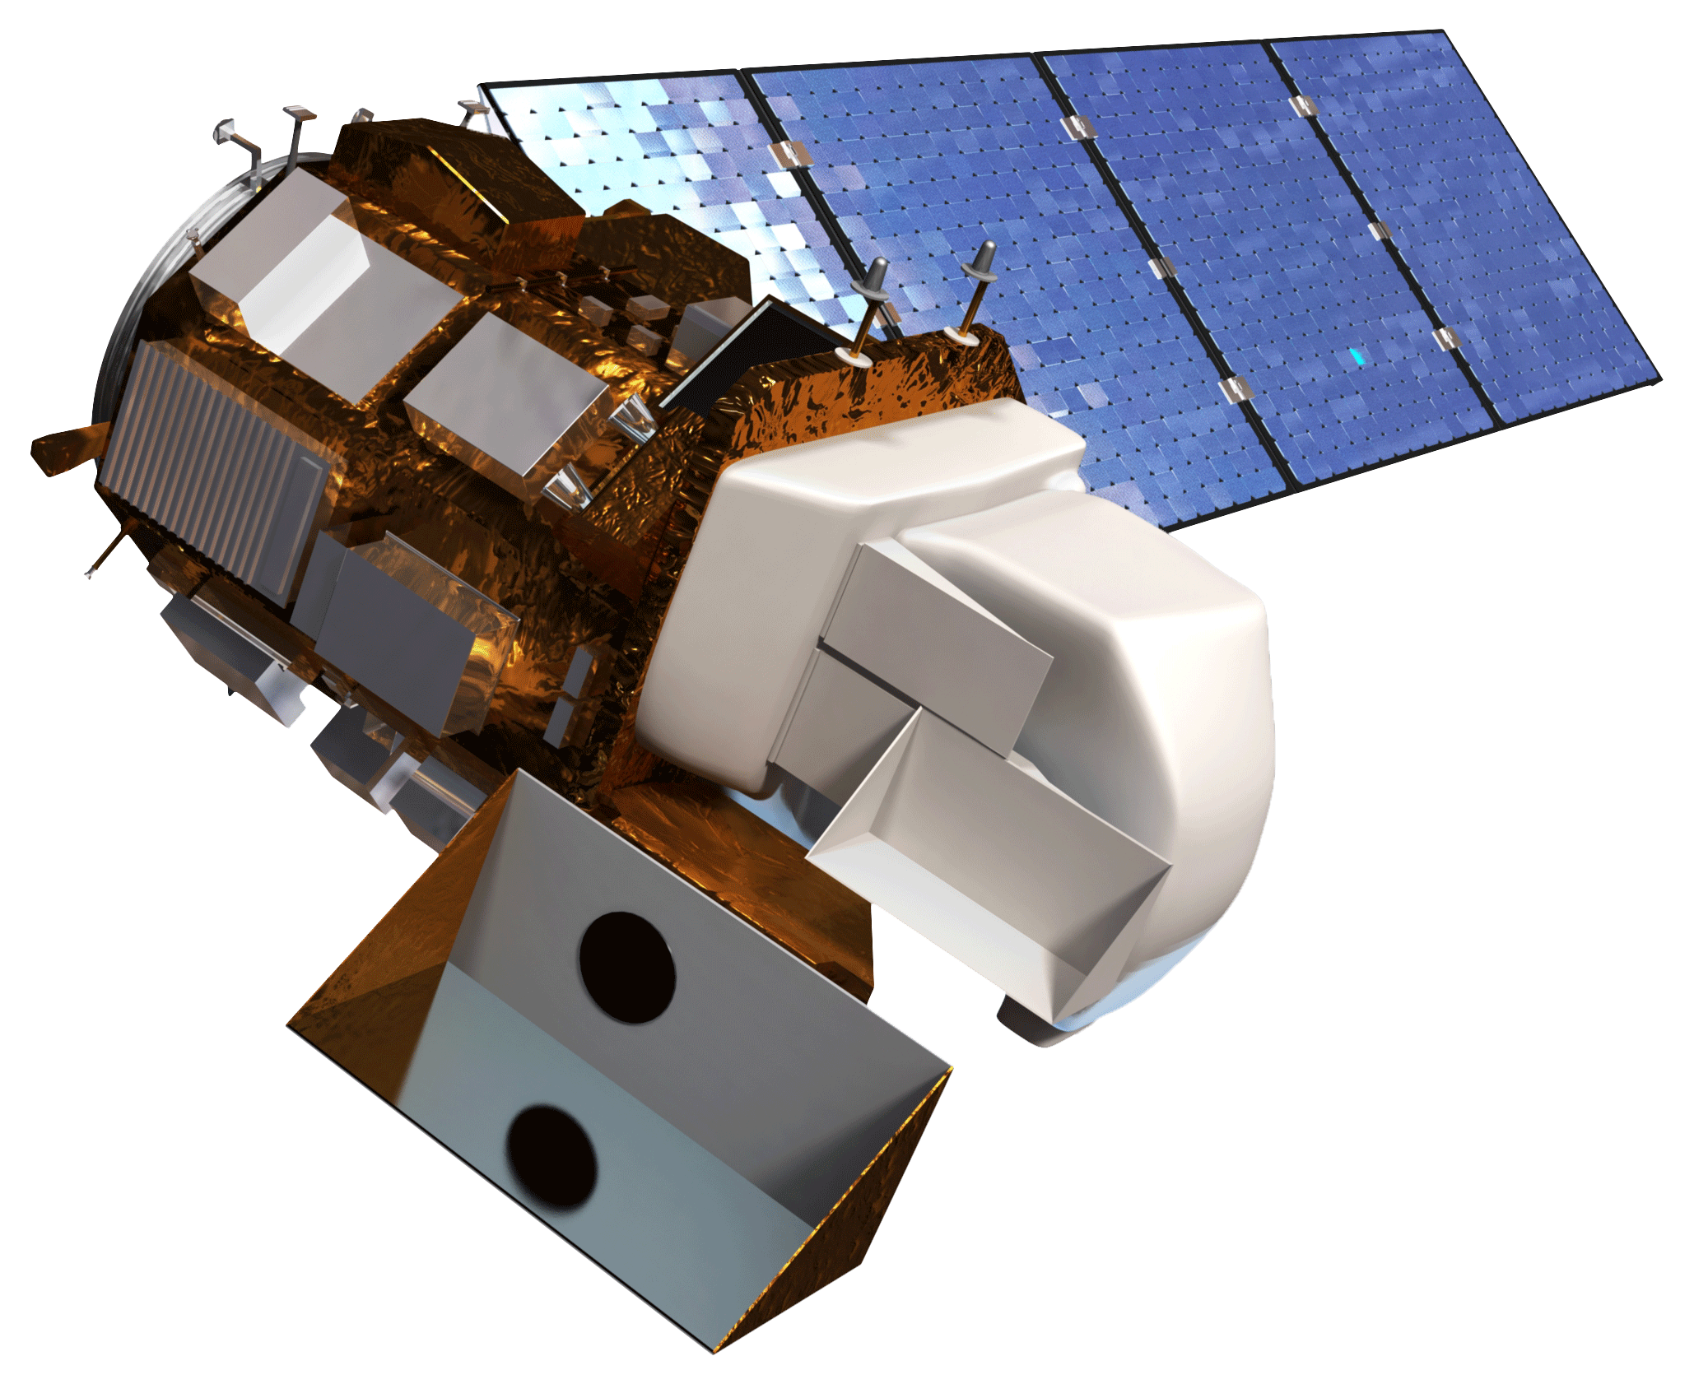
Earth Observations
Landsat 8 OLI

Slide 9
Other Data
boundaries of the lakes:
……
field data:
our trip
Pictures

Slide 10
Methodology
Landsat 8 OLI
VARI
OceanOptics JAZ
Green NDVI
Model Calibration
Hydrilla Density and Distribution Maps
Best Fit Model Selection
Basler acA1300
Vegetation Fraction
Model Validation
Biomass
DJI Phantom 2 Vision+

Slide 11
Results
1
distribution map
2
a model to forecast future distribution

Slide 12
Conclusions

Slide 13
Future Work

Slide 14
Advisors
Dr. Deepak Mishra, Department of Geography, UGA
Dr. Susan Wilde, Warnell School of Forestry and Natural Resources, UGA
Partners
Dr. Stephen W. Golladay, Joseph W. Jones Ecological Research Center
Anthony Dodd, Georgia Power Company
Ken Presley, Henry County Water Authority
Others
Benjamin Page, University of Georgia
Ike Sari Astuti, University of Georgia

