Slide 1
Northwest United States Agriculture II
Evaluating Suitability for Apple Cultivation Based on Accumulated Chill Hours in Washington State from 2003-2065
Lydia Cuker
Laura Lykens
Alyssa Walzak
Timothy Stelter

Slide 2
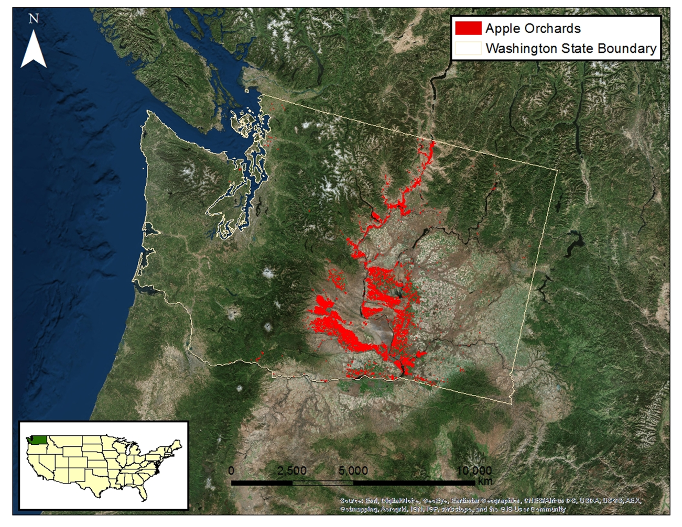
Study Area: Washington, USA
Study Period: 2003 – 2013, 2040 – 2070
Notes:
The study area for the project was the state of Washington for the years of 2003-2013 and 2040-2070. The location of apple orchards is shown in red. With the majority of orchards falling in the eastern half of the state, that was where the project focused.

Slide 3
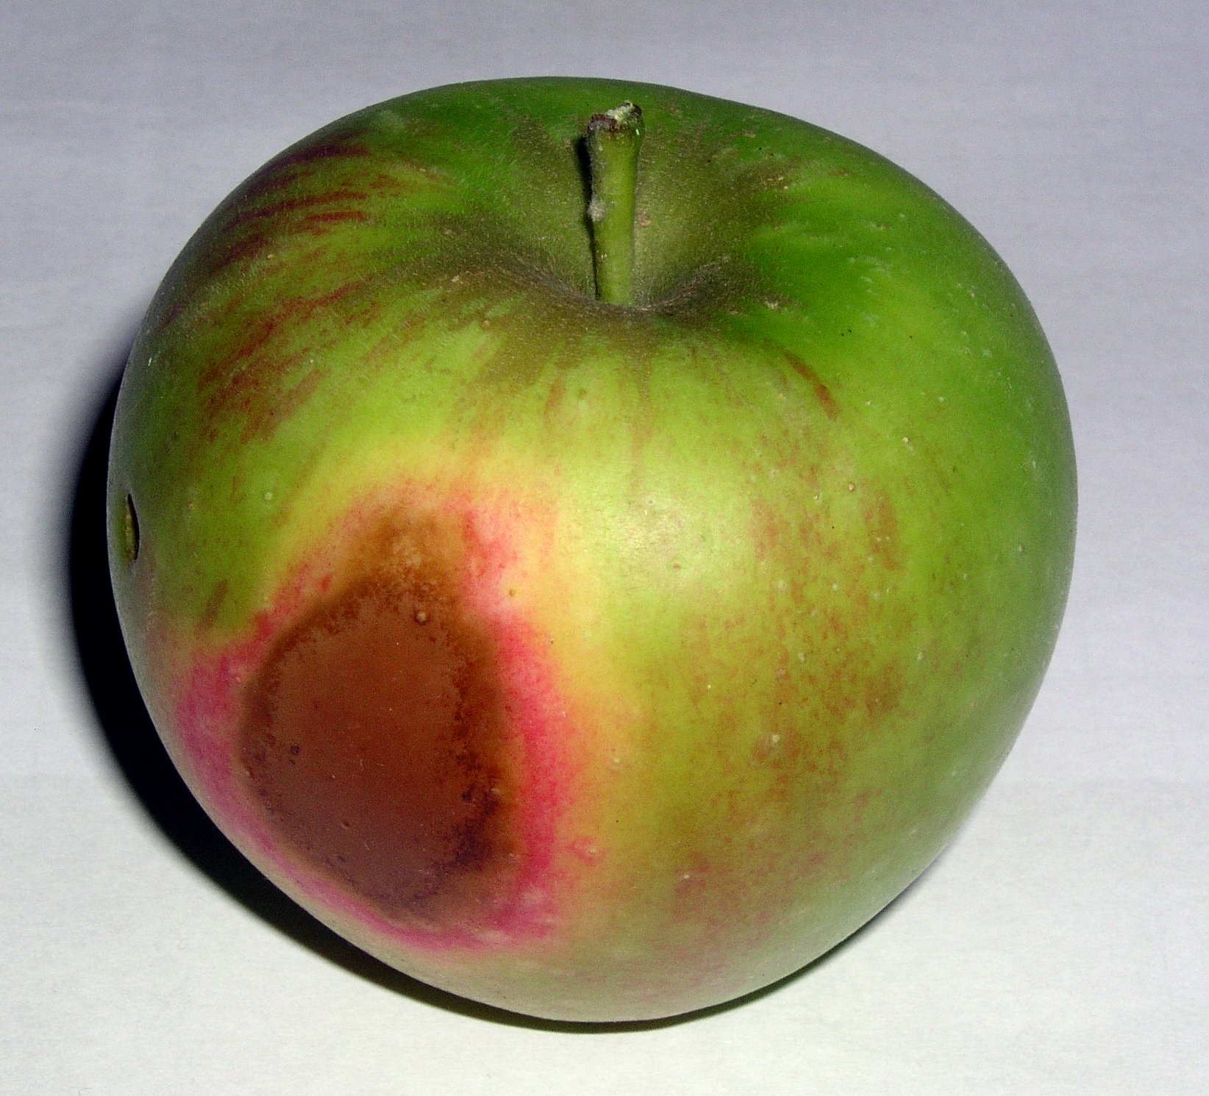
Community Concerns
Top apple producing state in US (USDA)
Majority of apple orchards are east of the Cascade Mountains
Climate fluctuations may alter temperature trends, resulting in negative impacts on apple growth
If temperatures rise there could be:
  A reduction in accumulated chill hours for locations where apples are currently grown
  An increased demand for irrigation resources, which could raise the cost of apple production
Apple Sunburn
Source: J. Stein
Notes:
The community concerns centered around apple production and the effect a fluctuating climate may have on it. Washington is the top apple producing state in the US and a rise in temperatures could negatively impact the industry. Two possible negative results could be that current orchards may see a reduction in accumulated chill hours and an increased demand for irrigation water. Both of these situations can lead to trees and fruit overheating, leading to damaged apples like this one here that has been sunburned.

Slide 4
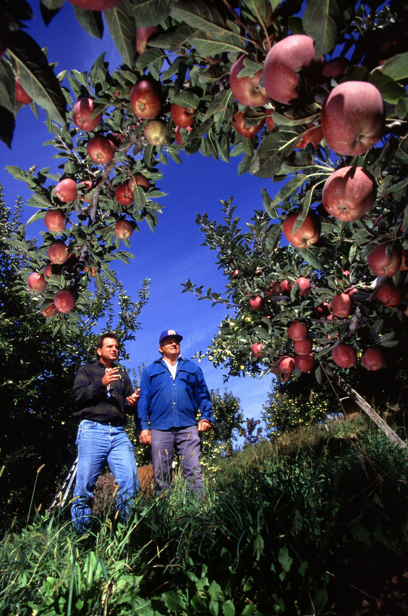

Objectives & Project Partner
Map accumulated chill hours
  Current accumulated chill hours
  Forecasted accumulated chill hours
Dr. Michael Glenn
Appalachian Fruit Research Station
USDA - Agriculture Research Service
Source: S. Bauer, USDA - ARS
Notes:
The objective of the project was to map accumulated chill hours for the region. First, a map of the current accumulated chill hours, and second, a map of forecasted accumulated chill hours for each 2045 and 2065. We partnered with Dr. Glenn from the USDA Agriculture Research Service and he disseminated the findings to growers in Washington.

Slide 5
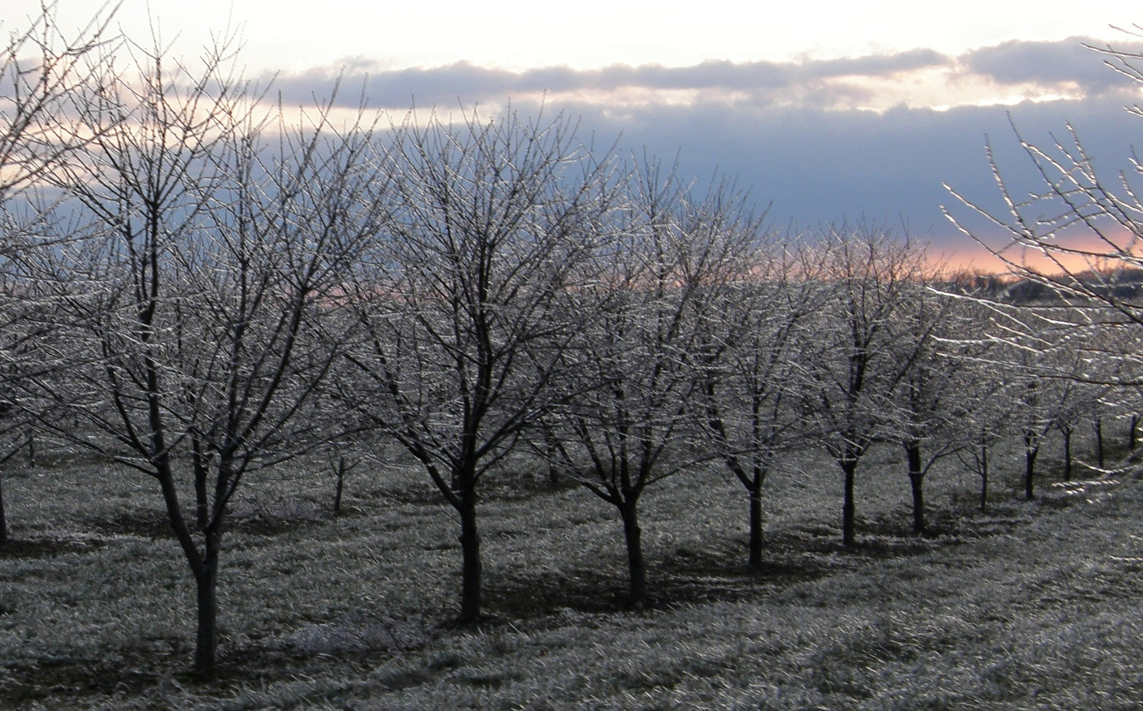
Chill Hours
The number of hours that fruit trees experience within a specific temperature range
  1.4ºC < T_{air} ≤ 12.4ºC
Apple trees require 500 – 1000 chill hours to produce optimal economic yields
Source: fauxto_digit

Slide 6
Chill Hours
The number of hours that fruit trees experience within a specific temperature range
  1.4ºC < T_{air} ≤ 12.4ºC
Apple trees require 500 – 1000 chill hours to homogenously break dormancy and bloom
Source: fauxto_digit
Notes:
In order for fruit to thrive in unfavorable weather, it is required for the trees to be accustomed to specific chilled temperature ranges for certain amount of hours, also known as chill hours. Apple trees require 500-1000 chill hours to break dormancy and continue to flower.

Slide 7
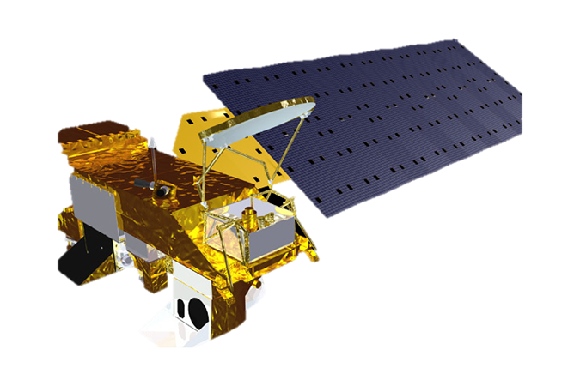

Earth Observations
Aqua MODIS
MODIS Lands Surface Temperature (LST)
Terra MODIS
Notes:
The Earth Observation Systems used for this project was Aqua and Terra MODIS

Slide 8
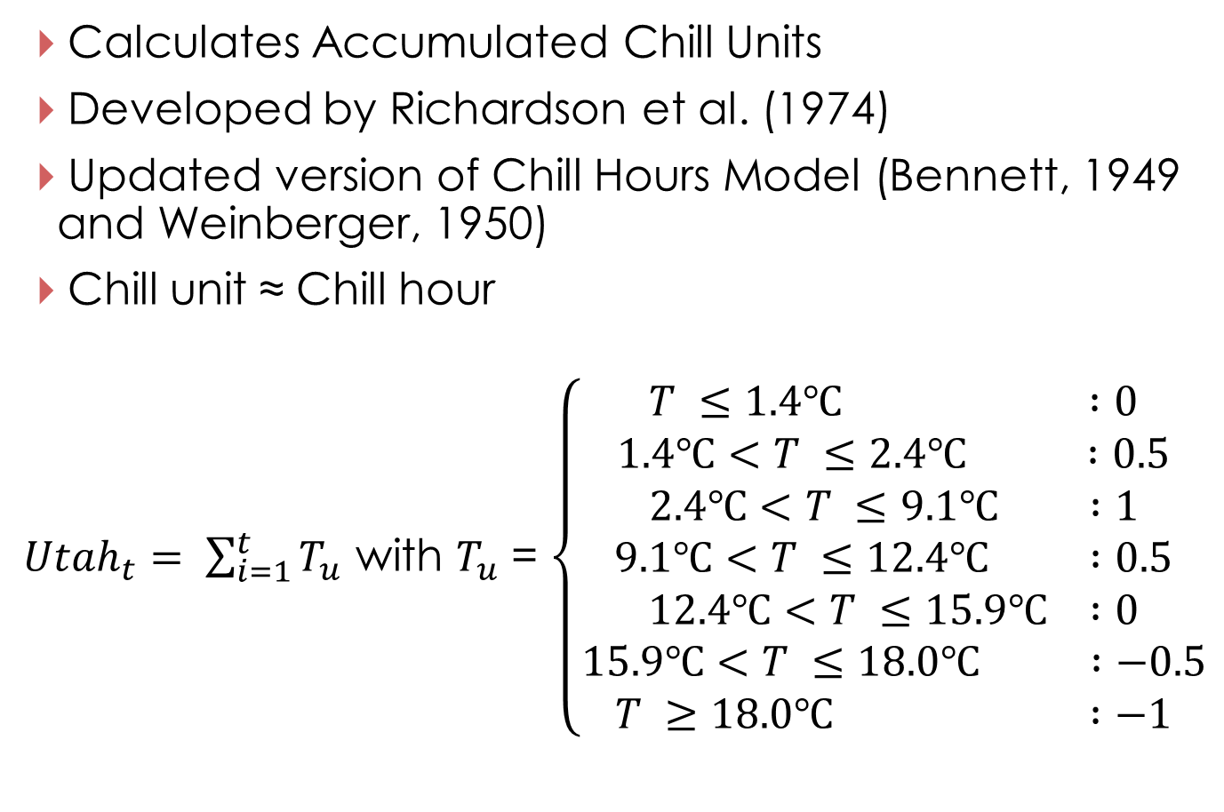
Utah Model
Calculates Accumulated Chill Units
Developed by Richardson et al. (1974)
Updated version of Chill Hours Model (Bennett, 1949 and Weinberger, 1950)
Chill unit ≈ Chill hour
${Utah}_{t}= \sum_{i=1}^{t}{T_{u}}$ with $T_{u}$ = $\left\{\begin{aligned}T ≤1.4℃ :0 \\ 1.4℃<T ≤2.4℃ :0.5 \\ 2.4℃<T ≤9.1℃ :1 \\ 9.1℃<T ≤12.4℃ :0.5 \\ 12.4℃<T ≤15.9℃ :0 \\ 15.9℃<T ≤18.0℃ :−0.5 \\ T ≥18.0℃ :−1\end{aligned}\right.$
Notes:
The Utah Model was used to calculate accumulated chill units. Adapted by Richardson et al., it built off of the Chill Hours Model developed in studies by Bennett and Weinberger.
One chill unit is approximately one chill hour, however chill units are calculated from more temperature divisions with weights applied to them. The whole equation is shown here with the divisions and weights assigned to the temperature ranges and then the number of units summed for the whole “year”. For every hour that there were temperatures between 1.4 C and 12.4 C, 0.5 or 1 chill unit contributed to accumulated chill hours. Meanwhile, for every hour that temperatures were above 15.9 C, units were detracted.
No units count towards the accumulated total for temperatures below 1.4 C because it is too close to freezing or below freezing.
For each temperature range there is an assigned chill unit. The sum of the chill units is accumulated chill units, which are roughly equal to accumulated chill hours, but more accurate because of the temperature divisions and assigned weights. This equation was entered into python to calculate the daily temperature hours and was the basis for project methodology.

Slide 9
Project Methodology
Data Acquisition
Data Processing
Data Analysis
Hourly Temperature
NOAA Ground
Weather Stations
2003 – 2013
Average hourly
temperature per day
Utah Model
Current Accumulated
Chill Units
Convert to T_{air}
Land Surface
Temperature (LST)
MODIS
2003 – 2013
Apply temperature fluctuation curve to daily T_{max} and T_{min}
Utah Model
Current Accumulated
Chill Units
Forecasted Air Surface Temperature (tas)
CMIP5 North American CORDEX Climate Model
2040 – 2070
Add forecasted changes
to T_{max} and T_{min}
Utah Model
Forecasted Accumulated Chill Units
Fit temperature curve to forecasted T_{max} and T_{min}
Notes:
This was the process we used for the project.

Slide 10
Project Methodology
Data Acquisition
Data Processing
Data Analysis
Hourly Temperature
NOAA Ground
Weather Stations
2003 – 2013
Average hourly
temperature per day
Utah Model
Current Accumulated
Chill Units
Convert to T_{air}
Land Surface
Temperature (LST)
MODIS
2003 – 2013
Apply temperature fluctuation curve to daily T_{max} and T_{min}
Utah Model
Current Accumulated
Chill Units
Forecasted Air Surface Temperature (tas)
CMIP5 North American CORDEX Climate Model
2040 – 2070
Add forecasted changes
to T_{max} and T_{min}
Utah Model
Forecasted Accumulated Chill Units
Fit temperature curve to forecasted T_{max} and T_{min}
Notes:
There were three forms of data used: Hourly Temperature, Land Surface Temperature, and modeled air temperature. The Hourly temperature measured at NOAA ground stations in Washington was acquired from NOAA National Climate Data Center for January 2003 to December of 2013. The Land Surface Temperature was retrieved from MODIS where we were able to identify the surface temperatures for the same 10 year period. The climate model that we used to project the forecasted temperatures between the years of 2040 and 2070 was the CMIP5 North American model and the CORDEX climate model.

Slide 11
Project Methodology
Data Acquisition
Data Processing
Data Analysis
Hourly Temperature
NOAA Ground
Weather Stations
2003 – 2013
Average hourly
temperature per day
Utah Model
Current Accumulated
Chill Units
Convert to T_{air}
Land Surface
Temperature (LST)
MODIS
2003 – 2013
Apply temperature fluctuation curve to daily T_{max} and T_{min}
Utah Model
Current Accumulated
Chill Units
Forecasted Air Surface Temperature (tas)
CMIP5 North American CORDEX Climate Model
2040 – 2070
Add forecasted changes
to T_{max} and T_{min}
Utah Model
Forecasted Accumulated Chill Units
Fit temperature curve to forecasted T_{max} and T_{min}
Notes:
The hourly temperature data were averaged for every hour of the day, for each day of the year, across the 11 year time span. The hourly temperatures for each day were plotted to determine the function by which the temperatures fluctuate over a 24 hour period. The MODIS LST was converted to air temperature and provided the maximum and minimum temperatures for each day. The daily temperature oscillation curve was applied to the daily max and min air temperatures to calculate the number of hours at each temperature. The forecasted changes to Tmax and Tmin were added to the MODIS derived air temperature and fitted to the same daily temperature fluctuation curve.

Slide 12
Project Methodology
Data Acquisition
Data Processing
Data Analysis
Hourly Temperature
NOAA Ground
Weather Stations
2003 – 2013
Average hourly
temperature per day
Utah Model
Current Accumulated
Chill Units
Convert to T_{air}
Land Surface
Temperature (LST)
MODIS
2003 – 2013
Apply temperature fluctuation curve to daily T_{max} and T_{min}
Utah Model
Current Accumulated
Chill Units
Forecasted Air Surface Temperature (tas)
CMIP5 North American CORDEX Climate Model
2040 – 2070
Add forecasted changes
to T_{max} and T_{min}
Utah Model
Forecasted Accumulated Chill Units
Fit temperature curve to forecasted T_{max} and T_{min}
Notes:
The averaged hourly temperatures were entered into the Utah Model to calculate Chill Units and summed for the 24 hour period to reach accumulated chill units for each day. Once the relationship between the total 24 hour dataset accumulated chill units and the max-min function dataset accumulated chill units was established, the function was applied to the 5 day rolling average maximum and minimum air temperatures calculated from MODIS data to determine the accumulated chill units for each day and summed for the year.

Slide 13
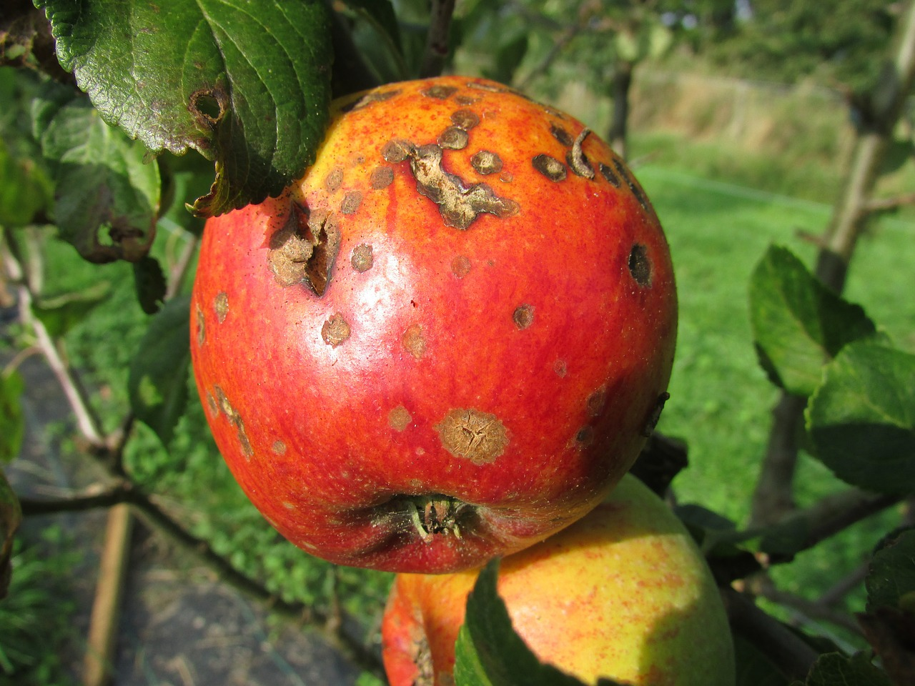
Results
Results
Discussion
Uncertainty/Error Analysis
Apple Blight
Source: Kasman
Notes:
TBD

Slide 14
Conclusions
Conclusions
Benefits of Research
Any Future Work (if applicable)
Notes:
TBD

Slide 15
Acknowledgements
Dr. Kenton Ross
NASA DEVELOP National Program
Science Advisor
Dr. Noel Baker
NASA Postdoctoral Program Fellow
Nathan Owen
NASA DEVELOP – Langley Center Lead
Jeffry Ely
NASA DEVELOP Geoinformation Scientist
Chad Smith
NASA DEVELOP – Langley Assistant Center Lead
This material is based upon work supported by NASA through contract NNL11AA00B and cooperative agreement NNX14AB60A.
Notes:
We would like to thank everyone who helped make this project possible, most notably Dr. Ross and Dr. Baker for their guidance and expertise, and Nathan and Jeff for their invaluable assistance throughout all aspects of the project. And thank you (audience) for your time.

