Slide 1
Great Salt Lake Health & Air Quality
Monitoring Lakebed Exposure and its Impact on Air Quality and Environmental Hazards in the Great Salt Lake Watershed
Piper Christian • Andrea Delgado • Fiona Summers • Yoana Vargas
Virtual Environmental Justice – VEJ | 2023
Notes:
Slide 1: Title
“Monitoring Lakebed Exposure and its Impact on Air Quality and Environmental Hazards in the Great Salt Lake Watershed”
[Team members introduce themselves]
In our presentation , we will be covering the following components: [Background, Methodology, Analysis, Results, Conclusions, Limitations].

Slide 2
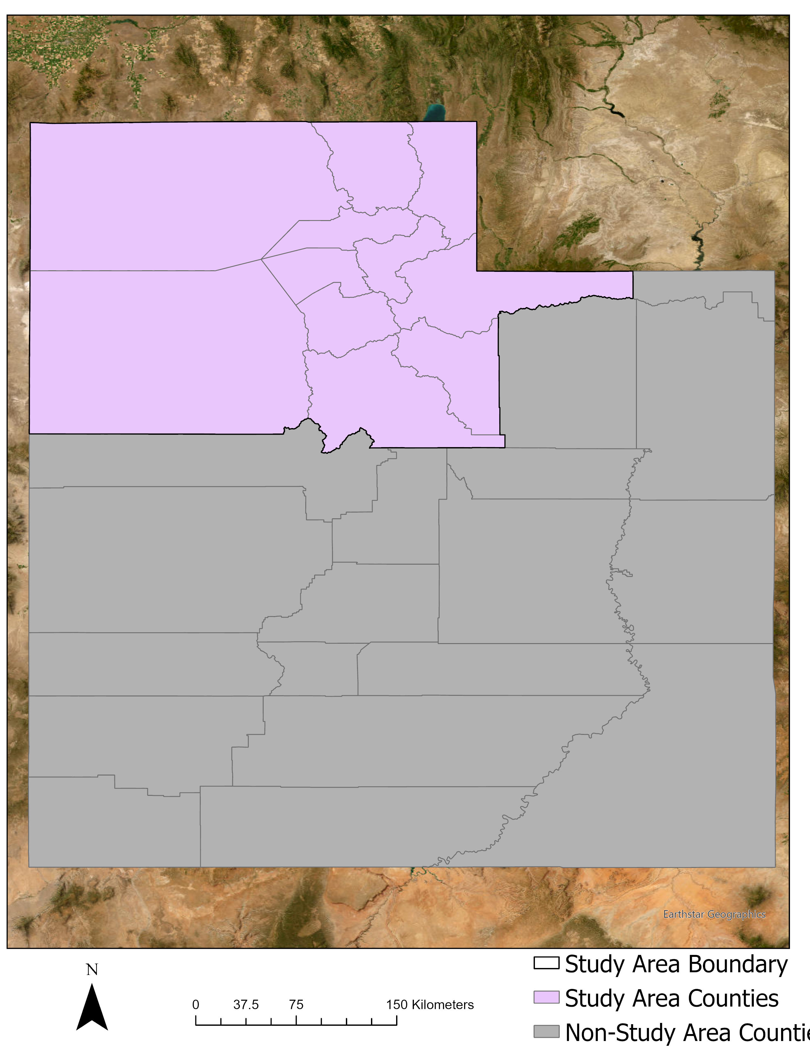
Study Area & Period
Great Salt Lake (GSL), Utah, USA
Target Counties
Box Elder*, Cache, Rich, Weber, Tooele*, Davis*, Morgan, Salt Lake*, Summit, Utah, and Wasatch Counties
Population: 2.5M
2010-2022
0 37.5 75 150 Kilometers
Study Area Boundary
N
Study Area Counties
Non-Study Area Counties
*Finer scale analysis on these counties of interest due to their GSL proximity and population.
Notes:
Slide 2: Study Area & Period
The counties of interest in our study area are Box Elder, Cache, Rich, Weber, Tooele, Davis, Morgan, Salt Lake, Summit, Utah, and Wasatch Counties, as shown on our map on the left. The population of our study area is 2.5 million residents.
Our partners and advisors chose the 2010-2022 study period because:
Enough GSL variations
Comparability & Overlapping: satellites/ancillary datasets
Accuracy
Feasibility
Focusing on:
Low levels: 2016 and 2021-2022
High Levels: 2011-2012 and 2017-2018

Slide 3
Partners
State Government
Utah Department of Environmental Quality, Division of Air Quality
Utah Department of Natural Resources, Division of Forestry, Fires, and State Lands
Academic
Westminster College, Great Salt Lake Institute
Dust^2
Non-profit
Great Salt Lake Coalition
Utah Physicians for Healthy Environment
Local Organization
Westside Coalition
End User
Notes:
Slide 3: Partners
Our partners come from the following backgrounds: state government, academic, non-profit, and local organizations. The organizations included [read organizations off the slide]. […] are end-user partners, and […] are collaborating partners. Their diverse perspectives lent valuable input to our research process and formulating community needs.

Slide 4
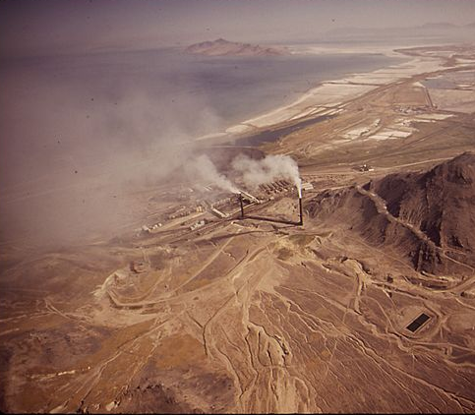
Community Concerns
Public Health
Climate Change
Air Quality
Environmental Justice
Redlining
Legacy of redlining results in inequitable pollution exposure
Industrial Air Pollution
Multiple point-source pollutants impact those near GSL
Great Salt Lake Dust
GSL dust may exacerbate existing environmental health disparities
Image Credit: Bruce McAllister, EPA; Chanut is Industries; Nuttapon Pohnprompratahn; Andre Baund
Notes:
Slide 4: Community Concerns
In our conversations with our community partners, we learned that salient community concerns include:
Public Health, Climate change, Air Quality
More specific community examples include: ecosystem & biodiversity loss, lifestyle/recreation, development/industry, transportation, economy/tourism
Community needs presented by partners included implementing suitable lakebed management practices, expanding targeted air monitoring, and furthering advocacy for GSL stewardship in decision-making.
Environmental Justice
Through research and conversations with community partners, we learned about a variety of environmental justice considerations for our project. For example, today, the demographics in many large cities reflect the Home Owners' Loan Corporation (HOLC) redlining maps created in the 1930s. In Salt Lake City, residents who live in previously redlined areas on the West side of the city are exposed to higher pollution sources at a higher concentration when compared to their majority white counterparts on the East side.
Dust from the Great Salt Lake will exacerbate pollution exposure for communities that are already exposed to a variety of point source pollutants in Northern Utah.
------------------------------Image Information Below ------------------------------
•Image Credit: Bruce McAllister, EPA
•Image Source: https://commons.wikimedia.org/wiki/File:KENNECOTT_SMELTER_AND_MINE_-_THE_LARGEST_OPEN-PIT_COPPER_MINE_IN_THE_WORLD_-_NARA_-_544788.jpg (Public Domain)
-------------------Image Credits------------------------------
Utah
Image Credit- Mark McClellan , US (Public Domain) from the Noun Project
Image Source- https://thenounproject.com/icon/utah-30976/
2. Air Quality Control
Image Credit- Chanut is Industries US (Public Domain) from the Noun Project
Image Source- https://thenounproject.com/icon/air-quality-control-4322214/
3. Public Health
Image Credit- Nuttapon Pohnprompratahn, US (Public Domain) from the Noun Project
Image Source- https://thenounproject.com/icon/cross-in-circle-2198605/
4. Climate Change
Image Credit- Andre Baund, US (Public Domain) from the Noun Project
Image Source- https://thenounproject.com/icon/climate-change-5041222/

Slide 5
Map regional dust & air quality indices
Map regional dust & air quality vulnerability
Objectives
Understand the relationship between lakebed exposure & AQ
Produce impactful visual & storytelling materials
Icon Credit: Chanut is Industries, Eucalyp, Adrien Coquet, AB Designs
Notes:
Slide 5: Objectives
There are particular objectives associated with our project deliverables.
Dust and Air Quality Indicator Map Package
Map dust and air quality index and lakebed exposure changes utilizing Earth observations to provide partners with a better understanding of neighborhoods or corridors with highly susceptible populations in surrounding counties based on dust exposure, sociodemographic and -economic indicators, public health metrics, and additional air quality hazards.
Dust and Air Quality Vulnerability Map Package
Map dust and air quality vulnerability utilizing Earth observations to display the relationships between dust, air quality, and lakebed exposure to better understand resulting hazards, particularly in the highly populated urban areas near GSL.
Creative Communication Deliverable
Create a creative communication deliverable using impactful visual and storytelling materials regarding the environmental changes occurring at and around the GSL for partners by using findings to engage with and educate members of the legislature and the public.
------------------------------Image Information Below ------------------------------
Air Quality Control
Image Credit- Chanut is Industries, US (Public Domain) from the Noun Project
Image Source- https://thenounproject.com/icon/air-quality-control-4322214/
2. Air Pollution
Image Credit - Eucalyp, US (Public Domain) from the Noun Project
Image Source - https://thenounproject.com/icon/air-pollution-3783418/
3. Tutorial
Image Credit – Adrien Coquet, US (Public Domain) from the Noun Project
Image Source - https://thenounproject.com/icon/tutorial-2366973/
4. Creative Communication Image Credit – AB Designs, US (Public Domain) from the Noun Project
Image Source - https://thenounproject.com/icon/idea-5332510/

Slide 6
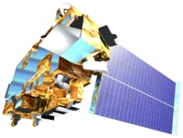
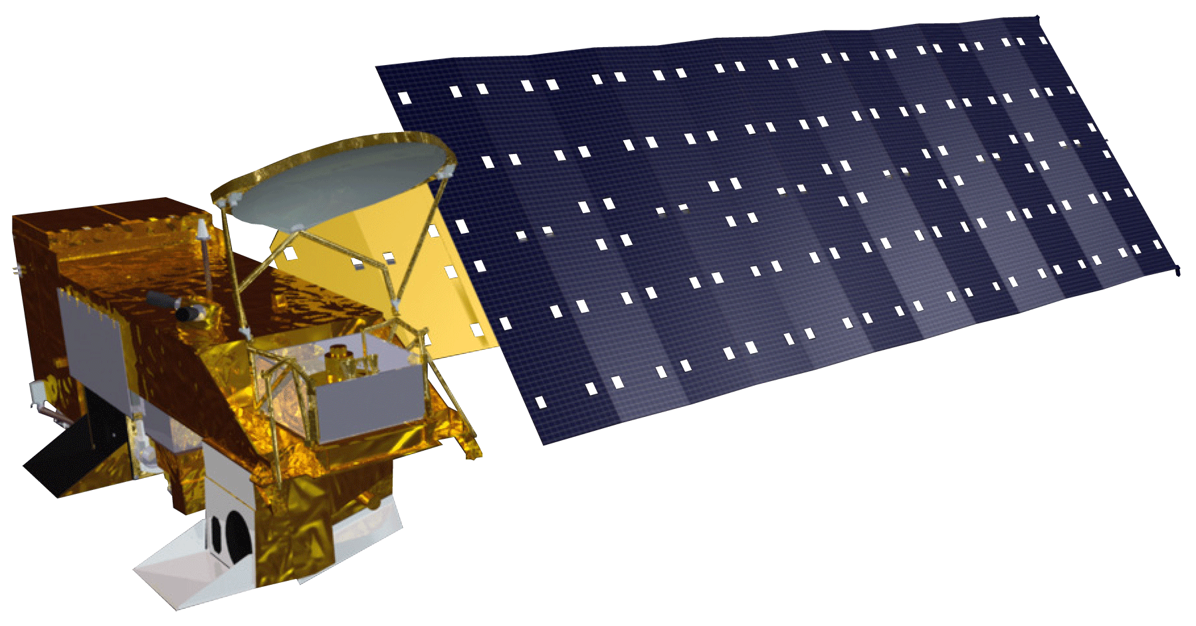
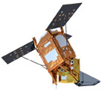
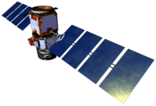
Earth Observations
Landsat 8
Landsat 5, 7, 8
OLI/TIRS (JRC) Lake Surface Area (SA)
Terra
MODIS Aerosol Optical Depth (AOD)
Aqua
MODIS Aerosol Optical Depth (AOD)
Sentinel-5
TROPOMI Nitrogen Dioxide (NO2) Formaldehyde (HCHO) Carbon Monoxide (CO)
CALIPSO
CALIOP Aerosol Type/Height
*The JRC dataset is a preprocessed Landsat-5, 7, 8 dataset with cloud masks, water masks, and historical water classifications.
Image Credit: NASA
Notes:
Slide 6: Earth Observations
Our project used Earth observations to better understand dust, air quality, lakebed exposure, alongside community vulnerability, at the Great Salt Lake.
We used SATELLITE IMAGERY, GROUND AIR MONITOR & WATER GAUGE SENSOR DATA, and CENSUS DEMOGRAPHIC DATA to carry out our study.
We gathered data on Annual Lake Surface area from 2010-2021 from OLI/TIRS JRC Product from the Landsat 5/7/8 Satellites to analyze Lake Surface Area.
We gathered _____ from [insert dataset] from [insert sensor] from [insert satellite] to analyze [insert variable].
[Follow this pattern for all other satellites]:
To begin speaking about our methodology, we will cover the methods for 3 aspects of our project including Seasonal Trends, Dust Event Day Case Studies, and Pollution & Social Vulnerability.
Image Credit:
NASA Satellites: List of Satellite Pictures - DEVELOPedia (developexchange.com)

Slide 7
Seasonal Trends Methodology
Data
Processed Product
Validation
Analysis
End-Product
AOD validation with
EPA Ground AQS PM2.5
MAM 95th percentile AOD
2010-2021
MODIS AOD
AOD Distribution Map (MAM)
wildfire dust differentiation with TROPOMI CO
correlation of MAM SA & AOD
Lake Surface Area Map (Annual)
MAM Average Lake Surface Area
2010-2021
JRC
Lake SA
SA validation with
USGS Gauge Station Water Level
Correlation Plots of SA and AOD
Notes:
Slide 7: Seasonal Trends Methodology
This workflow depicts our methodology workflow to create our Regional Dust and Air Quality Indicator Map Package by looking at seasonal trends.
We looked at seasonal trends of Aerosol Optical Depth and Lake Surface Area. We used Aerosol Optical Depth, or AOD, as a proxy for dust. We used lake surface area as a proxy for lakebed exposure. We mapped the relationship between the Great Salt Lake water changes over time with dust changes over time.
To do this, we utilized data from the following datasets [read sections in yellow]. We validated our data with the following ground sensors [read sensors in white section] [read validation and analysis steps].
We conducted the following processing steps to look specifically at the 95th percentile of AOD for March, April and May. In short, this shows the average AOD of the 5% of days that have the highest AOD levels. We chose March, April, and May because this is the season with meteorological conditions which cause dust events. We found mean lake surface area over March, April, and May for each year so that it temporally matched our AOD data.
This resulted in the following end products [read end products].
Image Credit:
NASA Satellites: List of Satellite Pictures - DEVELOPedia (developexchange.com)

Slide 8
Dust Event Case Studies Methodology
Dust Event Days (DEDs)
CALIPSO
Vertical Feature Mask
Extinction Coefficient Plot
Aerosol Type & Height
MAM
JJA
DJF
SON
Based on 2010-2022 meteorological data from KSLC (Salt Lake international airport).
Notes:
Slide 8:
Case Studies – Dust Event Days
This workflow depicts our methodology workflow to support our Regional Dust and Air Quality Indicator Map Package by looking at specific dust event case studies to determine aerosol type and height information to determine potential dust sources and implications on public health.
Our case studies depict more detailed data regarding dust location and its composition on Dust Event Days. We took the following steps for our case studies: [read steps].
We used 2010-2022 meteorological data from KSLC (Salt Lake international airport) to find particular dust event days within our dust season of MAM, and then checked to ensure that CALIPSO data was available for the given day, since it is only available every 16 days (temporal resolution).

Slide 9
Dust Vulnerability Index Methodology
Principle Component Analysis (PCA)
Social variables by census tract data
Environmental variables by census tract data
End-product
Dust & air quality vulnerability index by census tract
95th Percentile Pollution
Bivariate Choropleth Maps
Race
Income
Preexisting Medical Conditions
Age < 5
Age > 64
AOD
NO2
HCHO
Social Vulnerability
Environmental Pollution
via
EPA EJ Screen
via TROPOMI and MODIS
+ TROPOMI Validation with EPA AQS
Image Credit: Kalinin Ilya; riki harun, Landan Loyd, Khoirin; Nesterenko Ruslan
Notes:
Slide 9: Dust Vulnerability Index
This workflow depicts our methodology workflow to support our Regional Dust and Air Quality Vulnerability Map Package.
Our dust vulnerability index looks at how demographic variables may compound with pollution exposure to produce pollution vulnerability. To do this, we [read slide]…
Variable selection was influenced by community partner input, science advisors, and literature review.
Social Variables
Social variables included [read from slide] which were analyzed using Principle Component Analysis (PCA).
We extracted a CSV of demographic data from EJ Screen using RStudio
We then ran a principle component analysis, which refined our many demographic variables into a single variable: aggregated vulnerability by census tract.
Environmental Variables
Environmental variables included were 95th percentile of 3 pollutants of concern by census tracts.
AOD will compound with the below listed pollutants to impact health.
We used TROPOMI to determine how particular air pollutants NO2, HCHO (precursors to ozone) will compound and impact health.
We used results from the pollution exposure variable PCA and vulnerability index PCA to create bivariate choropleth maps with data by census tracts to determine dust and air quality vulnerability.
We will begin speaking about our results with associated analysis regarding the 3 parts of our project including Seasonal Trends, Dust Event Day Case Studies, and Pollution & Social Vulnerability.
-------------------Image Credits------------------------------
Leaf Map
Image Credit- Kalinin Ilya (Creative Commons License, Public Domain)
Image Source- https://thenounproject.com/icon/growth-map-plant-2725685/
Satellite
Image Credit- riki harun (Creative Commons License, Public Domain)
Image Source- https://thenounproject.com/icon/satelitte-5324351/
List
Image Credit - Landan Loyd (Creative Commons License, Public Domain)
Image Source - https://thenounproject.com/icon/list-1297768/
Air Pollution
Image Credit - Khoirin (Creative Commons License, Public Domain)
Image Source - https://thenounproject.com/icon/air-pollution-5549321/
Personal Data
Image Credit - Nesterenko Ruslan (Creative Commons License, Public Domain)
Image Source - https://thenounproject.com/icon/personal-data-5317609/

Slide 10
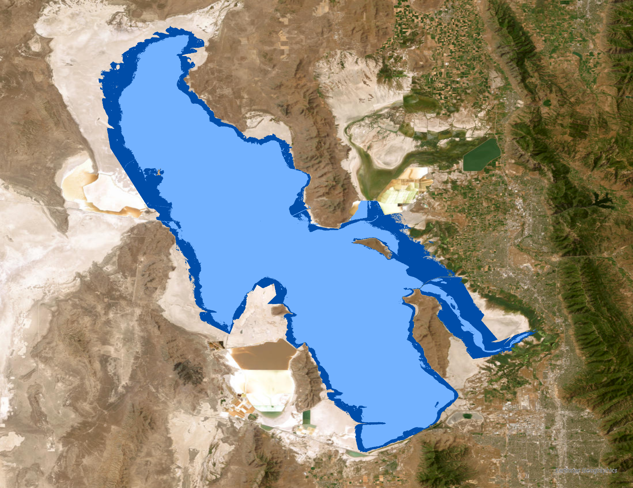
GSL Surface Area
N
2011
2021
0 4 7 15 kilometers
High (2011) & Low (2021) lake surface area during the study period (Landsat JRC).
Notes:
Slide 10: GSL Surface Area
We plotted the changes in average GSL Surface Area over time. In the lefthand graph, you can see the difference in lake SA from our high water year to our low water year. In the righthand plot, you can see the steady decline in surface area over our study period.
To validate that our surface area measurements were a good proxy for water level, we first plotted the Surface area annually against the water gauge on the north arm of the lake and south arm of the lake, as the lake levels are different on the two arms due to the causeway that bisects the lake. Then we calculated the mean of the north and south arm gauges and plotted it against Surface Area. We calculated an R^2 of .862, showing a strong relationship between the two variables.
Additional Info
2 USGS gages
North arm: USGS gage station 10010100/Great Sal Lake Near Saline, UT (GSLNS),
Latitude 41°15'19" and Longitude 112°29'46" NAD27
South arm: USGS gage station 10010000/Great Salt Lake at Saltair Boat Harbor, UT (GSLSBH) Latitude 40°43'53" and Longitude 112°12'46" NAD27

Slide 11
MAM 95th Percentile AOD
Notes:
Slide 11: MAM AOD 95th Percentile
We calculated the 95th percentile monthly mean for each month in our study period (Left). We then calculated the mean of the whole dust season 95th percentile AOD, for MAM (right). In short, this shows the average AOD of the 5% of days that have the highest AOD levels, or dust levels. This was an effort to analyze the trends for the worst pollution over the years within our study period.

Slide 12
AOD and Lake Surface Area
Notes:
Slide 12: AOD and Lake Surface Area
We determined what proportion of variance in AOD can be explained by lake surface area. Thus, we plotted the average lake surface area for MAM against 95th percentile AOD for MAM (Figure 7). We then calculated the linear regression, which resulted in an R² of 0.3423 showing that 95th percentile AOD and lake surface area follow the same trend and there is a linear relationship between the two variables during MAM season.

Slide 13
Differentiation from Wildfire Dust
Notes:
Slide 13: Wildfire Dust Differentiation
We plotted CO in two different seasons MAM (study season) and ASO (wildfire season) to prove that within MAM all high AOD response that we obtained is related to dust events rather than wildfires. The first graph in MAM shows how CO is low when ADO is low and maintains this flat behavior even when AOD spikes, on the other hand, ASO graph shows how CO follows AOD high values an expected behavior for wildfires.

Slide 14
AOD Validation
Notes:
Slide 14: AOD Validation
We wished to validate that the AOD that is being captured from the satellite matches the findings of the AOD that is captured from the Aeronet AOD ground sensor, to ensure the soundness of our data. Plotting the readings for one month of AOD measurements from MODIS and AERONET, we calculated an R^2 of .5, which shows a relationship between the two.

Slide 15
HCHO and NO2 Pollutant Trends
Notes:
Slide 15: HCHO and NO2 Pollutant Trends
We plotted 95th percentile for formaldehyde and nitrogen dioxide for our counties of interest with a finer scale analysis due to their GSL proximity and population.
Highlight the peak HCHO concentration for Davis County in 2021.
Higher NO2 concentrations are seen for SLCo and Davis Counties. SLCo seems to be the most impacted county by this pollutant. Additionally, 2021 generally seemed to be a high year for poor air quality and associated health risks when analyzing both ozone precursors.

Slide 16
AOD Trends
Notes:
Slide 15 We plotted AOD in MAM per county to understand dust effect on air quality, and AOD in all seasons to observe general pollution effect that includes all sources even wildfires.

Slide 17
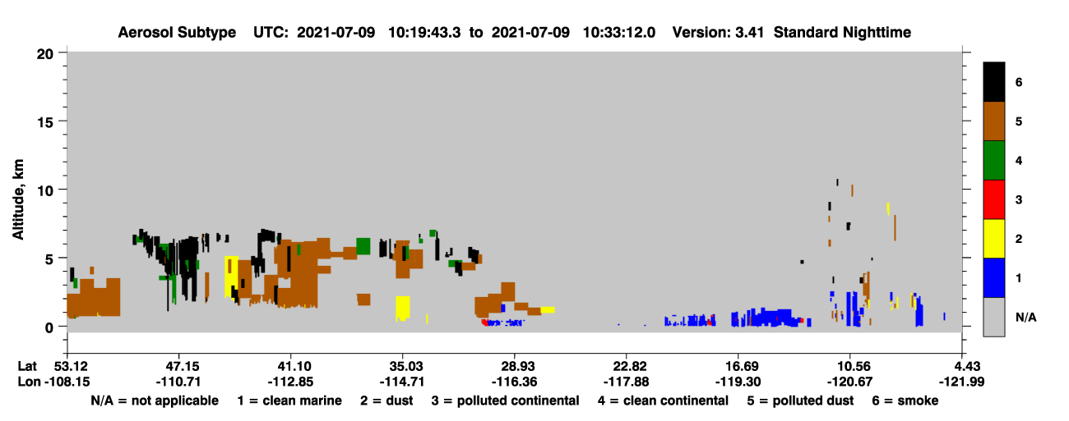
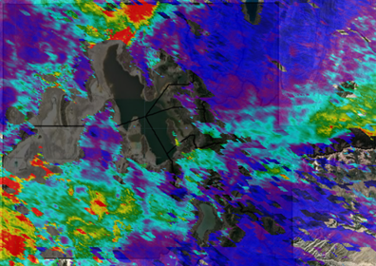
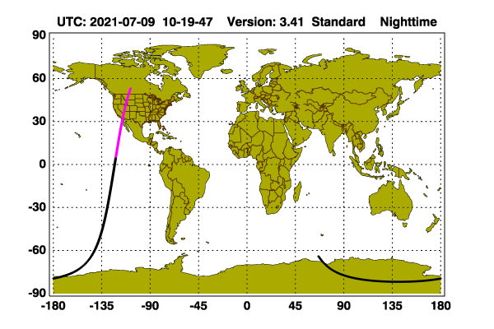
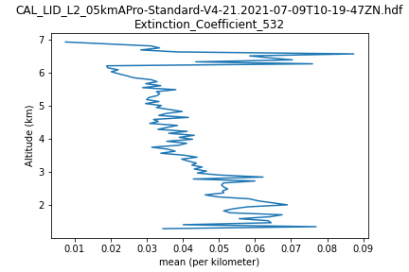
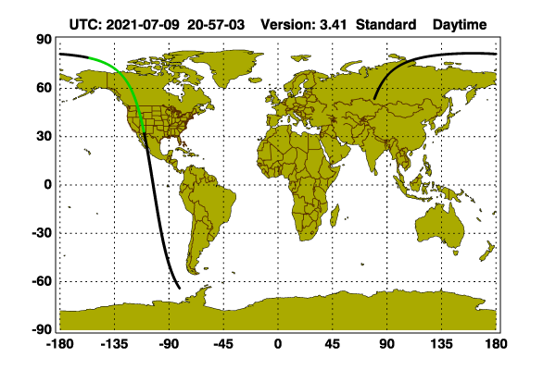
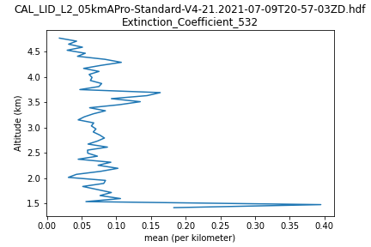
DED Aerosol Type and Height
CALIPSO VFM & Extinction Coefficient
DED: July 9, 2021
Nighttime
Daytime
Notes:
Slide 16: DED Aerosol Type and Height
MODIS showed high AOD on July 9th, 2021. The dust event day was analyzed using the CALIPSO satellite, by creating a vertical feature mask to classify Aerosol by sub-type and plot aerosol extinction coefficient to determine aerosol height. High extinction coefficient indicates high absorption and scattering of light and high associated aerosols present in the atmosphere, which can be comparable with ground sources.
The altitudes of the five layers are as follows:
Exosphere: 700 to 10,000 km (440 to 6,200 miles)
Thermosphere: 80 to 700 km (50 to 440 miles)
Mesosphere: 50 to 80 km (31 to 50 miles)
Stratosphere: 12 to 50 km (7 to 31 miles)
Troposphere: 0 to 12 km (0 to 7 miles)
Aerosols inside the tropospheric layer, the atmospheric layer closest to the surface that is ~12km thick, represents a risk for human health.
The altitude of the aerosol layer for the selected bounding box in the area of study is around 1.8 km from surface and the thickness of the aerosol layer is around 5.2 km.
The VFM proves that the aerosol subtype is mainly polluted dust which is in the troposphere level or near to the surface.

Slide 18
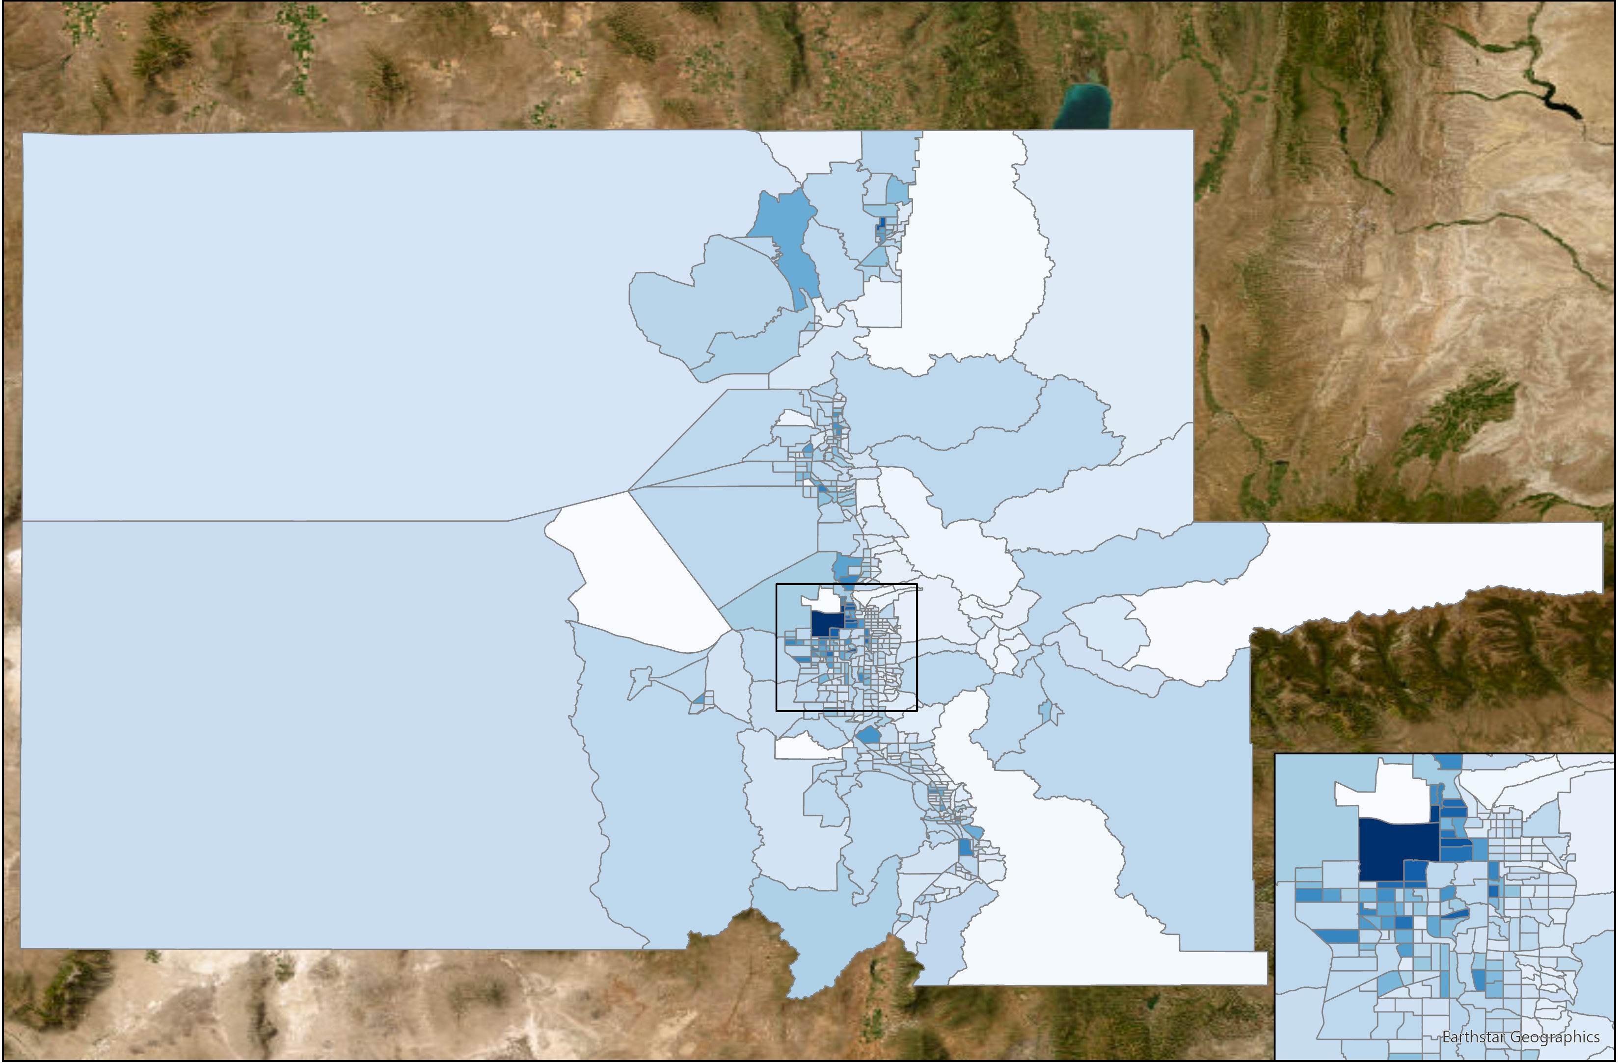
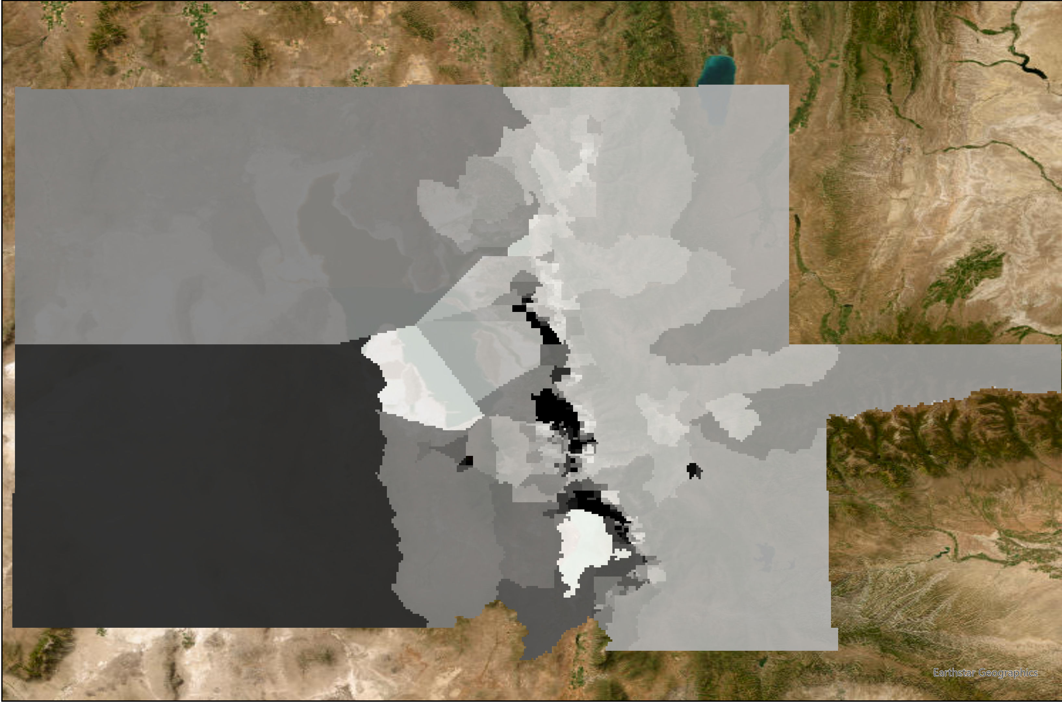
Social Vulnerability and Dust Exposure
Social Vulnerability by Census Tract
95th Percentile MAM AOD by Census Tract (2019)
N
0 20.1 40.2 80.5 km
N
0 20.1 40.2 80.5 km
4.2
-1.6
.265333
.183333
Notes:
Slide 17: Social Vulnerability & Dust Exposure
There are our preliminary Social Vulnerability & Pollution Maps.
We were able to social vulnerability considering the compounded variables by Census Track with demographic data from 2016-2019 [refer to it]. Explain.
We matched our environmental pollution data for 2019.
We mapped 95th percentile MAM AOD by Census Track in 2019 [refer to it]. Explain.

Slide 19
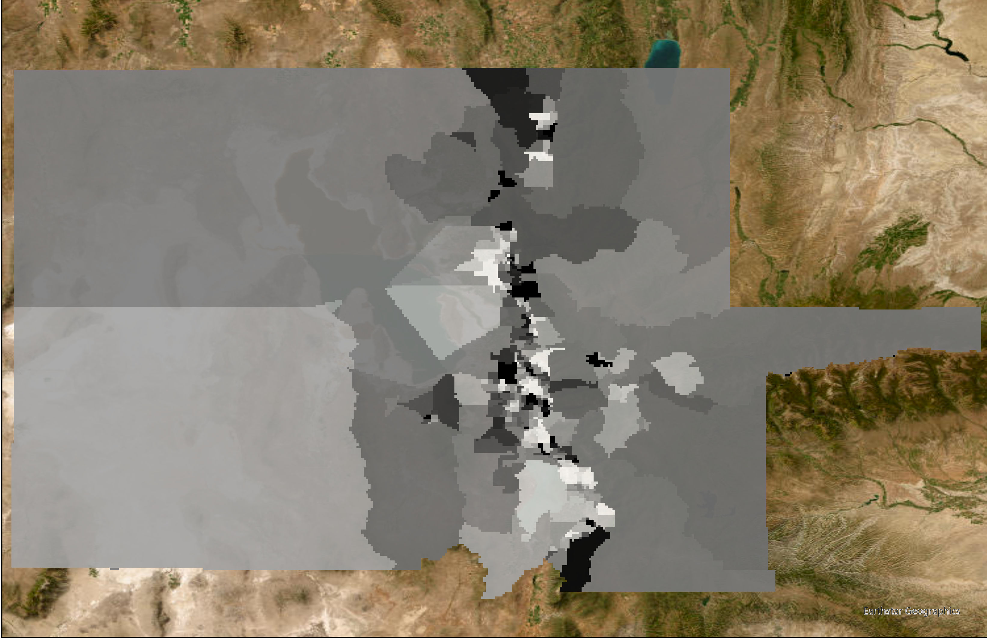
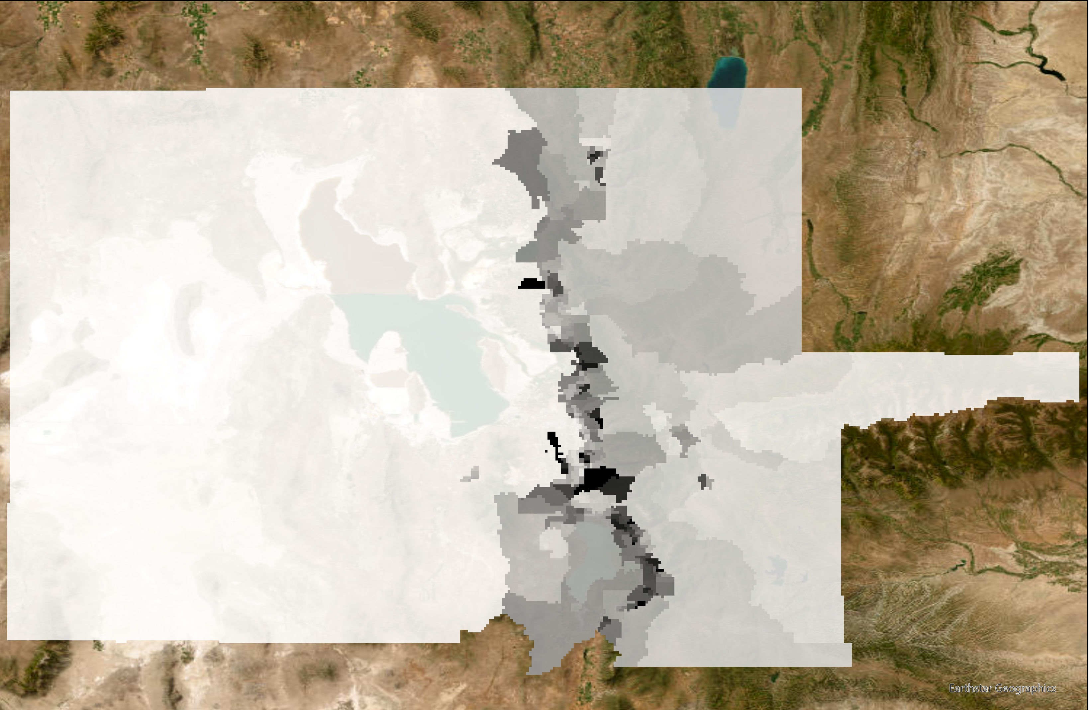
NO2 and HCHO Exposure
95th Percentile HCHO by Census Tract (2019)
95th Percentile NO2 by Census Tract (2019)
N
0 20.1 40.2 80.5 km
.000178437
-8.15812e-06
N
0 20.1 40.2 80.5 km
.000439831
-.000251101
Notes:
Slide 18: NO2 and HCHO exposure
There are our continued preliminary maps for NO2 and HCHO exposure.
We mapped 95th percentile NO2 by Census Track in 2019 [refer to it]. Explain.
We mapped 95th percentile HCHO by Census Track in 2019 [refer to it]. Explain

Slide 20
Conclusions
The annual lake surface area shows a decreasing trend (R² = 50.96%) from 2010 to 2021, which accounted for a 22.67% decrease in lake surface area from 2011 (high) to 2021 (low).
Certain DEDs demonstrated an aerosol subtype primarily composed of polluted dust located near the surface in the troposphere, which poses a potential public health hazard.
Census Tracts with high social vulnerability are disproportionately impacted by pollution. There is high AOD along the I15 corridor, high HCHO levels in Davis County, and high NO2 levels in Salt Lake County.
Earth Observations can be utilized to better understand dust, air quality, lakebed exposure, and community vulnerability, at GSL.
Lake surface area and AOD exhibit a moderate correlation (R² = 34.23%) between elevated dust season AOD and increased lakebed exposure from 2010 to 2022.
Notes:
Slide 18: Conclusions
[read points off slide]

Slide 21
Limitations
Did not include asthma variables in our social vulnerability PCA
Lacked access to Suomi NPP VIIRs MAIAC data
Performed DED case studies outside of MAM due to CALIPSO data availability
No strong linear relationship between AOD and PM2.5 in MODIS validation
Project Study Limitations
Did not have access to 2022 data in the JRC Dataset for lake surface area
Notes:
Slide 19: Limitations
These were some of the limitations in our study. [read off slide]
No clear linear relationship between AOD and PM2.5 in MODIS validation, which might indicate that this relationship is far more complex. There might be additional critical factors playing a role in the AOD concentrations, such as meteorological conditions.

Slide 22
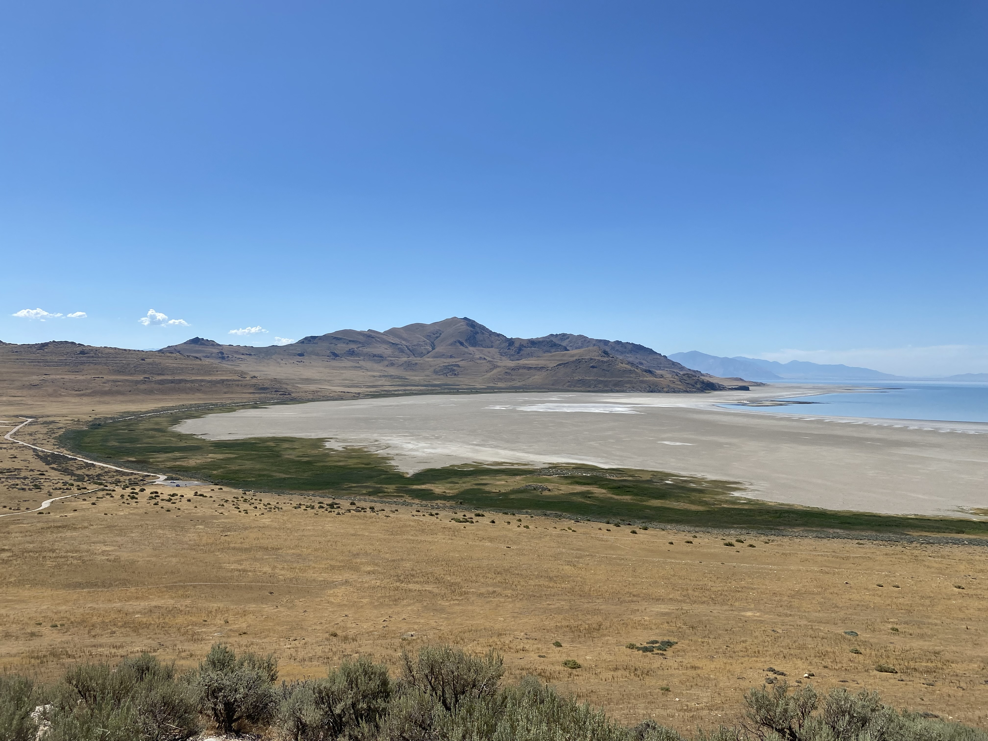
We'd like to acknowledge those who supported us in our project. Thank you for attending our presentation.
Julianne Liu - Fellow at DEVELOP Virtual Environmental Justice
Partners:
Utah Department of Environmental Quality, Division of Air Quality
Utah Department of Natural Resources, Division of Forestry, Fires, and State Lands
Westminster College, Great Salt Lake Institute
Dust^2
Northwestern Band of the Shoshone Nation
Great Salt Lake Coalition
Utah Physicians for Healthy Environment
Westside Coalition
Science Advisors:
Dr. Travis Toth - NASA Langley Research Center
Dr. Kenton Ross - NASA Langley Research Center
Lauren Childs-Gleason - NASA Langley Research Center
Dr. Bonnie Baxter - Westminster College, Great Salt Lake Institute
Dr. Maura Hahnenberger - Salt Lake Community College, Dust^2
Image Credit: Fiona Summers
Notes:
Slide 20: Acknowledgements
We would like to acknowledge all the individuals and partnering organizations who supported us in our project. Thank you for attending our presentation.

