Slide 1
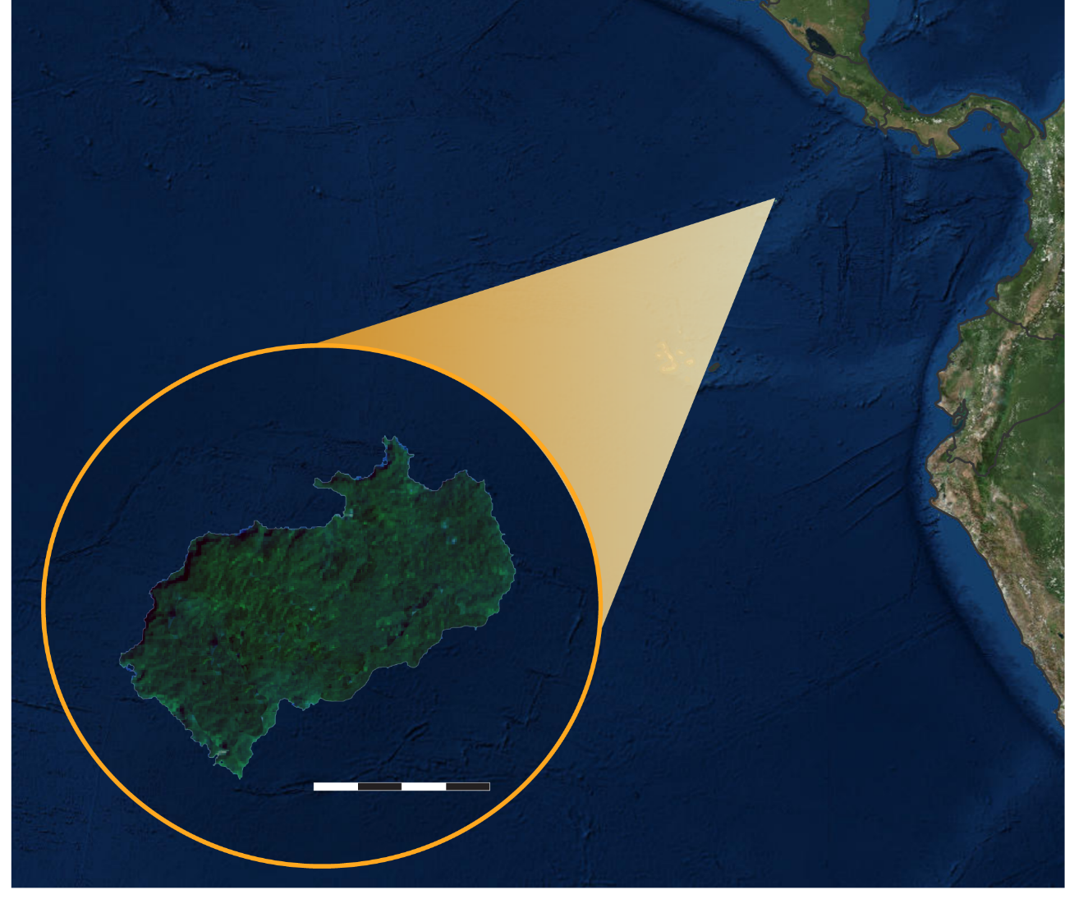
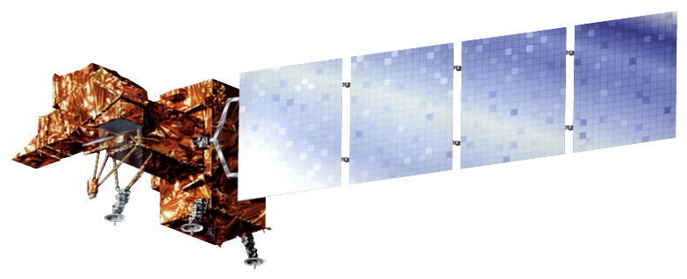
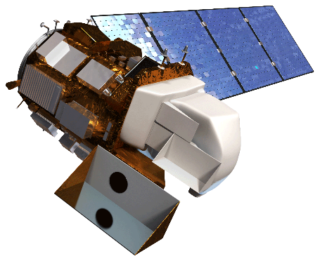
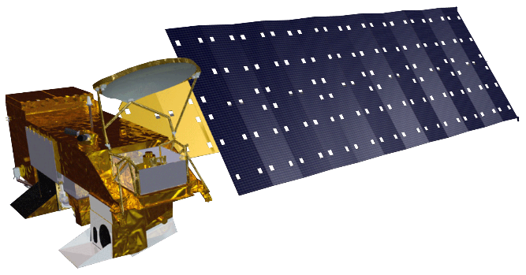
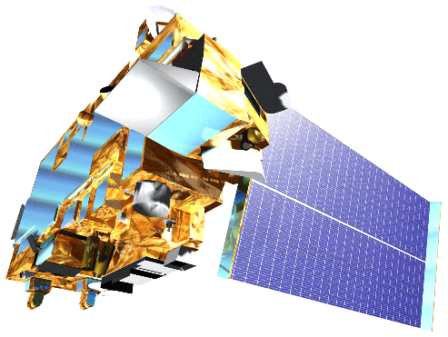
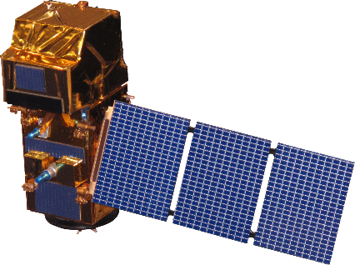
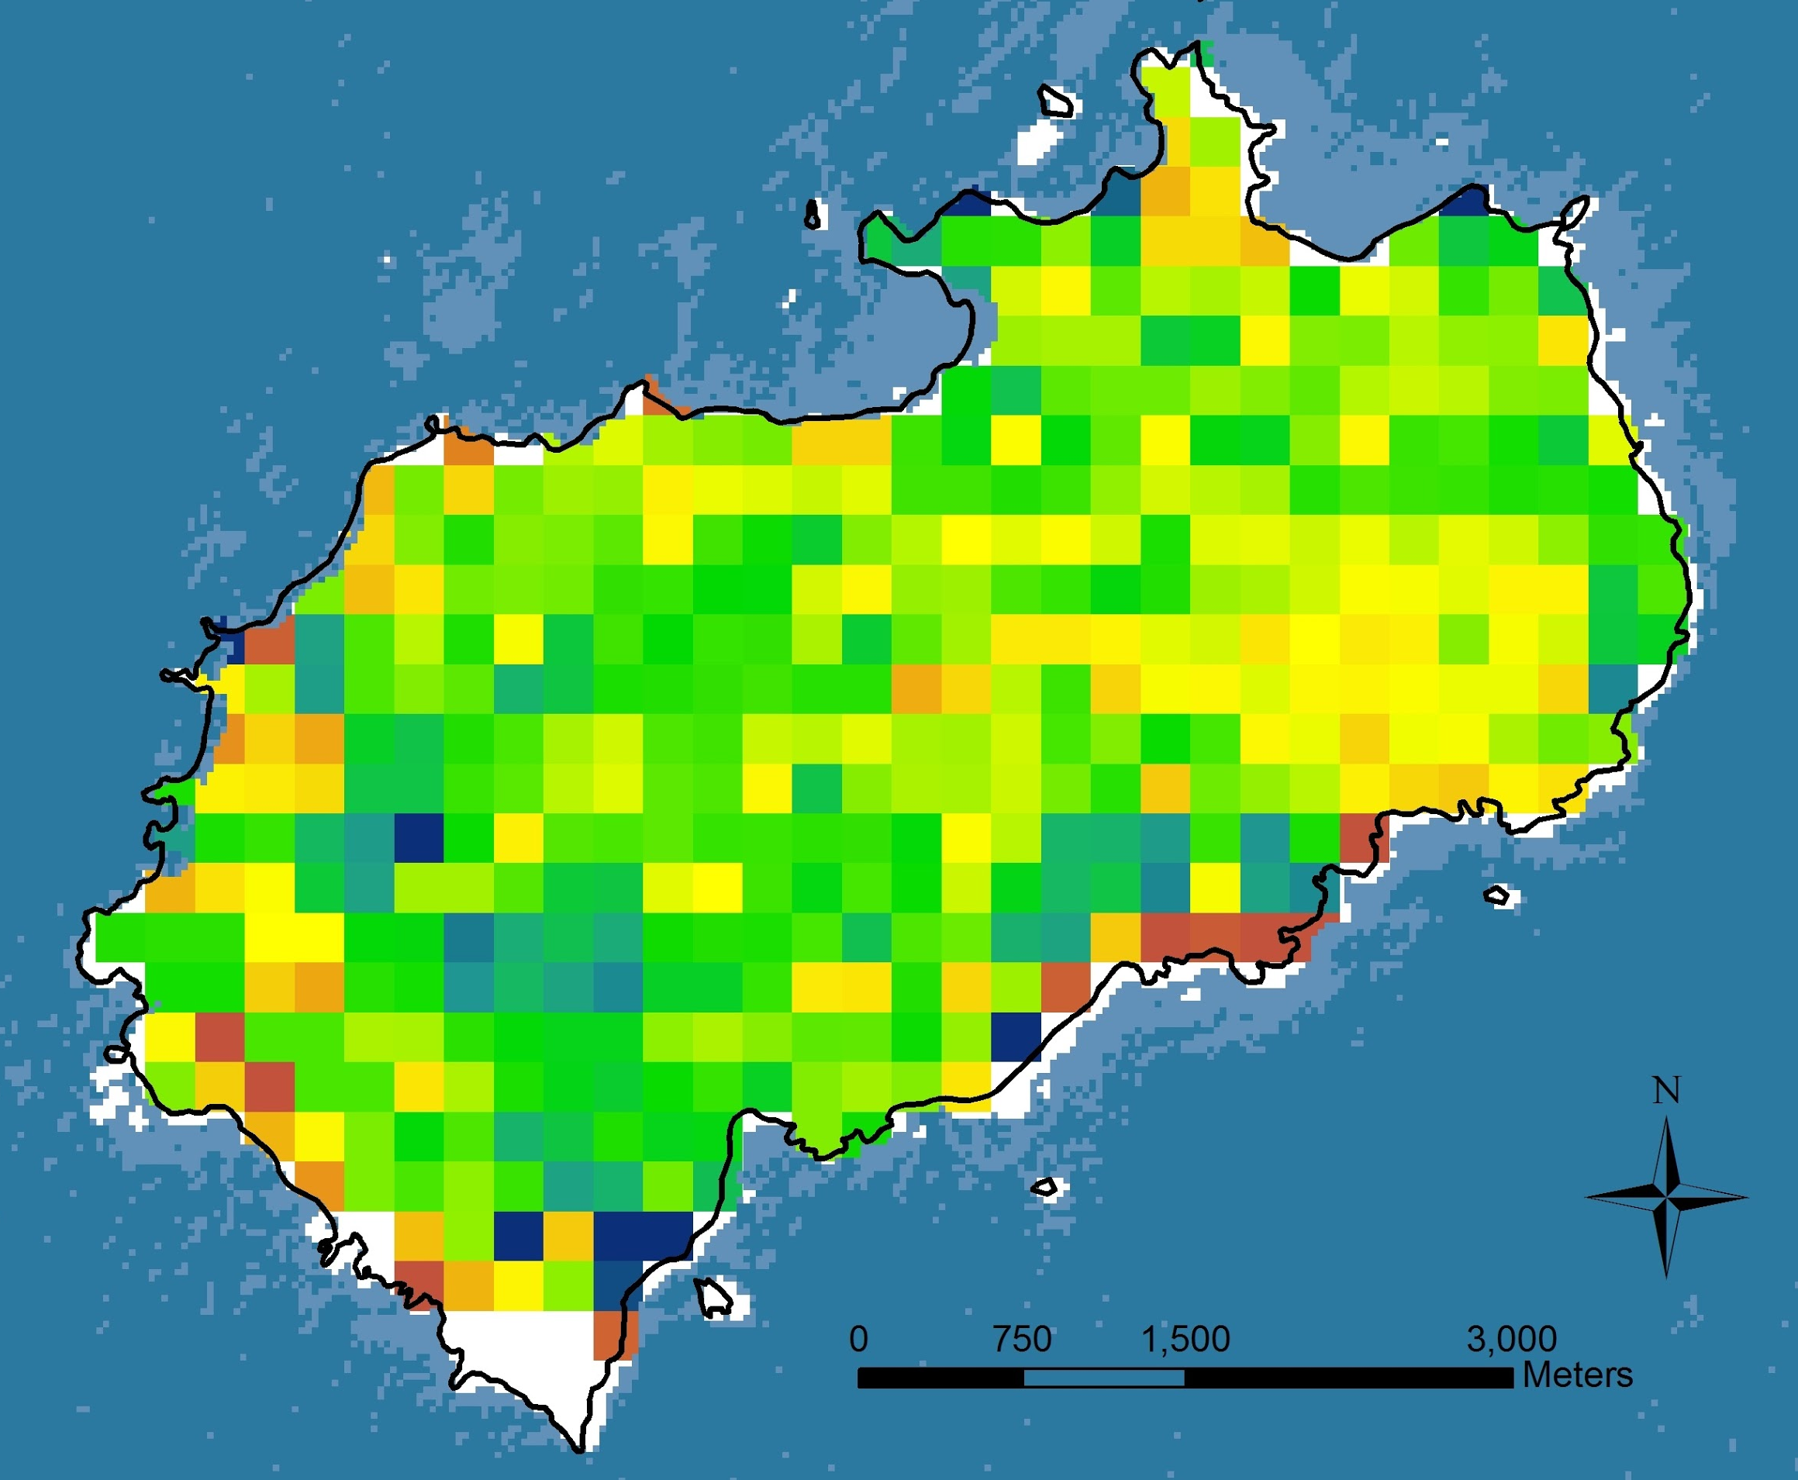
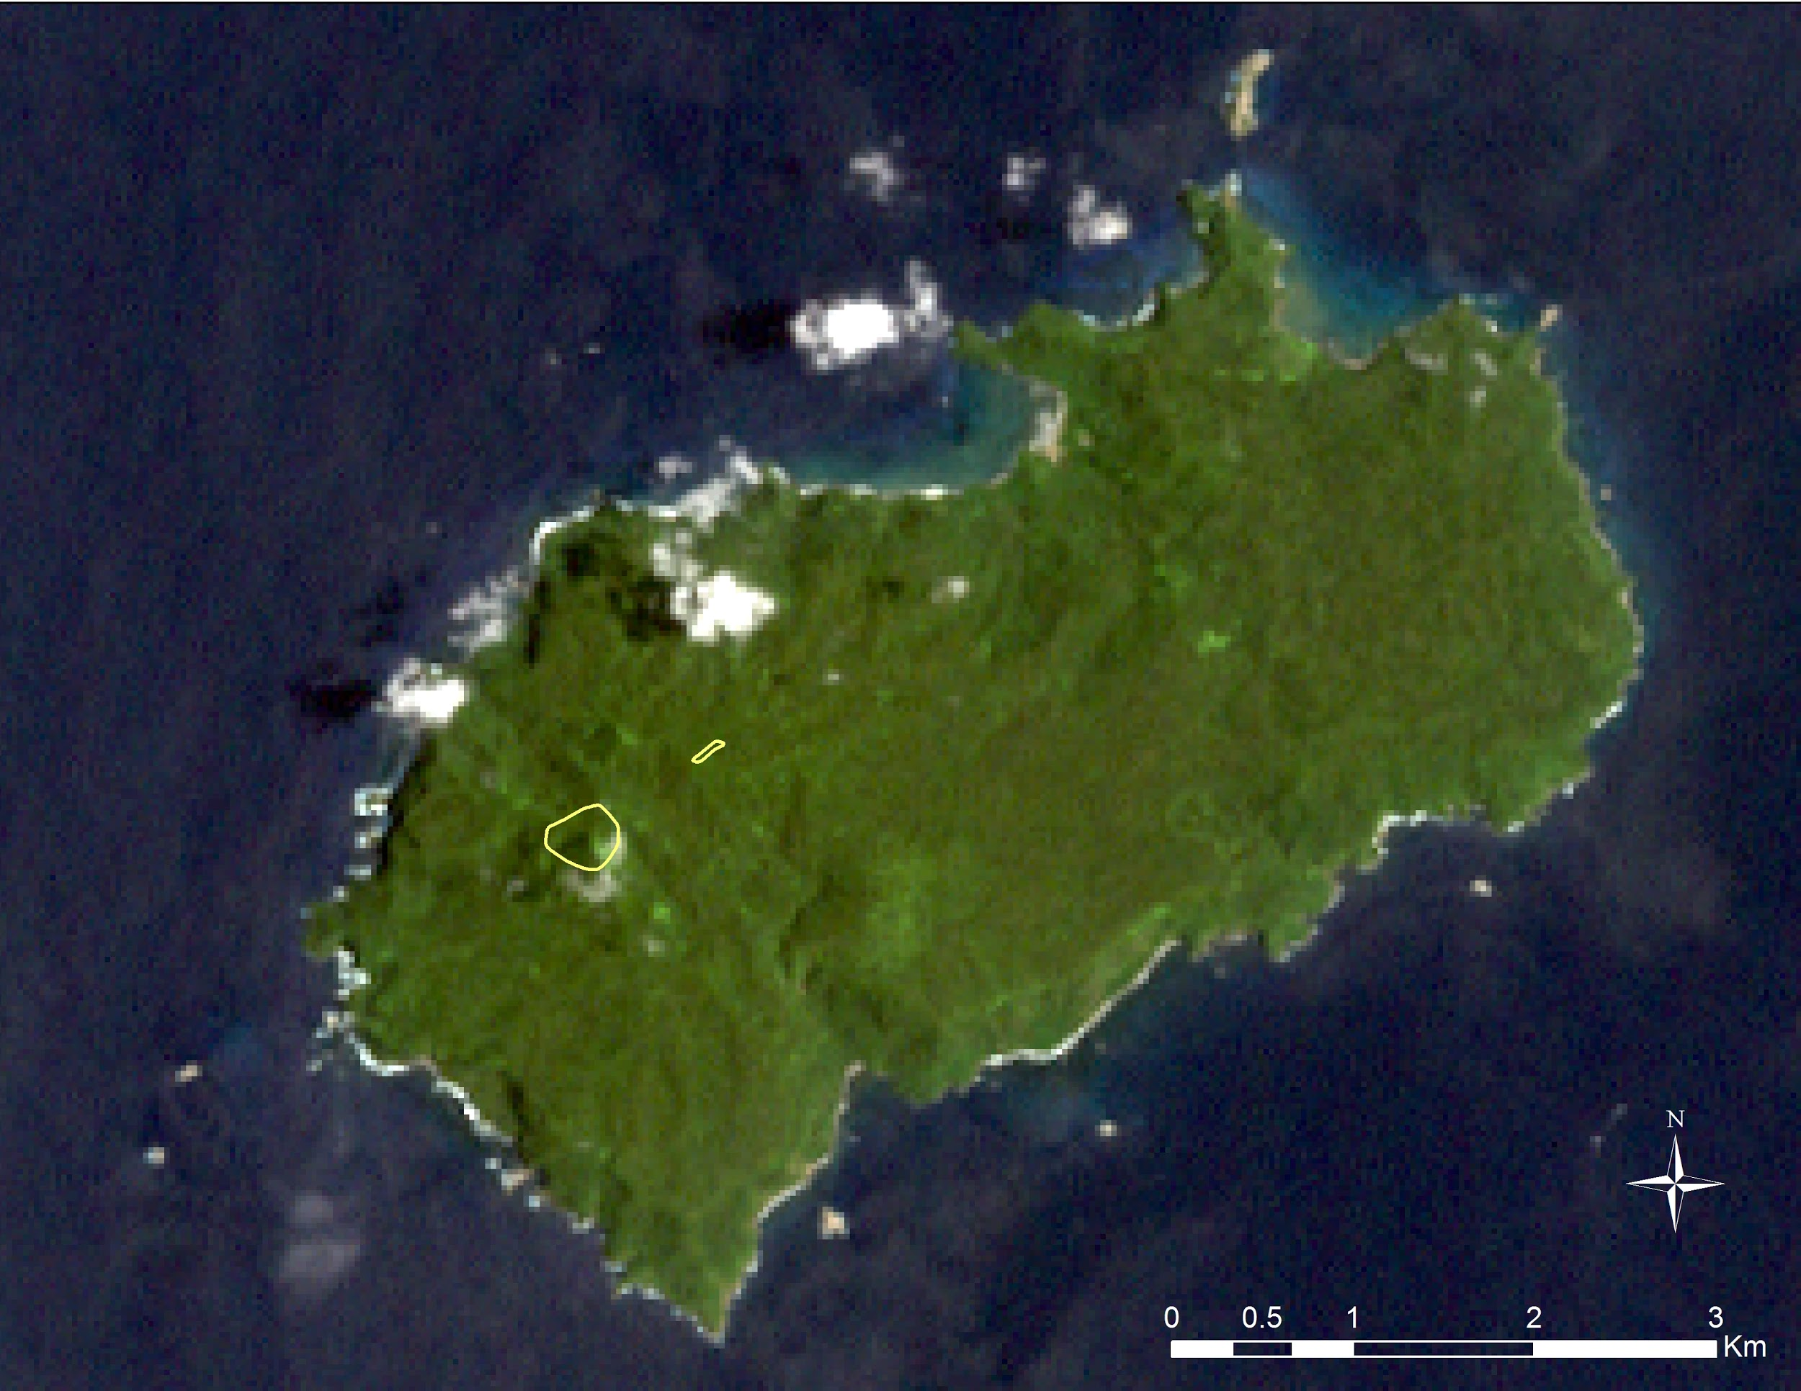
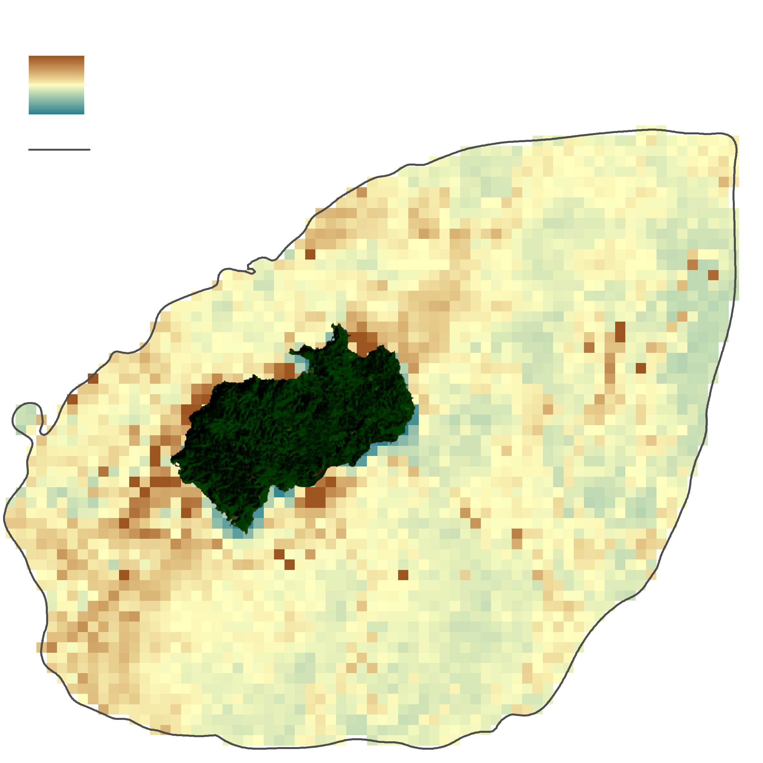
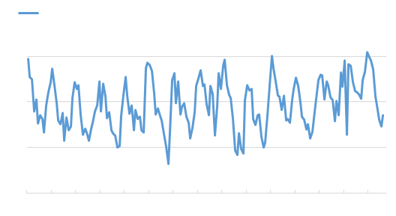
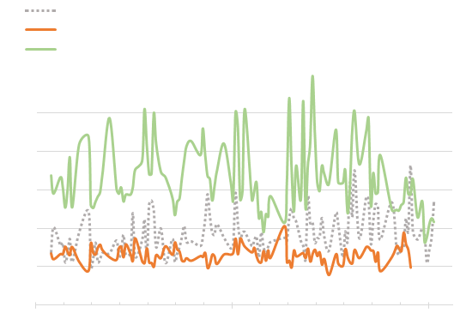
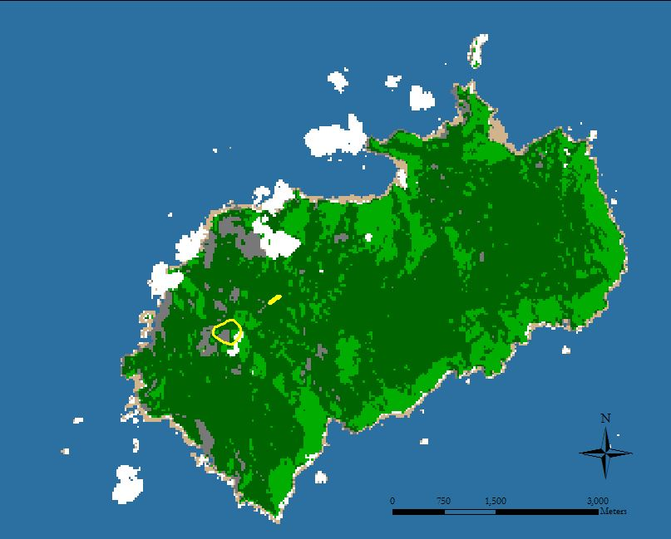
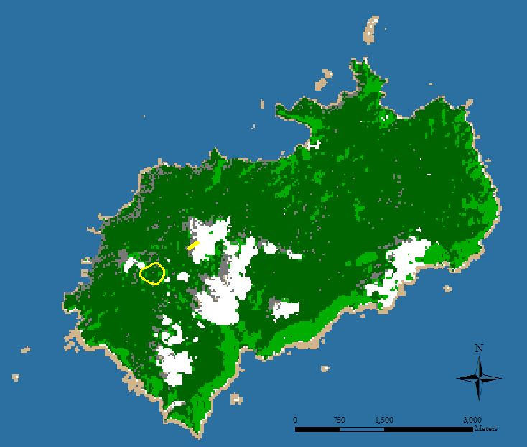
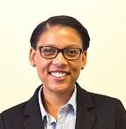
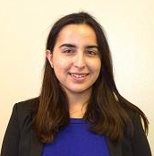
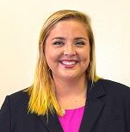
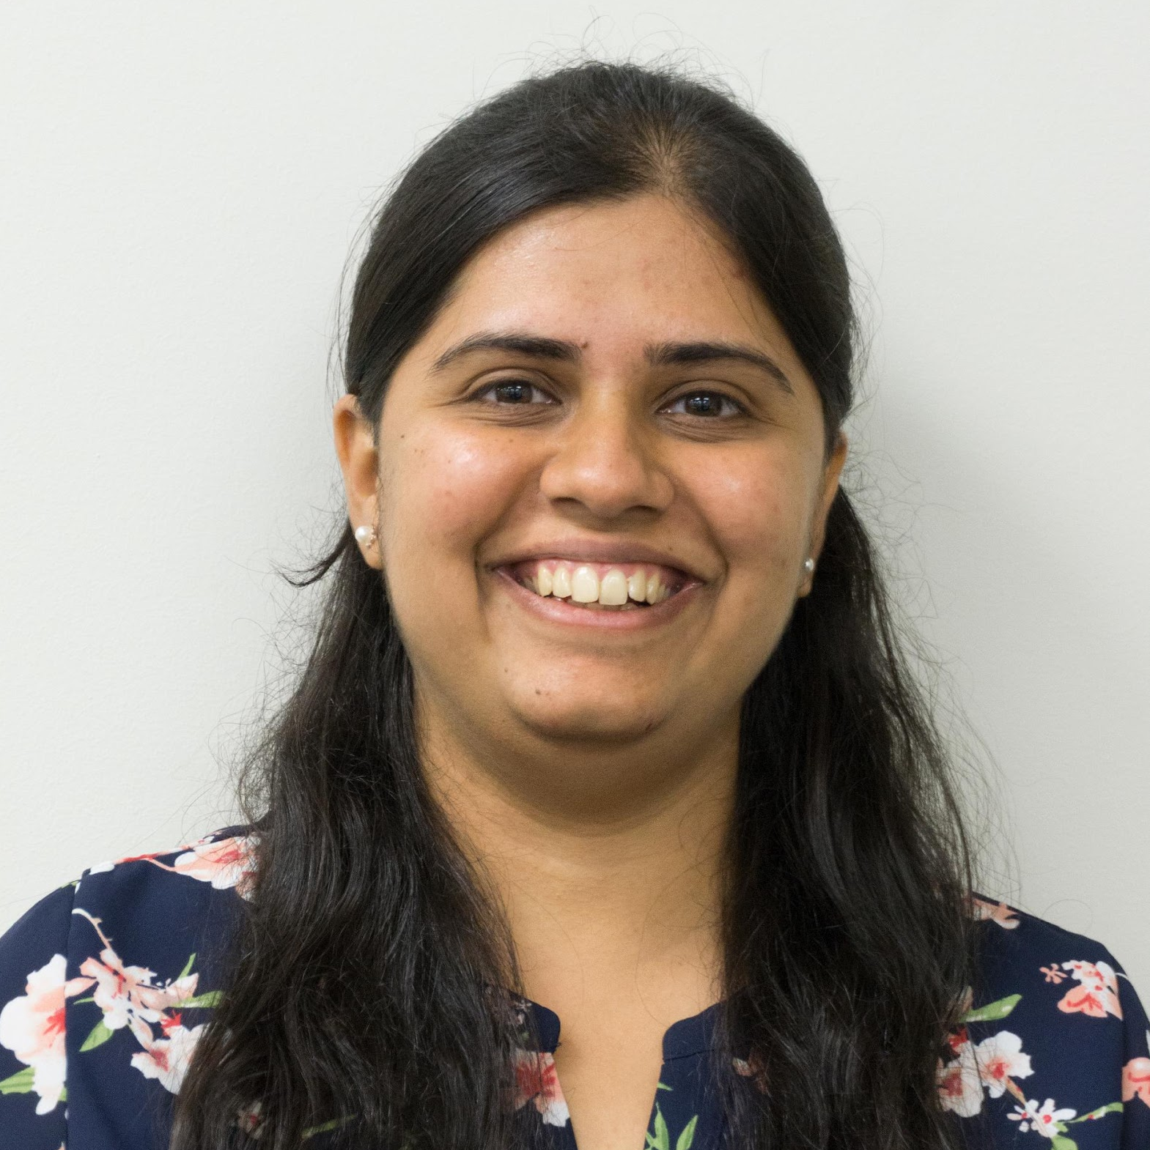
Assessing Changes in Vegetation and Marine Environments at the Isla del Coco Marine Reserve with Satellite Imagery
Abstract
Objectives
The Isla del Coco Marine Reserve resides on the coast of Costa Rica and is undergoing a variety of environmental change, including rising sea surface temperature (SST), coral reef bleaching, coastal erosion, and cloud forest change. Such challenges can not only threaten the well-being of vegetation and marine ecosystems, but also the national park’s infrastructure. In response, this project was conducted to provide a better understanding of various environmental threats by using remote sensing time series to assess changes in the island’s vegetation and biophysical parameters in the surrounding ocean, including SST, total suspended sediments (TSS), remote sensing reflectance (Rrs(λ)), and inherent optical properties (IOPs). Satellite data from Landsat 7 Enhanced Thematic Mapper Plus (ETM+), Landsat 8 Operational Land Imager (OLI), Moderate Resolution Imaging Spectroradiometer (MODIS), and Medium Resolution Imaging Spectrometer (MERIS) were acquired for March 2002 to October 2016 to analyze health of vegetation types, including cloud forest. NetCDF data products of SST, Rrs(λ), IOPs were converted to raster and subset to aid trend analysis. MERIS level 2 products were used in combination with products derived from Sentinel-2 level 1 data to create a time series analysis for TSS. Results of this project are being used by Sistema Nacional de Áreas de Conservación de Costa Rica, Embassy of Costa Rica to the United States, and the Ministry of Environment and Energy-Water Directorate to help manage and protect the marine reserve.
Compile current and historic land cover maps
Analyze and create time series of vegetation health and cloud coverage
Estimate ocean water TSS
Detect changes in R_{rs}(λ) and IOPs of the deep-water area
Evaluate annual SST variations
Study Area
Isla Del Coco
Costa Rica
Methodology
Landsat 7 ETM+ & Landsat 8 OLI
Aqua & Terra MODIS
Envisat MERIS & Sentinel-2 MSI
POES AVHRR
4 km
Land Cover Classification
NDVI Time Series, Cloud Detection Time Series
Biophysical Variables Time Series
Benthic Mapping & TSS Time Series
SST Variations
Earth Observations
Vegetation Health Monitoring
Coral Reef Vulnerability Assessment
Landsat 7 ETM+
Landsat 8 OLI
Envisat MERIS
Results
Costa Rica Oceans
MODIS Maximum NDVI Changes 2003 - 2016
Landsat 7 ETM+ True Color, March 2000
Aqua MODIS
Terra MODIS
Sentinel-2 MSI
NDVI Percent Change
TSS (g/m³)
Total Suspended
Sediment
Mean 2002-2012
Time Series of SST, R_{rs}(λ) and IOPs
51.0
500 m Elevation
.59
Monthly SST
NDVI
.031
°C
-94.0
1.0
200m Depth
30
0
Major TSS Contributor
28
26
24
2002
2009
2016
R_{rs}(λ) at 443nm
Absorption due to gelbstoff and detrital material at 443nm
Land Cover 2000
Land Cover 2016
Absorption due to phytoplankton at 443nm
500m Elevation
500m Elevation
R_{rs}(λ) in Sr⁻¹
Absorption in m⁻¹
Water
Water
0.025
0.025
Shadow
Shadow
0.02
0.02
Coastal Forest/Scrub
Coastal Forest/Scrub
Evergreen Forest
Evergreen Forest
0.015
0.015
Cloud
Cloud
0.01
0.01
Barren
Barren
0.005
0.005
Conclusions
0
2002
2009
2016
0
Relatively cloud free Landsat data were useful for mapping land cover and MODIS annual NDVI data showed promise for monitoring vegetation greenness change.
Time series analysis of SST, Rrs(λ), IOPs data was used for biogeochemical activity assessment.
Bahia Wafer, Chatham, and Iglesias are frequent contributors to TSS based on data ranging from 2002-2012.
Team Members
Project Partners
Dionne Blanks
Project Co-Lead
Yu Chuan Shan
Project Co-Lead
Farnaz Bayat
Samantha Darring
Área de Conservación Marina Isla del Coco (ACMIC) (Costa Rica)
The Embassy of Costa Rica to the United States
The Ministry of Environment and Energy, Water Directorate (DA-MINAE)
Acknowledgements
We thank Caren Remillard, Tyler Lynn, Sean Cameron, and Dr. Bernard Eichold for their tremendous efforts in facilitating meetings and mentorship. We thank Dr. Marguerite Madden, Dr. Deepak Mishra, Dr. Cedric Fichot, Joseph Spruce, Benjamin Page, and Steve Padgett-Vasquez for giving insightful suggestions on data processing and analysis throughout the project. We express appreciation to Esteban Herrera and Alejandra Solano Cabalceta for their partnership on this project.
Elaina Gonsoroski
Andrew Knight
Manasi Parkhi
University of Georgia & Mobile County Health Department – Summer 2017

