Slide 1
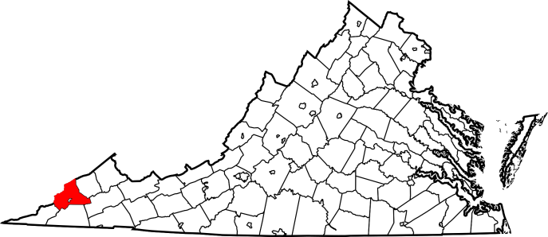
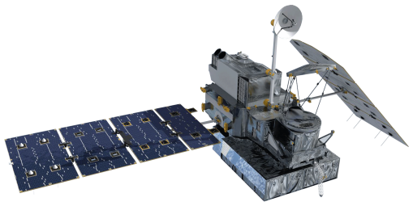
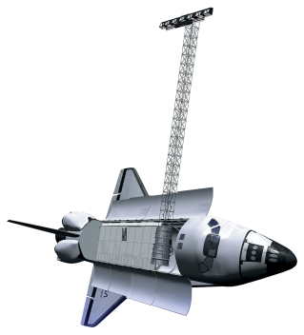
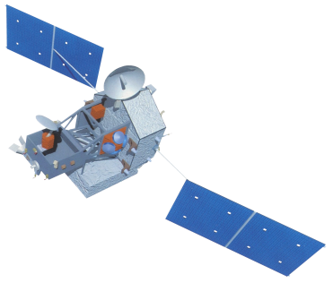
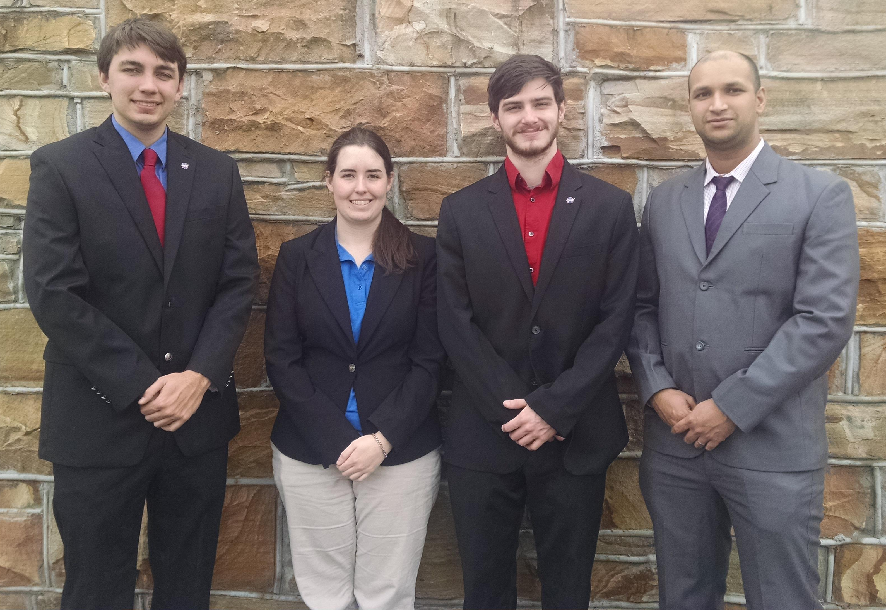
Wise County Disasters
Identifying the past and future extent of flooding throughout Wise County, Virginia.
Kimberly Berry (Project Lead^{)1,} Abhijeet Singh Baghel¹, Grant Bloomer¹, Zachary Tate¹, Dr. Kenton Ross¹, Dr. DeWayne Cecil², Bob VanGundy³
¹NASA DEVELOP National Program, ²Global Science and Technology, NOAA NCEI, ³The University of Virginia’s College at Wise
Abstract
Objectives
Keep this blank for now.
Body text point size should be at least 24.
Caption text point size should be at least 16.
Feel free to rename, move, and resize sections as needed.
Compare historical floods to our flood models
Understand what times see peak flooding conditions
Identify areas in the Wise County area susceptible to floods
Provide Wise County information needed to help prepare for future floods
Methodology
Study Area
DIGITAL ELEVATION
Rain Data
FLOW DIRECTION
Basics Folder
CREST Model
Surface Water Flow
Earth Observations
FLOW ACCUMULATION
STREAM
PETs
GPM
SRTM
Results
TRMM
Use images.
Make sure that it has some sort of flow, that it makes sense. Show your results in a logical order.
No bullets.
Conclusions
Use bullets.
Use complete sentences with periods.
Team Members
Project Partners
Acknowledgements
Wise County Board of Supervisors
Dr. Kenton Ross, Science Advisor
Dr. DeWayne Cecil, Science Advisor
Bob VanGundy, Science Advisor
Grant Bloomer, Kimberly Berry, Zachary Tate, Abhijeet Baghel

