Slide 1
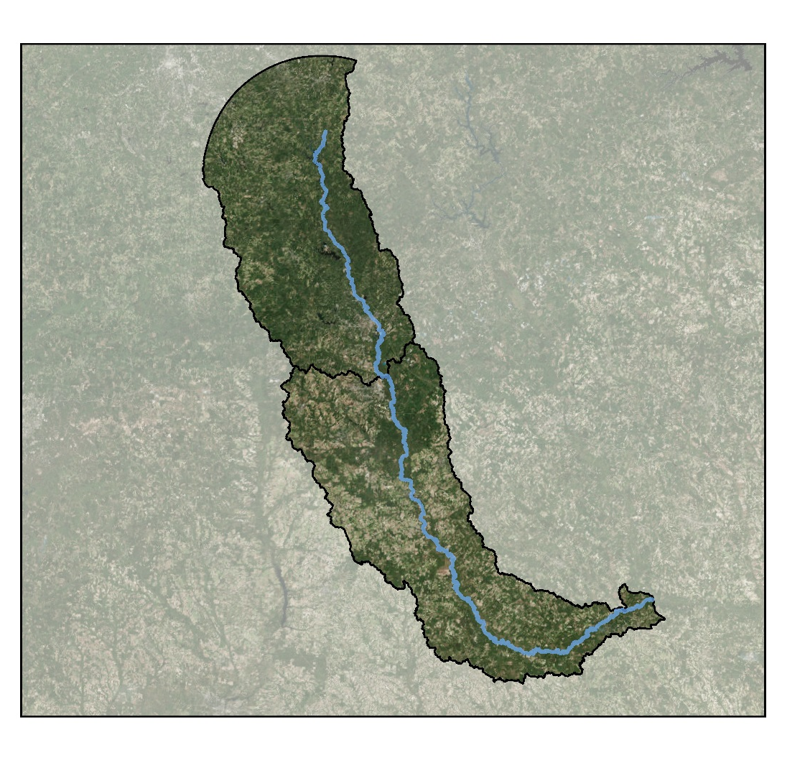
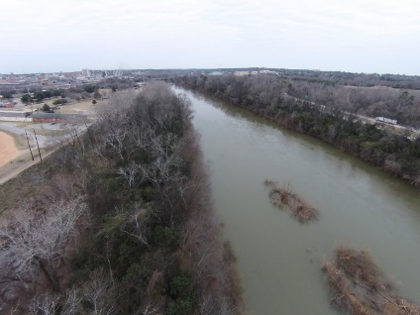
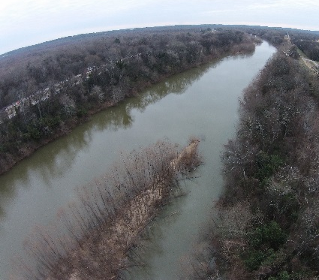
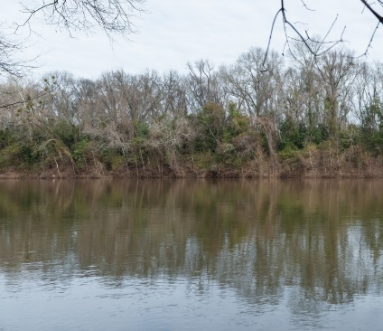
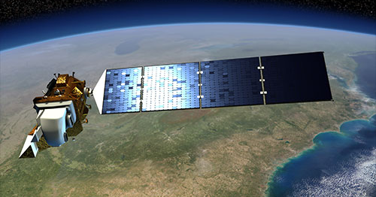
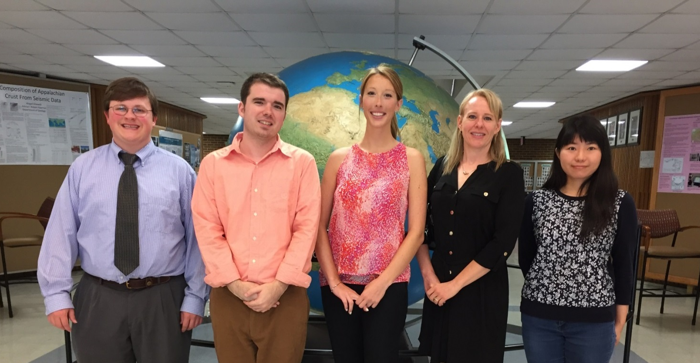
Ocmulgee Ecological Forecasting II
Utilizing NASA’s Earth Observations for Forecasting Land Use Change and Wildlife Disturbances Along the Ocmulgee River Corridor
Christopher Cameron (Project Lead), Andrew Herring, Ayn Remillard, Zhan Shi
NASA DEVELOP University of Georgia
Abstract
Objectives
Keep this blank for now.
Body text point size should be at least 24.
Caption text point size should be at least 16.
Feel free to rename, move, and resize sections as needed.
Produce a 2014 land cover dataset using Landsat 8 imagery
Quantify land cover change in the Ocmulgee River Valley
Assess historic trends in land cover from 2001 to 2014
Predict land cover changes within the Ocmulgee Corridor
Model effects of land cover change on ecological habitats
Identify priority wildlife conservation areas for state agencies
Study Area
Methodology
DATASETS
ANALYSIS
PRODUCTS
Macon, GA
Landsat 8 Imagery
2014 Land Cover Dataset
Land Cover Change Predictions
Earth Observations
Historic Land Cover
Ecological Forecasting
Land Cover Change Detection
Threat and Opportunity Assessment
Ecology and Wildlife
Results
Conclusions
Landsat 8, OLI
Use images.
Make sure that it has some sort of flow, that it makes sense. Show your results in a logical order.
No bullets.
Use bullets.
Use complete sentences with periods.
Project Partners
Team Members
Acknowledgements
The Georgia Department of Natural Resources, Wildlife Resources Division (GA DNR)
The University of Georgia, Center for Geospatial Research (UGA-CGR)
Science Advisors:
Dr. Thomas Jordan (UGA-CGR)
Dr. Marguerite Madden (UGA-CGR)
Project Partners:
Thomas Litts (GA DNR)
Melanie Riley (GA DNR)
Past Contributors:
Peter Hawman (DEVELOP)
Gail Miller (DEVELOP)
Steve Padgett-Vasquez (DEVELOP)
Caren Remillard (DEVELOP)
Simmone Simpson (DEVELOP)
Left to right: Andrew Herring, Christopher Cameron, Ayn Remillard, Melanie Riley (GA DNR), and Zhan Shi
University of Georgia

