Slide 1
U.S.
DISASTERS II
Using GRACE-Derived Water and Moisture Products as a Predictive Tool for Wildfire Response in the Contiguous United States
Brittany Zajic (Project Lead)
Daniel Jensen
Nick Rousseau

Slide 2
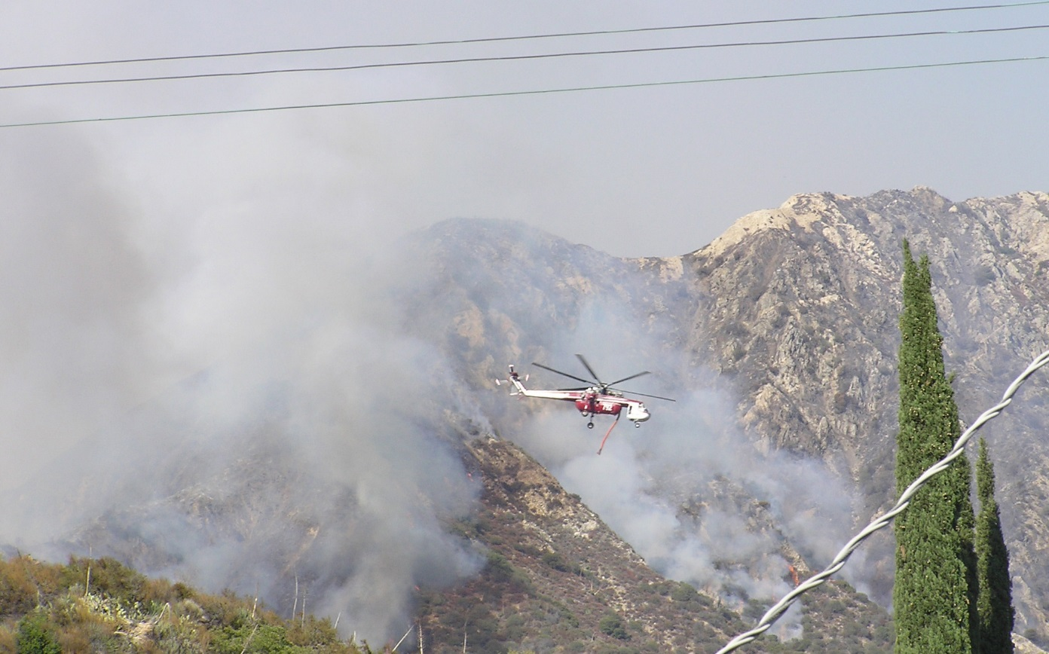
Introduction
Wildfires in the contiguous United States have become more frequent in the last several decades
Recent drought conditions have escalated wildfires causing:
Economic Loss
Environmental
Degradation
Property Damage
Source: Nick Rousseau
Notes:
Wildfires across the contiguous United States have increasingly become larger and more frequent in the last several decades. In turn, this has caused an increase in fire suppression costs, a higher rate of natural resource degradation and an increase in property damage in the form of structures burned.
Trends contributing to both an increase in the number of wildfires as well as large fire area correlate with a decrease in terrestrial water supply (Dennison et al. 2014).
Image: 2009 Station Fire located near Big Tujunga Canyon, California (Source: Nick Rousseau)

Slide 3
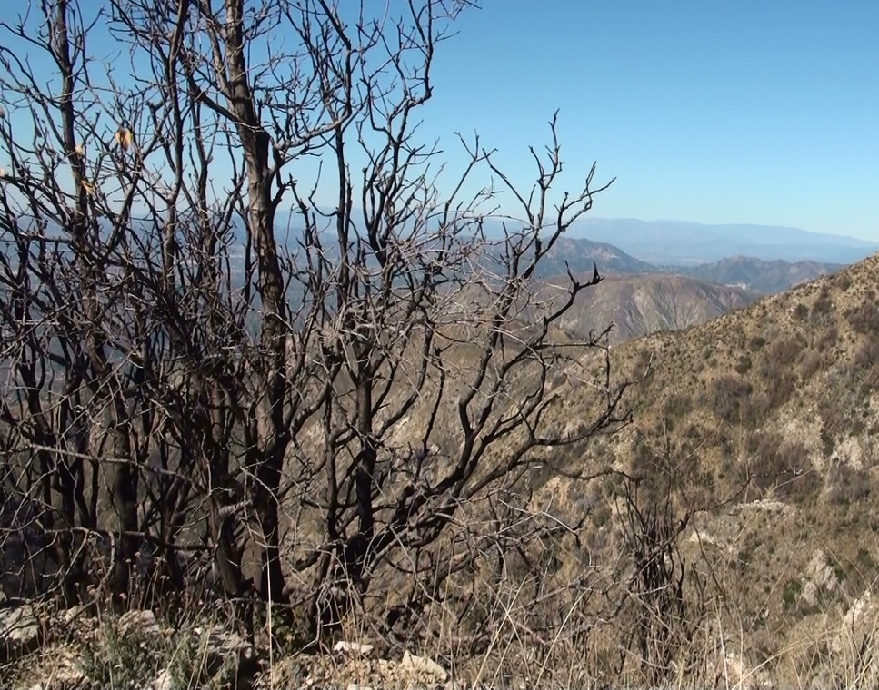
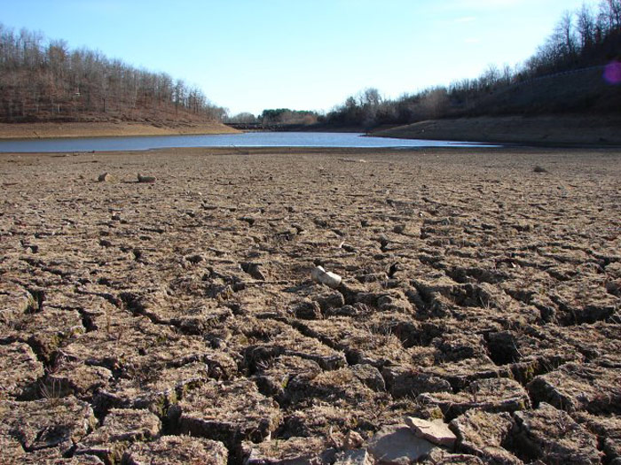
Introduction
Rising wildfire trends can be correlated with the increase of drought
Understanding the relationship between wildfire activity and soil moisture in the U.S. has faced limited ability
Source: Nick Rousseau
Source: NOAA
Notes:
Fire season in the western United States has historically occurred from the months of June through October which also is the driest time of the year in the western U.S., but over the past decade fire season has increasingly lengthened due to the drought.
2003-2012: 71.7 million acres burned, 2006 record for most acres burned at 9.8 million acres (National Interagency Fire Center.)
If we can understand how regional climate conditions effect terrestrial water supply we can better understand and possibly predict potential wildfires.
Higher precipitation rates during the wet season generally lead to higher rates of vegetation growth or “fire fuel”, which can lead to greater potential for fire in the dry season.
Image 1: Post wildfire burn areas near Mt. Lukens, San Gabriel Mountains, California (Source: Nick Rousseau)
Image 2: River basin in the Western United States (source: http://www.noaa.gov/features/monitoring_0209/watersupply.html)

Slide 4
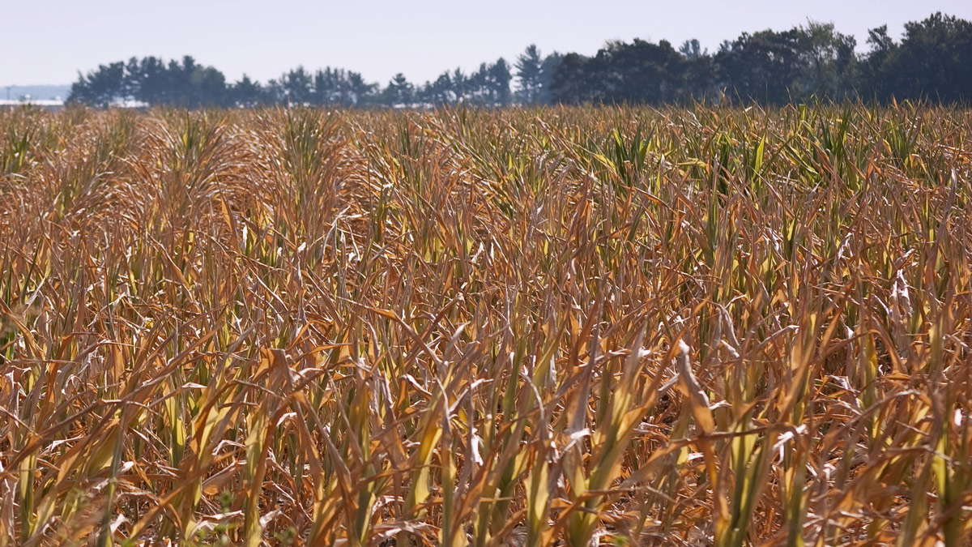
Introduction
A major contributing factor to wildfires is fuel moisture content (FMC)
Low FMC means higher fire risk as wells as a potentially higher fire severity
No accurate remotely-sensed FMC product available
Source: Wikimedia Commons
Notes:
Fuel moisture content (FMC) is a measure of the amount of water in a fuel (vegetation) available to a fire.
The moisture content and distribution of fuels determine how quickly a fire can spread and how intense or hot a fire may become. The burning speeds in vegetation with a higher FMC will be slower than vegetation with a lower FMC because the heat from the fire must first eliminate the moisture within that higher FMC vegetation type.
Low FMC means higher fire risk as well as higher potential fire severity, thus increasing the degree of environmental degradation caused by a fire.
There is currently no accurate remotely-sensed fuel moisture content product in use. A remotely-sensed FMC proxy, combined with an analysis of yearly wet and dry patterns, could provide fire managers and responders with a powerful predictive tool for understanding fire risk and response.
Image: http://www.jpl.nasa.gov/news/news.php?release=2014-376

Slide 5
Objectives
Develop a methodology and toolset for forecasting wildfire activity based on GRACE assimilated data in Python
Correlate GRACE assimilated data with wildfire data in the contiguous United States
Create a predictive algorithm that forecasts areas of potential high fire activity risk

Slide 6
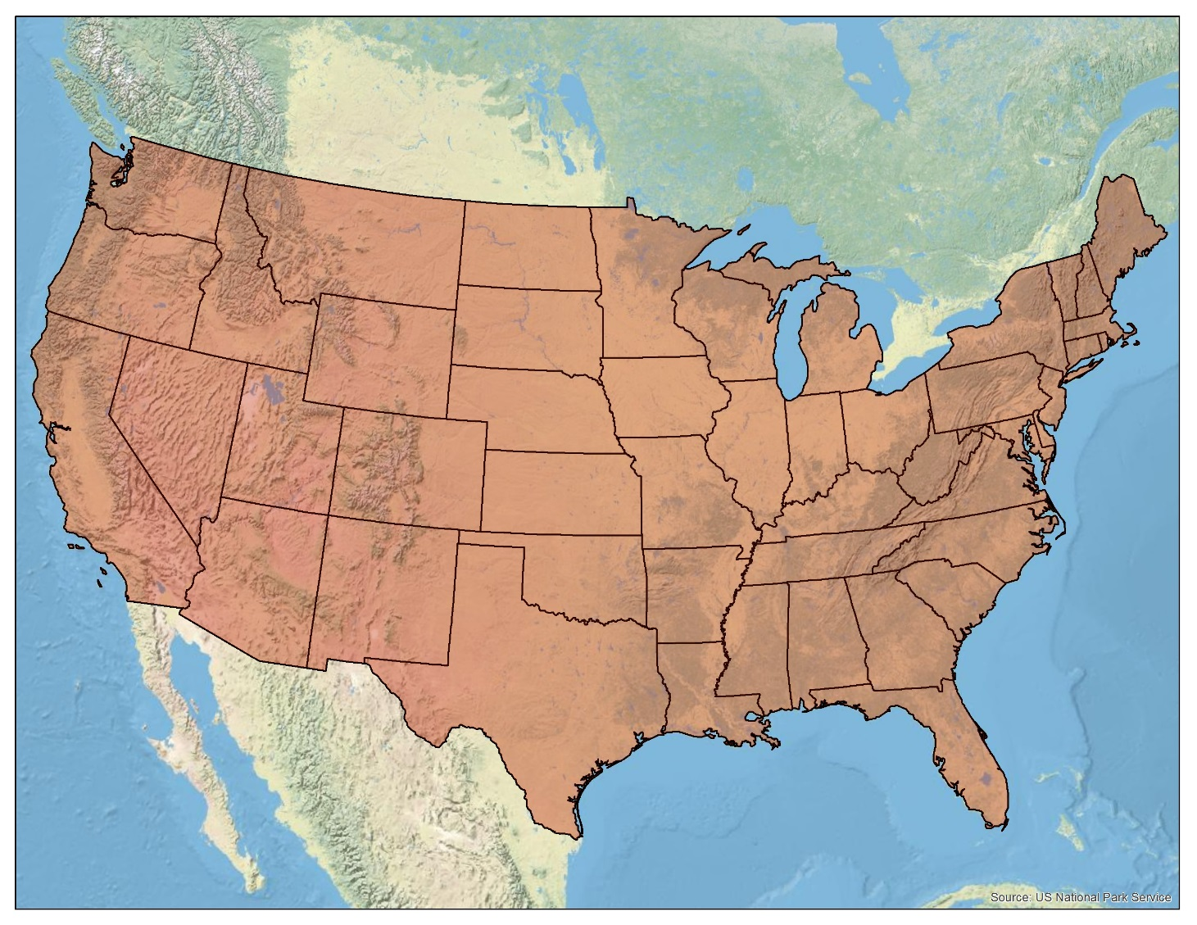
Study Area and Period
Location: Contiguous United States
Study Period: January 2003 to December 2013
Notes:
Our focus is on the contiguous United States, mainly areas that are most affected by wildfires using data from a ten-year period: January 2003 to December 2012. This period was used to determine the extent to which dry years following wet years correlate with fire severity. Trends contributing to both an increase in the number of wildfires as well as large fire area correlate with decreased soil moisture (Dennison et al. 2014).

Slide 7
Study Area and Period
Study Period: January 2003 to December 2013
Location: Contiguous United States
Credit: National Park Service
Notes:
Our focus is on the contiguous United States, mainly areas that are most affected by wildfires using data from a ten-year period: January 2003 to December 2012. This period was used to determine the extent to which dry years following wet years correlate with fire severity. Trends contributing to both an increase in the number of wildfires as well as large fire area correlate with decreased soil moisture (Dennison et al. 2014).

Slide 8
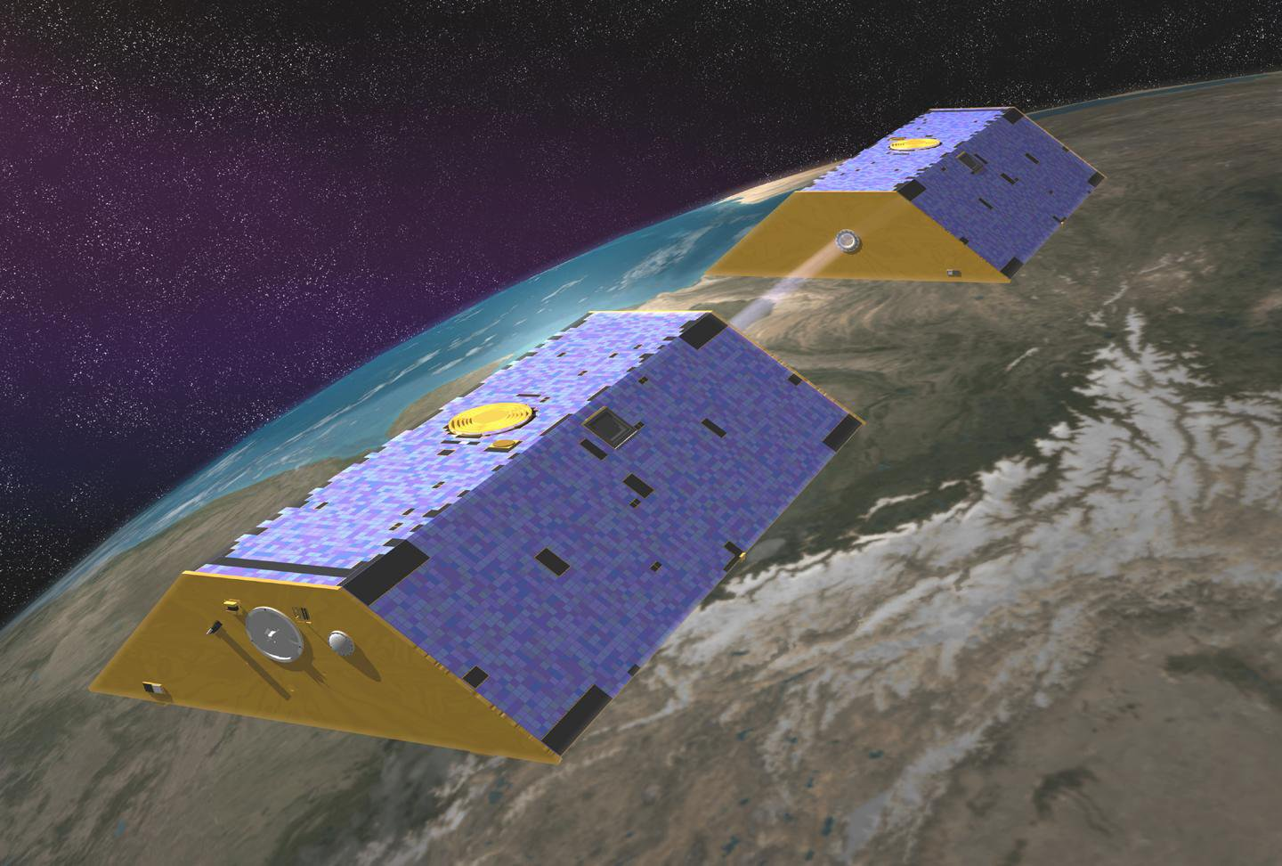
Gravity Recovery and Climate Experiment (GRACE)
Source: NASA/JPL-Cal Tech
Notes:
NASA’s Gravity Recovery and Climate Experiment (GRACE) is made up of a pair of Earth-observing satellites that measure Earth’s gravity field. From that we can measure how Earth’s gravity field changes over time. If we can look at something in monthly scale, we can look at how much the gravity field has diverted from the mean gravity field. The only thing that moves around that time scale is water. At the time scales we are looking at with GRACE is how Earth’s terrestrial water storage changes over time and derive assimilated data that depicts water stored at all levels. This enables reliable detection of spatial and temporal variations in total terrestrial water storage (TWS) (Houberg et al. 2010, Houberg et al. 2012).
Image source: http://www.nasa.gov/topics/earth/features/Grace_OBP.html

Slide 9
Project Methodology
GRACE Assimilated Data
(Surface Soil Moisture)
Correlation
(Python - NumPy)
Fire Program Analysis Fire-Occurrence Database
(Wildfire data)
Multivariate Regression
(Python - SciPy)
Predictive Algorithm
NLCD Land Cover Types
Land Cover Analysis
FPA FOD Wildfire data

Slide 10
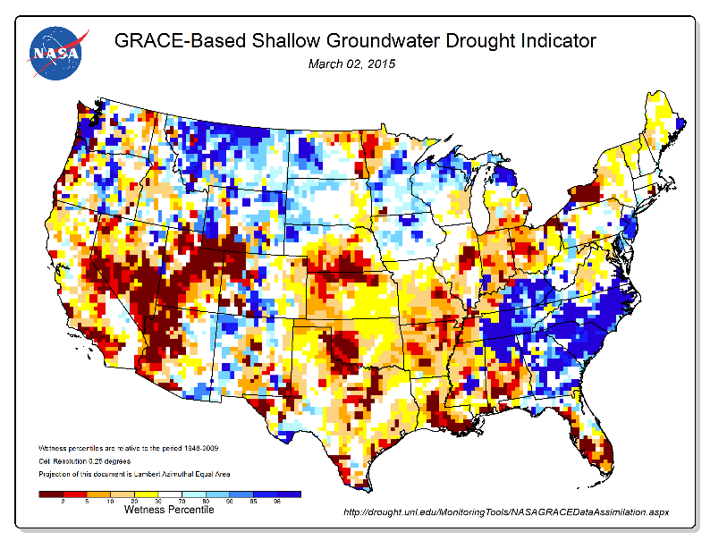
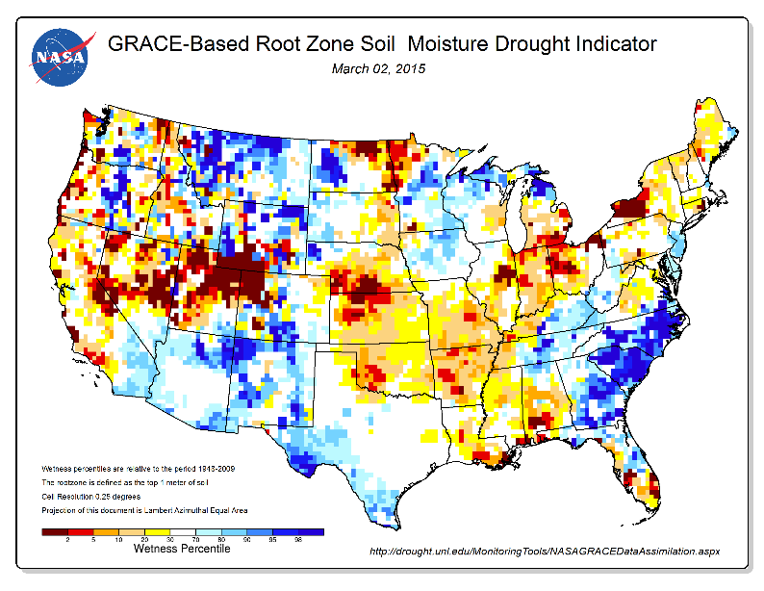
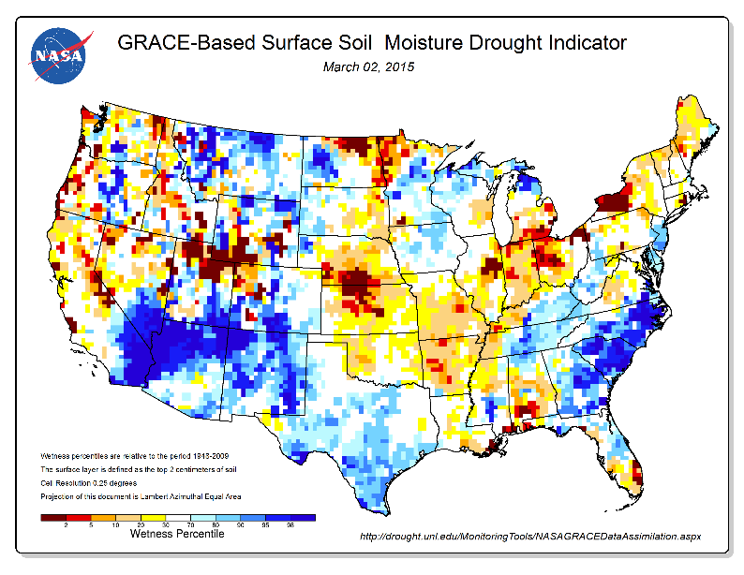
GRACE Assimilated Data
Terrestrial Water Storage (TWS)
GRACE assimilated data measures terrestrial water storage (TWS), root zone moisture content (RZMC), and surface soil moisture content (SFMC)
Root Zone Soil Moisture Content (RZMC)
Surface Soil Moisture Content (SFMC)
Source: National Drought Mitigation Center
Notes:
These maps represent GRACE assimilated data used as drought indicators for terrestrial water storage (TWS) root zone soil moisture content (RZMC), and surface soil moisture content (SFMC). They depict drought associated with climatic variability, as opposed to depletion of aquifers due to groundwater withdrawals that exceed recharge. Estimates of terrestrial water storage in the contiguous U.S. are crucial for predicting climate change, weather, and natural hazards, especially wildfires (Tapley et al. 2004). Because biomass is largely built up during wet years and fire risk is greatest during dry years, dry years that are preceded by wet years are of great importance for fire risk assessment.
Image source: http://drought.unl.edu/MonitoringTools/NASAGRACEDataAssimilation.aspx

Slide 11
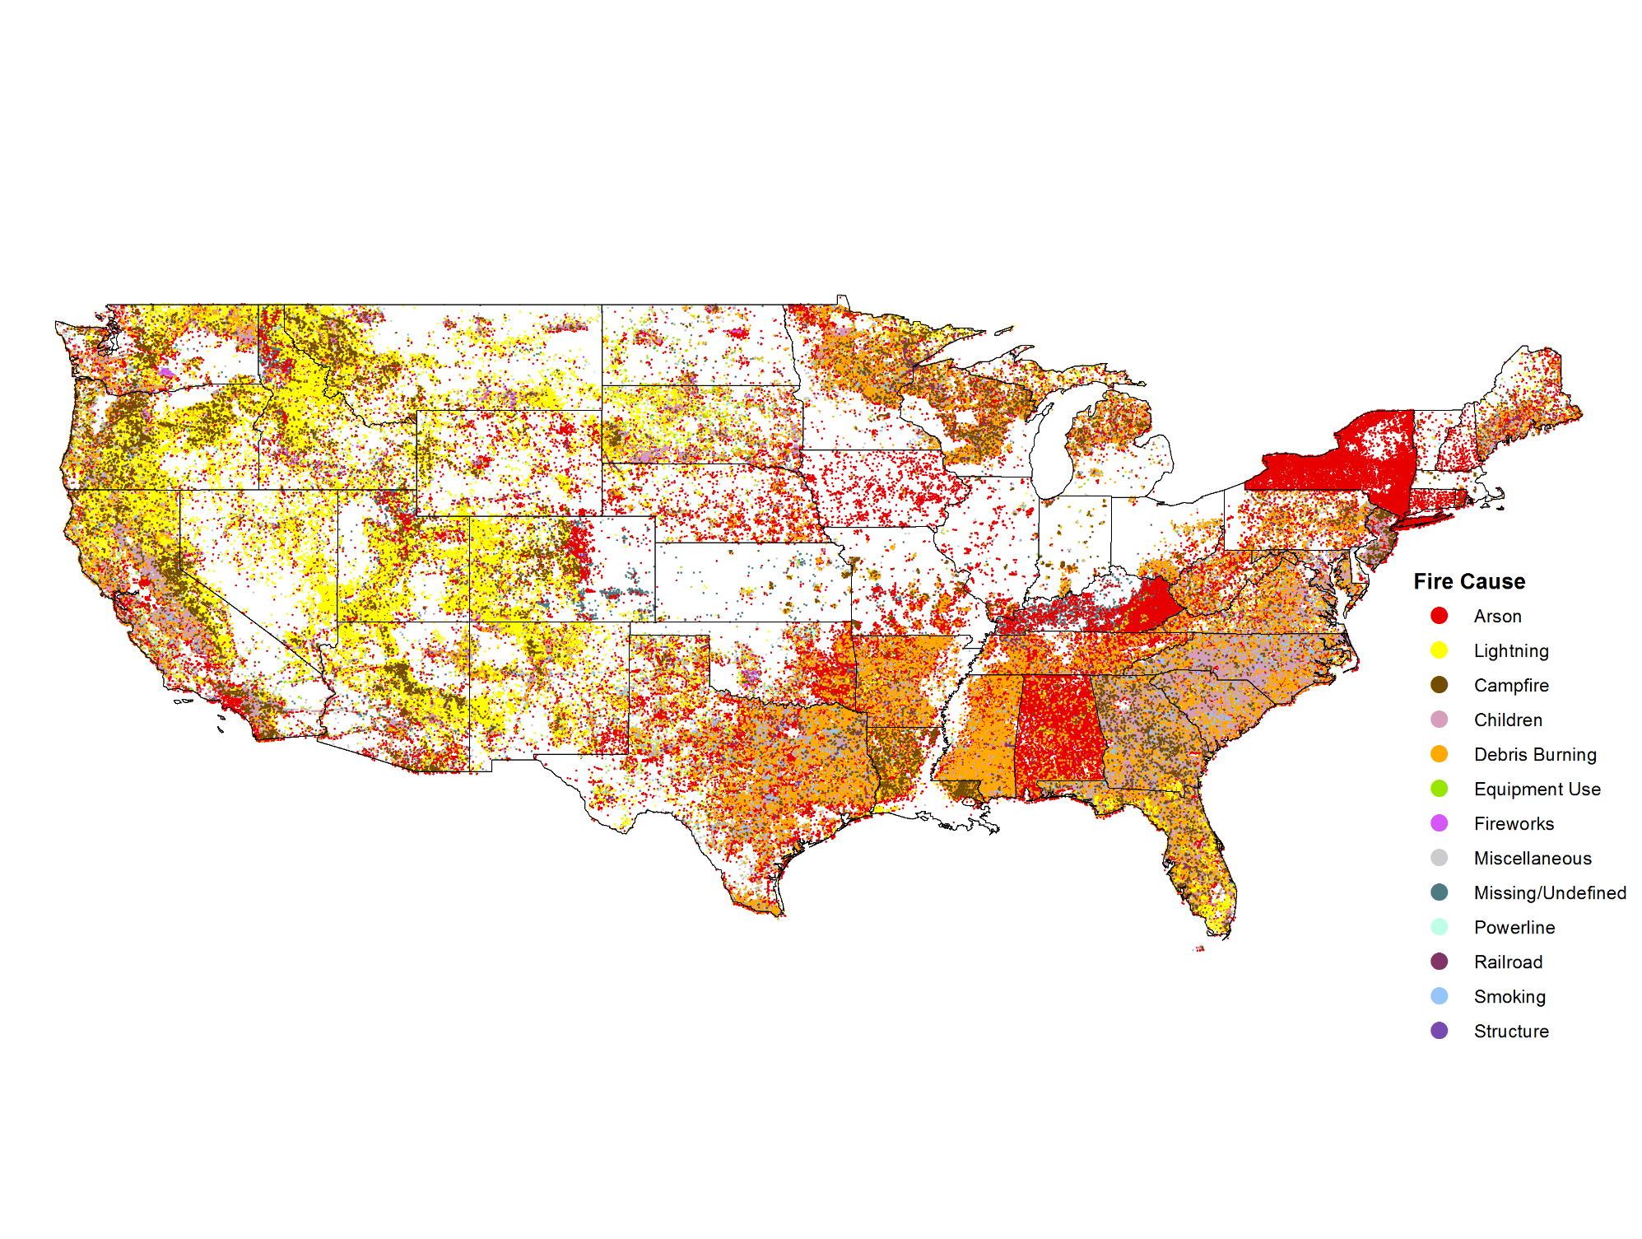
Fire Program Analysis Fire-Occurrence Database (FPA FOD)
Notes:
This data product contains a spatial database of wildfires that occurred in the United States from 1992 to 2013, generated for the national Fire Program Analysis (FPA) system. The wildfire records were acquired from the reporting systems of federal, state, and local fire organizations. The following core data elements were required for records to be included in this data product: discovery date, final fire size, and a point location at least as precise as Public Land Survey System (PLSS) section (1-square mile grid). The data were transformed to conform, when possible, to the data standards of the National Wildfire Coordinating Group (NWCG). Basic error-checking was performed and redundant records were identified and removed, to the degree possible. The resulting product, referred to as the Fire Program Analysis fire-occurrence database (FPA FOD), includes 1.73 million geo-referenced wildfire records, representing a total of 126 million acres burned during the 22-year period.
http://www.fs.usda.gov/rds/archive/Product/RDS-2013-0009.3/
Short, Karen C. 2015. Spatial wildfire occurrence data for the United States, 1992-2013 [FPA_FOD_20150323]. 3rd Edition. Fort Collins, CO: Forest Service Research Data Archive. http://dx.doi.org/10.2737/RDS-2013-0009.3

Slide 12
Results

Slide 13
Discussion

Slide 14
Conclusions

Slide 15
Partners
Dr. Matt Rodell, NASA Terrestrial Hydrology Program at Goddard Space Flight Center
Mark Finney, Chuck McHugh, and Everett Hinkley, USDA Forest Service
Advisor
Dr. John T Reager, NASA Jet Propulsion Laboratory
Past Contributors
Max Baldridge, NASA DEVELOP
Notes:
Image Source: http://commons.wikimedia.org/wiki/File:Claude_Monet_-_The_Magpie_-_Google_Art_Project.jpg

Slide 16
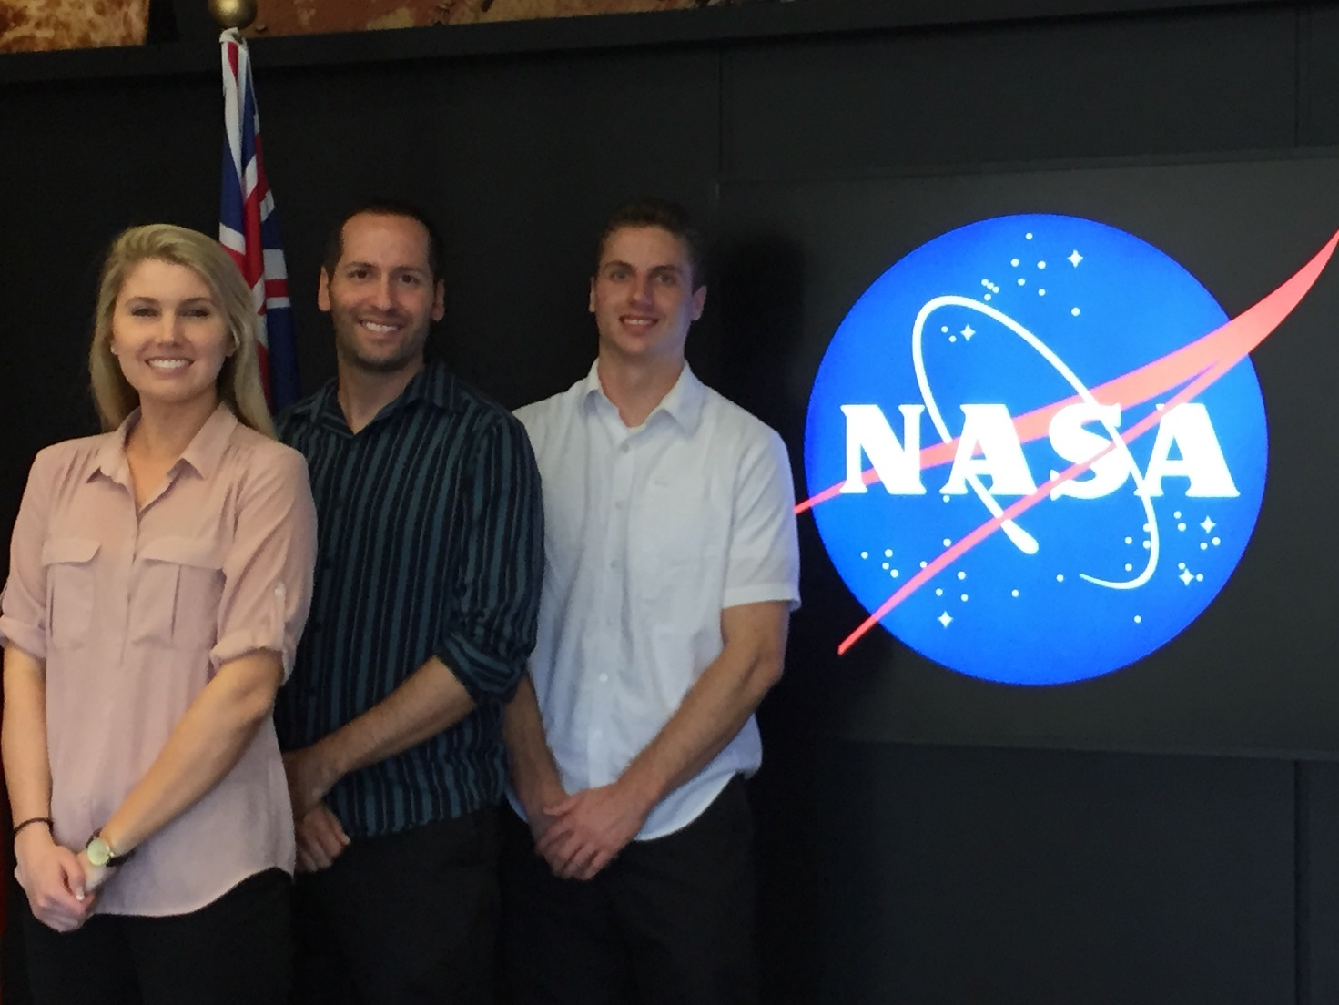
Questions?
Brittany Zajic, Nick Rousseau, Daniel Jensen
U.S. Disasters II Team, Summer 2015

Slide 17
General Guidelines I
Things that are typically included in a presentation:
The slides provided in the template are just a starting point for teams. Feel free to expand upon these topics, alter the headings, and change the order of the slides to fit your needs.
Study area
Study period
Objectives
Community concerns
NASA satellites/sensors used
Methodology
Results
Conclusions
Errors & uncertainties
Future work
Acknowledgements
Backup slides
Required Statement

Slide 18
General Guidelines II
Header text point size should be between 40 and 60 on most slides.
Body text point size should be at least 20.
Use Century Gothic.
Keep text to a minimum.
Try to use a consistent font size between slides.
Image Credit: Monet
Notes:
Image Source: http://commons.wikimedia.org/wiki/File:Claude_Monet_-_The_Magpie_-_Google_Art_Project.jpg

Slide 19
Image Credit: Monet
General Guidelines III
Include speaker notes for each slide (see below).
Include a visual on each slide, if possible.
Arrange content to minimize white space.
Notes:
These notes should be thorough enough for someone not familiar with the project to clearly present the material.
Image Source: http://commons.wikimedia.org/wiki/File:Claude_Monet_-_The_Magpie_-_Google_Art_Project.jpg

Slide 20
Maps & Logos
Maps
Import the legend separately.
Make sure all text is legible and editable.
Cite base layer source in speaker notes.
Logos
US Federal logos only.
No state, NGO, local and or international government logos, or software logos.

Slide 21
Photos & Figures I
You may only use images taken by your team, provided by your partners (as long as you have permission from them), from a Federal Agency, from the new DEVELOP stock imagery collection on DEVELOP’s Flickr page, or Creative Commons images.
Obtain a media release form from all people in photos that your team has taken — no children!
All image sources should be cited using a consistent format and should be visible on the slide.

Slide 22
Photos & Figures II
Please do not include the image URL in the source text box but rather place it in the notes section below.
If you use a border for your images include it on all photographs to keep your presentation consistent.
Keep all images and text boxes editable, including individual elements of flowcharts.
Background images are discouraged. If you use one, make sure that your text remains clear and legible.

Slide 23
Acknowledgements
List advisors, partners, and others who have contributed in any way to the project.
If your project is a multi-term one, acknowledge past contributors.
Choose one of the two following slides as an acknowledgements page. Feel free to modify them as needed to fit your content.
Image Credit: Monet
Notes:
Image Source: http://commons.wikimedia.org/wiki/File:Claude_Monet_-_The_Magpie_-_Google_Art_Project.jpg

