Slide 1
Southeast US Climate II
Leveraging Earth Observations to Estimate Carbon Dioxide Emissions from Forest Cover Loss in Alabama and Tennessee
Cassie Ferrante • James Karroum • Cate Lull • Katherine Scott
Alabama – Marshall| Spring 2023
Notes:
Speaker Notes:
Hello, thank you for joining us today. We are the Southeast US Climate II Team from the Marshall Space Flight Center node. We will be presenting our work "Leveraging Earth Observations to Estimate Carbon Emission Trends Caused by Deforestation in Alabama and Tennessee".
Our team members are: Cassie Ferrante, James Karroum, Katherine Scott, Cate Lull.
Short title font size: 32pt Long title font size: 22pt Team names font size: 20pt

Slide 2
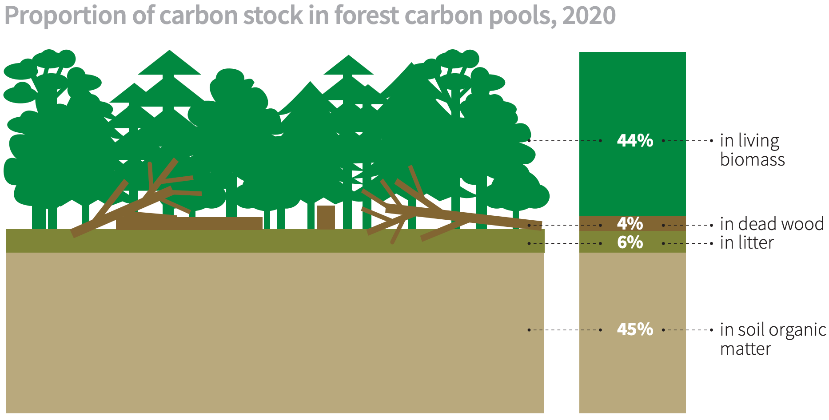
Background
Balancing carbon sources and sinks is vital for climate change mitigation
Forests are the largest carbon sink in the US (15 of 2021 CO₂ emissions%)
US reports annual CO₂ emissions to United Nations Framework Convention on Climate Change
44%
44%
In living biomass
4%
4%
In deadwood litter
6%
6%
45%
In soil organic matter
45%
Image Credit: Food and Agriculture Organizations of the United Nations, Global Forest Resources Assessment 2020
Notes:
Speaker Notes:
Previous research has shown that not only are atmospheric carbon dioxide levels rising, but also that this change is causing temperatures across the globe to increase in a phenomenon that we now call climate change. In order to prevent temperatures from continue to rise we need to rebalance carbon sinks, which take in carbon dioxide from the atmosphere, and carbon sources, which release carbon dioxide to the atmosphere. In the united states, forests are the largest carbon sink and responsible for absorbing more than 14% of the country's carbon dioxide emissions. As trees grow they pull carbon dioxide out of the atmosphere and store it in their crown, trunk, and roots- collectively known as their biomass. After a tree dies that carbon is released back to the atmosphere through dead wood, leaf litter, and the process of decomposition or combustion. When forest land is converted and cleared for other uses this natural carbon cycle is disrupted. Increasing forest cover and forest land that continues to mature are known to pull large amounts of carbon from the atmosphere while deforestation that occurs without a plan for forest regrowth can be a large sources of carbon emissions. So, gross carbon dioxide emissions can be offset by forest grown and newly forested lands. It is important to accurately track changes in forest land and subsequent carbon emissions for reporting purposes, such as annual carbon dioxide reports to the United Nations Framework Convention on Climate Change.
------------------ Image Information ------------------
•Image Credit: Food and Agriculture Organizations of the United Nations, Global Forest Resources Assessment
•Image Source: https://www.fao.org/3/ca8753en/ca8753en.pdf | Creative Commons Attribution-NonCommercial-ShareAlike 3.0 IGO (CC BY-NC-SA 3.0 IGO)

Slide 3
Framework
SERVIR-Carbon Pilot Program (S-CAP)
Southeast US Climate I
NASA, U.S. Agency for International Development, and other geospatial organizations
Uses remote sensing to report carbon emissions from deforestation in SERVIR focus countries
Adapted S-CAP to Talladega National Forest
Notes:
Speaker Notes:
This project was inspired by NASA SERVIR. NASA SERVIR is a partnership between NASA, the United States Agency for International Development, and other geospatial organizations across the globe. The SERVIR-CArbon Pilot Program (S-CAP) uses remote sensing to monitor carbon emissions from deforestation in SERVIR focus conuntries. S-CAP uses an ensemble method approach, using global land cover datasets and regional aboveground biomass data to estimate carbon emissions. The first term of this project, called Southeast US Climate I, adapted SERVIR’s methodology to the Talladega National Forest in Alabama.
------------------------------Image Information Below ------------------------------
Image Credit: SERVIR
Image source: https://www.nasa.gov/sites/default/files/styles/full_width_feature/public/thumbnails/image/servir_mission_page_logosp2.jpg (public domain)

Slide 4
Adapted S-CAP tool for US use
Expanded study area to all of Alabama and Tennessee
Tested tool in Talladega National Forest
Analyzed forest change to estimate CO₂ emissions
Validated land forest cover and loss using Collect Earth Online
Two-Term Project
Fall 2022
Spring 2023
Notes:
Speaker Notes:
This is a second term project, which means we were expanding upon the work of a previous team. In the fall of 2022, the previous team conducted a tech and innovation project, where they adapted NASA SERVIR's S-CAP tool for domestic use and tested that tool in the Talladega National Forest. They were able to analyze forest cover change to estimate carbon emissions produced in their study area.
We will be expanding upon their work by broadening the study area to include all of Alabama and Tennessee. Additionally, we will be validating the land cover change using Collect Earth Online.

Slide 5
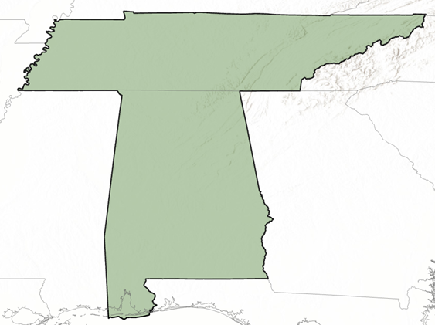
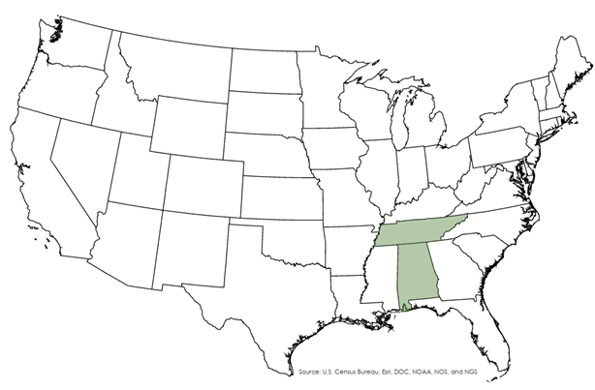
Study Area & Period
May 1st, 2016
to
Sept. 29th, 2022
Tennessee
Alabama
N
0
50
100
200 Miles
Notes:
Speaker Notes:
Last term's study area focused on the Talladega National Forest in Alabama. We expanded that study area to incorporate the entire states of Alabama and Tennessee, as pictured here. Our study period was from 2016 – 2022 because those years provide the greatest overlap between all of our land cover and biomass data sets.
------------------ Image Information ------------------
•Map Credit: Cate Lull

Slide 6
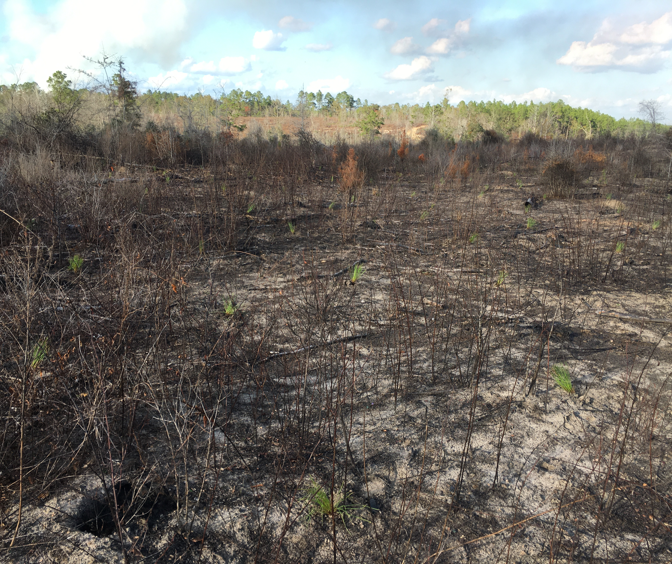
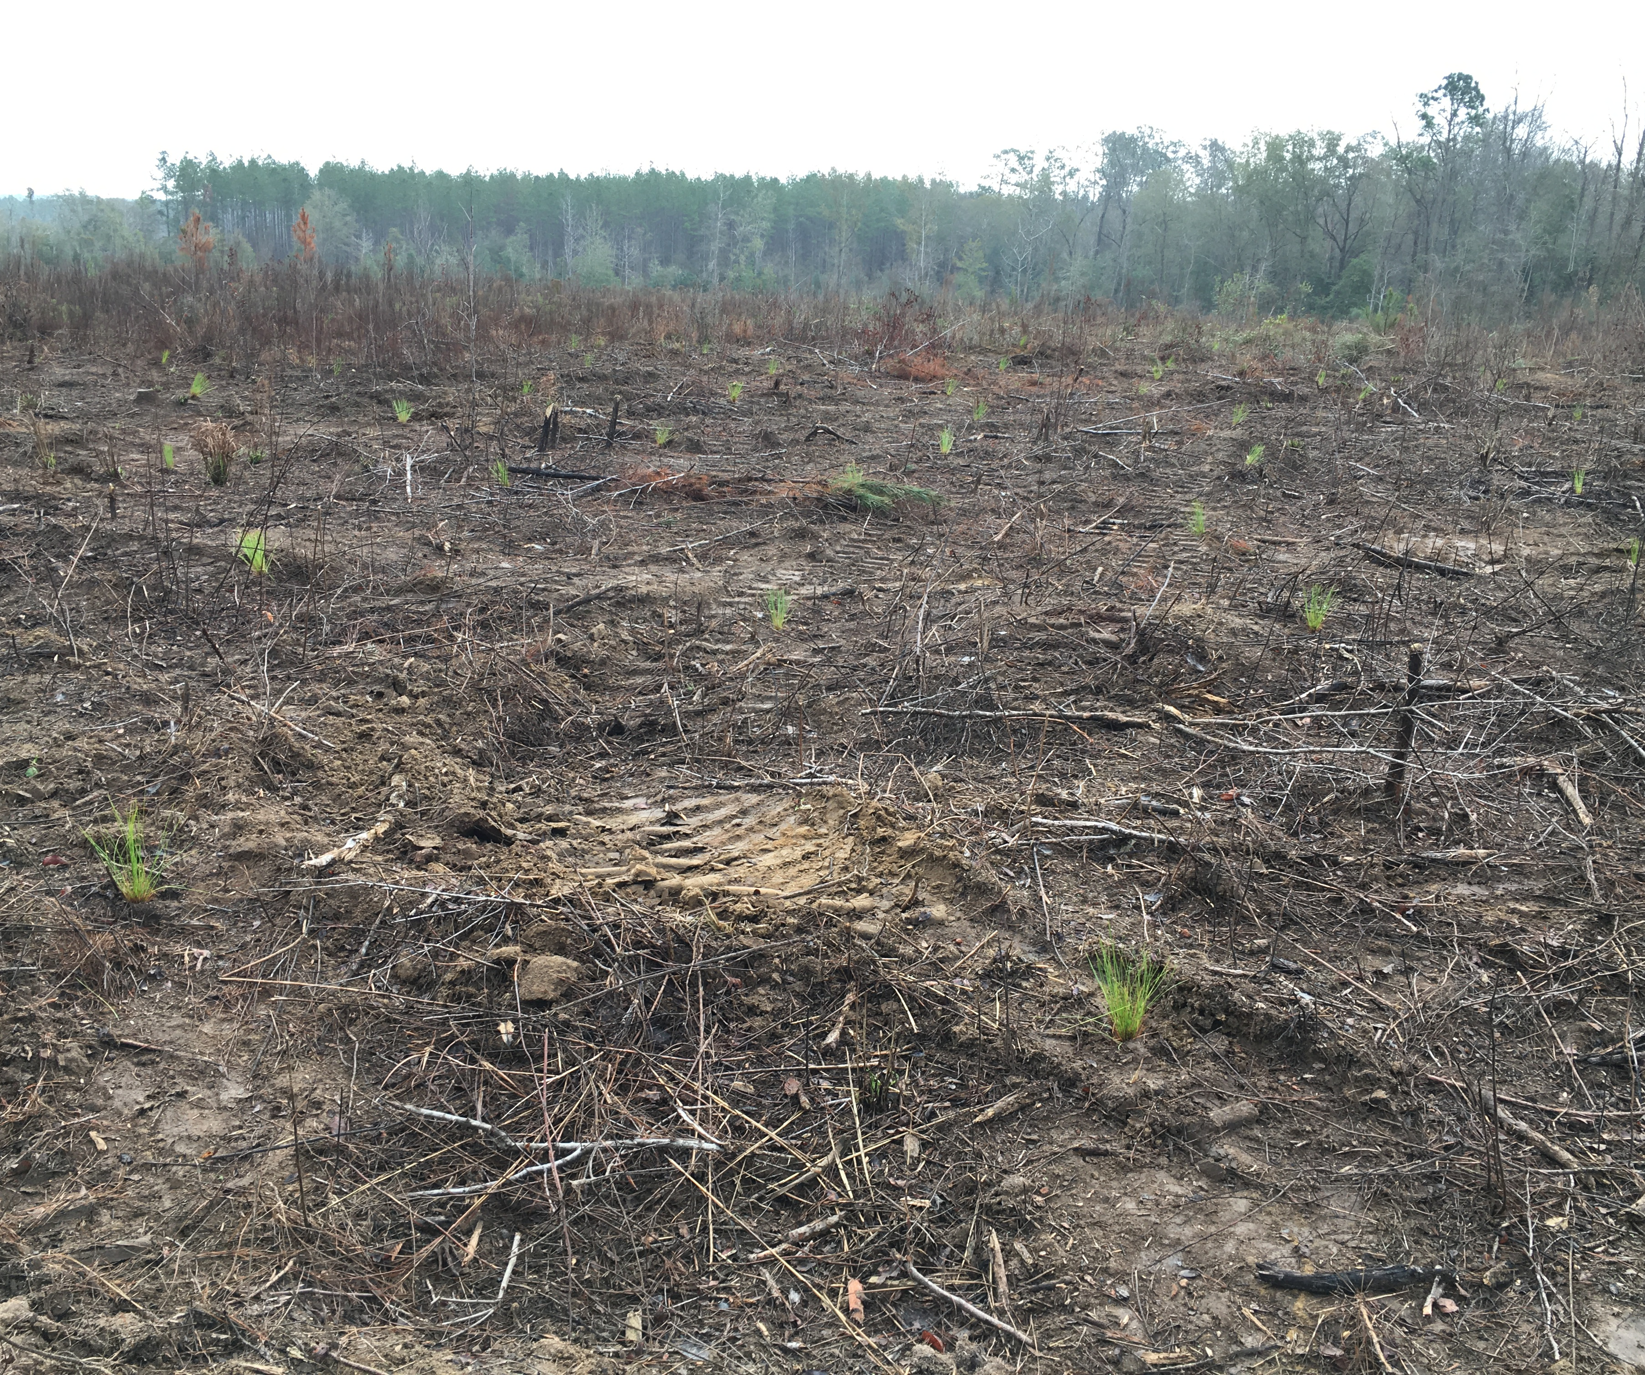
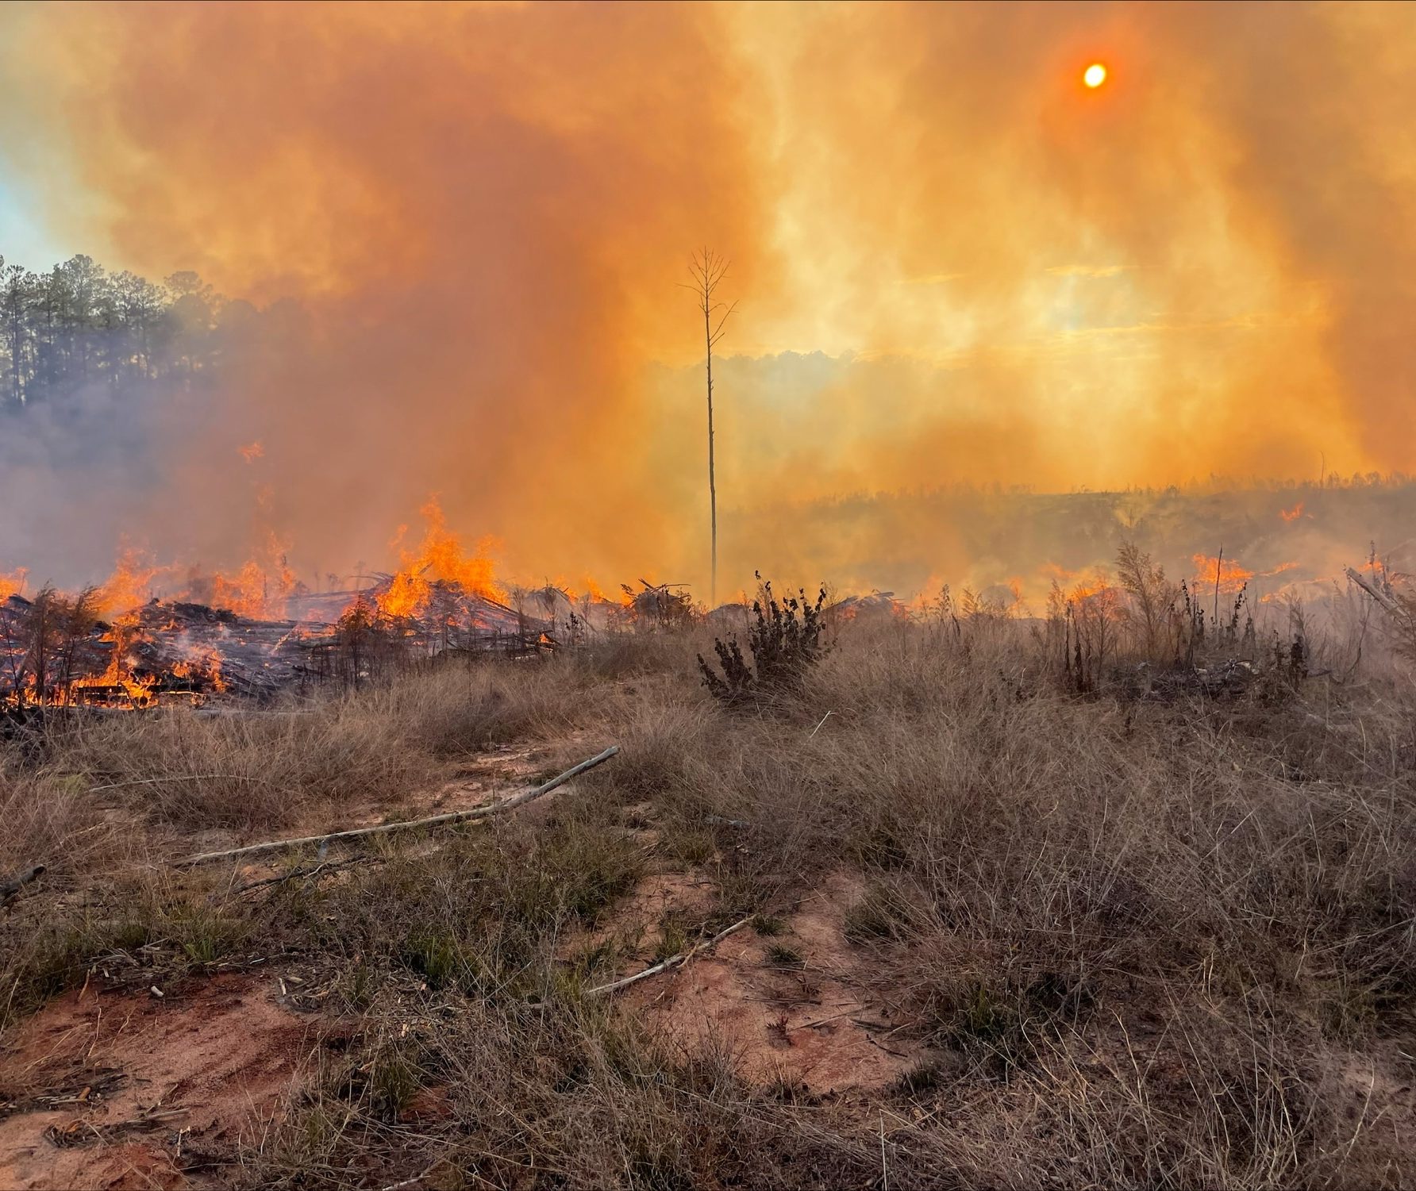
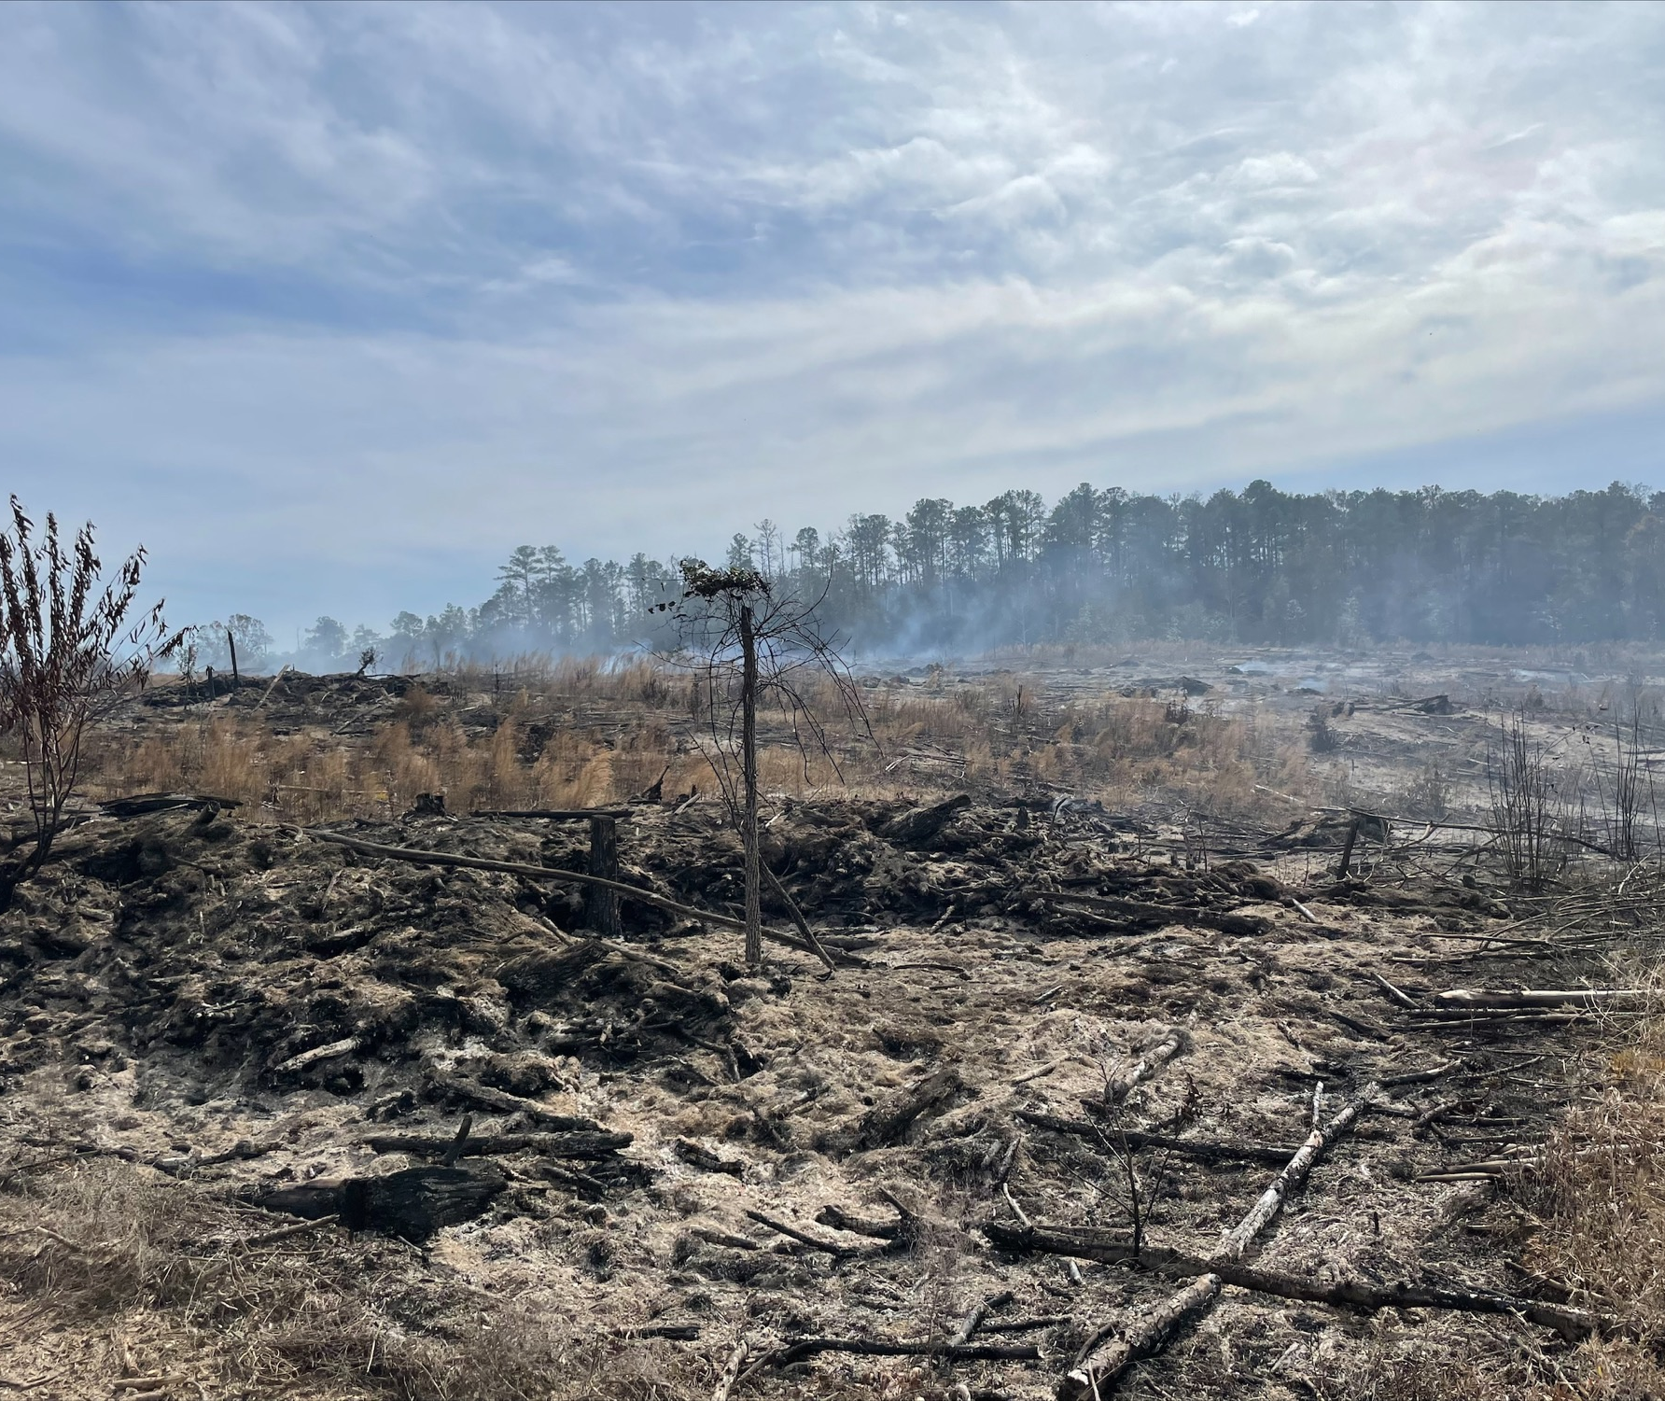
Partners
Land Trust of
North Alabama
TDEC: Division of Air Pollution Control
Alabama Forestry
Commission
American Forest
Foundation
TDEC: Division of Water Resources
Image Credits: Dan Chappell
Notes:
Speaker Notes:
Three of our partners were end users, meaning their primary role was to use any deliverables or tools that we created. These partners were the Alabama Forestry Commission, the Land Trust of Northern Alabama, and the American Forest Foundation. The Alabama Forestry Commission is a governmental organization tasked with educating the public about the benefits that forested lands provide, protect the natural resources in forests for recreational and economic uses, and provide information about forest management practices and strategies to private landowners. The commission must strategically make decisions about where to direct resources such as prescribed burns and concentrated management practices as well as choosing where and how timber harvesting and recreational activities take place.
The North Alabama Land Trust serves to preserve the scenic, historic, and ecological resources of Northern Alabama through conservation efforts, advocacy, recreational opportunities, and education. To date, the land trust is responsible for over 9,000 acres of preserved land across 6 different counties, with most of these spaces publicly available for recreational use as community access to these preserved spaces is a core component of the work that they do.
Our national partner, the Family Forest Carbon Program is a branch of the American Forest Foundation which works closely with The Nature Conservancy to connect small private forest owners to expert advice, resources, and management strategies to increase the carbon sequestration potential and health of their land. The additional carbon stored on participating land areas is sold to companies seeking to purchase carbon offsets. They use remote sensing products to find opportunities to involve additional landowners in their program, survey land for opportunities to increase carbon storage, and monitor changes in enrolled land to ensure compliance with new management strategies.
We had two partners that were contributors, meaning they contributed data and expertise, rather than using our end products. These partners are both within the Tennessee Department of Environment and Conservation, or TDEC: the Tennessee Division of Air Pollution Control and the Tennessee Division of Water Resources. The Division of Air Pollution Control aims to preserve the quality of air resources to a standard that protects normal health, general welfare, and physical property of citizens while also supporting healthy employment rates and industrial development in the state of Tennessee, while the Division of Water Resources manages and protects water quality.
------------------ Image Information -------------------
•Image Credits: Dan Chappell (Alabama Forestry Commission)
•Image Source: All four images provided by partner

Slide 7
Community Concerns and Objectives
Loss of forest cover impacts ecosystem and community services
Accurate carbon emission reporting
Generate forest cover + loss maps
Validate land cover change maps
Estimate CO₂ emissions
Notes:
Speaker Notes:
Carbon emissions from deforestation our the main community concern that we will be addressing in our research. Forests in the Southeastern US provide important ecosystem functions. Our different partners have brought more specific community concerns to our attention as well. The Alabama Forestry Commision must advise landowners on forest management strategies based on changing emissions in trends. They are also concerned with protecting the forests from natural and anthropogenic harm with both ecosystem services and economic interests in mind.
The Family Forest Carbon Program, of the American Forest Foundation, is especially concerned with the change in carbon emissions pre- and post-enrollment in their program because the post-enrollment additional credits are sold to corporations as carbon offsets, and this is where the monetary component of the program exists. Folks often get involved in the Family Forest Carbon Program (American Forest Foundation) because they want to take better care of their land but don't have the expertise, resources, or funds to do so. The program removes those barriers for private landowners The Land Trust of North Alabama is especially focused on keeping green spaces accessible for the community to use recreationally- free and public access and located near the populous and with green space conservation, including the conservation of plant and animal species

Slide 8
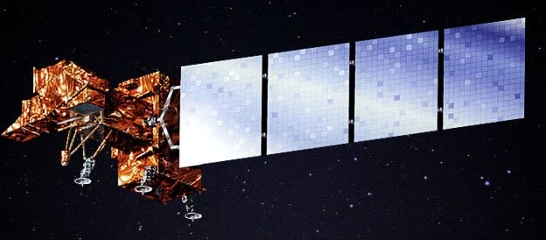
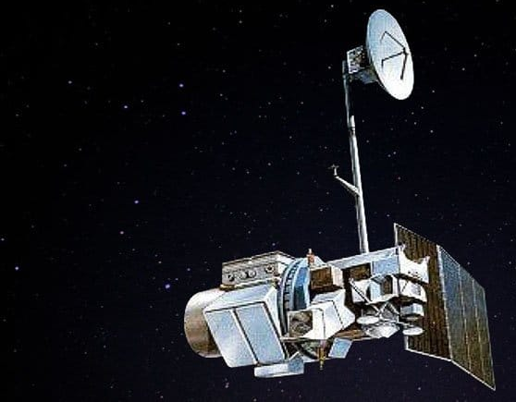
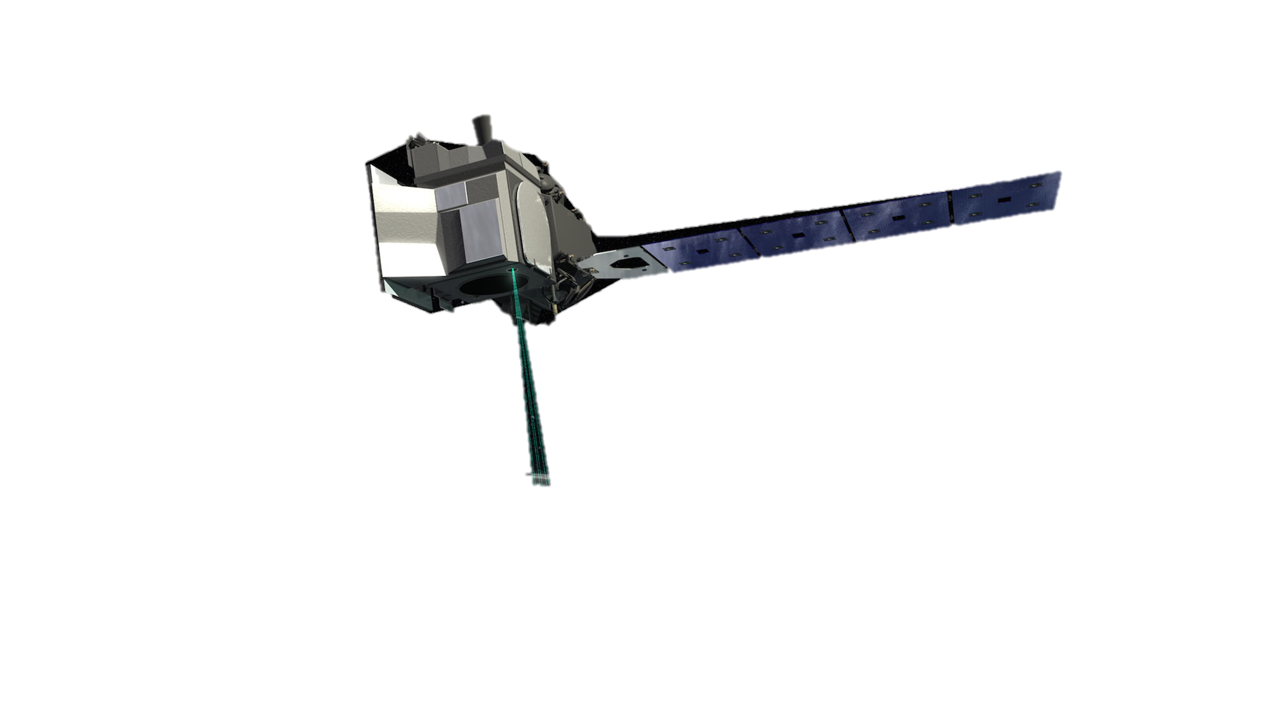
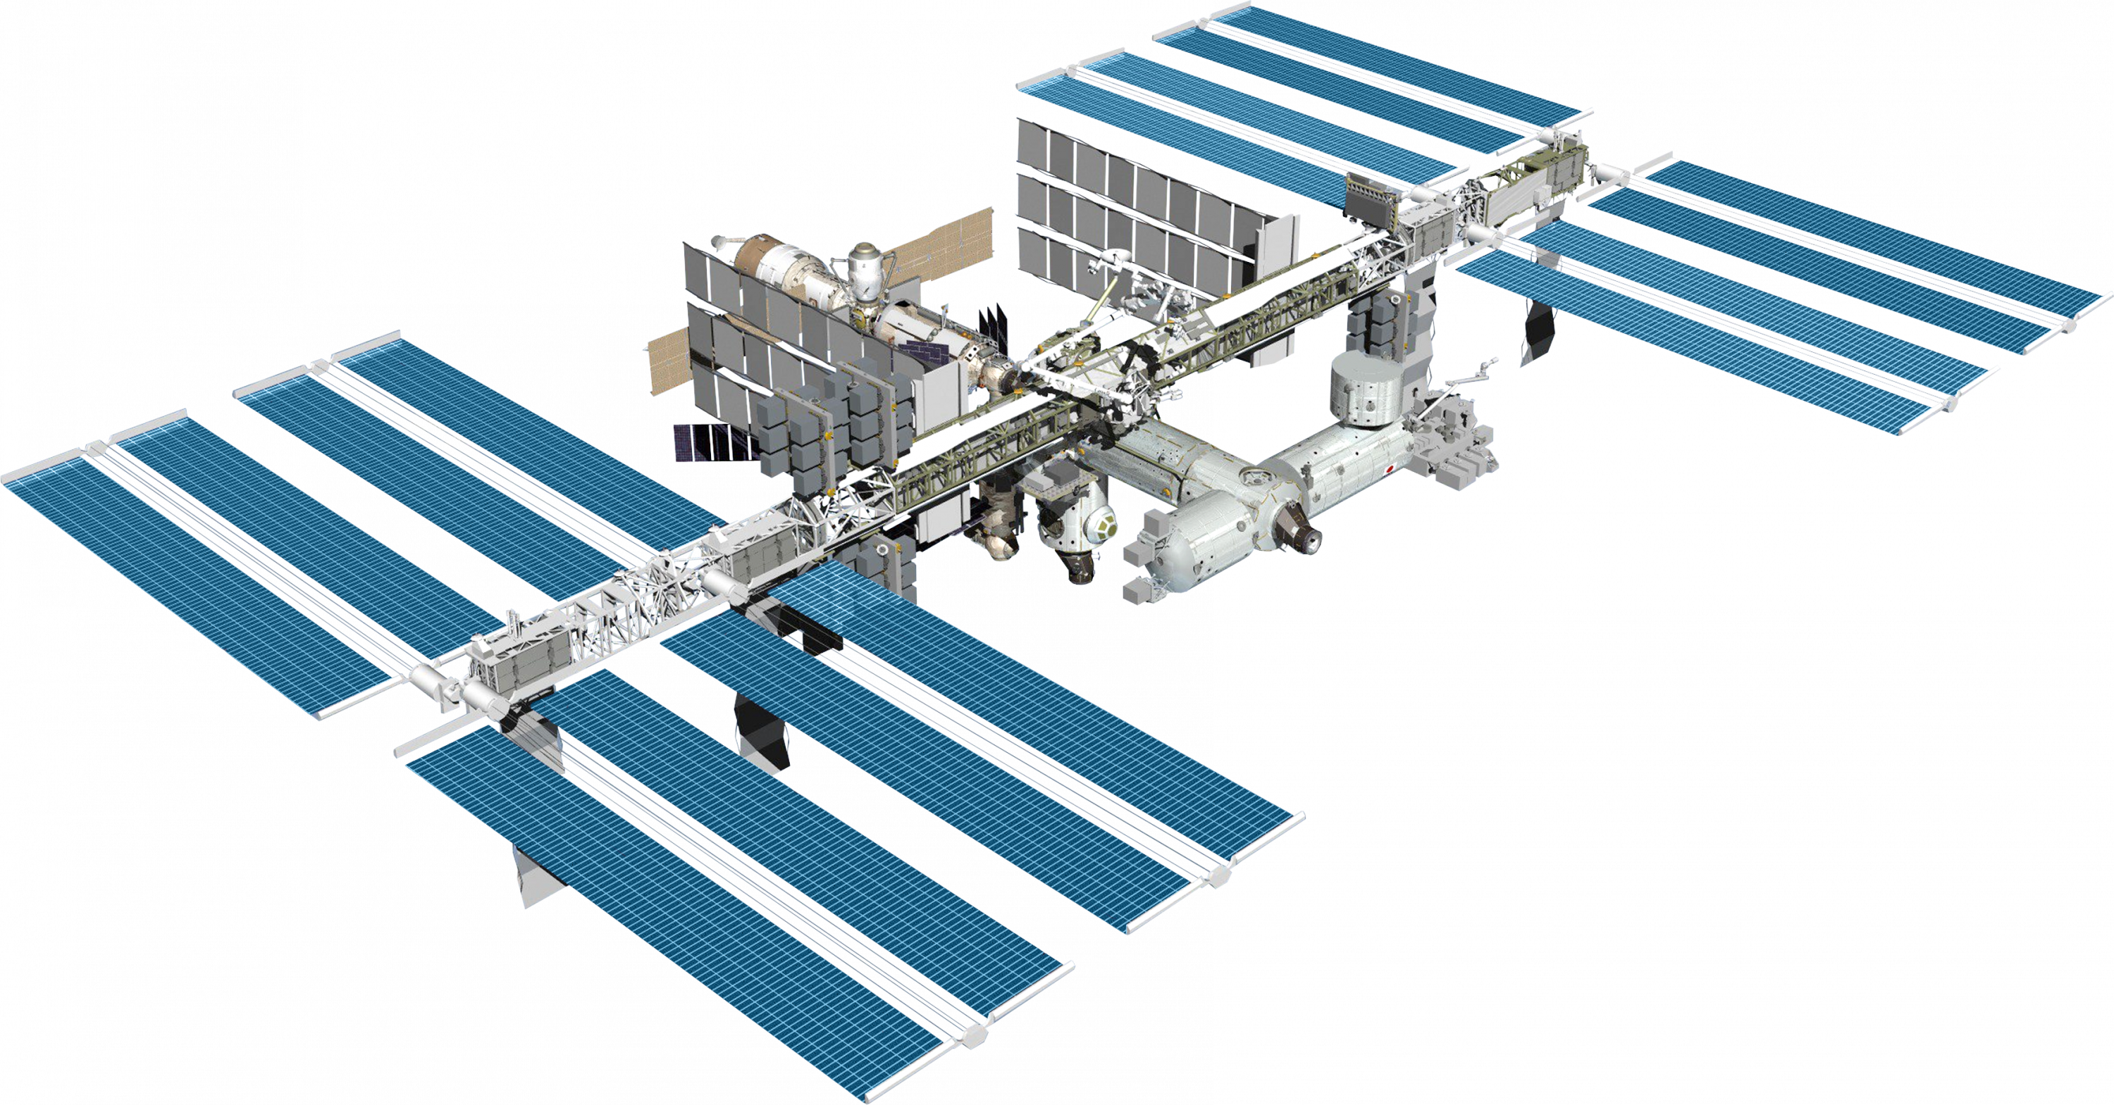
Earth Observations
Landsat 7 ETM+
Landsat 5 TM
Sentinel-2
ICESat-2 ATLAS
GEDI
Landsat 8 OLI
Image Credits: USGS; NASA; ESA
Notes:
Speaker Notes:
These are all the satellites used in our project. We used USGS Landsat Surface Reflectance Tier 1 data sets to build our forest change maps that identify forest cover change. These data were acquired from Landsat Series 4, 5, 7, and 8. To validate those forest change maps, we used Sentinel-2 true color imagery. And, to obtain biomass estimates, we used LiDAR datasets from ISS GEDI and ICESat-2 ATLAS.
------------------------------Image Information Below ------------------------------
•Image Credit: USGS (All Landsat images)
•Image Sources: Landsat 5 | U.S. Geological Survey (usgs.gov) Public Domain
Landsat 7 | U.S. Geological Survey (usgs.gov) Public Domain
Landsat 8 | U.S. Geological Survey (usgs.gov) Public Domain
•Image Credit: NASA (ICESAT-2 & ISS GEDI)
•Image Sources: image001.jpg (480×320) (nasa.gov) Public domain
Global Ecosystem Dynamics Investigation Lidar (EVI-2) | NASA's Earth Observing System Public Domain
https://science.nasa.gov/get-involved/toolkits/spacecraft-icons
•Image Credit: European Space Agency (Sentinel-2)
•Image Source: Developedia Shared Earth Observation Images

Slide 9
Methodology
National Land Cover Dataset (NLCD)
Stratified Random Sampling
Forest Cover Loss Maps
LandTrendr
Global Forest Watch (GFW)
Landscape Change Monitoring System (LCMS)
Validation in Collect Earth Online
GEDI
Above-ground Biomass Density
CO₂ Emissions from Forest Cover Loss
ATLAS
Notes:
This chart shows an overview of our workflow. Forest cover loss maps in our study area and were built with 4 modules: National Land Change Dataset (NLCD), LandTrendr – an algorithm that utilizes Landsat Surface Reflectance Tier 1 images, Global Forests Watch dataset (GFW) and Land Change Monitoring System (LCMS).
Above Ground Biomass estimates were determined from ISS GEDI and ICESat-2 ATLAS observation data.
For each of the forest cover loss maps, we reclassified the maps into three different categories: forest loss, non-forest, and stable forest. We then applied stratified randon sampling in Google Earth Engine. We then brought these points into collect earth online in order to validate our forest cover loss maps with Sentinel-2 reference imagery. This allowed us to compare the datasets and determine their overall accuracy.
The resulting land change maps and above ground biomass estimates allowed us to determine carbon stock loss and ultimately total carbon emissions.

Slide 10
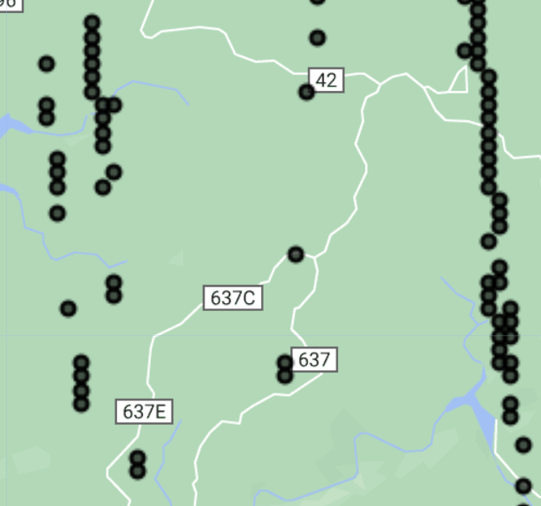
Methodology: Aboveground Biomass (AGB)
ATLAS AGB Density Estimates
Data available from 2018 – Present on NASA Earth Data Search
Provides canopy height data in point form
Notes:
Speaker Notes:
For each forest change map, we calculated Aboveground Biomass estimations using both ISS GEDI and ICESat-2 ATLAS LiDAR Data. ICESat-2 data is available to download in HDF5 form, and needs to be converted into a shapefile before it can be uploaded into ArcGIS Pro and processed further. In ArcGIS Pro, the data, which is available as canopy height estimates in point form, was clipped to our region of interest using the extract raster by mask tool, with the ROI as the mask, and Aboveground Biomass estimates were calculated for each point using an allometric model that was developed for use in the continental US.
After calculating AGB, ICESat-2 data is clipped to where stable forest was identified by each change map, creating four separate ICESat-2 point layers. Then, a mean AGB is calculated for each county in our ROI, as well as for the ROI as a whole.
------------------------------Citation Information Below ------------------------------
Berrick, S. (2023). EarthDataSearch. https://search.earthdata.nasa.gov/search
Cherrington, E. (2020). Icesat2_shp.py. https://gist.github.com/bzgeo/950f3db986b3513311ed42efe2395171
Nelson, R., Margolis, H., Montesano, P., Sun, G., Cook, B., Corp, L., Andersen, H.-E., deJong, B., Pellat, F. P., Fickel, T., Kauffman, J. & Prisley, S. (2017). Lidar-based estimates of aboveground biomass in the continental US and Mexico using ground, airborne, and satellite observations. Remote Sensing of Environment, 188, 127–140. https://doi.org/10.1016/j.rse.2016.10.038
Neuenschwander, A. L., K. L. Pitts, B. P. Jelley, J. Robbins, B. Klotz, S. C. Popescu, R. F. Nelson, D. Harding, D. Pederson, & R. Sheridan. (2021). ATLAS/ICESat-2 L3A Land and Vegetation Height, Version 5 [Data Set]. Boulder, Colorado USA. NASA National Snow and Ice Data Center Distributed Active Archive Center. https://doi.org/10.5067/ATLAS/ATL08.005.
------------------------------Image Information Below ------------------------------
•Image Credit: Team generated images using Google Earth Engine

Slide 11
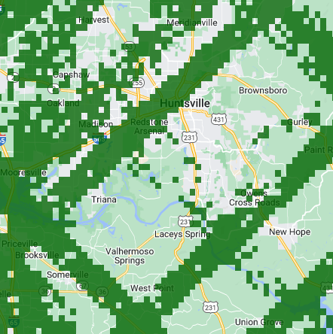
Methodology: Aboveground Biomass (AGB)
GEDI AGB Density
Data available from 2019-2021 on Google Earth Engine
Provides AGB data at 1-km resolution along tracks
Notes:
Speaker Notes:
GEDI is a sensor, currently aboard the International Space Station, that measures, among other things, the vertical distribution of vegetation on the earth's surface. The GEDI Aboveground Biomass dataset is available in Google Earth Engine, so we didn't have to do any pre-processing before using it in our code. This data product provides 1 square kilometer mean biomass estimates from 2019 to 2021.
In the image shown, you can see the 1 square kilometer pixels where GEDI AGB desnity are available for this snapshot of our region of interest.
We first exported the dataset so that we could process it in ArcGIS Pro. In ArcGIS Pro, we converted these pixels into points using the raster to point tool, so that GEDI data was consistent with our ICESat-2 data. Then it went through the same process as ICESat-2 in ArcGIS Pro, so that we could calculate mean AGB for each county in our ROI. After going through this process with ICESat-2 and GEDI, we had 8 separate sets of AGB density estimates for each county in our ROI.
------------------------------Citation Information Below ------------------------------
Dubayah, R.O., J. Armston, S.P. Healey, Z. Yang, P.L. Patterson, S. Saarela, G. Stahl, L. Duncanson, & J.R. Kellner. 2022. GEDI L4B Gridded Aboveground Biomass Density, Version 2. ORNL DAAC, Oak Ridge, Tennessee, USA. https://doi.org/10.3334/ORNLDAAC/2017.
NASA Goddard Space Flight Center (GSFC), University of Maryland (UMD) (2023). GEDI Ecosystem Lidar Instrument Overview. https://gedi.umd.edu/instrument/instrument-overview/
------------------------------Image Information Below ------------------------------
•Image Credit: Team generated images using Google Earth Engine

Slide 12
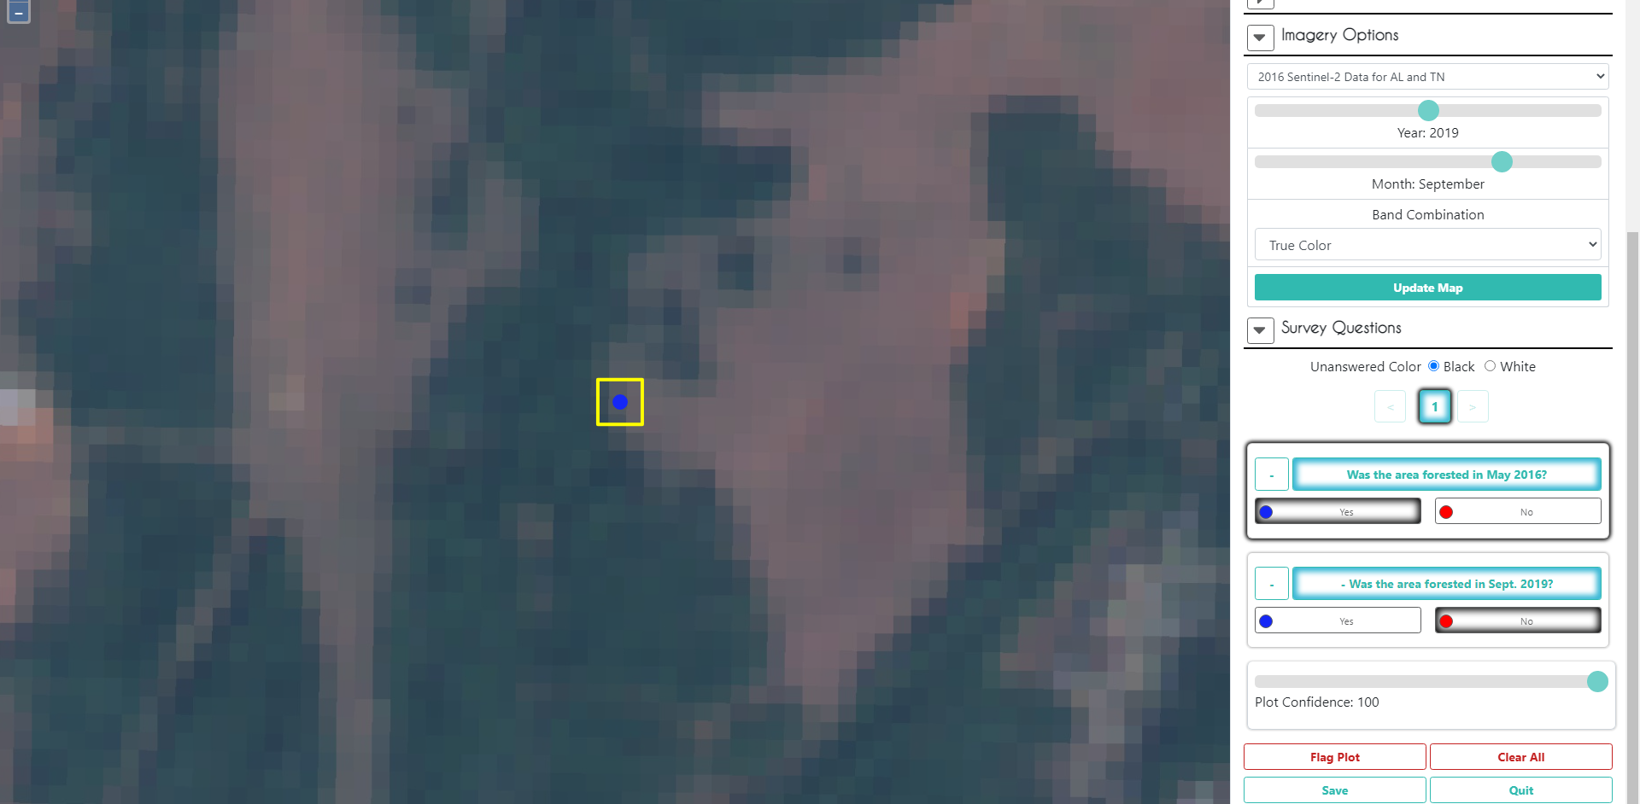
Methodology: Validation
Image Credits: Collect Earth Online, Google
Notes:
We validated our land cover change maps using Collect Earth Online based on SERVIR' recommendation. In this example, we are looking for at the plot window for NLCD Forest Loss. The yellow square on the left highlights the area under review. The reference background imagery is taken from Sentinel-2. Under Imagery Options on the right, you can adjust the year and month using the slider bar you are pulling the Sentinel-2 data in from. The survey questions are indicated on the right (was the area forested in 2016, was the area forested in 2019). If we were unsure about a plot, we flagged it, and at the end of reviewing the plots we brought the KML file into Google Earth Pro to look at the area with higher resolution.
------------------------------Image Information ------------------------------
•Image Credit: Collect Earth Online
•Image Source: https://www.collect.earth/ : Free, open-source system for viewing satellite imagery

Slide 13
Methodology: Confusion matrices
Accuracy: Overall success of the map’s ability to correctly sort the study area into forest loss and not forest loss
Sensitivity: Proportion of forest loss area classified as such
Precision: Proportion of area classified as forest loss that was forest loss
NLCD had the highest accuracy and precision
Notes:
Speaker Notes:
This chart visualizes confusion matrices from forest loss for all four maps. NLCD had the highest accuracy and precision out of all four maps.

Slide 14
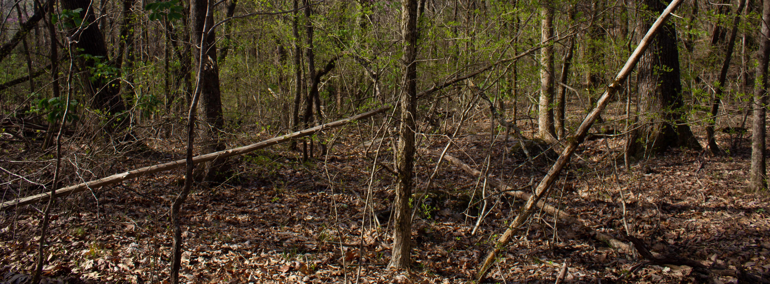
Methodology: CO₂ Emissions
Carbon Stock = Mean AGB * Dry Matter Carbon Fraction
AGB measured in tonnes/ha
Carbon Fraction used = 0.47 tonne C/tonne dry tree matter
CO₂ Emissions = Carbon Stock * Area of Forest Cover Loss * 44/12
Insert relevant diagram/graphic here
Image Credit: James Karroum
Notes:
Speaker Notes:
The amount of carbon stored in a forest, or the carbon stock, can be estimated by multiplying the forest biomass by a constant, called the carbon fraction. This constant represents the carbon concentration held in dry tree matter and can be thought of as (Mg C / Mg dry tree matter). This constant should be determined by available data on the forest type and makeup. We chose our carbon faction to be 0.47 based on the 2006 IPCC Guidelines for National Greenhouse Gas Inventories.
Once you have calculated carbon stock, the total amount of carbon emissions released in the deforestation process can be calculated by multiplying the carbon stock by the area of the forest loss. Multiplying that number by 44/12 converts the equation to represent carbon dioxide, rather than carbon.
------------------------------Citation Information Below ------------------------------
Aalde, H., Gonzales, P., Gytarsky, M., Krug, T., Kurz, W. A., Ogle, S., Raison, J., Schoene, D., Ravindranath, N. H., Elhassan, N. G., Heath, L., Higuchi, N. K., Kainja, S., Matsumoto. M., Sanchez, M. J. S., Somogyi, Z., Carle, J. B., Murthy, I. K. (2006). 2006 IPCC Guidelines for National Greenhouse Gas Inventories. Volume 4: Agriculture, Forestry and other Land Use. https://www.ipcc-nggip.iges.or.jp/public/2006gl/pdf/4_Volume4/V4_04_Ch4_Forest_Land.pdf
------------------------------Image Information ------------------------------
•Image Credit: James Karroum
•Image Source: Personal photo at Land Trust property

Slide 15
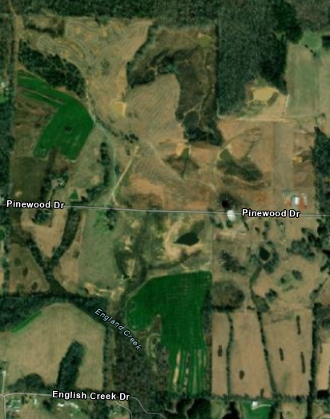
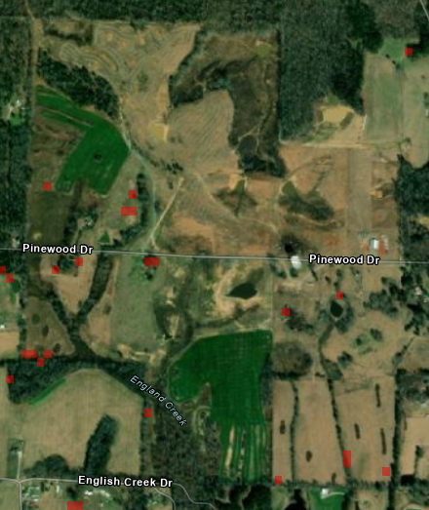
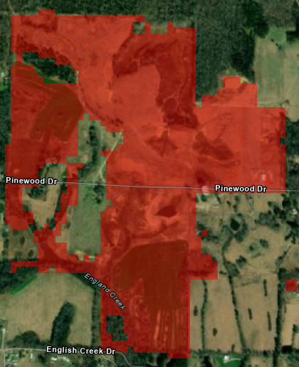
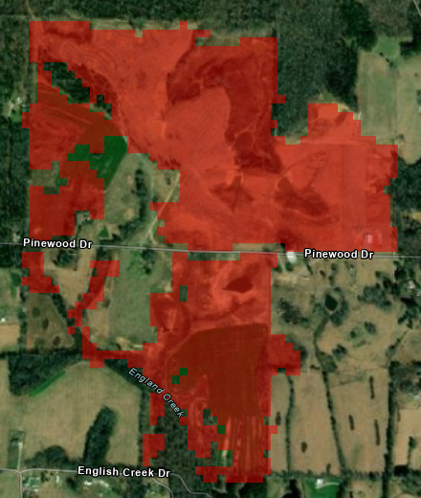
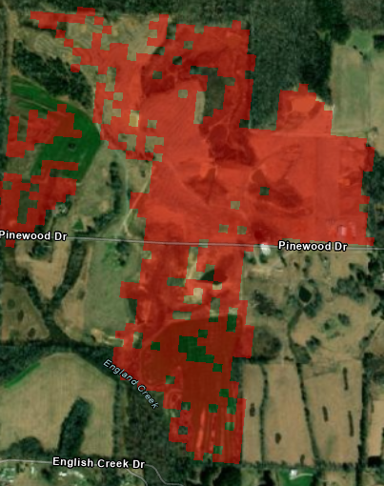
Forest Loss in Example Area
LCMS (2016 – 2021)
GFW (2016 – 2021)
NLCD (2016 – 2019)
LandTrendr (2016 – 2022)
N
0
500ft
Notes:
Speaker Notes:
Here you can see a selection of our ROI, located just outside of Huntsville, AL. The red areas were identified as areas that experienced forest cover loss within our study period, which was different for each map due to availability of data. You can see that the maps varied, with LCMS demonstrating the most drastic change from the others. ----- was the most conservative in estimating forest cover loss overall, while ---- estimated the most forest cover loss. We also identified stable forest within our study area, which means that the land classification schema identified the area as forest in the start year and in the end year. Through our validation process, ---- was identified as the most accurate land cover change map for identifying forest cover loss overall.
------------------ Image Information ------------------
•Image Credit: Katherine Scott
Basemap sources: Esri, HERE, Garmin, FAO, NOAA, USGS, OpenStreetMap contributors, and the GIS User Community

Slide 16
All Study Area Results
Change map | First year | Last year | 2016 forest cover (ha) | Forest cover lost over each analysis period (ha) | Average annual forest cover loss (ha/year) | AGB data source | AGB mean density (tonnes/ha) | CO₂ emissions (tonnes) | Average annual CO₂ emissions (tonnes /year)
GFW | 2016 | 2021 | 13,691,199 | 1,251,033 | 208,506 | GEDI | 146 | 243,626,380 | 40,604,397
 |  |  |  |  |  | ATLAS | 255 | 431,363,292 | 71,893,882
LandTrendr | 2016 | 2022 | 15,093,066 | 456,851 | 65,264 | GEDI | 148 | 89,382,421 | 12,768,917
 |  |  |  |  |  | ATLAS | 249 | 155,079,040 | 22,154,149
NLCD |  | 2019 | 17,106,687 | 396,089 | 99,022 | GEDI | 145 | 90,876,819 | 22,719,204
 |  |  |  |  |  | ATLAS | 251 | 162,612,240 | 40,653,060
LCMS |  | 2021 | 21,127,172 | 718,897 | 135,852 | GEDI | 137 | 149,691,082 | 24,948,513
 |  |  |  |  |  | ATLAS | 240 | 269,280,811 | 44,880,135
Notes:
Speaker Notes:
Using the AGB density and CO₂ emissions equations that we discussed, we calculated overall CO₂ emissions estimates, and ended up with the results you see in the chart above.
------------------------------Image Information Below ------------------------------
•Image Credit: Team using powerpoint

Slide 17
Average Annual CO₂ Emissions from Forest Loss for All Generated Maps
Notes:
Speaker Notes:
This chart visualizes the average carbon dioxide emissions from forest loss for all four maps split between GEDI and ATLAS estimates. ATLAS had a higher estimation than GEDI, and GFW had the highest estimations of CO₂ emissions among all four land cover maps.
------------------------------Image Information Below ------------------------------
•Image Credit: Team using PowerPoint

Slide 18
Average Aboveground Biomass Density in Forest Land
Highest AGB density is in Northeast Tennessee
Indicative of forest type, and possibly maturity
Average AGB density in forest land (tonnes/ha)
≤ 100
≤ 125
≤ 150
≤ 190
≤ 270
N
0
50
100
200 Miles
Notes:
Speaker Notes:
This is a map of GEDI AGB density in stable forest, as identified by NLCD, for our ROI, broken down by county. You can see the highest AGB density is in Northeast Tennessee, where Great Smoky Mountains National Park is.
------------------ Image Information ------------------
•Image Credit: Katherine Scott

Slide 19
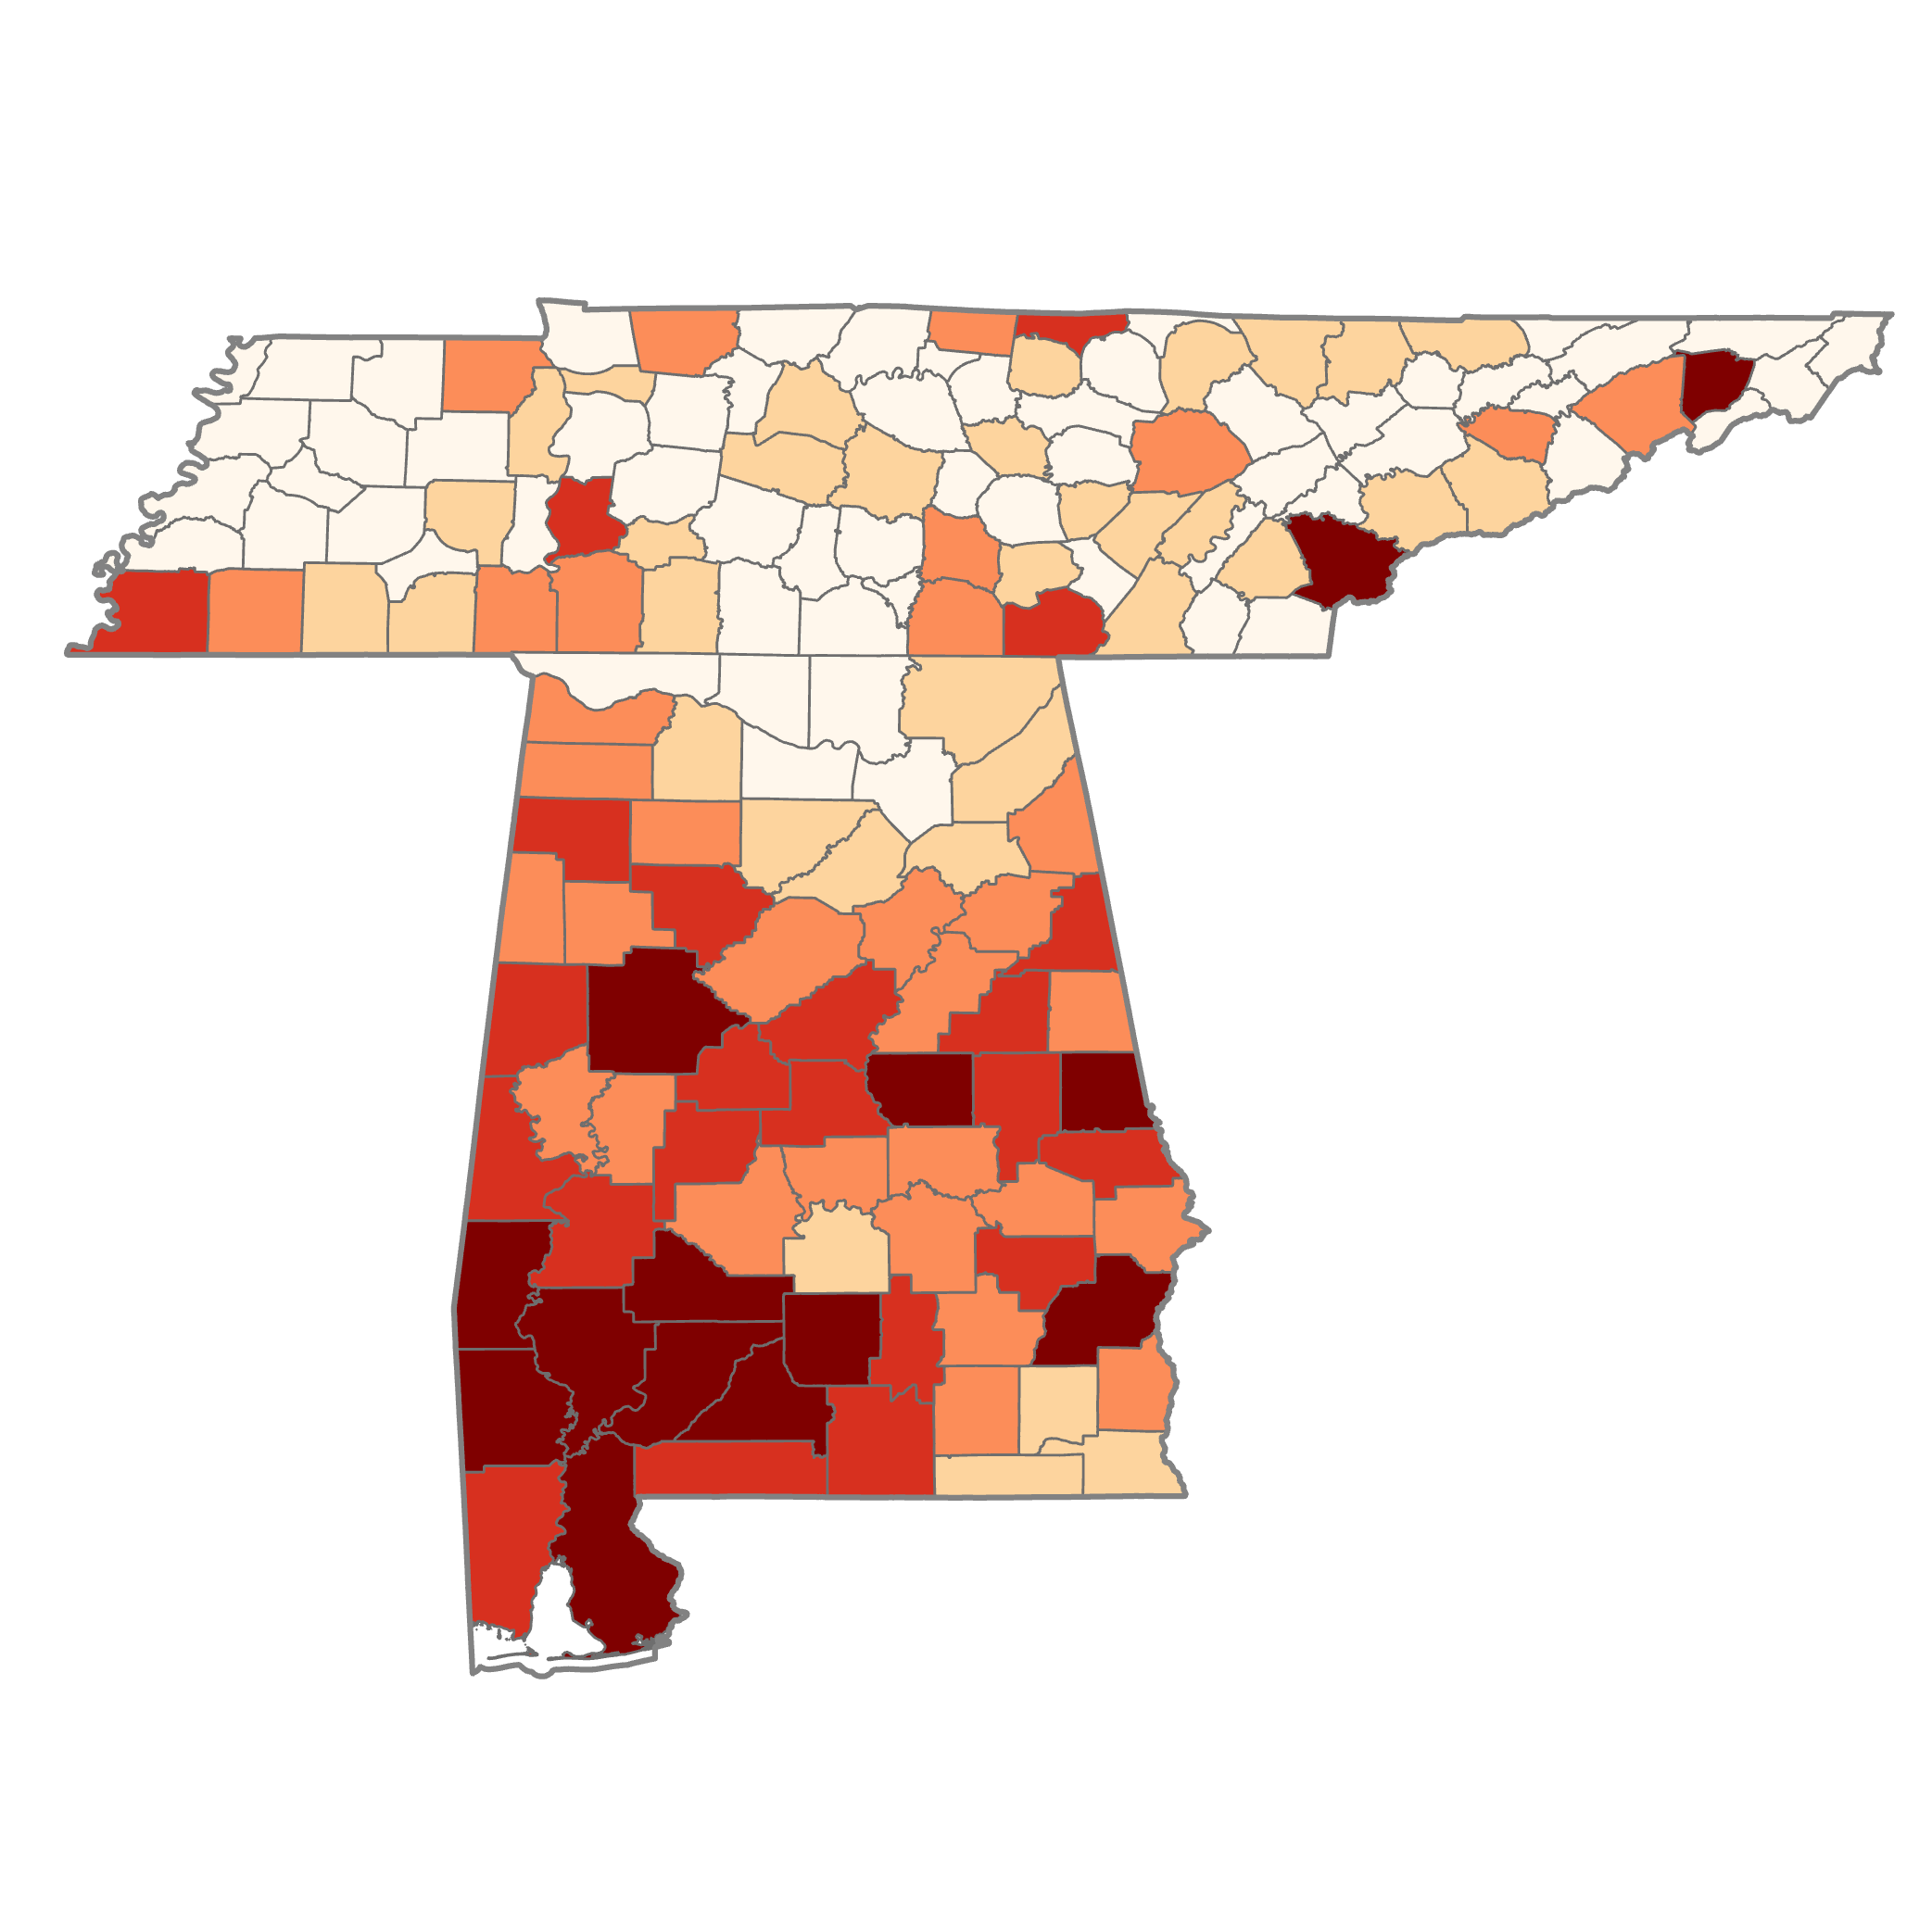
Average Annual CO₂ Emissions from Forest Cover Loss per County, 2016 – 2019
using NLCD forest cover loss map & GEDI AGB density
Highest emissions from forest loss in Southern Alabama
Tonnes CO₂/year
≤ 45,000
≤ 120,000
≤ 250,000
N
≤ 350,000
≤ 600,000
0
50
100
200 Miles
Notes:
Speaker Notes:
Here you can see a map that identifies carbon emissions, with dark red counties emitting the most carbon dioxide, and lighter counties emitting less, as was estimated by NLCD and GEDI.
------------------ Image Information ------------------
•Image Credit: Katherine Scott

Slide 20
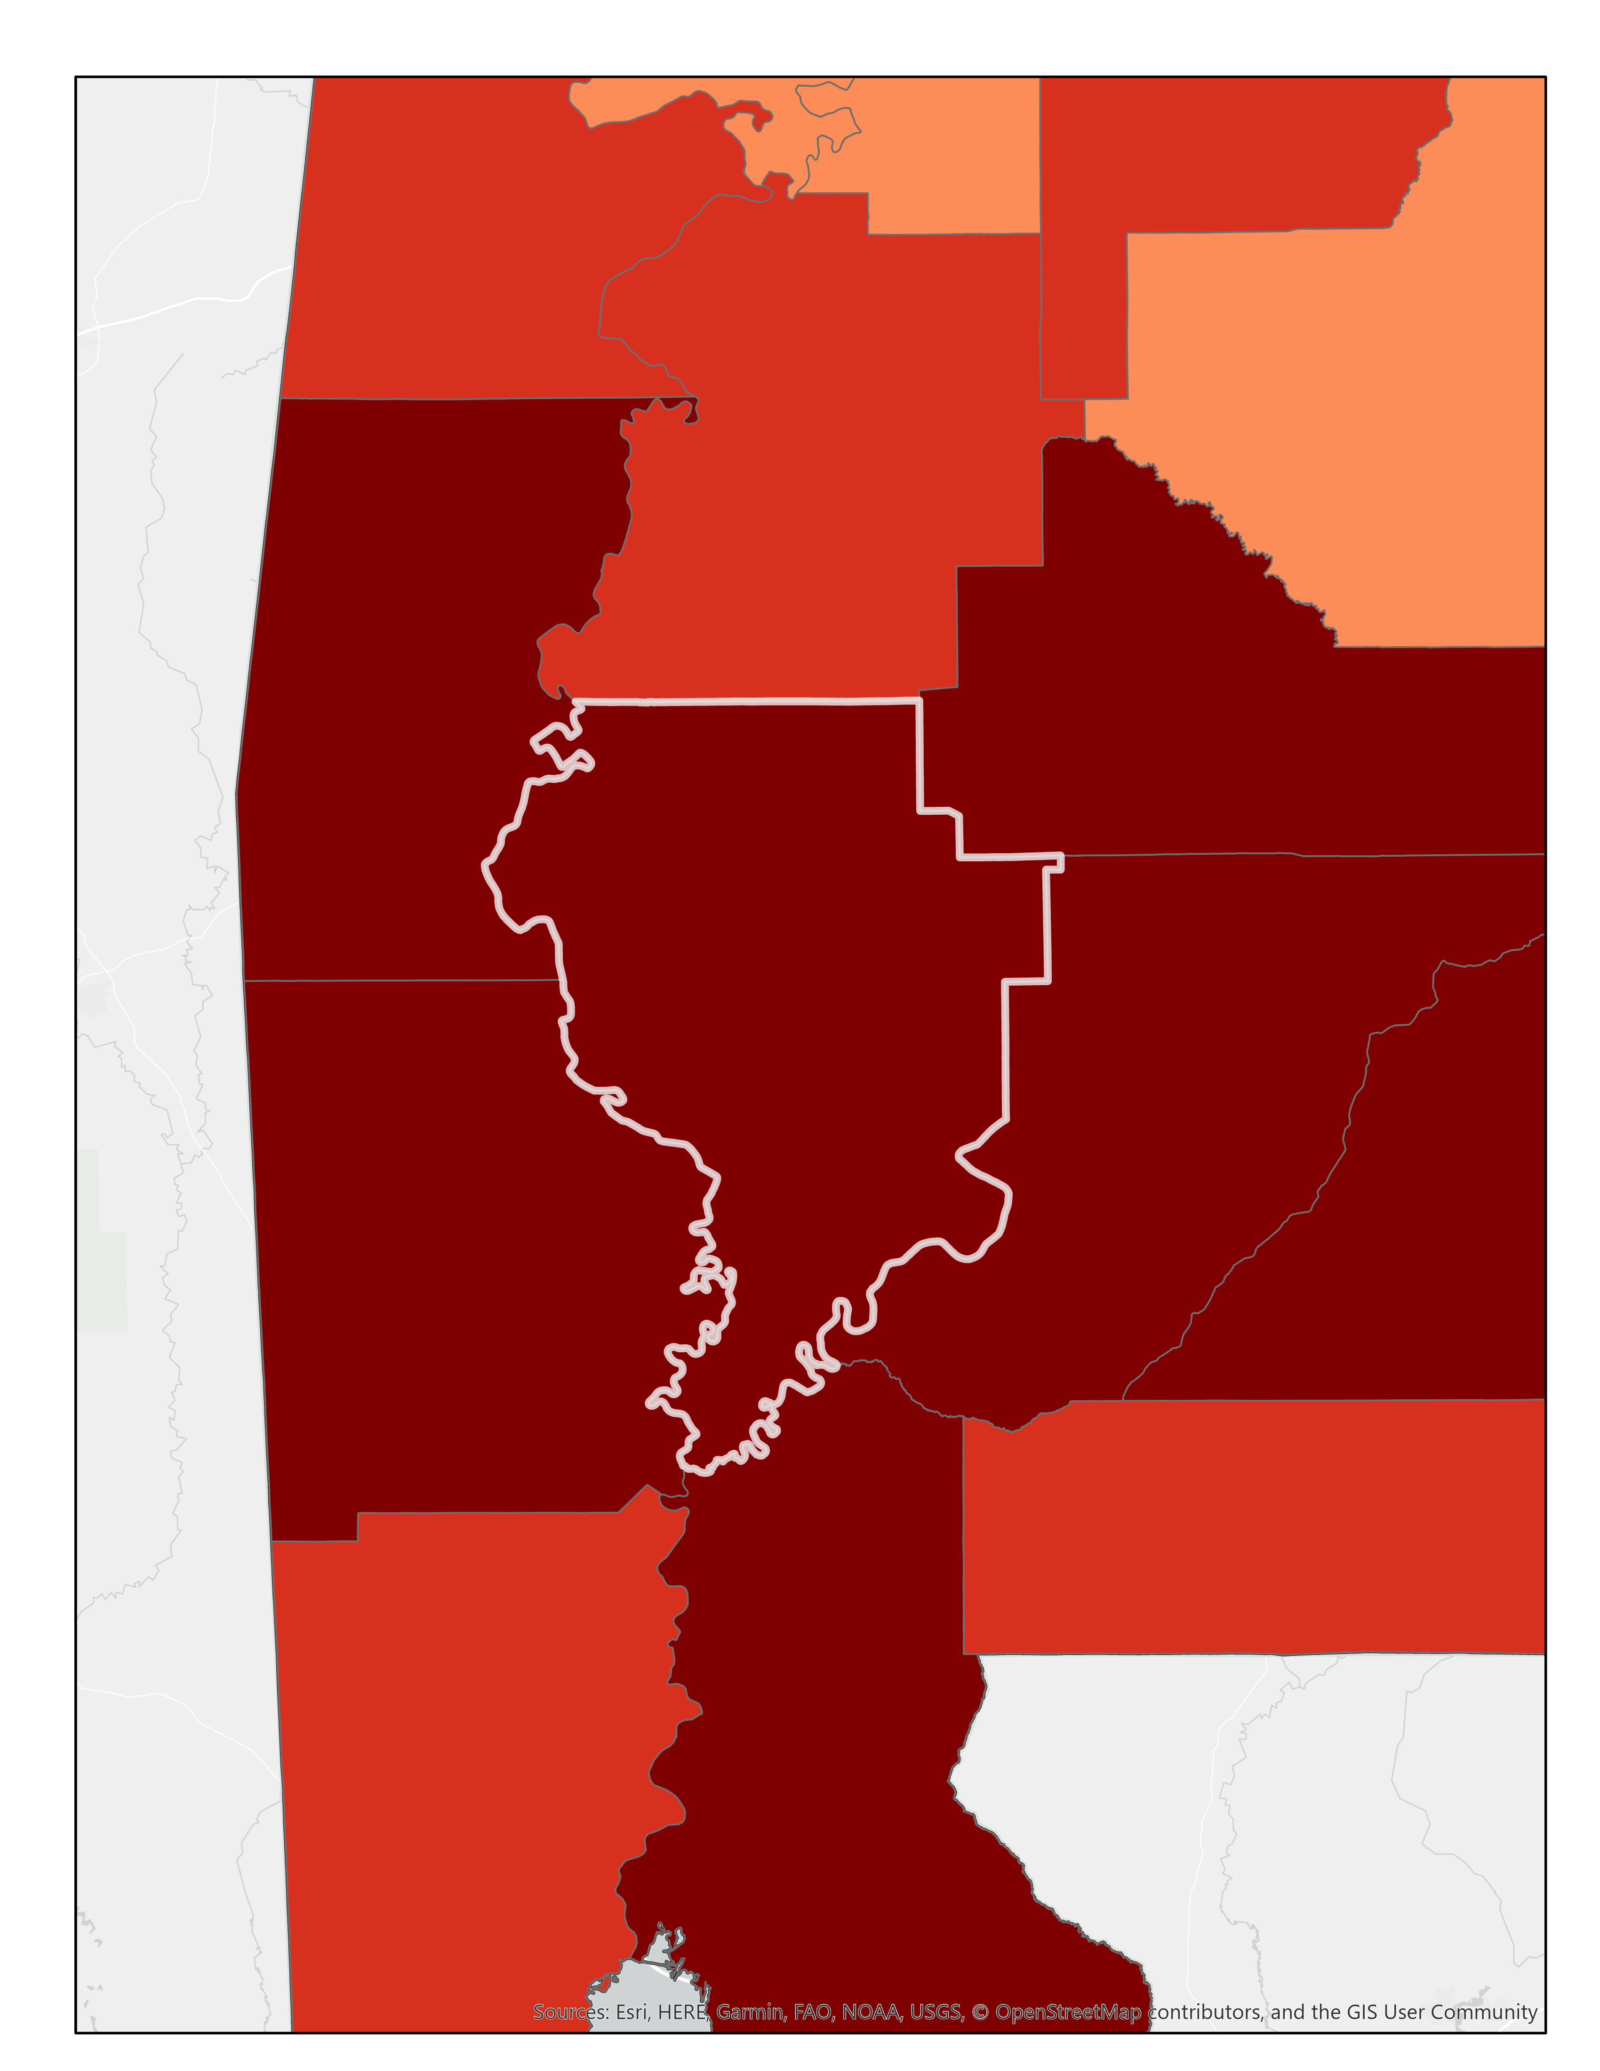
Case Study of Clarke County, AL
Tonnes CO₂/year
≤ 45,000
≤ 120,000
≤ 250,000
≤ 350,000
N
≤ 600,000
0
50 Miles
Notes:
Speaker Notes:
We decided to do a case study of Clarke County, so that you can see how what our results look like in a smaller region. Clarke County, which is located in Southwestern Alabama, is the county that produced the highest carbon dioxide emissions estimate in our ROI for all land change and Lidar inputs. Alabama in general has a rich history of forestry and timber harvest, with much of this industry being located in the south of the state.
------------------ Image Information ------------------
•Image Credit: ArcGIS Pro, Katherine Scott
Basemap sources: Esri, HERE, Garmin, FAO, NOAA, USGS, OpenStreetMap contributors, and the GIS User Community

Slide 21
Case Study of Clarke County, AL
N
0
50 Miles
NLCD (2016 – 2019)
LCMS (2016 – 2021)
GFW (2016 – 2021)
LandTrendr (2016 – 2022)
Stable Forest
GFW was the least precise and accurate map, while NLCD was the most precise and accurate, as determined by our validation process
Forest Cover Loss
Notes:
Speaker Notes:
Here you can see the results of our land change maps, with green representing stable forest and pink representing forest cover loss.
------------------ Image Information ------------------
•All Image Credit: Katherine Scott,
basemap sources: Esri, Maxar, Earthstar Geograpjhics, and the GIS User Community

Slide 22
Case Study of Clarke County, AL
Notes:
Speaker Notes:
Here is a collection of bar graphs that show how the different land classification and LiDAR datasets estimated AGB density.

Slide 23
Case Study of Clarke County, AL
Notes:
Speaker Notes:
Here is a collection of bar graphs that show how the different land classification and lidar datasets estimated carbon dioxide emissions from the previously shown AGB density.

Slide 24
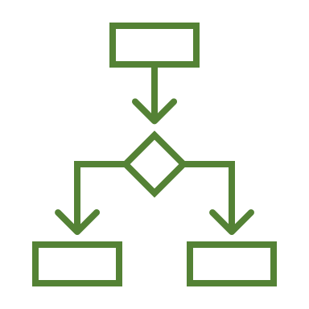
Errors and Uncertainties
Causes and permanence of forest cover loss
Validation accuracy and sample sizes
Year and month ranges
Forest carbon to CO₂ conversion
Forest cover gain
Method choice
Notes:
Speaker Notes:
We have summarized 6 areas of uncertainties here:
1) Causes of deforestation: We did not discern between deforestation and forest degradation in this analysis, rather we interpreted forest cover loss as determined by each change map method.
2) Validation: We were unable to validate change map and biomass accuracy using field knowledge. LiDAR data and field data could be used to quantify these uncertainties. Our term also did not validate satellite Lidar data for the entire ROI, due to lack of time, and instead used last term's Lidar validation, which only looked at Talladega National Forest, a small fraction of our expanded ROI.
3) Dates: Our change map and biomass data were collected in different epochs which made data overlap difficult. Also, we were unable to account for seasonal conditions for every dataset. Were we to have the same dates for Lidar and forest cover change data, we could have calculated the exact AGB lost from forest cover loss, rather than calculating a mean for each county.
4) Land change map methods: Despite using the same Landsat series for our the change maps, they classified our ROI differently. Therefore we could not be consistent in how we identified "forest cover loss" among maps.
5)Reforestation: We did not take forest cover gain into consideration for our study due to the short time frame. This leads to not having a full picture of net carbon dioxide emissions from forest cover loss, as reforestation would produce more carbon sinks, thus lowering the net emissions in the ROI.
6) Method Choice: Method choice falls into two main camps: which forest change map should be used and which biomass data should be used? While we did perform validation statistics, there are many forest change maps and biomass data that we left out of our study due to the 10-week time frame. Furthermore, depending on the ROI, that recommendation would probably change. That being said, we determined that --- was the most accurate land change map for our ROI. Since GEDI biomass estimates seem to fall into in the window of our other estimates, this also may be a promising biomass choice for future teams. Lastly, we recommend the allometric equations used to transform height data, be location specific. We used Nelson's allometric equation because it was specific to the continental US.
------------------------------Image Information Below ------------------------------
Image Credit: Powerpoint Icons, from previous term's errors + uncertainties slide
Image source: Powerpoint

Slide 25
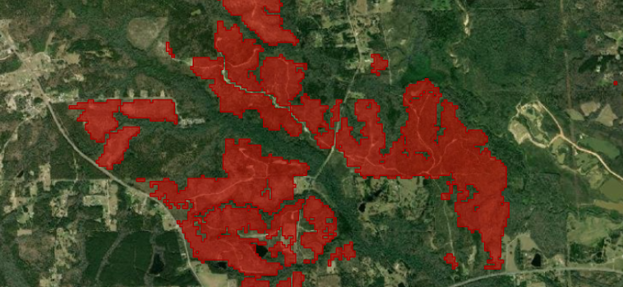
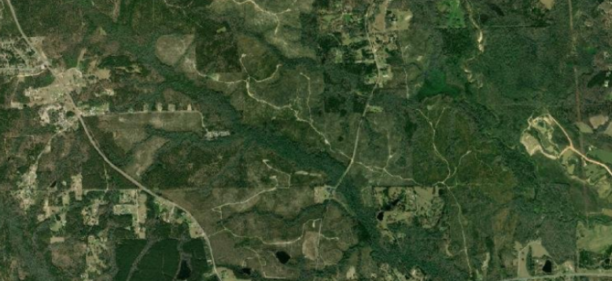
Conclusions
Highest CO₂ emissions in Southern Alabama
Consistent with pine plantations in that area
NLCD forest loss map was most accurate
Estimated CO₂ emissions vary depending on dataset, and most suitable dataset will vary between regions
Notes:
Speaker Notes:​
​
Our team found that the highest carbon dioxide emissions were found in Southern Alabama, which is consistent with pine plantations in that area.​
​
Through our validation process, our team found that the NLCD forest cover and loss map had the highest accuracy compared to the other maps. ​
​
In experimenting with each dataset for forest change maps, we found that the amount of forest loss depended on both the amount of land classified, as well as the forest loss detection method. ​​
​
​
------------------------------Image Information Below ------------------------------ ​
Image Credit: ArcGIS Pro, Kat Scott​
Basemap Source: Esri, HERE, Garmin, FAO, NOAA, USGS, OpenStreetMap contributors, and the GIS User Community​
​
​

Slide 26
Future Work
Test out other land cover change datasets and change detection algorithms (e.g., CCDC-SMA) to find the best one for this region
Expand the study area to other states in the Southeast US to adapt and further test our methodology
Add a ‘forest gain’ class to our analysis to account for regrowth, reforestation, and afforestation
Notes:
Speaker Notes:​
​
Due to time constraints, the team was unable to account for forest regrowth that occurred after deforestation or reforestation due to human-initiated tree planting. However, reforestation and regrowth can significantly impact the amount of carbon sequestered in an area and should be accounted for in order to make the best possible carbon emissions estimates. The team did also not have time to compare our project results with ground-based forest carbon stock estimates, like the inventory based estimates conducted by the US Forest Service Forest Inventory and Analysis.​
​
The team also restricted the study region to include only two states in the Southeastern US, so it would be prescient to expand the study area and validate the data in the new region to determine whether or not the results of this study are valid given additional area.​

Slide 27
Science Advisors
Christine Evans, SERVIR Science Coordination Office
Dr. Emil Cherrington, SERVIR Science Coordination Office
Joseph Spruce, Science Systems and Applications, Inc.
Micky Maganini, SERVIR Science Coordination Office
Dr. Jeffrey Luvall, NASA Marshall Space Flight Center
Dr. Robert Griffin, University of Alabama in Huntsville
Partners
Dana Stone, Alabama Forestry Commission
Marie Bostick, Land Trust of North Alabama
Maria Swindells, American Forest Foundation
Michelle Oaks, Tennessee Division of Air Pollution Control
Brian Ham, Tennessee Division of Water Resources
Previous Contributors
Heidi Rogers
Mistaya Smith
Maggie Mason
Anish Holla
Fellows
Brianne Kendall
Caroline Williams (Southeast US Climate I)
Notes:
Speaker Notes:
Once again, thank you so much for attending our presentation. Before we close, our team would like to give a huge thanks to our Fellow, Brianne Kendall, as well as our partners including the Alabama Forestry Commission, Land Trust of North Alabama, American Forest Foundation, and the Tennessee Division of Air Pollution Control and Water Resources. We also want to specifically thank our science advisors, Christine Evans and Dr. Emil Cherrington, for their invaluable input over the course of this project. Finally, we have some miscellaneous thanks to give for others who significantly impacted our work, including the Southeast Climate I team. Thank you all for your contributions, and with that, we will open the floor for any questions.

Slide 28
Extra Slides

Slide 29
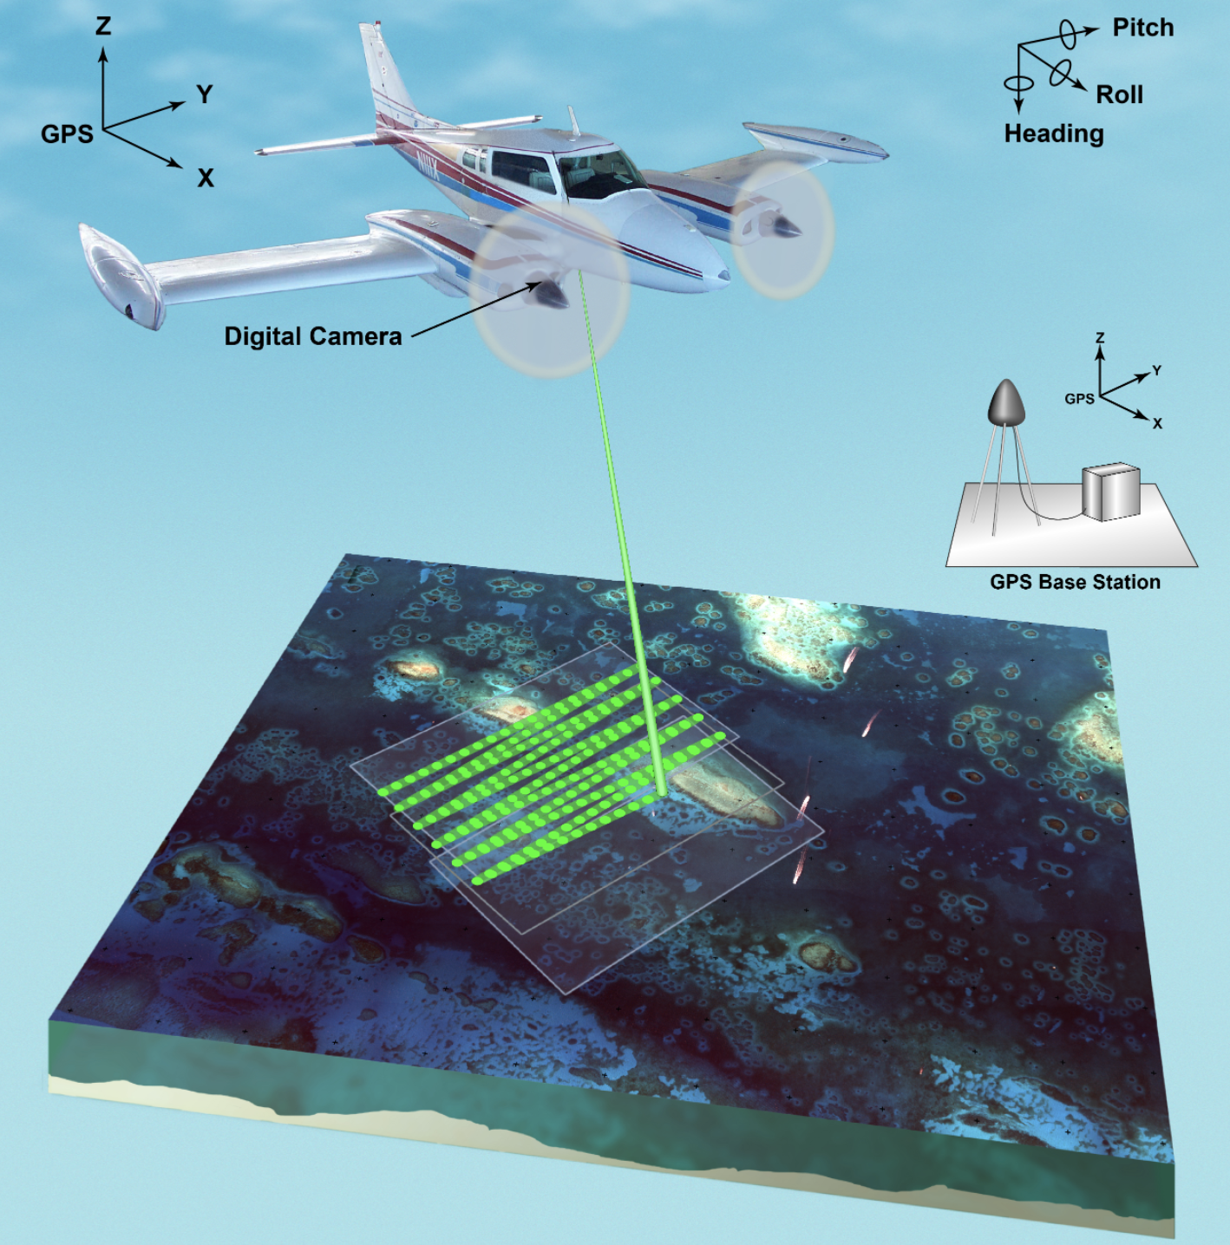
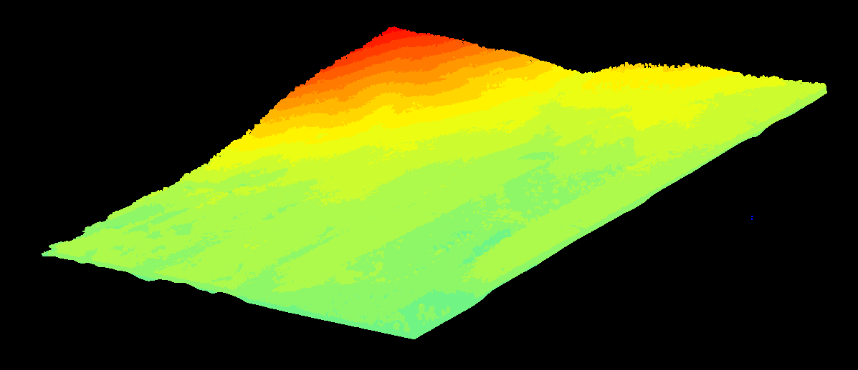
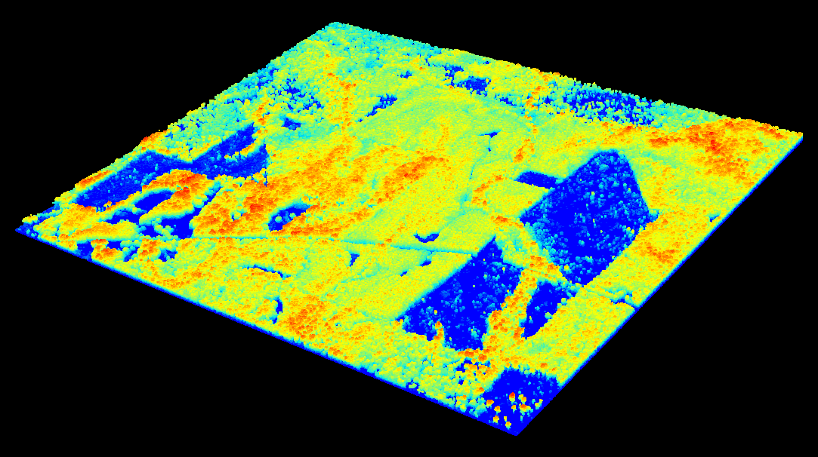
Airborne Lidar
Image Credit: NASA
Image Credit: USGS
Notes:
Speaker Notes:
Field studies are the gold standard in our ability to validate earth observation techniques. However, when it comes to height measurement, airborne lidar is a close second.
Airborne Laser Scanning uses laser sensors mounted in an aircraft or drone and directed to the ground in a scanning pattern. Lidar technology allows researchers to capture greater areas of canopy height measurements than could be done by foot, with high precision. There are still limitations in data availability as these flights are expensive, can only be done during certain conditions, and often have to be contracted out.
We aimed to use this data to validate our satellite remote sensing methods, which we will discuss next.
------------------------------Image Information Below ------------------------------
Left image
•Image Credit: USGS
•Image Source: https://www.usgs.gov/media/images/lidar-plane (Public Domain)
Right image team-produced in R

Slide 30
Methodology
Land Cover Change Maps
Above Ground Biomass Estimates
Best Land Cover Map
Carbon Emissions Estimate
Validation: Collect Earth Online & Airborne LiDAR
Best Biomass Estimate
Notes:
Speaker Notes:
This diagram shows an overview of our workflow, beginning with land cover change maps and canopy height estimates. The next few slides with go into each of these steps one by one.

Slide 31
Methodology: LandTrendr
2
3
Notes:
Speaker Notes:
Once you have your parameters selected, you can run the script and it will generate a map showing disturbance events within the study period.
------------------------------Image Information ------------------------------
•Image Credit: eMapR Lab
•Image Source: LT-GEE Change Mapper (earthengine.app) (Open-source LandTrendr Change Mapper UI)

Slide 32
Case Study of Clarke County, AL
300 mg/ha
275 mg/ha
250 mg/ha
225 mg/ha
200 mg/ha
AGB (Mg/ha) Stable Forest
175 mg/ha
150 mg/ha
125 mg/ha
100 mg/ha
75 mg/ha
50 mg/ha
GEDI Stable Forest AGB Density
ATLAS Stable Forest AGB Density

